Slide 1
Rich Feature Hierarchies for Accurate Object Detection and Semantic Segmentation
Ross Girshick, Jeff Donahue, Trevor Darrell, Jitendra Malik

Slide 2
Rich Feature Hierarchies for Accurate Object Detection and Semantic Segmentation
Ross Girshick, Jeff Donahue, Trevor Darrell, Jitendra Malik
Notes:
Hello, my name is Ross Girshick.
Today, I will be presenting a new approach to object detection based on bottom-up region proposals and multi-layer convolutional networks.

Slide 3
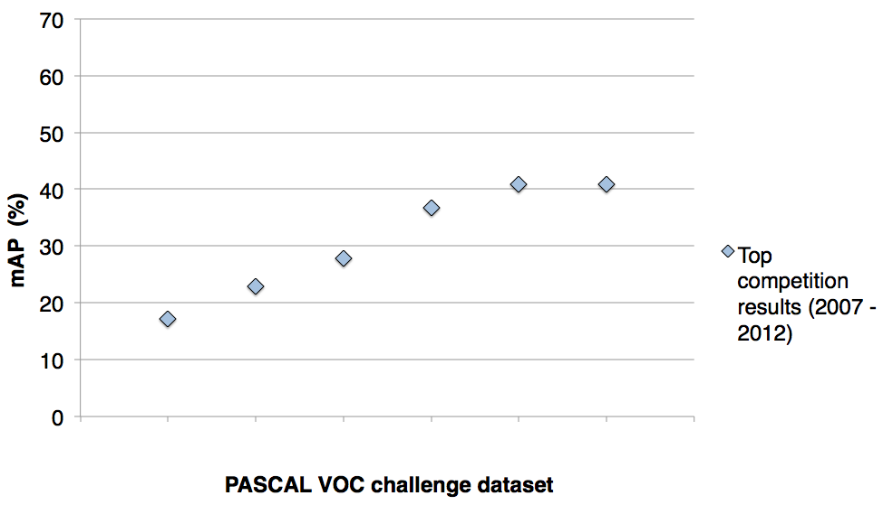
PASCAL VOC detection history
41%
41%
37%
DPM++,
MKL,
Selective
Search
Selective
Search,
DPM++,
MKL
28%
DPM++
23%
DPM,
MKL
17%
DPM,
HOG+BOW
DPM
DPM
VOC’07
VOC’08
VOC’09
VOC’10
VOC’11
VOC’12
PASCAL VOC challenge dataset
[Source: http://pascallin.ecs.soton.ac.uk/challenges/VOC/voc20{07,08,09,10,11,12}/results/index.html]
Notes:
To place our method in context,
I want to start with a brief history of object detection on the PASCAL dataset.
This chart shows the mean average precision of the methods that won the detection challenge from 2007 until its final year in 2012.

Slide 4
A rapid rise in performance
41%
41%
37%
DPM++,
MKL,
Selective
Search
Selective
Search,
DPM++,
MKL
28%
DPM++
23%
DPM,
MKL
17%
DPM,
HOG+BOW
DPM
DPM
VOC’07
VOC’08
VOC’09
VOC’10
VOC’11
VOC’12
PASCAL VOC challenge dataset
[Source: http://pascallin.ecs.soton.ac.uk/challenges/VOC/voc20{07,08,09,10,11,12}/results/index.html]
Notes:
As you can see, performance increased rapidly from 2007 through 2011.

Slide 5
Complexity and the plateau
plateau & increasing complexity
41%
41%
37%
DPM++,
MKL,
Selective
Search
Selective
Search,
DPM++,
MKL
28%
DPM++
23%
DPM,
MKL
17%
DPM,
HOG+BOW
DPM
DPM
VOC’07
VOC’08
VOC’09
VOC’10
VOC’11
VOC’12
PASCAL VOC challenge dataset
[Source: http://pascallin.ecs.soton.ac.uk/challenges/VOC/voc20{07,08,09,10,11,12}/results/index.html]
Notes:
However, it reached a plateau and there was no improvement from 2011 to 2012.
Meanwhile, the winning systems were becoming complex ensembles.

Slide 6
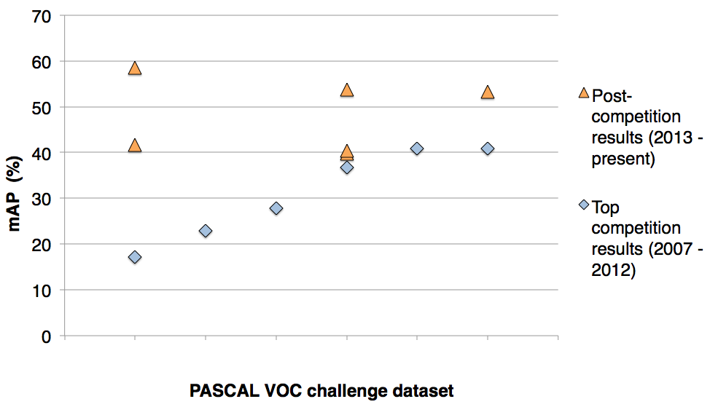
SIFT, HOG, LBP, ...
SegDPM (2013)
Regionlets
(2013)
Regionlets (2013)
DPM++,
MKL,
Selective
Search
Selective
Search,
DPM++,
MKL
DPM++
DPM,
MKL
DPM,
HOG+BOW
DPM
VOC’07
VOC’08
VOC’09
VOC’10
VOC’11
VOC’12
PASCAL VOC challenge dataset
[Regionlets. Wang et al. ICCV’13]
[SegDPM. Fidler et al. CVPR’13]
Notes:
In the year following the final challenge, the best methods still remained at the plateau.
One notable commonality between these approaches is that they all use low-level image features like SIFT, HOG, and LBP.

Slide 7
R-CNN: Regions with CNN features
R-CNN
58.5%
R-CNN
R-CNN
53.7%
53.3%
VOC’07
VOC’08
VOC’09
VOC’10
VOC’11
VOC’12
PASCAL VOC challenge dataset
Notes:
In this talk, I will present R-CNN: Regions with Convolutional Neural Network features.
R-CNN uses features learned by a large convolutional network together with bottom-up region proposals.
It dramatically outperforms all previous approaches on PASCAL VOC and ImageNet detection.

Slide 8
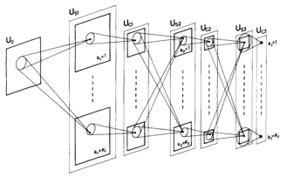
Feature learning with CNNs
Fukushima 1980
Neocognitron
Notes:
R-CNN builds on a long line of research into feature learning with convolutional networks.
Many of the basic ideas were already present in Fukushima’s neocognitron.
The neocognitron, however, lacked a supervised training algorithm.

Slide 9
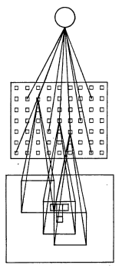
Feature learning with CNNs
Fukushima 1980
Neocognitron
Rumelhart, Hinton, Williams 1986
“T” versus “C” problem
Notes:
Building on the neocognitron, Rumelhart, Hinton, and Williams trained a network to discriminate between the characters “T” and “C” using supervised error back-propagation.

Slide 10
Feature learning with CNNs
Fukushima 1980
Neocognitron
Rumelhart, Hinton, Williams 1986
“T” versus “C” problem
LeCun et al. 1989-1998
Handwritten digit reading / OCR
Notes:
LeCun et al. showed the effectiveness of deeper networks trained with backprop in application to reading handwritten digits and understanding documents.

Slide 11
Feature learning with CNNs
Fukushima 1980
Neocognitron
Rumelhart, Hinton, Williams 1986
“T” versus “C” problem
LeCun et al. 1989-1998
Handwritten digit reading / OCR
...
Krizhevksy, Sutskever,
Hinton 2012
ImageNet classification breakthrough
“SuperVision” CNN
Notes:
More recently,
Krizhevsky, Sutskever and Hinton showed that an efficient GPU implementation of a particular deep CNN architecture gave breakthrough results on the ImageNet classification challenge.

Slide 12
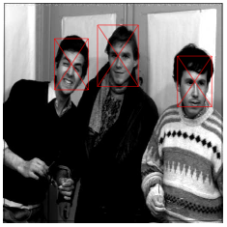
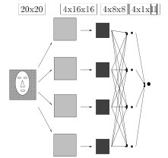
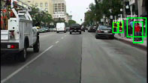
CNNs for object detection
Vaillant, Monrocq, LeCun 1994
Multi-scale face detection
LeCun, Huang, Bottou 2004
NORB dataset
Cireşan et al. 2013
Mitosis detection
Sermanet et al. 2013
Pedestrian detection
Szegedy, Toshev, Erhan 2013
PASCAL detection (VOC’07 mAP 30.5%)
Notes:
CNNs have also been used for object detection since the mid 1990s.
However, none of these approaches outperforms HOG-based detection methods on PASCAL-like datasets.

Slide 13
Can we break through the PASCAL plateau
with feature learning?
Notes:
Motivated by Krizhevsky et al., we set out to see if we could break through the PASCAL plateau using feature learning.

Slide 14
R-CNN: Regions with CNN features
Input
image
Extract region
proposals (~2k / image)
Compute CNN
features
Classify regions
(linear SVM)
Notes:
Here’s a schematic of the system that we came up with.
Compared to previous state-of-the-art methods, R-CNN is relatively simple and does not rely on an ensemble of classifiers.
Let’s see how it works at test time.

Slide 15
R-CNN at test time: Step 1
Input
image
Extract region
proposals (~2k / image)
Proposal-method agnostic, many choices
- Selective Search [van de Sande, Uijlings et al.] (Used in this work)
- Objectness [Alexe et al.]
- Category independent object proposals [Endres & Hoiem]
- CPMC [Carreira & Sminchisescu]
Active area, at this CVPR
- BING [Ming et al.] – fast
- MCG [Arbelaez et al.] – high-quality segmentation
Notes:
In step 1, R-CNN takes an input image and extracts bottom-up region proposals.
In this work, we use selective search configured to return about two thousands proposals per image.
Region proposal generation is an active area of research.
Some examples at this CVPR include
BING, which focuses on fast proposals
and MCG, which focuses on high-quality segmentation.

Slide 16
R-CNN at test time: Step 2
Input
image
Extract region
proposals (~2k / image)
Compute CNN
features
Notes:
In step 2, each region proposal is converted into a feature vector by running it through a CNN.
To do this, we start with the original proposal...

Slide 17
R-CNN at test time: Step 2
Input
image
Extract region
proposals (~2k / image)
Compute CNN
features
Dilate proposal
Notes:
...and dilate its bounding box.
This expanded window allows the network to see edges that are close to the proposal’s boundary, as well capture a small amount of context.

Slide 18
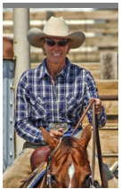
R-CNN at test time: Step 2
Input
image
Extract region
proposals (~2k / image)
Compute CNN
features
a. Crop
Notes:
Then, we crop out the region of interest...

Slide 19
R-CNN at test time: Step 2
Input
image
Extract region
proposals (~2k / image)
Compute CNN
features
227 x 227
a. Crop
b. Scale (anisotropic)
Notes:
...and scale it to a fixed size square so that it can be input into the CNN.

Slide 20
R-CNN at test time: Step 2
Input
image
Extract region
proposals (~2k / image)
Compute CNN
features
c. Forward propagate
Output: “fc7” features
1. Crop
b. Scale (anisotropic)
Notes:
We then forward propagate it through the network to produce a feature vector from the 7th layer, which we call fc7.

Slide 21
R-CNN at test time: Step 3
Input
image
Extract region
proposals (~2k / image)
Compute CNN
features
Classify
regions
person? 1.6
...
horse? -0.3
...
4096-dimensional
fc7 feature vector
linear classifiers
(SVM or softmax)
Warped proposal
Notes:
In step 3, we classify the region using a linear classifier on the four-thousand dimensional fc7 feature vectors.
We have one classifier per class that was trained to discriminate between well-localized instances of that class and poorly-localized instances.

Slide 22
Step 4: Object proposal refinement
Linear regression
on CNN features
Original
proposal
Predicted
object bounding box
Bounding-box regression
Notes:
Finally, we refine the original object proposals with a simple regression step.
We use a linear regressor on the CNN features to predict a new bounding box relative to the proposal.
This regression step improves localization and allows non-maximum suppression to be more effective.

Slide 23
Bounding-box regression
w
Δw × w + w
(x, y)
h
(Δx × w + x,
Δy × h + h)
Δh × h + h
original
predicted

Slide 24
R-CNN results on PASCAL
 | VOC 2007 | VOC 2010
DPM v5 (Girshick et al. 2011) | 33.7% | 29.6%
UVA sel. search (Uijlings et al. 2013) |  | 35.1%
Regionlets (Wang et al. 2013) | 41.7% | 39.7%
SegDPM (Fidler et al. 2013) |  | 40.4%
R-CNN | 54.2% | 50.2%
R-CNN + bbox regression | 58.5% | 53.7%
Reference systems
metric: mean average precision (higher is better)
Notes:
Now, let’s look at results on PASCAL in more detail.
First, here are reference systems including the most recently published top-performing methods.

Slide 25
R-CNN results on PASCAL
 | VOC 2007 | VOC 2010
DPM v5 (Girshick et al. 2011) | 33.7% | 29.6%
UVA sel. search (Uijlings et al. 2013) |  | 35.1%
Regionlets (Wang et al. 2013) | 41.7% | 39.7%
SegDPM (Fidler et al. 2013) |  | 40.4%
R-CNN | 54.2% | 50.2%
R-CNN + bbox regression | 58.5% | 53.7%
metric: mean average precision (higher is better)
Notes:
Here are our results using R-CNN.
R-CNN improves over the previous state-of-the-art by more than 30% relative and is the most dramatic improvement in object detection performance since the early years of the PASCAL challenge.

Slide 26
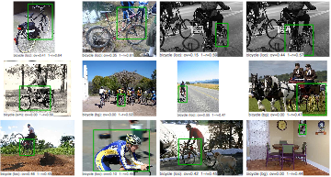
Top bicycle FPs (AP = 72.8%)
Notes:
Let’s go back to the bicycle false positives and take a closer look at one these errors...

Slide 27
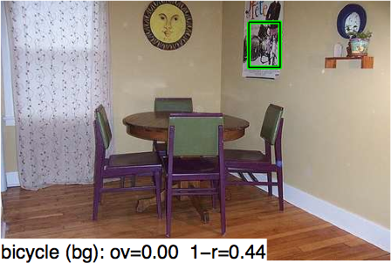
False positive #15
Notes:
...and now magnify the area around the false positive.

Slide 28
False positive #15
(zoom)
Unannotated bicycle
Notes:
On closer inspection, the detector fired on a poster on the wall that actually contains an unannotated illustration of a bicycle!

Slide 29
False positive #15
1949 French comedy by Jacques Tati
Notes:
Here’s a clearer image of the poster.
While definitely a bicycle, this is a very challenging instance to detect.

Slide 30
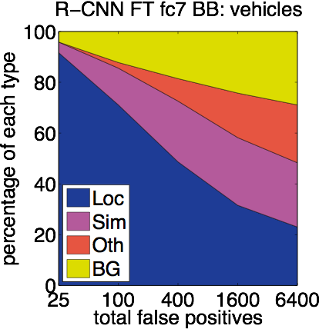
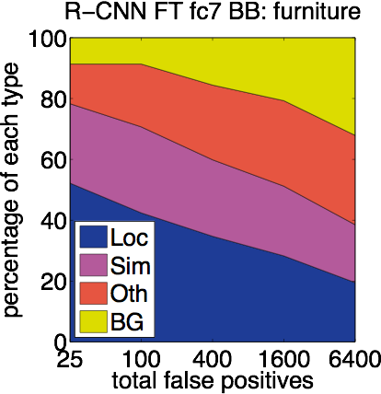
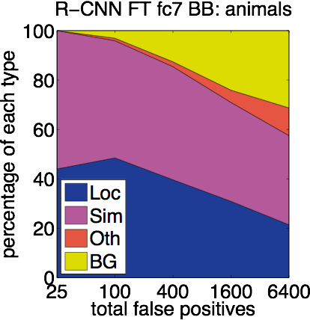
False positive type distribution
Loc = localization
Oth = other / dissimilar classes
Sim = similar classes
BG = background
Analysis software: D. Hoiem, Y. Chodpathumwan, and Q. Dai.
Diagnosing Error in Object Detectors. ECCV, 2012.
Notes:
We can look at these errors through a more quantitative lens.
Here we show the distribution of false positive types, where each false positive is classified as a localization error, confusion with a similar category, confusion with a dissimilar class, or a firing on the background.
For vehicle and furniture classes, the localization errors dominiate.
For animals there is still significant confusion between animal categories.

Slide 31
Training R-CNN
Bounding-box labeled detection data is scarce
Key insight:
Use supervised pre-training on a data-rich auxiliary task and transfer to detection
Notes:
Now let’s talk about how R-CNN is trained.
Unlike image classification, detection training data is relatively scarce.
One key insight in this work is that when the target task has too little training data, we can use supervised pre-training on a data-rich auxiliary task and transfer the learned representation to detection.

Slide 32
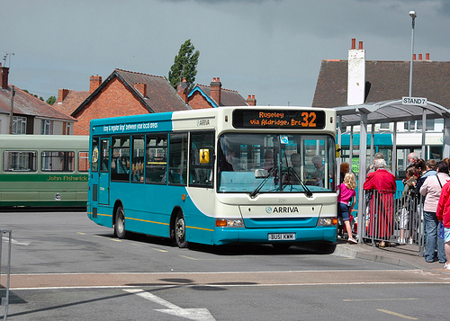
ImageNet LSVR Challenge
– Image classification
(not detection)
– 1000 classes
(vs. 20)
– 1.2 million training labels
(vs. 25k)
bus anywhere?
[Deng et al. CVPR’09]
Notes:
We become interested in ConvNets because of a well-known empirical result on the ImageNet Large Scale Visual Recognition Challenge.
Unlike PASCAL detection, this is an image classification task.
It’s also much larger scale, with 1000 categories and 1.2 million training labels.

Slide 33
ILSVRC 2012 winner
“SuperVision” Convolutional Neural Network (CNN)
input
5 convolutional layers
fully connected
ImageNet Classification with Deep Convolutional Neural Networks.
Krizhevsky, Sutskever, Hinton. NIPS 2012.
Notes:
The winner of the 2012 ImageNet classification challenge was the SuperVision group from the University of Toronto.
They showed that a large convolutional network could be trained with an efficient GPU implementation.

Slide 34
Impressive ImageNet results!
1000-way image classification
 | Top-5 error
Fisher Vectors (ISI) | 26.2%
5 SuperVision CNNs | 16.4%
7 SuperVision CNNs | 15.3%
now: ~12%
metric: classification error rate (lower is better)
But... does it generalize to other datasets and tasks?
[See also: DeCAF. Donahue et al., ICML 2014.]
Spirited debate at ECCV 2012
Notes:
The result was a breakthrough in ImageNet classification, dropping the top-5 error rate from 26% to 15%.
At the time of the workshop, there were was a spirited debate about whether this result would generalize to other datasets and other tasks---in particular people were curious about detection in PASCAL.

Slide 35
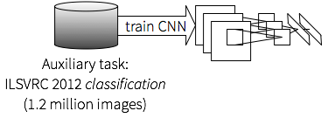
R-CNN training: Step 1
Supervised pre-training
Train a SuperVision CNN* for the 1000-way
ILSVRC image classification task
*Network from Krizhevsky, Sutskever & Hinton. NIPS 2012
Also called “AlexNet”
Notes:
In the first step of R-CNN training, we train a SuperVision CNN for 1000-way ImageNet classification.

Slide 36
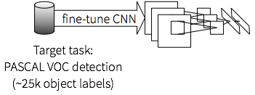
R-CNN training: Step 2
Fine-tune the CNN for detection
Transfer the representation learned for ILSVRC
classification to PASCAL (or ImageNet detection)
Notes:
In the second step, we transfer the learned representation to the target task and dataset.
To do this we “fine-tune” the network, which simply means that we continue running stochastic gradient descent, but with a couple modifications
- first, we replace the 1000-way softmax with an 21-way softmax for PASCAL (or 201 for ImageNet)
- second, and we train using region proposals from the target dataset

Slide 37
R-CNN training: Step 2
Fine-tune the CNN for detection
Transfer the representation learned for ILSVRC
classification to PASCAL (or ImageNet detection)
Try Caffe! http://caffe.berkeleyvision.org
- Clean & fast CNN library in C++ with Python and MATLAB interfaces
- Used by R-CNN for training, fine-tuning, and feature computation
Notes:
For CNN training, fine-tuning, and feature extraction we use the Caffe CNN library

Slide 38
R-CNN training: Step 3
Train detection SVMs
(With the softmax classifier from fine-tuning
mAP decreases from 54% to 51%)
Notes:
In the last step, we train detection SVMs.
To do this, we use the fine-tuned network to compute fc7 features for all object proposals.
We then label these proposals and train 20 one-vs-rest linear SVMs.
It’s also possible to skip this step and use the CNN’s softmax classifier directly, however performance drops.
With some adjustments, we expect to be able to remove this last training step with no loss in performance.

Slide 39
Compare with fine-tuned R-CNN
 | VOC 2007 | VOC 2010
Regionlets (Wang et al. 2013) | 41.7% | 39.7%
SegDPM (Fidler et al. 2013) |  | 40.4%
R-CNN pool5 | 44.2%
R-CNN fc6 | 46.2%
R-CNN fc7 | 44.7%
R-CNN FT pool5 | 47.3%
R-CNN FT fc6 | 53.1%
R-CNN FT fc7 | 54.2% | 50.2%
fine-tuned
metric: mean average precision (higher is better)

Slide 40
What did the network learn?
Notes:
In order to gain insight and direct future research, it’s important to understand what the network learned.
Rather than thinking about it as a blackbox, we can probe the net to gain some intuition.

Slide 41
What did the network learn?
“stimulus”
← feature channels →
y
y
x
x
pool5 feature map
Notes:
One simple method is to visualize the image regions--or “stimuli”--that cause a particular unit in the network to fire.
Let’s look at units in the pool5 feature map as an example.

Slide 42
What did the network learn?
“stimulus”
← feature channels →
6 cells
227 pixels
y
y
6
227
x
x
pool5 feature map
feature position receptive field
Visualize images that activate pool5 a feature
Notes:
Each feature in pool5 comes from one of 256 feature channels and has an (x,y) spatial position and a receptive field in the input image.
In the following 5 visualizations, we show the top activations for 5 different features.

Slide 43
Notes:
Receptive fields are shown as white rectangles.
As one might expect, there’s a feature that fires on cat faces.

Slide 44
Notes:
There’s also a human-face feature.

Slide 45
Notes:
However, there are more abstract features.
Such as this one, which fires on green leafy patterns.

Slide 46
Notes:
This one, which fires on specular highlights.

Slide 47
Notes:
And this one, which responds to text.

Slide 48
Take away
Dramatically better PASCAL mAP
R-CNN outperforms other CNN-based methods on ImageNet detection
Detection speed is manageable (~11s / image)
Scales very well with number of categories (30ms for 20 → 200 classes!)
R-CNN is simple and completely open source
Notes:
To conclude, R-CNN is a new object detection system that
- performs dramatically better on PASCAL than any previous approach
- R-CNN also outperforms other CNN-based methods on ImageNet detection
- Detection speed, while not fast, is a manageable 11s / image
- However, it scales very well with the number of object categories: detecting 200 object categories takes only 30ms longer than detecting 20!
- Finally, R-CNN is comparatively simple and completely open source

Slide 49
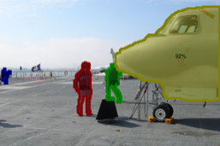
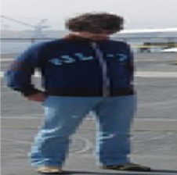
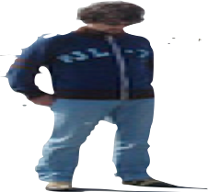
Semantic segmentation
CPMC segments
(Carreira & Sminchisescu)
full
fg
Notes:
Before concluding, I also want to mention that because R-CNN operates directly on regions, it is easy to extend it to the task of semantic segmentation.
In a pilot experiment, we applied R-CNN to both the full region window and the region foreground mask.

Slide 50
Semantic segmentation
CPMC segments
(Carreira & Sminchisescu)
full
fg
 | VOC 2011 test
Bonn second-order pooling (Carreira et al.) | 47.6%
R-CNN fc6 full+fg (no fine-tuning) | 47.9%
Improved to 50.5% in our upcoming ECCV’14 work:
Simultaneous Localization and Detection. Hariharan et al.
Notes:
Our results are comparable to the state-of-the-art second-order pooling method from Carreira et al., but much faster to train.
In our upcoming work at ECCV’14, Hariharan et al. improve this result to 50.5%, while also unifying the tasks of detection and segmentation.

Slide 51
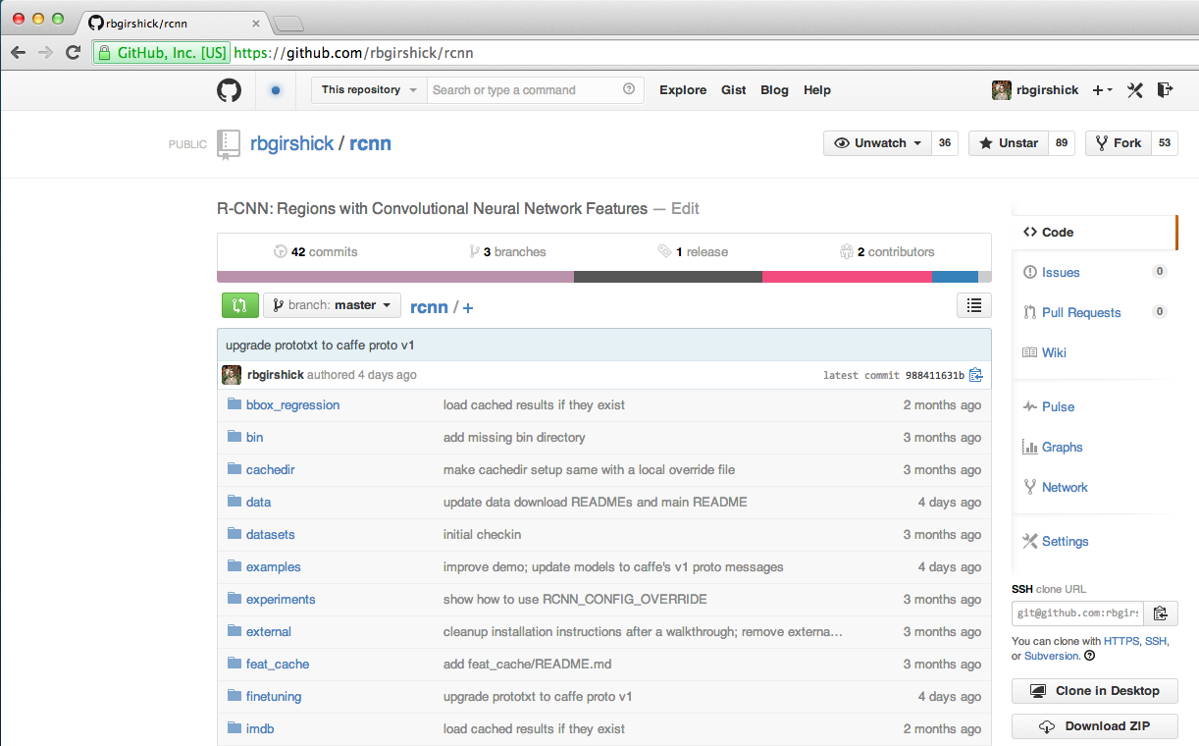
Get the code and models!
bit.ly/rcnn-cvpr14
Notes:
In fact, if the internet is currently working, you can download code and models right now.

Slide 52
Supplementary slides follow

Slide 53
Pre-trained CNN + SVMs (no FT)
 | VOC 2007 | VOC 2010
Regionlets (Wang et al. 2013) | 41.7% | 39.7%
SegDPM (Fidler et al. 2013) |  | 40.4%
R-CNN pool5 | 44.2%
R-CNN fc6 | 46.2%
R-CNN fc7 | 44.7%
R-CNN FT pool5 | 47.5%
R-CNN FT fc6 | 53.2%
R-CNN FT fc7 | 54.1% | 50.2%
metric: mean average precision (higher is better)

Slide 54
False positive analysis
No fine-tuning
Analysis software: D. Hoiem, Y. Chodpathumwan, and
Q. Dai. “Diagnosing Error in Object Detectors.” ECCV, 2012.

Slide 55
False positive analysis
After fine-tuning

Slide 56
False positive analysis
After bounding-box regression

Slide 57
What did the network learn?
z
y
y
x
x
pool5 “data cube”
unit position receptive field
Visualize pool5 units

Slide 63
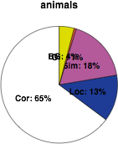
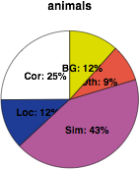
Comparison with DPM
R-CNN
DPM v5
animals
animals

Slide 64
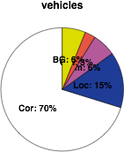
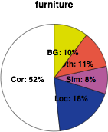
Localization errors dominate
dissimilar
classes
similar
classes
background
localization
animals
vehicles
furniture
Analysis software: D. Hoiem, Y. Chodpathumwan, and Q. Dai.
Diagnosing Error in Object Detectors. ECCV, 2012.
Notes:
We can
If we look at false positive errors in general, we observe that even with bounding-box regression localization errors still dominate.

