Slide 1
Action Recognition
CS 280, Spring 2015
by Georgia Gkioxari

Slide 2
Examples of actions
Movement and posture change
e.g. run, walk, crawl, jump, hop, swim, dance, sit
Object manipulation
e.g. pick, carry, hold, push, pull, touch, drive, bike, play musical instrument
Conversational gesture
e.g. point ...
Sign Language
Notes:
Action recognition is the task of recognizing an action given an image or a video. There are different types of actions. Those involve movements (such as running), or actions which involve interacting with objects or with other people (such as carry or hand shake). Another subfield of action recognition with great impact on society is sign language recognition. There is a lot of work on this field, involving methods that try to detect, recognize and understand sign language. We will not be covering this in today’s class, but feel free to contact me or Pulkit for papers in the field.
We categorize actions in different groups, merely because our algorithms make use of the properties of actions. In today’s class we will focus on how to design systems that recognize actions, making use of the properties of actions mentioned before.

Slide 3
Key cues for action recognition
Morpho-kinetics of action
shape and movement of the body
Identity of objects
Activity context
scene or other people performing actions
Notes:
When performing an action we move in specific to that action ways. So naturally, information about pose is of extreme importance
In actions which involve objects, it seems rational to identify those objects. This can help in action recognition quite a bit.
Activity context refers to the scene and the other actions performed in the image or video. For example, in a swimming pool you will most likely see a person swimming or diving. Also, if a person is surrounded by people running there is a big chance that person is also running (maybe a marathon?)

Slide 4
Action recognition
Static action recognition
from 2D images
Video action recognition
from videos
Notes:
In computer vision, we talk about static action recognition or video action recognition. These refer to the nature of the input. In the first case you are given a 2D image, in the second case a video. As mentioned before, a video is just like images but with an additional dimension, that of time. This allows for computing and using motion cues which help in recognizing actions. We will discuss this in detail shortly.

Slide 5
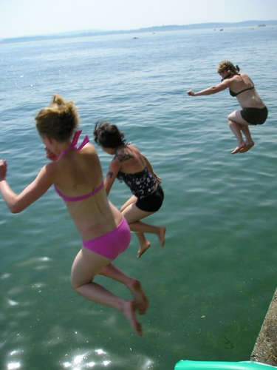

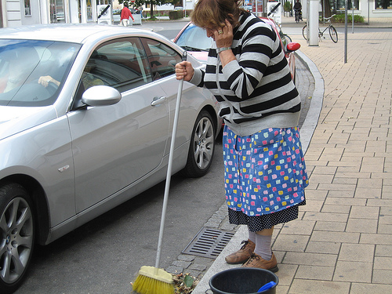
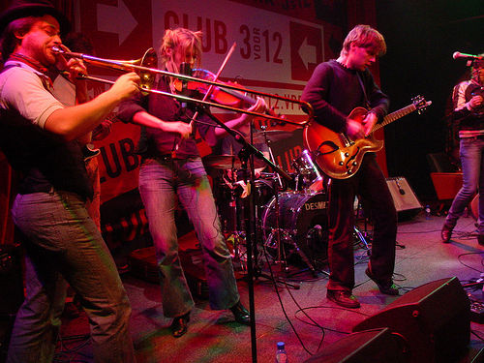
Static Action Recognition - Datasets
PASCAL VOC Action
10 actions [ jumping, phoning, riding bike…]
12000 instances for train & test
Notes:
Turning to the task of static action recognition. In this task usually we are given a set of images and bounding boxes of people, whose actions we need to identify. Such a dataset, which is the standard dataest in the community for this task is PASCAL VOC.

Slide 6
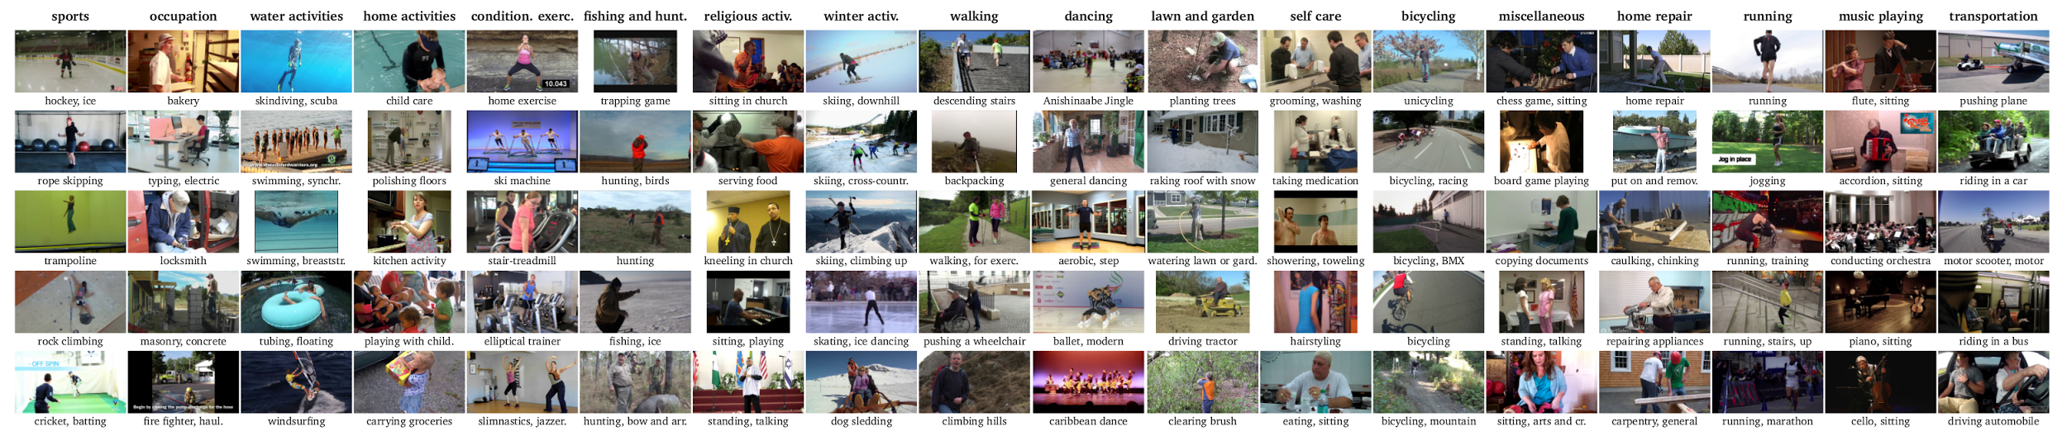
Static Action Recognition - Datasets
MPII Human Dataset
410 actions
40000 instances for train & test
Notes:
Another dataset, which is newer and bigger, is the MPII dataset.

Slide 7
Static Action Recognition - Approach
CNN for action recognition:
Input: Region containing the actor
Output: One of A action labels
Loss during CNN training: log loss of softmax probabilities
mean AP (%) | 8-layer CNN | 16-layer CNN
CNN | 68.2 | 77.8
Notes:
Alright! Now you’ve seen the datasets, you have familiarized yourself somewhat with the task. What do you do to build an action recognition system? Any ideas…?
Let’s train a CNN. When it comes to training a CNN you need to define 4 things.
architecture
input
output
loss for training (task specific)

Slide 8
Static Action Recognition - Approach
Observations:
Some regions in the image matter more than others
Max pooling layers hide important cues from subsequent layers
Notes:
Hmm can do we better? Let’s make some observations.
Looking at the dataset and the actions we observe that some regions are more important than others for some actions (e.g. when taking a photo, the lower part of the body is not important, the pose of the face, hands and the interaction with the camera is on the other hand very important). So it seems that the network should focus on that area when making a decision about the action.
Particular elements of the architecture of the network might not allow the system to do that e.g. max pooling layers. A deep learning fanatic will say that with enough data and a network of high enough capacity, this should not cause any problems. Correct but a) we don’t have enough data b) we do not know what it means for a network to have high ENOUGH capacity for a particular task.

Slide 9
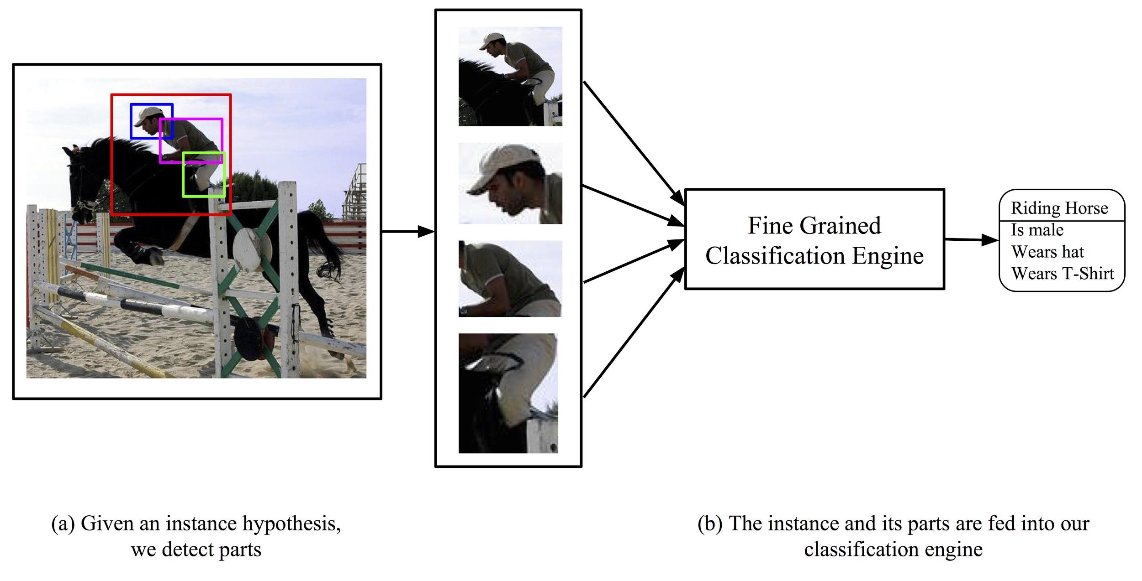
Static Action Recognition - Approach
[1] G. Gkioxari, R. Girshick and J. Malik, Actions and Attributes from Wholes and Parts, arXiv 2014
Notes:
So, we can force the network to see the regions of interest. Instead of feeding in the region corresponding to the person, we can add some pose normalized patches, i.e. regions that correspond to particular body parts such as head, torso and legs. This will make the network see the the parts it should care about for different actions and weight them accordingly when scoring for an action, i.e. legs for running or head, shoulder, arms for taking photo.
That sounds great, right! But how do we discover those parts? You guys have heard about parts before, from DPM. Those parts are smaller parts of the object that are discovered and aim to help detect the object. However, those parts are latent. We want discriminative parts that correspond to particular parts of the human body, such as face or legs.

Slide 10
Part detectors^{[1]}
Definition: Parts should capture human body parts of distinct pose and viewpoint
Collection: Given locations of landmarks on the human body (e.g. nose, shoulder) we can obtain examples of pose clusters
Notes:
Collection: We use keypoints, i.e. annotated locations of human body landmarks. Using those keypoints, we can cluster the space of keypoint configurations. This will result in clusters that correspond to different poses. For more details, you should read our paper!

Slide 11
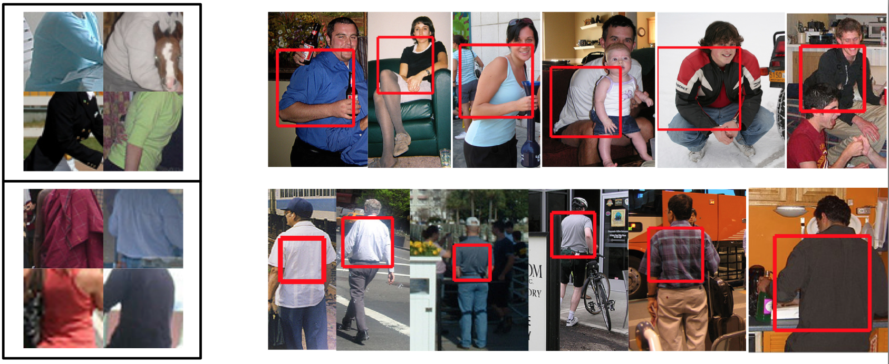
Part detectors^{[1]}
Learning: Train models (e.g. SVM) for each pose cluster on features (e.g. pool5)
Pose clusters for torso (collection)
Part detections on test set
Notes:
Now, we have identified poses and positive examples for them. We need to train part models that can identify them. We train SVM models with the sliding window paradigm.
why sliding window, and not bottom up regions?
We need to overcome occlusion, confusion from multiple instances (i.e. many people next to each other) so we need the best features on the market. Of course those will be “deep” features. Alright, more details on our paper.

Slide 12
Static Action Recognition - Approach
mean AP (%) | 8-layer CNN | 16-layer CNN
CNN | 68.2 | 77.8
Whole & Parts CNN^{[1]} | 71.5 | 80.4
Notes:
Now we have parts. We can feed them into the CNN. We train a CNN jointly for the whole person and the parts. Again more details on the implementation and the learning procedure on the paper.

Slide 13
Static Action Recognition - Approach
Object Context: The objects surrounding the actor, e.g. horse, bike
Action Context: Actions other people in the image perform, e.g. running in a marathon
Scene: The scene the action is taking place, e.g. swimming pool
mean AP (%) | 8-layer CNN | 16-layer CNN
CNN | 68.2 | 77.8
Whole & Parts CNN^{[1]} | 71.5 | 80.4
Whole & Parts CNN^{[1]} with context rescoring | 73.5 | 82.6

Slide 14
Attribute Recognition
mean AP (%) | 8-layer CNN | 16-layer CNN
CNN | 79.1 | 88.4
Whole & Parts CNN^{[1]} | 86.0 | 89.5

Slide 15
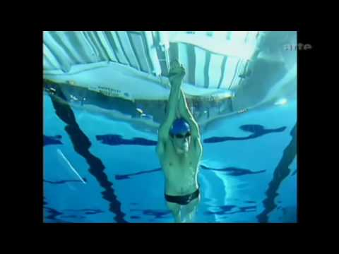
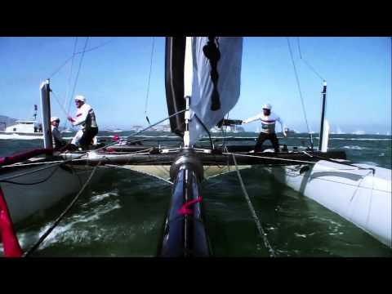
Video action recognition
Freestyle swimming
Sailing
Notes:
Let turn to videos. In video recognition, you are given videos like those given above and you need to predict action labels, such as the ones given below the videos.

Slide 16
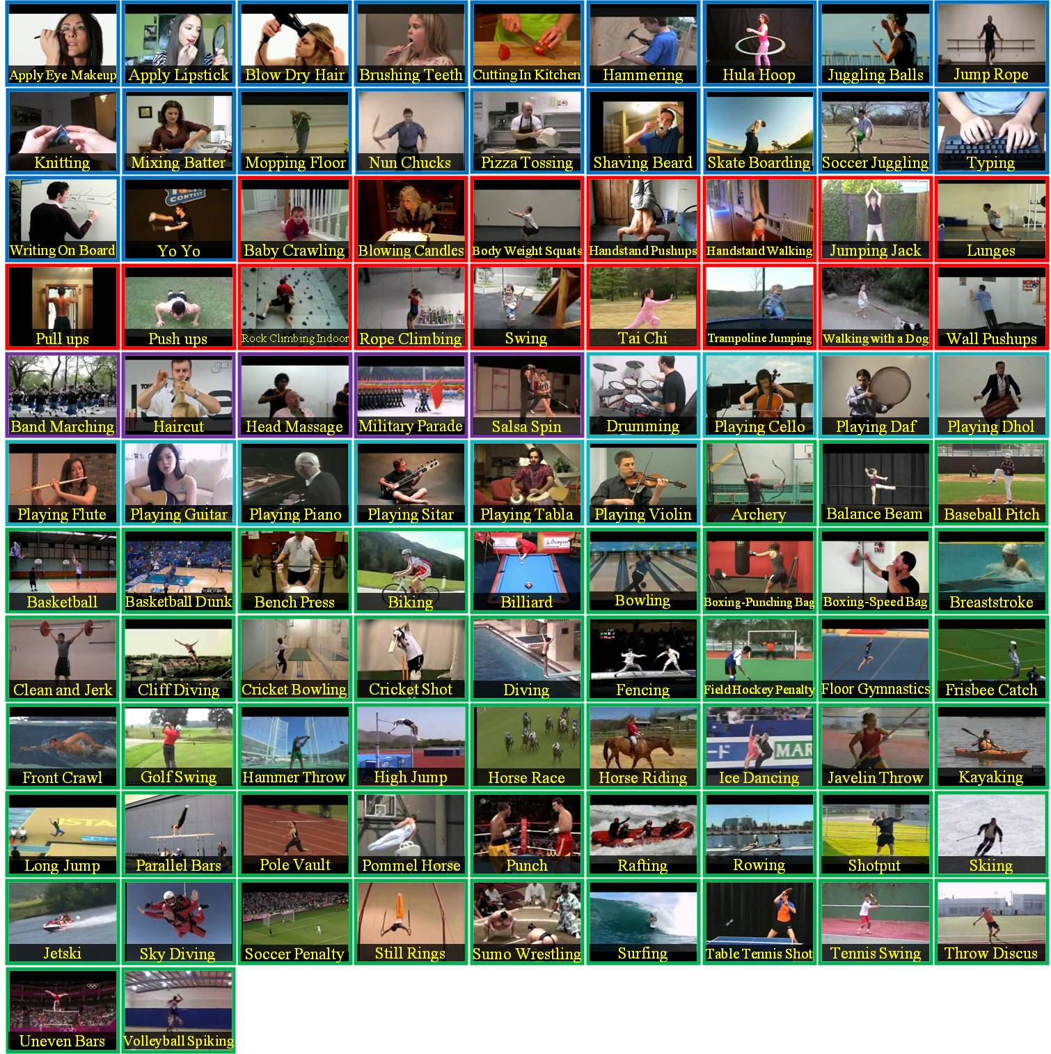
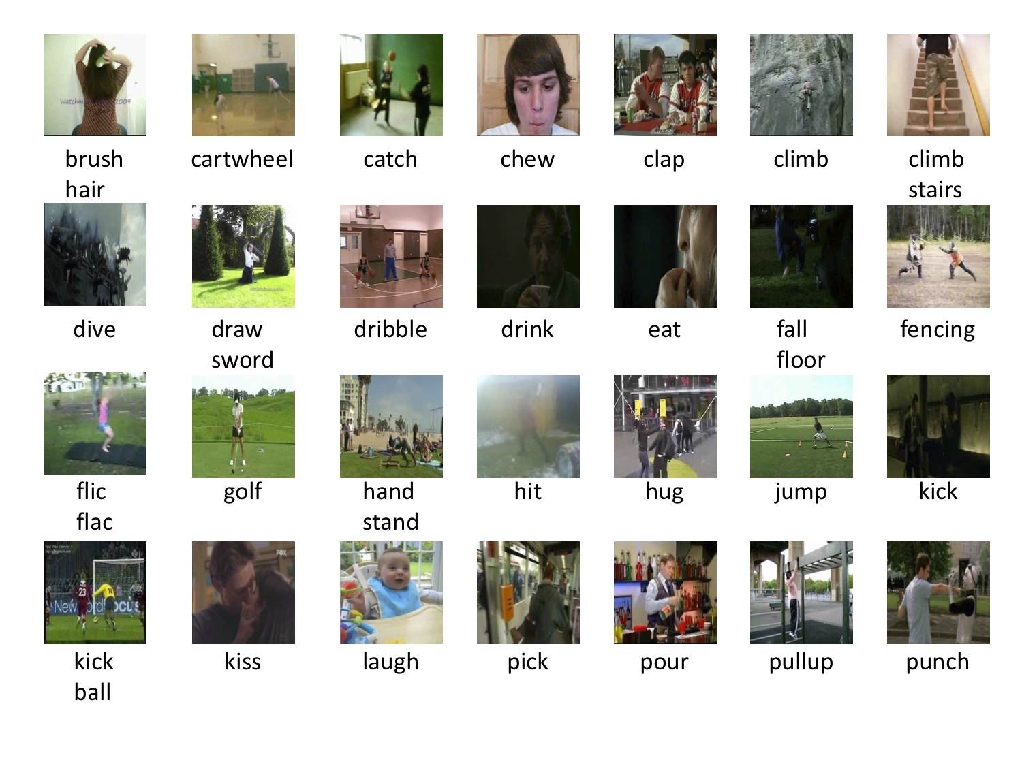
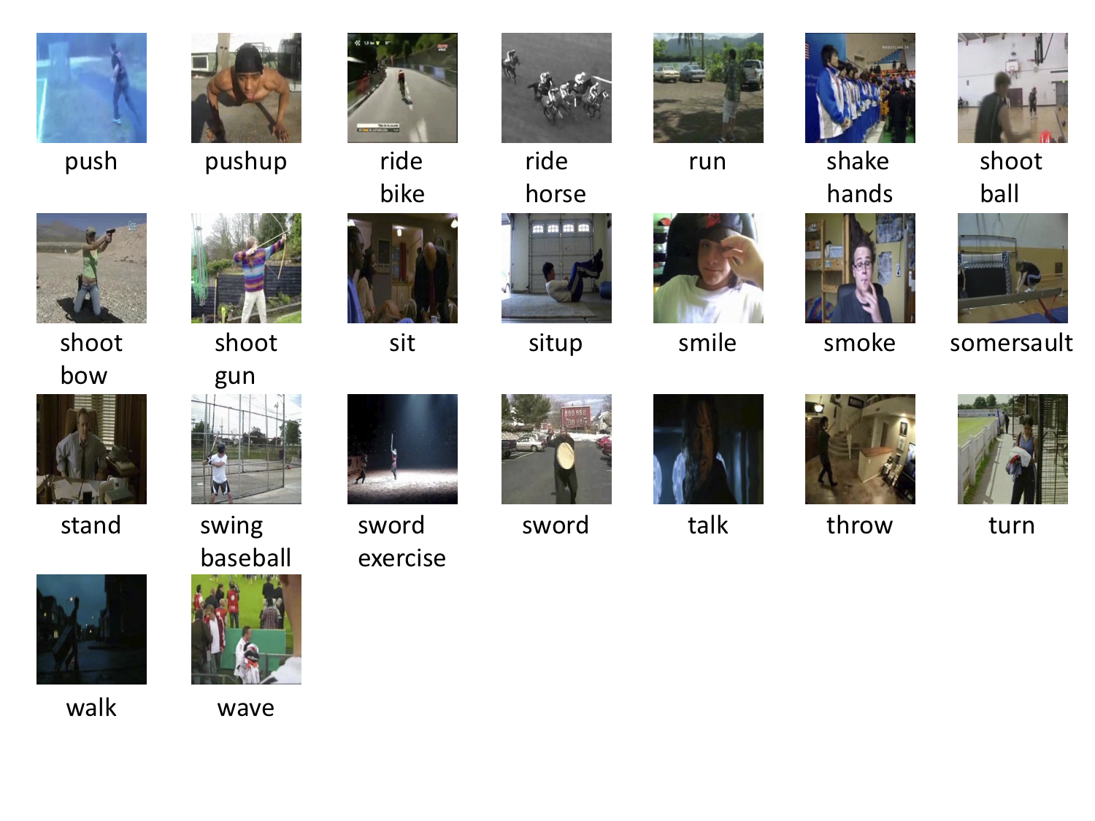
Video action recognition - Datasets
UCF 101
HMDB
Notes:
Two standard datasets for these tasks.

Slide 17
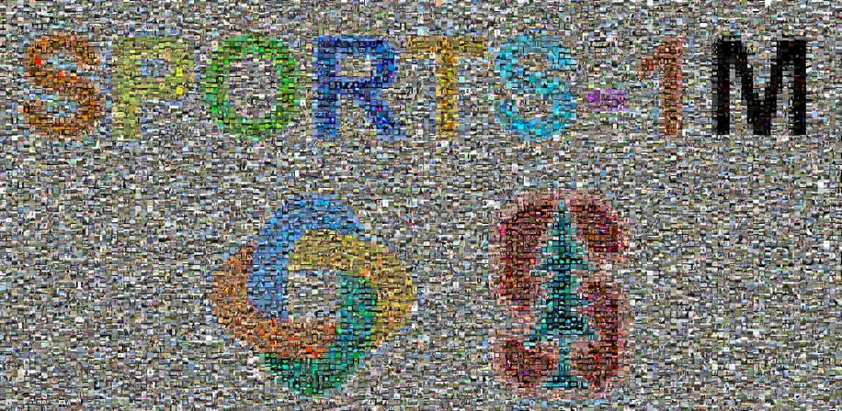
Video action recognition - Datasets
UCF 101
101 actions
13302 videos
HMDB
51 actions
6849 videos
1M sports dataset
487 actions
1,133,158 videos
Notes:
Pros:
YouTube videos (commercial type and not professional)
Big diversity of actions

Slide 18
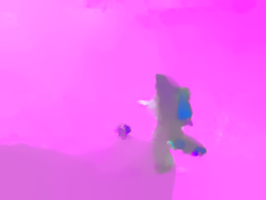
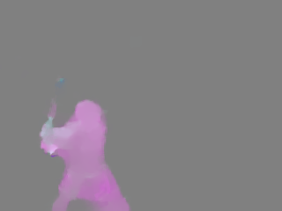
Video action recognition
Motion cues play important role in videos
We capture motion with optical flow
Optical flow between frames no.8 - no.9

Slide 19
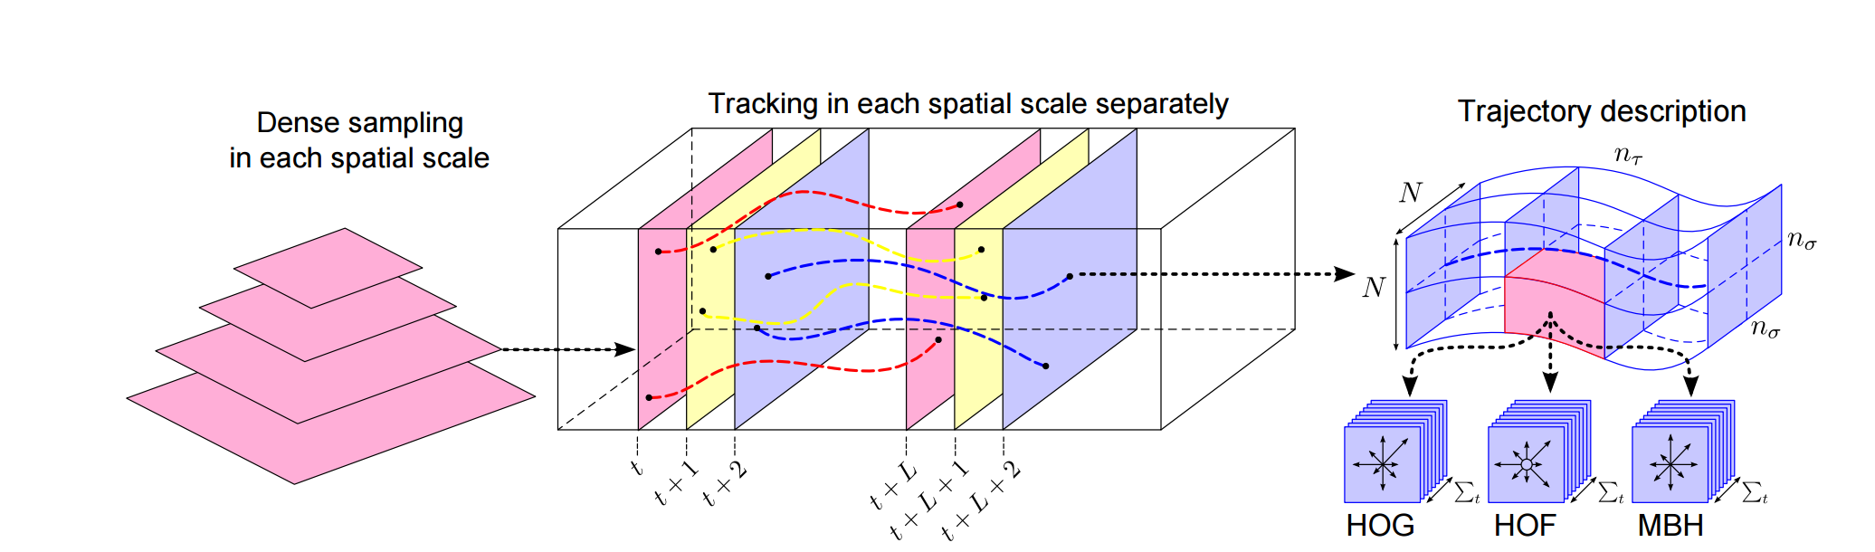
Video action recognition - approach^{[1]}
Accuracy (%) | UCF 101 | HMDB
Dense Trajectories | 85.9 | 57.2
[1] Wang et al, Action Recognition by Dense Trajectories, CVPR 2011

Slide 20
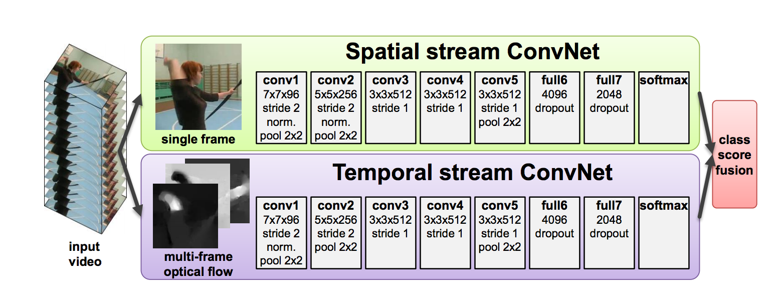
Video action recognition - approach^{[2]}
[2] Simonyan and Zisserman, Two-Stream Convolutional Networks for Action Recognition in Videos, NIPS 2014

Slide 21
Video action recognition - approach^{[2]}
Accuracy (%) | UCF 101 | HMDB
Dense Trajectories | 85.9 | 57.2
Spatial stream CNN | 73.0 | 40.5
Temporal stream CNN | 83.7 | 54.6
Two-stream CNN | 88.0 | 59.4
[2] Simonyan and Zisserman, Two-Stream Convolutional Networks for Action Recognition in Videos, NIPS 2014

Slide 22
Video action recognition - problems
Scene bias
most videos can be classified correctly solely based on the scene
Multiple actions
the tasks assigns one label to the whole video, what if more actions are being performed?
Localization
the location of the predicted action is not specified

Slide 23
Action detection in video^{[3]}
Task: Given a video, localize the action(s) being performed in the video
Method
  Start from regions (prune based on motion saliency)
  Classify each region based shape and motion cues (spatial- & motion- CNNs and fusion)
  Link detections across frames (dynamic programming)
[3] Gkioxari and Malik, Finding Action Tubes, CVPR 2015

Slide 24
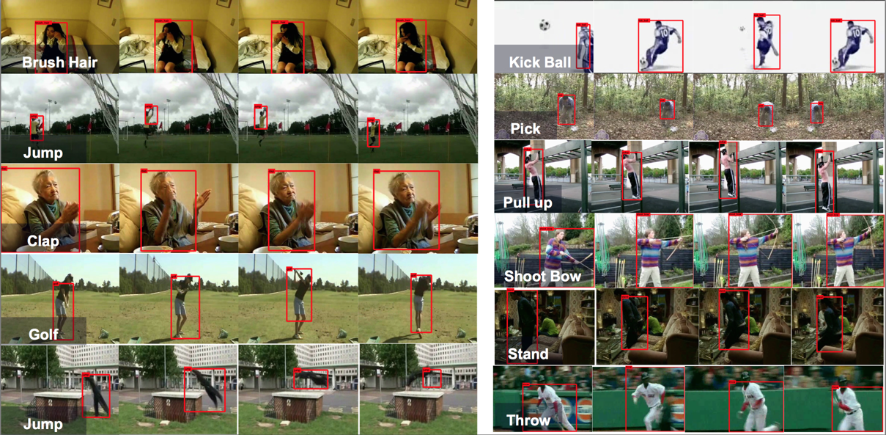
Action detection in video^{[3]}
[3] Gkioxari and Malik, Finding Action Tubes, CVPR 2015

Slide 25
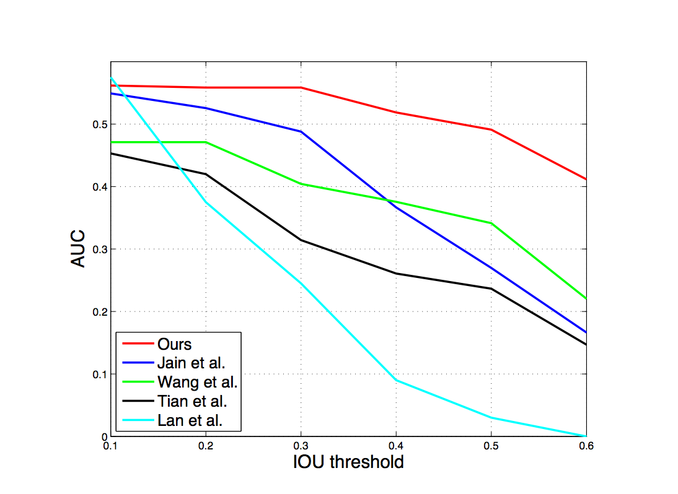
Action detection in video^{[3]}
[3] Gkioxari and Malik, Finding Action Tubes, CVPR 2015

Slide 26
Action detection in video^{[3]}
Action classification can be benefited from analyzing an action wrt the actor
Accuracy (%) | Wang et al.^{[1]} | Two-stream CNN^{[2]} | Action Tubes^{[3]}
J-HMDB | 56.6 | 56.5 | 62.5
[3] Gkioxari and Malik, Finding Action Tubes, CVPR 2015

Slide 27
Questions?

Slide 28
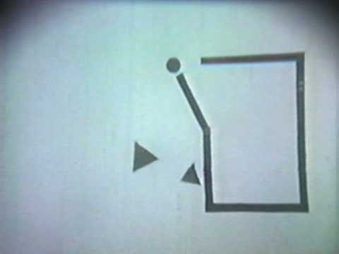
Heider & Simmel 1944

