Slide 1
A Taste of F#
UCL Algo Trading
Day, 20/6/11
Don Syme
Principal Researcher/Architect
Microsoft

Slide 2
What is F# and why is it interesting?

Slide 3
F# is…
...a productive, supported, interoperable, functional-first programming language that allows you to write simple code to solve complex problems.

Slide 4
Crossing boundaries
“Fresh Code” Performance
Professional Development
Programming
C++
Financial engineering
Algorithmic Trading
C#
Java
F#
QF modelling
Dynamic scripting…
Math software…
Programming
Expressivity for
Mathematical tasks

Slide 5
Why is F# appealing in finance?
Functional programming fits with much financial work
“Programmatic modelling”
A typed, efficient scripting language gets you a long way
Plays differently for different roles:
Enable quants to contribute to component development
Enables architects to explore hard problems fluently
Enables developers to tackle parallel and async programming

Slide 6
Simple Code, Strongly Typed

Slide 7
Simplicity: Functions as Values
abstract class Command {
public virtual void Execute();
}
abstract class RoverCommand : Command {
protected Rover Rover { get; private set; }
public RoverCommand(MarsRover rover) {
this.Rover = rover;
}
}
class BreakCommand : RoverCommand {
public BreakCommand(Rover rover)
: base(rover) { }
public override void Execute() {
Rover.Rotate(-5.0);
}
}
class TurnLeftCommand : RoverCommand
{
public TurnLeftCommand(Rover rover)
: base(rover) {
}
public override void Execute() {
Rover.Rotate(-5.0);
}
}
OO
F#
type Command = Command of (Rover -> unit)
let BreakCommand =
Command(fun rover -> rover.Accelerate(-1.0))
let TurnLeftCommand =
Command(fun rover -> rover.Rotate(-5.0<degs>))

Slide 8
Simplicity: Functional Data
C#
let swap (x, y) = (y, x)
let rotations (x, y, z) =
[ (x, y, z);
(z, x, y);
(y, z, x) ]
let reduce f (x, y, z) =
f x + f y + f z
Tuple<U,T> Swap<T,U>(Tuple<T,U> t)
{
return new Tuple<U,T>(t.Item2, t.Item1)
}
ReadOnlyCollection<Tuple<T,T,T>> Rotations<T>(Tuple<T,T,T> t)
{
new ReadOnlyCollection<int>
(new Tuple<T,T,T>[]
{ new Tuple<T,T,T>(t.Item1,t.Item2,t.Item3);
new Tuple<T,T,T>(t.Item3,t.Item1,t.Item2);
new Tuple<T,T,T>(t.Item2,t.Item3,t.Item1); });
}
int Reduce<T>(Func<T,int> f,Tuple<T,T,T> t)
{
return f(t.Item1) + f(t.Item2) + f (t.Item3);
}
F#

Slide 9
The Big Trends
THE CLOUD
MULTICORE

Slide 10
Async.Parallel [ httpAsync "www.google.com"; httpAsync "www.bing.com"; httpAsync "www.yahoo.com"; ]
Parallel I/O
|> Async.RunSynchronously

Slide 11
Async.Parallel [ for i in 0 .. 200 -> computeTask i ]
Parallel CPU
|> Async.RunSynchronously

Slide 12
F# 2.0 ships with Visual Studio 2010

Slide 13
Demo
Notes:
If you would like to host your demo on the Virtual Server, please use the myVPC demo slide, not this slide.

Slide 14
F# can be used for everything, but excels at analytical engines

Slide 15
Example #1 (Power Company)
I have written an application to balance the national power generation schedule … for an energy company.
...the calculation engine was written in F#.
The use of F# to address the complexity at the heart of this application clearly demonstrates a sweet spot for the language … algorithmic analysis of large data sets.
Simon Cousins (Eon Powergen)

Slide 16
Examples #2/#3: Finance companies

Slide 17
Example #4: Biotech
...F# rocks - building algorithms for DNA processing
and it's like a drug. 12-15 at Amyris use F#...
F# has been phenomenally useful. I would be writing a lot of this in Python otherwise and F# is more robust, 20x - 100x faster to run and faster to develop.
Darren Platt, Amyris BioTechnologies

Slide 18
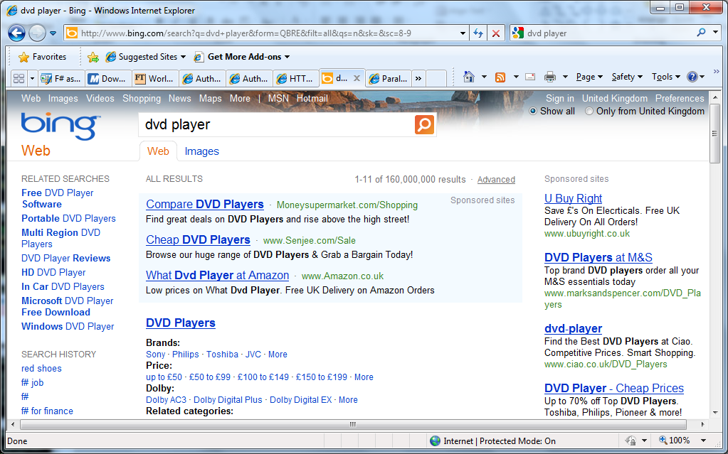
Case Study #5: Microsoft “adPredict”

Slide 19
Case Study #5: Microsoft “adPredict”
4 week project, 4 machine learning experts
100million probabilistic variables
Processes 6TB of training data
Real time processing (N,000 impression updates / sec)
“F# was absolutely integral to our success”
“We delivered a robust, high-performance solution on-time.”
“We couldn’t have achieved this with any other tool given the constraints of the task”
“F# programming is fun – I feel like I learn more about programming every day”

Slide 20
Asynchronous & Parallel & Reactive
async { let! res = <async-event>
... }
React to a GUI Event
React to a Timer Callback
React to a Query Response
React to a HTTP Response
React to a Web Service Response
React to a Disk I/O Completion
Agent reacts to Message

Slide 21
F# async + immutable
Parallel
Server
Agents

Slide 22
Units of Measure
let EarthMass = 5.9736e24<kg>
// Average between pole and equator radii
let EarthRadius = 6371.0e3<m>
// Gravitational acceleration on surface of Earth
let g = PhysicalConstants.G * EarthMass / (EarthRadius * EarthRadius)

Slide 23
Units of Measure – Typical Example
[<Measure>] type money
[<Measure>] type shares
[<Measure>] type volume
type Price = { Open: float<money>;
High: float<money>;
Low: float<money>;
Close: float<money>;
Volume: float<volume> }

Slide 24
F# Futures: Language Integrated Data
demo

Slide 25
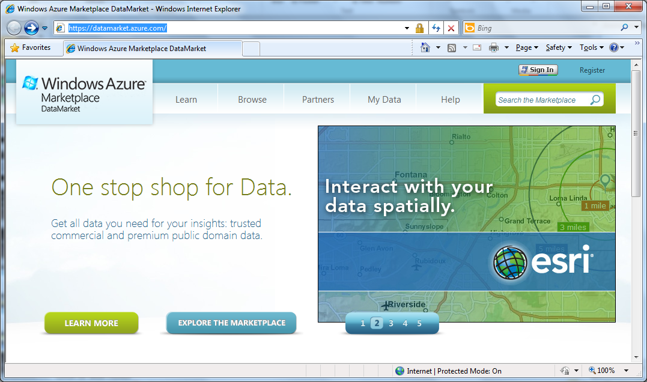

Slide 26
Type Providers: The Vision
…web data
…data markets
…systems data
…spreadsheets
…web services
…CRM data
…social data
…SQL data
…XML data
...
strongly typed
without explicit codegen
extensible, open

Slide 27
In Summary
F#
Ready for supported use in VS2010
F# greatly simplifies parallelism
An amazing data-rich future ahead
Simple, expressive, productive addition to .NET

Slide 28
http://meetup.com/FSharpLondon
Jul 4, 6:30pm
SkillsMatter
A great place to meet F# users, trainers, architects, consultants, …

Slide 29
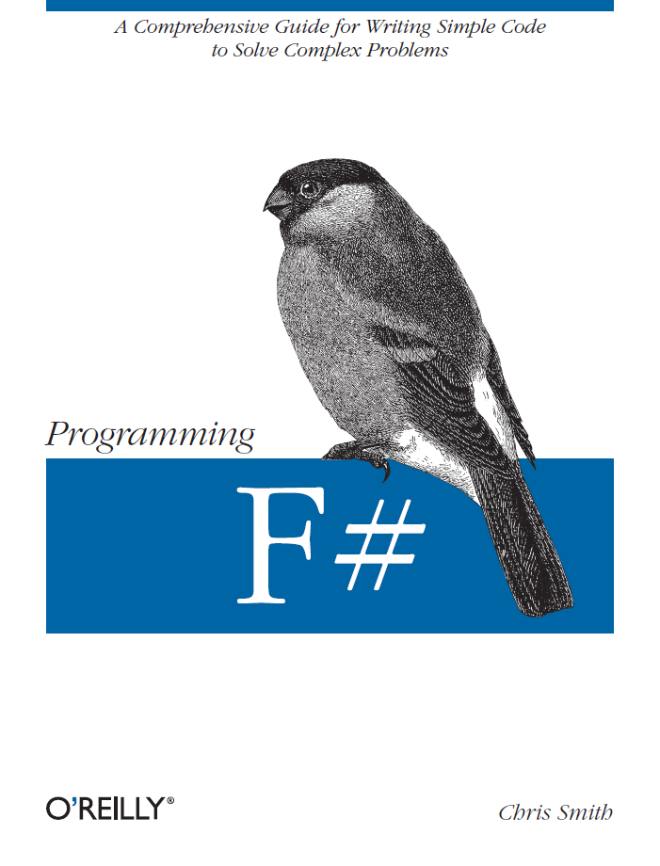
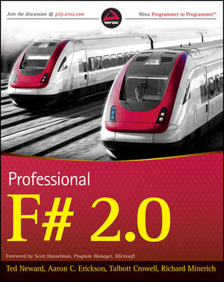
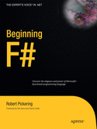
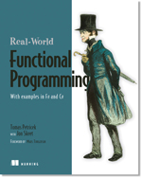
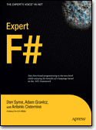
Latest Books about F#
Visit www.fsharp.net

