Slide 1
The F# Path to Relaxation
Language Design, Community, Openness, Independence…. And what it all means for .NET ☺
Don Syme, F# Community Contributor

Slide 2
A Gentle Stroll Through the Land of Language Design and Delivery

Slide 3
A starting position…. The great disputes of computer science should be struggled with…. They are chances to make a better, simpler, more relaxed world as much as create opposing camps

Slide 4
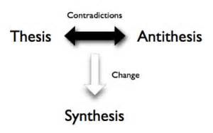
Not a new idea…

Slide 6
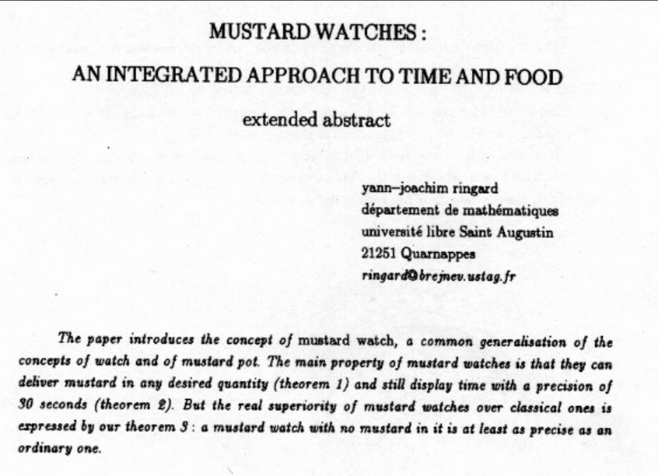
You can of course take this too far :)

Slide 7
X
Y
?

Slide 8
Functional
Interop

Slide 9
Then (2003) Functional languages were isolated, non-interoperable, using their own VMs. Interop standards like C-calls, COM, CORBA, XML were a mess for language-integration.

Slide 10
The F# Approach Embrace industry-standard runtime layers, and influence them. Keep exosystem at an appropriate distance. Design with end-to-end interop in mind. Compromise where needed.

Slide 11
Relaxation Achieved, 200% ✔ ✔ A path followed by Scala, Swift and now many others ✔ Today’s FP languages are immensely interoperable while staying true to FP principles. ✔ F# type providers raise interop to a completely new level ✖ Some tensions remain – not all functional techniques are easily implemented on industry standard VMs
Functional
Interop

Slide 12
Functional
Objects

Slide 13
Then (2003) In the 1990s functional languages were historically anti-OO Even today any mention of objects gives some people an “urrgghhh…” reaction. Modern Compiler Implementation with Standard ML - Chapter 14, Object Oriented Programming object – to express a dislike or distaste for something

Slide 14
F# - Objects + Functional
type Vector2D (dx:double, dy:double) =
let d2 = dx*dx+dy*dy
member v.DX = dx
member v.DY = dy
member v.Length = sqrt d2
member v.Scale(k) = Vector2D (dx*k, dy*k)
Inputs to object
construction
Object internals
Exported properties
Exported method

Slide 15
Objects
Constructed Class Types
type ObjectType(args) =
let internalValue = expr
let internalFunction args = expr
let mutable internalState = expr
member x.Prop1 = expr
member x.Meth2 args = expr
Object Expressions
{ new IObject with
member x.Prop1 = expr
member x.Meth1 args = expr }
{ new Object() with
member x.Prop1 = expr
interface IObject with
member x.Meth1 args = expr
interface IWidget with
member x.Meth1 args = expr }
Object Interface Types
type IObject =
interface ISimpleObject
abstract Prop1 : type
abstract Meth2 : type -> type

Slide 16
The F# approach is to embrace objects, make them fit with the expression-oriented typed functional paradigm especially for interop and software engineering purposes but not embrace full “object-orientation”

Slide 17
Functional
 | Expression-oriented | No null | Multiple Args = Tuples | Closure and Capture | First-class Values | Currying | HM Type Inference
void (unit) | ✓ | ✓ | ✓ | ✓ | ✓ | ✓ | ✓
Object Types | ✓ | ✓ | ✓ | ✓ | ✓ | ✓ | ✓
Subtyping | ✓ | ✓ | ✓ | ✓ | ✓ | ✓ | ✓
Dot-notation | ✓ | ✓ | ✓ | ✓ | ✓ | ✓ | ¾
Inheritance | ✓ | ✓ | ✓ | ✓ | ✓ | ✓ | ¾
Method Overloding | ✓ | ✓ | ✓ | ✓ | ¾ | ✗ | ¾
Objects
Relatively Graceful Degradation
(some type annotations needed)
Relatively Graceful Degradation
(some type annotations needed)
Some combinations outlawed for sanity

Slide 18
A functional-first approach makes a huge difference in practice fsharp.org/testimonials

Slide 19
An analysis (Simon Cousins, Energy Sector)
350,000
lines of C# OO
by offshore team
30,000
lines of robust F#, with
parallel +more features
An application to evaluate the revenue due from Balancing Services contracts in the UK energy industry
http://simontcousins.azurewebsites.net/does-the-language-you-use-make-a-difference-revisited/

Slide 20
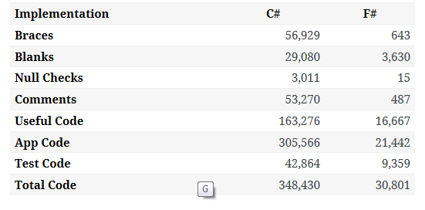

Slide 21
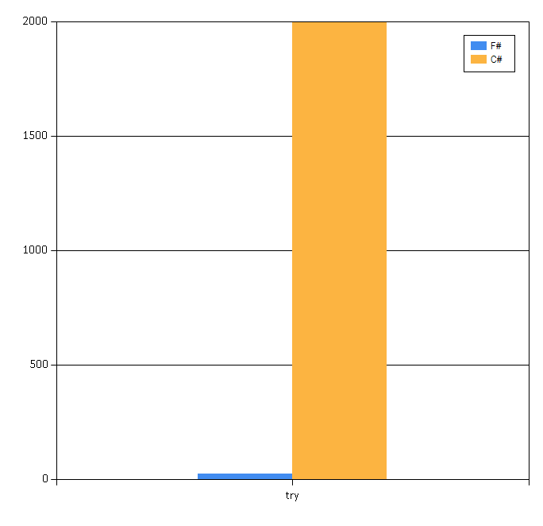

Slide 22
Simon Cousins, Energy Sector
Zero
bugs in deployed system
“F# is the safe choice for this project,
any other choice is too risky”
An application to evaluate the revenue due from Balancing Services contracts in the UK energy industry
http://simontcousins.azurewebsites.net/does-the-language-you-use-make-a-difference-revisited/

Slide 23
Functional
Objects
Positive Synthesis Achieved ✔ OO and Functional, Happy Together

Slide 24
F# Active Patterns ✔
Pattern Matching
Abstraction

Slide 25
F# Type Providers ✔
Code
Data
Relaxation Achieved (200%) F# Type Providers have been a staggeringly successful feature – their range of useful application is enormous.

Slide 26
F# Async Programming ✔
Sync
Async

Slide 27
F# Units of Measure + Inference ✔
Numbers
Numbers-with Units

Slide 28
GPU
CPU
F# Quotations ✔
Alea GPU

Slide 29
X
Y
?

Slide 30
Enterprise
Openness

Slide 31
TL;DR – Where we are now
F# is open, cross-platform, neutral, independent
The F# Compiler Service powers many other tools
F# 4.1 nearing completion!
Debian .NET Core, Docker, Suave and other packages for Linux/OSX
The F# language is accepting contributions
The F# community is very “self-empowered”
fsharp.org
The Visual F# Tools are Microsoft’s professional tools for Windows and Azure
Xamarin provide F# tools Android and iOS

Slide 32
The F# Language Design Process fslang.uservoice.com F# RFCs Pull Requests

Slide 33
F# 4.0 ✔ True shift to cross-platform open engineering ✔ Long laundry list of language items ✔ Normalized core library ✔ Type providers more powerful ✔ Better debugging, tooling, performance ✔ ~20% compiler perf improvement

Slide 34
F# 4.1 (being finalized) ✔ Struct records ✔ Struct unions (1-case) ✔ Struct tuples (compat with C# 7.0) ✔ Mutually referential types and modules ✔ “fixed” ✔ + other items and several fixes

Slide 35
The F# Compiler Service fsharp.github.io/FSharp.Compiler.Service

Slide 36
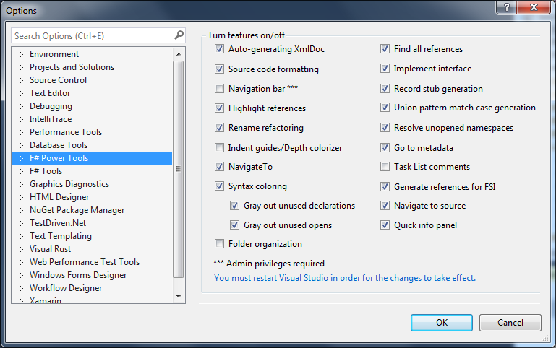
The Visual F# Power Tools
fsprojects.github.io/VisualFSharpPowerTools

Slide 37
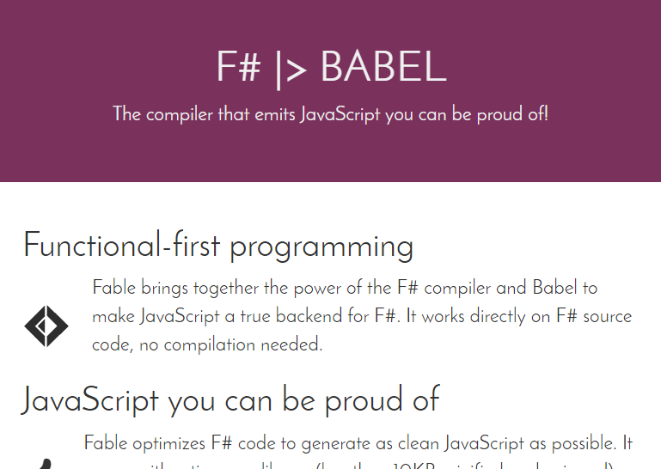
Fable = F# to JS
http://fsprojects.github.io/Fable/

Slide 38
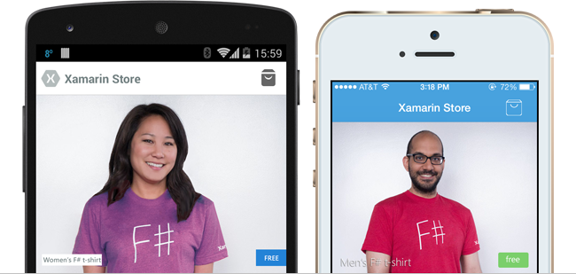
F# for Android, iOS, Linux, Mac

Slide 39
100% open source, community driven

Slide 40
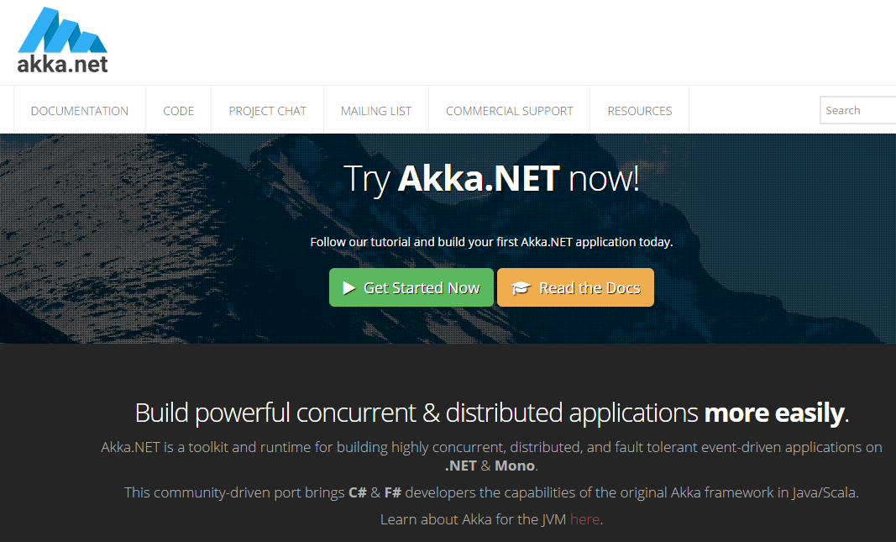
100% open source, community driven

Slide 41
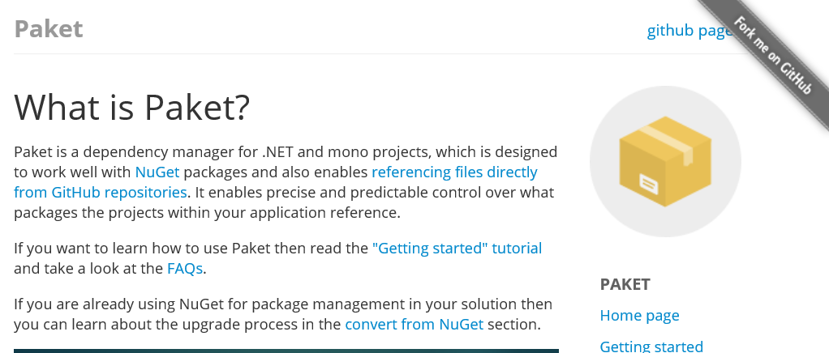
http://fsprojects.github.io/Paket/

Slide 42
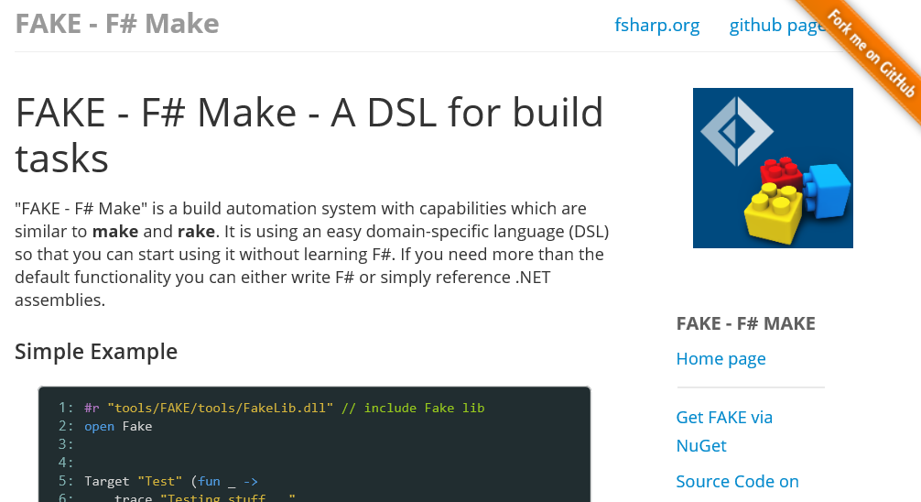
http://fsharp.github.io/FAKE/

Slide 43
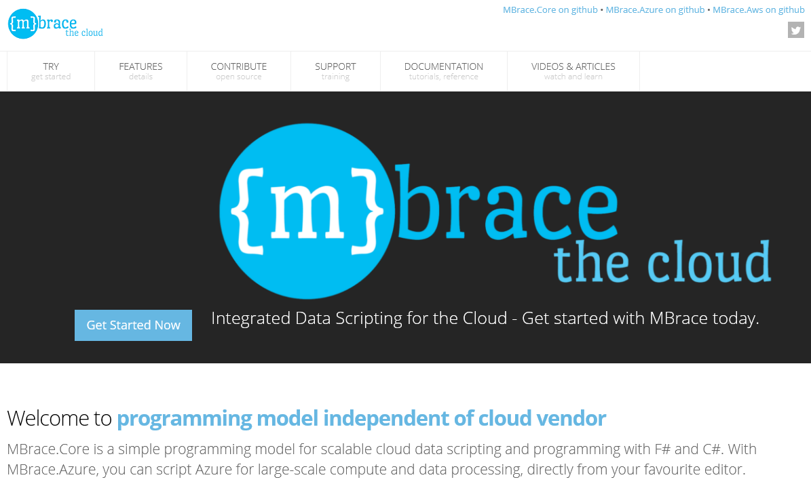
100% open source, community driven
http://mbrace.io/

Slide 44
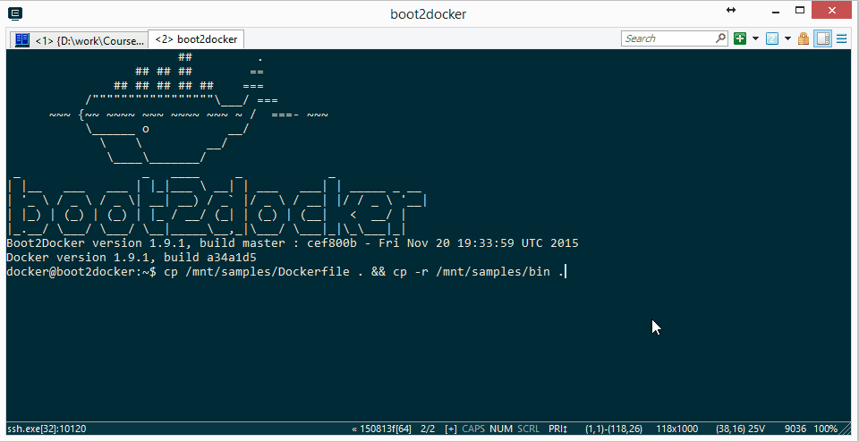
F# for Docker? Yes! hub.docker.com/fsharp/fsharp

Slide 45
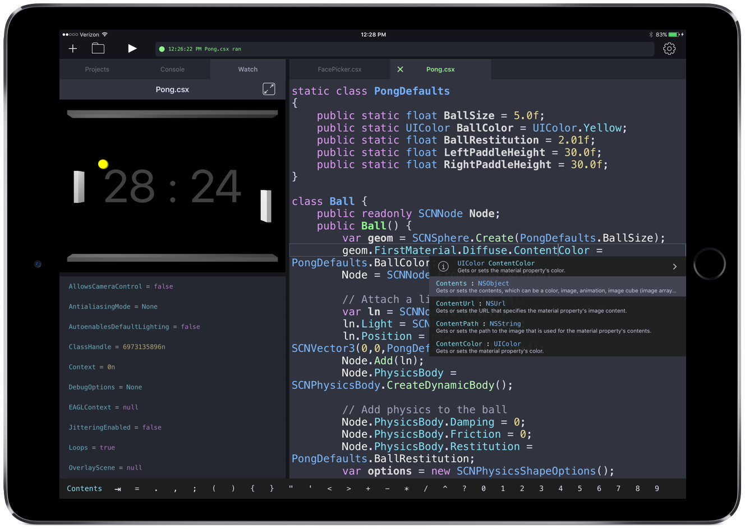

Slide 46
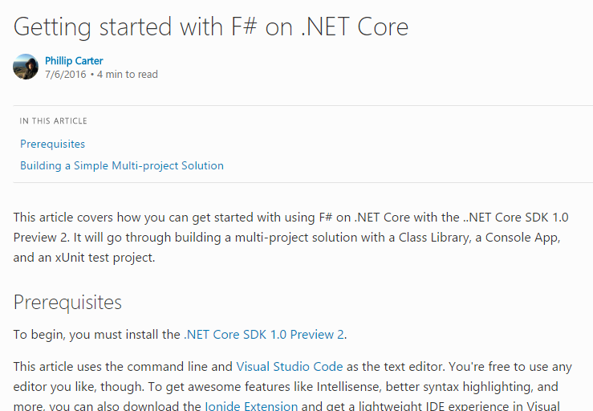
F# for CoreCLR – Yes!

Slide 47
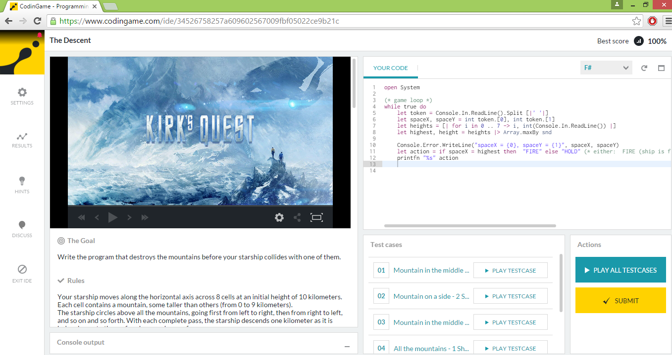
Fun @ Coding Game

Slide 48
Relaxation Achieved ✔ Enterprise Quality + Openness + Community + Tooling + Ecosystem + Evolution Path = Goodness
Enterprise
Openness

Slide 49
Dependence
Independence

Slide 50
The Genesis of the F# Software Foundation, 2014 Houston, we have a problem. But what sort of problem exactly? And what would a solution look like?

Slide 51
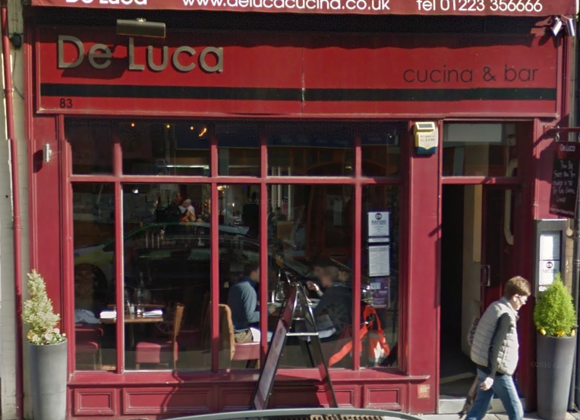
The Genesis of the F# Software Foundation, 2014 Houston, we have a problem. But what sort of problem exactly? And what would a solution look like?

Slide 52
.NET is at a similar juncture. We all know it. The lesson from F# is that the solution is not just technical. It’s social.

Slide 53
The principles of founding the FSSF
Open, worldwide, free membership, social media, education focus
Every base technology needs a social organization that acts in its interests.
Companies struggle to provide a voice strong enough for a base technology today. They can contribute but won’t succeed alone.
Let’s shift F# to where we want to be, not where we are.
Let’s embrace both commercial and non-commercial. Be a DMZ.
Let’s solve our weaknesses (e.g. cross-platform, open-source). If we’re not perfectly XYZ, work on it. It’s painful, but do it.
Self-consistency and an empowered user base are more valuable than sheer size in the long run.

Slide 54
Memetic Independence When a technology can be virally communicated as an idea independently of other technologies, associations or vested interests

Slide 55
Does Visual Basic have memetic independence? No Does F# have memetic independence? Yes Do .NET and C# have memetic independence? Your challenge

Slide 56
.NET, C# and F# need…
Memetic independence.
A community(ies) that is worth being a part of.
A community(ies) with a strong, positive voice of its own.
A community(ies) that can include people and companies who are not aligned to Microsoft's interests.
A community(ies) with generational renewal. A place for 20-year olds. 18 year olds. 16 year olds.
A Technology Creators Conference open to all .NET tech creators

Slide 57
Warning Signs…
When searching for .NET/C#/F# leads you straight to one company
When the first sentence explaining .NET includes “Windows”, “Microsoft” or “Visual Studio” 100% of the time.
When you can only reasonably contribute to a technology on Windows
When all major community contributors are MVPs from one company.
When everyone giving talks or attending is using Windows or VS.
When inspirational upstack frameworks, languages and creative tooling are not encouraged, but extinguished.
When community are unkind, unwelcoming or negative. Amplify positivity.

Slide 58
The Great Challenge for .NET, C# and F# = Social Independence + Memetic Independence + Enterprise-Ready Contribution = Goodness
Dependence
Independence

Slide 59
In Conclusion!
Functional
Objects
Sync
Async
Code
Data
Open
Enterprise
…
…
Opposites come in all shapes and flavours
Relaxation can be achieved ☺☺☺☺
Synthesis from contradiction is at the heart of what we do

Slide 60
Thank you!! Questions?

Slide 61
Mixed OO/Functional Programming Has Won Lambdas in C#, Java, C++, … Async monadic modality in C#, Javascript, PHP (Hack), … Function types in C#, TypeScript, … Generics in C#, Java, Visual Basic, … …

Slide 62
… except where it hasn’t Inheritance everywhere!!! Nulls everywhere!!! Circularities everywhere!!!!

Slide 63
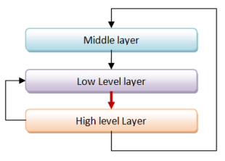
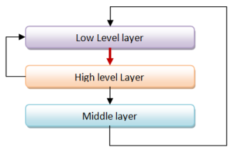
Unnecessary Circularities are Evil
To the functional programmer, it is “obvious” that our software methodology should help minimize and reduce cyclic dependencies in program structure.

Slide 64
The C# approach to circularity
All files in an “assembly” are mutually referential
Arbitrary circularity between “internal” items in an assembly
Mutually recursive “assemblies” are possible if you try hard

