Slide 1
Data, Programming, Cloud
Don Syme, @dsyme
Microsoft Research, F# Community Contributor

Slide 2
Our Expertise (at MSR Cambridge)
Programming!
More Productive Programming!
Lots of ideas needed!
Lots of technical work!
Safer Programming!
More Correct Programming!
More Interoperable Programming!
More Efficient Programming!
More Enjoyable Programming!
….

Slide 3
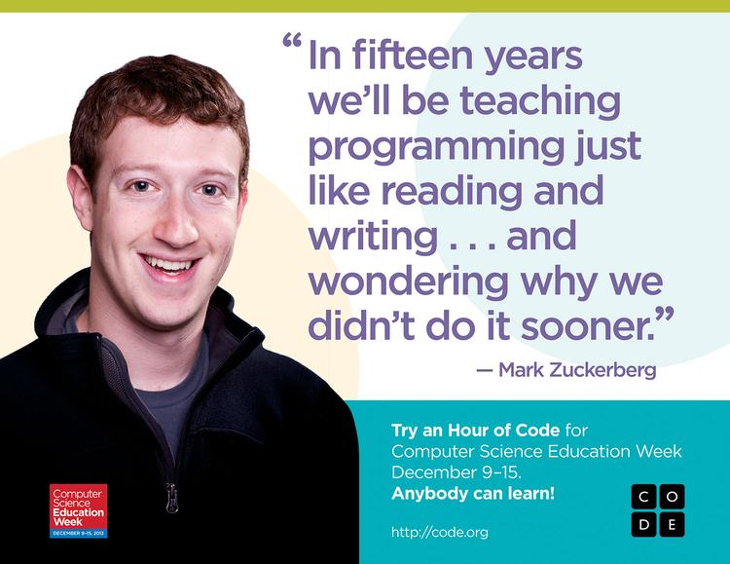
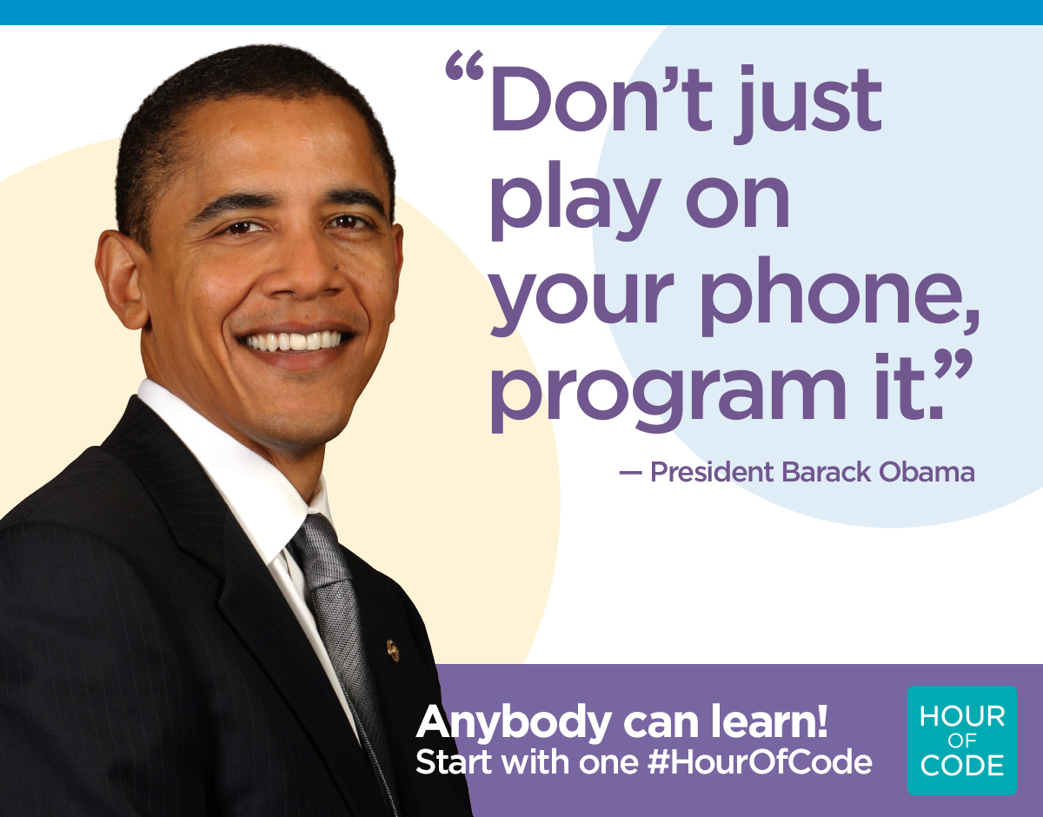
Programming matters!

Slide 4
Programming matters!
The worldwide view:
10Million devs x $100K/year productivity
=
$1Trillion/year
1% productivity increase = $1Billion!!

Slide 5
But isn’t today is about data and cloud!??!

Slide 6
X
Y
?

Slide 7
Code
Data
In one large company, ~500 people work on tooling for this
…and 5000+ people work on tooling for this

Slide 8
Proposition 1 We are living through an information revolution

Slide 9
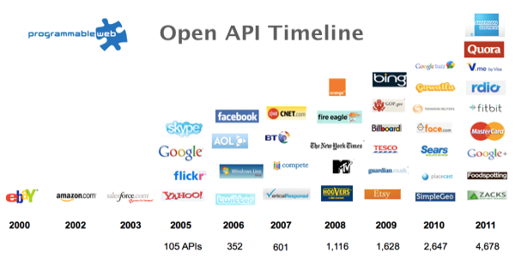
The Information Revolution
2012
2013
6,432
10,537

Slide 10
Proposition 2 Our programming languages are information-sparse

Slide 11
Proposition 3 This is a big problem for all languages (Java, C#, F#, Python, C++, …)

Slide 12
We need to bring information into the language… At internet-scale, strongly tooled, strongly typed

Slide 13
But before we get into that… A bit about F#

Slide 14
F# is a programming language
The F# language is accepting contributions
Debian and other packages for Linux
Microsoft provide F# tools for Windows/Azure in Visual Studio
Xamarin provide F# tools for Android and iOS
C#, F# and .NET are free, open, cross-platform
F# is a companion to C#, widely used in enterprises
fsharp.org
F# 4.0 just complete

Slide 15
Example #1 (power company)
We have written an application to balance the national power generation schedule … for an energy company.
...the calculation engine was written in F#.
The use of F# to address the complexity at the heart of this application clearly demonstrates a sweet spot for the language … algorithmic analysis of large data sets.
Simon Cousins (Eon Powergen)

Slide 16
Example #1 (power company)
Time to Market
Efficiency
Interoperation ... Seamless. The C# programmer need never know.
Units of measure … a huge time saver...it eradicates a whole class of errors…
Exploratory programming …Working with F# Interactive allowed me to explore the solution space more effectively.
Unit testing …a joy to test. There are no complex time-dependent interactions to screw things up….
Parallelism …The functional purity ... makes it ripe for exploiting the inherent parallelism in processing vectors of data.
Code reduction… … vectors and matrices…higher order functions eat these for breakfast with minimal fuss, minimal code. Beautiful.
Lack of bugs… Functional programming can feel strange. .. once the type checker is satisfied that’s often it, it works.
Correctness
Time to Market
Time to Market
Correctness
Correctness

Slide 17
Example #1 (Simon Cousins, Energy Sector)
350,000
lines of C# OO
by offshore team
30,000
lines of robust F#, with
parallel +more features
An application to evaluate the revenue due from Balancing Services contracts in the UK energy industry
http://simontcousins.azurewebsites.net/does-the-language-you-use-make-a-difference-revisited/

Slide 18
Example #1 (Simon Cousins, Energy Sector)
Zero
bugs in deployed system
“F# is the safe choice for this project,
any other choice is too risky”
An application to evaluate the revenue due from Balancing Services contracts in the UK energy industry
http://simontcousins.azurewebsites.net/does-the-language-you-use-make-a-difference-revisited/

Slide 19
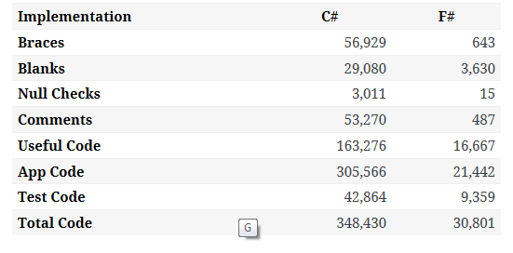

Slide 20
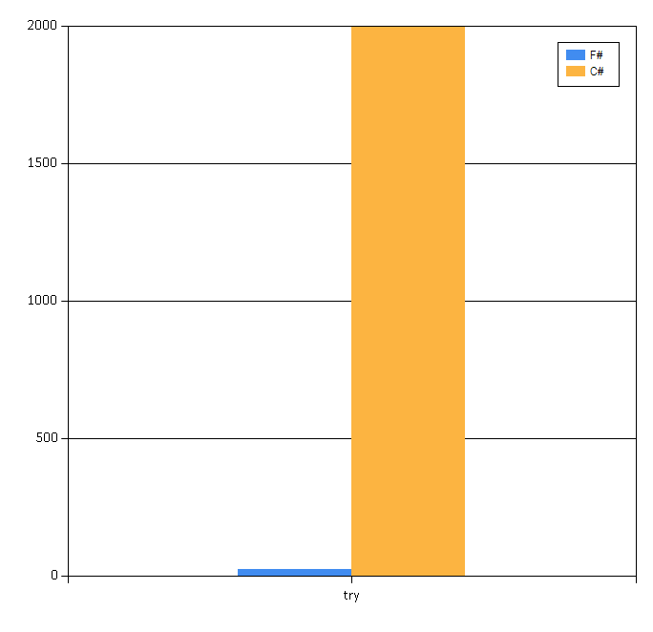

Slide 21
Example #2: F# for Cloud Social Gaming
Efficiency
F# is becoming an increasingly important part of our server side infrastructure that supports our mobile and web-based social games with millions of active users. F# first came to prominence in our technology stack in the implementation of the rules engine for our social slots games which by now serve over 700,000 unique players and 150,000,000 requests per day at peaks of several thousand requests per second.
The F# solution offers us an order of magnitude increase in productivity and allows one developer to perform the work that are performed by a team of dedicated developers on an existing Java-based solution, and is critical in supporting our agile approach and bi-weekly release cycles.
Yan Cui, Lead Server Engineer
Time to Market
fsharp.org/testimonials

Slide 22
F# for Android, iOS, Linux, Mac fsharp.org/use/android fsharp.org/use/ios fsharp.org/use/linux fsharp.org/use/mac

Slide 23
Programming + Data

Slide 24
Data is like water…

Slide 25
Data is like water…
Everyone needs it. Everyone knows where to get it.
Nobody is sure where it really came from, or goes to.
…really knows its true cost, or true value.
…likes to pay for it, or to share it.
…knows how much is wasted.
You might get washed away by it.
You only find out it was bad after you have drunk it.

Slide 26
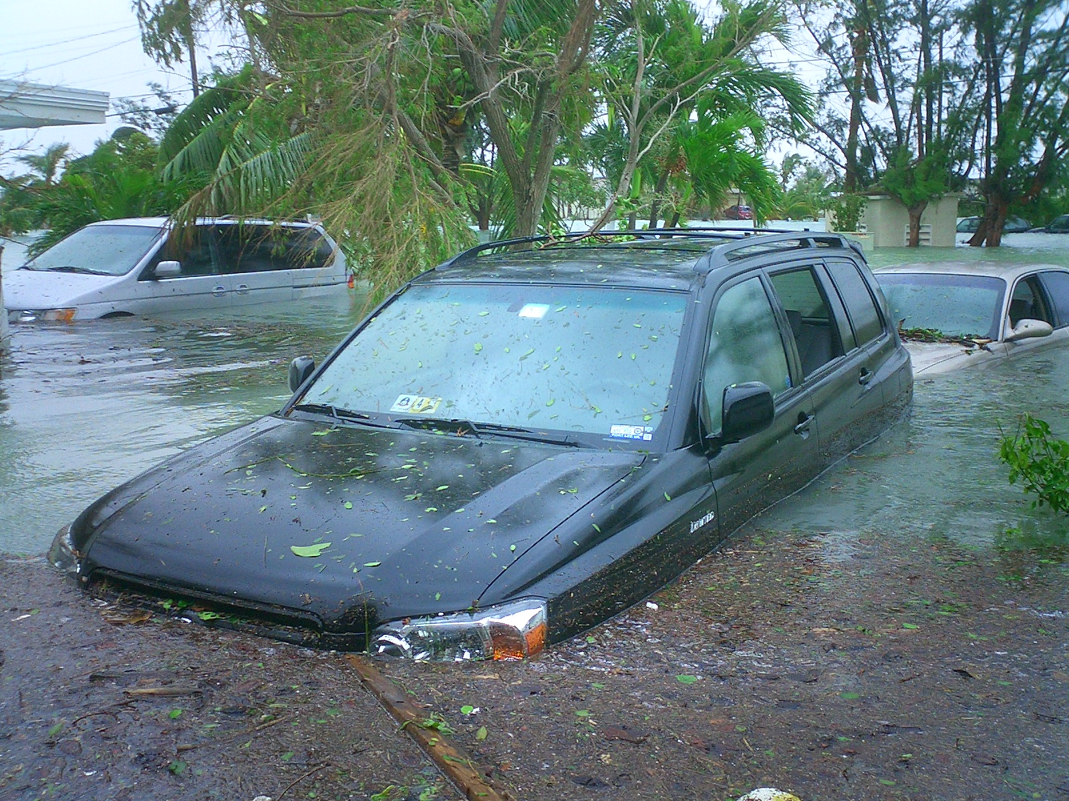
Actually these days it’s more like a flood…

Slide 27
The Problem Our programming tools are data-sparse getting data into a programming language is tiresome, error prone and boring

Slide 28
The Problem Our data tools are programming-sparse doing programming in a data tool is tiresome, error prone, weak

Slide 29
We need to bring data into the language… At internet scale, strongly tooled, strongly typed

Slide 30
Problem: Integrate all of worldbank.org/data “as if it were a library”

Slide 31
Demo
F# + WorldBank
An F# type provider for a specific large data source

Slide 32
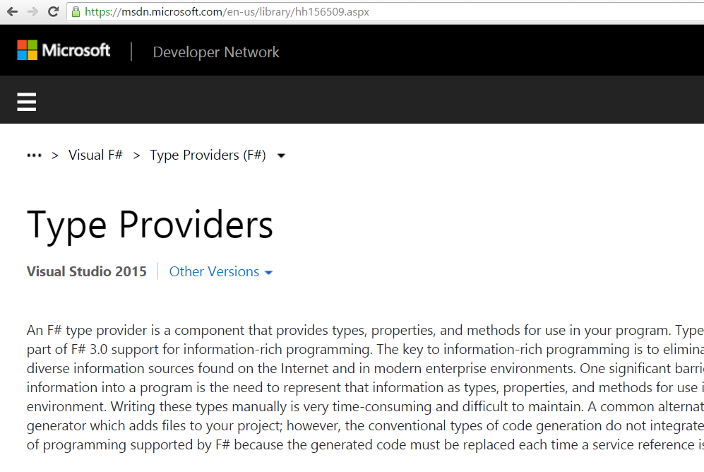
Enter F# Type Providers…

Slide 33
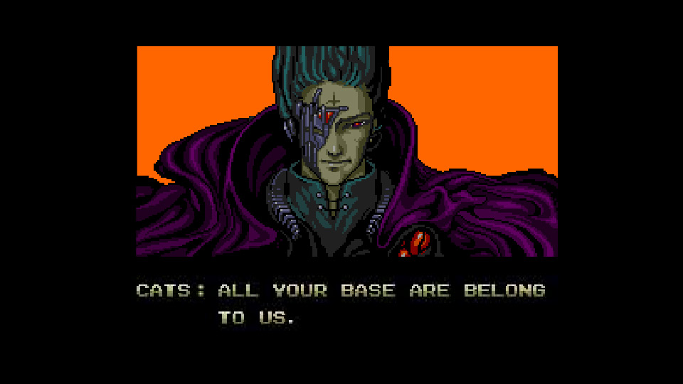
Theme #1 - Many Data Sources, One Mechanism
Segoe UI Light
types

Slide 34
SQL #1

Slide 35
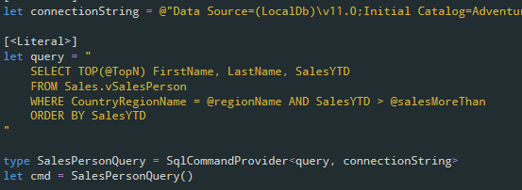
SQL #2

Slide 36
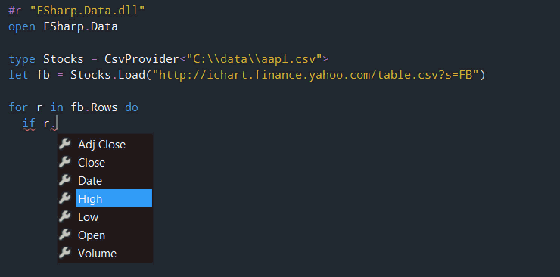
CSV

Slide 37
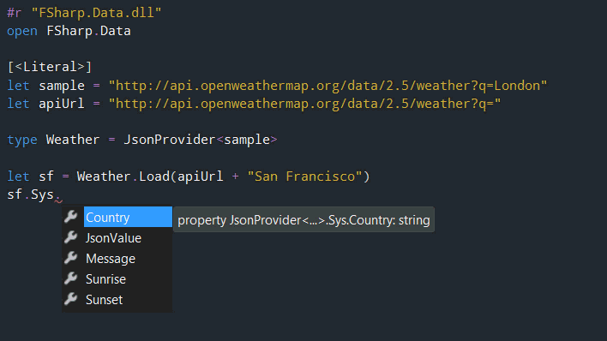
JSON

Slide 38
XML

Slide 39
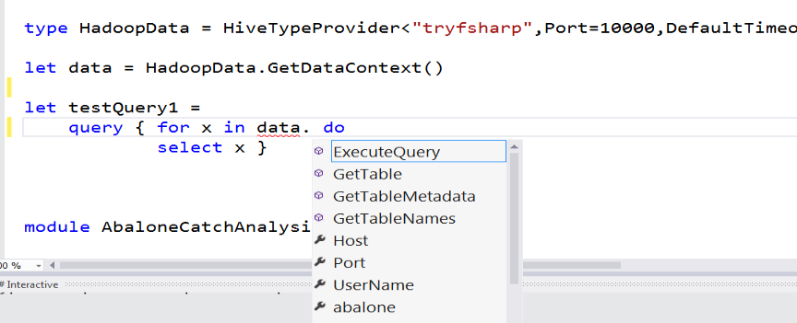
Hadoop/Hive

Slide 40
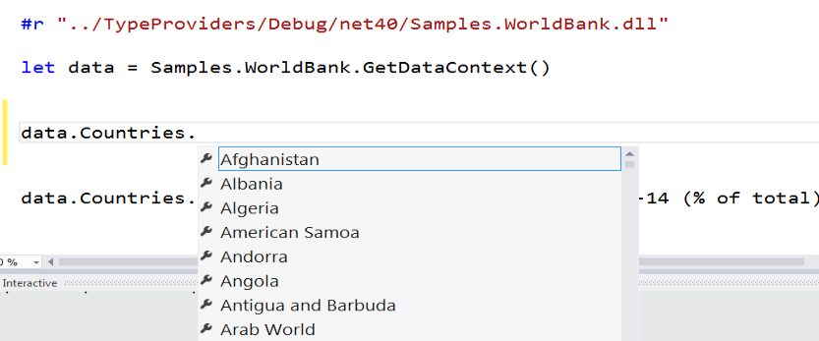
Web APIs

Slide 41
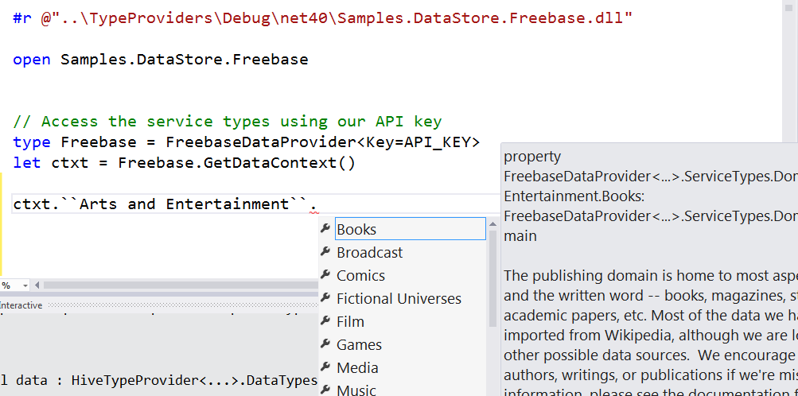
Entity Graphs

Slide 42
WSDL

Slide 43
R

Slide 44
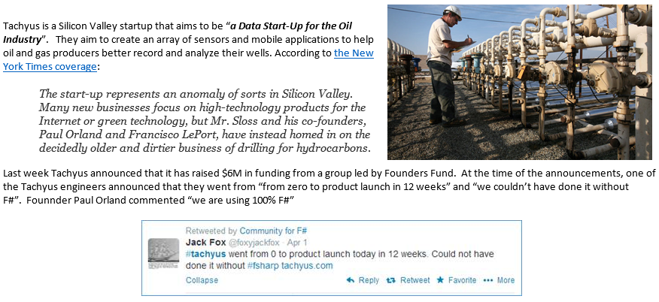
SQL #2 - Application
Correctness
Time to Market

Slide 45
Theme #2 - Data at Multiple Scales
From Everything to Individuals
Data Scripters need to work with different granularities of schematization
data.AllEntites
data.Automotive.``Automobile Models``
data.Automotive.``Automobile Models``.Individuals.``Porsche 911``
…Only a language that supports massively scalable metadata can operate at all these levels
Every stable entity can get a unique type

Slide 46
“The idea of integrating internet-scale information services directly into the program's variable and type space is probably the most innovative programming language idea I’ve heard of in a decade” (Jim Cordy, Queens U) Overly kind, but thought provoking!

Slide 47
Programming + Data + Cloud

Slide 48
The problem: cloud programming is hard The solution: simple, scalable cloud+data scripting

Slide 49
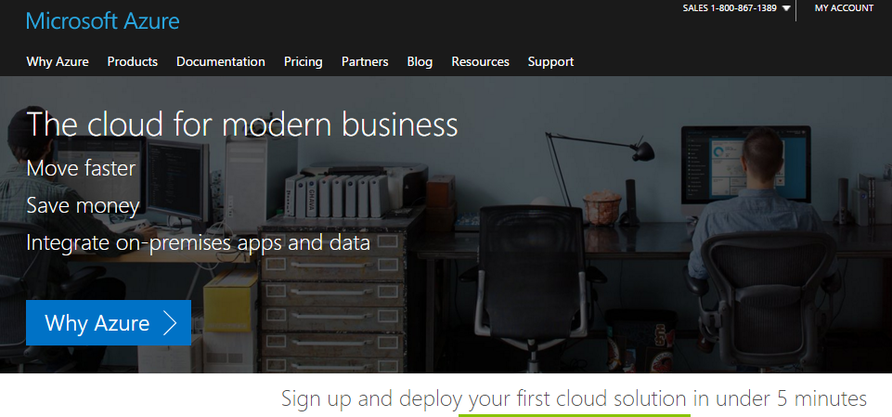
Context: Microsoft Azure

Slide 50
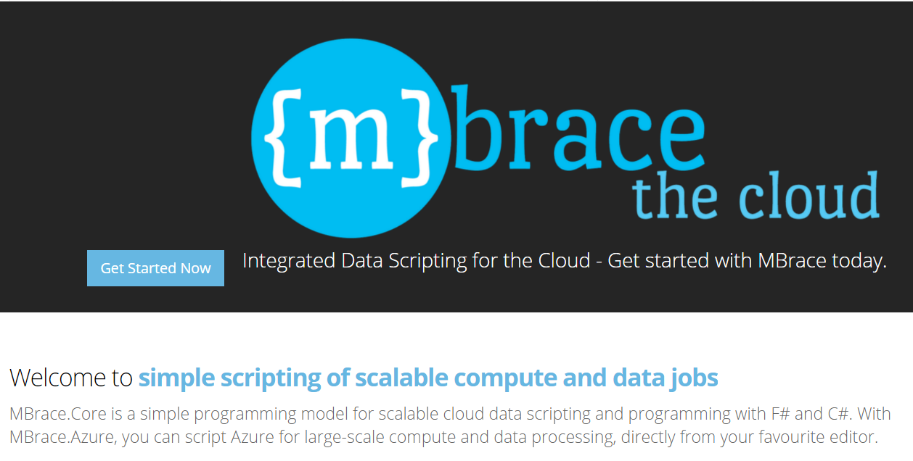
100% open source, community driven
http://mbrace.io/

Slide 51
Summary

Slide 52
Summary
Data + Cloud + Programming is a major challenge
Correct, scalable programming lies at the heart of successful tech companies
At MSR we have deep expertise in programming tech
F# is an enterprise-ready tool uniquely suited to data + cloud + programming

Slide 53
Questions?

Slide 54
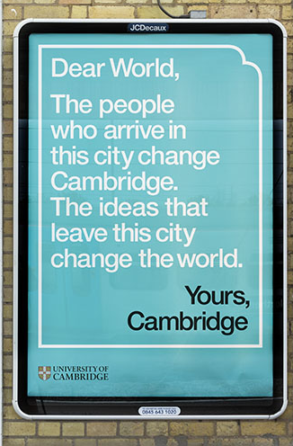
Ideas matter!

Slide 55
Ideas matter!
To: developers
Cup<T>?
async { ? }
(|A|B|) ?
float<kg>?
(a,b)?
safe? immutable?
secure? private?
Yours,
Microsoft Research
Cambridge
To: developers
From: MSR
Cup<T>?
async { ? }
(|A|B|) ?
float<kg>?
(a,b)?
immutable?

Slide 56
Providing Units of Measure
If the metadata contains units…
via F#’s Units of Measure
…then these can be projected into the programming language.

Slide 57
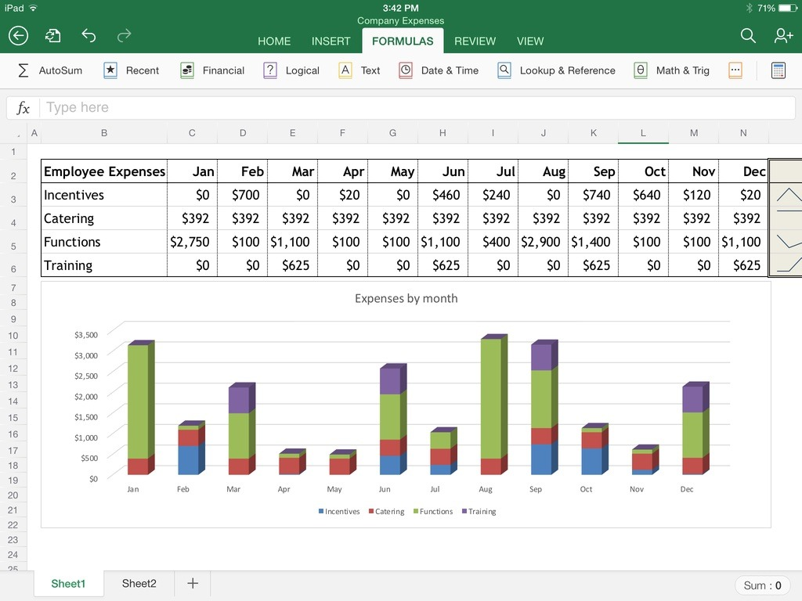
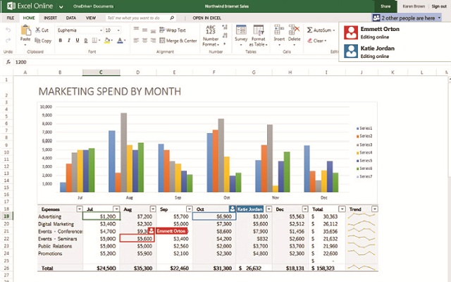
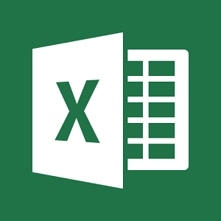
Aside: Excel!!

