Slide 1
Machine Learning with Apache Dhruv Kumar
Hortonworks. We do Hadoop.
May 14, 2015
Spark
Streaming*
Spark
SQL*
MLlib
(machine learning)
Scala
Java
Python
libraries
Spark Core

Slide 2
Agenda
What is Data Science?
Why do Data Science, after all?
What is Spark and MLlib?
How can Amazon, Pandora, etc. know what products and songs I like?
Where can I learn more?

Slide 3
Agenda
What is Data Science?
Why do Data Science, after all?
What is Spark and MLlib?
How can Amazon, Pandora, etc. know what products and songs I like?
Where can I learn more?
Notes:
And

Slide 4
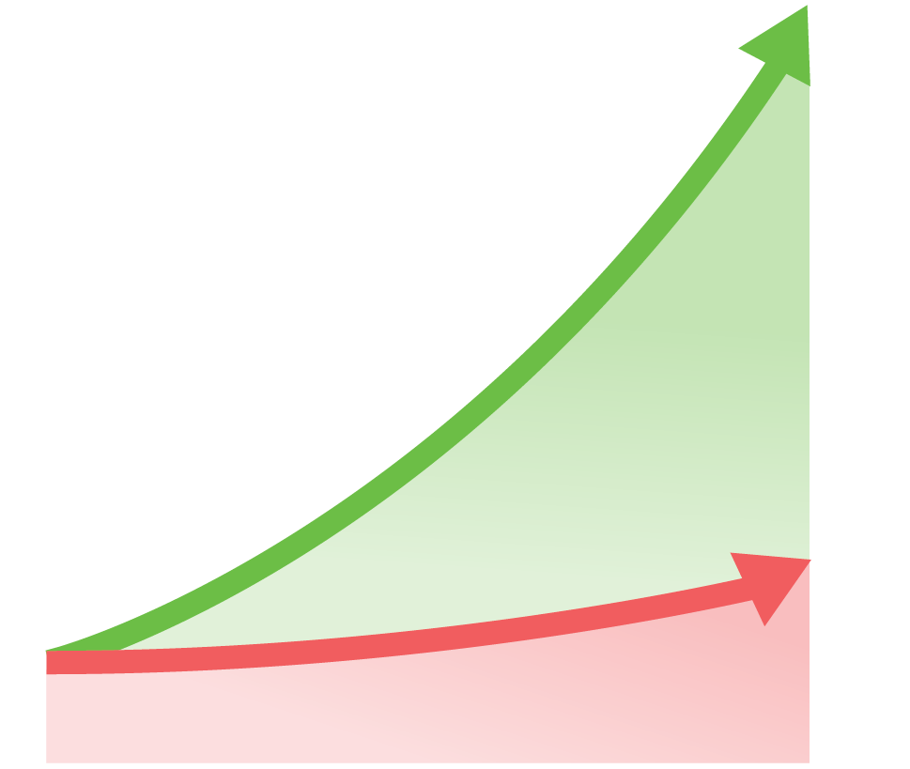
Let’s look at Data in Data Science
2020
40 Zettabytes
Challenges
Constrains data to app
Can’t manage new data
Costly to Scale
1
INDUSTRY LEADERS
Clickstream
Geolocation
Web Data
Internet of Things
Docs, emails
Server logs
2
New Data
Business Value
New
ERP
CRM
SCM
LAGGARDS
2012
2.8 Zettabytes
Traditional

Slide 5
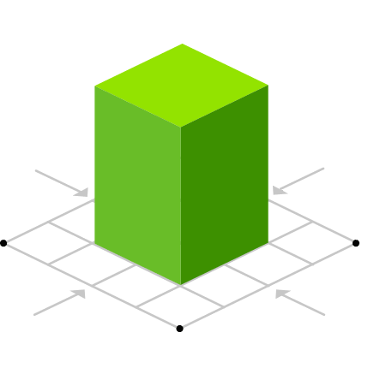
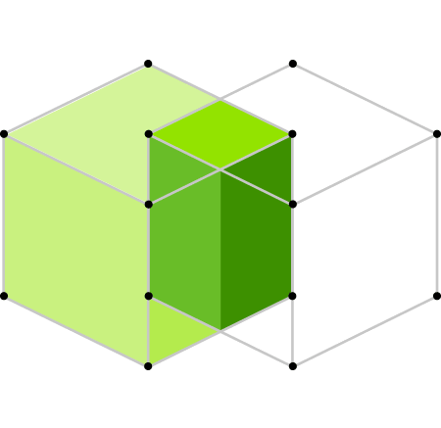
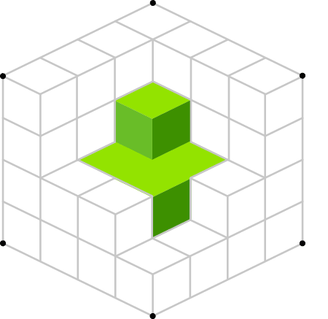
Data Science drives Hadoop
 | Single View Improve acquisition and retention | Predictive Analytics Identify your next best action | Data Discovery Uncover new findings
Financial Services | New Account Risk Screens | Trading Risk | Insurance Underwriting
 | Improved Customer Service | Insurance Underwriting | Aggregate Banking Data as a Service
 | Cross-sell & Upsell of Financial Products | Risk Analysis for Usage-Based Car Insurance | Identify Claims Errors for Reimbursement
Telecom | Unified Household View of the Customer | Searchable Data for NPTB Recommendations | Protect Customer Data from Employee Misuse
 | Analyze Call Center Contacts Records | Network Infrastructure Capacity Planning | Call Detail Records (CDR) Analysis
 | Inferred Demographics for Improved Targeting | Proactive Maintenance on Transmission Equipment | Tiered Service for High-Value Customers
Retail | 360° View of the Customer | Supply Chain Optimization | Website Optimization for Path to Purchase
 | Localized, Personalized Promotions | A/B Testing for Online Advertisements | Data-Driven Pricing, improved loyalty programs
 | Customer Segmentation | Personalized, Real-time Offers | In-Store Shopper Behavior
Manufacturing | Supply Chain and Logistics | Optimize Warehouse Inventory Levels | Product Insight from Electronic Usage Data
 | Assembly Line Quality Assurance | Proactive Equipment Maintenance | Crowdsource Quality Assurance
 | Single View of a Product Throughout Lifecycle | Connected Car Data for Ongoing Innovation | Improve Manufacturing Yields
Healthcare | Electronic Medical Records | Monitor Patient Vitals in Real-Time | Use Genomic Data in Medical Trials
 | Improving Lifelong Care for Epilepsy | Rapid Stroke Detection and Intervention | Monitor Medical Supply Chain to Reduce Waste
 | Reduce Patient Re-Admittance Rates | Video Analysis for Surgical Decision Support | Healthcare Analytics as a Service
Oil & Gas | Unify Exploration & Production Data | Monitor Rig Safety in Real-Time | Geographic exploration
 | DCA to Slow Well Declines Curves | Proactive Maintenance for Oil Field Equipment | Define Operational Set Points for Wells
Government | Single View of Entity | CBM & Autonomic Logistic Analysis | Sentiment Analysis on Program Effectiveness
 | Prevent Fraud, Waste and Abuse | Proactive Maintenance for Public Infrastructure | Meet Deadlines for Government Reporting

Slide 6
So, who is a Data Scientist?
“A data scientist knows statistics better than most data engineers and a data engineer knows programming better than most data scientists.”
Data Engineer = a software engineer specializing in building production-grade large scale data pipelines.
Data Science = Predictive Analytics, Advanced Analytics, Machine Learning, etc.

Slide 7
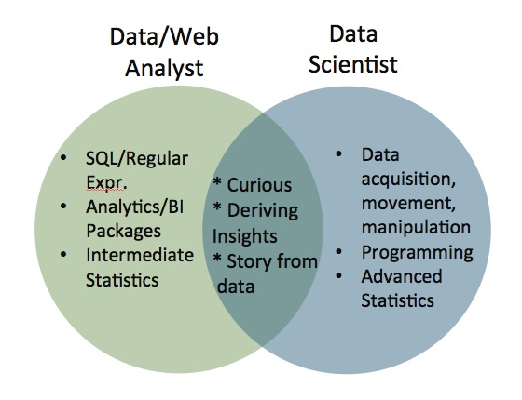
Analytics vs Predictive Analytics

Slide 8
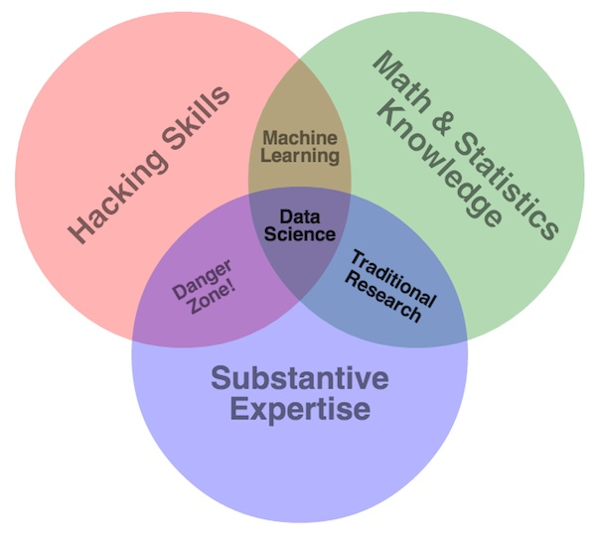
What does a Data Scientist need to know?
Is there a robust framework which allows a Data Scientist to conveniently work on large data sets?

Slide 9
HDP delivers a comprehensive data management platform
BATCH, INTERACTIVE & REAL-TIME DATA ACCESS
HDP 2.2
Hortonworks Data Platform
YARN is the architectural center of HDP
Enables batch, interactive and real-time workloads
Single SQL engine for both batch
and interactive
Enables best of breed ISV tools to
deeply integrate into Hadoop via YARN
Provides comprehensive enterprise capabilities
Governance
Security
Operations
The widest range of
deployment options
Linux & Windows
On premise & cloud
GOVERNANCE & INTEGRATION
SECURITY
OPERATIONS
Data Workflow, Lifecycle & Governance
Falcon
Sqoop
Flume
NFS
WebHDFS
Script
Pig
SQL
Hive HCatalog
NoSQL
HBase
Accumulo
Stream
Storm
Search
Solr
In-Memory
Spark
Other ISVs
Authentication
Authorization
Accounting
Data Protection
Storage: HDFS
Resources: YARN
Access: Hive, …
Pipeline: Falcon
Cluster: Knox
Provision, Manage & Monitor
Ambari
Zookeeper
Tez
Tez
DATA MANAGEMENT
YARN: Data Operating System
Scheduling
Oozie
HDFS (Hadoop Distributed File System)
1
°
°
°
°
°
°
°
°
°
°
°
°
°
°
°
°
°
°
°
°
°
°
°
°
°
°
°
°
°
°
°
N
Deployment Choice
Linux
Windows
On-Premise
Cloud

Slide 10
Let’s drill into one workload … Spark
BATCH, INTERACTIVE & REAL-TIME DATA ACCESS
HDP 2.2
Hortonworks Data Platform
YARN is the architectural center of HDP
Enables batch, interactive and real-time workloads
Single SQL engine for both batch
and interactive
Enables best of breed ISV tools to
deeply integrate into Hadoop via YARN
Provides comprehensive enterprise capabilities
Governance
Security
Operations
The widest range of
deployment options
Linux & Windows
On premise & cloud
GOVERNANCE & INTEGRATION
SECURITY
OPERATIONS
Data Workflow, Lifecycle & Governance
Falcon
Sqoop
Flume
NFS
WebHDFS
Script
Pig
SQL
Hive HCatalog
NoSQL
HBase
Accumulo
Stream
Storm
Search
Solr
In-Memory
Other ISVs
Authentication
Authorization
Accounting
Data Protection
Storage: HDFS
Resources: YARN
Access: Hive, …
Pipeline: Falcon
Cluster: Knox
Provision, Manage & Monitor
Ambari
Zookeeper
Tez
Tez
DATA MANAGEMENT
YARN: Data Operating System
Scheduling
Oozie
HDFS (Hadoop Distributed File System)
1
°
°
°
°
°
°
°
°
°
°
°
°
°
°
°
°
°
°
°
°
°
°
°
°
°
°
°
°
°
°
°
N
Deployment Choice
Linux
Windows
On-Premise
Cloud

Slide 11
What is ?
Applications
A framework with set of APIs and libraries for workloads requiring fast in-memory processing
Data workers can rapidly iterate over data for:
Machine Learning
ETL
Stream Processing
SQL
Spark
Streaming*
Spark
SQL*
MLlib
(machine learning)
Scala
Java
Python
libraries
Spark Core
Resource Management
Storage
°
°
°
°
°
°
°
°
°
* Part of Spark Tech Preview

Slide 12
1.2.1 in HDP 2.2
Applications
. . .
Spark
Streaming*
Spark
SQL*
MLlib
(machine learining)
Scala
Java
Python
libraries
. . .
Spark Core
Governance
Compiler / Optimizer
Security
Operations
DAG Execution Engine
YARN: Data Operating System
(Cluster Resource Management)
HDFS
°
°
°
°
°
°
°
°
°
°
°
°
°
* Part of Spark Tech Preview
Production-Ready Spark
Centralized resource management, consistent operations and comprehensive security
Alongside other data engines managed by YARN
Deployable anywhere

Slide 13
Spark’s Position in a Modern Data Platform
Data Sources
Data Processing, Storage & Analytics
Data Access
Ad Hoc/On Demand Source
Data Science
Spark-ML, Spark-SQL
Advanced Analytics
Streaming Source
Stream Processing
Storm/Spark-Streaming
Long Term Data Warehouse
Hive + ORC
Operational Reporting
Disk Based
Source
Data Pipeline
Hive/Pig/Spark
Data Discovery
Reference Data
Business Intelligence
Hortonworks Data Platform

Slide 14
Agenda
What is Data Science?
Why do Data Science, after all?
What is Spark and MLlib?
How can Amazon, Pandora, etc. know what products and songs I like?
Where can I learn more?
Notes:
And

Slide 15
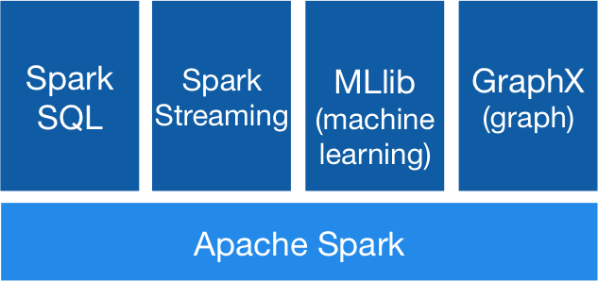
Spark Components
Spark allows you to do data processing, ETL, machine learning, stream processing, SQL querying from one framework

Slide 16
Why Spark?
One tool for data engineering and data science tasks
Native integration with Hive, HDFS and any Hadoop FileSystem implementation
Faster development: concise API, Scala (~3x lesser code than Java)
Faster execution: for iterative jobs because of in-memory caching (not all workloads are faster in Spark)
Promotes code reuse: APIs and data types are similar for batch and streaming

Slide 17
Overview of Spark App Lifecycle
Test/Develop/REPL loop
Developer
Write Spark App
Deploy in Spark Standalone
Spark App is Ready
Take Spark App
Deploy Spark Apps on YARN in a Staging/Production Cluster
Monitor Debug Spark Job

Slide 18
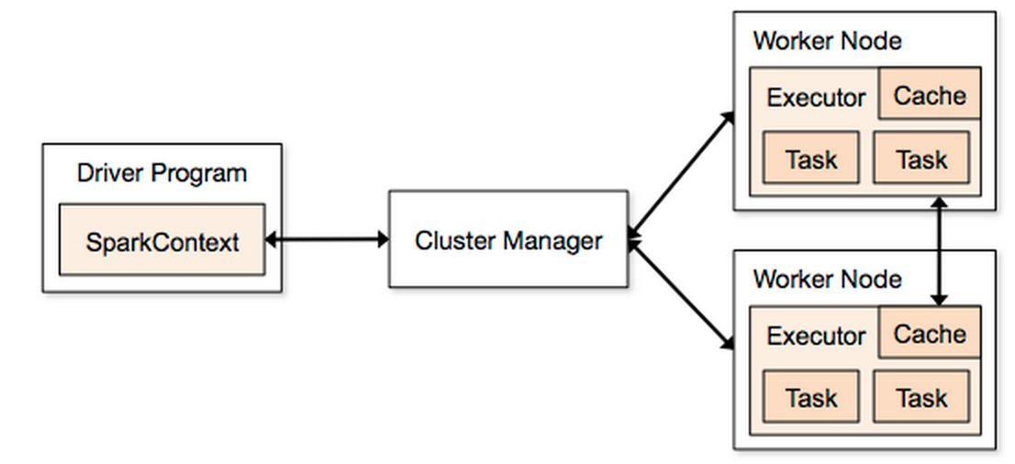
Spark on YARN
Monitoring UI
YARN RM
App Master

Slide 19
How Does Spark Work?
RDD
Your data is loaded in parallel into structured collections
Actions
Manipulate the state of the working model by forming new RDDs and performing calculations upon them
Persistence
Long-term storage of an RDD’s state

Slide 20
Things You Can Do With RDDs
RDDs are objects and expose a rich set of methods:
Name | Description | Name | Description
filter | Return a new RDD containing only those elements that satisfy a predicate | collect | Return an array containing all the elements of this RDD
count | Return the number of elements in this RDD | first | Return the first element of this RDD
foreach | Applies a function to all elements of this RDD (does not return an RDD) | reduce | Reduces the contents of this RDD
subtract | Return an RDD without duplicates of elements found in passed-in RDD | union | Return an RDD that is a union of the passed-in RDD and this one

Slide 21
What is MLlib?
MLlib is a Spark implementation of some common machine learning algorithms and utilities, including:
classification
regression
Clustering
Recommender Engines
dimensionality reduction
MLlib allows data scientists the ability to easily scale machine learning algorithms on a Hadoop cluster.

Slide 22
Data Science Algorithms of MLlib
Classification (in the pyspark.mllib.classification module):
Linear Support Vector Machine: the SVMWithSGD class
Naive Bayes: the NaiveBayes class
Logistic regression: the LogisticRegressionWithSGD class
Regression (in the pyspark.mllib.regression module)
Linear least squares: the LinearRegressionWithSGD class
Ridge regression: linear least squares with L2 regularization, it is implemented with the RidgeRegressionWithSGD class
Lasso: linear least squares with L1 regularization, it is implemented with the LassoWithSGD class
Clustering
K-Means: the pyspark.mllib.clustering.KMeans class
Recommendation
Alternating least squares: the pyspark.mllib.recommendation.ALS class

Slide 23
Eg: K-Means Clustering
from pyspark.mllib.clustering import KMeans
from numpy import array
from pyspark import SparkContext
training_data = array([[1,1],[2,2],[1,3],[0.5,0],[0.3,3],
[0.9,0.8],[0.9,1.2],[1.1,0.8],[1.8,1.5],[0.8,2.1],[3.1,3.3],
[3.2,2.9],[3,5],[2.9,4.5],[0.3,0.4],[3,3],[4,4],[3.5,3.1],
[3.9,4.2],[2.5,2.9]])
dist_training_data = sc.parallelize(training_data)
clusters = KMeans(dist_training_data, 2,
maxIterations=10, runs=10, initializationMode="random")

Slide 24
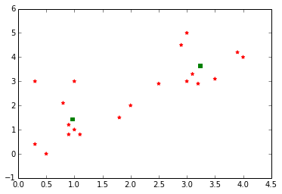
K-Means Clustering (cont.)

Slide 25
Agenda
What is Data Science?
Why do Data Science, after all?
What is Spark and MLlib?
How can Amazon, Pandora, etc. know what products and songs I like?
Where can I learn more?
Notes:
And

Slide 26
What is a recommender system?
“A system that seeks to predict the ‘rating’ or ‘preference’ that a user would give an item they have not yet considered”

Slide 28
Content based recommenders
Determine some content-based features for movies
Example: genre, length, producer
Score each item with these features
Based on previous user preferences, build profile for user around these features
E.g., Ofer likes dramas directed by Ang Lee
Recommend for each user movies that fit their profile

Slide 29
Collaborative Filtering: the preference matrix
Ofer: Harry Potter=4, Argo=4, The Hobbit=5, Looper=4
Danny: Harry Potter=3, The Hobbit=5, Looper=4
Sheryl: Lincoln=5, The Hobbit=3
Ram: Life of Pi=4, ParaNorman = 5, Looper=2
Li: Harry Potter=4, Lincoln=2, Argo=5, Zero Dark Thirty=5, The Hobbit=4
 | Harry Potter | Argo | The Hobbit | Life of Pi | Para- Norman | Lincoln | Zero Dark Thirty | Looper
Ofer | 4 | 4 | 5 | NA | NA | NA | NA | 4
Danny | 3 | NA | 5 | NA | NA | NA | NA | 4
Sheryl | NA | NA | 3 | NA | NA | 5 | NA | NA
Ram | NA | NA | NA | 4 | 5 | NA | NA | 2
Li | 4 | 5 | 4 | NA | NA | 2 | 5 | NA

Slide 30
How collaborative filtering works
Inputs: use the known values in the user/item matrix
Goal: predict the missing (NA) values accurately
Types of collaborative filtering algorithms:
User-based nearest neighbors
Item-based nearest neighbors
Latent Factors (e.g., Alternating Least Squares)

Slide 31
Latent factor based CF
Intuition:
Every user’s preference of an item is composed of a sum of preferences about various aspects of the item (aka “latent factors”)
Example factors: romance, car chases, stars
How to compute preferences?

Slide 32
Mathematical foundation: SVD
1
n
1
n
1
R
1
U
t(M)
1
≈
p
m
m
1
p
Singular Value Decomposition
Given a parameter p (number of latent factors in our case)
Given a matrix R
Estimate two oblong matrices: U (m x p) and M (n x p)
R’ = U * t(M)
SVD ensures that RMSE(R, R’) is minimized

Slide 33
Our problem: missing values (NA) in R
1
n
1
n
1
R
1
U
t(M)
1
≈
p
m
m
1
p
Solution approach:
We compute U and M such that error on KNOWN RATINGS is minimized
K = set of (u,i) pairs for which we know the rating
λ = regularization factor (lambda), to reduce over-fitting

Slide 34
Latent factor CF: prediction
1
n
1
n
1
R’
1
U
t(M)
1
=
p
m
m
1
p
We then compute R’ = U * t(M)
Use values in R’ to predict ratings for missing values

Slide 35
Latent factor CF: example
 | LF#1 | LF#2 | LF#3
Ofer | … | … | …
Danny | … | … | …
Sheryl | … | … | …
Ram | … | … | …
Li | … | … | …
X
 | HP | ARG | TH | LOP | PN | LNLN | ZDT | LPR
Ofer | 4 | 4 | 5 | NA | NA | NA | NA | 4
Danny | 3 | NA | 5 | NA | NA | NA | NA | 4
Sheryl | NA | NA | 3 | NA | NA | 5 | NA | NA
Ram | NA | NA | NA | 4 | 5 | NA | NA | 2
Li | 4 | 5 | 4 | NA | NA | 2 | 5 | NA
≈
R
 | LF#1 | LF#2 | LF#3
Ofer | 0.1 | -0.2 | 1.23
Danny | 0.02 | 0.23 | 3.2
Sheryl | … | … | …
Ram | … | … | …
Li | 2.1 | -2.2 | 1.2
X
 | HP | ARG | TH | LOP | PN | LNLN | ZDT | LPR
LF #1 | 1.0 | 0.7 | 0.8 | -2.0 | … | … | … | …
LF #2 | -2 | -1.2 | … | … | … | … | … | …
LF #3 | 0.2 | 1.2 | 1.7 | -2 | -3.2 | 2.0 | 1.3 | 1.2
M
U
Note: numbers in U and M are meant just to exemplify

Slide 36
Demo
Let’s build a music recommendation engine

Slide 37
Agenda
What is Data Science?
Why do Data Science, after all?
What is Spark and MLlib?
How can Amazon, Pandora, etc. know what products and songs I like?
Where can I learn more?
Notes:
And

Slide 38
Resources
Hortonworks offers Hadoop Data Science courses
Go to Udacity, Coursera and EdX for free Machine Learning courses.
Databricks has excellent Spark resources

