Slide 1

Beyond the Basics of SonarQube: Improve Your Java(Script) Code Even Further
Johan Janssen (Info Support)

Slide 2
Agenda
SonarQube basic features
Analyzing data
Code review
Hunting bad design and architecture
Testing
Other languages
Plugins
Using SonarQube on existing projects
Tips / summary
Questions

Slide 3

Quality for thousands of years

Slide 4

Quality after years of improvements

Slide 5

Quality for 39 days

Slide 6
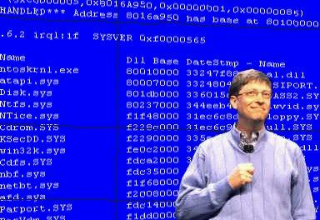
Bugs
Microsoft Applications: "about 10 - 20 defects per 1000 lines of code during in-house testing, and 0.5 defect per 1000 lines of code in released product (Dave Moore 1992).“

Slide 7
Bugs
NASA's Spirit rover became unresponsive on January 21, 2004, a few weeks after landing on Mars. (Wikipedia)
In January 2009, Google's search engine erroneously notified users that every web site world wide was potentially malicious, including its own. (Wikipedia)

Slide 8

Find them as fast as possible

Slide 9
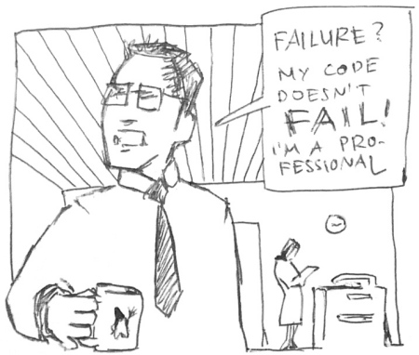
Why should I use SonarQube?
I’m told to use it.
We need to achieve certain results (SIG…)
I want to improve my coding standards
Notes:
Source: http://www.unix-ag.uni-kl.de/~guenther/images/failure-small.jpg

Slide 10
SonarQube
Platform to manage code quality
Open source, possible to pay for support and some plugins
Since 2006; now they have 200 customers and SonarQube is used in 15.000 organizations
Active community: support, plugins, books

Slide 11

SonarQube
2013:
5 releases of SonarQube platform
130 releases of ecosystem products
75,000 downloads of SonarQube
13,000+ messages on mailing lists

Slide 12
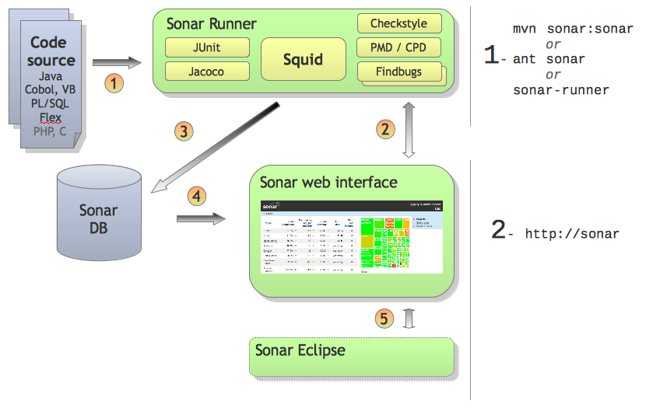
SonarQube architecture

Slide 13

SonarQube basic features

Slide 14
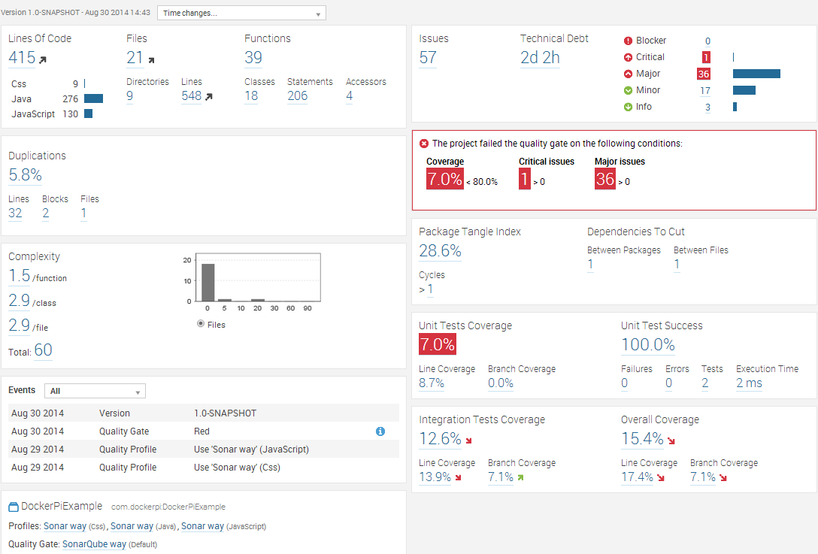

Slide 15
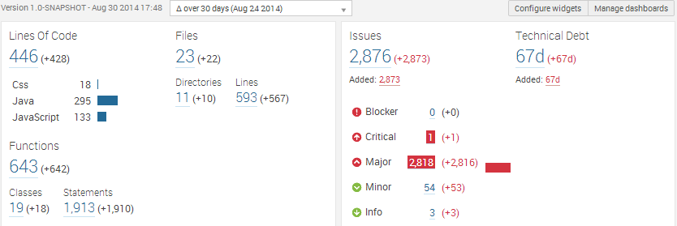
Dashboard with ‘time changes’

Slide 16
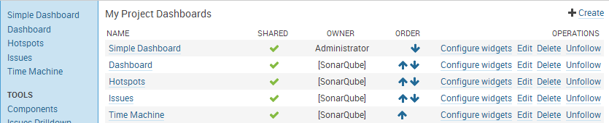
Configure dashboards

Slide 17
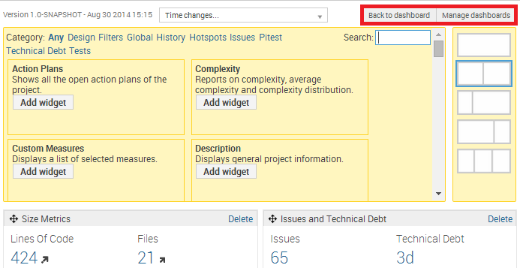
Configure dashboards

Slide 18
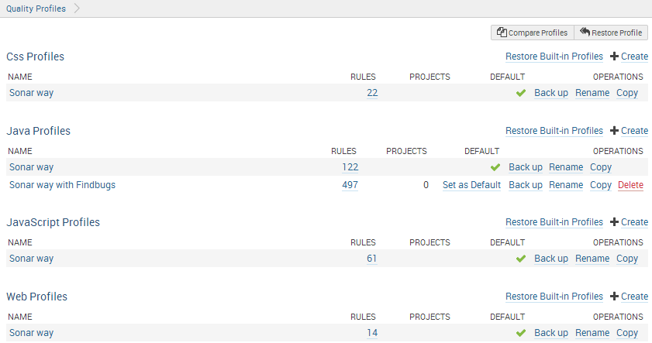

Slide 19
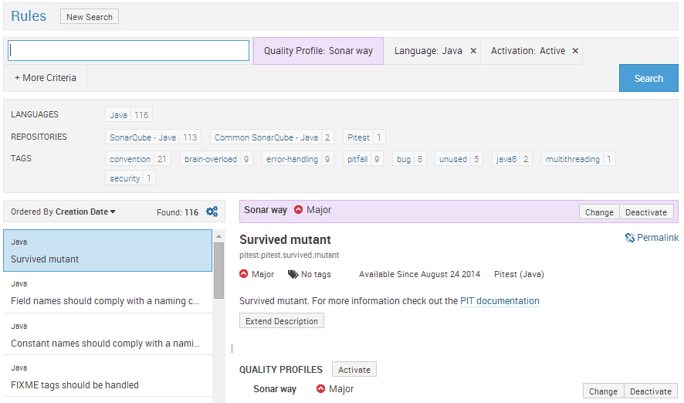

Slide 20
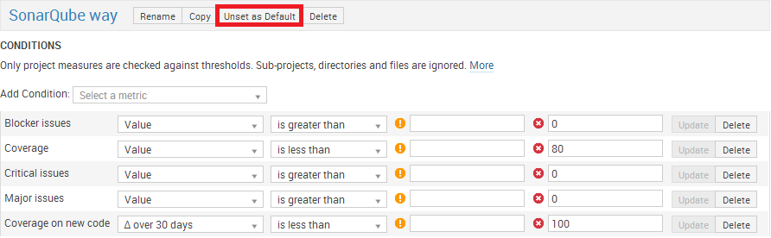
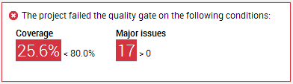
Quality Gates

Slide 21
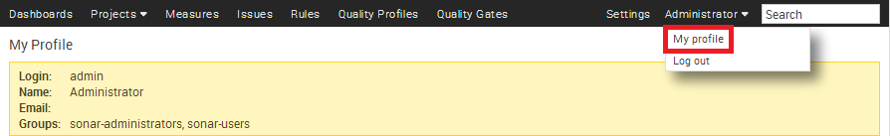
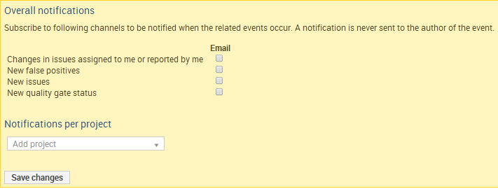
Notifications

Slide 22

Analysing data

Slide 23
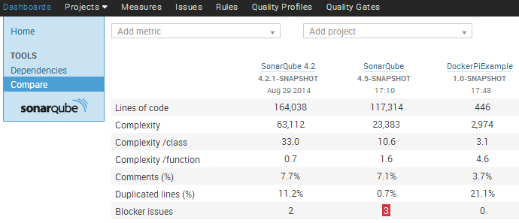
Compare

Slide 24
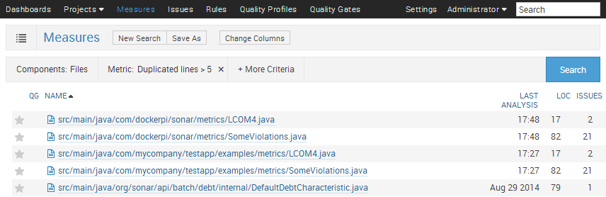
Measures

Slide 25
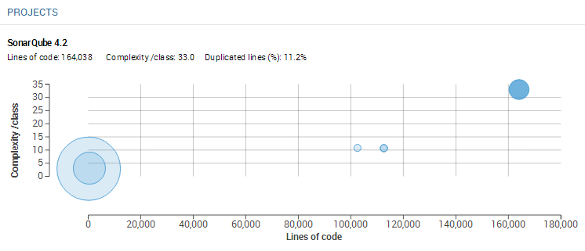
Measure Filter as Bubble Chart

Slide 26
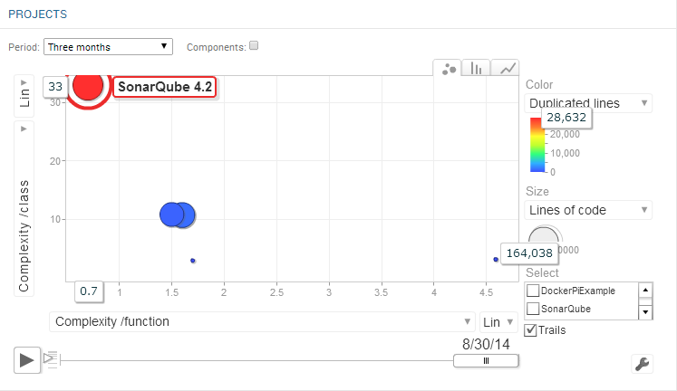
Filter Motion Chart

Slide 27
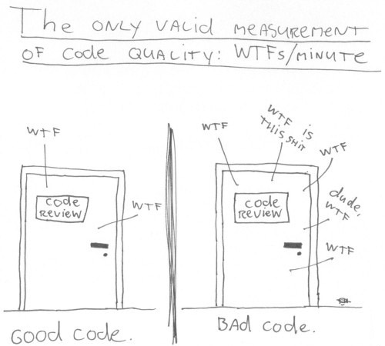
What is good code?

Slide 28

Code review
Notes:
Source: http://eugenedvorkin.com/wp-content/gallery/cache/220__320x240_code_reviews.jpg

Slide 29
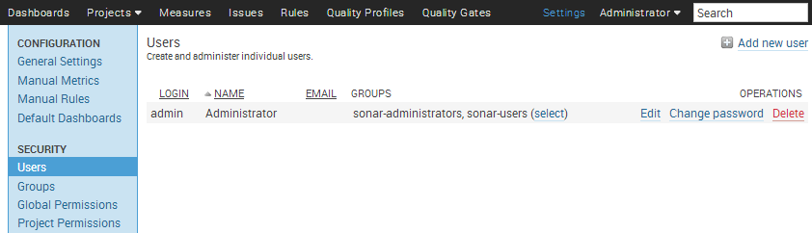
Roles

Slide 30
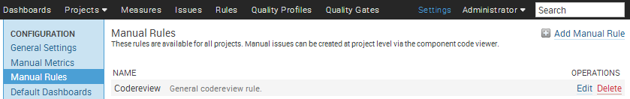
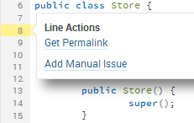
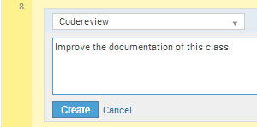
Add code review
Notes:
First time by admin

Slide 31
Why code reviews?
“We all need people who will give us feedback. That's how we improve.”
- Bill Gates

Slide 32
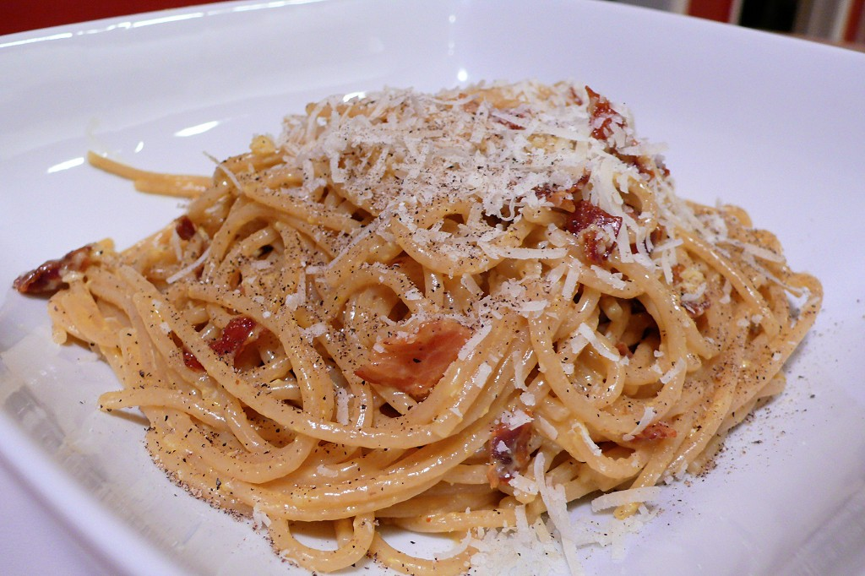
Hunting bad design and architecture

Slide 33

Hunting bad design and architecture

Slide 34
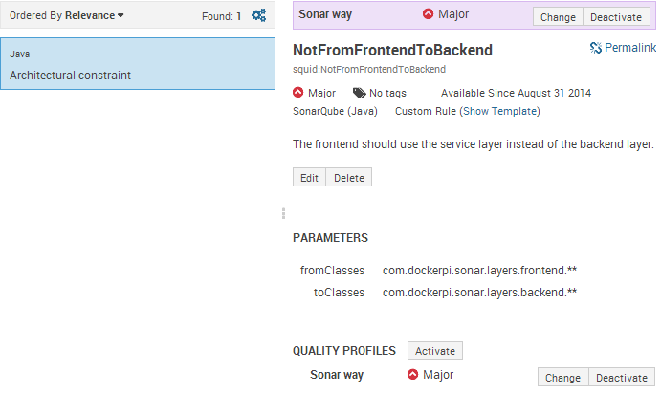
Architectural constraints

Slide 35
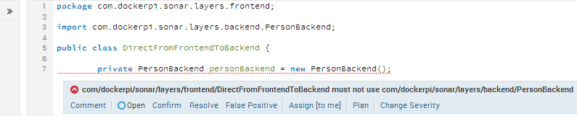
Architectural constraints

Slide 36
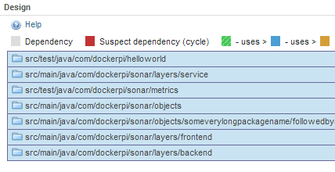
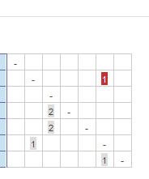
Package tangle index

Slide 37
Package tangle index

Slide 38

Testing

Slide 39
Now manual execution of unit tests
mvn clean install mvn sonar:sonar
mvn clean org.jacoco:jacoco-maven- plugin:prepare-agent install
-Dmaven.test.failure.ignore=true mvn sonar:sonar

Slide 40

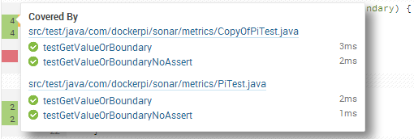
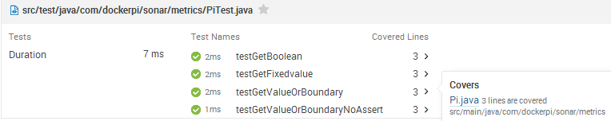
Coverage per test

Slide 41
Coverage per test
Configure the POM (see next slide)
Activate profile to get coverage per test information
mvn org.jacoco:jacoco-maven- plugin:prepare-agent clean
install -Pcoverage-per-test
Analyze the project
mvn sonar:sonar

Slide 42
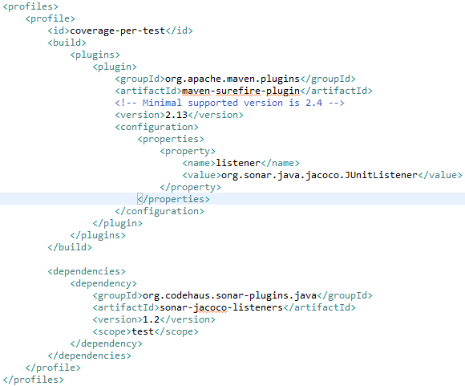

Slide 43
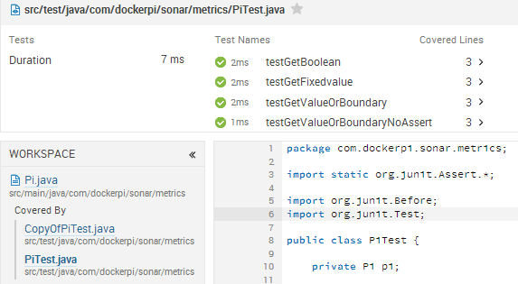
Coverage per test workspace

Slide 44
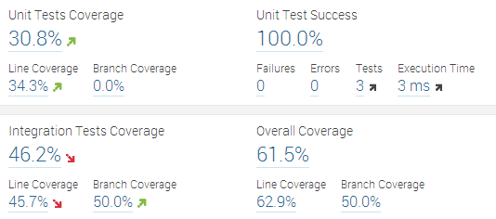
Integration testing

Slide 45
Integration testing
Add integration test coverage widget to SonarQube
Download Jacoco agent
Configuration for Tomcat’s catalina.bat:
set JACOCO=-javaagent:$path$\lib\jacocoagent.jar, destfile=$resultpath$\jacoco.exec, append=false,includes=com.dockerpi.*
set JAVA_OPTS=%JAVA_OPTS% %JACOCO%

Slide 46
Integration testing
Start Tomcat
Execute tests (manual, integration, performance…)
Stop Tomcat and execute SonarQube analysis
mvn clean install sonar:sonar
-Dsonar.dynamicAnalysis=reuseReports
-Dsonar.jacoco.itReportPath=
$resultpath$\jacoco.exec

Slide 47
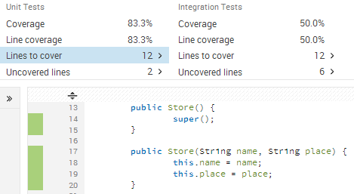
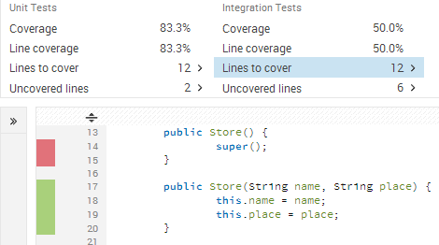
Unit and integration testing combined

Slide 48
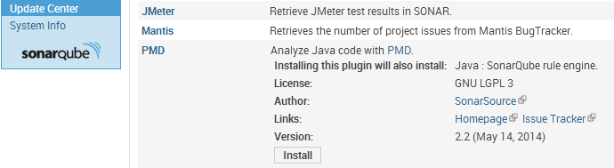
PMD rules for unit testing

Slide 49
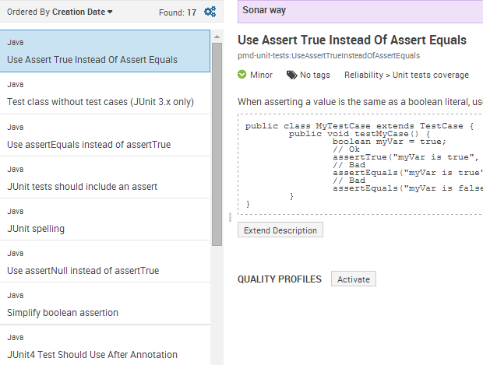
PMD rules for unit testing

Slide 50
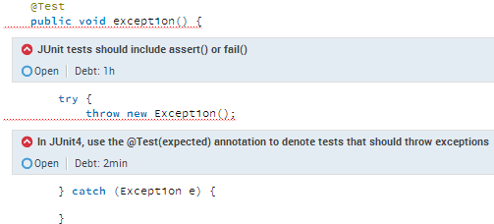
PMD rules for unit testing

Slide 51
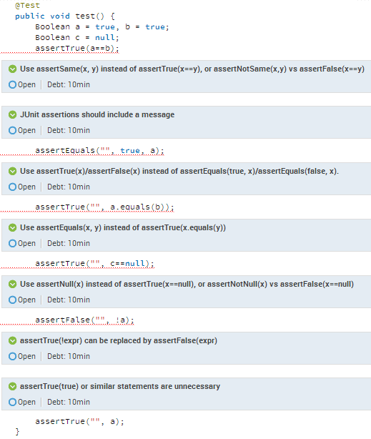

Slide 52

Other languages

Slide 53
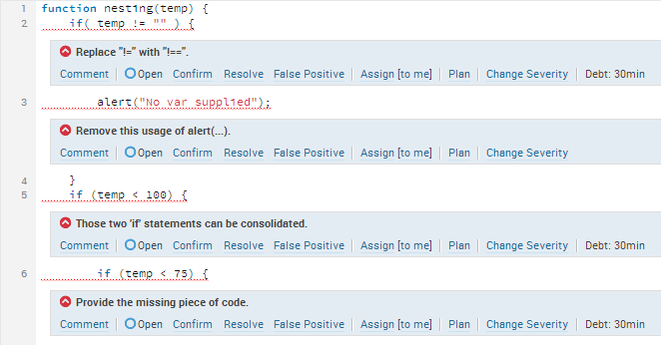
JavaScript

Slide 54
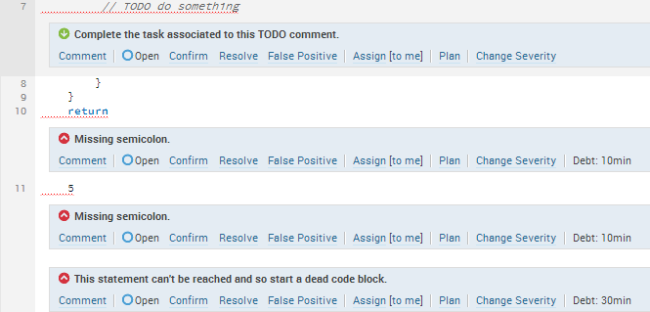
JavaScript

Slide 55
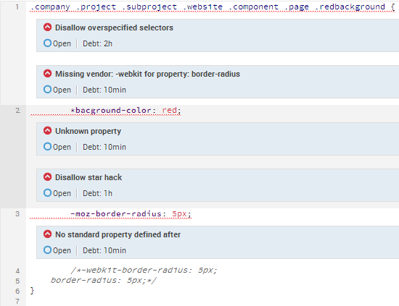
CSS

Slide 56
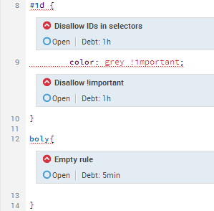
CSS

Slide 57
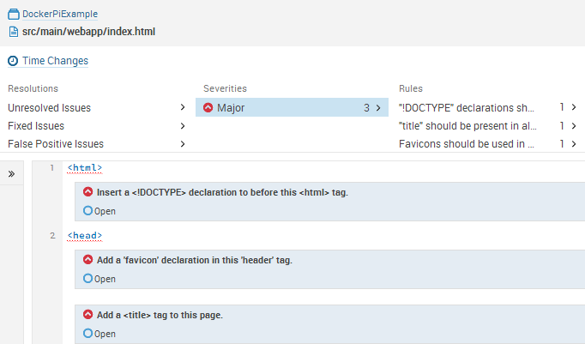
Web plugin

Slide 58

Plugins

Slide 59

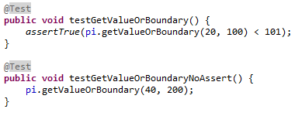
Pitest plugin

Slide 60
Pitest plugin
Enable ‘Survived mutant’ rule in SonarQube Quality Profile
Configure Pitest for instance with Maven (see next slides)

Slide 61
Pitest plugin
Execute tests and send results to SonarQube
mvn org.pitest:pitest- maven:mutationCoverage
mvn sonar:sonar
-Dsonar.pitest.mode=reuseReport

Slide 62
Pitest plugin
Maven configuration inside the build/plugins section
<plugin>
<groupId>org.pitest</groupId>
<artifactId>pitest-maven</artifactId>
<version>LATEST</version>
<configuration>
<inScopeClasses>
<param>com.example*</param>
</inScopeClasses>
<targetClasses>
<param>com.example*</param>
</targetClasses>
<outputFormats>
<outputFormat>XML</outputFormat>
</outputFormats>
</configuration>
</plugin>

Slide 63
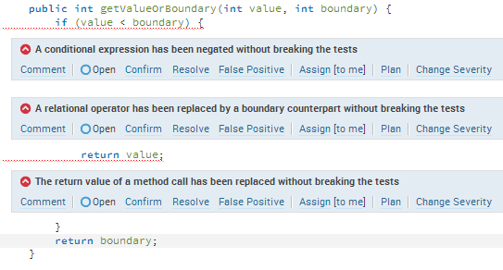
Pitest plugin

Slide 64
Build breaker plugin
[INFO] [15:15:57.671] Executing post-job class org.sonar.plugins.buildbreaker.AlertBreaker
[ERROR] [15:15:57.673] [BUILD BREAKER] Coverage < 80
[ERROR] [15:15:57.673] [BUILD BREAKER] Critical issues > 0
[ERROR] [15:15:57.673] [BUILD BREAKER] Major issues > 0
[ERROR] Alert thresholds have been hit (3 times).
[INFO] ------------------------------------------------------------------------
[INFO] BUILD FAILURE
[INFO] ------------------------------------------------------------------------
[INFO] Total time: 8.169s
[INFO] Finished at: Sat Aug 30 15:15:57 CEST 2014
[INFO] Final Memory: 21M/234M
[INFO] ------------------------------------------------------------------------
[ERROR] Failed to execute goal org.codehaus.mojo:sonar-maven-plugin:2.4:sonar (default-cli) on project DockerPiExample: Alert thresholds have been hit (3 times)

Slide 65
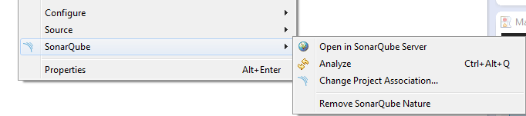
(Eclipse) IDE integration
Supports incremental analyses (default)
Install plugin through Eclipse Marketplace
Configure SonarQube server:
Window -> Preferences -> SonarQube -> Servers
Right click on your project in the Project Explorer
Configure -> Associate with SonarQube

Slide 66
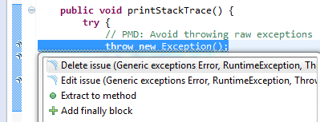
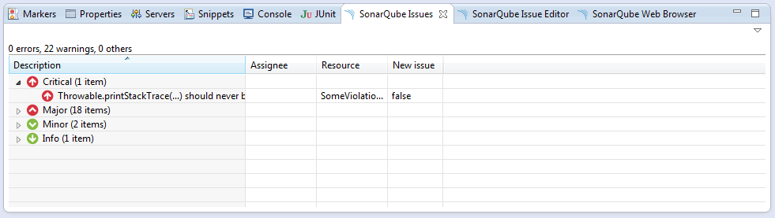
Eclipse SonarQube Issues

Slide 67
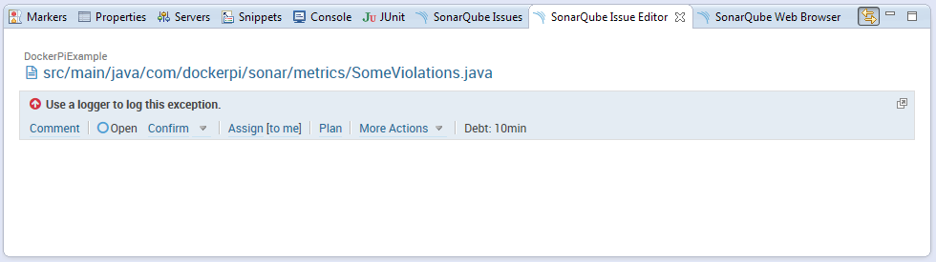
Eclipse SonarQube Issues Editor

Slide 68
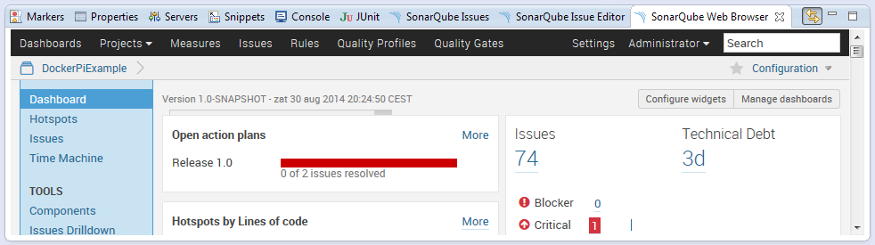
Eclipse SonarQube Web Browser

Slide 69

SCM Activity plugin

Slide 70

Build Stability plugin

Slide 71

Build Stability plugin

Slide 72

Tab metrics plugin

Slide 73

Mojo Bridge Plugin (Development)

Slide 74

Mojo Bridge Plugin (Development)

Slide 75

Leftovers

Slide 76

Libraries

Slide 77

Branches
mvn sonar:sonar -Dsonar.branch=4.4

Slide 78

Exclusions
Ignore files
Ignore issues
Ignore duplications
Ignore code coverage
Example:
mvn sonar:sonar -Dsonar.exclusions=
src/main/webapp/lib/*.js

Slide 79

Duplications across projects

Slide 80

Duplications across projects

Slide 81

Complexity

Slide 82

Technical debt pyramid

Slide 83

LCOM4 / RFC

Slide 84

Using SonarQube on existing projects
Notes:
Package tangle index and duplications from Jenkins

Slide 85




Using SonarQube on existing projects
Notes:
Package tangle index and duplications from Jenkins

Slide 86
Using SonarQube on existing projects
Identity hotspots
Use action plans
Maybe use a less strict quality profile
Add tasks/stories in the sprint to improve quality
Monitor quality of new code.
Cutoff plugin

Slide 87

Hotspots

Slide 88


Planning issues

Slide 89

Issues

Slide 90
Tips for using SonarQube in a project
Create stories/tasks to improve the quality
Perform manual code reviews
Agree on a standard for items SonarQube cannot check
Fix items or mark them as false positive
Use separate logins
Settings/reviews are project specific

Slide 91
Tips for using SonarQube in a project
Options to use SonarQube
Central server (commit AND nightly)
IDE plugin (for instance Eclipse plugin)
Local in your development environment
Check code quality before ‘To verify’ step
First merge your code so it is up to date
Verifier should also verify the quality

Slide 92







Slide 93
Accept failure, but improve continuously
“Once we accept our limits, we go beyond them.”
- Albert Einstein

Slide 94

Questions
Ask me!
SonarQube dev /user mailinglist
Sonarqube.org
Nemo example dashboard
SonarQube books
johan.janssen@infosupport.com

