Slide 3
Introduction To JavaFX Scenic View
Jonathan Giles
Principle Member of Technical Staff
Java Client Group
October, 2015
Copyright © 2015, Oracle and/or its affiliates. All rights reserved. |
Notes:
This is a Title Slide with Java FY15 Theme slide ideal for including the Java Theme with a brief title, subtitle and presenter information.
Do not customize this slide with your own picture.
To copy this branded background to another presentation on PC
Locate and open the presentation where you will be placing this artwork. Click New Slide from the Home tab's Slides group and select Reuse Slides.
Click Browse in the Reuse Slides panel and select Browse Files. Double-click the PowerPoint presentation that contains the background you wish to copy.
Check Keep Source Formatting and click the slide that contains the background you want.
Click the left-hand slide preview to which you wish to apply the new master layout.
Apply New Layout (Important): Right-click any selected slide, point to Layout, and click the slide containing the desired layout from the layout gallery.
Delete any unwanted slides or duplicates.
To copy this branded background to another presentation on Mac
Locate and open the presentation where you will be placing this artwork. Click New Slide from the Home tab's Slides group and select Insert Slides from Other Presentation…
Navigate to the PowerPoint presentation file that contains the background you wish to copy. Double-click or press Insert. This prompts the Slide Finder dialogue box.
Make sure Keep design of original slides is unchecked and click the slide(s) that contains the background you want. Hold Shift key to select multiple slides.
Click the left-hand slide preview to which you wish to apply the new master layout.
Apply New Layout (Important): Click Layout from the Home tab's Slides group, and click the slide containing the desired layout from the layout gallery.
Delete any unwanted slides or duplicates.

Slide 5
Warning: This is almost last years BOF.
If you attended last year, you may not want to
stick around…
5

Slide 6
Scenic View in a Nutshell
Scenic View is to JavaFX what
Firebug is to websites
6

Slide 7
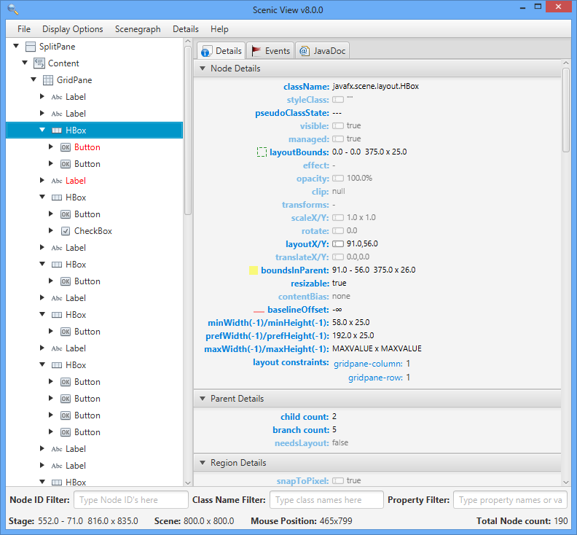
Scenic View in a Nutshell
7

Slide 8
Scenic View in a Nutshell
Scenic View is a free JavaFX scenegraph analyser.
I develop Scenic View,
when time permits,
it is not my job!
Download and find out more about Scenic View here: http://www.scenic-view.org
8

Slide 9
Scenic View
What is Scenic View?
Originally built by Amy Fowler for diagnosing runtime issues with UI layout
It was really simple to use: just add ScenicView.show(scene) in your code
I took Amy’s code and polished the UI considerably before the first public release of Scenic View on May 6, 2012
It looked a little like this:
9

Slide 10
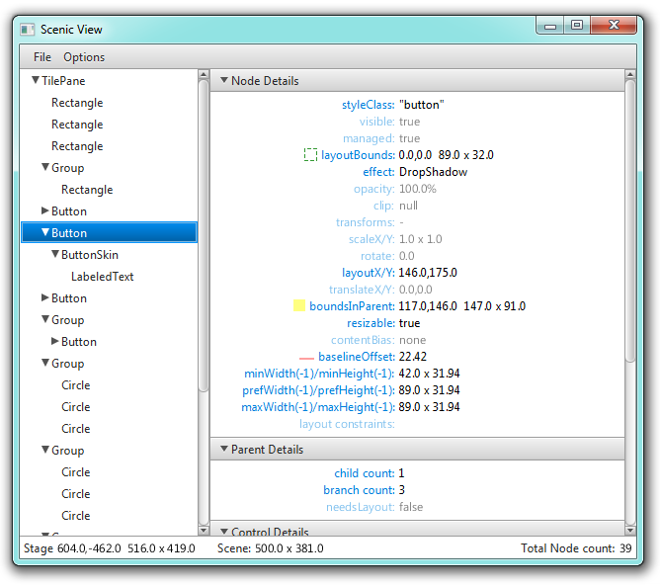
Scenic View Pre-1.0.0
Tree showing scenegraph structure of running application
The most important properties for the selected node
Application overview
10

Slide 11
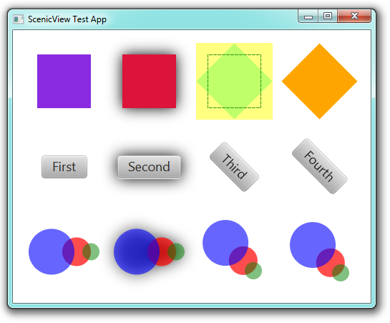
Scenic View
Scenic View can also draw overlays in the application it is observing.
The green dashed rectangle shows the layoutBounds, and the yellow filled rectangle shows the boundsInParent.
This can be very useful for debugging.

Slide 12
Scenic View
The response to the public release of Scenic View was extremely positive.
Most feedback was of the form: “I love it, but it needs to do X”
X included:
Live editing
Filtering
Selecting nodes by clicking in the UI
Event tracing
12

Slide 13
Scenic View 1.0.0
Ander Ruiz contacted me after the first release, and had a number of ideas.
Even better, he was keen to help program them!
Together we made available Scenic View 1.0.0 on June 4, 2012
The first versioned release of Scenic View
It looked a little like this:
13

Slide 14
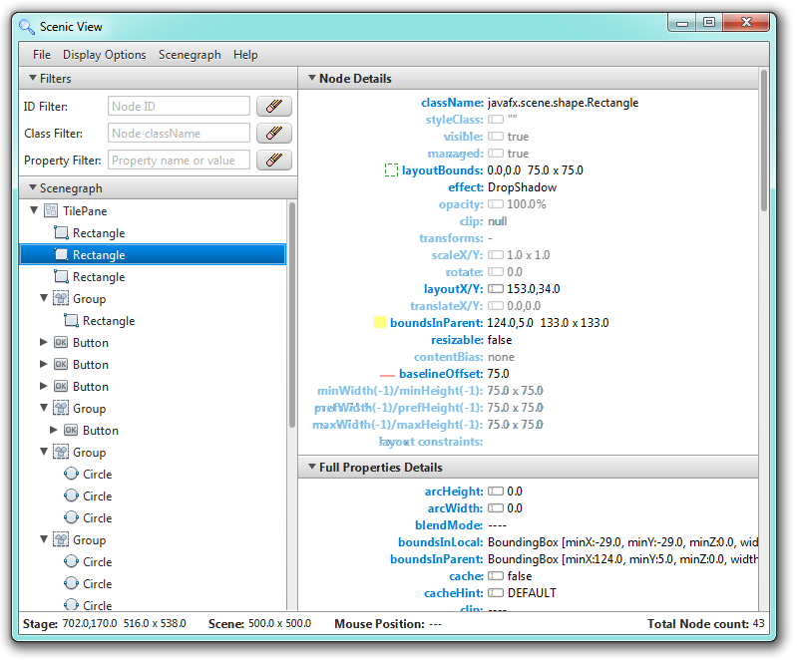
Scenic View 1.0.0
Ability to filter the tree area by typing in an ID or class name.
Ability to filter the details area by typing in a property name
14

Slide 15
The Problem with Scenic View 1.0.0
The major complaint Ander and I heard from users:
People did not want to have to modify their code by adding ScenicView.show(scene).
This proved an interesting (and complex) problem to resolve!
We needed a way to connect to applications at runtime without any modification of their code.
We settled on two solutions
15

Slide 16
Solution 1: Java Agents
The Java agent API allows for an external library to be called when an application starts.
Simply add the following when starting your application: -javaagent:ScenicView.jar
Scenic View will start when your application starts
It will automatically discover all stages in your application
Best approach: in your IDE have two ‘run’ profiles, one with Scenic View enabled and the other without
16

Slide 17
Solution 2: Java Attach API
Java provides the Attach API to discover running Java applications
We use this to install a small socket server into your application at runtime, through which Scenic View can communicate
This means that Scenic View can discover all running JavaFX applications and you don’t need to do anything!
To use this solution, simply start Scenic View directly and it’ll start in this mode
17

Slide 18
Scenic View 1.1.0
Scenic View 1.1.0 was released on August 14th, 2012 after much testing and user feedback
This release required a massive amount of reworking and foundation building.
We were incredibly relieved to get this working on Windows, Mac OS and Linux!
However, things are never perfect, and Scenic View 1.1.1 was released on August 16th, 2012
This improved our ability to debug peoples issues.
18

Slide 19
Scenic View 1.2.0
Still, we knew there was more to do, so we carried on and released Scenic View 1.2.0 on September 25th, 2012.
This release included:
Event tracing support
JavaDoc browsing support
Streamlined menus (context menus)
Bug fixes!
19

Slide 20
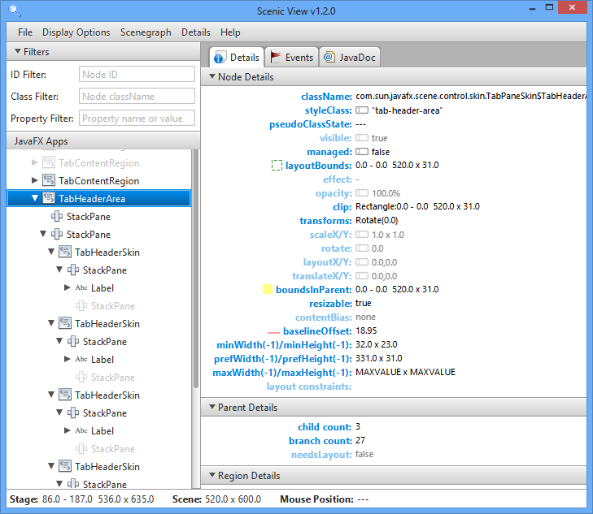
Scenic View 1.2.0
Tabbed area for new functionality
20

Slide 21
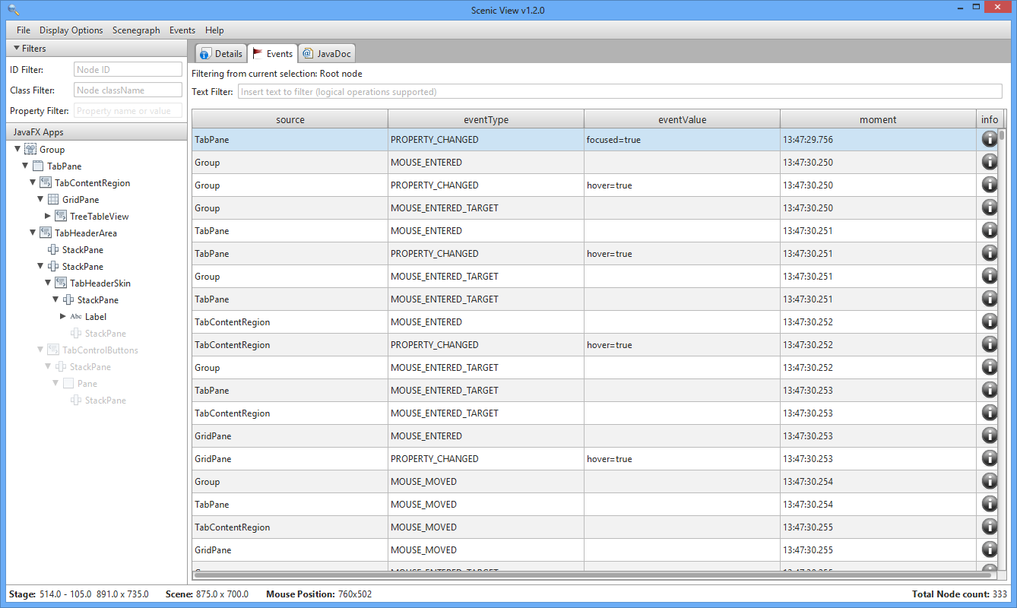
Scenic View 1.2.0: Event Tracing
Event tracing is enabled from the Events menu
Events are recorded only from selected node down
Table shows all matching events
Events can be searched using boolean statements
Click the info button for the entire stacktrace
21

Slide 22
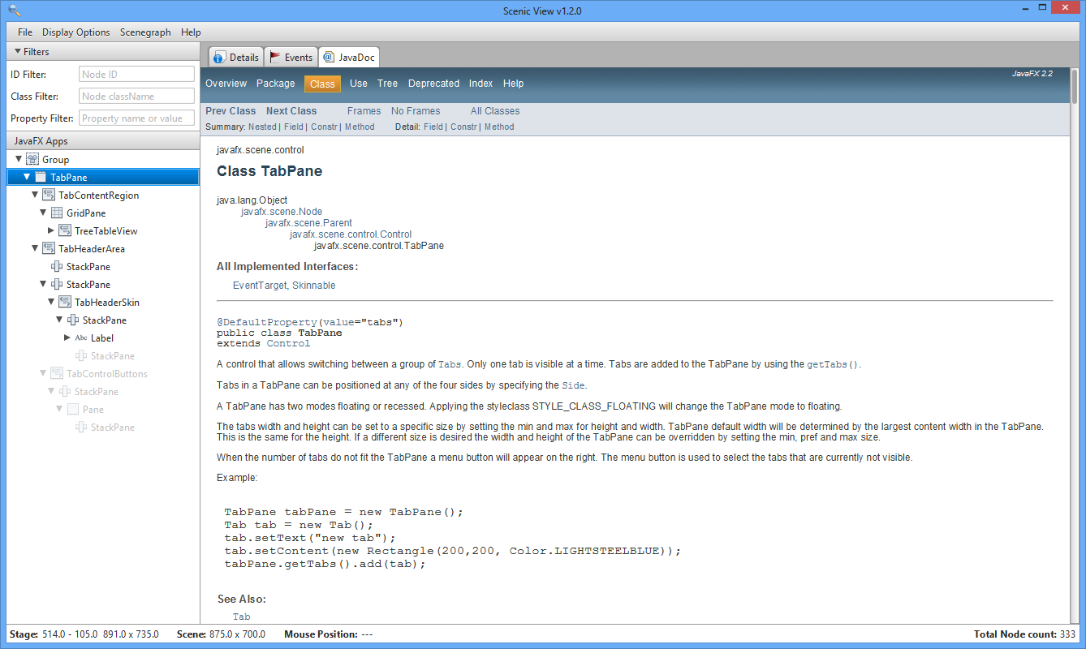
Scenic View 1.2.0: JavaDoc Browser
Browser shows JavaDoc for currently selected node
22

Slide 23
Scenic View 1.3.0
Scenic View 1.3.0 was released on November 12, 2012
What was new?
Massive performance gains
Animation tracer
Improved CSS support
Version update checking
Mac native menubar integration
Bug fixes and miscellaneous improvements
23

Slide 24
Beyond Scenic View 1.3.0
Scenic View 1.3.0 was the last release with support for JavaFX 2.x.
Unfortunately at this stage Ander had to drop out due to work commitments
24

Slide 25
Downloads
I track downloads of Scenic View.
The results are pleasing (as of September 8th, 2014):
Version | Release Date | Downloads
8.0.0 (Developer Preview 1) | 3rd February, 2013 | 177
8.0.0 (Developer Preview 2) | 26th February, 2013 | 378
8.0.0 (Developer Preview 3) | 21st April, 2013 | 436
8.0.0 (Developer Preview 4) | 8th August, 2013 | 3769
8.0.0 (Developer Preview 5) | 14th August, 2014 | 136
8.0.0 (Developer Preview 6) | 17th August, 2014 | 583
25

Slide 26
Working Towards Scenic View 8.0.0
Irregular developer preview releases:
Developer Preview 1: February 3, 2013
Developer Preview 2: February 26, 2013
Developer Preview 3: May 20, 2013
Developer Preview 4: August 8, 2013
Developer Preview 5: August 14, 2014
Developer Preview 6: August 17, 2014
26

Slide 27
Scenic View 8.0.0
Released and open sourced at JavaOne 2014
GPL licensed
Code repository is open here: https://bitbucket.org/scenicview/scenic-view
27

Slide 28
Scenic View 8.6.0
Released September 2nd, 2015
Primarily consists of two very cool community contributions :
ThreeDOM
CSSFX
28

Slide 29
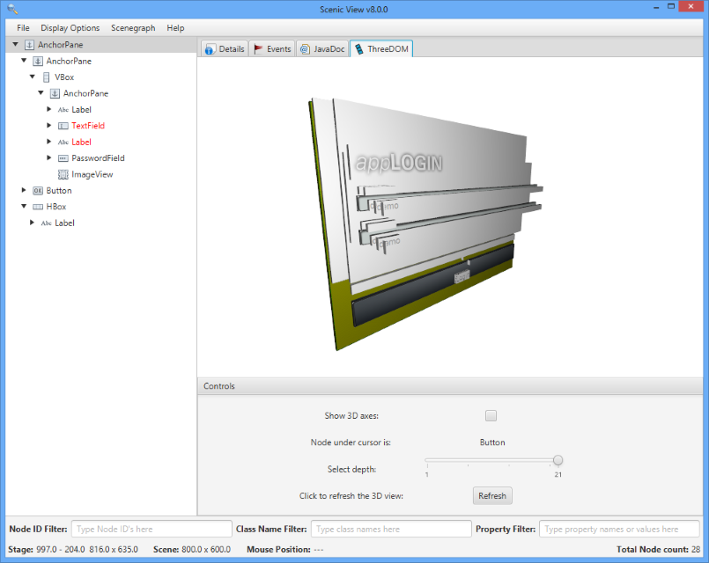
ThreeDOM
3D ‘explosion’ view of user interface
29

Slide 30
CSSFX
Ability to edit / save CSS files and have them be dynamically reloaded at runtime without needing to restart application.
30

Slide 31
Downloads
I track downloads of Scenic View.
The results are pleasing (as of October 20th, 2015):
Version | Release Date | Downloads
1.0.0 | 4th June, 2012 | 208
1.0.1 | 7th June, 2012 | 859
1.1.0 | 14th August, 2012 | 575
1.1.1 | 16th August, 2012 | 539
1.2.0 | 25th August, 2012 | 932
1.3.0 | 9th November, 2012 | 7164
8.0.0 | 29th September, 2014 | 8103
8.6.0 | 2nd September, 2015 | 1591
31

Slide 32
Scenic View Demo

Slide 33
Getting Started - In Six Simple Steps!
The following software is required:
Mercurial
Gradle
JDK 8
You’ll need a Bitbucket account
Accounts are free from http://bitbucket.org
1
2

Slide 34
Getting Started - In Six Simple Steps!
Fork the repo.
Go here to create your own fork
https://bitbucket.org/scenicview/scenic-view/fork
Clone your fork:
hg clone https://<username>@bitbucket.org/<username>/<forkname>
e.g.
hg clone https://jonathangiles@bitbucket.org/jonathangiles/scenic-view
3
4

Slide 35
Getting Started - In Six Simple Steps!
Build your clone. From clone root directory, run:
gradle clean assemble
Run your clone:
gradle run
5
6

Slide 36
The Future of Scenic View
What else is there left to do?
Should I pack my bags and stop developing Scenic View now?
Is there a feature you’d love to have?
Tell me!
Email me and let me know at jonathan.giles@oracle.com
Some ideas:
Pulse logger support (pulse duration, time since last pulse, etc)
Less bugs, faster, better UI, etc
36

Slide 37
The Future of Scenic View
Even better – please join in and help me to develop it!
Fork the project on bitbucket and do pull requests
37

Slide 38
Thanks for Attending! It’s Discussion Time!
How to contact me:
jonathan@jonathangiles.net
@JonathanGiles

