Slide 1
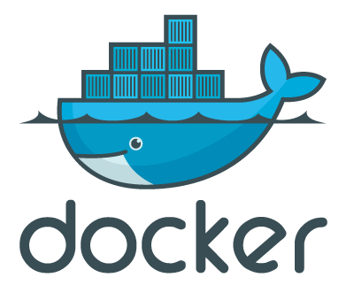
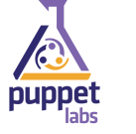
Java Developer Intro to Environment Management with Vagrant, Puppet, and Docker
Lucas Jellema
JavaOne 2015, San Francisco, 26th October 2015

Slide 2
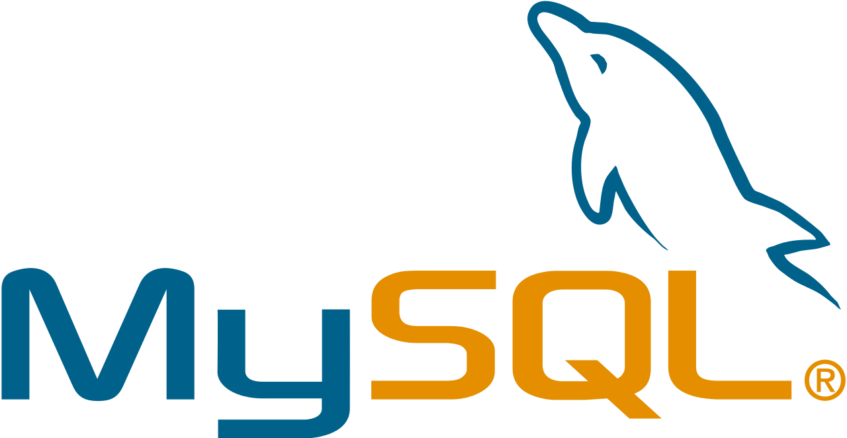
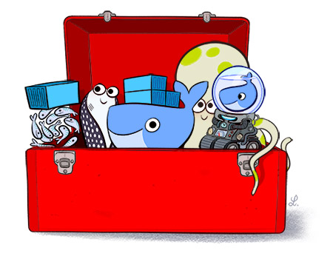
Overview
Docker Hub

Slide 3
Who are you?
Developer or Administrator – Java, Oracle, Web, NoSQL, …
Perhaps on a non-Linux laptop
Limited physical computer resources
CPU, Memory, Disk Space
Inclined to try out new stuff – frameworks, tools, products, …
Quickly, smoothly, without messing up your environment
Create things you want to share
Without creating elaborate instructions for installing and configuring
Without discussions around ‘it works on my machine’ , ‘send me your config files’
Interested in running stuff on “the cloud”
No Linux allergy
Interested in ‘that Docker thing’
(a bit like me)

Slide 4
This session will give you
What is this Docker thing and why is it a hype?
How do Containers compare to Virtual Machines?
How can I build, ship [| share | distribute] and run containers?
On my local machine and in the cloud?
A way to more efficiently leverage the physical resources in my computer?
than through juggling VMs
A structured and fast way to try out new software
Without messing up my local environment.
What tools do I need to get started with Docker on my non-Linux laptop?
What is the status of Docker and where is it going?
How can I get going on my own with Docker?

Slide 5
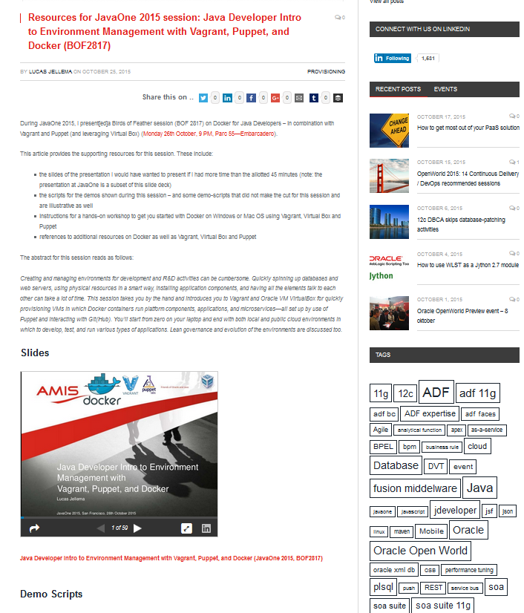
Supporting Materials
The slides for this presentation
All demo scripts
Extended slides with more details and examples
Workshop Introduction Docker + Vagrant + Puppet
http://bit.ly/1LWZZ4s

Slide 6
Run
Docker Container runs Linux – as does the host
Container is isolated - feels as stand alone run time environment
Directory structure, IP address, users and groups
Shared resources with underlying host (and therefore other containers)
memory, CPU, host
Light weight:
Quick starting up and stopping
Leverages underlying Linux kernel, only adds what is different/additional
Far less physical resource requirements (disk space and memory) than VMs
Clusters of containers
Dynamic adding/removing containers from clusters can be done very quickly (Google)
Especially when containers are stateless
(no shared session state in containers; possibly in joint cache, shared file system or NoSQL database)
Management tools – to monitor and manage individual containers and clusters of containers (dynamically scale up/scale down)
Docker Host
Docker Container
Docker Container
ip address
directories & files
users & groups
process table

Slide 7
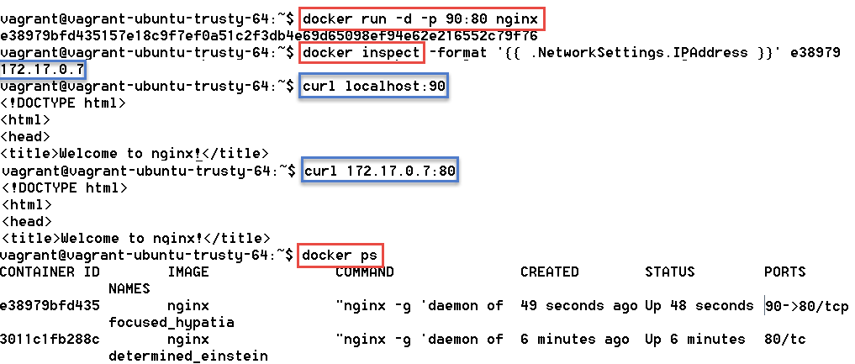
Demo – Run our first Docker container based on the nginx image

Slide 8
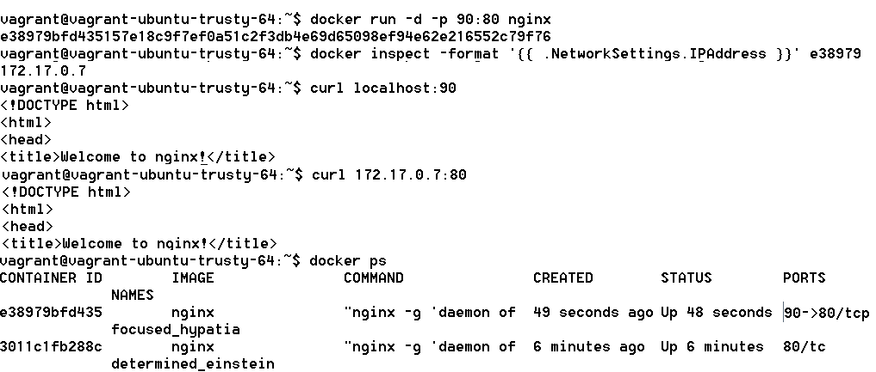
Demo –running NGINX container; with port forwarding
port 90
port 80
IP 172.17.0.7

Slide 9
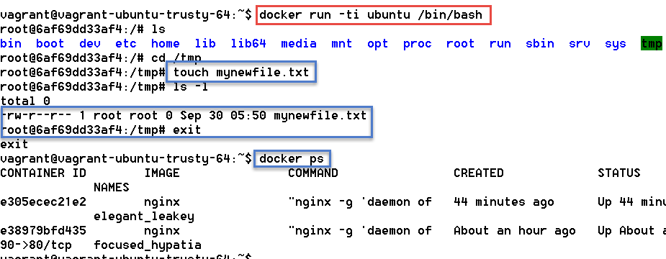
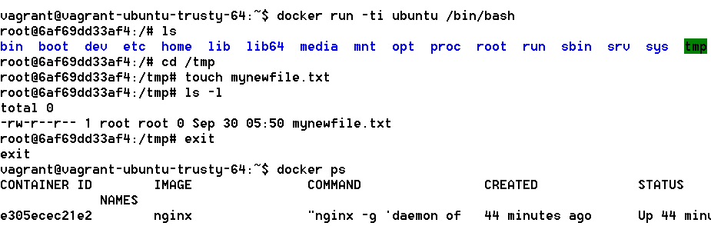
Demo: run container for Ubuntu image in interactive mode using shell
dockerhost
/tmp/mynewfile.txt

Slide 10
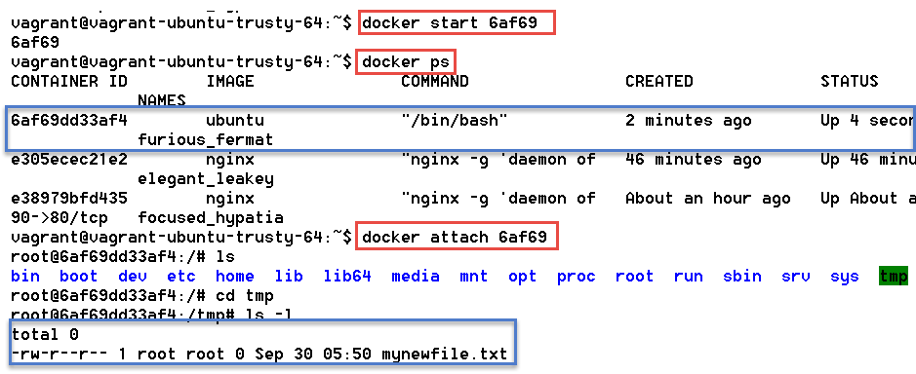
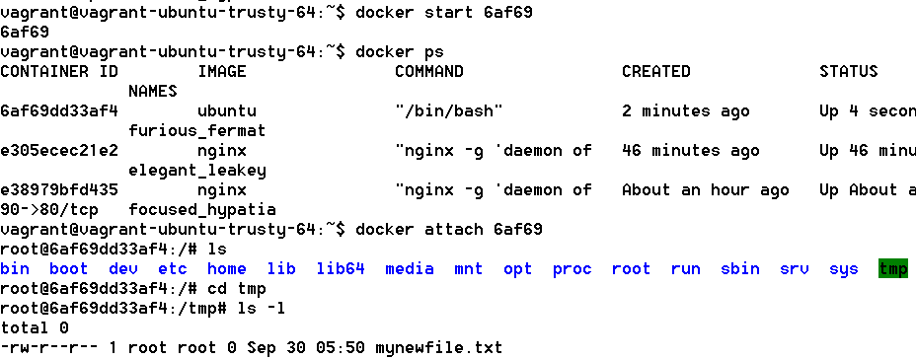
Demo: restart container and attach to it and locate my file
dockerhost
/tmp/mynewfile.txt

Slide 11
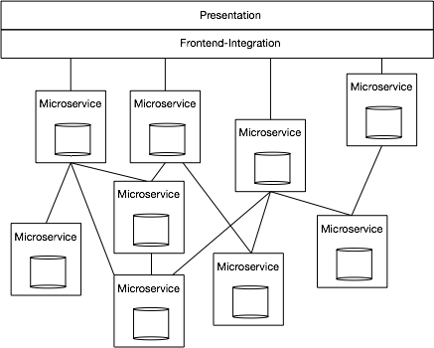
Micro Services
Architect the application into a set of collaborating services.
Each service implements a set of narrowly, related functions.
The services are elastic, resilient, composable, minimal, and complete.
Services communicate using standard protocols such as HTTP/REST
Services are developed and deployed independently of one another.
Each service manages its own state

Slide 12
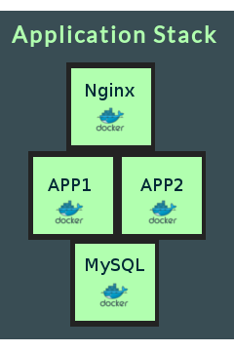
Micro Services
With Docker, each Micro Service is implemented with a single container
The micro service is not just encapsulated functionality that needs to be deployed onto some platform (such as an ESB or BPEL engine)
instead it ships complete with the fully configured engine that runs in the standardized container platform
All you need to run is:
Start container. Period.
Linux Host + Docker Engine

Slide 13
Ship (Container Images)
Package, Distribute, Share, Publish and Consume container images
The frozen state of a container (committed after building and further manipulating)
With everything needed to run the micro service: application and underlying platform & OS, ready to run on any Docker Engine anywhere
With an implicit interface (environment variables, link, volume)

Slide 14
Docker Image Registry
Public Docker Registry
Docker Hub
push
pull &run
Private Docker Registry
Docker Hub
push
pull &run

Slide 15
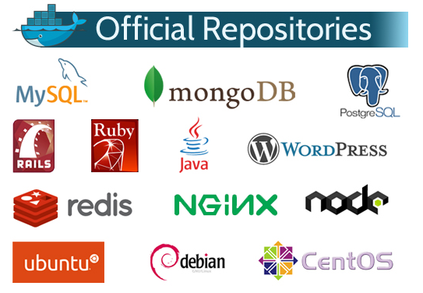
Docker Registry
Images can be published to Public and Private Registries
Docker Hub is the default registry
Docker Hub contains official repositories from many projects and vendors
Private Registries can be created in the cloud and on premises
Containers can be started from such images

Slide 16
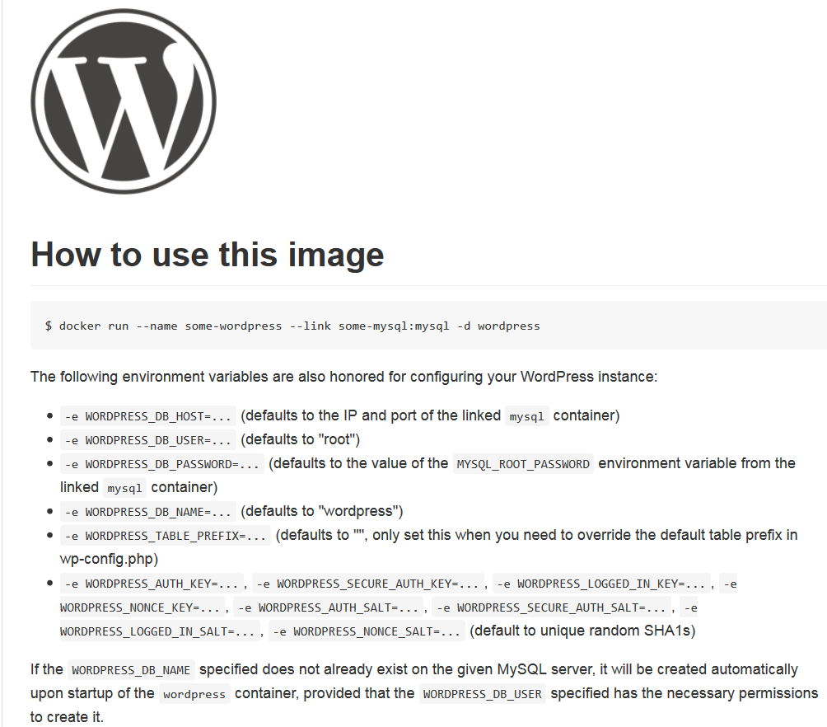
Implicit Image Interface: environment variables, link, volume
Docker Hub
Parameters:
WORDPRESS_DB_PASSWORD, WORDPRESS_DB_USER, …
link mysql
Parameters:
MYSQL_DATABASE, MYSQL_ROOT_PASSWORD
Volume
..:/var/lib /mysql

Slide 17
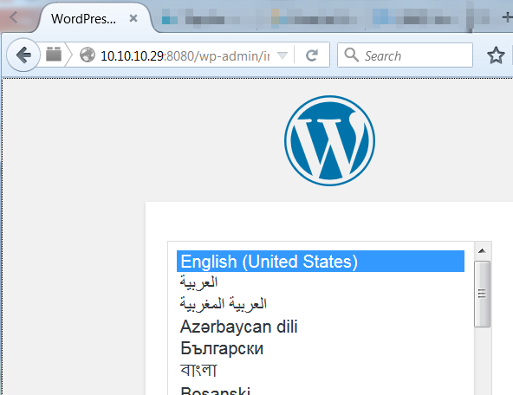
Demo Ship Run MySQL and Wordpress

Slide 18
Running Wordpress instance by pulling two public images
dockerhostvm
IP: 10.10.10.29
Docker Hub
port 8080
port 80

Slide 19
Commit container as image and push to registry
Docker Hub
Dockersig-trial:1.0
dockerhostvm
/tmp/mynewfile.txt

Slide 20
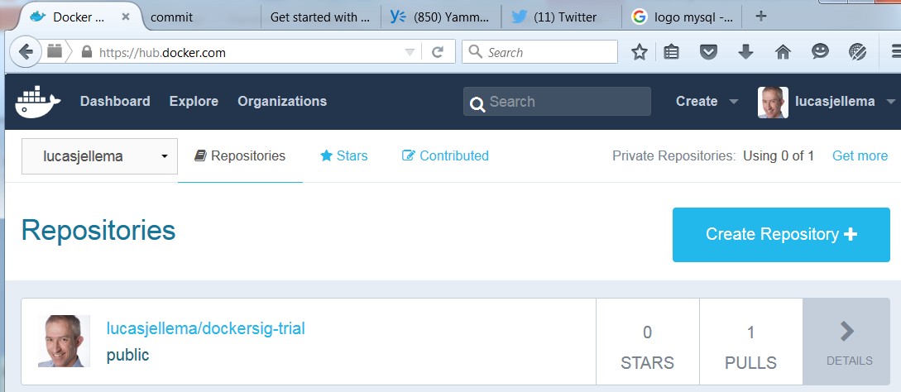
Image published on public Docker Hub registry

Slide 21
Run container based on my published image
Docker Hub
Dockersig-trial:1.0
dockerhostvm
Dockersig-trial:1.0
/tmp/mynewfile.txt

Slide 22
How to Ship a Stand-Alone product?
Create Installers + Configuration Instructions?
Make your product success dependent on platform configuration and OS settings?
Ship as a container image – everything set up and ready to run!
For example:
RubiconRed – Preferred way to deliver their tool MyST: as Docker Container (image)

Slide 23
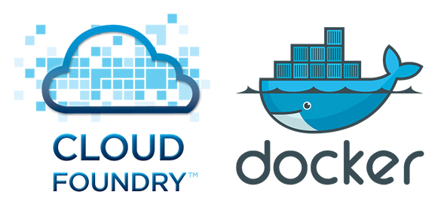
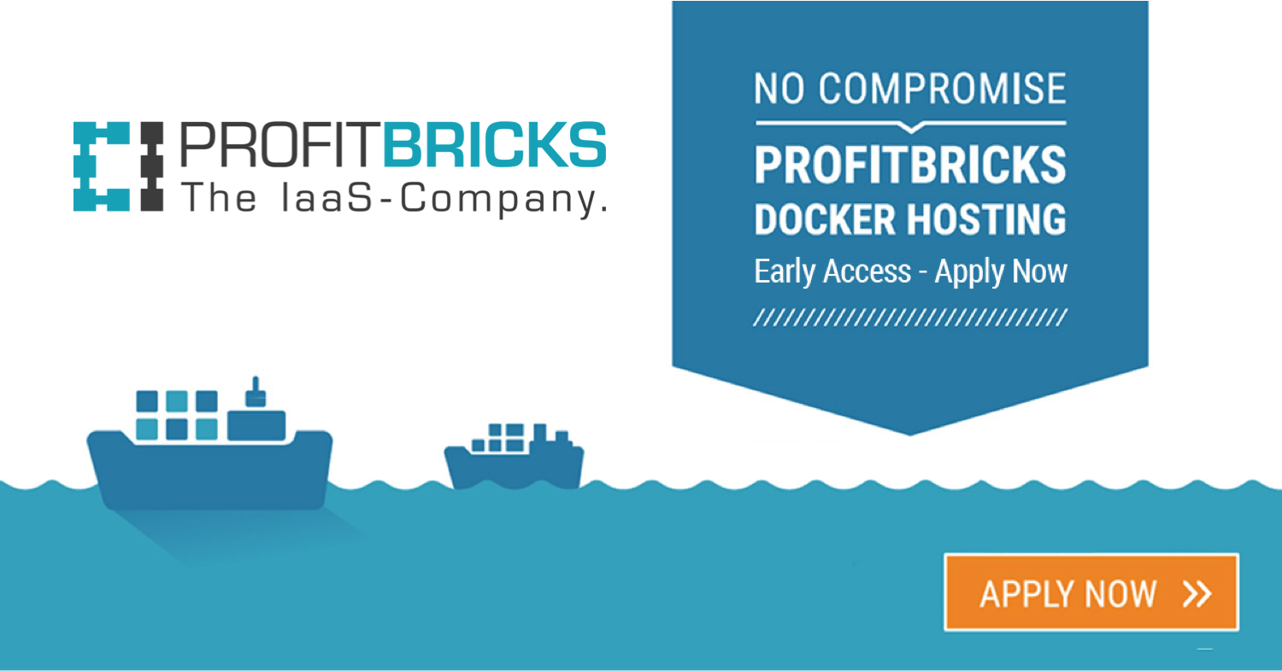
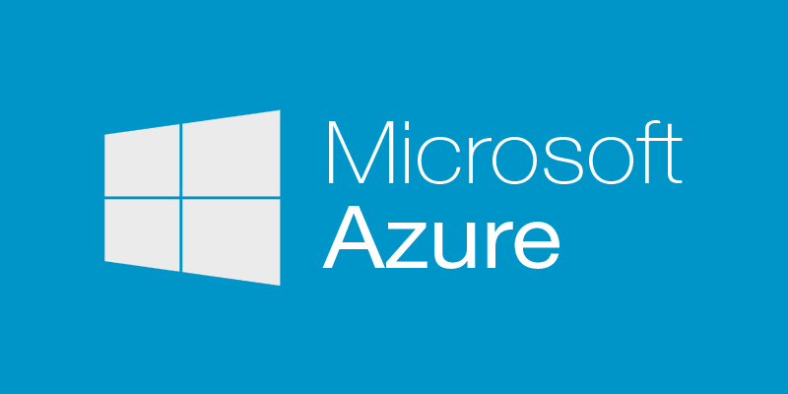
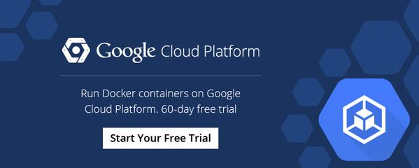
Ship to Cloud
Ship Image to [Run on] Cloud
All product installation, configuration, custom software deployment and testing has been done – all we need is a place for it to land
Complete environment, ready to run on any Docker enabled platform
Many public cloud providers support running Docker Containers
Public Docker Registry
Docker Hub
pull &run

Slide 24
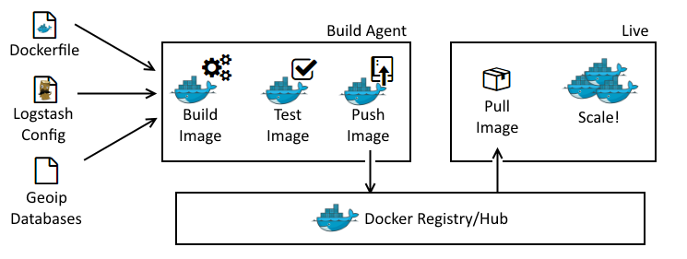
CD = Container Delivery
Why not make continuous software delivery include the container as well?
Automated build does not just build the software but the container as well
The delivered artifact is the container image
The Test and Acceptance Environment are by definition the same as the development environment – because they are the container

Slide 25
Containers are built on layers
Containers (and Container Images) are collections of files in a Docker controlled file system
Files are copied-on-write in this file system – and shared until then
(read only) Images are shared across all containers run from them
And also shared across images built on top of them
The Docker host running the below 9 containers has
5 containers sharing the same Ubuntu 14.04 image (188 MB once, not 5 times!)
4 containers sharing the same CentOS 7 image
My Simple Container
web
IAM
app
1
app 2
X
Y
Z
mydb
3rd party
NGINX
Tomcat
Node.js
MySQL
Image
Ubuntu 14.04
Image
CentOS 7

Slide 26
Running a Container adds a Writable Layer
A container is run from a predefined Image
This image can be local – possibly used by an existing container or image
Running a Container entails adding a container specific Writable Layer to the stack of reuable image layers
Copy on write: edit or create a file and it gets copied to the writable layer
A container can be stopped – the writable layer is saved and preserved
When the container is restarted, the writable layer is activated
A container can be committed as image – the writable layer becomes part of the new image
and is what the new image adds
My Web App
Container
My Web App
Container
My Web App
Image
3rd party
server.xml
server.xml
NGINX
Tomcat
server.xml
Image
Ubuntu 14.04

Slide 27
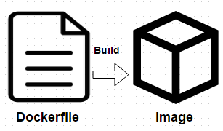
Building a Docker Container
Dockerfile specifies all build steps
With fairly low level commands
Start from base image - each step in the Docker Script adds a layer
A layer is a logical ‘savepoint’ in the container history
That marks an intermediate ‘image’
A physical directory somewhere on the Docker Host
The build context contains all files available during the build process
Note that additional files can be downloaded (e.g. HTTP with wget and Linux package updates with apt-update)
Final Image
FROM Ubuntu:14.04
COPY
RUN
WORKDIR
RUN
EXPOSE
CMD
RUN
RUN
COPY
Build context
Image
Ubuntu 14.04
Intermediate Image

Slide 28
Subsequent Build Actions
When actions are performed in the container as initially built – more files are added to the writable layer
There is no distinction between what was initially done based on the Dockerfile and what is subsequently done in the running container
At some point, the container is committed and becomes an image – to be published, shipped, run and extended even further
Writable Layer
Final Image
RUN
run
commit
RUN
RUN
COPY
RUN
Base Image
Ubuntu 14.04
COPY
Base Image
Ubuntu 14.04

Slide 29
Build
In addition to 10Ks of reusable images to start containers from
There are a zilion Dockerfiles to leverage for building images
Download script
Add software packages and installers (because of license reasons)
Tweak the script to fit your own needs OR (preferably)
Run the script, create a local image and then create your own Docker File that takes this image as its starting point
Standard Image, locally built
Your Own Dockerfile
Your Tweaked Image

Slide 30
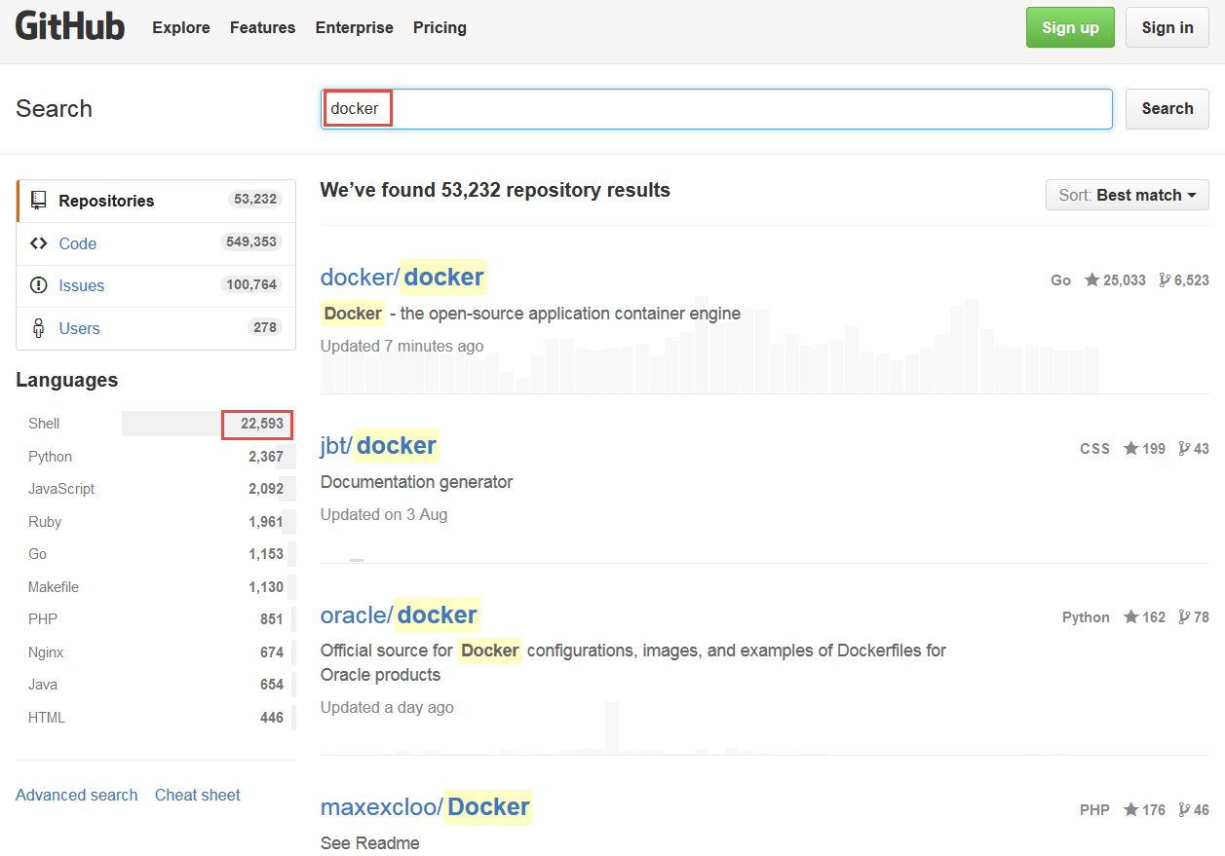
“Docker” Search results on GitHub

Slide 31
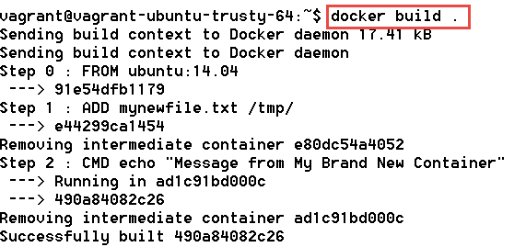
Demo Build

Slide 32
Demo run container after build

Slide 33
Image and Container Specifics
Container
diff
commit
run
Writable Layer
Container “state”
create
RUN
save
tar
load
…
tag
remove
inspect
RUN
COPY
history
Base Image
Ubuntu 14.04
registry
pull

Slide 34
Image and Container Specifics
start
attach
(un)pause
kill
stop
restart
remove
inspect
Flattened, no image details
logs
Container
export
tar
diff
commit
import
run
Writable Layer
Container “state”
…
RUN
RUN
COPY
Base Image
Ubuntu 14.04

Slide 35
Container Details & Operations
1
8080
Container
web
Container db
80
4
link
link
Docker storage
2
/data
4
Container xxx
link
/host_files
/repos
/repos
2
3
/tmp/files
/software
Shared Files
Shared Files
docker run –it
<image-id> /bin/bash
–p 8080:80
-v /data -v /tmp/files:/host_files
-volumes-from xxx
--name web --link db:db1 –link xxx:web_xxx
1
2
3
4

Slide 36
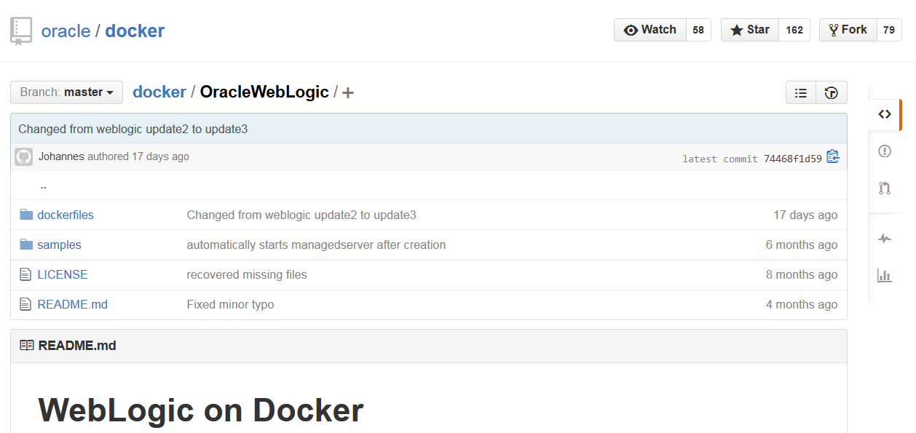
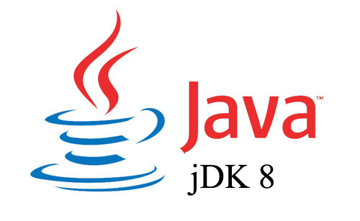
For example: build container for Oracle WebLogic
Clone from GitHub to Docker host
Dockerfile
Shell scripts
Supporting files
Download RPMs for
JDK 8
WebLogic 12.1.3
Docker Build
Optionally use second Docker file on top of WebLogic image to create a WLS Domain
Standard Oracle WebLogic Image, locally built
download and add to build context

Slide 37
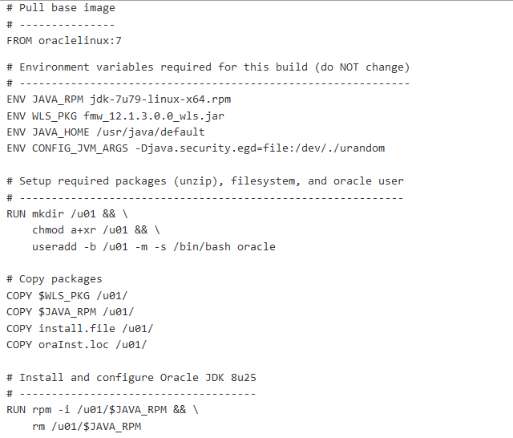
Build File for WebLogic
RUN
COPY
COPY
COPY
COPY
RUN
Base Image
Oraclelinux:7

Slide 38
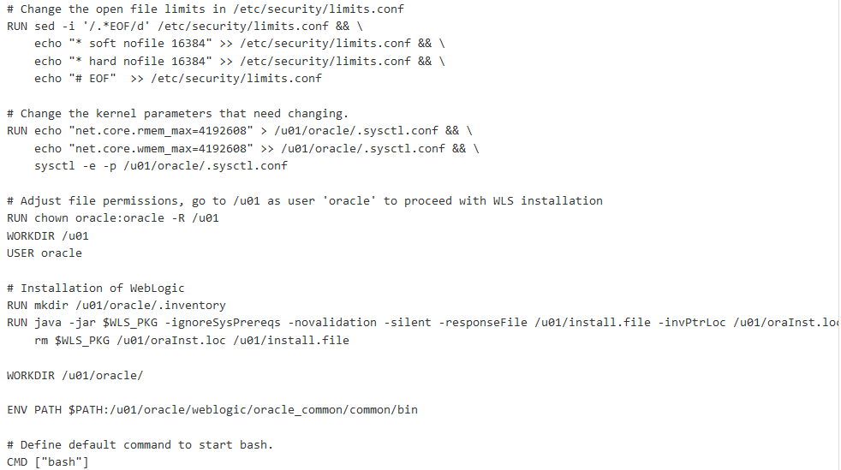
Build File for WebLogic (2)
RUN
RUN
RUN
RUN
RUN
RUN
COPY
COPY
COPY
COPY
RUN
Base Image
Oraclelinux:7

Slide 39
Turn container into image
RUN
RUN
RUN
RUN
RUN
RUN
COPY
COPY
COPY
COPY
RUN
RUN
Base Image
Oraclelinux:7
RUN
RUN
docker commit <container-id> weblogic:12.1.3-dev
RUN
RUN
RUN
COPY
COPY
COPY
COPY
RUN
Base Image
Oraclelinux:7

Slide 40
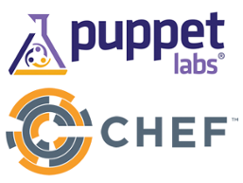
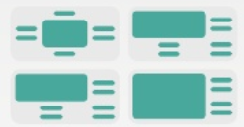
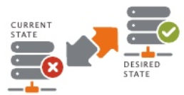
Automated Configuration Management
Use of (hard coded, environment specific) Shell Scripting to create | compose | configure environments is not exactly the latest fashion
Declarative, automated configuration management tools have us specify what we need and then make that happen
No scripting
Cross platform
Parametrized
Leveraging public catalogs of environment definitions

Slide 41
Proposed workflow for building Docker Container Images
Container Build process
Regular Docker Build
From base image
Add Puppet support
Add Puppet Manifests & Modules
Start Container
Optional: Map Volume from host with large files
Run Puppet to apply Manifests
Perform additional actions in container
Stop Container, Commit as Image
Push/Ship new image
Run containers from final image
1
1
2
2
dockerhostvm
3
my-base-container
Dockerfile
/puppet
5
4
/files
5
6
4
6
3
7
/puppet Manifests/Modules
7
RUN
8
8
RUN
volume
RUN
RUN
RUN
RUN
COPY
COPY
COPY
COPY
RUN
9
Base Image
Oraclelinux:7
9
/files
Very big files

Slide 42
Notes on Using Puppet with Docker
After applying Puppet – the container can be stopped, tagged and used as base image for next Docker Build
That could add EXPOSE, ENV, CMD or ENTRYPOINT
With some workarounds, Puppet apply can be made to run during Docker Build (with RUN in Dockerfile)
Less control over build context
No Volume mapping from host
There are Puppet Modules to use for automating the build pipeline of Docker (leveraging the Docker API)
To install Docker, build container, create and ship an image, run container
What applies to Puppet by and large applies to similar tools such as Chef, Salt and Ansible
Puppet Modules are available for many Oracle Database & Fusion Middleware configuration management tasks
Oracle Database (EE, SE, XE)
WebLogic, SOA Suite, OSB, BPM Suite, WLST
JDK, Opatch, VirtualBox, GlassFish, Hudson, Maven

Slide 43
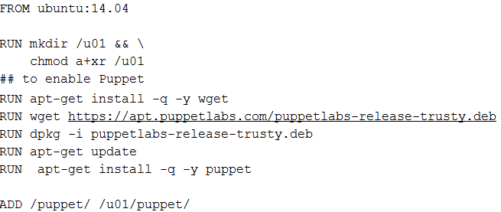
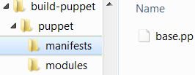
Demo build with Puppet

Slide 44
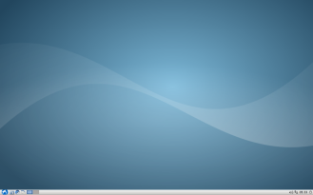
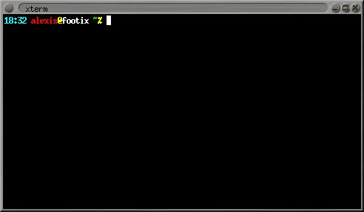
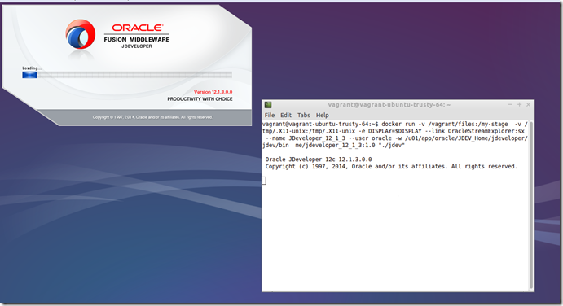
Run GUI applications in Docker Container
dockerhost
Container
GUI applications
/tmp/.X11-unix
/tmp/.X11-unix
docker run –d –it
-v /tmp/.X11-unix:/tmp/.X11-unix
-e DISPLAY=$DISPLAY <image-id> /bin/bash
Notes:
https://technology.amis.nl/2015/08/29/vagrant-docker-virtualbox-and-the-graphical-desktop-for-gui-applications-in-docker-containers/

Slide 45
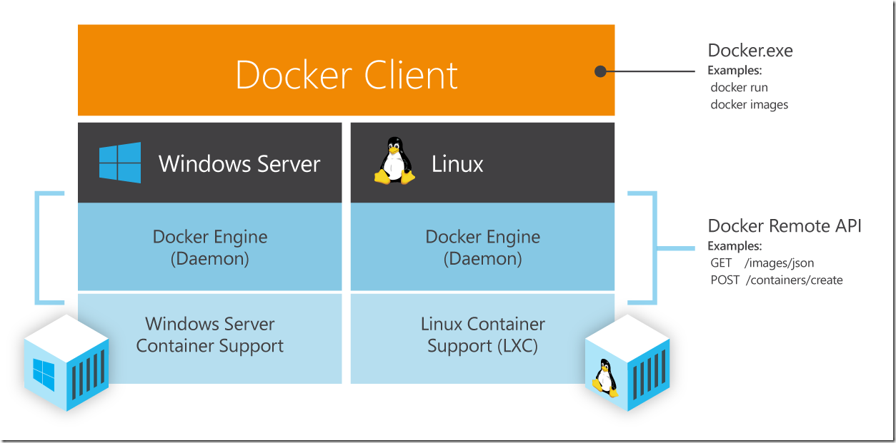
Docker and Windows
Docker sits on Linux Containers
Windows Server 2016 will have containers too – and Docker will sit on those as well
However, today, Docker does not run on Windows (nor on )

Slide 46
Docker cannot run on Windows - directly
dockerhost
Container
Container
Container

Slide 47
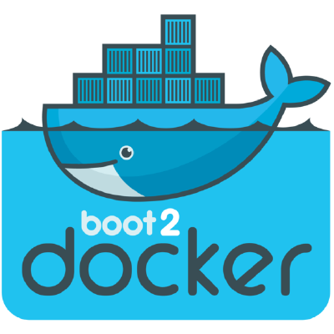
Docker cannot run on Windows - directly, without Linux VM
dockerhost
Container
Container
Container

Slide 48
Vagrant to the rescue
dockerhost
Container
Container
Container

Slide 49
Vagrant to the rescue
Based on simple declarative definitions…
Vagrant provisions environments through various providers
VirtualBox, VMware, AWS
Subsequently, provisioning (‘configuration management’) using shell scripts, Chef, Ansible, Salt or Puppet
Vagrant supports Docker
Create Docker Host VM, Build | Run | Manage Container
Vagrant makes host-container folder mapping and networking quite easy
dockerhost
Container

Slide 50
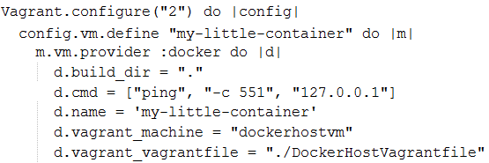
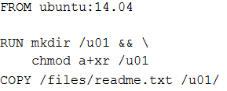
Vagrant Docker Provisioning
Vagrantfile defines the Container to run – including name and initial command and also synched folders (i.e. host <=> container mapping)
Dockerfile contains build recipe for the Container we want to build
DockerHostVagrantfile describes the VM to be used as Docker Host
dockerhostvm
Vagrantfile
my-little-container
DockerHostVagrantfile
other-container
Dockerfile
some-container

Slide 51
Vagrant Docker Provisioning
Vagrant Boxes
Docker Hub
ubuntu/trusty64
ubuntu:14.04
dockerhostvm
build process
Vagrantfile
DockerHostVagrantfile
my-little-container
Dockerfile
/u01/readme.txt

Slide 52
Vagrant with Docker Folder Mapping
dockerhostvm
/vagrant
Vagrantfile
my-little-container
/var/lib /docker /docker_ generatedId
/vagrant
DockerHostVagrantfile
/host_data
/host_temp

Slide 53
Demo – Run Docker Containers with Vagrant
This entire session was Vagrant based!
Vagrant:
Configures Windows Host/Container Folder mapping and Host VM IP Settings
Can stop and start as well as create and destroy containers
Note: docker-run and docker-logs are special Vagrant commands
For one-off command in container and to get insight in what happens in the container

Slide 54
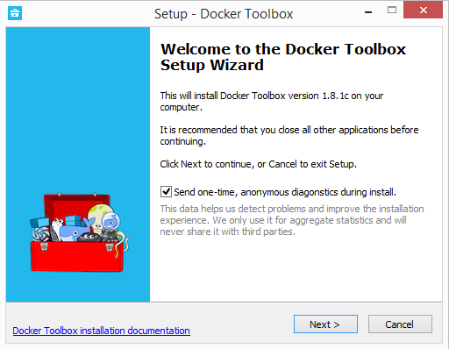
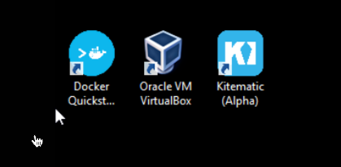
Docker on Windows – other options
Docker Toolbox (since August 2015) replaces Boot2Docker
Contains Docker Client for Windows, Kitematic (Docker GUI, alpha release), Docker Machine, Docker Engine and leverages Oracle VirtualBox
Still uses Boot2Docker Linux Distribution to run containers
No support for GUI in containers

Slide 55
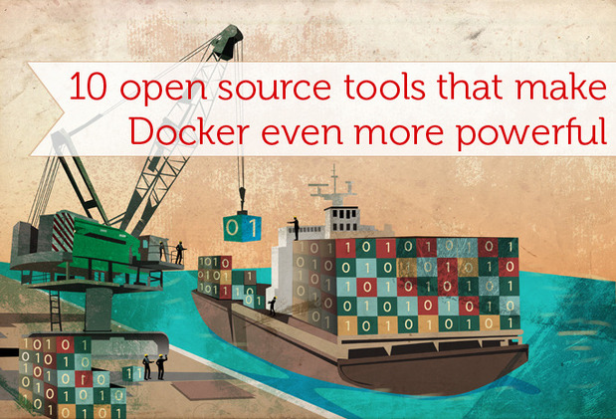
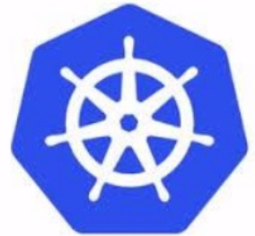
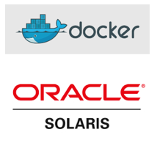
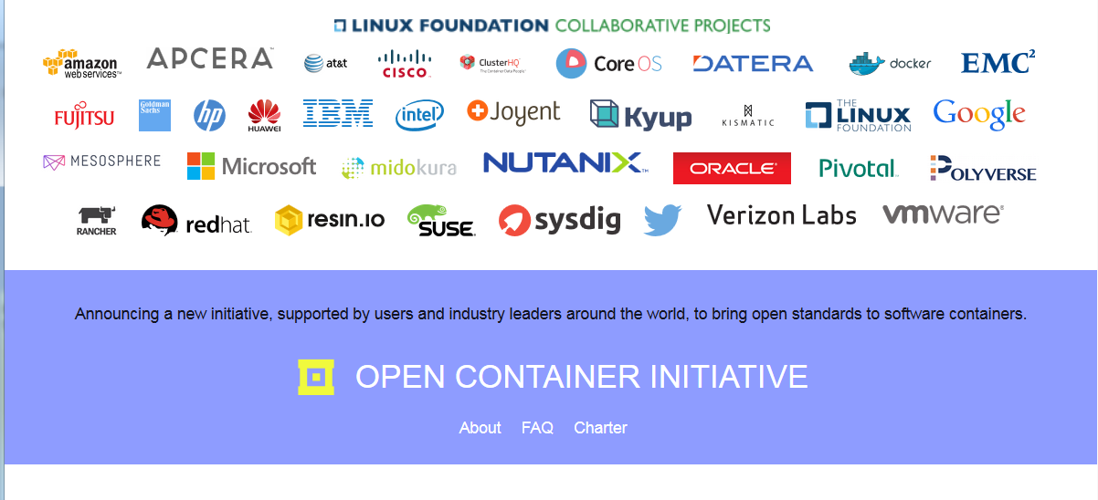
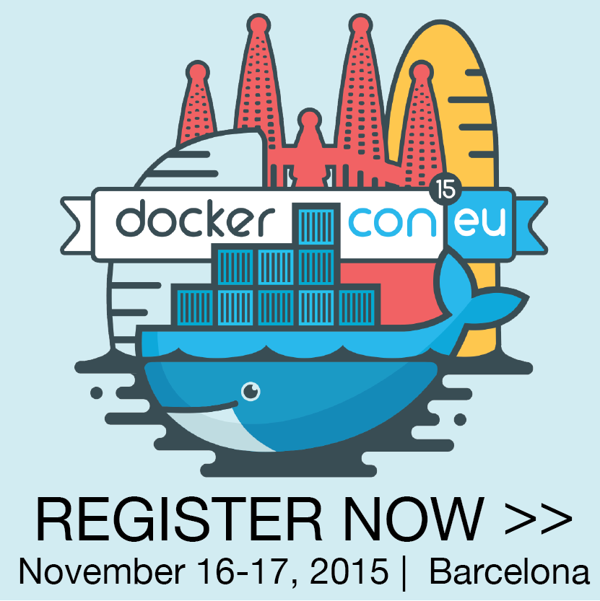
Docker Containers Status & Future
Growing adoption beyond innovators and [very] early adopters
Growing number of tools around Docker
Monitoring, Management, Clustering, …
Windows
support for containers in Windows 2016
Solaris Zones to work with Docker Client
Cloud Support
By a fast evolving number of IaaS/PaaS cloud providers
AWS, Azure, Google Container Engine
Open Container Initiative
docker.con (EU)

Slide 56
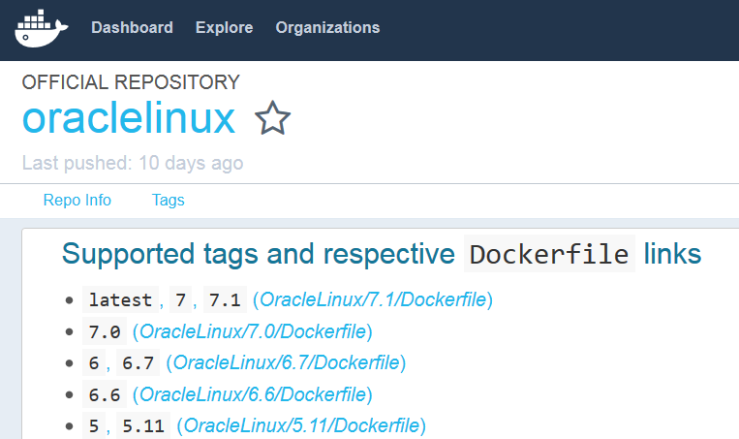
Oracle and Docker
Oracle Linux 6 and 7 Images
Oracle MySQL image
WebLogic certified on Docker
Official “Docker Build-scripts in GitHub to create images”
Solaris Zones leveraged by Docker Engine
Participate in OCI
Docker on Oracle Cloud??

Slide 57
Summary
Docker helps you run isolated environments in a quick, lean way
Containers are far more light weight, yet almost as stand alone as VMs
Hundreds of official Docker Container base images are publicly available
Docker Containers are micro services
with an exposed interface to inject dependencies (volume, link, environment settings)
Share | Distribute | Publish your complete, working environments is very easy using Docker container images
Either push to registry or save as TAR
CD could become ‘Container Delivery’ – deliver software + environment
Many cloud providers can run Docker Containers
Do not attempt to build containers completely from Dockerfile
Leverage declarative configuration management tools such as Puppet and Chef
Tools like Vagrant allow you to easily work with Docker on a non-Linux host

Slide 58
What did you get from this session?
What is this Docker thing and why is it a hype?
How do Containers compare to Virtual Machines?
How can I build, ship [| share | distribute] and run containers?
On my local machine and in the cloud?
A way to more efficiently leverage the physical resources in my computer?
than through juggling VMs
A structured and fast way to try out new software
Without messing up my local environment.
What tools do I need to get started with Docker on my non-Linux laptop?
What is the status of Docker and where is it going?
How can I get going on my own with Docker?
REPEAT SHORT URL FOR RESOURCES

Slide 59
Blog: http://technology.amis.nl
Twitter: lucasjellema
Mail: lucasjellema@gmail.com

