Slide 1
Writing Better Code: How the NetBeans IDE Helps You Write, Test, and Debug Java
Sophia Matarazzo
Georgia Ingham
Notes:
Intro:
Hi I'm Sophia And my name is Georgia.
Welcome to our presentation today .
Today we are are going to talk about how the NetBeans IDE helps you to write, test and debug java. we're also going to demonstrate and explain to you how you can use all of these cool and helpful tools to help you write better code.
We're both really excited to have been given this awesome opportunity and to be here today to share all of our Netbeans hints and tips.
So before we begin we're going to give you little bit of background history on who we are

Slide 2
About Us
Who are we?
What do we do?
Who are you?
Notes:
Ok, so who am I? Okay so my name is Georgia. I have studied at Computer Science at De Montfort University and my hobbies include reading and cycling. This opportunity to speak to you all represents a lot of firsts for me. This is my first time at Java one and my first time in America actually. We both came a couple of days early just to site see. This is also my first time giving a presentation in front of so many people so you will have to forgive me if I am a bit nervous.
I am sophia as i mentioned previously, and I have recently finished my Software Engineering Degree at De Montfort university. I am now working towards a whole new chapter in my life. And this talk is just the beginning of it all.
What do we do:
so what do we do? Together we both work at IDR Solutions which is a small, dynamic company based in the UK who specialize in Java, PDF and HTML5 solutions. We have a large customer database which is composed of customers who are based all around the world.
It is when we are working on the development of our java pdf library, we utilize the vast amount of features which netbeans contains. We love how Netbeans works and how we individually and as a team work with netbeans, this is why we want to share our knowledge with you today.
who are you?
So who are you? We both know that everyone here has different backgrounds.
You may have worked with different languages both on and off the screen, worked with different IDE's and have varying levels of experience.
We're hoping that no matter where you've come from, that by the end of this presentation, you can all walk away with having learnt something new about how the netbeans IDE can also help you.

Slide 3
What will our talk cover?
What is NetBeans?
Why switch to NetBeans?
Our favourite features and options
Hands on demonstration
Recommendations
Questions
Notes:
What is netbeans?
Before we try and convince you that the sun shines brighter with the NetBeans IDE we should probably fill you guys in with what Netbeans is and how we found it to be the most helpful and useful IDE.
Why Switch to netbeans?
Why should you switch to netbeans you ask? well We've put together a list of reasons as to why we think you should switch and why people are already switching
Our favourite features and options
We're going to show you our favourite features and options. We use a lot of these on a day to day basis and they save a lot of time and it allows us to write better quality code. This work ethic goes nicely with our company motto 'If you can keep it simple, then do'.
Hands on demo
We will also be giving a hands on demonstration to highlight more features.
While hoping the I.T gods will be on our side.
If not then we have plenty cat pictures to show you as a back up.
Recommendations
We have a list of different recommendations, this includes a few books, websites and other learning material.
Questions
if you have any question then please ask them at the end of the presentation.

Slide 4
What is NetBeans?
NetBeans Time Line
1996
Xelfi created by students from Charles University in Prague
1999
Sun Microsystems purchased NetBeans
2000
NetBeans became open source
2010
Oracle acquired Sun Microsystems
2015
NetBeans is on Version 8.0.2

Slide 5
Why Switch to NetBeans?
The top reason people are switching:
NetBeans works straight out of the box
Powerful GUI Builder
Dedicated Support - Developer Support Packages
Support for Java Standards and Platforms - Java Mobility Support - Java Standard Edition - Java Enterprise Edition

Slide 6
Our Favourite Features and Demo
NetCAT
Start-up and sample projects
Plugin manager
Customise and import shortcuts
Code Completion
Built in testing
Formatting options
Free Profiler
Version Control
Never leave NetBeans

Slide 7
1. NetCAT
Voluntary Testing Program
Run before every new release
Divided into NetCAT Tribes
Leader's additional duties include: - Primary point of contact - Gathering feedback from tribe members - Co-ordinating tests - Updating wiki status
Completed by users for users

Slide 8
2. Start up and sample projects
NetBeans Start up Page:
Learn and Discover - Try a sample Project
My NetBeans - Quick access to recent projects
What's new - Updated regularly - Contains the latest NetBeans news and community blogs.

Slide 9
2. Start up and sample projects
Quick Steps to creating a sample project:
Click on the sample project button on the start up page.
Select the type of project you would like to sample.
Amend your project properties
Click Run and it will execute your sample project

Slide 10
3. Customise and import shortcuts
Fully customise your NetBeans with your own imports and shortcuts:
Profile management
Customise keyboard shortcuts
Import shortcuts
Can from another version of NetBeans
Can create your own
Can be from another IDE
Keep settings consistent for a team

Slide 11
4. Plugin Manager
NetBeans Plugin Manager:
Allows you add extra functionality to NetBeans
Displays plugin details in dialog box
Search feature
Can install, activate and disable plugins

Slide 12
5. Code completion
You can use NetBeans Code Completion tool for the following:
“Smart” Code Completion
Context Sensitive
Generate Code
Keywords, variable names
Working with JavaDoc
Managing Imports
Automatic imports when class dynamically imported

Slide 13
6. Built in testing
NetBeans has a range of tools to help test and improve code quality:
Testing tools - JUnit - TestNG
Code analysers - PMD - FindBugs

Slide 14
7. Formatting options
NetBeans offers a range of Formatting Options:
Imports and the order they are written
Only import specific package files
Easy naming conventions
Local variable Prefixes and Suffixes
Braces
Helping keep code consistent
Spaces
NetBeans will sort this out for me

Slide 15
8. Free Profiler
Monitoring Applications - JVM properties, thread activity and memory allocations.
Analyse CPU Performance - Count method duration and number of times method is invoked
Analyse memory performance - Object allocation and garbage collection details
Free built-in profiler:

Slide 16
9. Version Control
NetBeans supports different versioning systems:
- CVS
- SubVersion
- Mercurial - ClearCase
Stores login credentials
Provides buttons for version control actions

Slide 17
10. Never leave NetBeans
Built-in facilities means users never have to leave:
Built in browser
Hudson and Jenkins - View job status - Receive alerts
Terminal Emulator

Slide 18
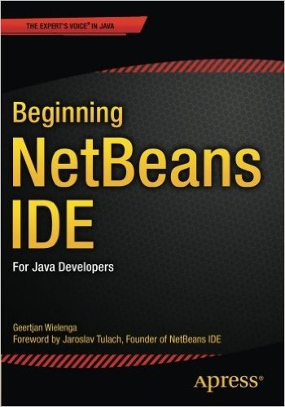
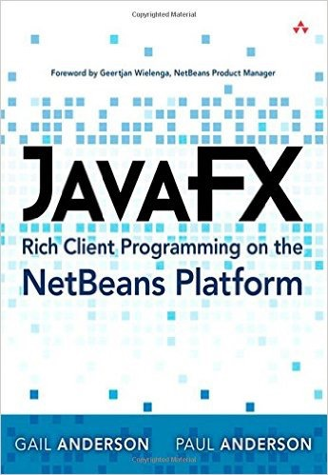
Recommendations
Beginning NetBeans IDE is your authoritative guide for getting started learning and using the free and open source NetBeans IDE. Written by Geertjan Wielenga, who has worked on the NetBeans Team since 2004, it shows you what the IDE is all about and how to use it with real-world case studies built from the ground up as you learn all about the IDE.
http://www.amazon.com/JavaFX-Client-Programming-NetBeans-Platform/dp/0321927710
JavaFX is a state-of-the-art graphics toolkit that is now built into Java and can be easily integrated with the NetBeans Platform. With JavaFX, you can create advanced user interfaces, manipulate media, generate graphical effects and animations, and much more. The NetBeans Platform provides a framework for building robust, modular applications with long life expectancies. Together, JavaFX and the NetBeans Platform provide the basis for creating visually appealing, industrial-strength applications.
http://www.apress.com/9781484212585

Slide 19
Questions
Thank you for listening.
Please feel free to ask us any questions

