Slide 1
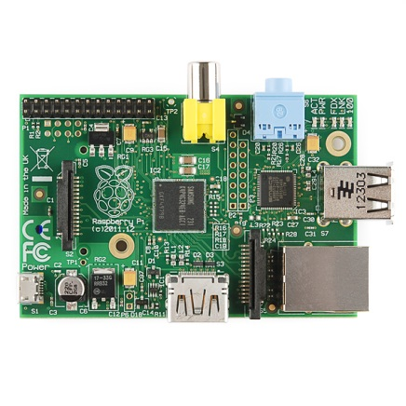
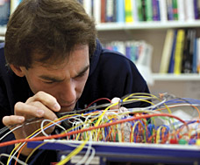
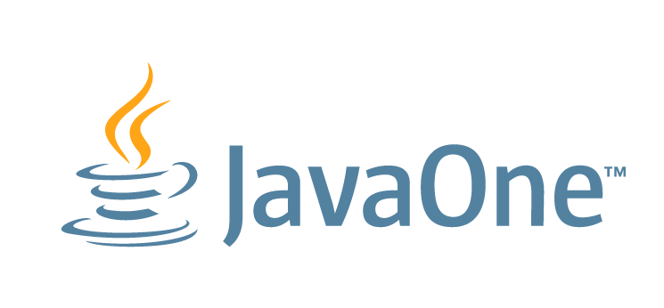
From Things to the Internet: Teaching Kids to Code Java on the Raspberry Pi
Ian Utting & Fabio Hedayioglu

Slide 2
Overview
What is the Pi?
What is the Pi for?
Developing for/on the Pi
Java for the Pi
BlueJ for the Pi
Challenges
Demo

Slide 3
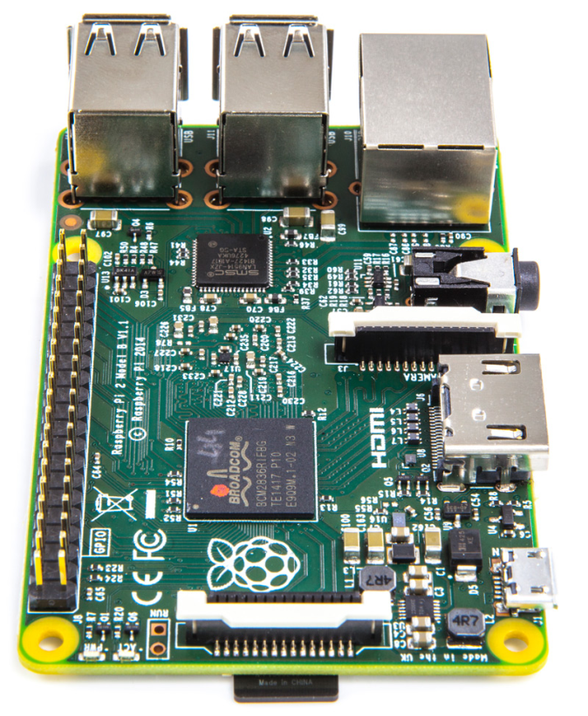
What is the Raspberry Pi?
A small, cheap, self-contained, Linux machine
Based on a Broadcom SoC:
900MHz ARM Cortex-A7, 1GB SDRAM
VideoCore IV GPU (OpenGL, 1080p, H264)
HDMI out
40 GPIO pins, I2C, CSI (Camera) etc.
Ethernet and 4xUSB 2.0 (e.g. for WiFi)
Raspbian Linux boots from Micro SD

Slide 4
What is the Raspberry Pi for?
To support/encourage/revive programming in schools
Conceived as an IoT sensor/actuator platform:
Many daughter boards available
But also as a desktop replacement:
Needs a keyboard/mouse and screen (TV or monitor)
In schools, crucially, it doesn’t need “permission”
Notes:
Outsourcing of schools’ IT support
C.f. the Apple 2/spreadsheets story.

Slide 5
Developing for the Pi: 2 approaches
Develop on a separate machine, treat the Pi as a slave
Allows use of standard tools (but their generality adds configuration complexity), and permission to install
Requires a second machine (and significantly complicates the execution model for beginners)
Develop on the Pi itself
Simplifies deploy/debug cycle
Standard tools (NetBeans/Eclipse) are too heavy, so use lightweight IDEs (IDLE) or vi/emacs and the command line
Notes:
Mention IDLE -- Python lightweight REPL/IDE

Slide 6
Java on the Pi: 2 approaches
Java ME
Wants to be headless – no GUI APIs
Unfamiliar i/o mechanisms (GCF etc.)
Views the Pi as a gateway platform for embedded systems
Very little support and material for beginners
Java SE
Includes Swing and JavaFX
Uses standard networking libraries
Pi4J library provides good access to GPIO etc.
Views the Pi as a desktop machine with hardware extensions
Lots of material and support for beginners available

Slide 7
BlueJ on the Pi
BlueJ is a lightweight Java SE IDE designed for beginners. Used by ~2.5M students/year
It includes complete (but basic) IDE functionality: edit, compile, execute, debug, and version control
It also includes direct object manipulation through the GUI – great for exploring APIs and behaviours
Pre-installed on the standard Raspbian desktop

Slide 8
It’s about The Internet and Things
Pi hardware is capable – real-time video with face recognition is feasible
Pi networking is easy (java.net.*)
This lets us link things (a small camera) to the internet (social networking – Twitter)
Our demo is about change detection – if we’d been sure of the room we’d have done it with door opening and tweeted the faces, as it is …

Slide 9
Demo

Slide 10
Summary
The Pi is a great platform for beginners to explore IoT
Self-hosted development is much easier for beginners than using remote Pro Tools
An IDE helps beginners focus on the task-in-hand
Abstractions of real Things into Java classes helps beginners to start progreamming for IoT
Allowing exploration of the implementation of those abstractions helps advanced students go further
More details and demos: bluej.org/raspberrypi

