Slide 1
IoT: What Is in It for Java Professionals?
[BOF4433]
Stephen Chin , Lead Java Community Manager, Oracle
Shyam Varan Nath – Industrial Internet Architect, GE Digital
Jayant Thomas – Snr Software Dev Mgr, GE Digital

Slide 2
Abstract – To be Removed
This BOF session is a moderated panel of industry professionals from the Internet of Things arena, Java professionals, and Oracle Java/IoT evangelist Stephen Chin.
The emergence of IoT creates several opportunities—such as data acquisition from devices, edge computing, complex event processing, and cloud analytics—for Java professionals at different levels. The session includes topics such as analytics and the IoT cloud, microservices architecture, and use of PaaS for enabling the monetization of data.
Use cases discussed involve agile development and the emergence of new products and hybrids of products and services. Overall, Java professionals will be able to look at career paths in this relatively new field of IoT.
Interoperability of different IoT Platforms

Slide 3
Agenda
What is IoT and IIoT?
IoT Reference Architecture
      Java Professionals skills
      New opportunities
Platform Tier
      Introduce Micro Services- complete
      Introduce different IoT Platforms
Loosely coupled API’s
  Best Practices of developing for MicroServices

Slide 4
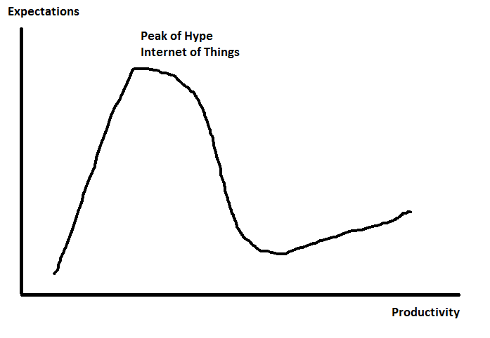
IoT is at the Peak of Hype
2015
2014
2013

Slide 5
Industrial Internet Computing Paradigm
Cloud
for efficiency and agility
Going mobile: anytime/ anywhere Access
End-to-end
Security
Predictive
insights from
Big Data
021010308
013161090
040109010
104078050
Consistent and meaningful
User experience
Cloud based Integrated
Asset
Management
Transition to
“Brilliant machines”

Slide 6
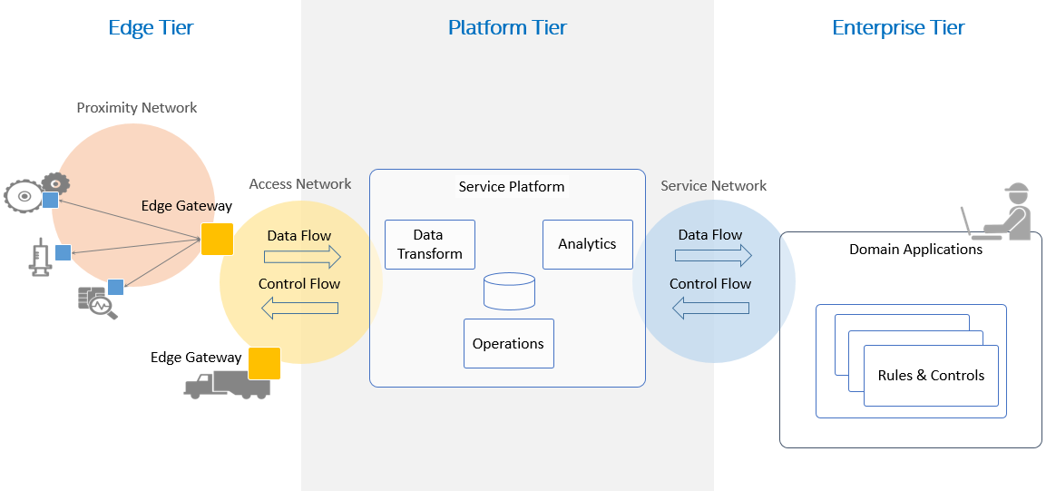
Industrial IoT – Reference Architecture Compliance
Industrial Internet Platform
Data, Analytics and Visualization
Factory – People / Operators
Manufacturing Process Machines & Sensors
Link to ERP / CRM

Slide 7
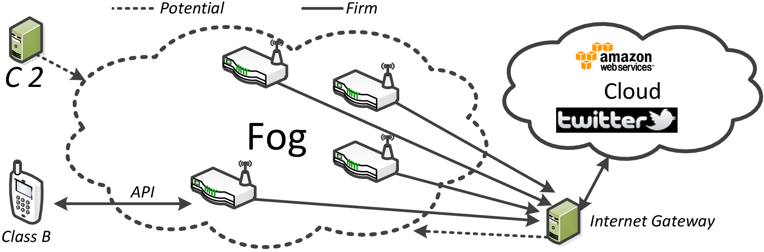
Cloud v/s Fog Computing
Role of J ME in edge / fog computing
Cloud Computing
http://thoughtsoncloud.com/2014/08/fog-computing/

Slide 8
What do I do as a Java Professional to be Ready for the Future?

Slide 9




Now is the Time – Industrial Internet is not just a hype anymore!
CONNECTIVITY
Data
CONNECTIVITY
CONNECTIVITY
Machines
Analytics
© General Electric Company, 2014. All Rights Reserved.

Slide 10
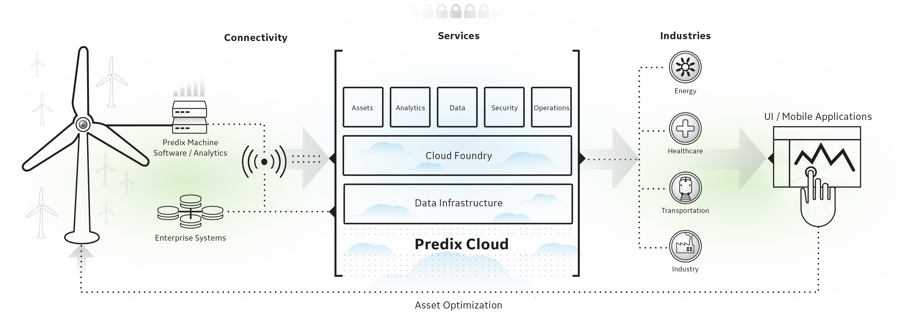
How to Monitor Asset Performance?
High Level View

Slide 11
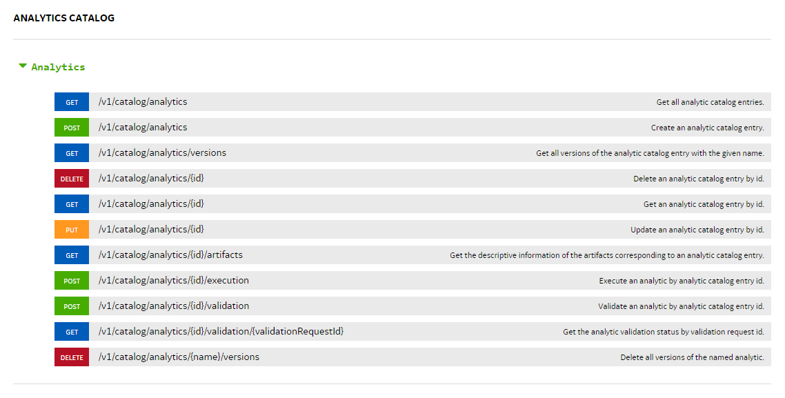
API Documentation

Slide 12
Microservices
“ Microservice architectural style is an approach to developing a single application as a suite of small services “
–Martin Fowler
“Loosely coupled service oriented architecture with bounded context “
–Adrian Cockcroft

Slide 13
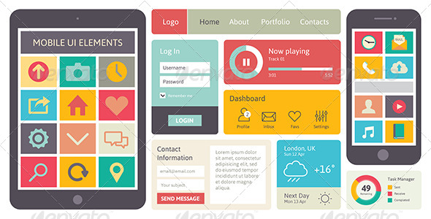


Monolithic Architecture
WAR
Alarm UI
Asset Service
User Service
Notes Service
DB
Notes:
Simple to develop, Easy to test, Very good tor simple application .
As the application get complex you can see it gets difficult to maintain and historically we have tried many approaches such as breaking up the application into mulitple war files ,
It is also difficult to make changes since a change to one table may impact the other parts of the application etc.
Difficult to adopt new technologies to parts of the application due to its coupling
Scalling issues : You have to scale the entieire application
Tightly coupled

Slide 14

Asset Service
Alarm Service
Notes Service
User Service
Notes:
Benefits of such an architecture : Each code base is relatively small, since it only contains its respective UI, Backend and DB makes the developer much more productive
Each services can be scalled independently
Each service can be developed by a relatively small team
Fault isolation is a key feature as well , we can now limit the exposure of say a memory issues etc to one microservice

Slide 15







Polyglot Microservice Architecture
Asset Service
Relational
DB
HTTP
HTTP
Notes Service
HTTP
Key/Value
Store
HTTP
HTTP
User Service
HTTP
HTTP
AMQP
…
AMQP
HTTP
Graph
DB
Notes:
REST and message-driven services
Polyglot persistence, services encapsulate data store semantics
Diversity of clients acknowledged
API Gateway for service aggregation, reduce chattiness, protocol translation, reduce latency/round-trips, deal with mobile device fragmentation, build use case/device specific API’s

Slide 16













Cloud Foundry Components
Router
Cloud Foundry PaaS
Cloud Foundry provides a services registry and runtime management layer. Components are dynamically discoverable and loosely coupled, exposing health through HTTP endpoints so agents can collect state
User Authentication and Authorization
Cloud Controller
Health Manager
Service Gateway
DEA Pool
Apps
Service Nodes
Service Connector
Build Packs
Messaging
Cloud Foundry BOSH
Public
Clouds
Private
Clouds
Micro
Clouds
Notes:
Cloud Foundry PaaS
An application runs in a DEA. The Cloud Controller orchestrates the routing and lifecycle of all DEAs in the pool. Routers manage application traffic. Health Manager reports mismatched application states to the CC. A service gateway provides an interface for services (native or external). A messaging bus manages all system communication. Apps are accessed directly through the router while web and CLI clients (e.g., vmc, STS) access Cloud Controller via RESTful services.

Slide 17

Microservices Ecosystem
Microservice
Tools
Micro Service Patterns
Aggregator framework
PaaS
MySql, Redis, Blob
Data Stores
Bosh,
Jenkins CI,
Configuration
CF Router, Zuul(Netflix OSS)
Router
Service Broker
Discovery
Health Manager
Observability
CloudFoundry
Notes:
Microservices development is complex due to the various interactions between the services,
It also requires that there is a level of cross coordination between the teams in identifying the interfaces and combined deployment strategies
Microservies also includes numerous deployment challenges and it it typically used in the context of a PaaS sysytem such as CloudFoundry

Slide 18

API Gateway Pattern :
Applicability :
The granularity of APIs provided by microservices is often different than what a client needs and hence we need a API that can support data for different clients
Very often clients have to call number of Microserices to display a single page , it is better to limit the calls to server side to optimize for the bandwidth and reduce latency
Asset Service
getPartial Details()
API Gateway
User Service
getDetails ()
Notes Service
Notes:
Sits between the client and the microservices and provide api’s customized for the clients.
Eg a mobile client could call a coarse grained API get all the product details vs a desktop client will call multiple calls since it uses a high performance netowrk

Slide 19
API Gateway Pattern :
Asset Service
API Gateway
Alarm Service
User Service
Notes Service
Notes:
Parallel access

Slide 20
API Gateway Pattern Benefits:
Remove Chattiness between Client and Server
Helps evolution of the different microservices without impacting the clients
Encapsulates orchestration of calls to different microservices such as Service chaining , Concurrent Services
GET→POST→GET
  GET→ GET
      → GET
      →POST→GET
Improves performance of the API’s by using Caching, Concurrency.
Distribute API Development and removes development bottlenecks

Slide 21
Circuit Breaker Pattern :
Applicability :
API to gracefully enable fallback mechanisms to kick in when a service dependency fails
A failure in a service dependency should not break client experience
API should automatically take corrective action when one of its service dependencies fails
Trip Circuit
Asset Service
API Gateway
User Service
Notes Service
Notes:
When is Circute Breaker Triggered
A request to the remote service times out
The thread pool and bounded task queue used to interact with a service dependency are at 100% capacity
The client library used to interact with a service dependency throws an exception

Slide 22
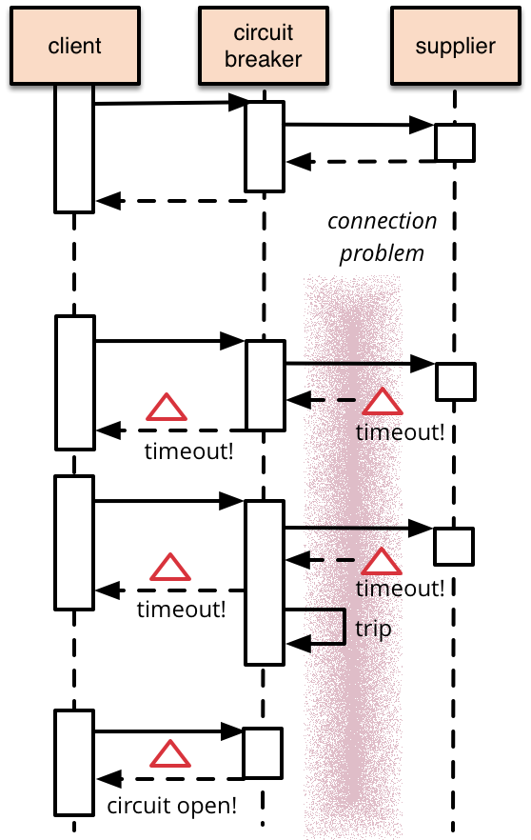
Microservice
Notes:
These buckets of failures factor into a service's overall error rate and when the error rate exceeds a defined threshold then we "trip" the circuit for that service and immediately serve fallbacks without even attempting to communicate with the remote service.

Slide 23
Circuit Breaker Pattern Benefits:
Custom fallback – Used in cases if the dependent service is down and we can retrieve the data from cache or call a fallback service
Fail silent – Used in cases If the dependent service contains optional data needed by clients we can send a null value
Fail fast - Used in cases where the data is required or there’s no good fallback and results in a client getting a 5xx response.
Notes:
This can negatively affect the device UX, which is not ideal, but it keeps API servers healthy and allows the system to recover quickly when the failing service becomes available again.

Slide 24
Cache Pattern :
Applicability :
Multiple calls to a microservice to retrieve read-only data eg list of items in Storefront may require same billing address
Workloads from specific providers where the read-only data is provided to clients and clients make a lot of repeated queries and perform analytics
Alarm Service
Asset Service
/asset/1
/asset/1
Cache Triggered
/asset/2
Notes:
When is Circute Breaker Triggered
A request to the remote service times out
The thread pool and bounded task queue used to interact with a service dependency are at 100% capacity
The client library used to interact with a service dependency throws an exception

Slide 25
Cache Pattern Benefits:
Increased throughput of the API
Improving performance of the composite API
Reduces rapid service invocation to retrieve temporal data
Various different caching strategies can be used , Memcache, Redis etc.

Slide 26
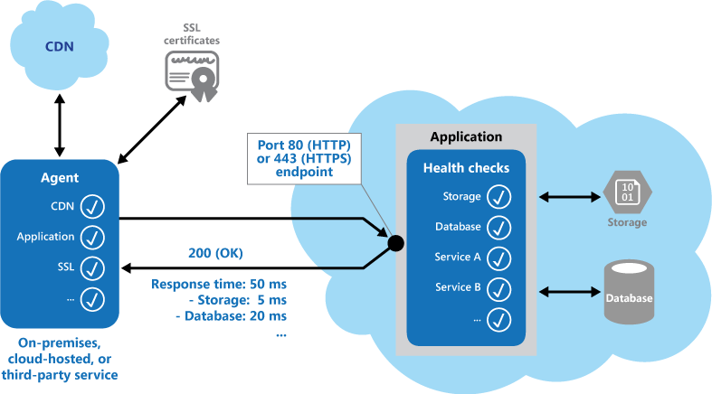
Health Endpoint Monitoring Pattern:
Applicability :
In microservices environment It is difficult to troubleshoot performance and availability of services an application may depend on.
Brownouts, or complete outages in a single microservice may negatively impact the application on which is depending on it, so it's imperative to provide an easy, light weight mechanism by which performance and availability status can collected.
Notes:
https://github.build.ge.com/industrial-cloud/Documentation/wiki/DRAFT:-CF-Micro-Service-Operational-Design-Patterns
https://msdn.microsoft.com/en-us/library/dn589789.aspx

Slide 27
Health Endpoint Monitoring Pattern Benefits:
Easy to identify the issue with the microservice proactively
Understand what issues are causing downtime of the Microservice
  Eg if a Microservice is dependend on the Service A , Infrastructure component B it is it better to know proactively which service is down.
Enables Monitoring of Microservcies to check for correct operation.
Easy to Monitoring middle-tier or shared services to detect and isolate a failure that could disrupt other applications.
To complement existing instrumentation within the application, such as performance counters and error handlers. Health verification checking does not replace the requirement for logging and auditing in the application. Instrumentation can provide valuable information for an existing framework that monitors counters and error logs to detect failures or other issues. However, it cannot provide information if the application is unavailable.

Slide 28
References :
State of Microservices : Adrian Cockcroft
http://thenewstack.io/dockercon-europe-adrian-cockcroft-on-the-state-of-microservices/
Cloud Foundry Architecture :
http://docs.cloudfoundry.org/concepts/architecture/
Microservices Architecture :
www.infoq.com/microservices

Slide 30
About Shyam@GE
Principal Architect, working on Industrial Internet at GE
Oracle Certified DBA since 1998, Certified in Oracle BI and BI Applications
Director of Special Interest Groups (SIG’s) as Board Member of IOUG (30K+ members)
Founder/President of Oracle Exadata SIG (10K members) and BIWA SIG (2.7K members), IoT Meetup in Bay Area
Speaker at OOW since 2003
MBA and MS from Florida Atlantic University

Slide 31
About JT@GE
Dev Mgr for Software, working on Industrial Internet at GE

