Slide 1
Thriving @monorepi use Pants
John Sirois
Stu Hood
Benjy Weinberger
Eric Ayers
Project Leader
Twitter
Foursquare
Square

Slide 2
A tale of three Monorepos… and one build tool

Slide 3
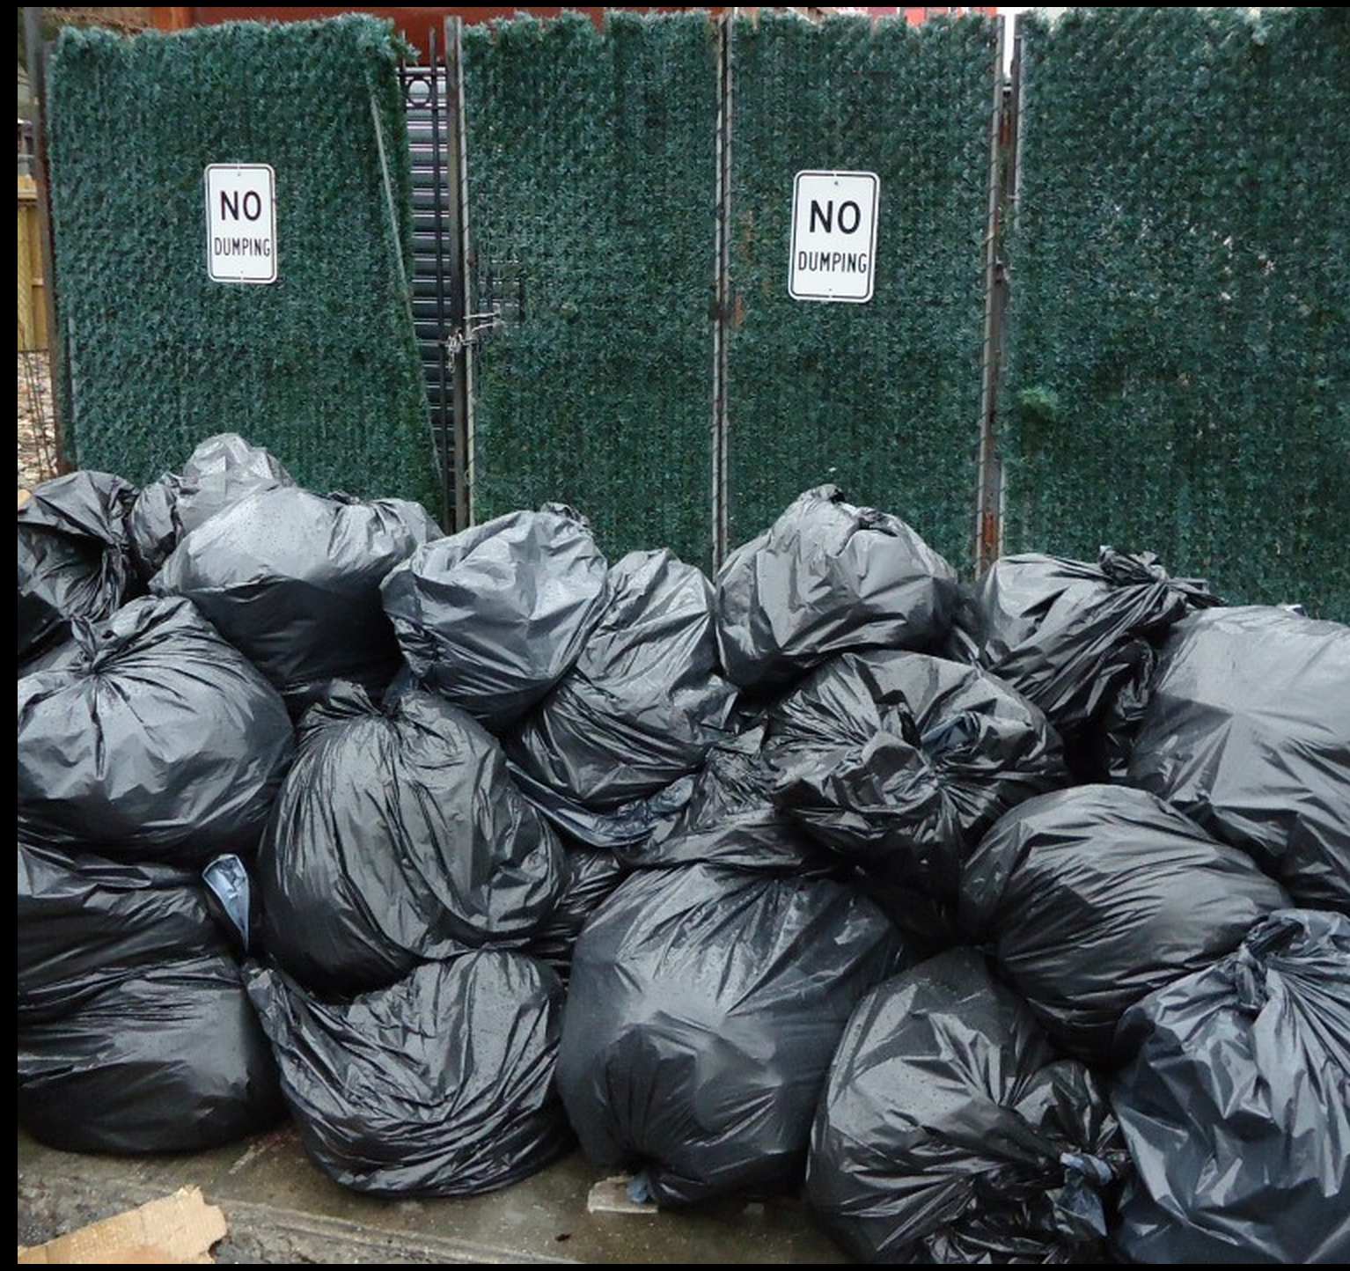
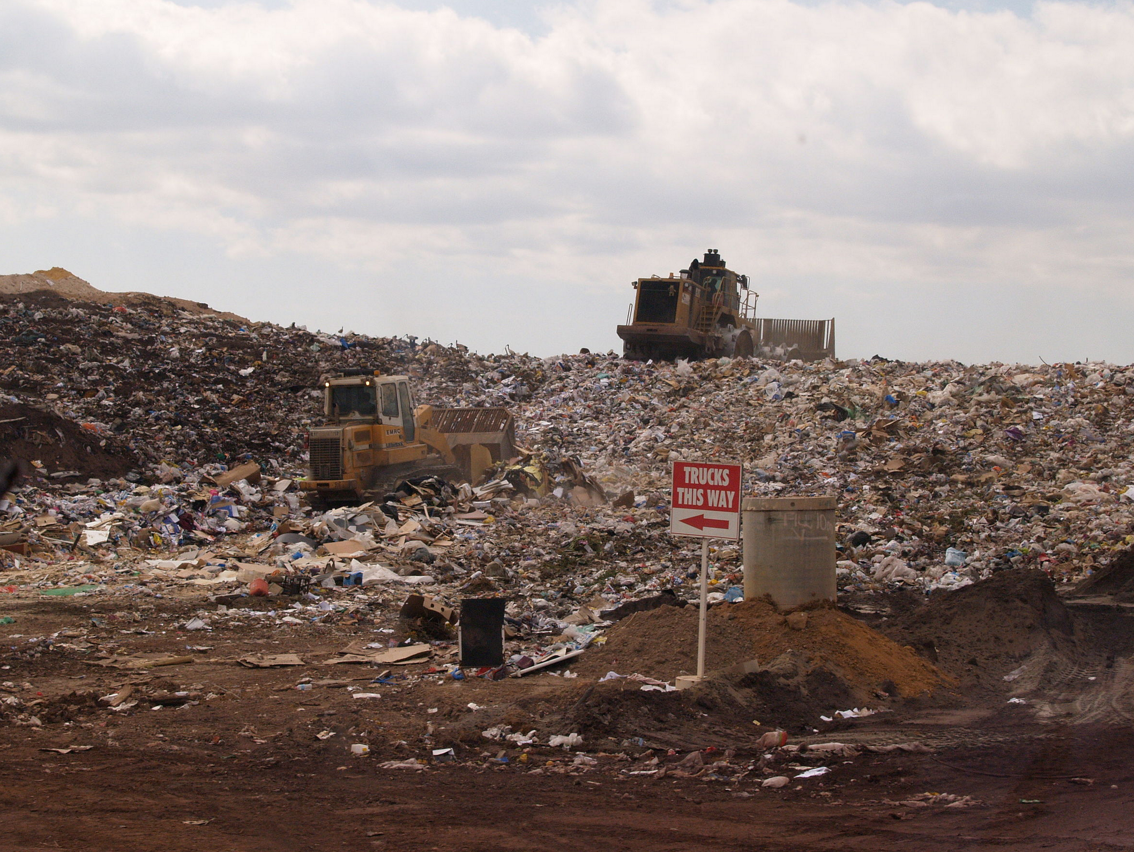
What is a monorepo?
There are two ways to organize your projects
vs.
images from wikimedia commons
Notes:
Benjy motivates code structure and BUILD structure in his series from single -> multi-project -> blaze style, so here just bring this in as a sketch.

Slide 4
Why would we use one?
Code discoverability
Deploy from HEAD of master
Changes immediately picked up by all products
Enables Refactoring across the repo
No need to maintain internal binary API discipline
Empowers all engineers to understand all code
(You don’t have to be Google scale)

Slide 5
What is pants?

Slide 6
Why would we write this?
Fine grained dependencies
Notes:
The commons jar case + perl script -> fine grained dependencies

Slide 7
Why would we write this?
Fine grained dependencies
$ ./pants list --provides | wc -l
82
Notes:
This is twitter-commons today - 82 jars

Slide 8
Why would we write this?
Fine grained dependencies
$ ./pants list --provides | wc -l
82
Community
Notes:
The commons jar case + perl script -> fine grained dependencies

Slide 9
Why would we write this?
Fine grained dependencies
$ ./pants list --provides | wc -l
82
Community
Notes:
The commons jar case + perl script -> fine grained dependencies

Slide 10
Why would we write this?
Fine grained dependencies
$ ./pants list --provides | wc -l
82
Community
Notes:
The commons jar case + perl script -> fine grained dependencies

Slide 11
How did we get here?
6-25-09
7-8-09
1-8-10
1-25-10
11-11-10
1-6-11
3-16-11
2-12-12
4-23-14
You are here
12-6-10
science
abuse
monetization
1st twitter-commons commit
1st Square commit
1st ant commit
1st pants commit
1st Foursquare commit

Slide 12
Foursquare

Slide 13
The Foursquare repo
~70 server engineers
~25 distinct services
~8K Java/Scala source files
~1M Java/Scala LoC
~1K Thrift files, generating ~3M Java/Scala LoC
Notes:
LoC- not counting blank and comment lines.
Also have another ~1M lines of HTML/JS/Python/CSS etc.

Slide 14
Scala challenges
The Scala compiler is a memory hog, is very slow, and produces huge numbers of classfiles.
Notes:
To be fair, it’s doing a lot more work. The joke is that it has two handicaps: the language it has to compile is Scala, and the language it’s written in is Scala.

Slide 15
Scala challenges
 | time | files | LoC | classfiles | classfiles/ srcfile | LoC/ classfile | LoC/ second
Java | 14 secs | 450 | 30K | 1000 | 2.2 | 30 | 2140
Scala | 135 secs | 350 | 40K | 5000 | 15 | 8 | 300
Notes:
These numbers were drawn from two real projects. If anything the Java project is atypical and has a relatively high number of classfiles per source. As you can see, there are 5x-10x differences.

Slide 16
The Scala conundrum
Productivity gains from fast coding lost to slow builds
Building faster == Building less
Notes:
What I mean by that is that once you do all the obvious optimizations, your build performance is (at best) a linear function of the amount of code you feed to the compiler. So making builds faster ends up meaning feeding less code to the compiler.
You may also be wondering about concurrent/distributed builds: Twitter’s talk will address that??

Slide 17
Building less code
Fine-grained dependency management
Build caching
Incremental compilation
Notes:
These of course apply to any language. Scala just makes them necessary sooner, and at lower scale.
These are all features that Pants supports (in some cases, we developed that support).

Slide 18
4sq/
src/
scala/
com/
foursquare/
...
base/
checkin/
tip/
venue/
Notes:
In this and in subsequent diagrams, the green nodes are where dependency information lives. I.e., they mark the atoms of your build. Note that in this simple case there is no dependency information.
Building something like this is easy using tools in the Ant/Maven/SBT family. You point them at the root of your source tree and that’s about it. But of course you have to build everything in order to build anything.

Slide 19
4sq-base/
4sq-checkin/
4sq-tip/
4sq-venue/
src/
src/
src/
src/
scala/
scala/
scala/
scala/
...
com/
com/
com/
com/
foursquare/
foursquare/
foursquare/
foursquare/
base/
checkin/
tip/
venue/
Notes:
Next iteration: subprojects. Now you only have to build the project (library or binary) you’re working on, and all the projects it transitively depends on. The atoms are still entire source (package) trees, as that’s what tools like SBT understand.
But this only takes you so far. You can imagine having a few of these subprojects. Maybe 10? 20? 50? You certainly wouldn’t want thousands of them. Each of these is in many ways a separate codebase. Each one you add makes it hard to find, navigate and share code. They lead to a balkanized codebase, which hurts the productivity and the cohesion of your engineering team.

Slide 20
4sq/
src/
scala/
com/
foursquare/
...
base/
checkin/
tip/
venue/
search/
rating/
Notes:
To get really fine-grained dependency management, at the level of a single JVM package (more or less) we need a build system that can understand dependencies inside a single source tree.
This is the Blaze model: code lives in a single shared source tree, and a build graph, specifically a DAG, is expressed in BUILD files that live alongside the code.

Slide 21
Managing fine-grained dependencies
Requires a different kind of build toolchain.
Pants takes advantage of this to restrict your builds to just the packages you need.
Leverages the insight that while source files are modeled as a tree, because they live on a filesystem, code is better modeled as a DAG.

Slide 22
Build caching
Fine-grained caching, at the target level, maximises cache hit rates.
Local and remote caches.
Huge wins: 40 minute builds now take 1-3 minutes.

Slide 23
Incremental compilation
SBT includes an incremental compiler.
Separated out as a library called ‘zinc’.
Pants uses it to further cut down on recompilation.
Notes:
You may wonder why we needed Pants at all, if SBT can invalidate per-source file (even more fine-grained than per-target). Answer: SBT’s invalidation relies on very heavyweight analysis, and it has to see the world. It becomes infeasible above high hundreds - low thousands of source files.

Slide 24
Twitter

Slide 25
‘Source’ at Twitter
Maven free since November 2014
Two monorepos merged to one as of July 2015

Slide 26
Build Graph Maturity
Size
~3000 services/binaries
~30K targets
~75K source files
~4M Scala, 2M Java LoC
Highly cross-language

Slide 27
Build Graph Health
Granularity
Still a long way to go on graph health
Primarily affects cold builds that miss the cache
File/target percentiles: 99th=41, 90th=11, 75th=4, 50th=1
Offenders:
1382 files, 64015 loc in a java target
505 files, 32834 loc in a scala target

Slide 28
Build Graph Health
3rdparty
Binary dependencies
Relative to The Big G:
Much higher fraction of running code was written outside Twitter
Choosing a single global resolution more difficult
Many possible resolutions; thus, cross-compilation of source!

Slide 29
Integrating ‘Source’
CI
Clusters of a few thousand machines constantly busy compiling and testing
CI machines read/write to remote buildcache concurrently
Lots more room for optimization

Slide 30
Future[Work]
Shrinking classpaths
2k-3k target binaries mean lots of IO during compilation
Making classpath usage more efficient
Most existence checks satisfied from in-memory analysis
JAR everything!
Background inference of dependencies to achieve the best of:
1) small targets, 2) minimal boilerplate

Slide 31
Square

Slide 32
The Square Java repo
internally hosted git repo
~30k source files
~3m lines of code
~200 micro services
~200 developers (30 day active)

Slide 33
Build Tool Landscape
In early 2014, Square evaluated tools for our monorepo

Slide 34
What’s wrong with Maven?
Incumbent BUILD system
Designed for Versioned components release model
Version abuse: 900 modules at HEAD-SNAPSHOT
Performance: Recursive evaluation of projects
Long refresh times in IDE
Stale artifacts with Incremental Builds

Slide 35
Why not Gradle?
Groovy integration is attractive
Android devs love it!
Scale: still does recursive evaluation
This left us with the Google Blaze clones

Slide 36
The Blaze Clones

Slide 37
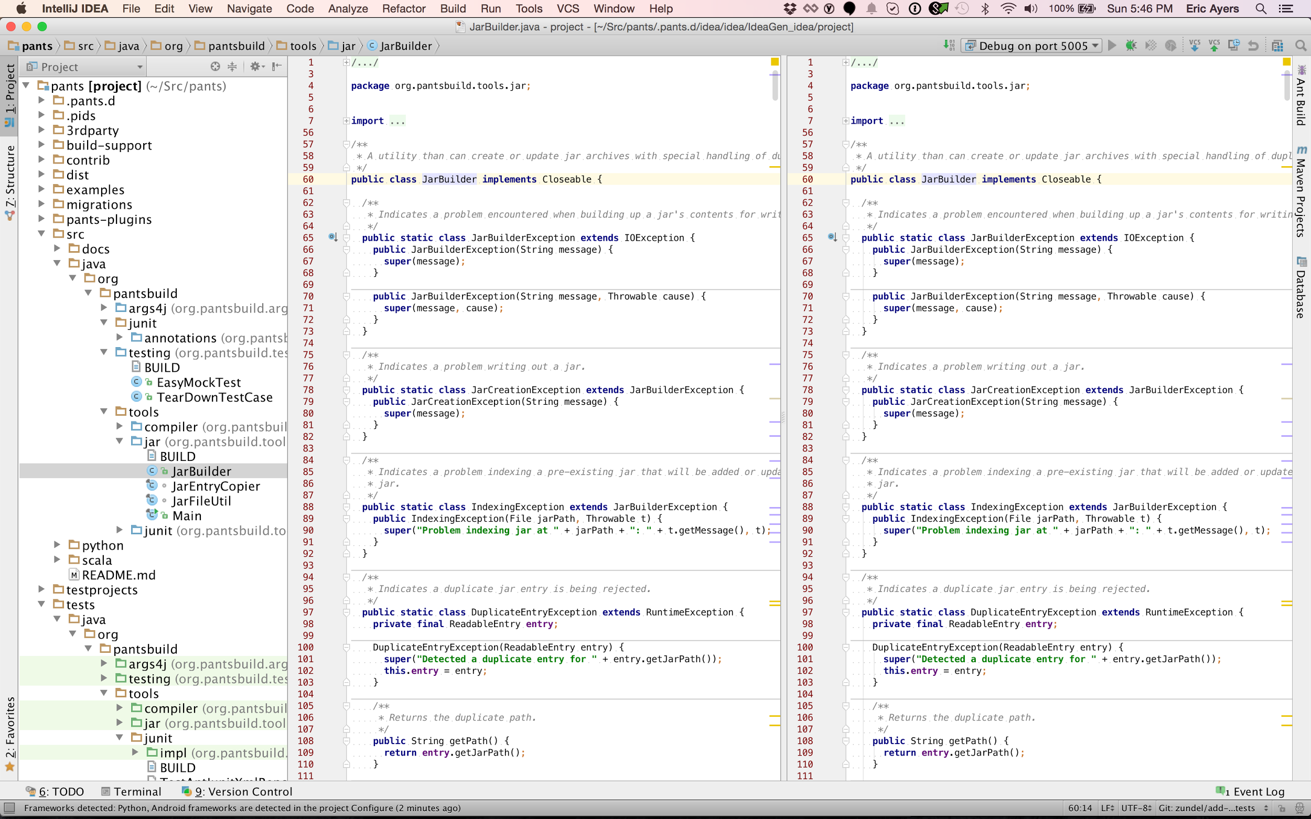
Important features for Square
Incremental Build
IDE Support
OSS repos
Community

Slide 38
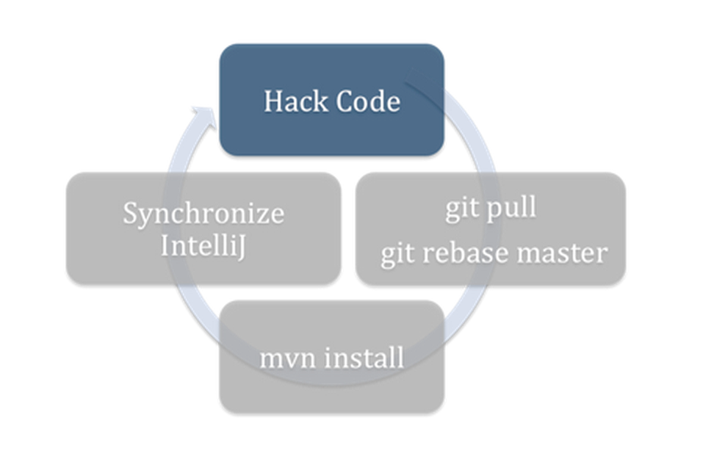
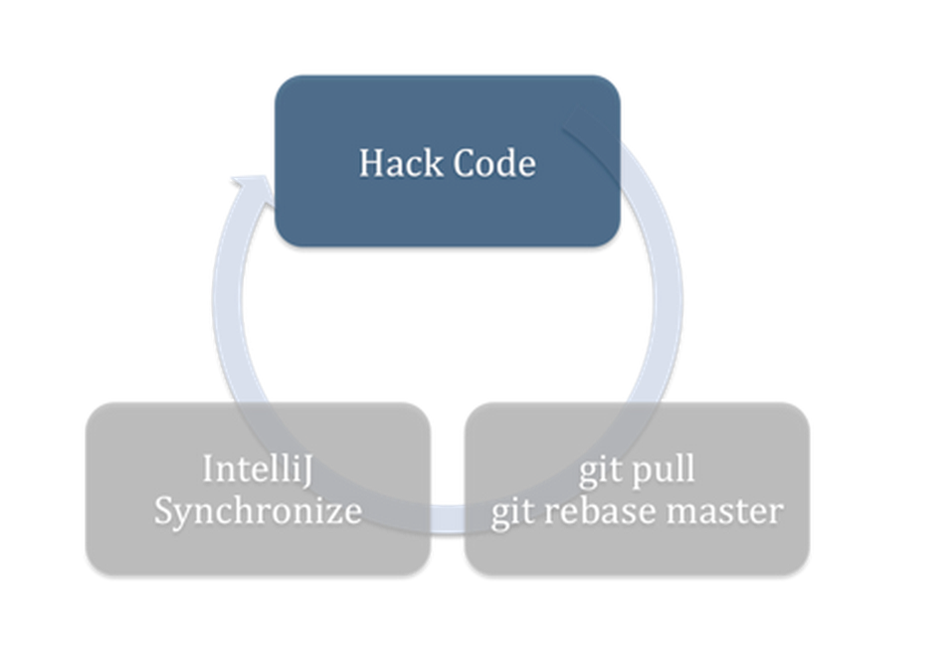
Maven workflows

Slide 39
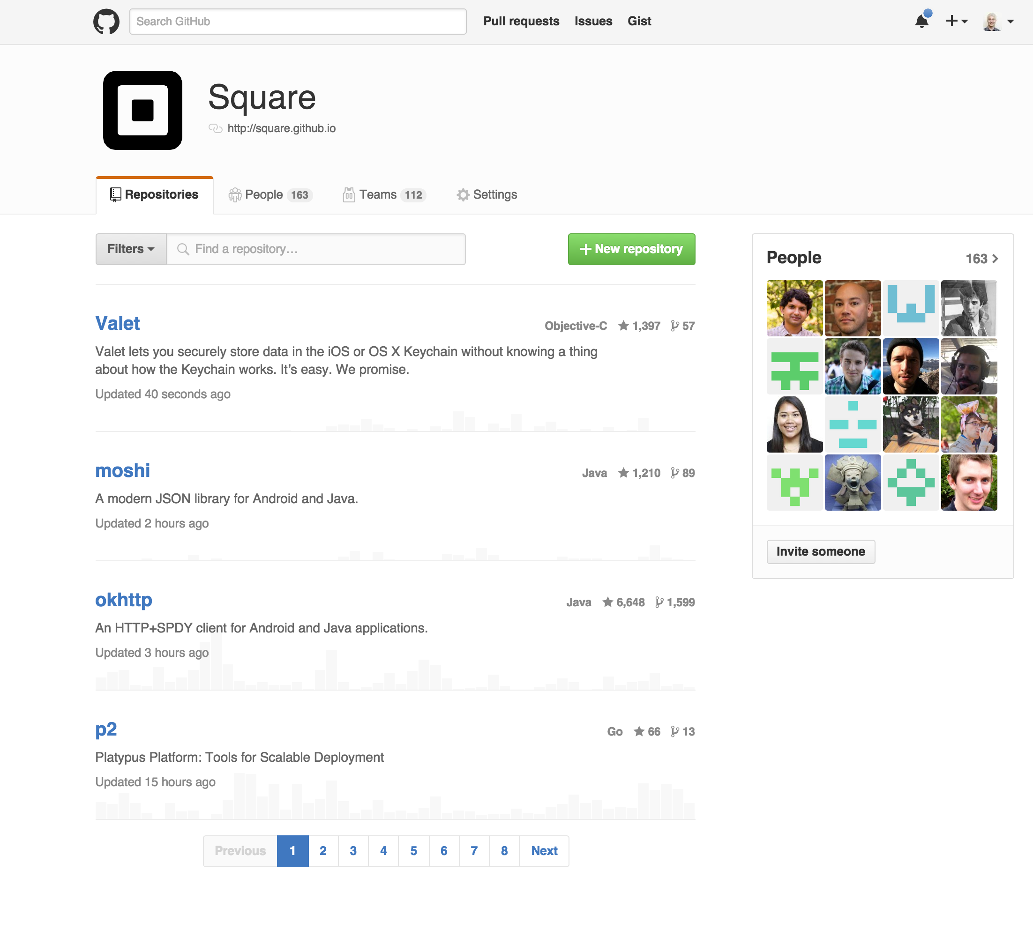
Square and Open Source

Slide 40
Open Source and Internal Binary Repositories

Slide 41
Pants Community
images from wikimedia commons

Slide 42
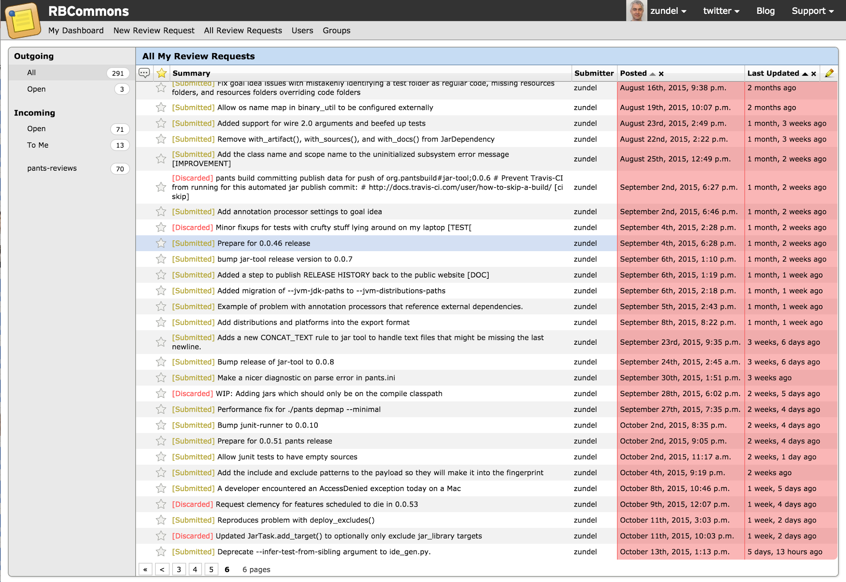
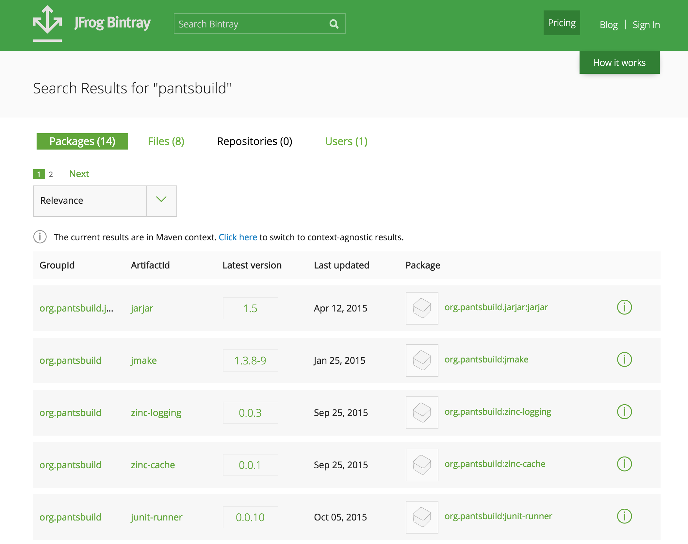
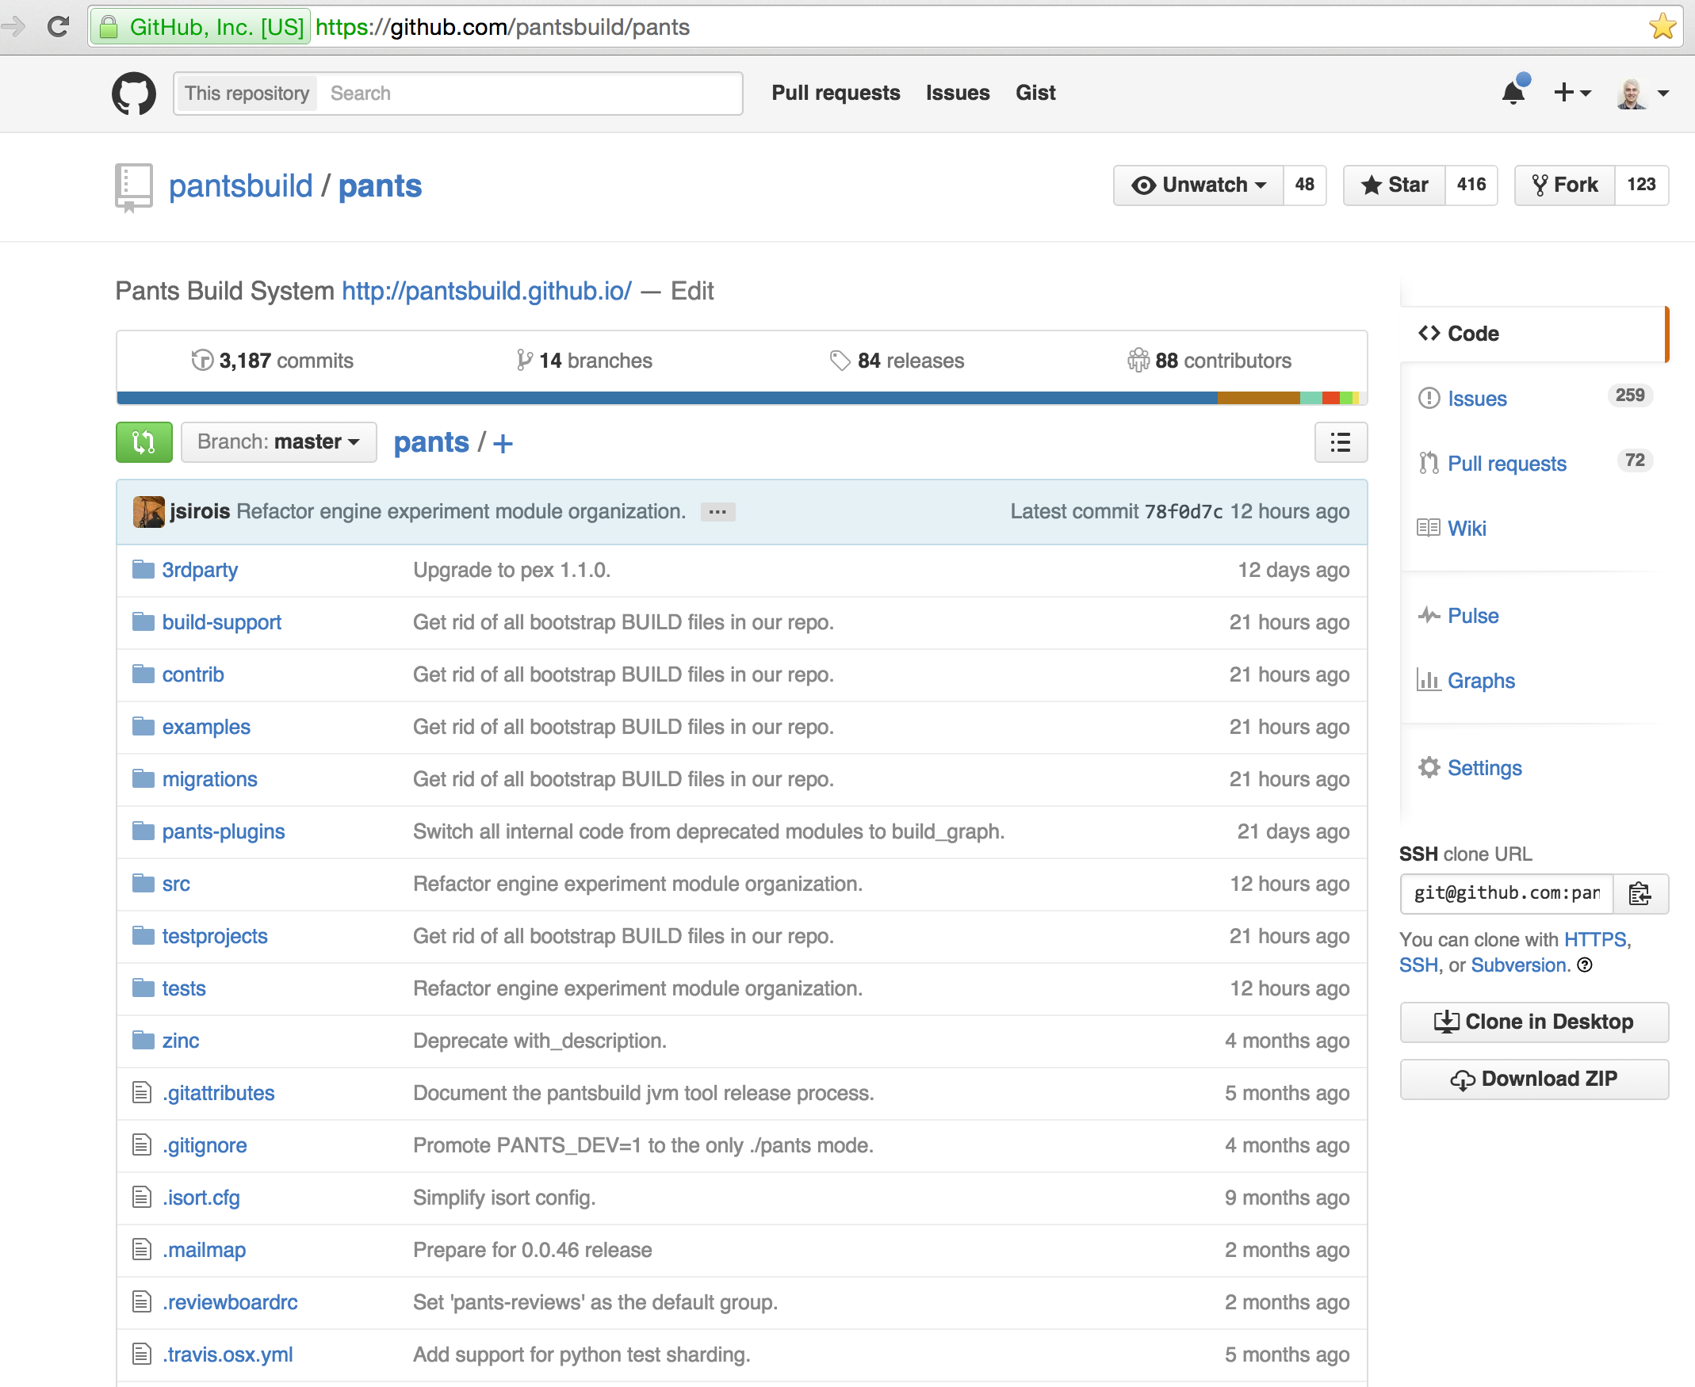
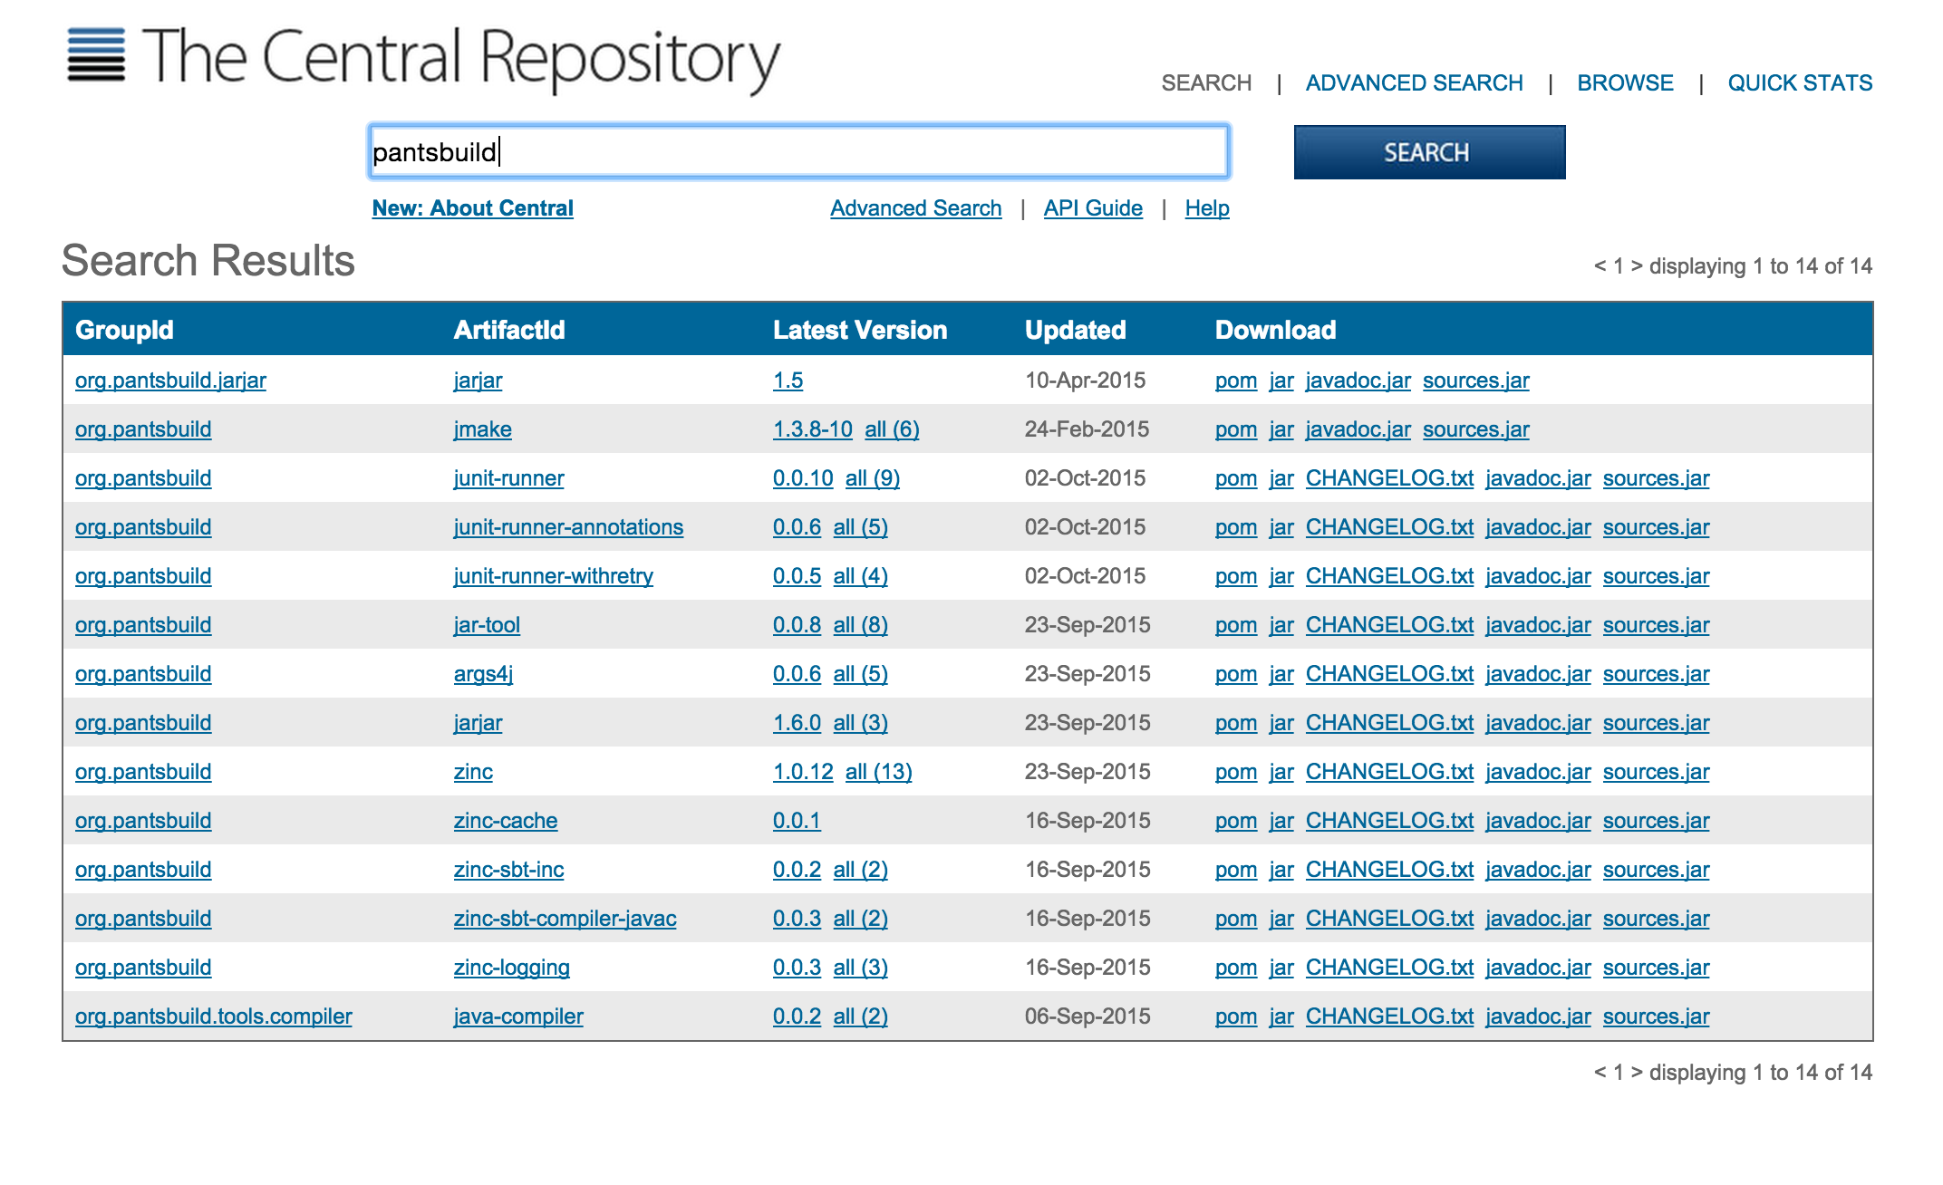
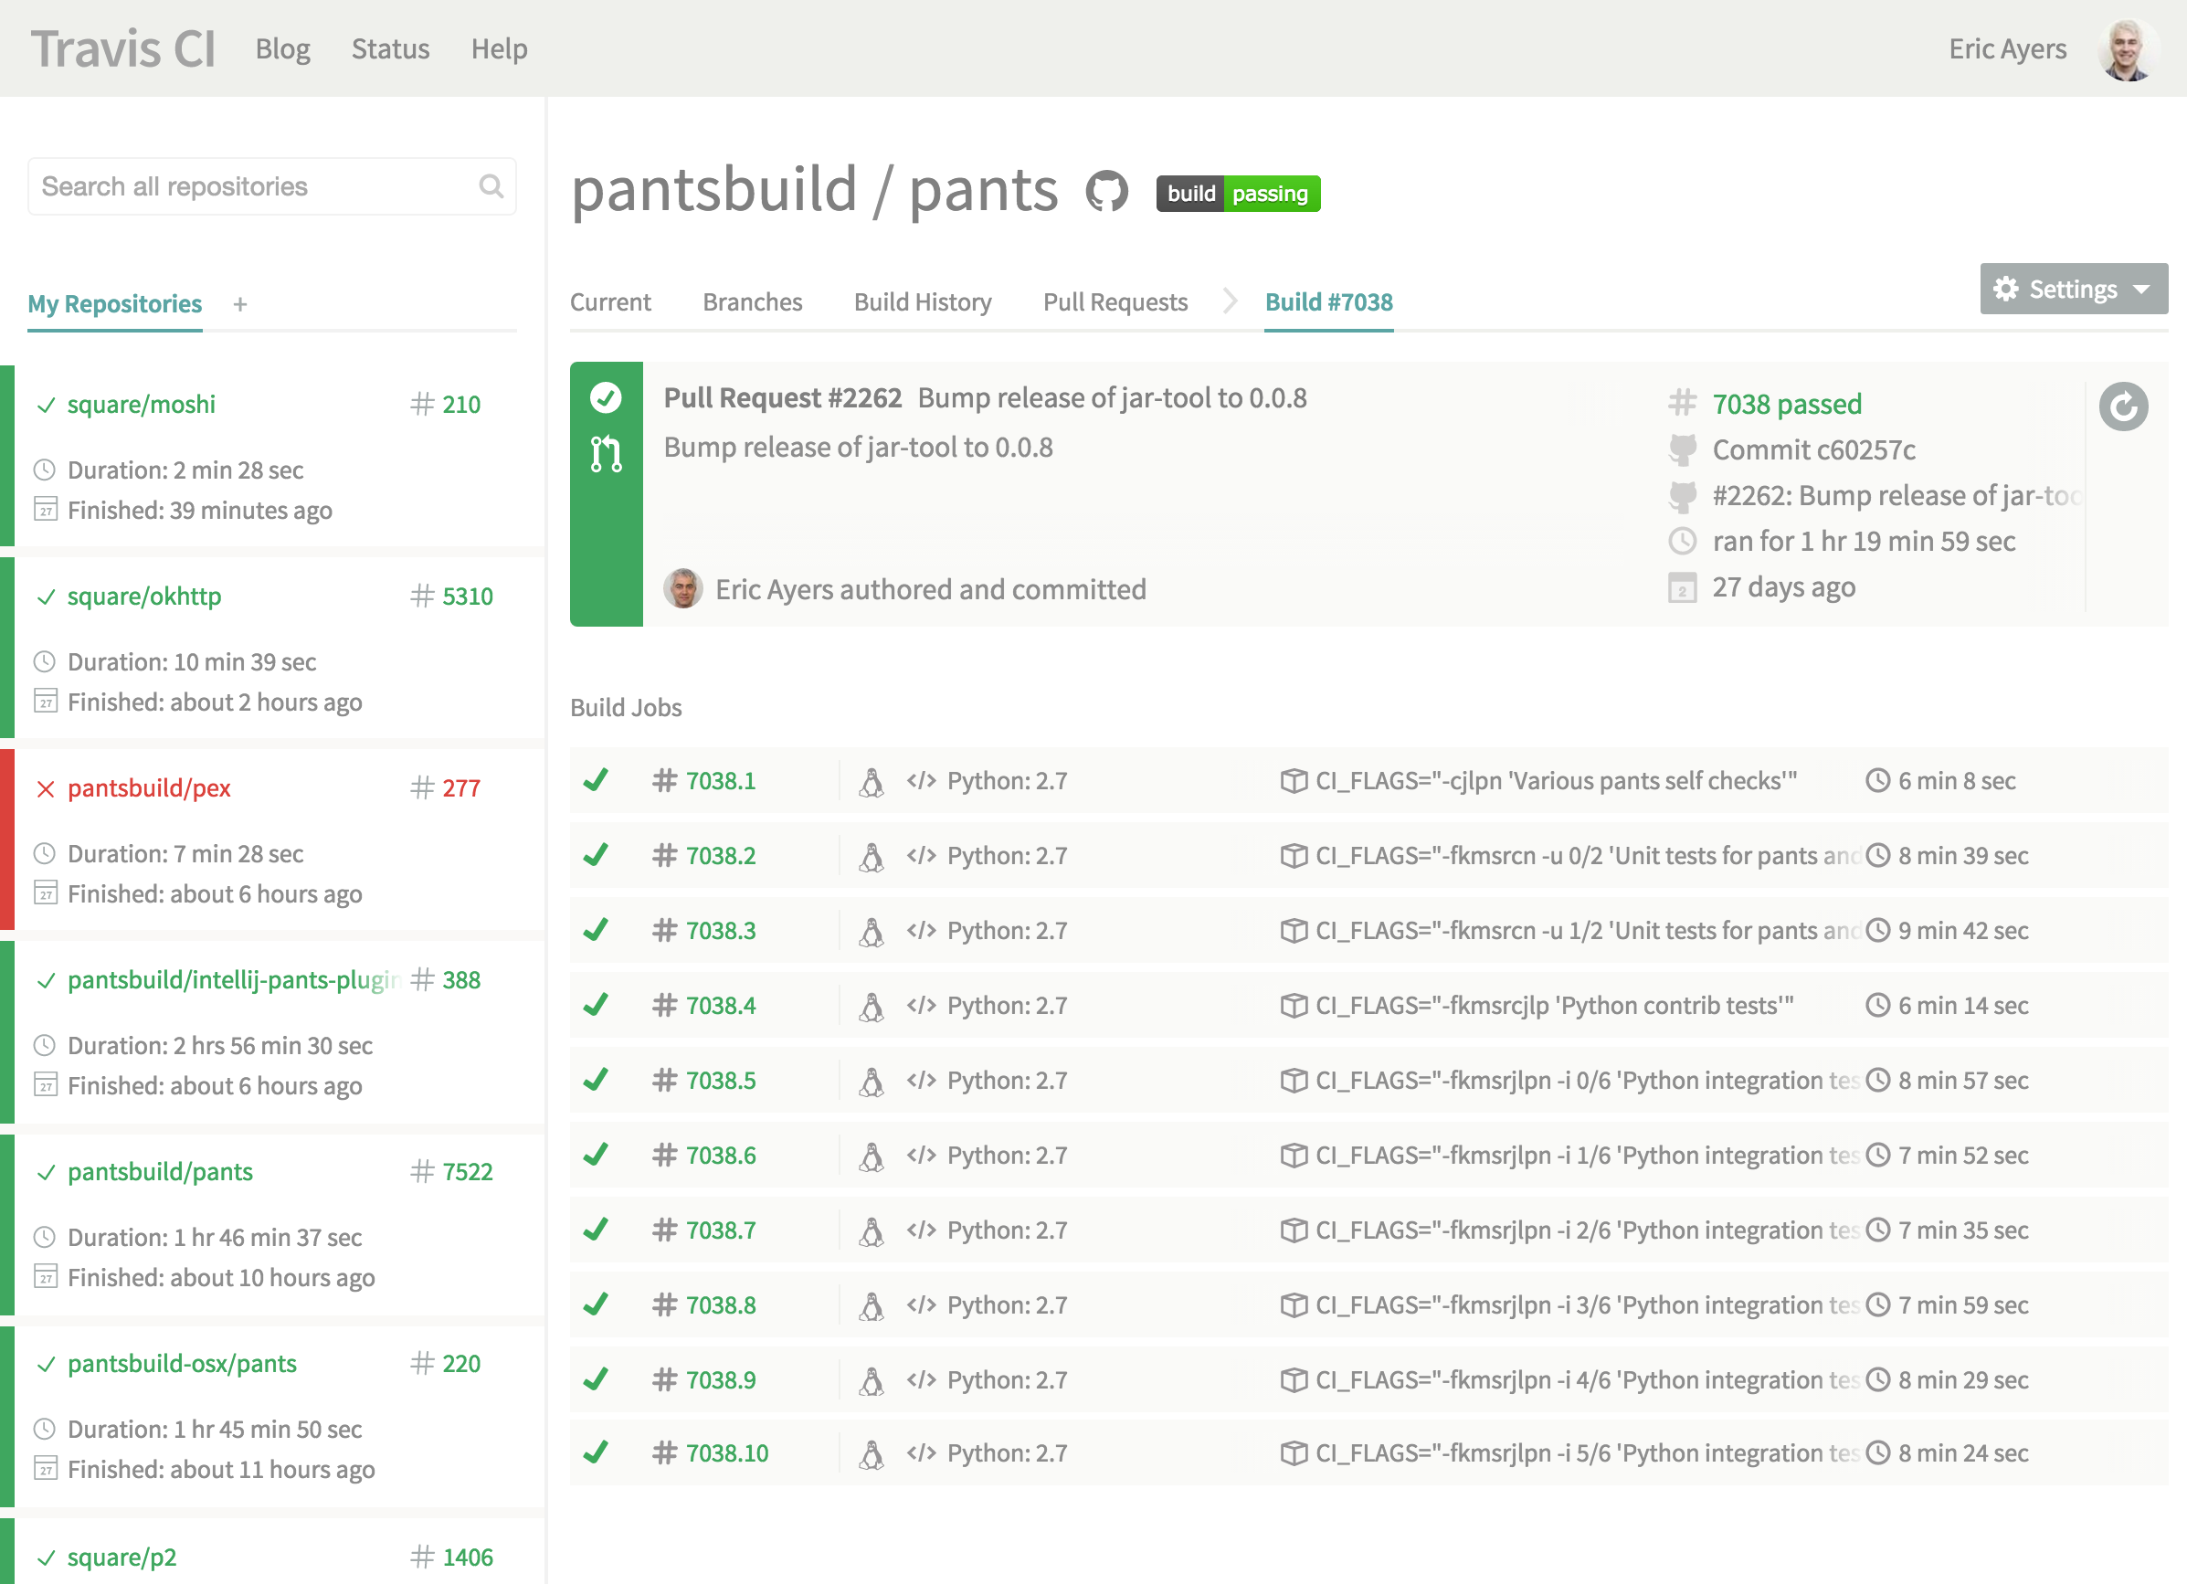
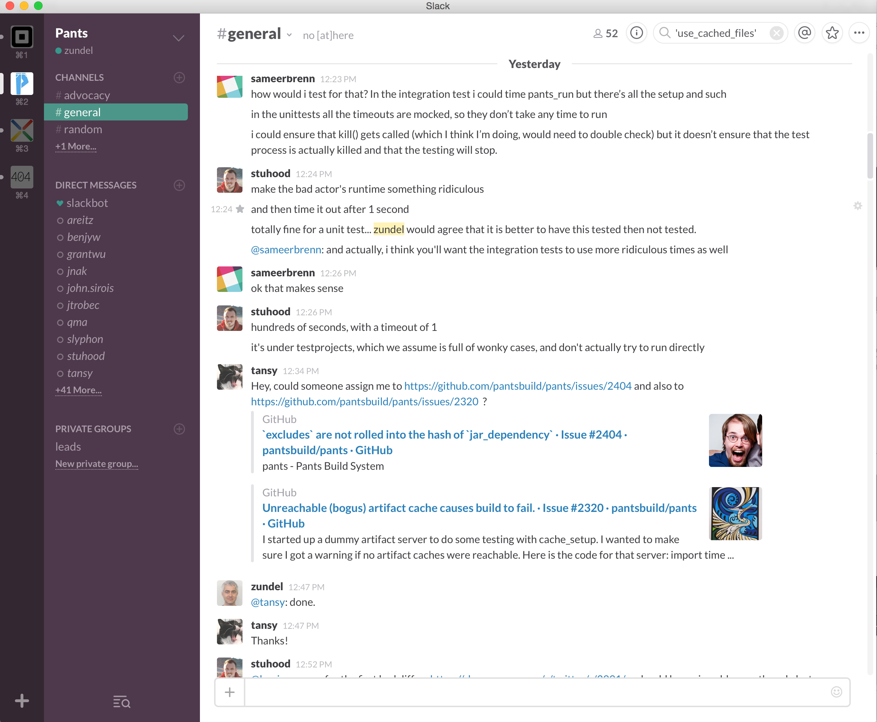
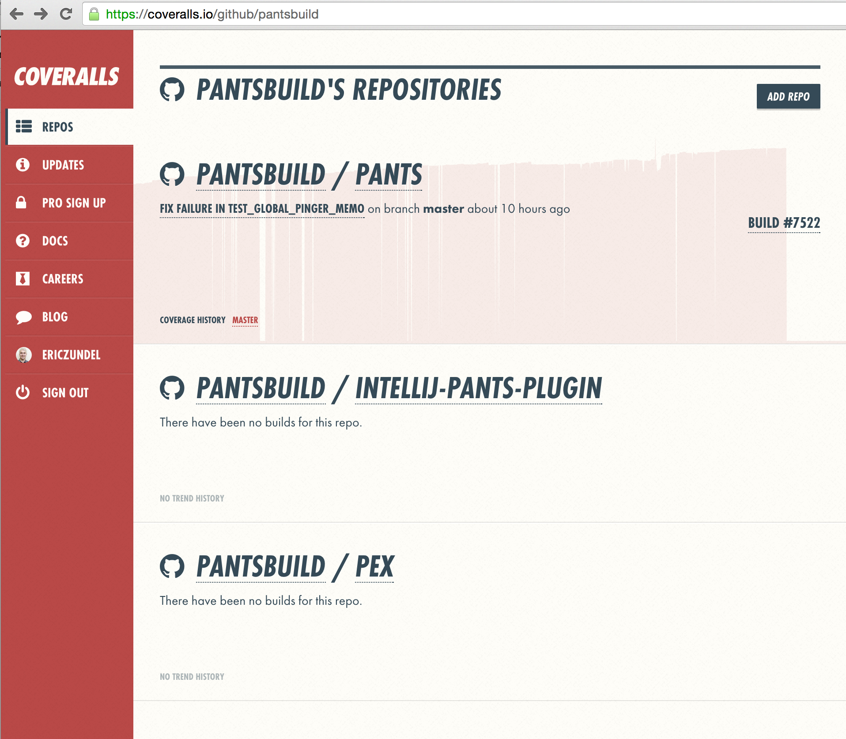
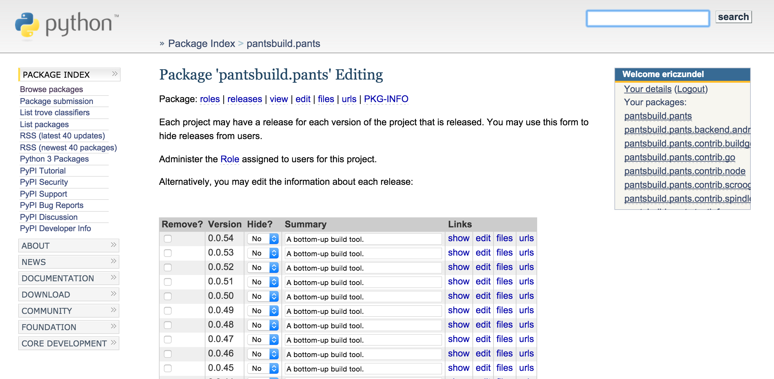
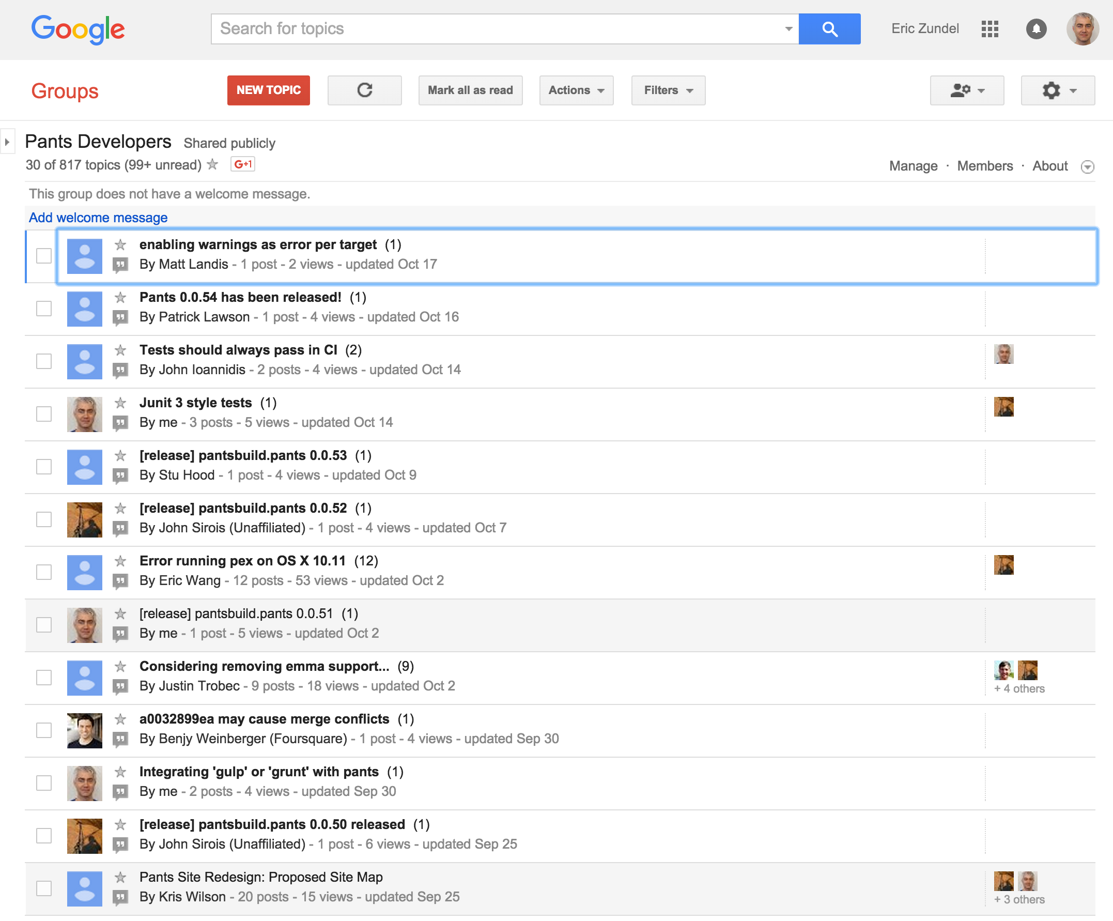
Pants Community - Tools
Github
Google Groups
Slack
Travis-CI
Coveralls
Bintray
PyPi
Central Repository
RB Commons

Slide 43
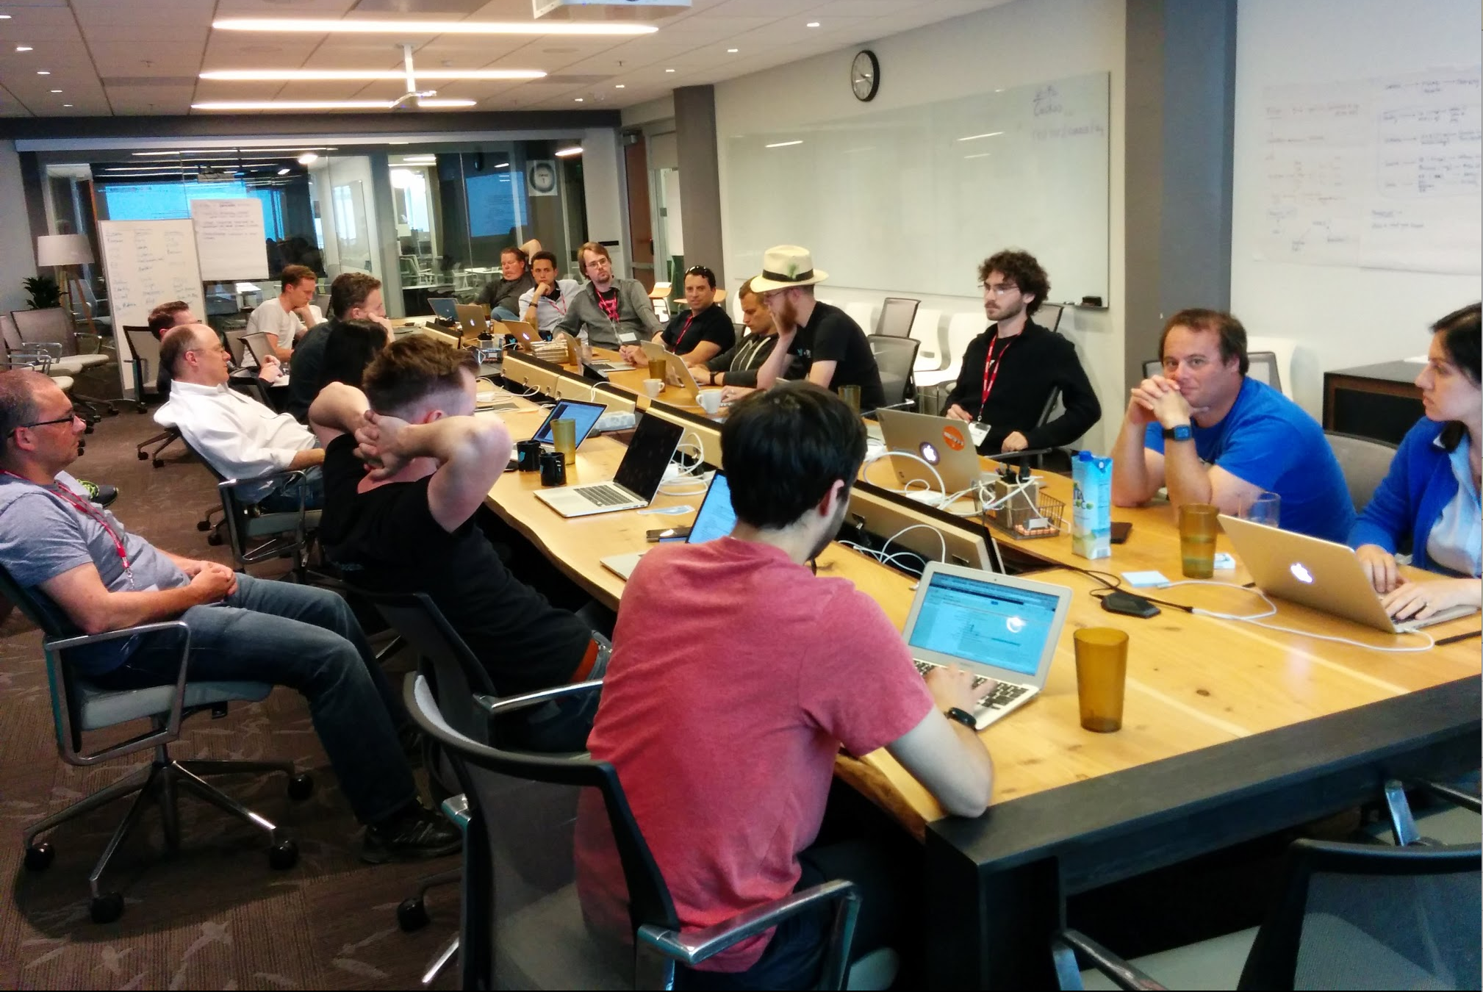
Pants Community - Summits
images from wikimedia commons

Slide 44
Pants Community - Velocity
github.com Contributions to master, excluding merge commits

Slide 45
Roadmap

Slide 46
The Future of Pants
Pants 1.0 Milestone
Improved Website
Plans beyond 1.0

Slide 47
Pants 1.0 Milestone
2 step install
Don’t pay for what you don’t use
Stable BUILD API
Stable plugin API

Slide 48
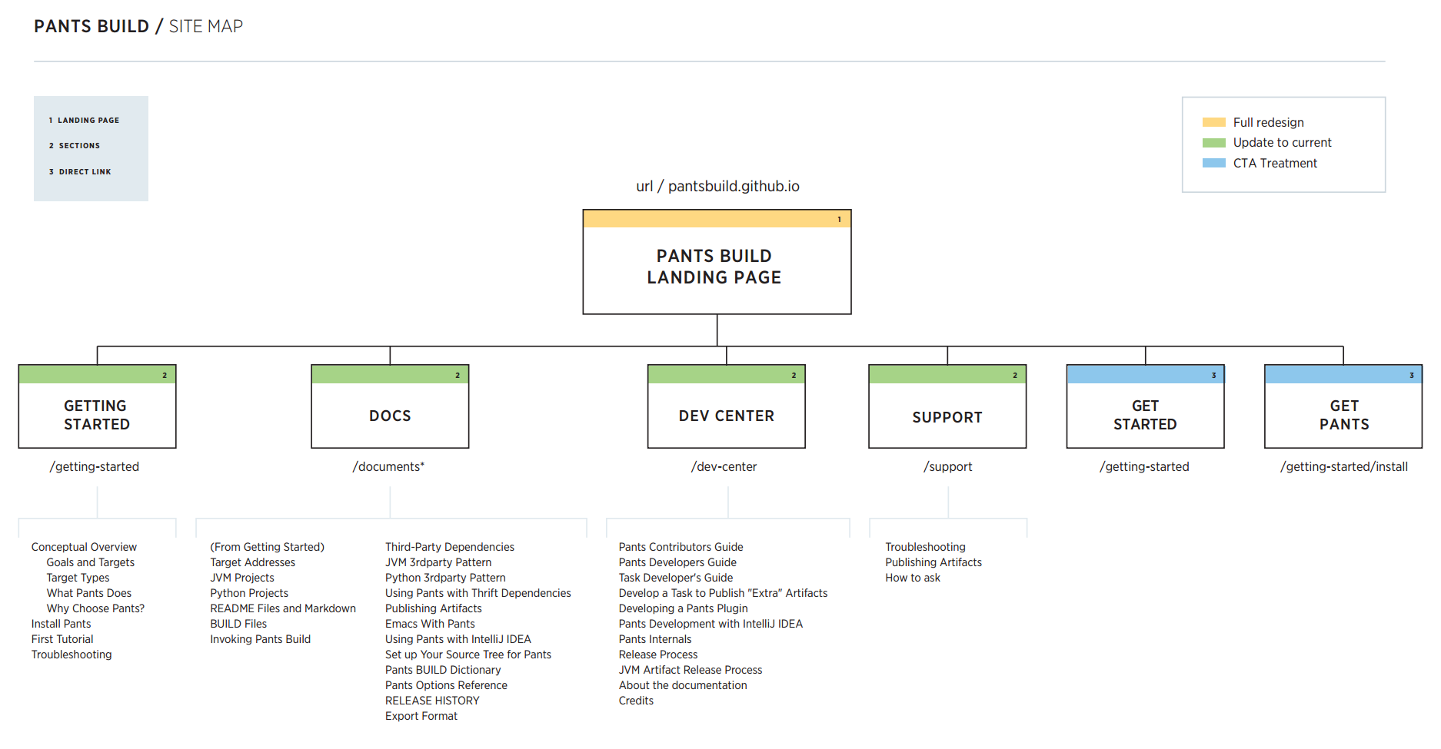
Improved Website

Slide 49
Plans Beyond 1.0
BUILD language
Pants daemon
Use all your cores
Use other folks cores

Slide 50
Thank you!

