Slide 1
Games of Codes, the CI battle
A view behind the Atlassian curtains
ESTHER ASENJO • BAMBOO DEV TEAM LEAD • ATLASSIAN • @STHREO
Notes:
Hi everyone, welcome to the Game of Codes: a view behind the curtains of how we apply CI and CD in Atlassian - in this Build track of Summit 2015.
Why Game of Codes? Because I consider it a very hard battle in which tools, processes and people play and important role to win this strategy game that CI is.

Slide 2
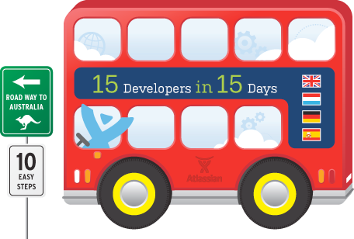
Who am I?
Notes:
But let me start introducing myself with my 1min elevator pitch: My name is Esther.
I was born in Spain.
I wanted to become a doctor, but ended up developing for a poker game server in Java.
This took me to London, and while I was there…Atlassian came on a bus to steal 15 developers in 15 days.
Lucky me, I was one of them.
So I moved to Sydney almost 3 years ago, to work in the development headquarters.
I started as a Confluence developer in the Collaboration family.
And driven by my passion in CI…
I moved into the Bamboo grooves to join other pandas - to be one of the Bamboo development team leaders.

Slide 3
ci introduction
THE CI BATTLE, AT ATLASSIAN
ci ANATOMY
ci culture
thinking beyond ci
the cd battle, AT atlassian
conclusion
Notes:
Today we’ll be talking about CI, and how we fight for it in Atlassian.
We’ll see the anatomy of the CI delivery pipelines of the teams in Atlassian.
And we’ll talk as well about how culture can have a huge impact in the way a team delivers software.
The logical conclusion of a successful continuous integration is continuous delivery. We’ll see how one of the teams in Atlasssian is fighting to make it happen.
I’ll talk a lot, and I’ll talk about tools, technology, processes, and people. And of course, I will talk about Bamboo.

Slide 4
ci introduction
THE CI BATTLE, AT ATLASSIAN
ci ANATOMY
ci culture
thinking beyond ci
the cd battle, AT atlassian
conclusion
Notes:
First things first. Let’s start with an introduction to CI.

Slide 5
“
Continuous Integration is a software development practice where members of a team integrate their work frequently. Each integration is verified by an automated build to detect integration errors as quickly as possible. This leads to significantly reduced integration problems and allows a team to develop cohesive software more rapidly.
”
martin fowler, thoughtworks
Notes:
So what’s CI?
For this talk, I wanted to find the best definition. I decided to pick up a quote from Martin Fowler, one of the gurus in this subject. The quote starts like this: “CI is a software development practise where members of a team integrate their work frequently”.
When rehearsing at home, I realised that even when this quote is the best definition of CI, it does not actually reflect the way I really feel after having worked with it for a few years. So I decided I wanted to come up with a definition on my own for you, and I finally did it when listening to a song of Daft Punk.
Hard to believe it right? So let me show you.

Slide 6
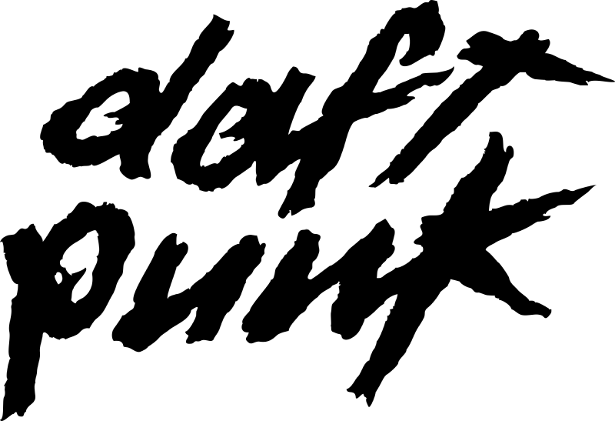
work it HARDER.
make it BETTER.
do it FASTER.
make us STRONGER.
Notes:
Every time I think of CI I picture teams that need to work it harder...

Slide 7
HARDER processes.
BETTER quality.
FASTER delivery.
STRONGER teams.
Notes:
Why harder?
CI implies harder processes. It can puts down dev speed, but just for the sake of something higher: turning code into high-quality code.
Why better?
Teams that apply CI deliver with a better quality. This teams will be able to pick up issues sooner than others, just exactly when it’s easier to fix them.
Why faster? Faster delivery.
Teams will work on defining and refining a delivery pipeline, that after several iterations will start running smoothly in the conveyor belt that implies taking code from commit to production.
And finally, Why stronger?
Teams that apply continuous integration are not just focused on coding a new feature, but also in how to integrate it, how to test it, in summary, how to deliver it.

Slide 8
ci introduction
THE CI BATTLE, AT ATLASSIAN
ci ANATOMY
ci culture
thinking beyond ci
the cd battle, AT atlassian
conclusion
Notes:
But how does this applies for a company as Atlassian, in the real world?

Slide 9
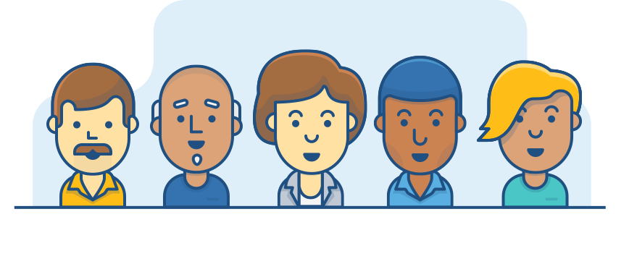
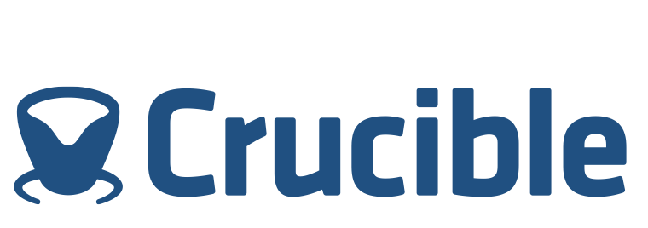
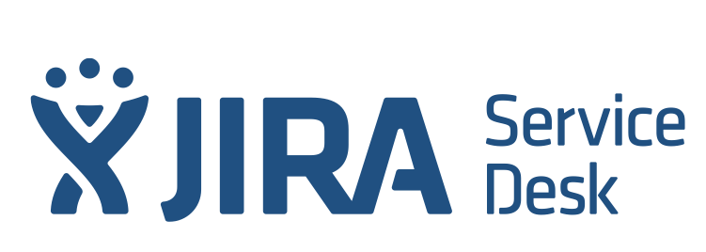
Atlassian, a software company
700+ R&D Staff
Flags!
400+ developers
Products
Services
www.atlassian.com
my.atlassian.com
Ecosystem
Notes:
Atlassian is a software company…
that has more than 700+ people in the R&D team distributed all around the world, with offices in 4 different continents and timezones, taking into account our partnerships.
Out of the R&D team, more than 400 of us are developers like me, who are pushing code like crazy...
to help build a wide range of products and plugins…
that come in different flavours - Cloud and Server…
and also public services, and internal services.
But what would Atlassian be without its ecosystem of 3rd party developers?
This ecosystem and our plugin framework, together with Atlassian Connect, pushes our integration points, and scalability, up to the roof.

Slide 10
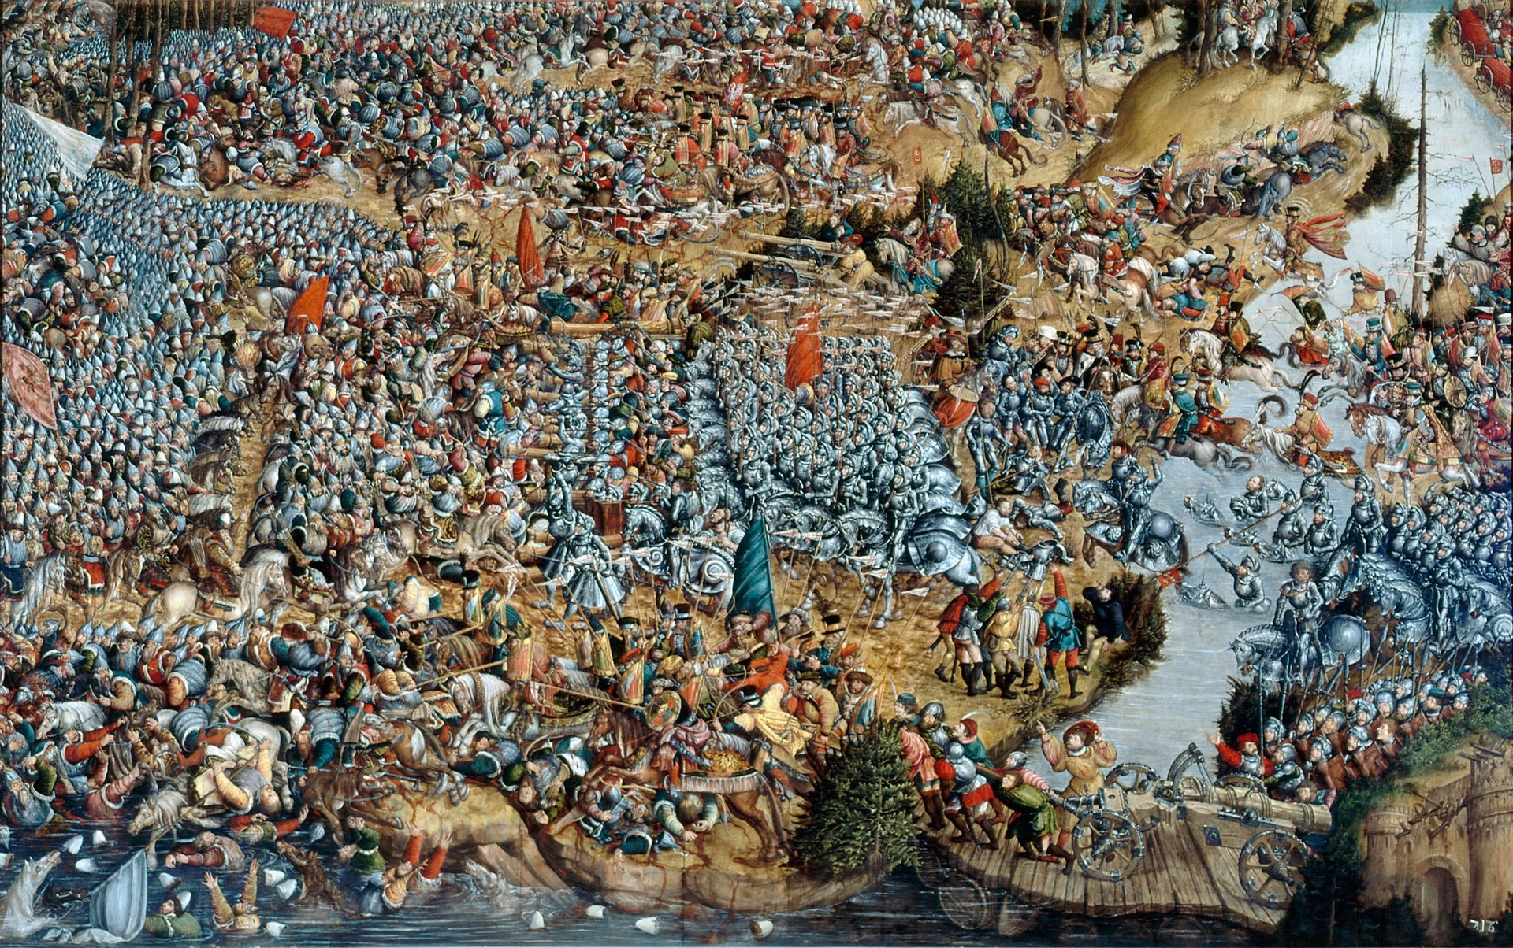
Continuous Integration
is a battle.
Notes:
In a scenario like this, I believe CI is a battle, and makes of Atlassian a very interesting company in terms of software delivery.
We are well aware of this, and that’s why we are trained - and I mean a real training - to fight this battle.
Like we did in one of our latests parties, which pictures I am going to show you now.

Slide 11
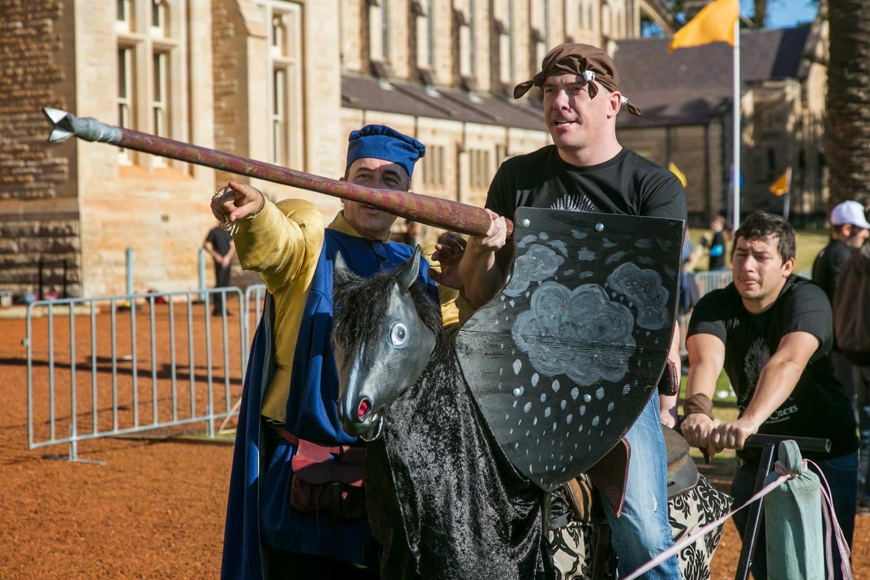
Notes:
In Atlassian, CI is a battle in which we use our own tools as weapons.

Slide 12
Notes:
And our precious Atlassian crew as army.

Slide 13
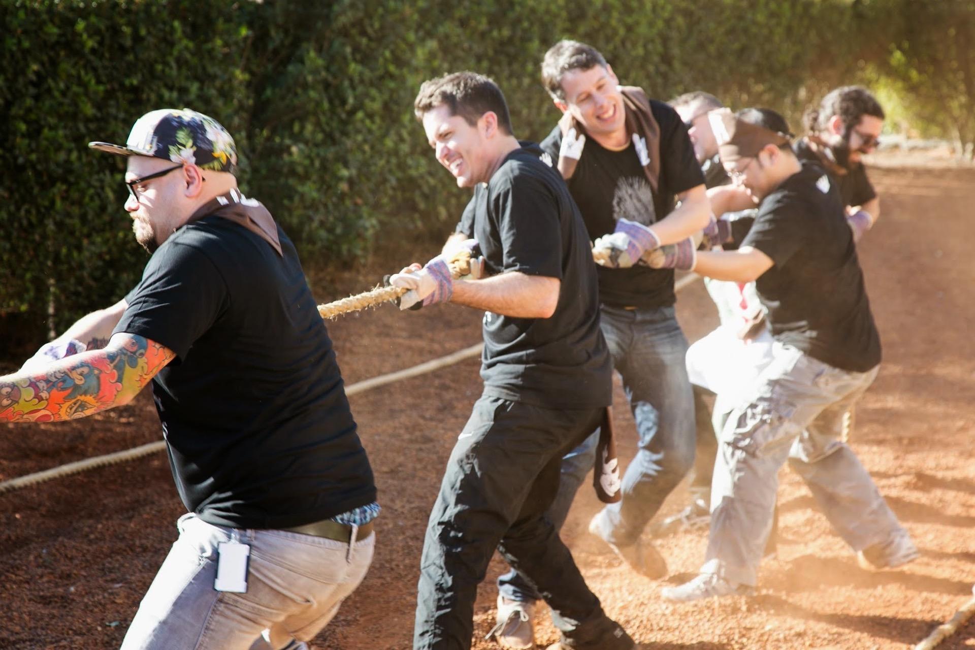
Notes:
Thanks to CI our teams and individuals are empowered to have a direct impact on the way we deliver software.

Slide 14
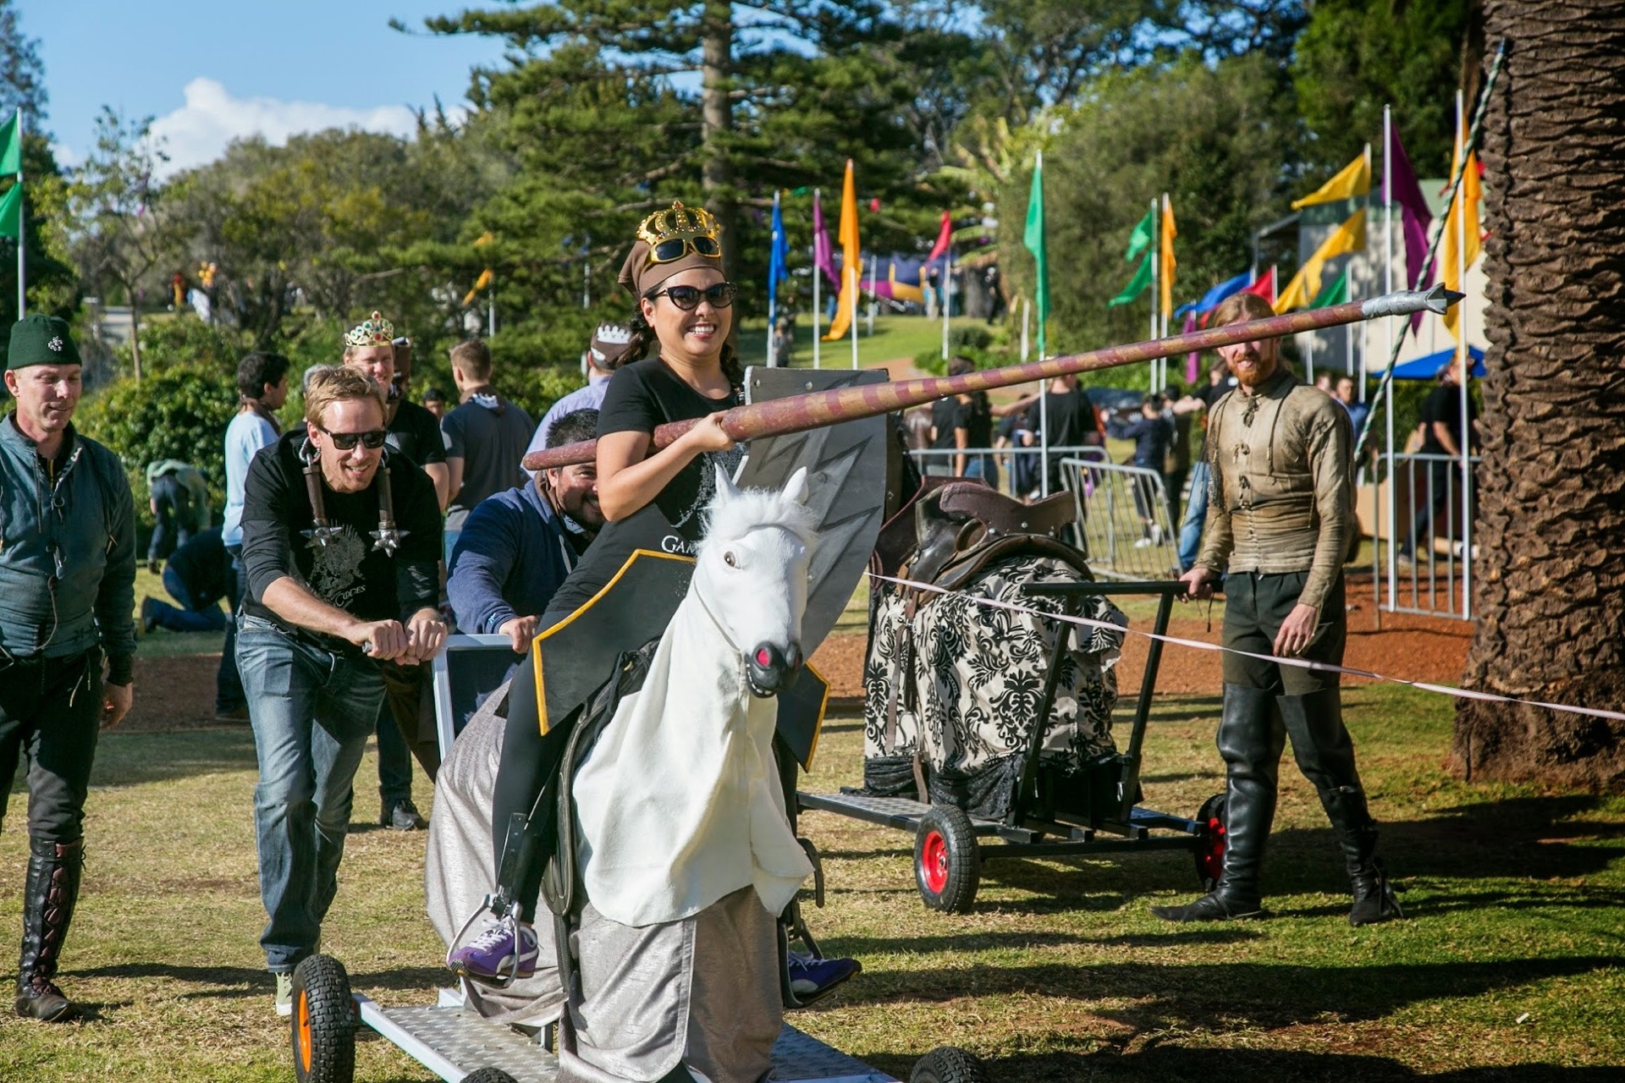
Notes:
Software that we aim to deliver with high quality and as fast as we can.

Slide 15
The Continuous Integration battle,
IT DOES NOT COUNT UNTIL IT’S SHIPPED
Notes:
We aim to have a tight cycle time to help us turn ideas into deliverables, and so get the most valuable feedback, the one that comes from our users, and so win the battle.
Because as we all know, in a CI world it does not count until it’s shipped.

Slide 16
When you play the Game of Codes,
you ship or you fail.
Notes:
When you play the Game of Codes you ship or you fail.

Slide 17
ci introduction
THE CI BATTLE, AT ATLASSIAN
ci ANATOMY
ci culture
thinking beyond ci
the cd battle, AT atlassian
conclusion
Notes:
So after this epic introduction to engage you and keep you awake…
Let’s go into low level details now, looking at the anatomy of a delivery pipeline in Atlassian.

Slide 18
Infrastructure
Notes:
What are the keys to rule this game?
CI is made up of 4 pieces: infrastructure…

Slide 19
Tools
Notes:
Tools….

Slide 20
Processes
Notes:
Processes…

Slide 21
People
Notes:
People

Slide 22
Infrastructure
Notes:
Let’s see how’s our infrastructure.

Slide 23
Build Infrastructure
Engineering
Collaboration
JIRA family
Dev Tools
Internal Services
Ecosystem
Notes:
We have several teams in Atlassian that are mapped into divisions. These are the Engineering division… Collaboration (Confluence and HipChat… JIRA family (JIRA Service Desk, JIRA Agile, JIRA for software), DevTools (Bamboo, Bitbucket, SourceTree among others), Internal Services (as our Purchasing and Atlassian Identity team), and Ecosystem.
Every division have different Bamboo instances, to isolate teams from each others, and to facilitate instances maintainability.
How do we manage these instances of Bamboo running at the same time?

Slide 24
Build Infrastructure
3,5k
build plans
Engineering
Collaboration
JIRA family
Dev Tools
Internal Services
Ecosystem
14k
branch build plans
12
Bamboo instances
15
Nexus instances
4
remote agents
1200
elastic agents
Maven repositories
Remote agents
Elastic agents
Build infrastructure
Build Engineering
20 AMIs
Notes:
We have a team, Build Engineering, that takes care of them in a very CI oriented approach, by using puppet.
The team started back in the middle of 2010, when the company was actually less than 300 people, and has been key in keeping our delivery process up and running while we keep growing. We consider them the first - and the bigger - customer that Bamboo has, and also the best friend that our team has. So big kudos to them.
They manage all our Bamboo instances, but not only that: build agents, Maven repositories, any kind of build infrastructure.
For the curious, the infrastructure that they handle implies 12 Bamboo instances…

Slide 25
Tools
Processes
Notes:
That’s the infrastructure. Let’s talk about processes and tools now.
While BE sets up the battle field, every development team is responsible for their own strategy in the battle. This strategy is called a pipeline.

Slide 26
Processes && Tools : A pipeline anatomy

Developer
Commit
Build
Test
Deliver
Notes:
In CI, every time a developer commits, and artifact is built, and a comprehensive set of tests is run, ending up in a potentially deliverable artifact. And that’s where the team may claim victory.

Slide 27
Processes && Tools : A pipeline anatomy

Developer
Commit
Build
Test
Deliver
Notes:
And it’s called Continuous because it happens all the time, per developer commit.

Slide 28
“
Continuously is more often than you think.
”
- continuous delivery (addison-wesley), jeb humble and david farley
Notes:
CI is more often than what you think.
And in the real world it’s also more complicated. In order to show you, I’ll take the Confluence team as example.

Slide 29
Confluence pipeline


































Notes:
In Confluence, a developer implies anyone of the 100 developers that are part of the team.
There’s not just one repo, but a lot of them if we consider plugin development.
And so a lot applications that need to get built, and a lot of build plans that need to run.
And when we talk about comprehensive tests of suite, remember that we have 100 developers contributing to it.

Slide 30
Confluence pipeline
100
developers
320
commits/day
435
build plans
20,000
tests
1,5 days
Notes:
So in summary. 100 developers, 435 build plans, and an impressive number of around 20,000 tests.
With this numbers, and taking into account other limitations in the build infrastructure - because we do not live in a world with infinite processor power, unlimited network bandwidth, a developer would have to wait up to 1,5 days to get to know if their changes have indeed broken something.
This 1,5 days is obviously a problem, so it’s a potential cause of quotes like this one...

Slide 31
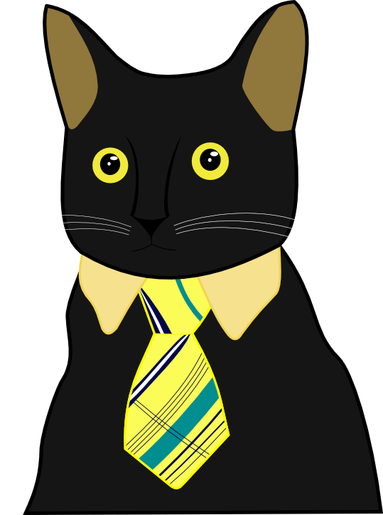
“
I’m not slacking off,
my build plans are still running.
”
- ME
Notes:
I’m not slacking off, my build plans are still running. I said once when browsing the internet looking for cats.

Slide 32
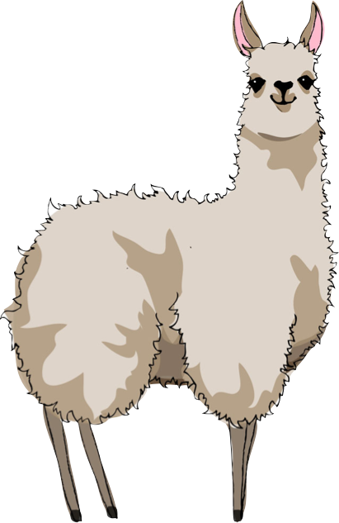
“
I’m not slacking off,
my build plans are queued.
I’m not slacking off,
my build plans are
”
- DANIEL KJELLIN, bamboo development team leader
Notes:
I’m not slacking off, my build plans are queued, said Daniel, one of my workmates, because he’s obsessed with llamas.
So IMO these are one of main reasons why nowadays a developer may be idle. And this is just one problem, there are many, and we face them all in Atlassian.

Slide 33
CI challenges our processes
Green production-ready master | Build plan branching
Long running branches | Dark features
Big&slow test suite | Build grid
Quick feedback | Build strategy
Exploratory testing
Blitz testing
Regression testing
Automate all-the-things
Notes:
Let’s see now how CI challenges our processes.
Having a robust continuous delivery pipeline and staying production ready is a battle!
We keep winning at this battle by leaning on Bamboo's continuous integration and deployment support. Our dev teams believe in feature driven development, so for every feature / bug-fix we work on an independent VCS branch.
Lucky us, Bamboo is awesome and is able to run build plans per branch.

Slide 34
CI challenges our processes
Green production-ready master | Build plan branching
Long running branches | Dark features
Big&slow test suite | Build grid
Quick feedback | Build strategy
Exploratory testing
Blitz testing
Regression testing
Automate all-the-things
Notes:
Obviously this leads into a problem: long running branches.
The longer we spend on a branch that it’s not master, the more difficult will be to merge it.
To battle this, we work with dark features flags, that allow us to hide features while the code is merged - and integrated - with the rest of the trunk.

Slide 35
CI challenges our processes
Green production-ready master | Build plan branching
Long running branches | Dark features
Big&slow test suite | Build grid
Quick feedback | Build strategy
Exploratory testing
Blitz testing
Regression testing
Automate all-the-things
Notes:
Having developers working on features will imply that they are writing tests as well, contributing to have a big&slow test suite.
The team needs to come up with a build grid, to split up the test suite, and so warrantee the quality of our deliverables.

Slide 36
CI challenges our processes
Green production-ready master | Build plan branching
Long running branches | Dark features
Big&slow test suite | Build grid
Quick feedback | Build strategy
Exploratory testing
Blitz testing
Regression testing
Automate all-the-things
Notes:
But having a lot of plans may imply that developers no longer have quick feedback, one of the main goals of CI. A build strategy is then required, to say what needs to run and when.
Looking at this slide seems pretty clear to me that CI is a strategy game.

Slide 37
Confluence pipeline strategy
Core
Test Suite
Cloud
Test Suite
1 per day
Every 2 weeks*
+
+
+
+
=
30 min
90 min
Confluence team
dog fooding
Cloud release
180
270
Full Test Suite
Acceptance testing
Monthly bug fixing
1 per week*
Cross-Platform testing
Quarterly release
Performance testing
Atlassian
dog fooding
Server release
Ecosystem testing
1,5 days
Notes:
A strategy game that the Confluence team in Atlassian masters, and I am going to show now.
A developer commits to a Stash repo, and then Bamboo comes into play and starts building artifacts and running tests. If all good, Bamboo will deploy the artifact built to an instance, in a process called dog fooding I will explain now in more detail. Finally at some point the Confluence team will consider it production-ready. That’s the pipeline anatomy, let’s see it in more detail.
Emma is a developer. She has been working on a new feature, is finally done, and she’s ready to merge the feature branch into master…
The Core Test Suite of Confluence is kicked off. This is a check-in suite that runs smoke tests - including unit tests, and takes up to 30 min, giving her confidence and quick feedback about her changes.
If successful, the Cloud Test Suite will be triggered… This is Cloud specific build plan that runs against a real Cloud instance and takes up to 90min.
...in parallel with the Full Test Suite is triggered. This is a build grid of build plans that run different kind of tests: acceptance testing, performance, cross-platform testing (so tests around all the types of JDK, databases, and OS the product supports), and plugins compatibility.
(These builds run tests which are grouped into functional areas, and run in parallel in different build jobs. If the build is broken, we would be able to identify pretty soon which feature is broken.)
The Cloud Test Suite finishes, and the resulting artifact gets deployed into the internal instance of the Confluence team. This happens one per day, as part of the dog fooding process that every team in Atlassian applies. This allows the Confluence team to start using and evaluating the latest artifact as soon as possible.
If the artifact is blessed, because the dog fooding has been successful, together with a green build grid, then the artifact gets deployed to Cloud customers at a pace of one time every two weeks on the Monday upgrade window.
In parallel, the team keeps preparing Server releases. The success of the internal deployment and having green builds warrantees that the team can deploy to corporative wiki that every employee across Atlassian uses on daily basis.
If everything is ok, the artifact will make progress to customers with the scheduled Server releases, which come around monthly for bug fixing and quarterly for major/minor releases.

Slide 38
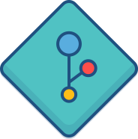
The continuous integration pipeline stages
functionally
non-functionally
deliverable
fully-operational
Commit
Automated testing
Manual testing
Release
usable
provides value
technically
Notes:
We’ve seen the Confluence pipeline in detail. Let’s map it with what books say.
A CI pipeline is made up of 4 stages:
The Commit stage - basically your code compiles, unit testing passes.
The Automated testing stage - it meets specs and expectations.
The Manual testing stage - basically it works like a charm.
The Release stage- where the awesomeness is delivered to customers.
What do they provide in terms of quality?
Commit stage - the system works at a technical level.
Automated testing - the products works functionally and non-functionally.
Manual testing - the system is usable, and valuable.
Release - the system is deliverable, and fully operational.

Slide 39
The continuous integration pipeline stages
Commit
Automated testing
Manual testing
Release
QA
Notes:
In Confluence, as in any other team in Atlassian:
The Commit stage - happens in Bamboo.
The Automated testing stage - again in Bamboo.
The Manual testing stage - this is an interesting one, because for the surprise of many we do not have testers in the company. How does this happens? Thanks to our QA team, that acts as Quality Assurance and it’s deeply involved all around the process to advice us so we prevent.
And also - do not forget - our dog fooding system.
The Release stage- again in Bamboo.

Slide 40
CI challenges Atlassian processes
User acceptance testing | Dog fooding
Monolithic applications | Plugin development
Plugin development | Cross-compatibility pipelines
Cloud integration | Cloud delivery pipeline
Exploratory testing
Blitz testing
Regression testing
Automate all-the-things
Notes:
Let’s see now in more details how CI challenges us again.
User acceptance testing is crucial in the success of a delivery. But so often it’s left until the end. But not in Atlassian. Thanks to dog fooding, user acceptance testing and exploratory testing are integrated in our development workflow. Also, it ensures the application is always on a running state. And finally, gives us feedback from our users, this time the internal ones.

Slide 41
CI challenges Atlassian processes
User acceptance testing | Dog fooding
Monolithic applications | Plugin development
Plugin development | Cross-compatibility pipelines
Cloud integration | Cloud delivery pipeline
Exploratory testing
Blitz testing
Regression testing
Automate all-the-things
Notes:
Another challenge for us is having monolithic applications everybody is contributing to.
In Atlassian we take advantage of our plugin framework, and many of the features are developed in plugins.

Slide 42
CI challenges Atlassian processes
User acceptance testing | Dog fooding
Monolithic applications | Plugin development
Plugin development | Cross-compatibility pipelines
Cloud integration | Cloud delivery pipeline
Exploratory testing
Blitz testing
Regression testing
Automate all-the-things
Notes:
But plugin development does not come without a cost, and we end up having a lot of integration pain, compatibility issues. Bamboo helps us here to define cross compatibility pipelines.

Slide 43
CI challenges Atlassian processes
User acceptance testing | Dog fooding
Monolithic applications | Plugin development
Plugin development | Cross-compatibility pipelines
Cloud integration | Cloud delivery pipeline
Exploratory testing
Blitz testing
Regression testing
Automate all-the-things
Notes:
And looking at our cloud offering, the range of products&plugins that we have in the Cloud, is obvious that our Cloud integration is a challenge. How do we make sure that allthethings keep working together?
Thanks to our Cloud delivery pipeline, a subject that would require a 30 min talk at least - so if you are curious I may come back next year to talk about it.

Slide 44
817
quarantined tests
out of > 300k test
Notes:
And well I intentionally left apart the most common problem that a software team faces.
These were the number of quarantined tests by the end of last year. 817.
Bamboo has a features, quarantining, that allows us to skip tests that are failing. In our case, almost all of them were flaky, intermittently failing tests.
This created a huge controversy in Atlassian. At this point, infrastructure, technology and processes were not enough to solve this problem. So people, and culture, came to the rescue.
In such a way that…

Slide 45
1,888
occurrences of flakiness
in our Confluence wiki
Notes:
This the number of times the word flakiness appears in our Confluence instance.

Slide 46
“
But hey: I am code too, you know?
I need attention!
”
- mauri edo (@mauri_edo), open letter from an @ignored test, developers.atlassian.com
Notes:
And not only that, because this subject has been the reason for us to publish an open letter from an ignored test, that I recommend to read.
This is culture, and people.

Slide 47
People
Notes:
Because now we’re going to talk about people.

Slide 48
“
CI is a practice, not a tool,
and requires discipline from the development team.
”
- continuous delivery (addison-wesley), jeb humble and david farley
Notes:
Because as you know… (Read the quote)

Slide 49
The Culture of Green
powered by
Notes:
That’s why in Atlassian we live The Culture of Green - please note, powered by Bamboo.
The Culture of Green remains us how important and complicated is to keep our builds green. And it remains as well that software delivery is not just about requirements and execution.

Slide 50
ci introduction
THE CI BATTLE, AT ATLASSIAN
ci ANATOMY
ci culture
thinking beyond ci
the cd battle, AT atlassian
conclusion
Notes:
So what’s culture?

Slide 51
Culture is what happens when
the founders are not around.
Notes:
(Read the quote). Thanks to the Green Culture some of the most important roles in the company exist: the people that help us deliver high-quality software in record time. Let me introduce you to the ambassadors of the Green Culture in Atlassian.

Slide 52
Notes:
CI books speak of “if the build is broken, drop whatever you’re doing and fix it”.
But we all know by experience that this is not the case all the time.
The Build Master role is a facilitator for this to happen. Someone who keeps an eye on the build grid, and it’s worried about turning it green.

Slide 53
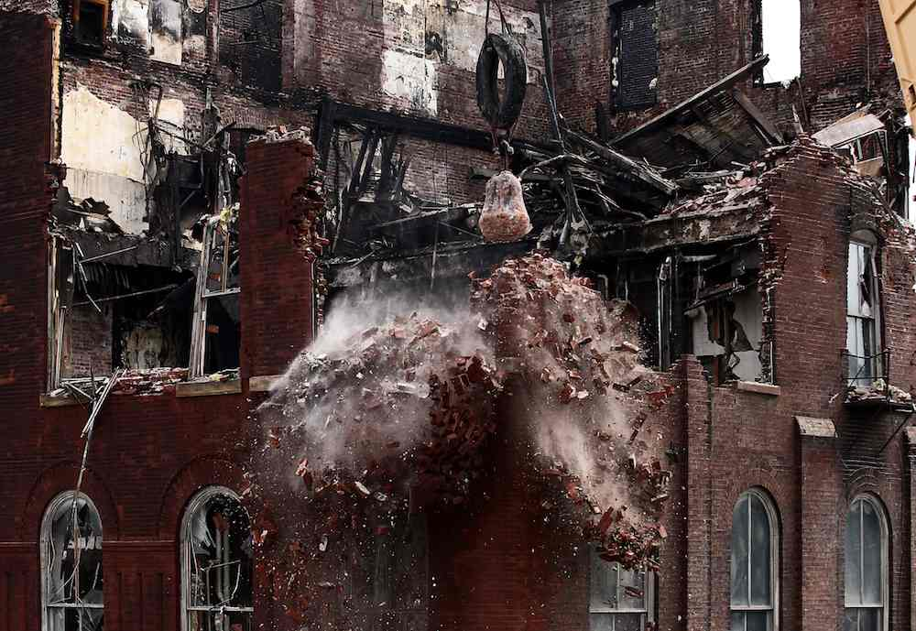
Notes:
Thanks to the Build Master, when someone breaks a build is identified quickly. This person will leave whatever they are doing to fix the build and so unblock the team.

Slide 54
Red is the new green.
Notes:
The culture of green also tells us that Red is the new green.
Why? Because we may be detecting an issue before it gets into customer hands.
So let’s embrace them. Well, not too much or we’ll get used to them.

Slide 55
Give feedback to people, so it’s fed-back.
Notes:
Also this culture encourages that we give feedback to people, so it gets fed-back.
Because with we have the right feedback, people will act on it (as feedback is not good unless it’s acted upon).

Slide 56
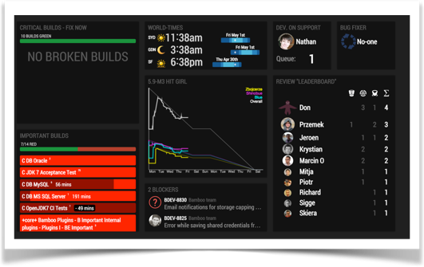
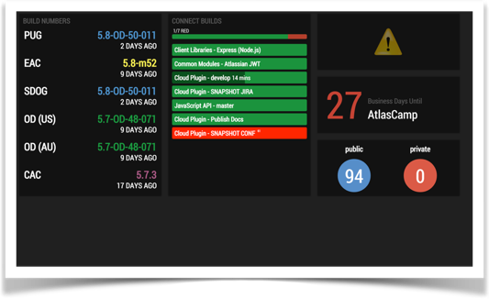
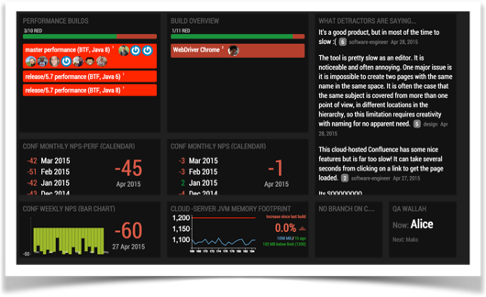
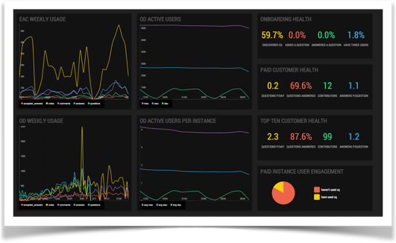
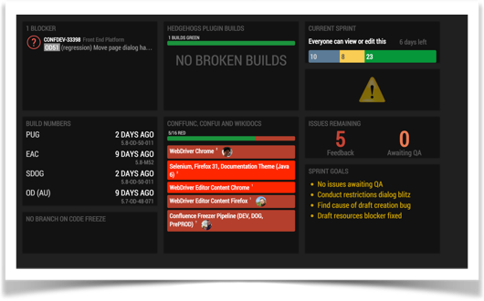
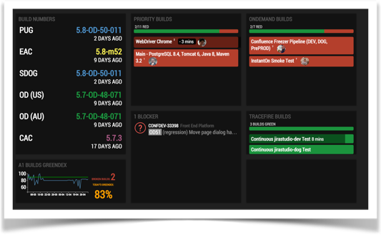
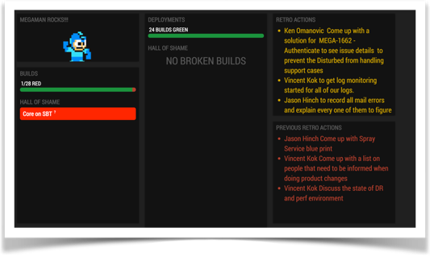
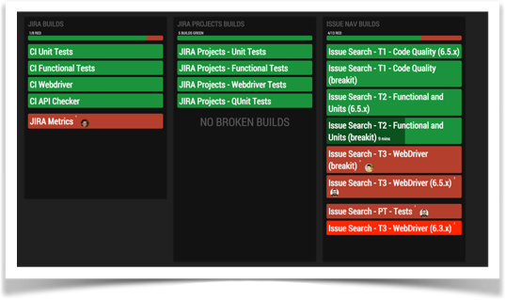
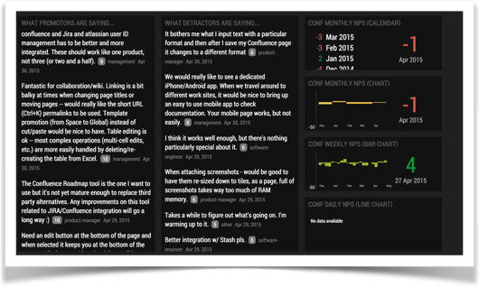
Notes:
Because of that, the Atlassian office is full of high visibility monitors that aggregate information from our build system to provide high-quality feedback. We call them AtlasBoards, and they were implemented initially as a ShipIt project. With them, teams are up to date about everything that matters from a CI perspective.

Slide 57
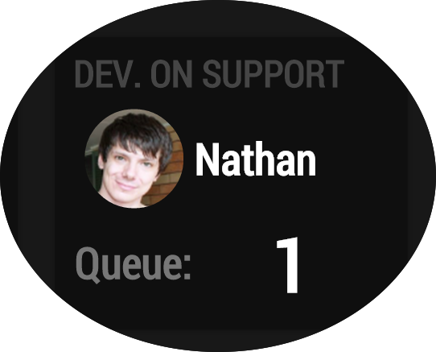
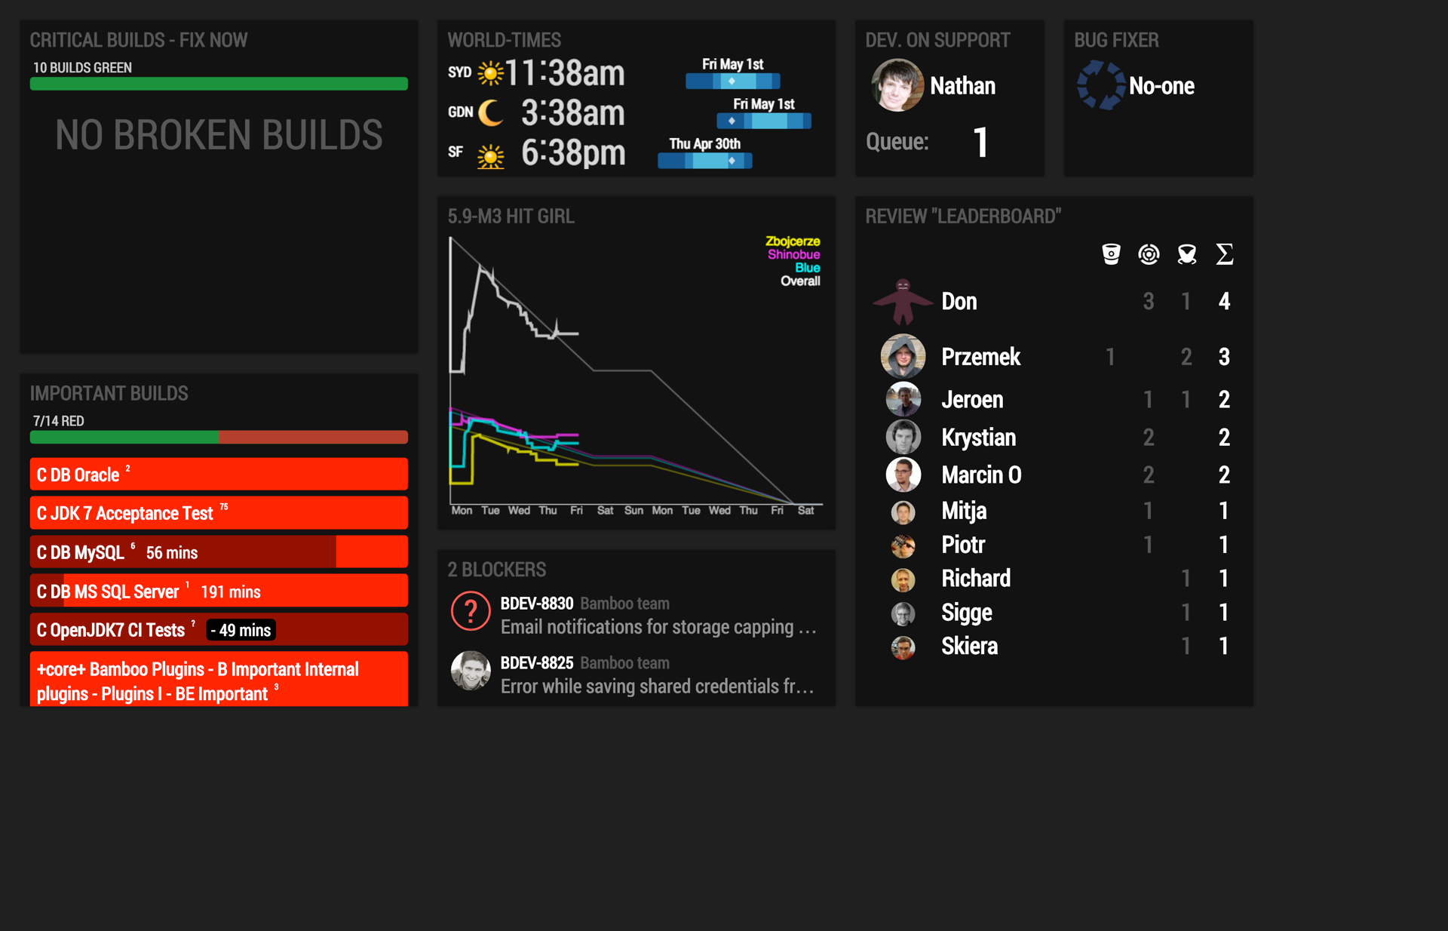
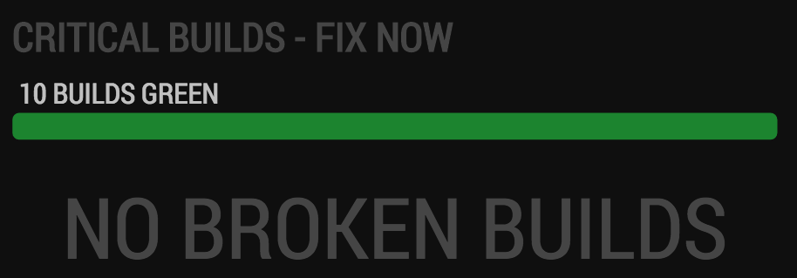
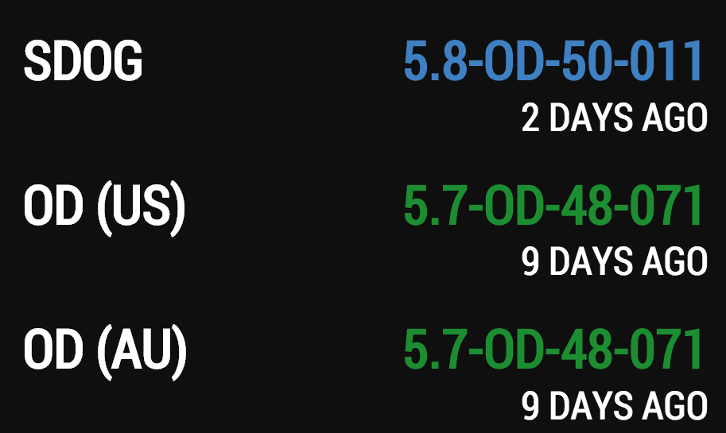
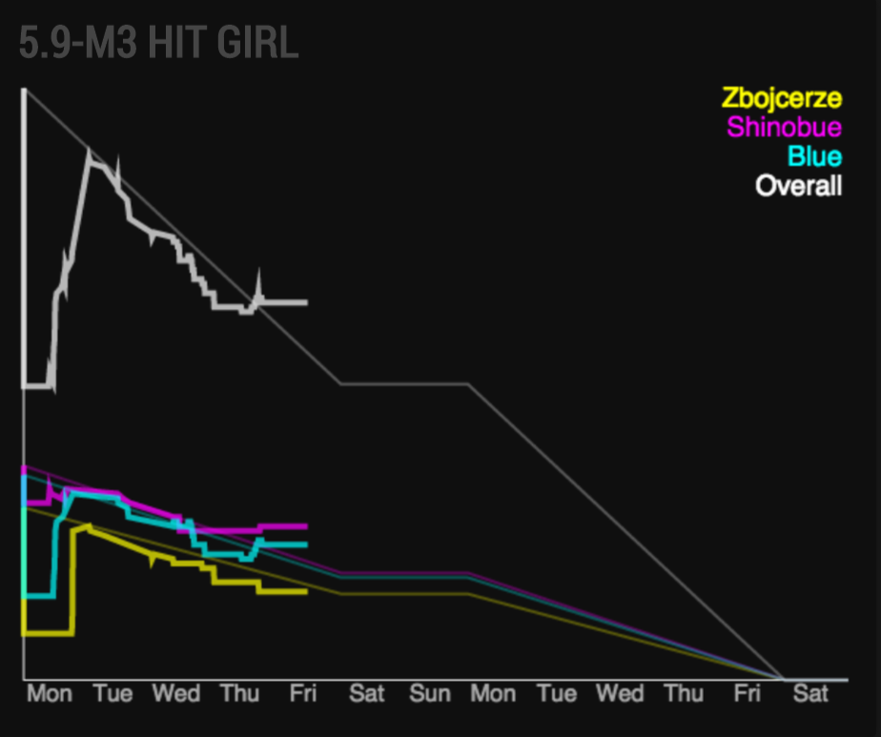
Notes:
We can see if there are broken builds in the critical path of the build grid.

Slide 58
0
Notes:
So applying this culture of green build, any ideas what’s this number nowadays?

Slide 59
0
quarantined tests
out of > 200k test
Notes:
The number of quarantined tests in Atlassian. The quarantined feature was turned off in all Atlassian instances. This is a positive note, as it implied acting on something that was bitting us hard. This does not mean we do not have flaky tests anymore. We still do. Some of them have been ignored in the code base, some of them are still around, and I am pretty sure we will create new ones through this year. But the takeaway for this is that we are taking action on them.

Slide 60
ci introduction
THE CI BATTLE, AT ATLASSIAN
ci ANATOMY
ci culture
thinking beyond ci
the cd battle, AT atlassian
conclusion
Notes:
As I said, for those who apply CI properly this leads to its logical conclusion: continuous delivery.

Slide 61
“
CI is not enough.
”
- continuous delivery (addison-wesley), jeb humble and david farley
Notes:
Because CI is not enough.
Yeah, all the efforts that we have spent to make it work and we end up realising that it’s not enough.
The thing here is that is not enough, but it’s mandatory to have it. But we need to aim higher.
Because CI is about the development team. But what’s up with Operations? Support? Technical Writers? What’s up with that ecosystem?

Slide 62
Non CD delivery strategy syndrome

Notes:
Why is that?
Well if you guys are applying CI then for sure when a developer commits, and artifact is built, and a comprehensive suite of tests run, ending up in a potentially deliverable artifact.
(Click) That if proven to be functional and non-functional working, useful, and providing value… Could be delivered to external users in a few hours.
(Click) But the reality is that this artifact may take up to months to get to production.
(Click) And then the team may claim victory, and the release parties come, and we all celebrate we have delivered something… that’s full of bugs. Or customers do not like. Or a new piece of feature, that people do not use because they are not able to discover it.
Really… Is that victory? By that time…

Slide 63
Non CD delivery strategy syndrome

Notes:
Why is that?
Well if you guys are applying CI then for sure when a developer commits, and artifact is built, and a comprehensive suite of tests run, ending up in a potentially deliverable artifact.
(Click) That if proven to be functional and non-functional working, useful, and providing value… Could be delivered to external users in a few hours.
(Click) But the reality is that this artifact may take up to months to get to production.
(Click) And then the team may claim victory, and the release parties come, and we all celebrate we have delivered something… that’s full of bugs. Or customers do not like. Or a new piece of feature, that people do not use because they are not able to discover it.
Really… Is that victory? By that time…

Slide 64
“
I cannot fix that bug…
I’m busy writing a new one.
”
- me, or you, or any developer affected by the lack of cd
Notes:
(Read slide)
Bugs will be reported and so often dev teams will be focused on the next buggy - I mean shiny - feature your Product Owners are thinking of to delight your users.

Slide 65
Question yourself, challenge your team
About your release process…
Is it documented?
Is it automated?
Is it traceable?
Is it reviewed?
Does it hurt?
Who runs it?
Is it secure?
Is it safe?
Notes:
I encourage you, as dev manager, team leader, developer, o dev ops, to go back to your team next week and ask yourself the following questions.
Is it manual?
Is it traceable?
Is it safe?
Is it secure?
Is it documented? Is it reviewed?
Does it hurt? One of the most popular soundbites from Agile says that “If it hurts, do it more often”.
Who runs it? (One person, it’s a rotation role, or is it a team effort?)
With these questions, you can identify if your delivery pipeline is a 1st class citizen or not.
Si no tienes una respuesta correcta a estas preguntas, entonces tu equipo no tiene la disciplina para aplicar CD.

Slide 66
ci introduction
THE CI BATTLE, AT ATLASSIAN
ci ANATOMY
ci culture
thinking beyond ci
the cd battle, AT atlassian
conclusion
Notes:
As I said, for those who apply CI properly this leads to its logical conclusion: continuous delivery.

Slide 67
Continuous Delivery is a software development discipline where you build software in such a way that the software can be released to production at any time.
“
”
- martin fowler, thoughtworks
Notes:
Again.. What’s CD?
Discipline.
At any time.
But I have again my very own definition, this time inspired by The Chemical Brothers.

Slide 68
Don't hold back!
'Cuz you woke up in the morning with initiative to move
'Cuz there's a party over here,
so you might as well be here
Where the people care
Notes:
For me CD is about do not holding back.
Because you may woke up in the morning with initiative to move - and change the way you do things, well you manually do things right?
Because there’s a party over here - the CD party - so you might as well be here where the people care. And so join the CD world where people are achieving fantastic results in quality and delivery.

Slide 69
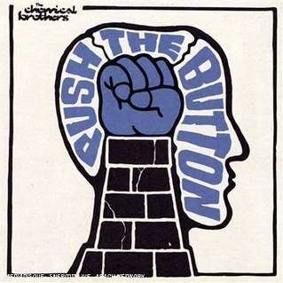
Don't hold back!
World, the time has come to
push the button
Notes:
Because world - the time has come to push the button.
So teams need a release pipeline that allow delivery - with speed and quality - by just pushing buttons.
How do I achieve this on my team?

Slide 70
Infrastructure
Processes
Tools
People
Notes:
With the same keys as we saw before:
Infrastructure. You need different environments: dev, staging and prod. Not just for the product, and for testing, but for testing your pipeline.
Tools. To manage your builds, and deployments.
Processes. To coordinate the cross-team efforts - as how developers work with operations. They need to be formalised, and automated.
People. Discipline in the team. Production ready code.

Slide 71
A deployment pipeline
Puede ser que vaya fuera.




Notes:
(A continuous delivery pipeline allows team to deploy frequently in an automated, low-risk, cheap, rapid and predictable process. And when would they be able to deploy? At any time.)
1st citizen release process.
One of the teams in Atlassian, the Purchasing team (which duty is to make sure customers are able to purchase our products having a great experience) is making titanic efforts to have a fully automated delivery pipeline that allows them to do continuously delivery - and so deploy to production at any time. For now, they succeed on delivering to production once per day. But they are working on the right direction: they treat their deployment pipeline as a 1st class citizen, and they test it frequently to make it seamless.
Let’s see in more detail how they do it.

Slide 72
Bamboo, the orchestrator tool

Can everybody run it?
Can you do it often?
Is it documented?
Is it automated?
Is it traceable?
Is it reviewed?
Is it secure?
Is it safe?
Notes:
Many tools involved in a release process.
Bamboo is the orchestrator of all of them.
We build an artifact - that automatically can be deployed to an environment.
Using it will allow us to answer the questions I formulated before:
Automated?
Secure?
Traceable?
Repeatable?
Decoupled?
Visible + self-documented.

Slide 73
A deployment pipeline, at Atlassian




09:00

09:00
dev
Notes:
In the morning a developer merges some changes to master. A build plan builds an artifact, and the tests pass so the artifact is blessed. The build plan is connected to a deployment project, and the artifact is deployed automatically to a machine in a development environment.
When this happens, thanks to Bamboo and HC integration the whole dev team is notified about this.

Slide 74
A deployment pipeline, at Atlassian




09:00

dev
DEV | STAGING | PROD
Notes:
So in the conveyor belt to production, we can see there’s a new artifact there.

Slide 75
A deployment pipeline, at Atlassian




09:00

dev




10:00

dev
Notes:
Another developer comes and by merging a change triggers another snapshot of the pipeline, resulting in another upgrade on the dev machine.

Slide 76
A deployment pipeline, at Atlassian




09:00

dev
DEV | STAGING | PROD




10:00

dev
Notes:
Another developer comes and by merging a change triggers another snapshot of the pipeline, resulting in another upgrade on the dev machine.

Slide 77
A deployment pipeline, at Atlassian




09:00

09:00
dev




10:00

dev

16:00
stg
Notes:
At 4pm the release manager comes into play. After checking that the build grid from the artifact deployed to dev is green, deploys the artifact to another machine - the one that maps with the Staging environment - using again a Bamboo deployment project.

Slide 78
A deployment pipeline, at Atlassian




09:00

09:00
dev
DEV | STAGING | PROD




10:00

dev

16:00
stg
Notes:
At 4pm the release manager comes into play. After checking that the build grid from the artifact deployed to dev is green, deploys the artifact to another machine - the one that maps with the Staging environment - using again a Bamboo deployment project.

Slide 79
A deployment pipeline, at Atlassian




09:00

09:00
dev




10:00

dev

16:00
stg
16:15

Notes:
At 4pm the release manager comes into play. After checking that the build grid from the artifact deployed to dev is green, deploys the artifact to another machine - the one that maps with the Staging environment - using again a Bamboo deployment project.

Slide 80
A deployment pipeline, at Atlassian




09:00

09:00
dev




10:00

10:00
dev

16:00
stg
16:15

16:30
Notes:
Once done, if successful, the release manager invokes a robot - just a script - that calculates the diff between the version previously deployed and the new one - and sends a comprehensive list of issues to a HipChat room, mentioning every developer that has been a committer.

Slide 81
A deployment pipeline, at Atlassian




09:00

09:00
dev




10:00

10:00
dev

16:00
stg

16:15
16:30

10:00
prd
Notes:
Once done, if successful, the release manager invokes a robot - just a script - that calculates the diff between the version previously deployed and the new one - and sends a comprehensive list of issues to a HipChat room, mentioning every developer that has been a committer.

Slide 82
A deployment pipeline, at Atlassian




09:00

09:00
dev
DEV | STAGING | PROD




10:00

10:00
dev

16:00
stg

16:15
16:30

10:00
prd
Notes:
Once done, if successful, the release manager invokes a robot - just a script - that calculates the diff between the version previously deployed and the new one - and sends a comprehensive list of issues to a HipChat room, mentioning every developer that has been a committer.

Slide 83
Free people to do
the interesting stuff,
and let Bamboo do the rest.
Notes:
(Read quote).
So a pipeline does not imply no human interaction. It’s about automating the error-prone and complex steps are automated, and then increasing collaboration thanks to valuable and quick feedback.

Slide 84
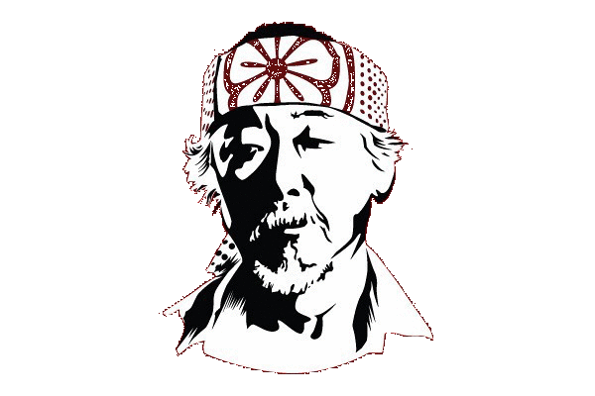
Wax in, wax off.
Notes:
(Read quote).
So a pipeline does not imply no human interaction. It’s about automating the error-prone and complex steps are automated, and then increasing collaboration thanks to valuable and quick feedback.

Slide 85
Define ban hammers.

Slide 86
Get used to write
production-ready code.
Notes:
(Read quote).
So a pipeline does not imply no human interaction. It’s about automating the error-prone and complex steps are automated, and then increasing collaboration thanks to valuable and quick feedback.

Slide 87
Be bold. Break more, fix sooner.
Notes:
break more, fix sooner.
quick feedback - I can rollback easily.
incremental deployments of features - feature toggling.
be production-aware. get to know when your code reaches production.
replicable + repeatable process.
expect the best, be ready for the worse.

Slide 88
ci introduction
THE CI BATTLE, AT ATLASSIAN
ci ANATOMY
ci culture
thinking beyond ci
the cd battle, AT atlassian
conclusion
Notes:
So we’re finally here! Time for conclusions.

Slide 89
19
42
34
18
Notes:
When I started this talk I said: “I’ll talk a lot, and I’ll talk about processes. And tools. And technology. And people. And Bamboo”.
But actually how many times?
The words I used the most are actually related to teams, individuals, people, culture.
Because after having working with CI for some time, I strongly believe that for doing CI you need the right tools, but as well people willing to do the right thing. So a daily battle in which without the right discipline, your attempts will not lead to the improvement in quality you are hoping for.

Slide 90
“
Do it, or do not.
There is no try.
”
Notes:
So you know, there’s no try, do it or do not.

Slide 91
“
Do it, or do not.
There is no try.
”
Notes:
Well if you want to be cool just do it.

Slide 92
“
Do it,
with .
”
Notes:
Or even better: do it, with Bamboo.

Slide 93
Thank you!
ESTHER ASENJO • BAMBOO DEV TEAM LEAD • ATLASSIAN • @STHREO

Slide 94
“
Building a software product is not just about writing code.
It’s about deploying it as well.
”
Notes:
So we need an end-to-end approach. If we just focus on building the software, we’re missing a high % of the actual deal. End-to-end here implies delivering it, in an automated way, and that conveyor belt to production does not come in a box - we need to sweat, repeat, iterate, polish, to make it happen.

Slide 95
The conveyor belt from commit to production does not come in a box.
We need to sweat it, iterate through it, run it, run it, run it, until it works smoothly.
“
”
Notes:
So we need an end-to-end approach. If we just focus on building the software, we’re missing a high % of the actual deal. End-to-end here implies delivering it, in an automated way, and that conveyor belt to production does not come in a box - we need to sweat, repeat, iterate, polish, to make it happen.
This is called a pull system.

Slide 96
Challenge yourself, challenge your team
Who is part of my team?
Do I write code thinking of how to deploy it?
Do we you ever change your mind based of the feedback you get?
How many manual steps
we have in our release process?
Do we deploy the same way
across all our environments?
Notes:
I encourage you, as dev manager, team leader, developer, o dev ops, to go back to your team next week and ask yourself the following questions.

Slide 97
A deployment pipeline
deploy the same way to every environment
if it hurts do it often
microservices
incremental deployments

