Slide 1
SQL for JSON:
Rich, Declarative Querying for NoSQL Databases and Applications
Gerald Sangudi | @sangudi | Chief Architect | Couchbase
Keshav Murthy| @rkeshavmurthy | Director | Couchbase
Team @N1QL
Notes:
In today’s world of agile business, Java developers and organizations benefit when JSON-based NoSQL databases and SQL-based querying come together. NoSQL provides schema flexibility and elastic scaling. SQL provides expressive, independent data access. Java developers need to deliver apps that readily evolve, perform, and scale with changing business needs. Organizations need rapid access to their operational data, using standard analytical tools, for insight into their business. In this session, you will learn to build apps that combine NoSQL and SQL for agility, performance, and scalability. This includes
• JSON data modeling
• Indexing
• Tool integration

Slide 2
Agenda
Why NoSQL?
JSON Data Modeling
SQL for JSON
Java APIs
Ecosystem

Slide 3











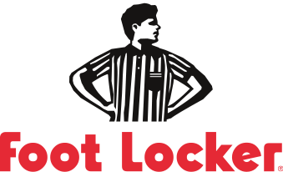





























Major Enterprises Across Industries are Adopting NoSQL
Technology
Retail & Apparel
Communications
E-Commerce & Digital Advertising
Finance &
Business Services
Travel & Hospitality
Games & Gaming
Media & Entertainment
3
Notes:
KEY POINT: MAJOR ENTERPRISES ACROSS NUMEROUS INDUSTRIES ARE ADOPTING COUCHBASE NOSQL TECHNOLOGY TO SUPPORT THEIR DATA MANAGEMENT NEEDS.
We’ve looked at what’s driving NoSQL and the advantages it delivers. So who are some of the companies that are actually adopting Couchbase?
As this slide shows, major enterprises across many different industries are adopting Couchbase NoSQL solution.
You see many innovative Internet companies here – like eBay, LinkedIn, Orbitz, and PayPal.
They were the early adopters of NoSQL. But it’s clear that NoSQL is now being adopted by a broad range of companies in many other industries:
Consumer electronics and technology companies like Apple and Cisco
Retail companies like Walmart and Tesco
Financial Services companies like VISA and Wells Fargo
Telcos like Verizon, AT&T and Vodafone
What’s also interesting is that we’re seeing the use of NoSQL expand inside many of these companies. Orbitz, the online travel company, is a great example – they started using Couchbase to store their hotel rate data, and now they use Couchbase in many other ways.
So the big takeaway is that an increasing number of companies across industries are seeing the value of NoSQL for a growing number of use cases.

Slide 4
Why NoSQL?

Slide 5
Why NoSQL?
Agility
Scalability
Performance
Availability
Notes:
SQL (relational) databases are great. They give you LOT OF functionality.
Great set of abstractions (tables, columns, data types, constraints, triggers, SQL, ACID TRANSACTIONS, stored procedures and more) at a highly reasonable cost. The cost is going down every day.
One thing RDBMS does not handle well is CHANGE.
Change of schema (both logical and physical), change of hardware, change of capacity.
Appdev: Changes are required not only during initial dev but also after going long-beta or production. Quick response to market feedback differentiates winners from loosers.
Scalability: Many of the digital economy business applications (every business is a digital economy business) expect high throughput (> 100K gets/s) with millions of customers. Physics of servers dictate we distribute the data to multiple nodes.
Consistent Perf: With high throughput comes high responsibility: consistently low latency queries.
Reliability: It’s not IF but WHEN some of the hardware goes down, be it disk, memory, server. Your business can’t be at the mercy of hardware.
Java and JDBC have had a very long and successful relationship.
JDBC Provides java connectivity to relational databases via SQL.
All of the application servers support using JDBC for persistence.
Lot of the object-relational mappers like hibernate, frameworks like ibatis, spring data all support database access via

Slide 6
Why NoSQL? Agility
Schema flexibility
Easier management of change
  In the business requirements
  In the structure of the data
Change is inevitable
Notes:
SQL (relational) databases are great. They give you LOT OF functionality.
Great set of abstractions (tables, columns, data types, constraints, triggers, SQL, ACID TRANSACTIONS, stored procedures and more) at a highly reasonable cost. The cost is going down every day.
One thing RDBMS does not handle well is CHANGE.
Change of schema (both logical and physical), change of hardware, change of capacity.
Change in the CONSTANT.
Appdev: Changes are required not only during initial dev but also after going long-beta or production. Quick response to market feedback differentiates winners from loosers.
Scalability: Many of the digital economy business applications (every business is a digital economy business) expect high throughput (> 100K gets/s) with millions of customers. Physics of servers dictate we distribute the data to multiple nodes.
Consistent Perf: With high throughput comes high responsibility: consistently low latency queries.
Reliability: It’s not IF but WHEN some of the hardware goes down, be it disk, memory, server. Your business can’t be at the mercy of hardware.
Java and JDBC have had a very long and successful relationship.
JDBC Provides java connectivity to relational databases via SQL.
All of the application servers support using JDBC for persistence.
Lot of the object-relational mappers like hibernate, frameworks like ibatis, spring data all support database access via

Slide 7
Why NoSQL? Scalability
Elastic scaling
  Size your cluster for today
  Scale out on demand
Cost effective scaling
  Commodity hardware
  On premise or on cloud
  Scale OUT instead of Scale UP
Notes:
SQL (relational) databases are great. They give you LOT OF functionality.
Great set of abstractions (tables, columns, data types, constraints, triggers, SQL, ACID TRANSACTIONS, stored procedures and more) at a highly reasonable cost. The cost is going down every day.
One thing RDBMS does not handle well is CHANGE.
Change of schema (both logical and physical), change of hardware, change of capacity.
Appdev: Changes are required not only during initial dev but also after going long-beta or production. Quick response to market feedback differentiates winners from loosers.
Scalability: Many of the digital economy business applications (every business is a digital economy business) expect high throughput (> 100K gets/s) with millions of customers. Physics of servers dictate we distribute the data to multiple nodes.
Consistent Perf: With high throughput comes high responsibility: consistently low latency queries.
Reliability: It’s not IF but WHEN some of the hardware goes down, be it disk, memory, server. Your business can’t be at the mercy of hardware.
Java and JDBC have had a very long and successful relationship.
JDBC Provides java connectivity to relational databases via SQL.
All of the application servers support using JDBC for persistence.
Lot of the object-relational mappers like hibernate, frameworks like ibatis, spring data all support database access via

Slide 8
Why NoSQL? Performance
NoSQL systems are optimized for specific access patterns
Low response time for web & mobile user experience
  Millisecond latency
Consistently high throughput to handle growth
Notes:
SQL (relational) databases are great. They give you LOT OF functionality.
Great set of abstractions (tables, columns, data types, constraints, triggers, SQL, ACID TRANSACTIONS, stored procedures and more) at a highly reasonable cost. The cost is going down every day.
One thing RDBMS does not handle well is CHANGE.
Change of schema (both logical and physical), change of hardware, change of capacity.
Appdev: Changes are required not only during initial dev but also after going long-beta or production. Quick response to market feedback differentiates winners from loosers.
Scalability: Many of the digital economy business applications (every business is a digital economy business) expect high throughput (> 100K gets/s) with millions of customers. Physics of servers dictate we distribute the data to multiple nodes.
Consistent Perf: With high throughput comes high responsibility: consistently low latency queries.
Reliability: It’s not IF but WHEN some of the hardware goes down, be it disk, memory, server. Your business can’t be at the mercy of hardware.
Java and JDBC have had a very long and successful relationship.
JDBC Provides java connectivity to relational databases via SQL.
All of the application servers support using JDBC for persistence.
Lot of the object-relational mappers like hibernate, frameworks like ibatis, spring data all support database access via

Slide 9
Why NoSQL? Availability
Built-in replication and fail-over
  No application downtime when hardware fails
Online maintenance & upgrade
  No application downtime
Notes:
SQL (relational) databases are great. They give you LOT OF functionality.
Great set of abstractions (tables, columns, data types, constraints, triggers, SQL, ACID TRANSACTIONS, stored procedures and more) at a highly reasonable cost. The cost is going down every day.
One thing RDBMS does not handle well is CHANGE.
Change of schema (both logical and physical), change of hardware, change of capacity.
Appdev: Changes are required not only during initial dev but also after going long-beta or production. Quick response to market feedback differentiates winners from loosers.
Scalability: Many of the digital economy business applications (every business is a digital economy business) expect high throughput (> 100K gets/s) with millions of customers. Physics of servers dictate we distribute the data to multiple nodes.
Consistent Perf: With high throughput comes high responsibility: consistently low latency queries.
Reliability: It’s not IF but WHEN some of the hardware goes down, be it disk, memory, server. Your business can’t be at the mercy of hardware.
Java and JDBC have had a very long and successful relationship.
JDBC Provides java connectivity to relational databases via SQL.
All of the application servers support using JDBC for persistence.
Lot of the object-relational mappers like hibernate, frameworks like ibatis, spring data all support database access via

Slide 10
NoSQL Landscape
Document
Couchbase
MongoDB
DynamoDB
DocumentDB
Key-Value
Couchbase
Riak
BerkeleyDB
Redis
…
Graph
OrientDB
Neo4J
DEX
GraphBase
Wide Column
Hbase
Cassandra
Hypertable
Notes:
NoSQL, although generally accepted as Not Only SQL, generally refers to databases which lack SQL.
Implementing generally accepted subset of SQL for flexible data model on a distributed system IS HARD.
Once the SQL language, transaction became optional, flurry of databases were created using distinct approaches for common use-cases.
KEY-Value simply provided quick access to data for a given KEY. Lot of the databases in this group provide additional functionality compared to memcached.
Wide Column databases
Graph databases can store large number of arbitrary columns in each row
Document databases aggregate data into a hierarchical structure.
With JSON is a means to the end. Document databases provide flexible schema,built-in data types, rich structure, implicit relationships using JSON.
With lot of these databases simple things like GET and PUT were done via very simple API.
Anything compilicated requires long, client side programs. Let’s seen an example.

Slide 11
JSON Data Modeling

Slide 12

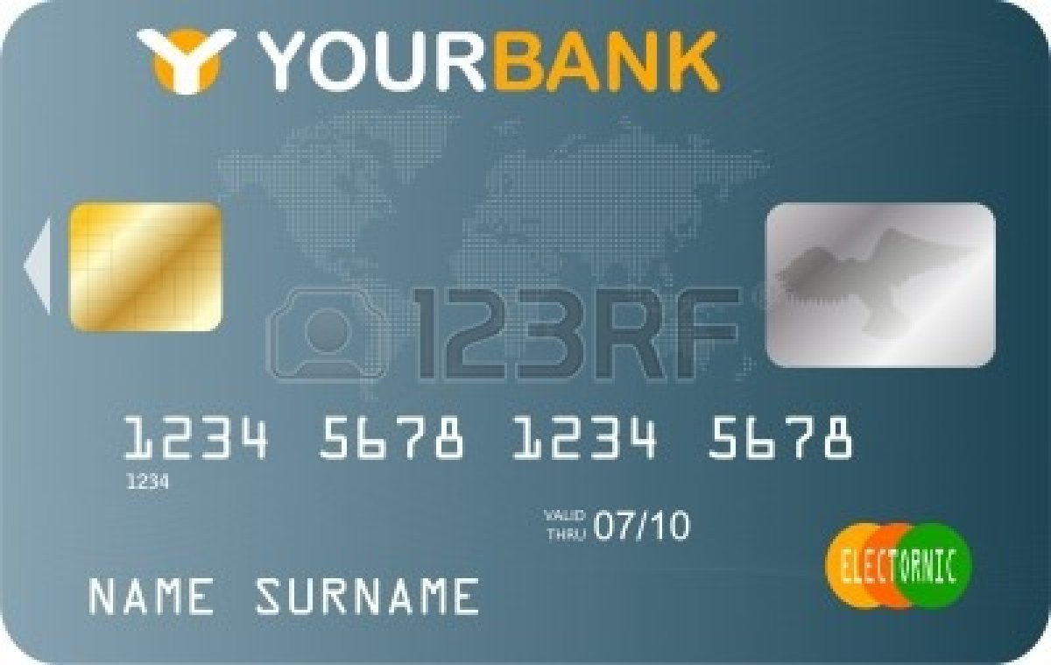
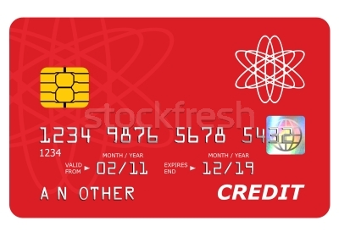




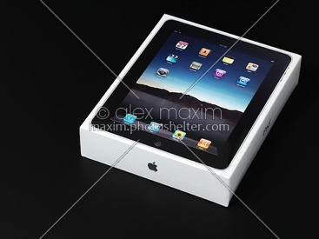
Properties of Real-World Data
Rich structure
  Attributes, Sub-structure
Relationships
  To other data
Value evolution
  Data is updated
Structure evolution
  Data is reshaped
Customer
Name
DOB
Billing
Connections
Purchases
Jane Smith
Jan-30-1990
Notes:
Let’s look at modeling Customer data.

Slide 13
Modeling Data in Relational World
Rich structure
  Normalize & JOIN Queries
Relationships
  JOINS and Constraints
Value evolution
  INSERT, UPDATE, DELETE
Structure evolution
  ALTER TABLE
  Application Downtime
  Application Migration
  Application Versioning
Contacts
Billing
Customer
Purchases
Connections
Notes:
Rich Structure
In relational database, this customers data would be stored in five normalized tables.
Each time you want to construct a customer object, you JOIN the data in these tables;
Each time you persist, you find the appropriate rows in relevant tables and insert/update.
Relationship
Enforcement is via referential constraints. Objects are constructed by JOINS, EACH time.
Value Evolution
Additional values of the SAME TYPE (e.g. additional phone, additional address) is managed by additional ROWS in one of the tables.
Customer:contacts will have 1:n relationship.
Structure Evolution:
This is the most difficult part.changing the structure is difficult, within a table, across tae table.
While you can do these via ALTER TABLE, requires downtime, migration and application versioning.
This is one of the problem document databases try to handle by representing data in JSON.

Slide 14
Using JSON For Real World Data
Table: Customer
Customer DocumentKey: CBL2015
CustomerID | Name | DOB
CBL2015 | Jane Smith | 1990-01-30
{
"Name" : "Jane Smith",
"DOB" : "1990-01-30”
}
The primary (CustomerID) becomes the DocumentKey
Column name-Column value become KEY-VALUE pair.
OR
{
"Name" : {
"fname": "Jane ",
"lname": "Smith”
}
"DOB" : "1990-01-30”
}
Notes:
Let’s see how to represent customer data in JSON.

Slide 15
Using JSON to Store Data
Table: Customer
Customer DocumentKey: CBL2015
CustomerID | Name | DOB
CBL2015 | Jane Smith | 1990-01-30
{
"Name" : "Jane Smith",
"DOB" : "1990-01-30",
"Billing" : [
{
"type" : "visa",
"cardnum" : "5827-2842-2847-3909",
"expiry" : "2019-03"
}
]
}
Table: Billing
CustomerID | Type | Cardnum | Expiry
CBL2015 | visa | 5827… | 2019-03
Rich Structure & Relationships
  Billing information is stored as a sub-document
  There could be more than a single credit card. So, use an array.

Slide 16
Using JSON to Store Data
Table: Customer
Customer DocumentKey: CBL2015
CustomerID | Name | DOB
CBL2015 | Jane Smith | 1990-01-30
{
"Name" : "Jane Smith",
"DOB" : "1990-01-30",
"Billing" : [
{
"type" : "visa",
"cardnum" : "5827-2842-2847-3909",
"expiry" : "2019-03"
},
{
"type" : "master",
"cardnum" : "6274-2542-5847-3949",
"expiry" : "2018-12"
}
]
}
Table: Billing
CustomerID | Type | Cardnum | Expiry
CBL2015 | visa | 5827… | 2019-03
CBL2015 | master | 6274… | 2018-12
Value evolution
  Simply add additional array element or update a value.

Slide 17
Using JSON to Store Data
Table: Connections
Customer DocumentKey: CBL2015
CustomerID | ConnId | Name
CBL2015 | XYZ987 | Joe Smith
CBL2015 | SKR007 | Sam Smith
{
"Name" : "Jane Smith",
"DOB" : "1990-01-30",
"Billing" : [
{
"type" : "visa",
"cardnum" : "5827-2842-2847-3909",
"expiry" : "2019-03"
},
{
"type" : "master",
"cardnum" : "6274-2542-5847-3949",
"expiry" : "2018-12"
}
],
"Connections" : [
{
"ConnId" : "XYZ987",
"Name" : "Joe Smith"
},
{
"ConnId" : ”SKR007",
"Name" : ”Sam Smith"
}
}
Structure evolution
  Simply add new key-value pairs
  No downtime to add new KV pairs
  Applications can validate data
  Structure evolution over time.
Relations via Reference

Slide 18
Using JSON to Store Data
DocumentKey: CBL2015
{
"Name" : "Jane Smith",
"DOB" : "1990-01-30",
"Billing" : [
{
"type" : "visa",
"cardnum" : "5827-2842-2847-3909",
"expiry" : "2019-03"
},
{
"type" : "master",
"cardnum" : "6274-2842-2847-3909",
"expiry" : "2019-03"
}
],
"Connections" : [
{
"CustId" : "XYZ987",
"Name" : "Joe Smith"
},
{
"CustId" : "PQR823",
"Name" : "Dylan Smith"
}
{
"CustId" : "PQR823",
"Name" : "Dylan Smith"
}
],
"Purchases" : [
{ "id":12, item: "mac", "amt": 2823.52 }
{ "id":19, item: "ipad2", "amt": 623.52 }
]
}
CustomerID | ConnId | Name
CBL2015 | XYZ987 | Joe Smith
CBL2015 | SKR007 | Sam Smith
CustomerID | Type | Cardnum | Expiry
CBL2015 | visa | 5827… | 2019-03
CBL2015 | master | 6274… | 2018-12
Contacts
Billing
Customer
CustomerID | Name | DOB
CBL2015 | Jane Smith | 1990-01-30
Purchases
Connections
CustomerID | item | amt
CBL2015 | mac | 2823.52
CBL2015 | ipad2 | 623.52
CustomerID | ConnId | Name
CBL2015 | XYZ987 | Joe Smith
CBL2015 | SKR007 | Sam Smith
Notes:
So, finally, you have a JSON document that represents a CUSTOMER.
In a single JSON document, relationship between the data is implicit by use of sub-structures and arrays and arrays of sub-structures.

Slide 19
Models for Representing Data
Data Concern | Relational Model | JSON Document Model (NoSQL)
Rich Structure | Multiple flat tables Constant assembly / disassembly | Documents No assembly required!
Relationships | Represented Queried (SQL) | Represented Queried? Not until now…
Value Evolution | Data can be updated | Data can be updated
Structure Evolution | Uniform and rigid Manual change (disruptive) | Flexible Dynamic change

Slide 20
SQL For JSON

Slide 21
Why SQL for JSON
NoSQL systems provide specialized APIs
  Key-Value get and set
  Script based query APIs
  Limited declarative query
Richer query is needed

Slide 22
Client Side Querying is Inadequate
Find High-Value Customers with Orders > $10000
LOOPING OVER MILLIONS OF CUSTOMERS IN APPLICATION!!!
Query customer objects from database
For each customer object
Find all the order objects for the customer
Calculate the total amount for each order
Sort the high-value customer list
Add customer to the high-value customer list
If grand total amount > $10000, Extract customer data
Sum up the grand total amount for all orders
Complex codes and logic
Inefficient processing on client side

Slide 23
Goal of Query for JSON
Give developers and enterprises an expressive, powerful, and complete language for querying, transforming, and manipulating JSON data.

Slide 24



Slide 25
Industry Is Choosing SQL to Query JSON
JSON support in SQL
  Oracle
  PostgreSQL
  MySQL
Microsoft: SQL for DocumentDB
UC San Diego: SQL++
Couchbase: N1QL

Slide 26

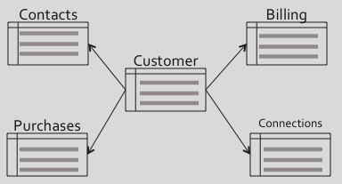
ResultSet
SQL
Notes:
SQL language operates on set of relations (table) and then projects another relation (table)

Slide 27
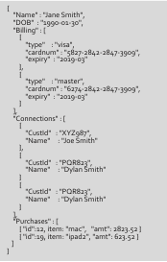
LoyaltyInfo
ResultDocuments
{
"Name" : "Jane Smith",
"DOB" : "1990-01-30",
"Billing" : [
{
"type" : "visa",
"cardnum" : "5827-2842-2847-3909",
"expiry" : "2019-03"
},
{
"type" : "master",
"cardnum" : "6274-2842-2847-3909",
"expiry" : "2019-03"
}
],
"Connections" : [
{
"CustId" : "XYZ987",
"Name" : "Joe Smith"
},
{
"CustId" : "PQR823",
"Name" : "Dylan Smith"
}
{
"CustId" : "PQR823",
"Name" : "Dylan Smith"
}
],
"Purchases" : [
{ "id":12, item: "mac", "amt": 2823.52 }
{ "id":19, item: "ipad2", "amt": 623.52 }
]
}
CUSTOMER
Orders
Notes:
N1QL is a SQL based language designed for JSON.
Input is set of related sets of JSON documents.
It operates on these documents and produces another set of JSON documents.
All of the SQL operattions, select, join, project operations are supported.
All of the common statements are supported: SELECT, INSERT, UPDATE, DELETE and MERGE.
Additionally, N1QL extends the language to support:
-- Fully address, access and modify any part of the JSON document.
-- Handle the full flexible schema where schema is self-described by each document.
-- key-value pairs could be missing, data types could change and structure could change!

Slide 28
N1QL examples
SELECT d.C_ZIP, SUM(ORDLINE.OL_QUANTITY) AS TOTALQTY
FROM CUSTOMER d
UNNEST ORDERS as CUSTORDERS
UNNEST CUSTORDERS.ORDER_LINE AS ORDLINE
WHERE d.C_STATE = ”NY”
GROUP BY d.C_ZIP
ORDER BY TOTALQTY DESC;
INSERT INTO CUSTOMER("PQR847", {"C_ID":4723, "Name":"Joe"});
UPDATE CUSTOMER c SET c.STATE=“CA”, c.C_ZIP = 94501
WHERE c.ID = 4723;

Slide 29
SELECT Statement
Dotted sub-document reference
Names are CASE-SENSITIVE
SELECT customers.id,
customers.NAME.lastname,
customers.NAME.firstname
Sum(orderline.amount)
FROM orders UNNEST orders.lineitems AS orderline
JOIN customers ON KEYS orders.custid
WHERE customers.state = 'NY'
GROUP BY customers.id,
customers.NAME.lastname
HAVING sum(orderline.amount) > 10000
ORDER BY sum(orderline.amount) DESC
UNNEST to flatten the arrays
JOINS with Document KEY of customers

Slide 30
Composable SELECT statement
SELECT *
FROM
( SELECT a, b, c
FROM us_cust
WHERE x = 1
ORDER BY x LIMIT 100 OFFSET 0
UNION ALL
SELECT a, b, c
FROM canada_cust
WHERE y = 2
ORDER BY x LIMIT 100 OFFSET 0) AS newtab
LEFT OUTER JOIN contacts
ON KEYS newtab.c.contactid
ORDER BY a, b, c
LIMIT 10 OFFSET 0

Slide 31
SELECT Statement Highlights
Querying across relationships
  JOINs
  Subqueries
Aggregation
  MIN, MAX
  SUM, COUNT, AVG, ARRAY_AGG [ DISTINCT ]
Combining result sets using set operators
  UNION, UNION ALL, INTERSECT, EXCEPT

Slide 32
N1QL Query Operators [ 1 of 2 ]
USE KEYS …
  Direct primary key lookup bypassing index scans
  Ideal for hash-distributed datastore
  Available in SELECT, UPDATE, DELETE
JOIN … ON KEYS …
  Nested loop JOIN using key relationships
  Ideal for hash-distributed datastore
  Current implementation supports INNER and LEFT OUTER joins

Slide 33
N1QL Query Operators [ 2 of 2 ]
NEST
  Special JOIN that embeds external child documents under their parent
  Ideal for JSON encapsulation
UNNEST
  Flattening JOIN that surfaces nested objects as top-level documents
  Ideal for decomposing JSON hierarchies
JOIN, NEST, and UNNEST can be chained in any combination

Slide 34
N1QL Expressions for JSON
j
Ranging over collections | WHERE ANY c IN children SATISFIES c.age > 10 END WHERE EVERY r IN ratings SATISFIES r > 3 END
Mapping with filtering | ARRAY c.name FOR c IN children WHEN c.age > 10 END
Deep traversal, SET, and UNSET | WHERE ANY node WITHIN request SATISFIES node.type = “xyz” END UPDATE doc UNSET c.field1 FOR c WITHIN doc END
Dynamic Construction | SELECT { “a”: expr1, “b”: expr2 } AS obj1, name FROM … // Dynamic object SELECT [ a, b ] FROM … // Dynamic array
Nested traversal | SELECT x.y.z, a[0] FROM a.b.c …
IS [ NOT ] MISSING | WHERE name IS MISSING
Notes:
Nielsen session and use case
Mention nested sourcing?

Slide 35
N1QL Data Types from JSON
N1QL supports all JSON data types
Numbers
Strings
Booleans
Null
Arrays
Objects

Slide 36
N1QL Data Type Handling
Non-JSON data types
  MISSING
  Binary
Data type handling
Date functions for string and numeric encodings
Total ordering across all data types
  Well defined semantics for ORDER BY and comparison operators
Defined expression semantics for all input data types
  No type mismatch errors

Slide 37
Data Modification Statements
UPDATE … SET … WHERE …
DELETE FROM … WHERE …
INSERT INTO … ( KEY, VALUE ) VALUES …
INSERT INTO … ( KEY …, VALUE … ) SELECT …
MERGE INTO … USING … ON …
    WHEN [ NOT ] MATCHED THEN …
    Note: Couchbase provides per-document atomicity.

Slide 38
Data Modification Statements
JSON literals can be used in any expression
INSERT INTO ORDERS (KEY, VALUE)
VALUES ("1.ABC.X382", {"O_ID":482, "O_D_ID":3, "O_W_ID":4});
UPDATE ORDERS
SET O_CARRIER_ID = ”ABC987”
WHERE O_ID = 482 AND O_D_ID = 3 AND O_W_ID = 4
DELETE FROM NEW_ORDER
WHERE NO_D_ID = 291 AND
NO_W_ID = 3482 AND
NO_O_ID = 2483

Slide 39
Index Statements
CREATE INDEX ON …
DROP INDEX …
EXPLAIN …
Highlights
Functional indexes
  on any data expression
Partial indexes

Slide 40
Index Overview: Secondary Index
Secondary Index can be created on any combination of attribute names.
  CREATE INDEX idx_cust_cardnum customer(ccInfo.cardNumber, postalcode)
Useful in speeding up the queries.
Need to have matching indices with right key-ordering
  (ccInfo.cardExpiry, postalCode)
  (type, state, lastName firstName)
Document key: “customer534”
"customer": {
"ccInfo": {
"cardExpiry": "2015-11-11",
"cardNumber”:"1212-232-1234",
"cardType": "americanexpress”
},
"customerId": "customer534",
"dateAdded": "2014-04-06",
"dateLastActive”:"2014-05-02”,
"emailAddress”:”iles@kertz.name",
"firstName": "Mckayla",
"lastName": "Brown",
"phoneNumber": "1-533-290-6403",
"postalCode": "92341",
"state": "VT",
"type": "customer"
}

Slide 41
Find High-Value Customers with Orders > $10000
LOOPING OVER MILLIONS OF CUSTOMERS IN APPLICATION!!!
Complex codes and logic
Inefficient processing on client side
Query customer objects from database
For each customer object
Find all the order objects for the customer
Calculate the total amount for each order
Sort the high-value customer list
Add customer to the high-value customer list
If grand total amount > $10000, Extract customer data
Sum up the grand total amount for all orders
API QUERY
VS.
SQL for JSON
SELECT Customers.ID, Customers.Name, SUM(OrderLine.Amount)
FROM Orders UNNEST Orders.LineItems AS OrderLine
JOIN Customers ON KEYS Orders.CustID
GROUP BY Customers.ID, Customers.Name
HAVING SUM(OrderLine.Amount) > 10000
ORDER BY SUM(OrderLine.Amount) DESC
Proven and expressive query language
Leverage SQL skills and ecosystem
Extended for JSON

Slide 42
Summary: SQL & N1QL
Query Features | SQL | N1QL
Statements | SELECT, INSERT, UPDATE, DELETE, MERGE | SELECT, INSERT, UPDATE, DELETE, MERGE
Query Operations | Select, Join, Project, Subqueries Strict Schema Strict Type checking | Select, Join, Project, Subqueries Nest & Unnest Look Ma! No Type Mismatch Errors! JSON keys act as columns
Schema | Predetermined Columns | Fully addressable JSON Flexible document structure
Data Types | SQL Data types Conversion Functions | JSON Data types Conversion Functions
Query Processing | INPUT: Sets of Tuples OUPUT: Set of Tuples | INPUT: Sets of JSON OUTPUT: Set of JSON

Slide 43
Java APIs

Slide 44
Java APIs
Standard JDBC driver (JDBC 4.0 and 4.1)
  Also, standard ODBC Driver
JDBC/JSON driver
  Extends JDBC for JSON
SDKs with Custom Query APIs

Slide 45
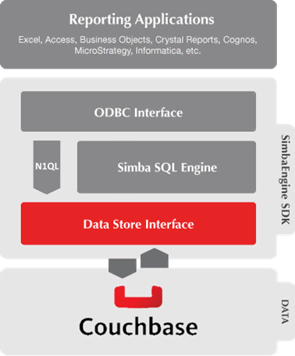
JDBC Driver
  JDBC 4.0 and 4.1
  Build an application which can query using SQL or N1QL
  Allow easy access to NoSQL data from BI and ETL tools, as well as your own applications
JDBC Interface

Slide 46

Conversion between ANSI SQL and N1QL/JSON
JDBC Driver
Simba Couchbase JDBC Driver
Allows users to infer or define schemas on schema-less JSON data
Converts JSON data to relational data
Based on JDBC 4.0 and 4.1 Standard
Full 64-bit and 32-bit support
Full SQL & N1QL support
Comprehensive unicode support
Driver Implementation
JDBC Interface
SQL-92
N1QL

Slide 47
JDBC: Connecting
import java.sql.*;
import java.util.*;
public class Demo {
public static void main(String[] args) {
String url = "jdbc:couchbase://localhost:8093";
try {
Connection conn = DriverManager.getConnection(url);
try {
System.out.println("Connection successful.");
} finally { conn.close(); }
} catch (SQLException e) { e.printStackTrace(); } }
}

Slide 48
JDBC: Executing Queries
private static void doQuery(Connection conn) {
try {
String query = "select SELECT d.C_ZIP, "
+ "SUM(ORDLINE.OL_QUANTITY) AS TOTALQTY "
+ "FROM CUSTOMER d "
+ "GROUP BY d.C_ZIP ";
Statement stmt = conn.createStatement();
ResultSet rs = stmt.executeQuery(query);
}
catch (SQLException e) {
System.out.println("Error: " + e.getLocalizedMessage());
}
}

Slide 49
JDBC: Executing in N1QL Mode
Can change the driver to execute in N1QL mode by appending the following to the connection URL:
;UseN1QLMode=1
Try the following N1QL query:
SELECT beer.name as beer_name, beer.abv, brewery.name as brewery_name FROM `beer-sample` beer JOIN `beer-sample` brewery ON KEYS [ beer.brewery_id ] WHERE beer.abv > 5 and beer.style != "Lager" and beer.type = "beer" and brewery.type = "brewery" ORDER BY beer.abv DESC LIMIT 5;

Slide 50
Java JSR-374
https://www.jcp.org/en/jsr/detail?id=374
This JSR is to provide an update for the Java API for JSON Processing Specification (JSON-P).
There are 3 goals for this JSR.
Support for JSON Pointer and JSON Patch
Add editing/transformation operations to JSON object model
Update the API to work with Java SE 8
JDBC will need to add enhanced JSON support.
  Couchbase has engaged with JDBC Committee
Notes:
This JSR is to provide an update for the Java API for JSON Processing Specification (JSON-P).
There are 3 goals for this JSR.
* Support for JSON Pointer and JSON Patch
After the release of JSR 353, the specifications for JSON Pointer (http://tools.ietf.org/html/rfc6901) and JSON Patch (http://tools.ietf.org/html/rfc6902) have been released. This JSR will update JSON-P to provide support for these specifications.
* Add editing/transformation operations to JSON object model
The current JSON object model provides immutable JSON objects and arrays. It is useful to provide editing or transformation functionalities to the basic JSON processing.
For a JSON object, an operation will be added to remove a name/value pair from the object. For a JSON array, operations will be added to insert, replace, or remove an entry of the array.
The builder pattern will be used to handle these operations: a builder is created with the initial JSON object or array, the operations are carried out by the builder, and the edited object or array is finally converted to an immutable JSON object or array.
* Update the API to work with Java SE 8
Queries on JSON object model are currently possible, using Java SE 8's stream operations and lambda expressions. However, to make them truly useful and convenient, there is a need for Collectors that return JSON objects or arrays instead of Maps or Lists. This JSR will define some common and useful Collectors.
It may also be useful to turn JSON parser events into a stream of events, so that SE 8's stream operations can be used.

Slide 51
SDKs with Custom Query APIs
Fluent APIs for N1QL
Use Domain Specific Language extensions
  Works well with query builders to provide features like auto completion
  Provides help with complex expressions like CASE, ANY, EVERY, etc.
Supports parameter Passing
Supports querying asynchronously
// raw string query
N1qlQueryResult queryResult =
bucket.query(N1qlQuery.simple("SELECT * FROM beer-sample LIMIT 10"));
// using the DSL
N1qlQueryResult query = bucket.query(select("*").from("beer-sample").limit(10));
bucket
.query(N1qlQuery.simple(select("*").from(i("beer-sample")).limit(10)))
.flatMap(AsyncN1qlQueryResult::rows)
.toBlocking()
.forEach(row -> System.out.println(row.value()));

Slide 52
Ecosystem

Slide 53









Ecosystem Integration

Slide 54
Try SQL for JSON
N1QL is available in Couchbase 4.0
  http://query.couchbase.com
  Online Interactive Tutorial
Ask us questions
  Couchbase forums, Stack Overflow, @N1QL

Slide 55
Thank you
Q & A
Gerald Sangudi | @sangudi | Chief Architect | Couchbase
Keshav Murthy| @rkeshavmurthy | Director | Couchbase
@N1QL | query.couchbase.com

