Slide 1
An introduction to
JVM performance

Slide 2
Performance-talk disclaimer
EVERYTHING IS A LIE!!
Please keep in mind:
The JVM’s performance model is an implementation detail you cannot rely on.
Performance is hard to get right and it is difficult to measure.
We look at HotSpot in this talk, other JVMs might behave differently.
Occasionally, implementations are performant without appearing to be.

Slide 3
How is Java code executed?
Java
javac
JVM
processor
source code
byte code
machine code
Optimizations are applied almost exclusively after handing resposibility to the
JVM. This makes them difficult to trace as the JVM is often seen as a black box.
Other compilers such as for example scalac might however apply optimizations
such as resolving tail recursion into ordinary loops.

Slide 4
HotSpot: interpretation and tiered compilation
interpreter
C1 (client)
C2 (server)
machine code
templating
no
profiling
simple
profiling
advanced
profiling
profile-based
optimization
level 0
level 1
level 2
level 3
level 4
C2 is busy
trivial method
Mostly, steady state performance is of interest. Compilation only of “hot spots” with
a single method as the smallest compilation unit.

Slide 5
A central building block: call sites
class Foo {
void bar() {
System.out.println("Hello!");
}
}
indirection
void doSomething(Foo val) {
val.bar();
}
A call site, that is a specific method call instruction in the code.
Other than in many languages, in Java, most method calls are virtual.
The question is: How does the JVM reason about what code to execute?
Method invocation is a very common task for a JVM, it better be fast!

Slide 6
Virtual method tables (vtables / itables)
# | Method | Code
1 | hashCode() | 0x234522
2 | equals(Object) | 0x65B4A6
3 | toString() | 0x588252
… | … | …
8 | bar()
class Foo {
void bar() {
System.out.println("Hello!");
}
}
class Foo
# | Method | Run
1 | hashCode() | 0x234522
2 | equals(Object) | 0x65B4A6
3 | toString() | 0x588252
… | … | …
8 | bar()
class Sub extends Foo {
@Override
void bar() {
System.out.println("Woops!");
}
}
class Sub
Single inheritance allows for index-based lookup of a method implementation.
But resolving this triple indirection on every method call is still too slow!

Slide 7
Inline caches
class Foo {
void bar() {
System.out.println("Hello!");
}
}
cached link
void doSomething(Foo val) {
val.bar(); [cache: val => Foo: address]
}
Inline caches observe instance classes and remember the address of a class’s
method implementation. This would avoid the lookup in a virtual method table.
Smalltalk is a prominent user of such caches. But this double indirection is still to slow!

Slide 8
Monomorphic (“linked”) call site
class Foo {
void bar() {
System.out.println("Hello!");
}
}
direct link
void doSomething(Foo val) {
[assert: val => Foo]
[goto: method address]
}
The JVM has created a profile for this call site. It is now optimisitc about what instances it will observe.
The JVM is based on making optimistic assumptions and adding traps when these
assumptions are not met (“adaptive runtime”). Heuristics show that most call sites only
ever observe a single class (“monomorphic”). These same heuristics also show that
non-monomorphic call sites often observe many types (“megamorphic”).

Slide 9
monomorphic
bimorphic
polymorphic
megamorphic
deoptimization
direct link
conditional
direct link
vtable
lookup
home of rumors
(about 90%)
(data structures)
(but dominant targets)
optimization
A call site’s profile is generated at runtime and it is adapted after collecting sufficient
information. In general, the JVM tries to be optimistic and becomes more pessimistic
once it must. This is an adaptive approach, native programs cannot do this.

Slide 10
Inlining
class Foo {
void bar() {
System.out.println("Hello!");
}
}
class Foo {
void bar() {
System.out.println("Hello!");
}
}
inlined
void doSomething(Foo val) {
[assert: val => Foo]
[goto: method address]
}
void doSomething(Foo val) {
[assert: val => Foo]
System.out.println("Hello!");
}
Inlining is often consider an “uber optimization” as it gives the JVM more code to
omtimize as a single block. The C1 compiler does only little inlining after performing “class
hierarchy analysis” (CHA). The C2 compiler inlines monomorphic and bimorphic call sites
(with a conditional jump) and the dominant target (> 90%) of a megamorphic call site.
Small methods (< 35 byte) are always inlined. Huge methods are never inlined.

Slide 11
Call receiver profiling: every type matters!
List<String> list = ... // either ArrayList or LinkedList
list.size(); // a bimorphic call site
// new class turns call site into megamorphic state
new ArrayList<String>() {{
add("foo");
add("bar");
}};
When the JVM profiles call sites or conducts class hierarchy analysis, it takes the receiver
type at a call site into consideration, it does not analyze if a method is actually
overridden. For this reason, every type matters (even when calling final methods).
You might wonder why this is not optimized:
Looking up an object’s class is an order-one operation. Examining a class hierarchy is not.
The JVM needs to choose a trade-off when optimizing and analyzing the hierarchy does
not pay off (educated guess). “Double brace initialization” is a however often introducing
new (obsolete) types at call sites. Often enough, this results in vtable/itable lookups!

Slide 12
Microoptimizing method dispatch
interface Foo { void m(); }
class Sub1 implements Foo { @Override void m() { ... } }
class Sub2 implements Foo { @Override void m() { ... } }
class Sub3 implements Foo { @Override void m() { ... } }
class Foo {
int id // 1, 2, 3
static void sub1() { ... }
static void sub2() { ... }
static void sub3() { ... }
}
Idea: avoid dynamic dispatch but emulate it at the call site.
(“call by id”)
void doSomething(Foo foo) {
foo.m();
}
void doSomething(Foo foo) {
switch (foo.id) {
case 1: Foo.sub1(); break;
case 2: Foo.sub2(); break;
case 3: Foo.sub3(); break;
default: throw new IllegalStateException();
}
}
Fields are never resolved dynamically. Static call sites always have an explicit target.
If all three types are observed, this call site is
megamorphic. A target is only inlined if it is dominant (>90%).
Do not microoptimize, unless you must! The improvement is minimal.
In general: static/private > class virtual (null check) > interface virtual (null + type check).
This is true for all dispatchers (C2, C1, interpreter)
Source: http://shipilev.net/blog/2015/black-magic-method-dispatch/

Slide 13
Call site specialization
static void log(Object... args) {
System.out.println("Log: ");
for (Object arg : args) {
System.out.println(arg.toString());
}
}
static void log(Object... args) {
System.out.println("Log: ");
for (Object arg : args) {
System.out.println(arg.toString());
}
}
inlined
void doSomething() {
System.out.println("Log: ");
Object[] args = new Object[]{"foo",4,new Object()};
for (Object arg : args) {
System.out.println(arg.toString());
}
}
void doSomething() {
System.out.println("Log: ");
System.out.println("foo".toString());
System.out.println(new Integer(4).toString());
System.out.println(new Object().toString());
}
void doSomething() {
log("foo", 4, new Object());
}
Unroll the entire loop as it is now of a fixed size.
Thanks to inlining (and loop unrolling), additional call sites are introduced.
This way, formerly megamorphic call sites can become monomorphic after duplication.
Generally, optimizations allow for new optimizations. This is especially true for inlining.

Slide 14

The Hulk performance rule #1
ONE TYPE GOOD!
MANY TYPES BAD!

Slide 15
All programs are typed!
Types (which do not equal to classes) allow us to identify “things” in our programs
that are similar. If nothing in your program has similarities, there might be something
wrong. Thus, even machines for dynamic languages look for types. (e.g. V8, Nashorn)
var foo = { };
foo.x = 'foo';
foo.y = 42;
V8, hidden class
*
x
var bar = { };
bar.y = 42;
bar.x = 'bar';
x, y
y
If your program has no structure, how should an
optimizer find any? Any “dynamic program” is typed,
but it is so implicitly. In the end, you simply did not
make this structure explicit.
y, x

Slide 16
Branch prediction
int size = 20_000;
int maximum = 100;
int[] values = randomValues(size, maximum);
Arrays.sort(values);
int sum = 0;
for (int i = 0; i < 1_000; i++) {
for (int value : values) {
if (value > 50) {
sum += value;
} else {
sum -= value;
}
}
}
A conditional control flow is referred to as branch.
Can the outcome of this conditional instruction be predicted (by the processor)?
Warning: This example is too simple, the VM (loop interchange, conditional moves) has
become smarter than that. After adding more “noise”, the example would however work.
An unfortunate example where the above problem applies are (currently!) Java 8 streams
which build on (internal) iteration and conditionals (i.e. filters). If the VM fails to inline such
a stream expression (under a polluted profile), streams can be a performance bottle neck.

Slide 17
Loop peeling (in combination with branch specialization)
int[][] matrix = ...
for (int[] row : matrix) {
boolean first = true;
for (int value : row) {
if(first) {
first = false;
System.out.println("Row: ");
}
System.out.print(value + " ");
}
System.out.println(" --- ");
}
int[][] matrix = ...
for (int[] row : matrix) {
boolean first = true;
int index = 0;
if(first) {
first = false;
System.out.println("Row: ");
}
System.out.print(value + " ");
for (index = 1; index < row.length; index++) {
if(first) {
first = false;
System.out.println("Row: ");
}
System.out.print(value + " ");
}
System.out.println(" --- ");
}
Disclaimer: There is much more “loop stuff”.

Slide 18
The Hulk performance rule #2
PREDICTION GOOD!
RANDOM BAD!
Keep in mind:
Obviously, any application contains an inherent unpredictability that cannot be removed.
Performant programs should however not add more complexity as necessary as this burdens modern processors which prefer processing long, predictable pipes of instructions.

Slide 19
Escape analysis
List<String> list = ...;
for (String s : list) {
System.out.println(s);
}
List<String> list = ...;
Iterator<String> it = list.iterator();
while (it.hasNext()) {
System.out.println(it.next());
}
scope
object allocation
Any heap allocated object needs to be garbage collected at some point. Even worse,
accessing an object on the heap implies an indirection what should be avoided.
Escape analysis is difficult (expensive) to conduct. By avoiding long scopes, i.e. writing
short methods, an object’s scope is easier to determine. This will most likely improve in
future JVM implementations.

Slide 20
The Hulk performance rule #3
STACK GOOD!
HEAP BAD!

Slide 21
Dead-code elimination
int size = 20_000;
int[] values = randomValues(size);
int size = 20_000;
int[] values = randomValues(size);
long start = System.currentTimeMillis();
long end = System.currentTimeMillis(); System.out.println("Took " + (end - start) + " ms");
int sum = 0;
for (int value : values) {
sum += value;
}
int sum = 0;
for (int value : values) {
sum += value;
}
Also, the outcome might dependant on the JVM’s collected code profile that was
gathered before the benchmark is run. Also, the measured time represents wall-clock
time which is not a good choice for measuring small amounts of time.

Slide 22
A better benchmark
void run() {
int size = 500_000;
for (int i = ; i < 10_000; i++) {
doBenchmark(randomValues(size));
}
int[] values = randomValues(size);
System.out.println("This time is for real!");
doBenchmark(values);
}
void doBenchmark(int[] values) {
long start = System.nanoTime();
int sum = 0;
for (int value : values) {
sum += value;
}
long end = System.nanoTime();
System.out.println("Ignore: " + sum);
System.out.println("Took " + (end - start) + " ns");
}

Slide 23
A good benchmark: JMH
class Sum {
int[] values;
@Setup
void setup() {
values = randomValues(size);
}
@Benchmark
int sum() {
int sum = 0;
for (int value : values) {
sum += value;
}
return sum;
}
}
In general, avoid measuring loops.

Slide 24
Measuring the right thing, the right way
Measuring the performance of two operational blocks does not normally resemble the
performance of the performance of both blocks if executed subsequently.
The actual performance might be better or worse (due to “profile pollution”)!
Best example for such “volume contractions”: Repeated operations. The more the JIT
has to chew on, the more the compiler can usually optimize.

Slide 25
The Hulk performance rule #4
HARNESS GOOD!
SELF-MADE BAD!

Slide 26
On-stack replacement
public static void main(String[] args) {
int size = 500_000;
long start = System.nanoTime();
int sum = 0;
for (int value : randomValues(size)) {
sum += value;
}
long end = System.nanoTime();
System.out.println("Took " + (end - start) + " ns");
}
On-stack replacement allows the compilation of methods that are already running.
If you need it, you did something wrong. (It mainly tackles awkward benchmarks.)

Slide 27
The Hulk performance rule #5
ON-STACK REPLACEMENT?
OVERRATED!
However:
If the VM must deoptimize a running method, this also implies an on-stack replacement of the running, compiled method. Normally, such deoptimization is however not referred to as on-stack replacement.

Slide 28
Algorithmic complexity
void sort(int[] values) {
while (!isSorted(values)) {
shuffle(values);
}
}
Data structures are a sort of algorithm!
Grows by array copying.
Random access of elements.
ArrayList
LinkedList
Grows by adding element.
Chained access of elements.
The JVM does not reason about algorithms. That is your job!

Slide 29
The Hulk performance rule #6
THINK GOOD!
GUESS BAD!

Slide 30
Reflection, method handles and regular invocation
class Foo {
int bar(int value) {
return value * 2;
}
}
Method method = Foo.class.getDeclaredMethod("bar");
int result = method.invoke(new Foo(), 42);
boxing
2xboxing
class Method {
Object invoke(Object obj, Object... args);
}
Escape analysis to the rescue? Hopefully in the future. Today, it does not look so good.

Slide 31
Reflection, method handles and regular invocation
class Foo {
int bar(int value) {
return value * 2;
}
}
MethodType methodType = MethodType
.methodType(int.class, int.class);
MethodHandle methodHandle = MethodHandles
.lookup()
.findVirtual(Foo.class, "bar", methodType);
int result = methodHandle.invokeExact(new Foo(), 42);
class MethodHandle {
@PolymorphicSignature
Object invokeExact(Object... args) throws Throwable;
}
This is nothing you could do but JVM magic. Method handles also work for fields.
Further intrinsification methods: share/vm/classfile/vmSymbols.hpp

Slide 32
The Hulk performance rule #7
REFLECTION GOOD!
BOXING BAD!

Slide 33
Exception performance
boolean doSomething(int i) {
try {
return evaluate(i);
} catch (Exception e) {
return false;
}
}
boolean evaluate(int i) throws Exception {
if(i > 0) {
return true;
} else {
throw new Exception();
}
}
Exceptions can be used to implement “distributed control flow”. But please don’t!

Slide 34
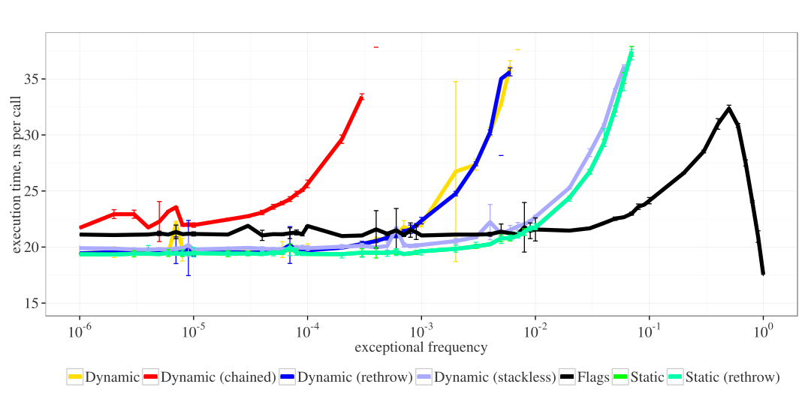
Exception performance (2)
Source: http://shipilev.net/blog/2014/exceptional-performance/
dynamic/static: exception is created on throw vs. exception is stored in field
stackless: avoid stack creation by flag or overridding creation method
chained / rethrow: wrapping catched exception vs. throwing again

Slide 35
The Hulk performance rule #8
EXCEPTION CONTROL-FLOW?
HULK SMASH!

Slide 36
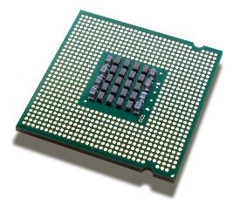
False sharing
L1 cache (1)
Main memory
14 7 “foo” 71 97 “bar”
24 7 “foo” 71 97 “bar”
14 7 “foo” 71 97 “bar”
14
1: writes x
7
contention
“foo” 71 97 “bar”
L1 cache (2)
class Shared {
int x;
int y;
}
14 1 “foo” 71 97 “bar”
class Shared {
@Contended
int x;
@Contended
int y;
}
14 7 “foo” 71 97 “bar”
2: writes y
Field annotation increases memory usage significantly! Adding “padding fields” can
simulate the same effect but object memory layouts are an implementation detail and
changed in the past. Note that arrays are always allocated in continuous blocks!
Conversely, cache (line) locality can improve a single thread‘s performance.

Slide 37
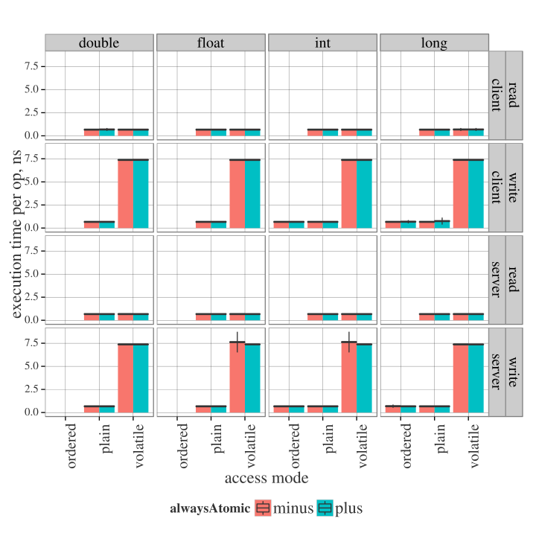
Volatile access performance (x86 Ivy bridge, 64-bit)
Source: http://shipilev.net/blog/2014/all-accesses-are-atomic/

Slide 38
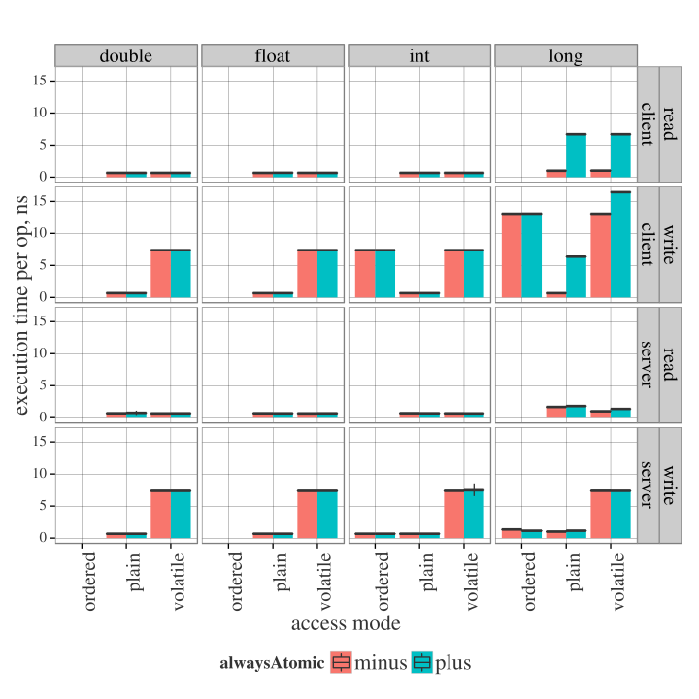
Volatile access performance (x86 Ivy bridge, 32-bit)
Source: http://shipilev.net/blog/2014/all-accesses-are-atomic/

Slide 39
Lock coarsening
void doSomething() {
foo();
bar();
}
void doSomething() {
synchronized(this) {
foo(); // without lock
bar(); // without lock
}
}
locks and unlocks twice
private void synchronized foo() {
// ...
}
private void synchronized bar() {
// ...
}
private void foo() {
// ...
}
private void bar() {
// ...
}
Locks are initially biased towards the first locking thread. (This is currently only possible
if the Identity hash code is not yet computed.) In conflict, locks are promoted
to become “thick” locks.

Slide 40
The Hulk performance rule #9
VOLATILE SLOW!
BLOCKING SLOWER!

Slide 41
javac optimizations: constant folding of compile-time constants
javac inlines all compile-time constants (JLS §15.28): compile-time constants are
primitives and strings with values that can be fully resolved at javac-compilation time.
"foo" // compile-time constant
"bar".toString() // no compile-time constant
Most common use case: defining static final fields that are shared with other classes.
This does not require linking or even loading of the class that contains such constants.
This also means that the referring classes need to be recompiled if constants change!
class Foo {
final boolean foo = true;
}
class Bar {
void bar(Foo foo) {
boolean bar = foo.foo;
}
}
class Foo {
final boolean foo = true;
}
class Bar {
void bar(Foo foo) {
foo.getClass(); // null check
boolean bar = true;
}
}
constant-folding
with null check
in disguise (JLS!)
Be aware of compile-time constants when using reflection! Also, be aware of stackless
NullPointerExceptions which are thrown by C2-compiled Object::getClass invocations.

Slide 42
The Hulk performance rule #10
JLS?
TL;DR!

Slide 43
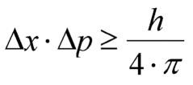
“A fool with a tool is still a fool“
The basic problem: (Heisenberg)
Once you measure a system‘s performance, you change the system.
In a simple case, a no-op method that reports its runtime is not longer no-op.

Slide 44
“A fool with a tool is still a fool“ (2)
Many profilers use the JVMTI for collecting data. Such “native-C agents” are only
activated when the JVM reaches a safe-point where the JVM can expose a sort
of “consistent state” to this “foreign code”.
blocked
running
If the application only reaches a safe point when a thread is blocked then a profiler would
suggest that the application is never running. This is of course nonsense.
“Honest profiler” (Open Source): Collects data by using UNIX signals.
“Flight recorder” (Oracle JDK): Collects data on a lower level than JVMTI.

Slide 45
“A fool with a tool is still a fool“ (3)
The JVM can expose quite a lot (class loading, garbage collection, JIT compilation,
deoptimization, etc.) when using specific XX flags. Possible to print JIT assembly.
push %rbp
mov %rsp,%rbp
mov $0x0,%eax
movl $0x0,-0x4(%rbp)
movl $0x5,-0x8(%rbp)
mov -0x8(%rbp),%ecx
add $0x6,%ecx
mov %ecx,-0xc(%rbp)
pop %rbp
retq
int doSomething() {
int a = 5;
int b = a + 6;
return b;
}
For some use cases, it helps to look at the assembly. For this you need a development
build or you need to compile the disassembler manually. Google is your friend. Sort of
painful on Windows. JMH has great support for mapping used processor circles to
assembly using Unix’s “perf”. JITWatch is a great log viewer for JIT code.

Slide 46

Professor Hulk’s general performance rule
Generally speaking, the JVM honors clean code, appropriate typing, small methods and predictable control flow. It is a clear strength of the JVM that you do not need to know much about the JVM‘s execution model in order to write performance applications. When writing critical code segments, a closer analysis might however be appropriate.

Slide 47



http://rafael.codes
@rafaelcodes
http://documents4j.com
https://github.com/documents4j/documents4j
http://bytebuddy.net
https://github.com/raphw/byte-buddy

