Slide 1
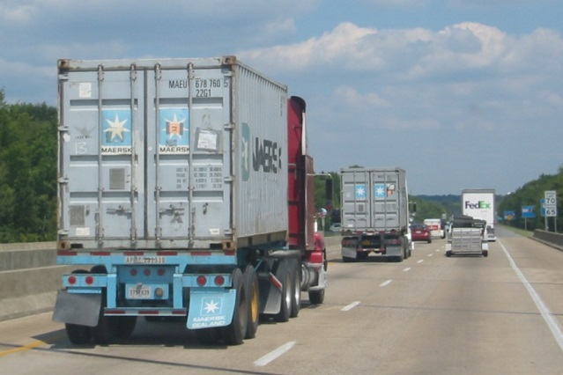
Hide Your (NetBeans) Development Environment and Application in a Container
Johan Janssen, Info Support, @johanjanssen42

Slide 2
Content
Why
Docker
Different options
Things to consider
Questions

Slide 3
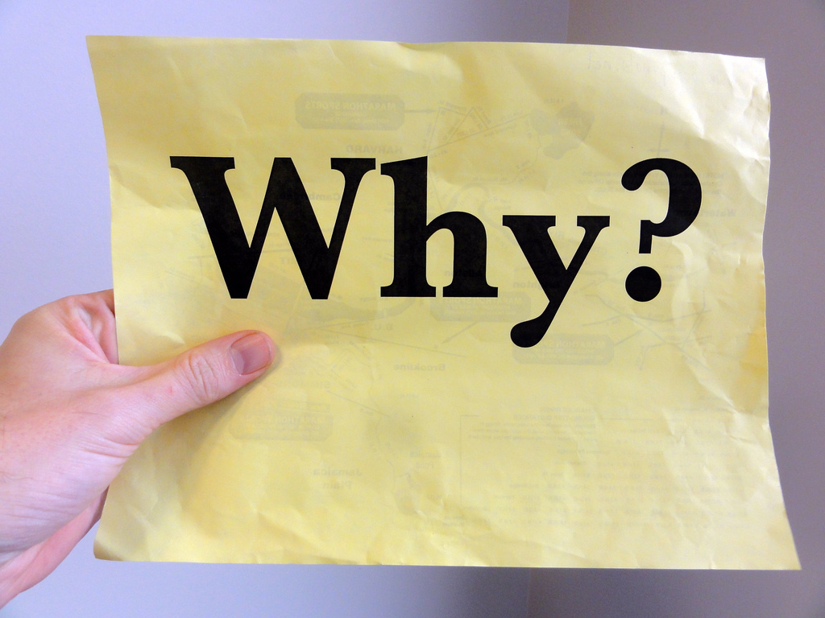

Slide 4
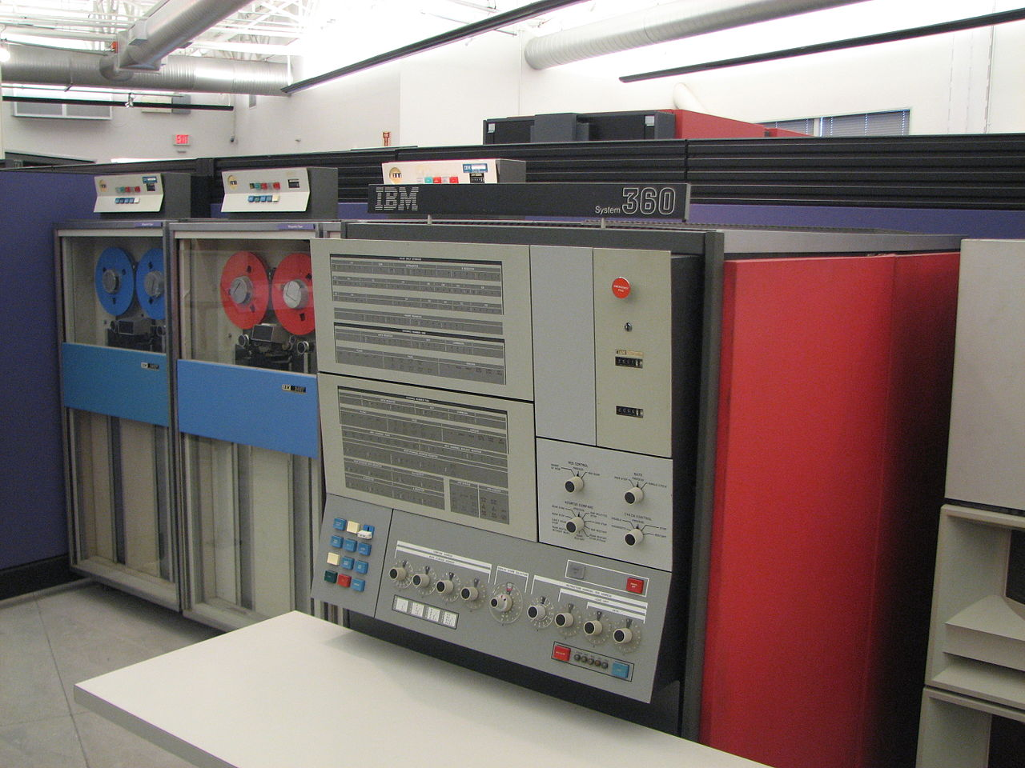
Notes:
Back to mainframe, one computer that runs all software, connect to that machine.

Slide 5
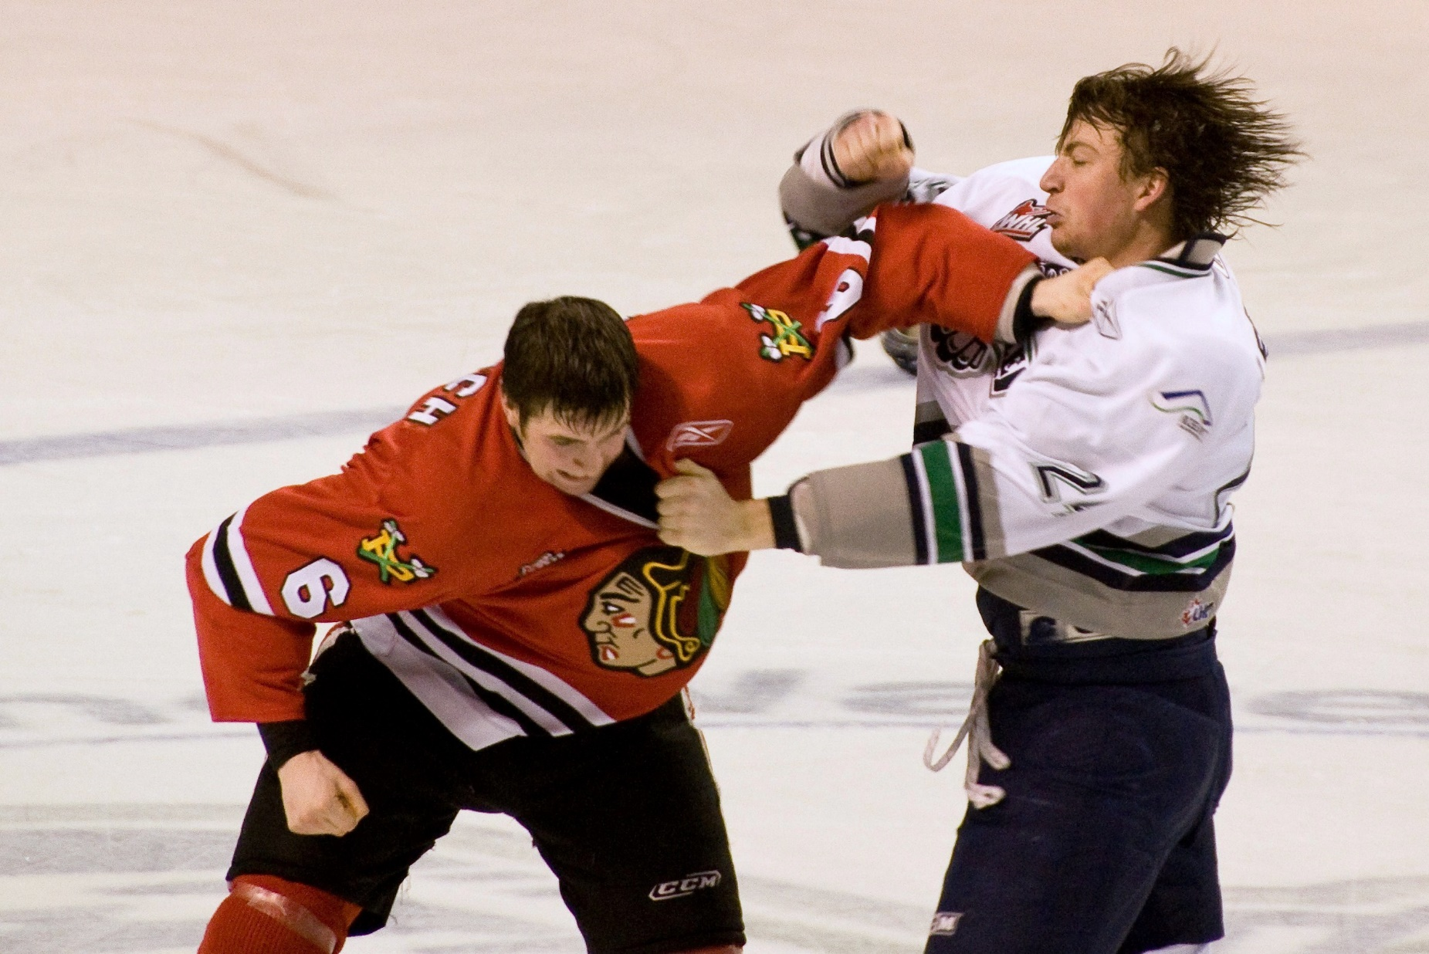
Notes:
Same ports

Slide 6
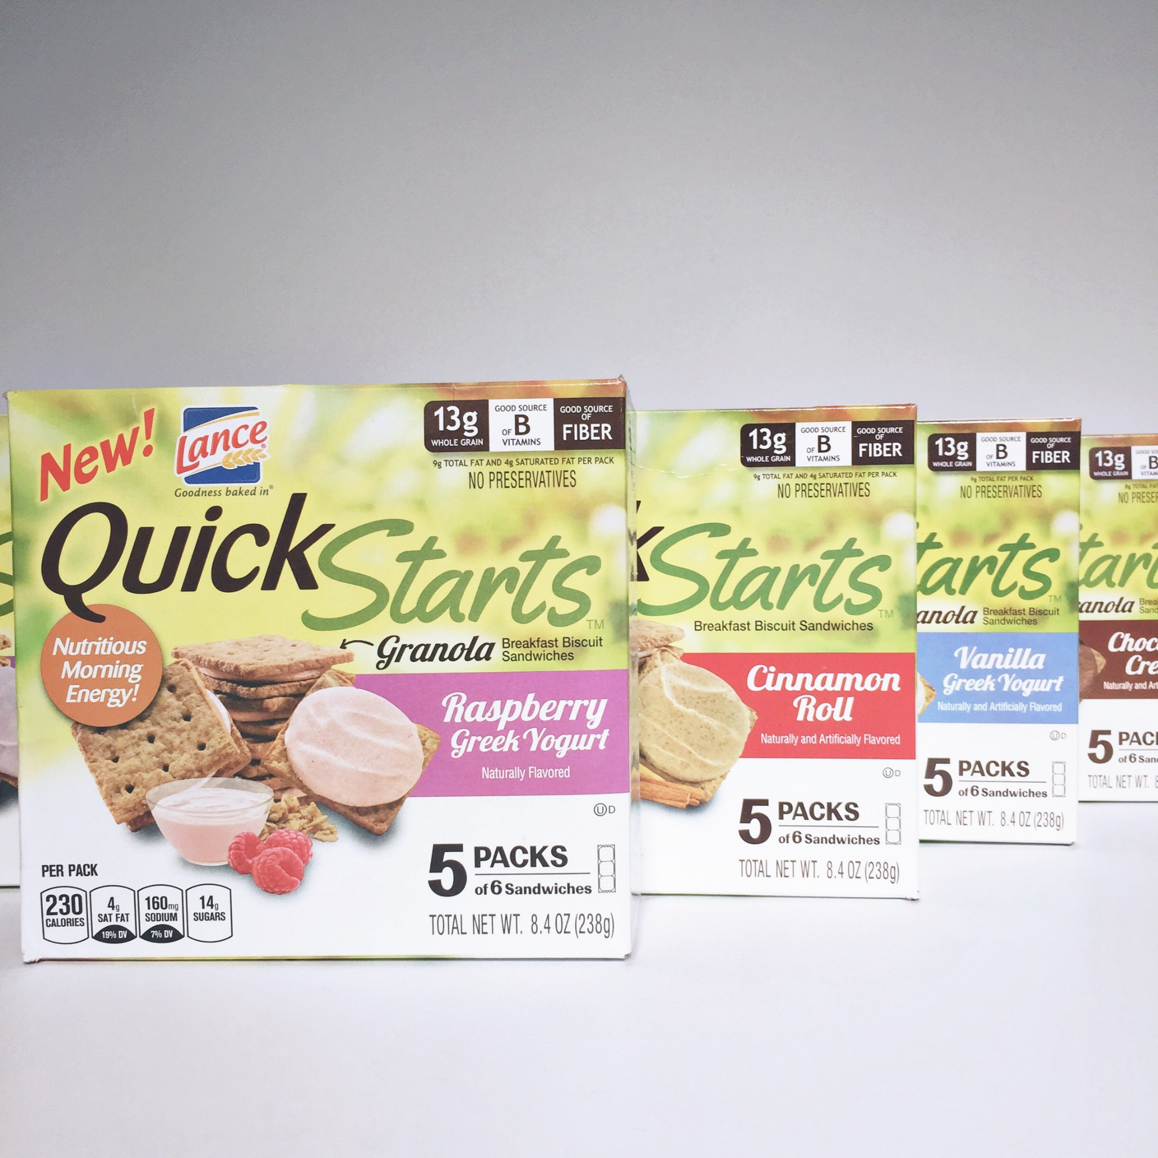
Notes:
Setting up environment for (new) teammembers quickly. Quickly change all environments.

Slide 7
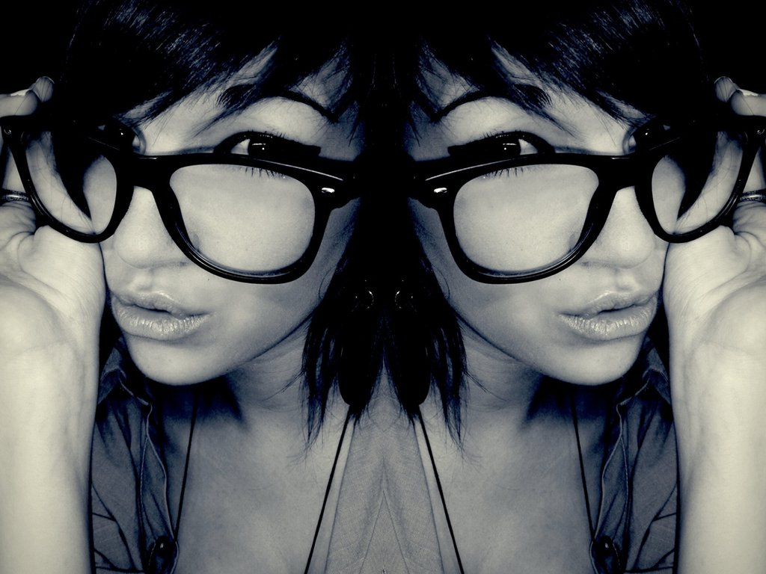
Notes:
Using Docker containers local and DTAP (at least the app server)

Slide 8
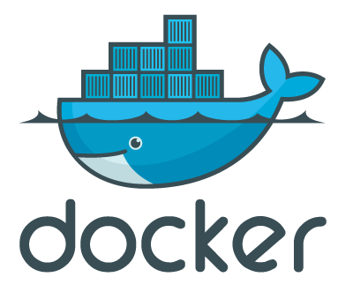
Docker

Slide 9
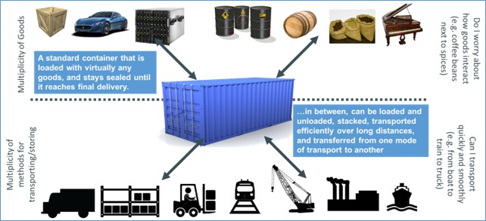
Transportation solution

Slide 10
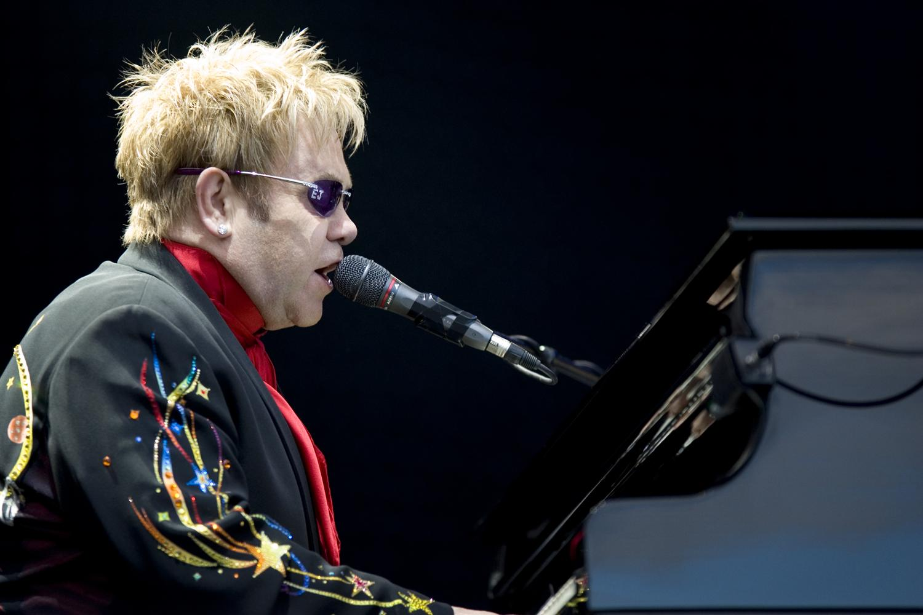

Slide 11
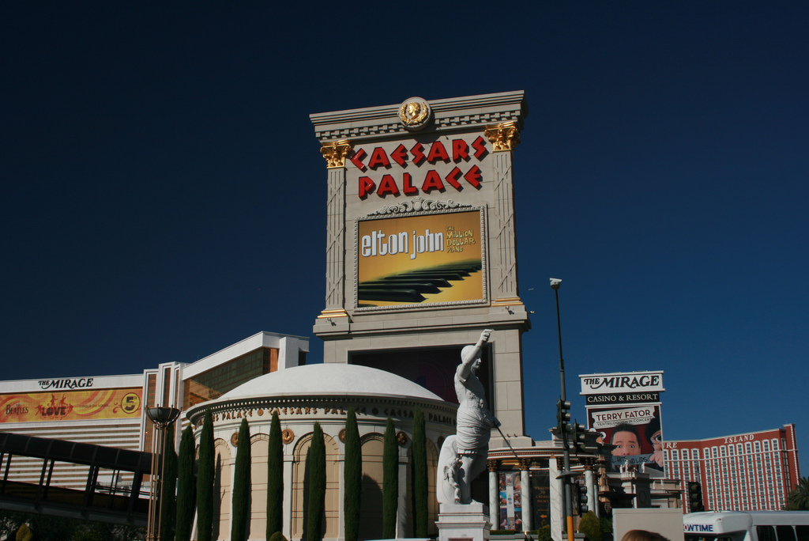

Slide 12
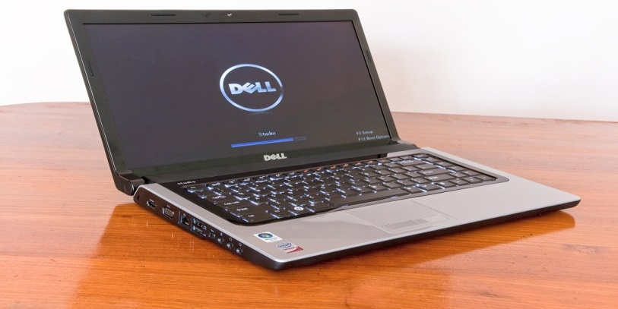
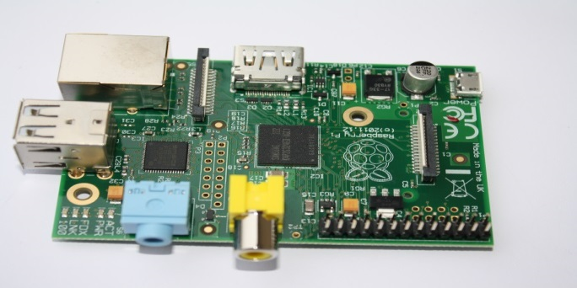
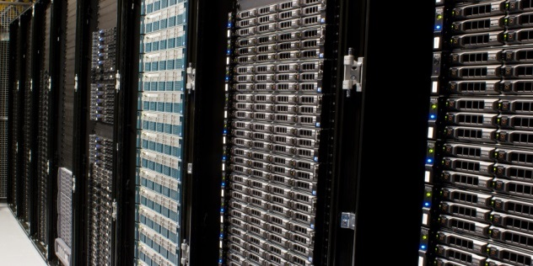
Docker compatibility

Slide 13
My first Docker container
Docker on Ubuntu 15.04
apt-get install docker.io
docker run -it
ubuntu:15.04 /bin/bash

Slide 14
Dockerfile
FROM java:8-jdk
RUN wget …/netbeans-8.0.2-linux.sh
RUN chmod +x netbeans*.sh
RUN sh netbeans*.sh --silent
CMD /usr/local/netbeans-8.0.2/bin/netbeans

Slide 15
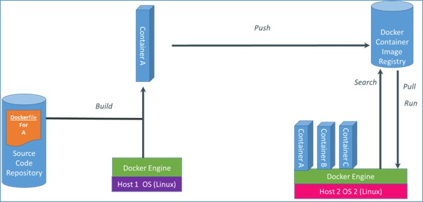
Docker overview

Slide 16
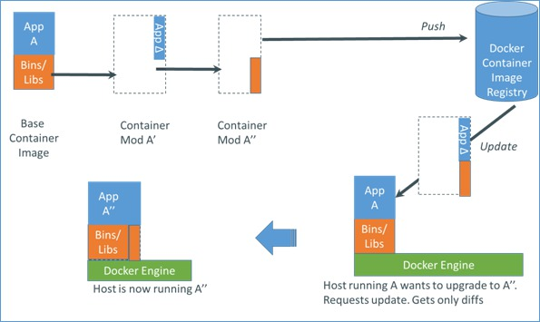
Updating containers

Slide 17
Pull update only on Docker client 2
docker images -tree
└─153bf43b408a 194.2 MB test-version-0.1:latest
docker pull 192.168.56.31:5000/test-version-0.2
ff7e110ebadd: Download complete
153bf43b408a: Download complete
docker images -tree
└─153bf43b408a 194.2 MB test-version-0.1:latest
└─ff7e110ebadd 194.2 MB test-version-0.2:latest

Slide 18
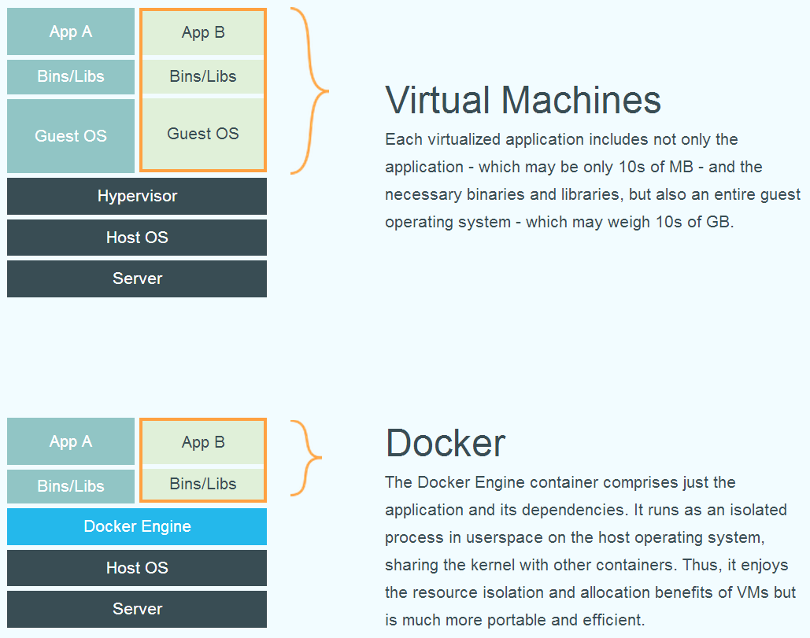
Docker vs Virtual Machines

Slide 19
Docker vs Virtual Machines
Disk space efficiency
Memory efficiency
Speed
Compatibility (run anywhere)
Isolation
Versioning
Internet of Things (Raspberry Pi etc.)

Slide 20
We need lots of Docker containers
GeneralBase
AppServerBase
Jenkins
Environment D
Environment T
Environment A
Environment P
Sonar
Gitblit
Nexus
JenkinsDataContainer

Slide 21
Diskspace
# docker.io images --tree
└─ 179.9 MB Tags: ubuntu:saucy
└─253.6 MB
└─741.8 MB Tags: GeneralBase:latest
└─763.6 MB Tags: AppServerBase:latest
├─763.6 MB Tags: EnvironmentP:latest
└─865.6 MB Tags: Nexus:latest
└─808.3 MB Tags: Gitblit:latest
└─901.5 MB Tags: Sonar:latest
└─805.4 MB Tags: Jenkins:latest

Slide 22
Execution time on laptop
real 4m11.729s
user 0m3.329s
sys 0m10.054s

Slide 23
Docker usecases
DTAP environment
Mainly running non-GUI applications
Continuous delivery, testing etc.
Development !

Slide 24
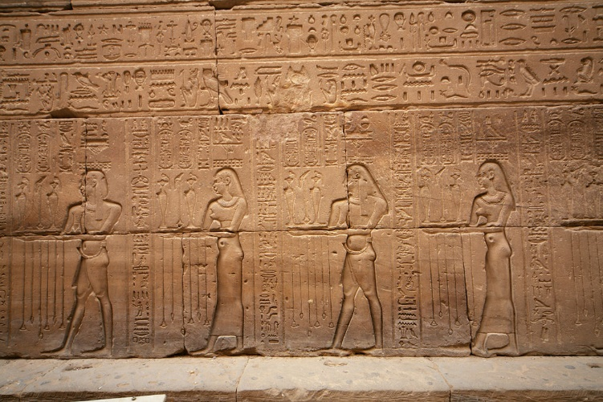

Slide 25
Persisting data on host
Docker run command:
-v $PWD/workspace:/workspace

Slide 26
What to persist?
Workspace
Plugins
Application in application server
Maven repo
Configuration
Entire home folder??

Slide 27
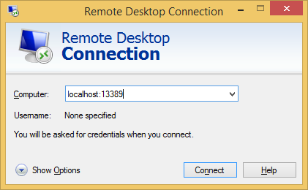
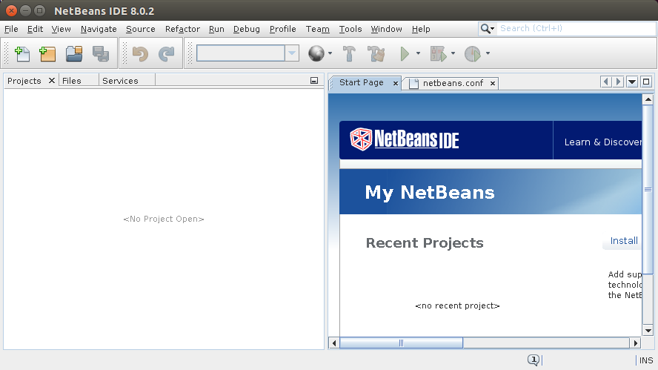
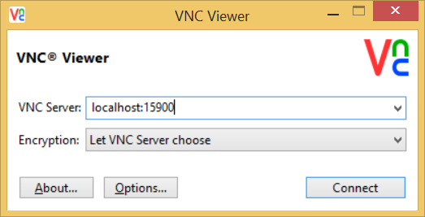
Different options
Notes:
X11 (different levels of security)
VNC
RDP (only app or complete desktop environment)

Slide 28
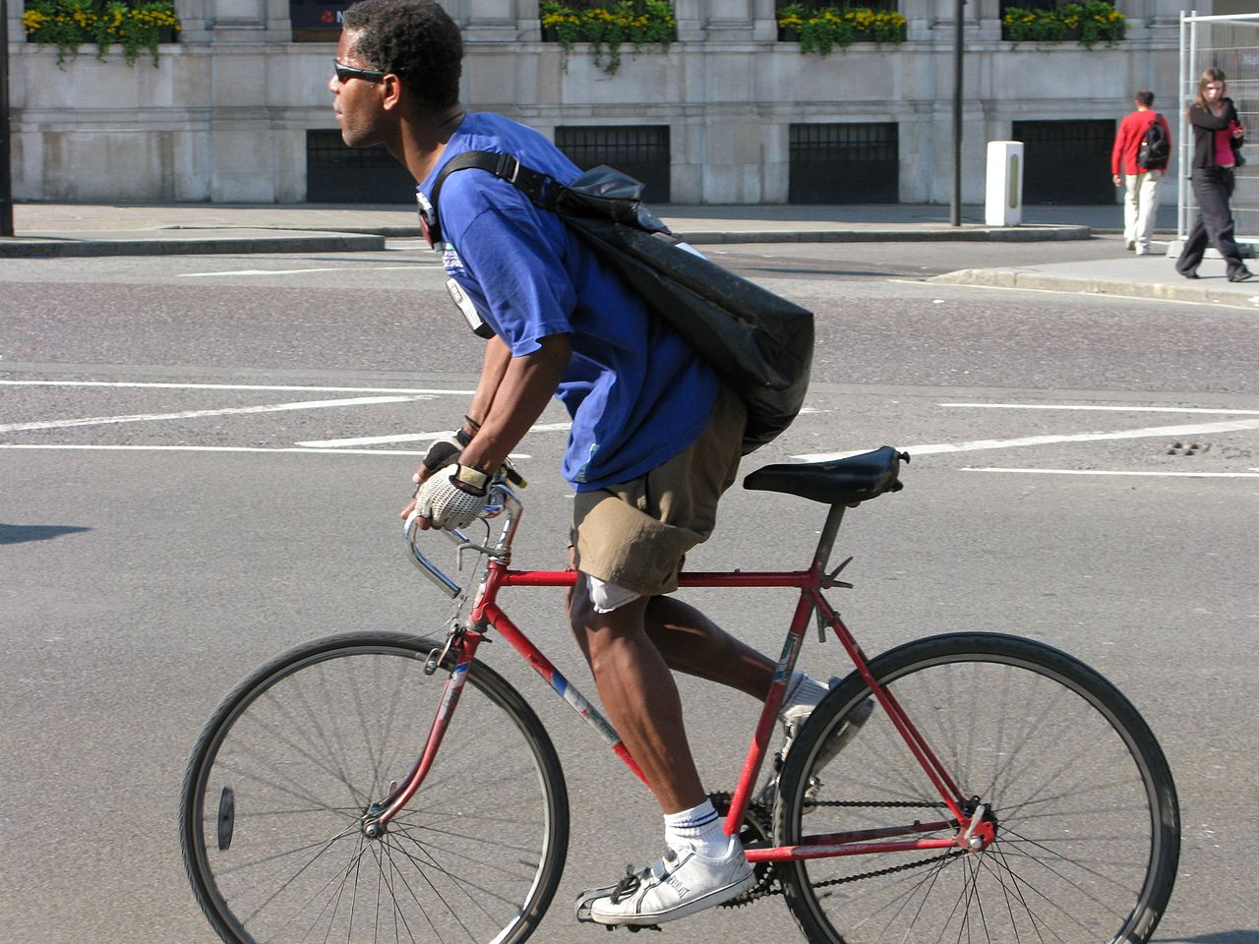
Notes:
Start is a bit slow as it’s the first time. Just like biking it takes some time to get up to speed.

Slide 29
X11

Slide 30
Security
Simple
Expose xhost
Read / write through the X11 unix socket
Safer
Use your user’s credentials to access the display server
Isolated
Create a user with the same uid and gid as the host
SSH
More info: http://wiki.ros.org/docker/Tutorials/GUI

Slide 31
No protocol specified error
No protocol specified error ->
xhost local:root

Slide 32
General part Dockerfile
RUN wget …/netbeans-8.0.2-linux.sh
RUN chmod +x netbeans*.sh
RUN sh netbeans*.sh –silent
// Set netbeans_default_userdir=/workspace/userdir
RUN sed -i …
// Set netbeans_default_cachedir=/workspace/cachedir
RUN sed -i …

Slide 33
X11 Dockerfile
FROM java:8-jdk
// General part
CMD /usr/local/netbeans-8.0.2/bin/netbeans

Slide 34
X11 build and run
docker build -t netbeansx11 .
docker run -ti --rm \
-e DISPLAY=$DISPLAY \
-v /tmp/.X11-unix:/tmp/.X11-unix \
-v $PWD/workspace:/workspace \
-v $PWD/m2:/root/.m2 \
-p 8081:8080 \
netbeansx11

Slide 35
VNC

Slide 36
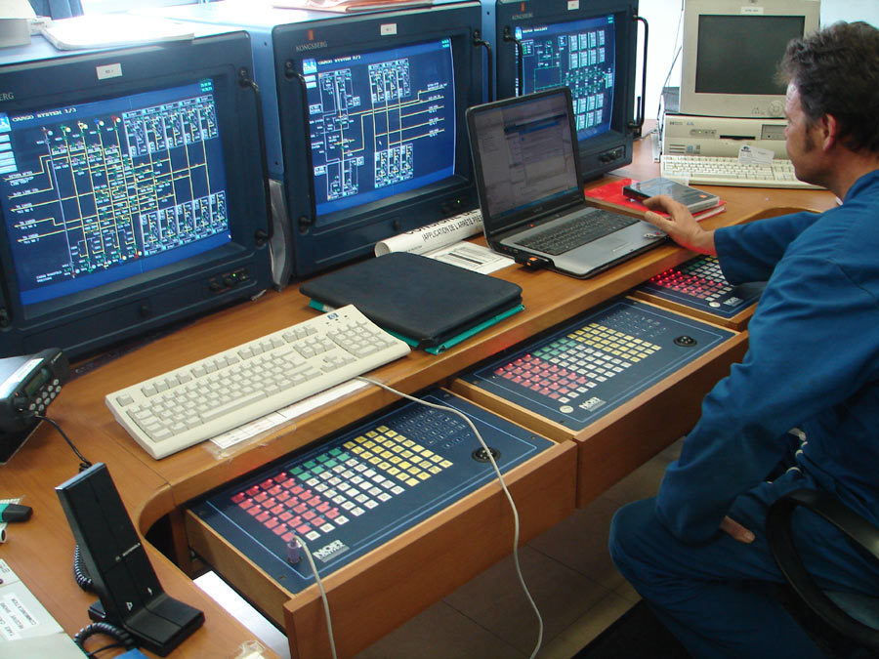
Notes:
Supervisord to monitor and control processes

Slide 37
VNC Dockerfile
FROM java:8-jdk
ENV DEBIAN_FRONTEND noninteractive
RUN apt-get update
RUN apt-get install -y xfce4 xvfb x11vnc supervisor
RUN adduser --disabled-password --gecos '' johan
ADD vnc.conf /etc/supervisor/conf.d/
// General part
EXPOSE 5900
CMD ["supervisord", "-n"]

Slide 38
VNC vnc.conf
[program:xvfb]
[program:x11vnc]
command=/usr/bin/x11vnc -forever -display :1
process_name = x11vnc
autorestart=true
user=johan
[program:xfce4]
command=/usr/bin/xfce4-session
process_name = xfce4
autorestart=true
user=johan
environment=DISPLAY=":1",HOME="/home/johan"

Slide 39
VNC build and run
docker build -t netbeansvnc .
docker run -d \
-v $PWD/workspace:/workspace \
-v $PWD/m2:/root/.m2 \
-p 5900:5900 \
-p 8082:8080 \
netbeansvnc

Slide 40
XRDP

Slide 41
XRDP Dockerfile (1/2)
FROM fedora:22
RUN dnf -y groupinstall 'Xfce Desktop' && yum clean all
COPY Xclients /etc/skel/.Xclients
RUN dnf -y install supervisor xrdp && dnf clean all
RUN useradd johan && echo johan:secret | chpasswd
COPY xrdp.ini /etc/supervisord.d/

Slide 42
XRDP Dockerfile (2/2)
# Allow all users to connect
RUN sed -i '/TerminalServerUsers/d' /etc/xrdp/sesman.ini && sed -i '/TerminalServerAdmins/d' /etc/xrdp/sesman.ini
RUN dnf -y install java java-devel
ENV JAVA_HOME /usr/lib/jvm/java-openjdk
// General part
EXPOSE 3389
CMD ["supervisord", "-n"]

Slide 43
XRDP xrdp.ini
[program:xrdp-sesman]
command=/usr/sbin/xrdp-sesman --nodaemon
process_name = xrdp-sesman
[program:xrdp]
command=/usr/sbin/xrdp -nodaemon
process_name = xrdp

Slide 44
XRDP build and run
docker build -t netbeansxrdp .
docker run -d \
-v $PWD/workspace:/workspace \
-v $PWD/m2:/root/.m2 \
-p 3389:3389 \
-p 8083:8080 \
netbeansxrdp

Slide 45
Notes:
Virtualbox / Windows not always stable

Slide 46
Notes:
Running Docker in a Virtual sometimes does not work well.

Slide 47
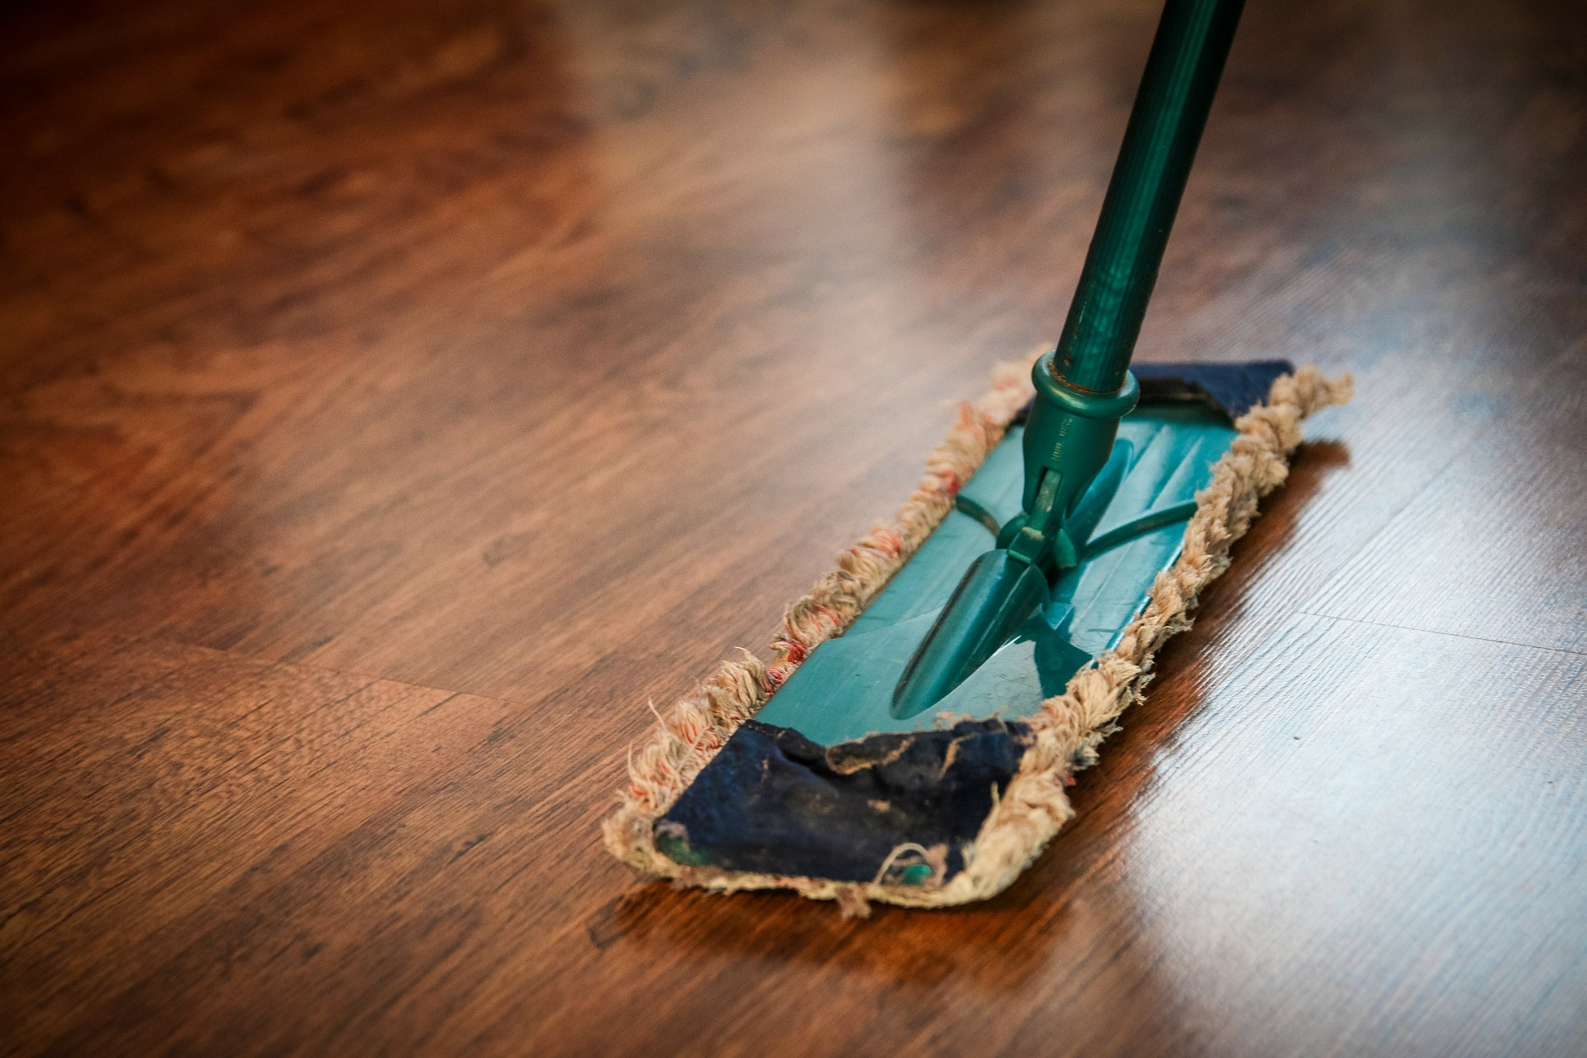
Notes:
Cleaning, remove downloads etc. from the Docker container

Slide 48
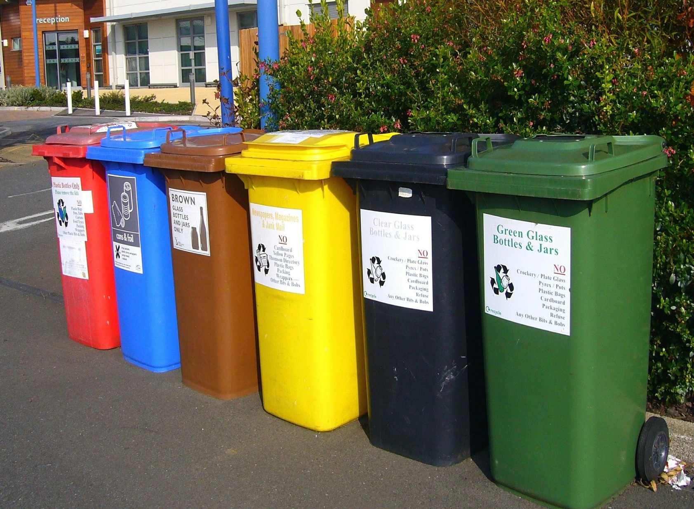
Notes:
Isolate different parts in separate containers. Nicer, but more maintenance.

Slide 49
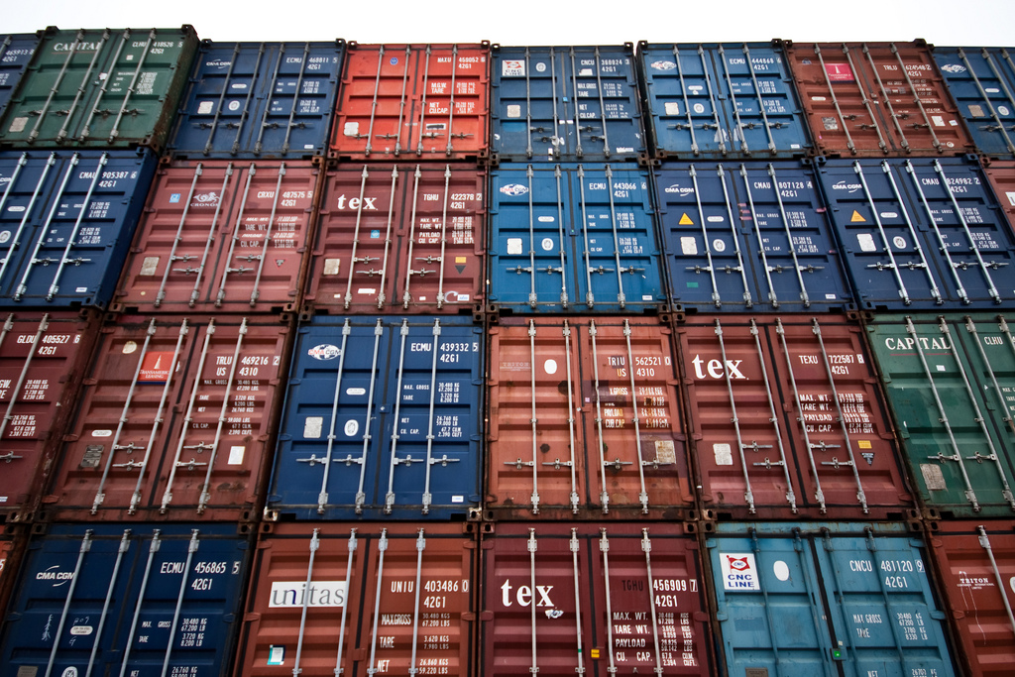
Notes:
Stacking containers on top of eachother.

Slide 50
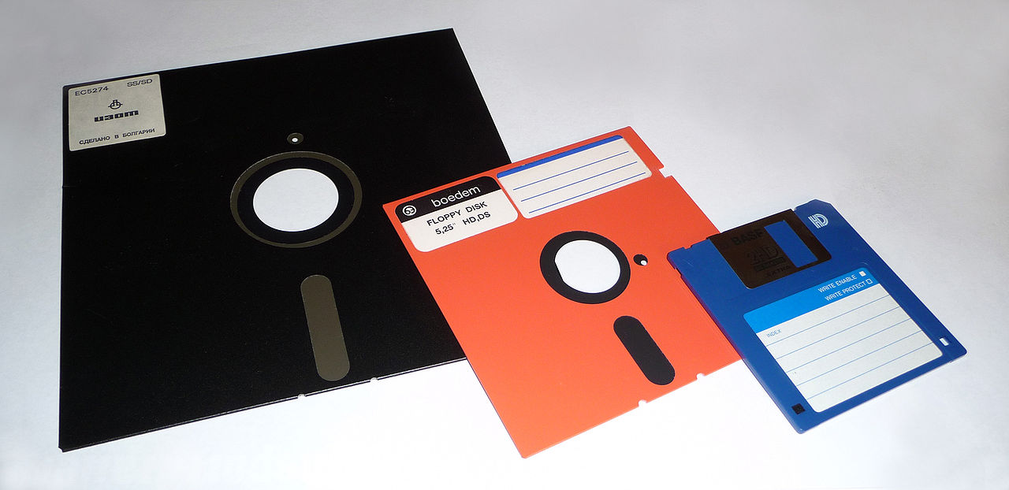
Notes:
Diskspace quickly disappears when playing with Docker. Do not forget to remove the containers/images.

Slide 51
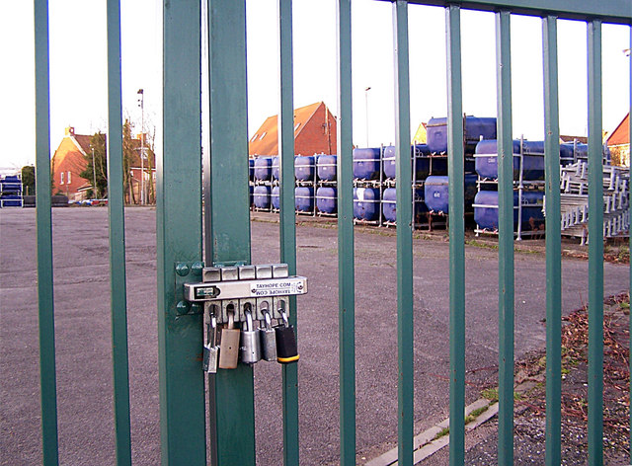
Notes:
How secure do you want it?

Slide 52
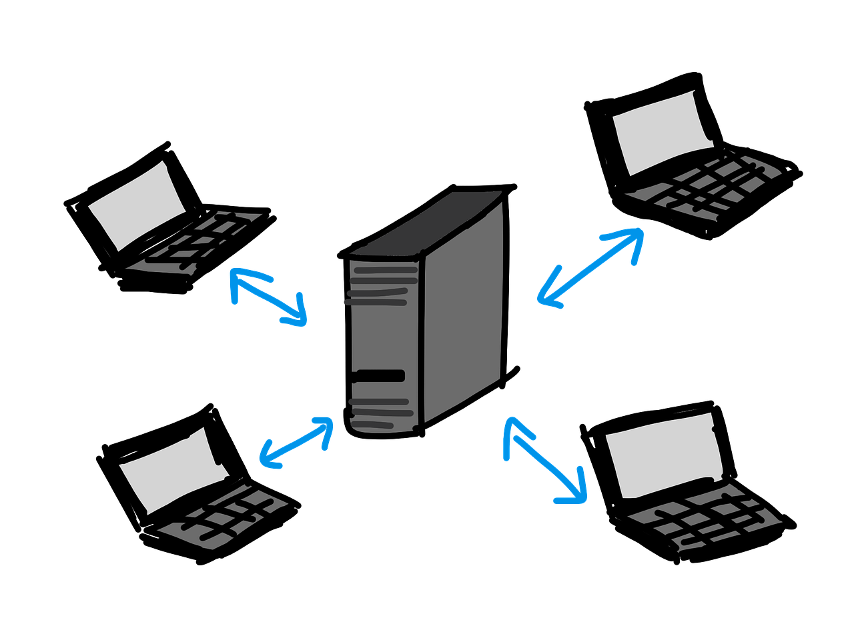
Notes:
Best scenario probably depends partly on the fact if the computer is dedicated or shared.

Slide 53
Summary
Easy to use
Highly flexible and customizable
Start playing with Docker!

Slide 54
Questions
https://bitbucket.org/johanjanssen/dockeride
@johanjanssen42 johan.janssen@infosupport.com

