Slide 1
Securing your JavaEE
Microservice with HMAC
Presents…
Davinder Kohli, Romana Sequeira, Scott Kramer

Slide 2



A little about Presenters…
Davinder Kohli
Head of Cloud Services
STA Group Inc.
Scott Kramer
Hands-On Architect
STA Group Inc.
Romana Sequeira
Hands-On Architect
STA Group Inc.

Slide 3
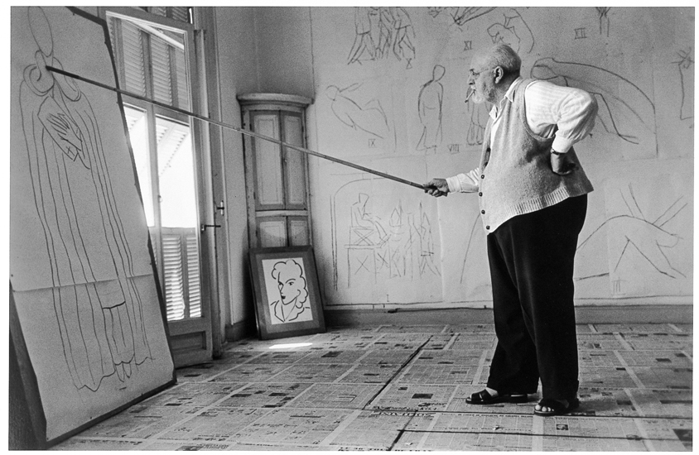
Agenda
Micro-services
  Concept and value proposition
  Monolithic architecture
  Micro-service architecture
  Security and data architecture
Securing Micro-services
  Cryptology Concepts
  HMAC
  When, Why, and How to use
Technical implementation
  Examples
Source: http://www.phaidon.com/

Slide 4









Generation
Payment Processing
Map<String, String>
process (Map<String, String>)
List<Payment>
processPayments (List<Integer>)
List<StudentPayment>
processStudentLoan (List<Integer>)

Slide 5

Micro-services concepts and value proposition
Service with single business capability
Separate process and self-contained
Share nothing model
Independently deployed
Atomic and idempotent
Performant
Usually REST based
Smart endpoint using dumb messaging

Slide 6
Monolithic architecture
REST API
Modular architecture
Supports multiple interfaces
All dependencies are well defined and contained
Security
Data Architecture
Underwriting Adapter
Doc Gen.
User Mgmt
Bank Adapter
Quote Purchase
Billing
Payments
Event Notf.
Notification Adapter
DB Adapter
WEB UI
Notes:
Data Arch – canonical models
Security – App level, DB level

Slide 7


Monolithic Architecture - Security & Data
LDAP Server
Perimetric Authenticator
LDAP
Token
App Server
DB Server
UI
Service
DAO
DB
Id/
Password
WAR
Authorization
Authorization
Authorization
DMZ
App Zone
Data Zone

Slide 8
SOA- Security & Data
VM
Perimetric Authenticator
LDAP
Token
VM
VM
WAR
UI
Service
DAO
APP DB
Id/
Password
SOAP
ESB
VM
SAML
LDAP
SSL
WS-Security
VM
VM
VM
VM
SVC A
SVC- A DB
SVC B
SVC - B DB
DMZ
App Zone
Data Zone

Slide 9
Microservices - Security & Data
VM
Perimetric Authenticator
LDAP
Token
VM
VM
WAR
UI
Service
DAO
APP DB
Id/
Password
REST
REST
VM
VM
VM
VM
SSL
HMAC
SVC A
SVC- A DB
SVC B
SVC - B DB
REST
VM
VM
Partner Service
LDAP
SSL
HMAC
SVC X
SVC - X DB
VM
VM
SVC Y
SVC - Y DB
App/Data Zone
DMZ

Slide 10

Cryptology Concepts
Basic Cryptology Concepts, Techniques, and Algorithms

Slide 11

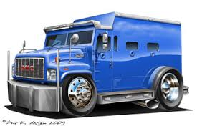


Ongoing Security Challenge…
Message authentication and encryption is simple, fast and stateless.
Easy to change access control based on shared secret keys.
Security is not dependent on the application communication topology.
Sender
Securing Message Transport
Receiver
Sender
Encrypting Message
Receiver
Notes:
-Plain Text vs Cipher Text
-History: earliest history to today problem is always getting message from sender to receiver securely; 2 solutions have emerged.

Slide 12
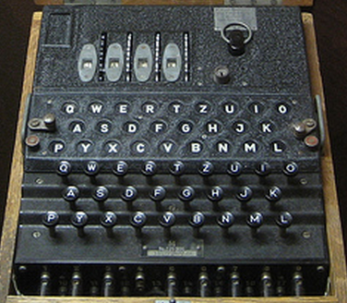
Basic Cryptology Concepts
A B C D E
1 2 3 4 5
ABC = 123
A B C D E
1 2 3 4 5
2 3 4 5 6
3 4 5 6 7
4 5 6 7 8
5 6 7 8 9
ABC = 135
Notes:
-> MATH IS THE BASIS FOR CRYPTOLOGY
-Enigma 150 Trillion Combinations for 4 wheels; 10 wires; or at 1 combo tried a second, 144,000 years!
->Key Concept is that complicated math is difficult even for the fastest computers and thus can be used for cryptology

Slide 13

Solution: How two people securely exchange a message ?
Clifford Cox solved this via complex mathematics
  RSA, basis for Public key and Private key and more….
  Multiplying two numbers is easy, determining the original prime numbers from result is hard.
  Factoring large integers that are product of multiplying two large prime numbers is complex.
  Can be slow; needs setup (Software Install; Key Locations; Certificate Authority, etc.)
  When to use?
    Certificate Authority setup;
    Configuration not a issue; Protocol independence not required
A
Public Key
Private Key
Alice
Bob
0101010
1011001
0101001
A
Space, The Final Frontier…
Space, The Final Frontier…
Encrypt
Decrypt
Notes:
-James Elis in 1970; -Clifford Cox
-Originally classified TOP SECRET
-Bob and Alice – All Security Documents Use it

Slide 14

Solution:
2 People (who never met) create a secret key publicly.
15
Eve
3 mod 17
13
Alice
6
Bob
12
3¹⁵ mod 17 = 6
3¹³ mod 17 = 12
12¹⁵ mod 17 =
6¹³ mod 17 =
10
10
3¹⁵ ¹³ mod 17 = 3¹³ ¹⁵ mod 17
Diffie-Hellman used “Discreet Logarithm” math to solve.
  <primitive-root>^{x} mod <base-number> Ξ <result>
One-way encoding is fast even with large numbers
Reversing the encoding without keys is very, very difficult
X * Y

Slide 15
Designing a better encryption technique…
Faster than Public/Private; protection from known attacks; simple to implement.
Hashed Method Authentication Code ( RFC-2104 )– basic idea is to concatenate key and message then hash them together.
HMAC = Hash(key ∥ Hash(key ∥ message)).
Unlike SSL it can be transmitted via any protocol with headers, is machine/router independent, and stateless.
Bob
Alice
AB
Shared Key
AB
Shared Key
H&%KS(A…
Space, The Final Frontier…
Space, The Final Frontier…
Space, The Final Frontier…
HMAC
H&%KS(A…
HMAC
H&%KS(A…
Notes:
What makes HMAC more secure than Message Authentication Code (MAC) is that the key and the message are hashed in separate steps.

Slide 16

Cryptology Algorithm Summary…
RSA – Asymmetric algorithm; Public/Private Key. Basis for SSL, SSH, PGP, TLS.
DIFFIE-HELLMAN – Public secure key exchange between 2 parties who have never met.
HMAC – Hashed Message Authentication Code; Very fast symmetric key algorithm (10 - 100000x).
AES - Advanced Encryption Standard, fast symmetric key algorithm supersedes DES is based on substitution permutation network.
SHA-2 - Secure Hash algorithm, replaced SHA-1(vulnerable) and considered a better choice than MD5. One way computation of hash from message.
Notes:
Any math crypto function relies on a impossible math problem. The longer the key and resulting cipher text determine its strength. As computers get more powerful, crypto is at risk.
The cryptographic strength of the HMAC depends upon the cryptographic strength of the underlying hash function, the size of its hash output, and on the size and quality of the key.
MD5 considered cryptographically broken and unsuitable for further use”
COMBINING TECHNIQUES CAN OVERCOME WEAKNESSES AND ENHANCE SECURITY

Slide 17
HMAC: Making it better…
While HMAC is a fast algorithm, the ability to send additional data with the HMAC allows for more benefits (Timestamps, Keys, UserID’s, etc).
  When decoding data, quickly discard inauthentic messages
  Limits denial of service attacks
  It reduces your "attack surface“ (areas where attack can occur.)
Encrypt-then-MAC is provably secure (similar to IPSEC).
Only possible attack against HMACs is brute force to get the secret key....
HMAC-MD5 does not suffer from weaknesses that have been found in MD5.
Notes:
-IPSEC (Tunnel and Gateway Modes)

Slide 18
Demo and Code Samples

Slide 19
Shopping Cart Example
Service Registry
WAR
Login
Product Catalog
Order/
Billing
Payment Confirmation
WAR
REST
REST
REST
User Service
Product Service
Order Service
REST
WAR
WAR
WAR
REST

Slide 20
Shopping Cart - HMAC Implementation
WAR
UI
HMAC Creation
Client JAR
REST
Product Service
Interceptor
HMAC Creation
REST Controller
WAR

Slide 21
Shopping Cart Example
UI Client
Request
AccessKeyId = …
Timestamp = …
1
Create a request:
Create
HMAC-SHA
signature:
String based on request contents
2
HMAC
CALC
Your Signature
Secret Access Key
wJalrXUtnFEMI/K7MDENG/
bPxRfiCYzEXAMPLEKEY
3
Send request and signature to Service:
Request
AccessKeyId = …
Timestamp = …
Order Service
Your Signature
Notes:
The sender generates a HMAC code that is sent with the message, the receiver calculates the HMAC for the message to authenticate it against senders HMAC.

Slide 22
Shopping Cart Example
Order Service
Request
AccessKeyId = …
Timestamp = …
Secret Access Key
Get Access Key ID
Get Secret Key
4
Retrieve Secret Access Key:
wJalrXUtnFEMI/K7MDENG/
bPxRfiCYzEXAMPLEKEY
Your Signature
Create HMAC-SHA signature:
String based on request
5
HMAC
CALC
Calc Signature
Secret Access Key
wJalrXUtnFEMI/K7MDENG/
bPxRfiCYzEXAMPLEKEY
Yes:
->Request authenticated
No:
->Request fails authentication
Compare the two signatures:
Calc Signature
Request Signature
6
?
UI Client

Slide 23
HMAC Code Client
SecretKeySpec signingKey = new SecretKeySpec(secretKey.getBytes(), HMAC_SHA256_ALGORITHM);
Mac mac = Mac.getInstance(HMAC_SHA256_ALGORITHM);
mac.init(signingKey);
String toSign = uri.getRawPath() + "\n" + accessKey + "\n" + timeStamp;
byte[] hmacBytes = mac.doFinal(toSign.getBytes());
String hmacString = new Base64().encodeAsString(hmacBytes);
Initialize MD5 MAC with signing key
Create request signature Hash
Encode the request Signature

Slide 24
HMAC Code Service
String apiKey = request.getHeader(HMACSigner.APIKEY_HEADER);
String timeStamp = request.getHeader(HMACSigner.TIMESTAMP_HEADER);
String signature = request.getHeader(HMACSigner.SIGNATURE_HEADER);
String calculatedSignature = hmacSigner.getSignature(apiKey, uri, timeStamp);
if (!calculatedSignature.equals(signature)) { // error }
Retrieve headers
Compute SHA256 MAC hash over the accessKey, uri and timeStamp
Client is authenticated if comparison of computed signature and Request header matches

Slide 25
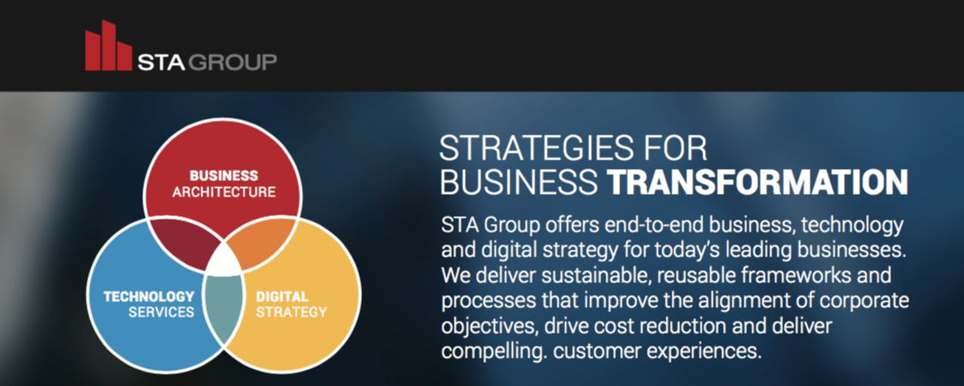
Mobile – Develop wide range of mobile apps for Fortune 500
Cloud – Expert cloud knowledge in host of technologies
Big Data – Certified in implementing many Big Data technologies
Security – Specialists in Application and Service Security
Digital Strategy – Handles many companies digital brands and UX
I.O.T .Technology – Significant IOT Developer for Fortune 500

