Slide 1
Antoine Chambille
Head of Research & Development, Quartet FS
@activepivot
Amir Javanshir
Principal Software Engineer, Oracle
@Amir_Javanshir

Slide 2
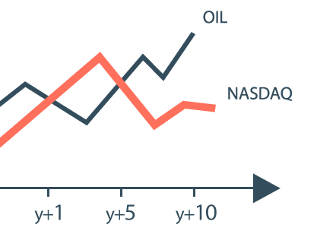
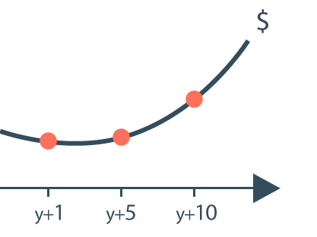
Credit Risk Use Case
Monte-Carlo simulation of future market data
Aggregate the valuation distribution vectors
x 5000
RISK ENGINES
Valuation of financial instruments for each simulation
Perform probabilistic calculation on aggregated vectors
x 200 time points
x 1M trades
ACTIVEPIVOT
= 8 TB of raw data

Slide 3
ActivePivot In-Memory Analytics
In-Memory Database…
Column Store
High Cardinality Bitmap Index
Multidimensional Aggregation
Designed for Multicore
… in Pure Java
Strong customization capabilities
Fast
Safe
Accessible to many

Slide 4
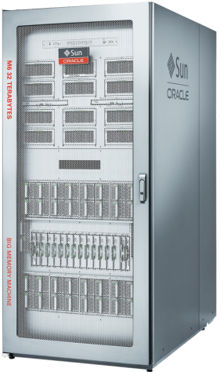
Oracle platform for in-memory computing
M6 Big Memory Machine: Terabyte Scale Computing leveraging Open Standards
384
3072
32
High Availability Build in
CORES
COMPUTE THREADS
TERABYTE
SYSTEM
MEMORY
LOW Latency < 170ns
3
1.4
1
TERABYTES PER SECOND
SYSTEM
BANDWIDTH
TERABYTES PER SECOND
MEMORY
BANDWIDTH
TERABYTE PER SECOND
I/O
BANDWIDTH
THE platform for in-memory computing
32 TERABYTE SYSTEM MEMORY

Slide 5
Off-Heap Memory (java.nio.Buffer)
// Allocate an array of doubles (in the heap)
double[] array = new double[1024*1024];
// ...
double value54 = array[54];
array[500] = array[100] + array[200];
// Allocate an off-heap buffer of doubles
DoubleBuffer buf = ByteBuffer.allocateDirect(8*1024*1024).asDoubleBuffer();
// ...
double value54 = buf.get(54);
buf.put(500, buf.get(100) + buf.get(200));

Slide 6
Off-Heap Memory (sun.misc.Unsafe)
// You know what this is
sun.misc.Unsafe UNSAFE = getUnsafe();
// Allocate 8MB of off-heap memory
long pointer = UNSAFE.allocateMemory(8*1024*1024);
UNSAFE.setMemory(pointer, 8*1024*1024, (byte) 0);
// ...
double value54 = UNSAFE.getDouble(pointer + 8*54);
UNSAFE.putDouble(
pointer + 8*500,
UNSAFE.getDouble(pointer + 8*100) + UNSAFE.getDouble(pointer + 8*200)
);

Slide 7
Off-Heap Memory
Performance:
Off-Heap Memory in the core data structures
Columns of numbers
Vectors of simulations
Hash tables
Indexes
Serialized objects
Usability:
Standard Java in the query engine
« Young » generation
1 to 4 ratio
3 TB Heap for queries and calculations
12 TB dataset Off-Heap
1 TO 4 RATIO
12 TB dataset Off-Heap
3 TB Heap for queries and calculations
« Old » generation

Slide 8
Unleashing Multi-Core Parallelism
Fork/Join Pool (©Doug Lea)
Reentrant thread pool
Work stealing
Lock-Free Data Structures
Dictionaries
Indexes
Queues
Lockless Transactions
Multiversion Concurrency Control
… are not enough
Scales on 4, 8, 16, 32 cores
Not much further
New approach required for Many-Cores architectures

Slide 9
Unleashing Many-Cores Parallelism
Before
After
DATA PARTITION
DATA
CPU

Slide 10
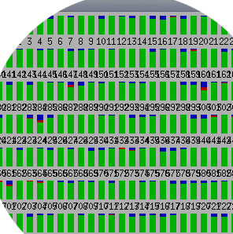
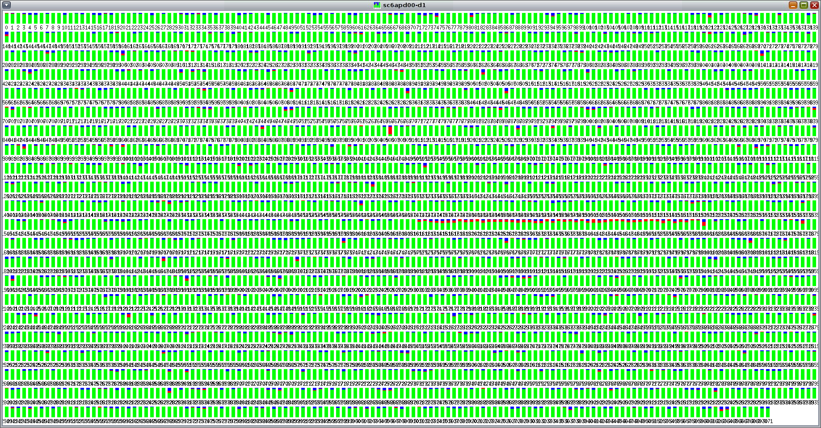
Unleashing Many-Cores Parallelism
1 thread
x 3072

Slide 11
Unleashing Many-Cores Parallelism
Query Time (seconds)
30
20
24 s
17 s
10
13 s
0
3 TB
6 TB
12 TB
&
&
&
8x
16x
32x

Slide 12
NUMA Architecture

Slide 13
NUMA Architecture
32 NUMA nodes

Slide 14
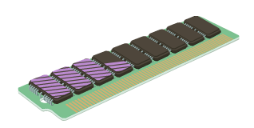
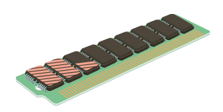
NUMA Architecture
Allocated memory A
Process A
Process B
Allocated memory B

Slide 15
NUMA System Library
Linux
protected interface NumaLibrary extends com.sun.jna.Library {
/** @return -1 if NUMA is not available, … */
int numa_available();
/** @return the number of memory nodes in the system. */
int numa_num_configured_nodes();
/** @return the NUMA node the cpu currently belongs to. */
int numa_node_of_cpu(int cpu);
int numa_run_on_node(int node);
int numa_distance(int node1, int node2);
//...
}

Slide 16
NUMA System Library
Linux
NumaLibrary numaLib = (NumaLibrary) Native.loadLibrary("numa", NumaLibrary.class);
PthreadLibrary pthreadLib =
(PthreadLibrary) Native.loadLibrary("pthread", PthreadLibrary.class);
int cpuId = pthreadLib.sched_getcpu();
int nodeCount = numaLib.numa_num_configured_nodes();
int currentNode = numaLib.numa_node_of_cpu(cpuId);
Solaris
LgrpLibrary lgrpLib = (LgrpLibrary) Native.loadLibrary("lgrp", LgrpLibrary.class);
long cookie = lgrpLib.lgrp_init(lgrp_view.OS);
int rootGroup = lgrpLib.lgrp_root(cookie);
int nbGroups = lgrpLib.lgrp_nlgrps(cookie);
// ...

Slide 17
NUMA System Library
Linux
NumaLibrary numaLib = (NumaLibrary) Native.loadLibrary("numa", NumaLibrary.class);
PthreadLibrary pthreadLib =
(PthreadLibrary) Native.loadLibrary("pthread", PthreadLibrary.class);
int cpuId = pthreadLib.sched_getcpu();
int nodeCount = numaLib.numa_node_of_cpu(cpuId);
int currentNode = numaLib.numa_node_of_cpu(pthreadLib.sched_getcpu());
// ...
// Bind the current thread to NUMA node '0'
numaLib.numa_run_on_node(0);

Slide 18
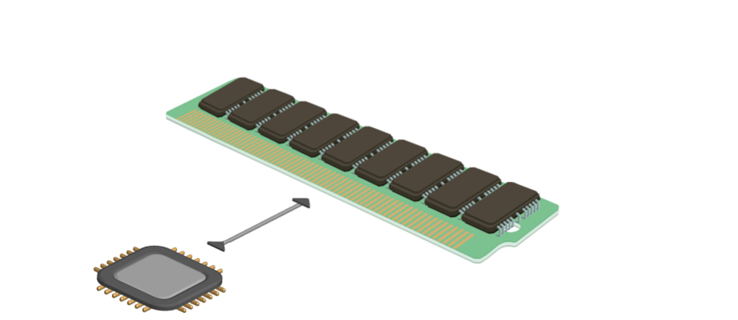
Unleashing NUMA Parallelism
DATA PARTITIONS

Slide 19
Unleashing NUMA Parallelism
Query Throughput
600
549
GB/s
400
399
GB/s
200
269
GB/s
0
3 TB
6 TB
12 TB
&
&
&
8x
16x
32x

Slide 20
Garbage Collection (G1 and the 3TB Heap)
-XX:+UseG1GC -XX:InitialHeapSize=3298534883328 -XX:MaxHeapSize=3298534883328 -XX:MaxDirectMemorySize=13194139533312 -XX:-UseAdaptiveSizePolicy -XX:+UnlockExperimentalVMOptions -XX:SurvivorRatio=1 -XX:ParallelGCThreads=960 -XX:ConcGCThreads=240 -XX:G1HeapWastePercent=5 -XX:G1MaxNewSizePercent=85 -XX:G1MixedGCLiveThresholdPercent=80 -XX:InitiatingHeapOccupancyPercent=10 -XX:G1NewSizePercent=70 -XX:G1ReservePercent=10 -XX:G1HeapRegionSize=33554432 -XX:LargePageSizeInBytes=268435456 -XX:MaxGCPauseMillis=1000 -XX:ReservedCodeCacheSize=251658240
-XX:+PrintAdaptiveSizePolicy -XX:+PrintGC -XX:+PrintGCApplicationConcurrentTime -XX:+PrintGCApplicationStoppedTime -XX:+PrintGCDetails -XX:+PrintGCTimeStamps -XX:+PrintTenuringDistribution -XX:+SegmentedCodeCache -XX:G1LogLevel=finest

Slide 21
Garbage Collection (G1 and the 3TB Heap)
-XX:+UseG1GC -XX:InitialHeapSize=3298534883328 -XX:MaxHeapSize=3298534883328 -XX:MaxDirectMemorySize=13194139533312 -XX:-UseAdaptiveSizePolicy -XX:+UnlockExperimentalVMOptions -XX:SurvivorRatio=1 -XX:ParallelGCThreads=960 -XX:ConcGCThreads=240 -XX:G1HeapWastePercent=5 -XX:G1MaxNewSizePercent=85 -XX:G1MixedGCLiveThresholdPercent=80 -XX:InitiatingHeapOccupancyPercent=10 -XX:G1NewSizePercent=70 -XX:G1ReservePercent=10 -XX:G1HeapRegionSize=33554432 -XX:LargePageSizeInBytes=268435456 -XX:MaxGCPauseMillis=1000 -XX:ReservedCodeCacheSize=251658240
-XX:+PrintAdaptiveSizePolicy -XX:+PrintGC -XX:+PrintGCApplicationConcurrentTime -XX:+PrintGCApplicationStoppedTime -XX:+PrintGCDetails -XX:+PrintGCTimeStamps -XX:+PrintTenuringDistribution -XX:+SegmentedCodeCache -XX:G1LogLevel=finest

Slide 22
Garbage Collection (G1 and the 3TB Heap)
-XX:+UseG1GC -XX:InitialHeapSize=3298534883328 -XX:MaxHeapSize=3298534883328 -XX:MaxDirectMemorySize=13194139533312 -XX:-UseAdaptiveSizePolicy -XX:+UnlockExperimentalVMOptions -XX:SurvivorRatio=1 -XX:ParallelGCThreads=960 -XX:ConcGCThreads=240 -XX:G1HeapWastePercent=5 -XX:G1MaxNewSizePercent=85 -XX:G1MixedGCLiveThresholdPercent=80 -XX:InitiatingHeapOccupancyPercent=10 -XX:G1NewSizePercent=70 -XX:G1ReservePercent=10 -XX:G1HeapRegionSize=33554432 -XX:LargePageSizeInBytes=268435456 -XX:MaxGCPauseMillis=1000 -XX:ReservedCodeCacheSize=251658240
-XX:+PrintAdaptiveSizePolicy -XX:+PrintGC -XX:+PrintGCApplicationConcurrentTime -XX:+PrintGCApplicationStoppedTime -XX:+PrintGCDetails -XX:+PrintGCTimeStamps -XX:+PrintTenuringDistribution -XX:+SegmentedCodeCache -XX:G1LogLevel=finest

Slide 23
Garbage Collection (G1 and the 3TB Heap)
-XX:+UseG1GC -XX:InitialHeapSize=3298534883328 -XX:MaxHeapSize=3298534883328 -XX:MaxDirectMemorySize=13194139533312 -XX:-UseAdaptiveSizePolicy -XX:+UnlockExperimentalVMOptions -XX:SurvivorRatio=1 -XX:ParallelGCThreads=960 -XX:ConcGCThreads=240 -XX:G1HeapWastePercent=5 -XX:G1MaxNewSizePercent=85 -XX:G1MixedGCLiveThresholdPercent=80 -XX:InitiatingHeapOccupancyPercent=10 -XX:G1NewSizePercent=70 -XX:G1ReservePercent=10 -XX:G1HeapRegionSize=33554432 -XX:LargePageSizeInBytes=268435456 -XX:MaxGCPauseMillis=1000 -XX:ReservedCodeCacheSize=251658240
-XX:+PrintAdaptiveSizePolicy -XX:+PrintGC -XX:+PrintGCApplicationConcurrentTime -XX:+PrintGCApplicationStoppedTime -XX:+PrintGCDetails -XX:+PrintGCTimeStamps -XX:+PrintTenuringDistribution -XX:+SegmentedCodeCache -XX:G1LogLevel=finest

Slide 24
Garbage Collection (G1 and the 3TB Heap)
-XX:+UseG1GC -XX:InitialHeapSize=3298534883328 -XX:MaxHeapSize=3298534883328 -XX:MaxDirectMemorySize=13194139533312 -XX:-UseAdaptiveSizePolicy -XX:+UnlockExperimentalVMOptions -XX:SurvivorRatio=1 -XX:ParallelGCThreads=960 -XX:ConcGCThreads=240 -XX:G1HeapWastePercent=5 -XX:G1MaxNewSizePercent=85 -XX:G1MixedGCLiveThresholdPercent=80 -XX:InitiatingHeapOccupancyPercent=10 -XX:G1NewSizePercent=70 -XX:G1ReservePercent=10 -XX:G1HeapRegionSize=33554432 -XX:LargePageSizeInBytes=268435456 -XX:MaxGCPauseMillis=1000 -XX:ReservedCodeCacheSize=251658240
-XX:+PrintAdaptiveSizePolicy -XX:+PrintGC -XX:+PrintGCApplicationConcurrentTime -XX:+PrintGCApplicationStoppedTime -XX:+PrintGCDetails -XX:+PrintGCTimeStamps -XX:+PrintTenuringDistribution -XX:+SegmentedCodeCache -XX:G1LogLevel=finest

Slide 25
Garbage Collection Stress Test
Garbage Collection Time Distribution
99%

Slide 26
What’s Next?
Already working
(Huge) read-only queries on (a lot of) static data
Oracle and Quartet FS partnership
Oracle Engineering will use ActivePivot as the reference use case for very large heap support
Quartet FS will implement recommendations by Oracle Engineering
The road to Operational Analytics
Large data updates
Real-time data updates
Continuous queries on live data
« Mixed Workload » operations
Objectives
Scale GC on many cores and NUMA
Reduce GC pause times
Accelerate Full GC
Support Mixed-Workload

Slide 27
Do you want to be part of it? Please make the connection
Antoine Chambille
antoine.chambille@quartetfs.com
Amir Javanshir
amir.javanshir@oracle.com
www.quartetfs.com

