Slide 1

Developing in the cloud
Ryan Cuprak

Slide 2

Developing in the Cloud
5000 ft versus 3000 ft
Notes:
In today’s presentation we will be looking at developing at 30k versus 5k ft – versus.
Which altitude gives you the best the view and least turbulence etc.
Since there is no cellphone service and only spotting internet, this is probably the best place to actually write code during the day.

Slide 3
Developing in the Cloud
Agenda
Cloud Development Tooling
Version Control
Issue Tracking
Java EE Testing
(cloud emphasis)
Continuous Integration
Continuous Deployment
Integration Testing
Notes:
I will be focusing on two things in this presentation – cloud development tooling and Java EE testing in the cloud.

Slide 4
Why Develop in the Cloud?
Work Development Processes
Processes are audited by customers (GMP)
All code changes are tracked
Rigorous life-cycle for features/defects
Dashboard for tracking development progress
Continuous integration setup:
Unit tests/Integration tests/system tests
Database setup
Automated process for testing deployment
I want this for home!
Notes:
I work for Dassault Systemes, specifically on software that is used in regulated industries.
Since I work on software used in
These products are regulated by the FDA. Hence we have to have a well defined development process.
- Every line of code has to be accounted for. I just can’t start making changes and check them it.

Slide 5
Why Develop in the Cloud?
Continuous Integration Challenges
Hardware
Software
Maintenance/Security
Configuration
Networking
Cost
Notes:
Challenges with standing up a development environment are many.
You need hardware and software (databases/web servers etc.)
You have to manage security and apply patches – which can be a fulltime job
Networking the machines
Cost of running the hardware – computers do consume quite a bit of electricity. I know that UPS and Mac mini along with the screen consumes something like $18 for month.

Slide 6
Why Develop in the Cloud?
Onsite versus Cloud
Constructing a robust development environment is:
Expensive
Hard
Time consuming
Cloud services simplifies CI environment:
Easy to setup…
Relatively cheap…
Low maintenance…
Future is here – many new software companies are only in the cloud.
Notes:
- So, summarizing the challenges, to setup your own environment is expensive, hard, and time consuming.
- All of the time you spend configuring and maintaining your environment will leave precious little time left to actually use it.

Slide 7
Why Develop in the Cloud?
Benefits of Cloud Development Environment
Minimize time spent configuring/managing tools
Scale projects as resource needs change
Easily support distributed development
Use pre-configured integrated tool stack
Build/test for other platforms requiring special hardware/tools.
iOS
Windows mobile
Scalability testing
Easily create a ‘clean environment’

Slide 8
Developing in the Cloud
Cloud Models
Self-Hosted in cloud
Create VMs and install developer tools (version control/bug trackers/etc.)
Manage all aspects of configuration/security
Costs: data storage and usage
Vendor Hosted in cloud
Vendor provides hosted solution – fully configured/managed.
Little maintenance or configuration
Costs: monthly fees, storage and usage
Hybrid
Some tools are hosted locally (example: code repository)

Slide 9
Services
Version Control Vendors
Vendor | Price (monthly)
github | $0-$50
BitBucket | $0-$200
Java.net | Free
Sourceforge | Free
Beanstalk | $15-$200
CodePlex | Free
Amazon | Free-$
* github and bitbucket are the leading vendors.

Slide 10
Services
Continuous Integration Vendors
Vendor | Opensource | Paid (monthly)
Atlassian | N/A | $10-$1000
CloudBees | N/A | $60-$200
Travis CI | Free | $129-$489
AppVeyor | None | $19-$99
Shippable | Free | $12-Custom
CodeShip | Free | $49-$1999
Semaphore | Free | $0-$199
drone.io | Free | $25-$49
Snap CI | Free | $0-$180
PhoneGap | Free

Slide 11
Services
Issue Trackers Vendors
Vendor | Monthly Price
JIRA | $10-$1000
YouTrack | Free-$500
BugHost | $29-$159
Bontq | $9-$149
FogBugz | $18-$540
CloudForge | $2-$10 (per user)
devZing (Bugzilla hosting) | $15
Many more…

Slide 12
Vendors
Old Services
Old Java standbys:
java.net
sourceforge.net
Features:
Wikis
Blogging
Issue tracking
No continuous integration support
Limited tooling integrat

Slide 13
Vendors
Considerations
Open source or private?
Paid or free account?
Use integrated issue system or separate?
Tool chain integration?
Customizable:
Operating systems
Databases
Test installation scripts
Data migrations
Workflows
Issue Tracking
Continuous Integration
Version Control
Deployment
How do these integrate?

Slide 14
Vendors
My Requirements
Private projects
Ability to switch from private to public and vice versa
Version control: git
Continuous integration Amazon
Projects:
Maven/Gradle builds
Junit/Jasmine for unit testing
NetBeans
IDEs
NetBeans
IntelliJ
SourceTree
xCode

Slide 15
Developing in the Cloud
What cloud services did I choose?
Github – version control ($7 / month)
Unlimited public repositories
5 private repositories
Bamboo – Continuous Integration ($10 / month)
10 jobs / 1 agent
Builds are executing on AWS EC2 instances.
JIRA – issue tracking ($10 / month)
10 users
Amazon Web Services
VMs/databases/VPS
Total cost: $27 / month (excluding AWS usage)

Slide 16


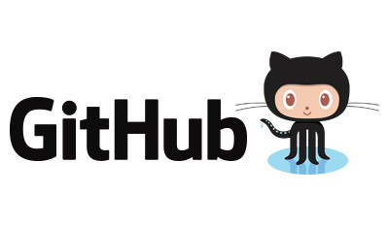


Developing in the Cloud
Puzzle Pieces

Slide 17
Developing in the Cloud
Getting Started
Create github account
Create JIRA/Bamboo account
Create AWS Account
http://github.com
http://tinyurl.com/leo7rop
http://aws.amazon.com

Slide 18
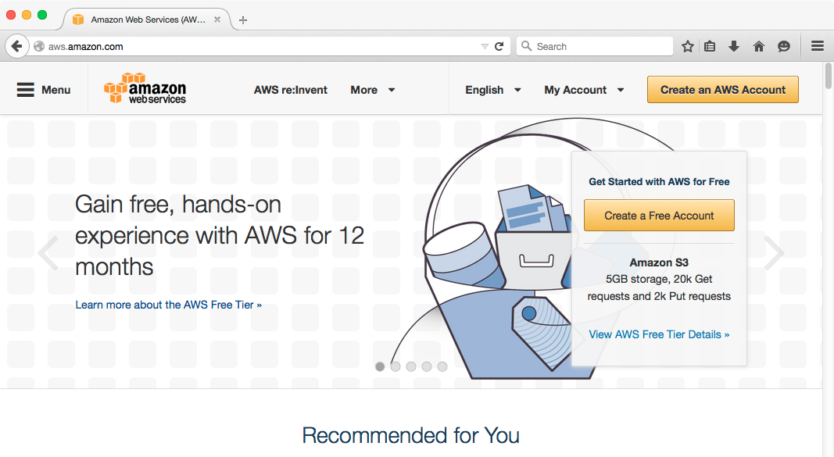
Amazon Web Services (AWS)
Available to Anyone

Slide 19
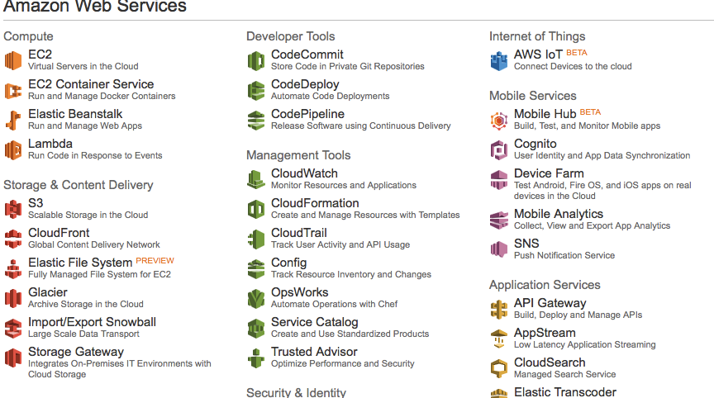
Amazon Web Services (AWS)
Amazon Web Services
EC2
RDS
VPC

Slide 20
Amazon Web Services (AWS)
Developer Tools
Code Commit
Managed source code control system (git)
Integrated with IAM
Code Deploy
Automates code deployments to EC2s (from git/S3)
Provides information on deployment status etc.
Integrates with Atlassian, CloudBees, Jenkins, etc.
Code Pipeline
Continuous delivery service
Automates building, testing, and deployment into production
Mobile Hub
Build and test on REAL mobile devices in the cloud

Slide 21
Amazon Web Services (AWS)
AWS Core Concepts – EC2 Prices Sampling
EC2 – Elastic Cloud Computing
VMs == AMI (Amazon Machine Image)
Name | vCPU | ECU | Memory (GiB) | Storage | Hourly Fee
t2.micro | 1 | Variable | 1 | EBS Only | $0.013
t2.small | 1 | Variable | 2 | EBS Only | $0.026
t2.medium | 1 | Variable | 4 | EBS Only | $0.052
m3.medium |  | 3 | 3.75 | 1 x 4 SSD | $0.070
m3.large | 2 | 6.5 | 7.5 | 1 x 32 SSD | $0.140
m3.xlarge | 4 | 13 | 15 | 2 x 40 SSD | $0.280
m2.2xlarge | 8 | 26 | 30 | 2 x 80 SSD | $0.560

Slide 22
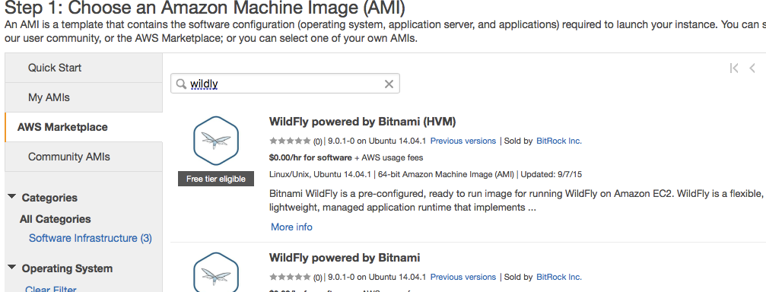
Amazon Web Services (AWS)
AWS Core Concepts – EC2
Amazon provides a large library of AMIs.
Bamboo has pre-configured AMIs with Bamboo agent installed.
Instances are accessed via ssh (download keys)

Slide 23
Amazon Web Services (AWS)
AWS Core Concepts - VPC
VPC = Virtual Private Cloud
Complete control over virtual networking environment:
IP address range
Subnets
Routing tables
Network gateways
VPC can be connected to a corporate data center
AMI instances can be launched into a VPC.
Databases belong to a VPC.

Slide 24
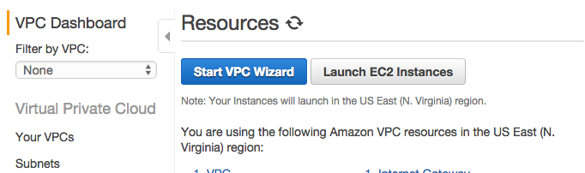
Amazon Web Services (AWS)
AWS Core Concepts – VPC Wizard

Slide 25
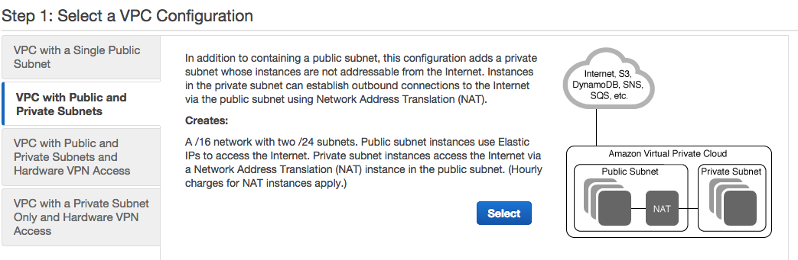
Amazon Web Services (AWS)
AWS Core Concepts – VPC Wizard

Slide 26
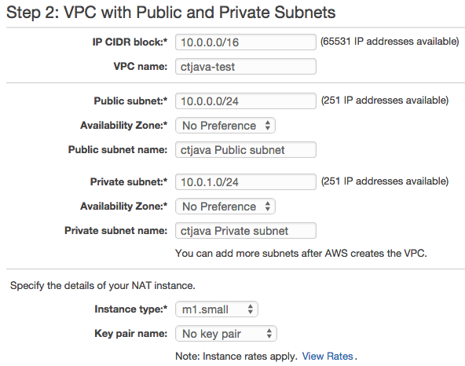
Amazon Web Services (AWS)
AWS Core Concepts – Wizard VPC

Slide 27
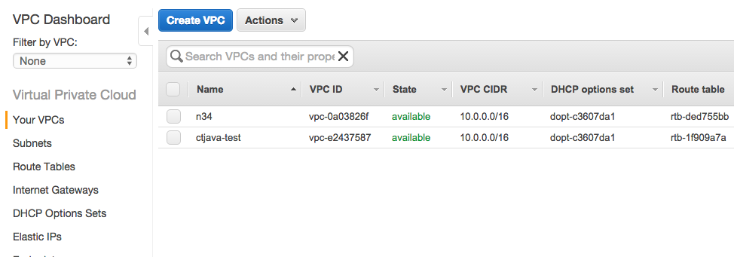
Amazon Web Services (AWS)
AWS Core Concepts – Wizard VPC

Slide 28
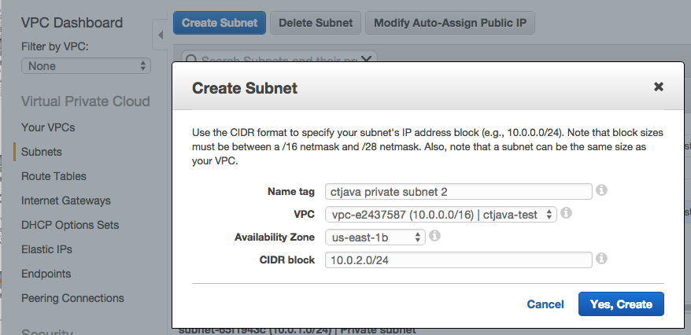
Amazon Web Services (AWS)
AWS Core Concepts – Wizard VPC

Slide 29
Amazon Web Services (AWS)
Amazon RDS
Amazon RDS – Amazon Relational Database Service
Supported databases:
MySQL
Oracle
Microsoft SQL Server
PostgreSQL
Provisioned using SSD, IOPS Storage, Magnetic.
Automated failover, backups, multiple-zones, mirroring
Can attach to a VPC.

Slide 30
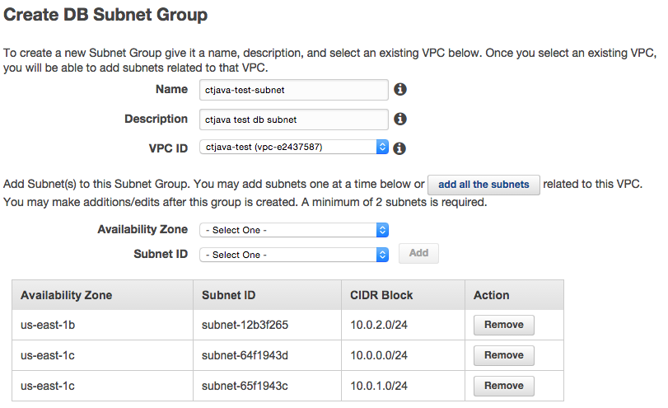
Amazon Web Services (AWS)
Amazon RDS

Slide 31
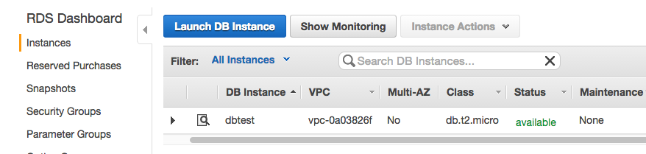
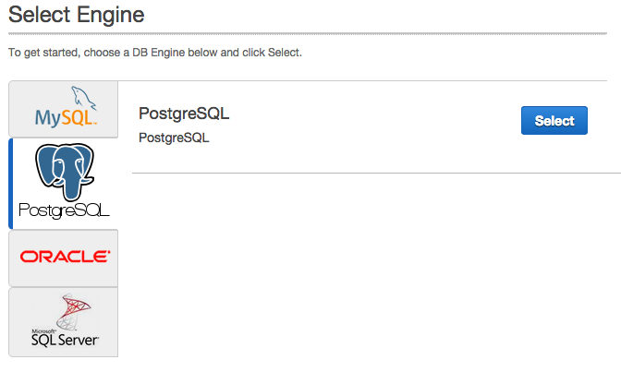
Amazon Web Services (AWS)
Amazon RDS

Slide 32
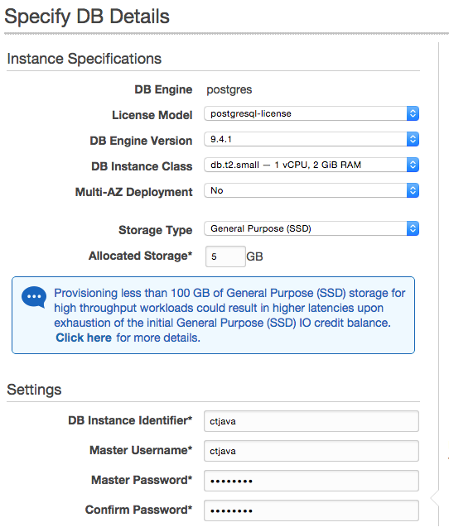
Amazon Web Services (AWS)
Amazon RDS

Slide 33
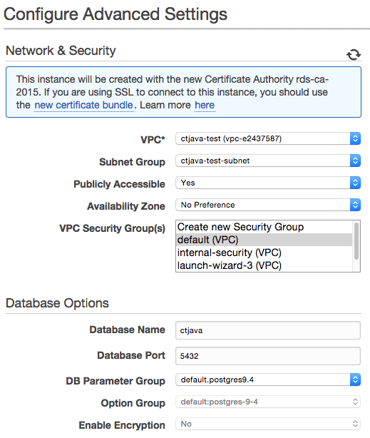
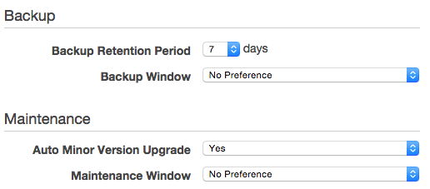
Amazon Web Services (AWS)
Amazon RDS

Slide 34
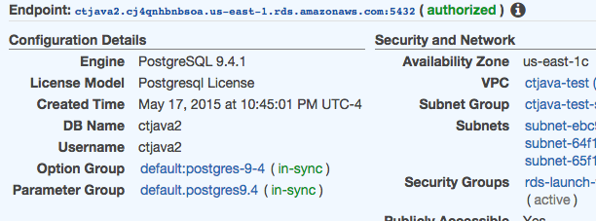
Amazon Web Services (AWS)
Amazon RDS
After database starts-up, log into a VM.
Run: “sudo yum postgresql” to install PostgreSQL client.

Slide 35

JIRA
Overview
Issue and bug tracking
Project management
Bamboo requires JIRA
Issue level security
Custom workflows
Visual workflow designer
Scheduling
Issue voting
Dashboards
Change logs
Cost $10/month cloud
Many More…

Slide 36
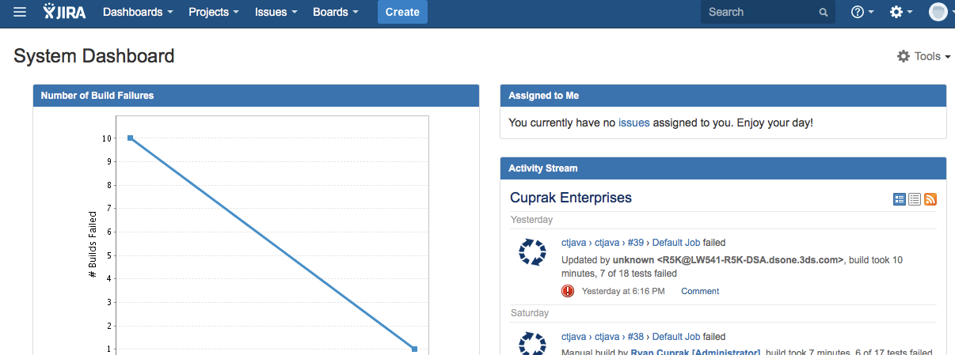
JIRA
Dashboard

Slide 37
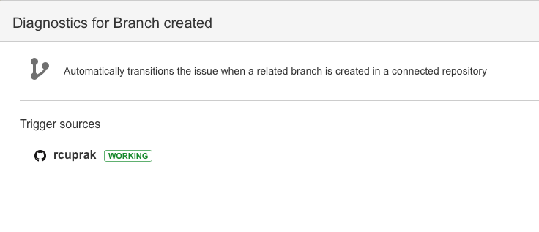
JIRA
JIRA Integration
Plugins available for IDEs (NetBeans/IntelliJ/Eclipse)
SourceTree integration
Benefits of integration
git pushes trigger issue state transitions.

Slide 38
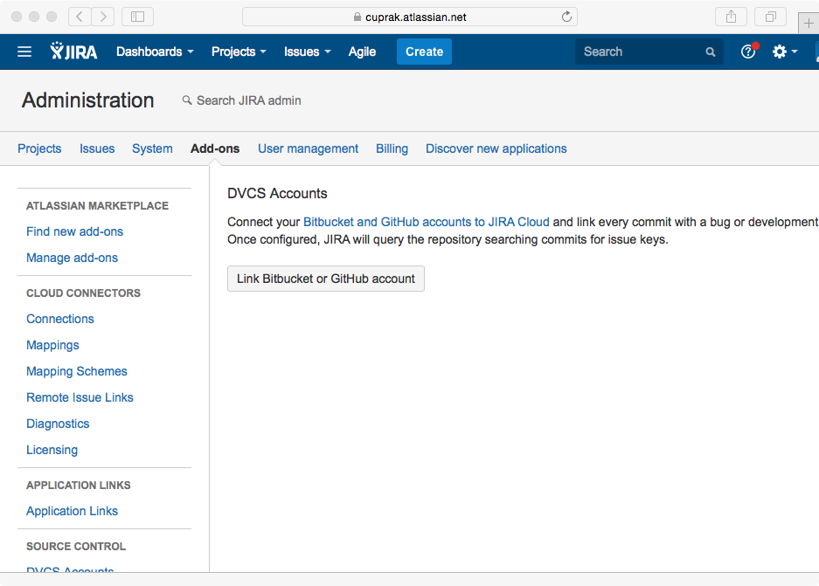
JIRA
Configuring Integration

Slide 39

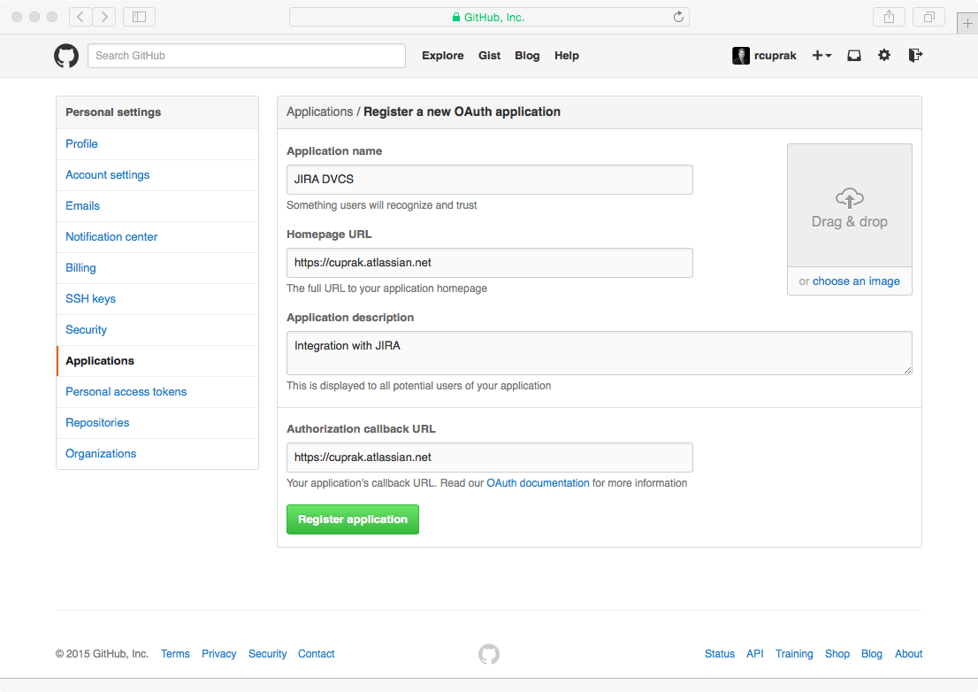
JIRA
GitHub Integration

Slide 40
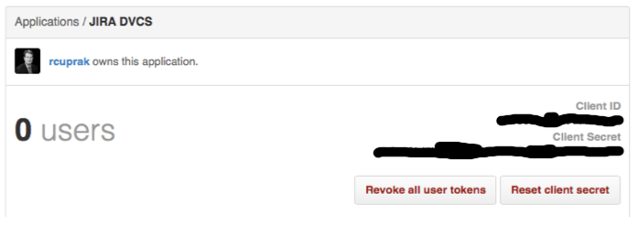
Developing in the Cloud
Configuring GitHub Integration

Slide 41
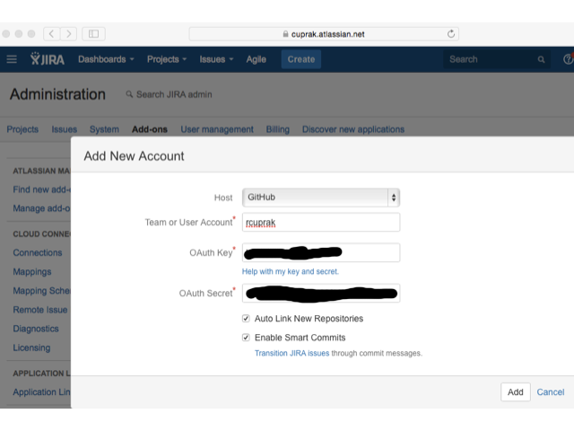
Developing in the Cloud
Configuring GitHub Integration

Slide 42

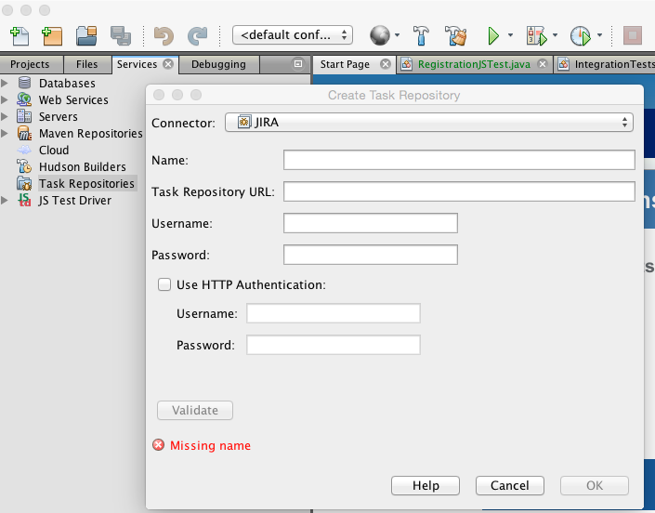
Developing in the Cloud
NetBeans JIRA Integration

Slide 43
Bamboo
Bamboo Overview
Bamboo is central management server which schedules/coordinates all work. With cloud, Bamboo management server is hosted at Atlassian.
Requires a license to JIRA.
Bamboo Agent – a service that can run build jobs.
Elastic Agent – a remote Bamboo agent that runs on Amazon EC2.
Capability – feature of an agent, such as JDK installed, version of Maven available, etc.

Slide 44
Developing in the Cloud
Bamboo - Building
Bamboo builds
Running Bamboo Agent
Run job
git pull
Build and test

Slide 45

Bamboo
Bamboo versus Jenkins
Jenkins
More popular than Bamboo.
Easier to configure than Bamboo.
Free
Large pool of plugins (1000+)
Bamboo
Integrated with JIRA.
Automated merging (git/mercurial)
CI & CD pipelines
Build agent
Requires JIRA for cloud account

Slide 46
Bamboo
Core Concepts
Term | Definition
Project | Provides reporting across all plans in a project.
Plan | Specifies default repository, how build is triggered, dependencies between other plans, notifications, permissions, definition of plan variables.
Stage | Processes its jobs in parallel on multiple agents. Can produce artifacts for another stage.
Job | Processes a series of one or more tasks that are run sequentially on the same agent. Controls which tasks are performed. Defines artifacts that the build will produce.
Task | Small discrete unit of work (code checkout, execute Maven goal, etc.). Is run sequentially within a job on a Bamboo working directory.

Slide 47
Bamboo
Concepts Illustrated
Plan
Stage
Stage
Stage
Job
Job
Job
Task
Task
Task
Task
Task
Job
Job
Task
Task
Task

Slide 48
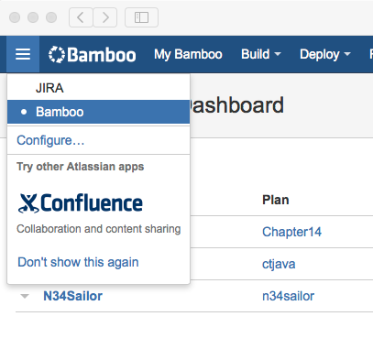
Bamboo
Navigation

Slide 49
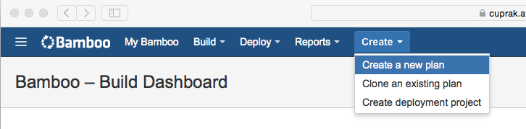
Bamboo
Getting Started

Slide 50
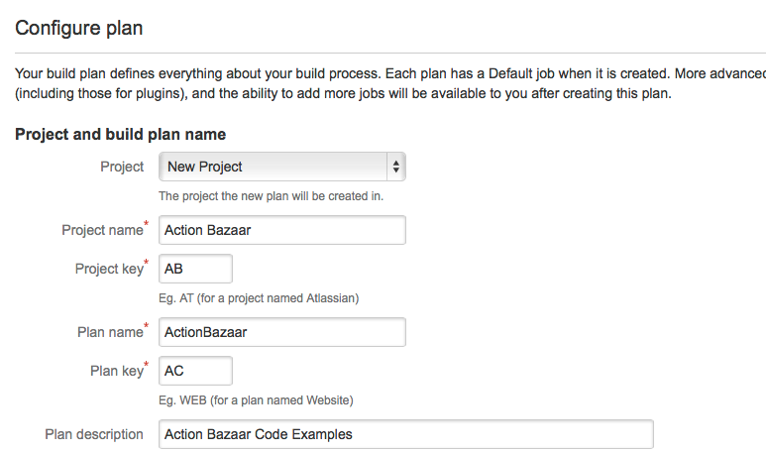
Bamboo
Plan Configuration

Slide 51
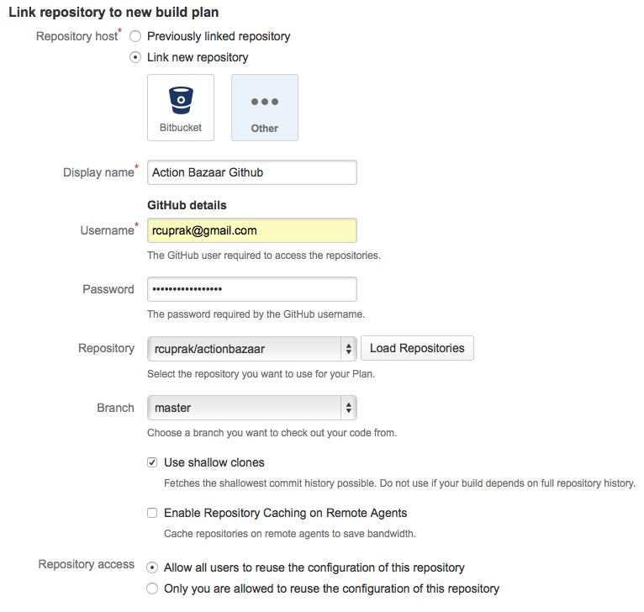
Bamboo
Plan Configuration

Slide 52
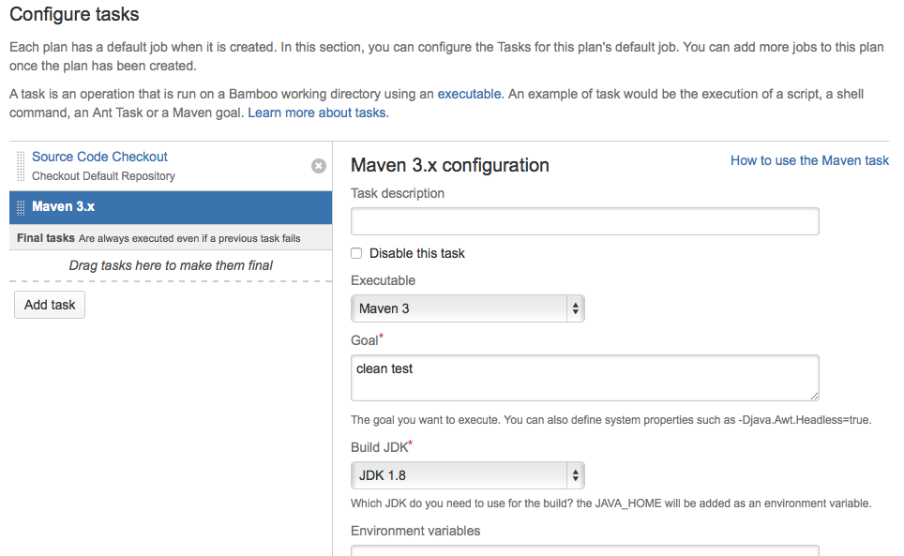
Bamboo
Task Configuration

Slide 53
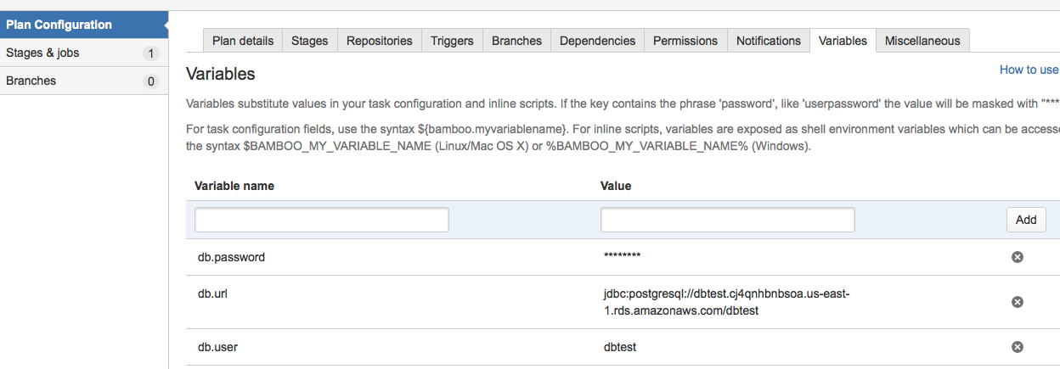
Bamboo
Environment Variables
These environment variables are passed to the JVM.

Slide 54
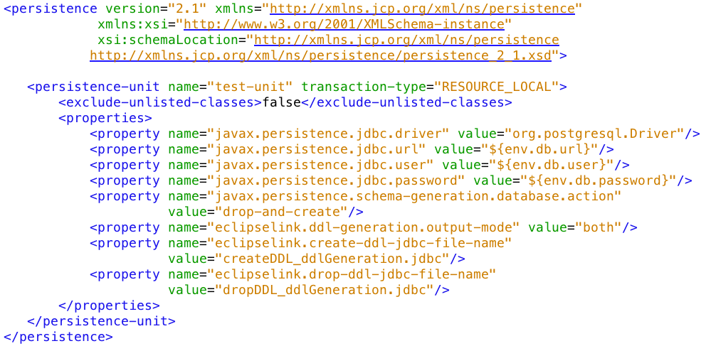
Bamboo
Accessing Bamboo Environment Variables

Slide 55
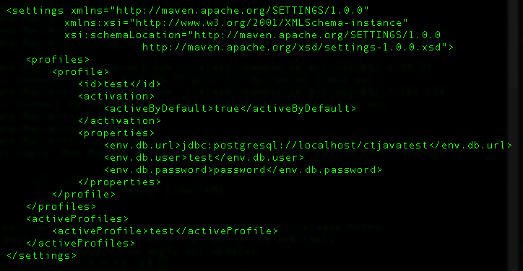
Bamboo
Locally Testing ~/.m2/settings.xml

Slide 56
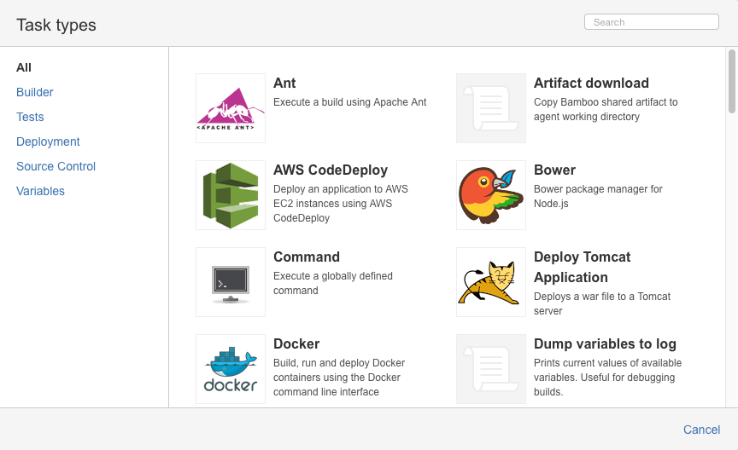
Bamboo
Tasks

Slide 57
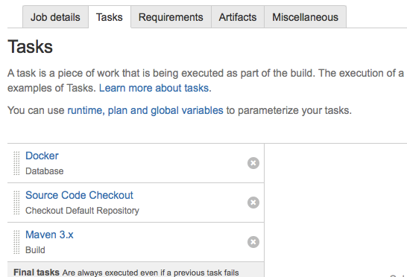
Bamboo
Tasks

Slide 58
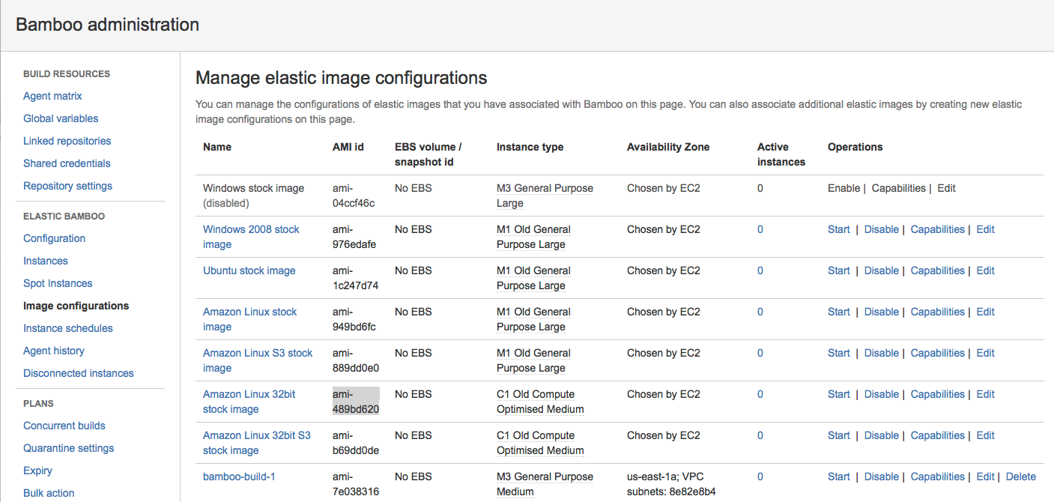
Bamboo
Agents

Slide 59
Developing in the Cloud
AMI Customization
Find Bambo AMI
Launch instance
Customize instance
Take Snapshot
Launch customized instance

Slide 60



Java EE + Cloud
Java EE + Bamboo + AWS
Bamboo + AWS = full testing in the cloud.
Create custom environments for simulating a cluster.
Test load balancing setup.
Test JavaScript code
Stress test server under heavy load.
Testing: unit testing, integration testing, load testing.

Slide 61

Java EE + Cloud
Testing Needs
RESTful endpoints
WebSocket endpoints
Security
Scalability
JavaScript code
JavaScript + Browser + Server
Server failures
Large scale deployment
Bad Data

Slide 62
Java EE + Cloud
Example Test Environment (VPC)
AWS

Slide 63
Java EE + Cloud
Java EE Application - ctjava
Project Overview
Java EE 7 web application
GlassFish 4.1
PostgreSQL
Maven based build
Arquillian unit testing
Setup
Modularized architecture
Data model and DAOs in ctcore
Unit and integration testing

Slide 64

Java EE + Cloud
Java EE Application - ctjava
ctcore
ctweb
migrate
ctadmin
ctmobile
Java EE 7 Application – Maven Based
https://github.com/rcuprak/ctjava.git

Slide 65
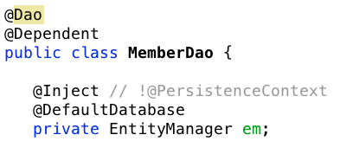
Java EE + Cloud
DAO Testing
Contains data model and DAOs.
No EJBs
@Dao and @DefaultDatabase are CDI Qualifiers.

Slide 66
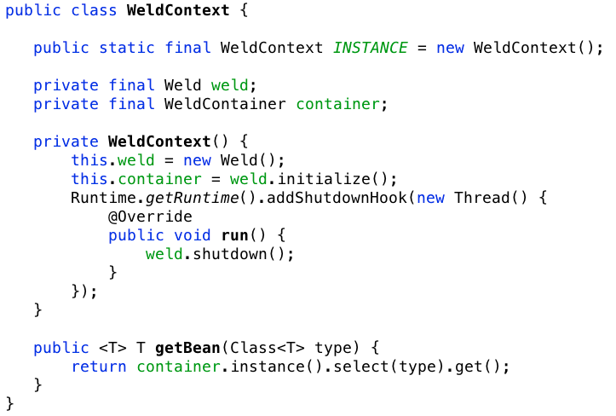
Java EE + Cloud
Testing ctcore – Configuring Weld

Slide 67
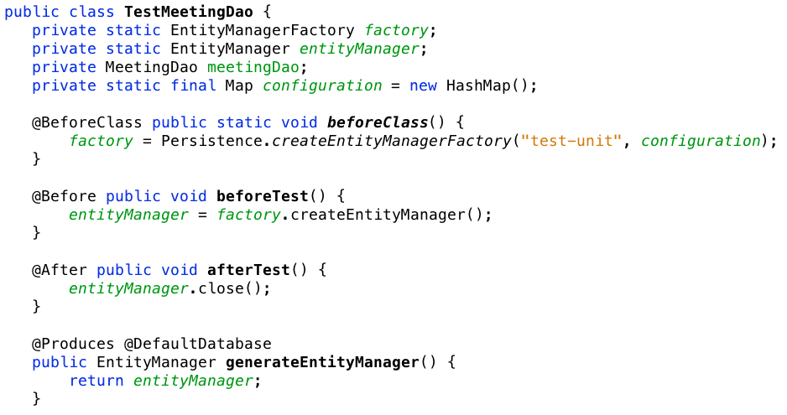
Java EE + Cloud
DAO Testing

Slide 68
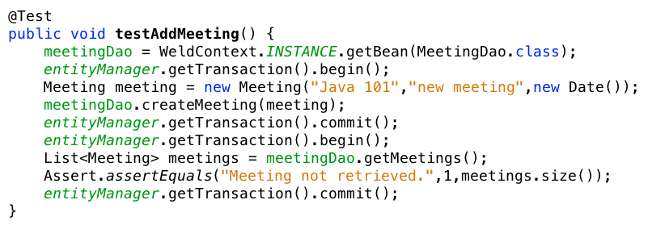
Java EE + Cloud
DAO Test

Slide 69
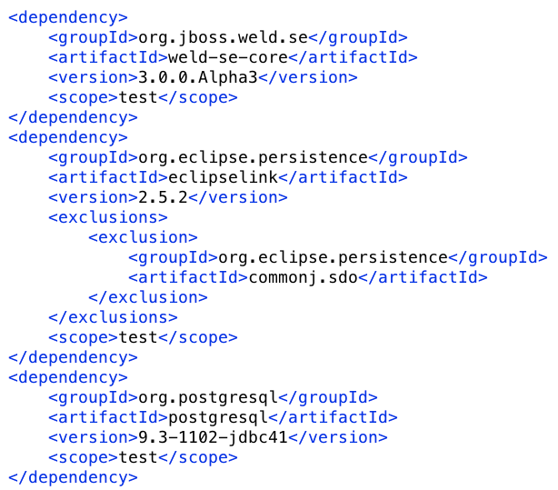
Java EE + Cloud
Testing ctcore – pom.xml dependencies
Dependencies:
Weld
EclipseLink
PostgreSQL
Scope: Test

Slide 70

Java EE + Cloud
What is Arquillian?
Project from JBoss.
Unit testing in the container (GlassFish/WebLogic/etc.)
ShrinkWrap
Arquillian
Container
Java EE app server
Servlet Container
Weld SE
Test Case
Unit testing framework
(Junit/TestNG)

Slide 71
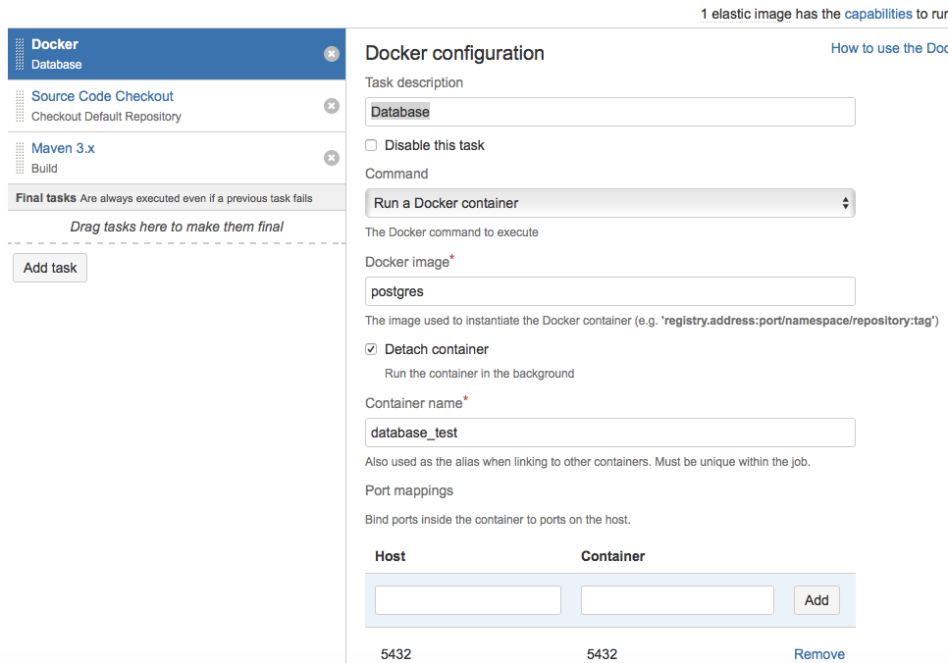
Java EE + Cloud
Docker & Atlassian

Slide 72
Java EE + Cloud
Testing Infrastructure
Test EJBs & Web Service Endpoints
Arquillian – embedded Java EE container
Create profiles for different containers (GlassFish/WildFly)
Arquillian + Selenium + PhantomJS + Jasmine
Test client JavaScript code
Test JavaScript code going against server
Run headless on AWS (pre-configure node with Node.js
Load Testing
AWS command line + docker instances (ECS)

Slide 73
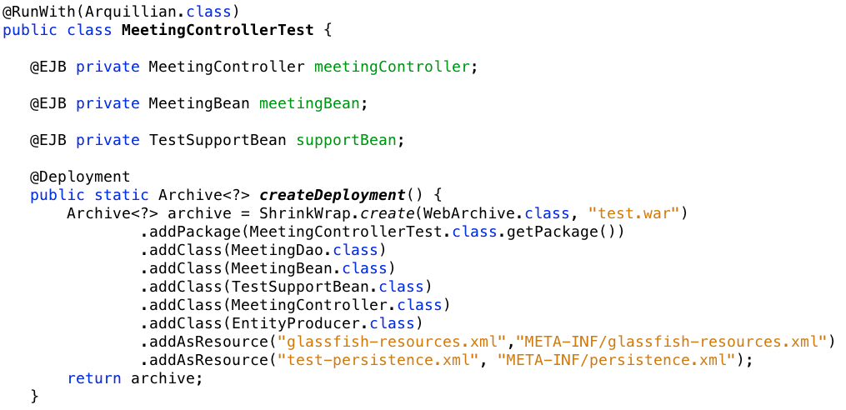
Java EE + Cloud
Arquillian Tests
Test runs in embedded GlassFish container.

Slide 74
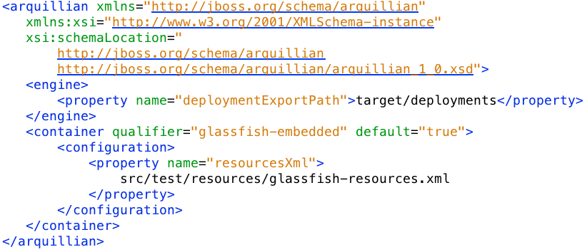
Java EE + Cloud
Arquillian Configuration

Slide 75
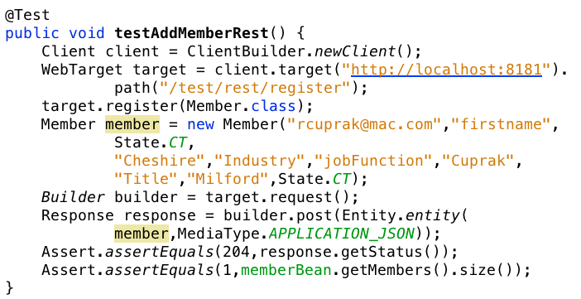
Java EE + Cloud
RESTful Testing

Slide 76
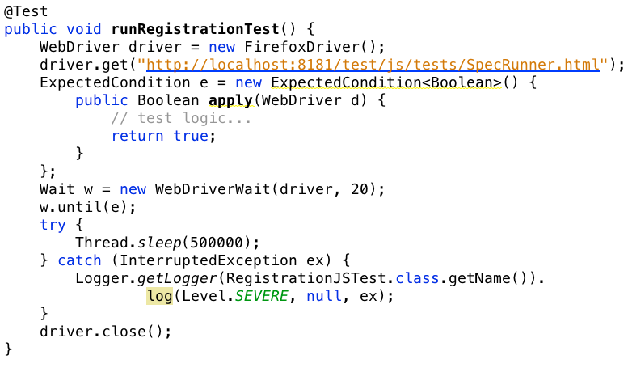
Java EE + Cloud
RESTful Testing

Slide 77
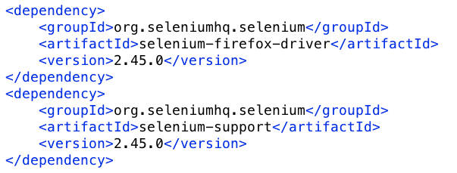
Java EE + Cloud
Selenium Dependencies

Slide 78
Java EE + Cloud
Testing ctweb – Registration Service Test (Setup) - JavaScript
Demo

Slide 79
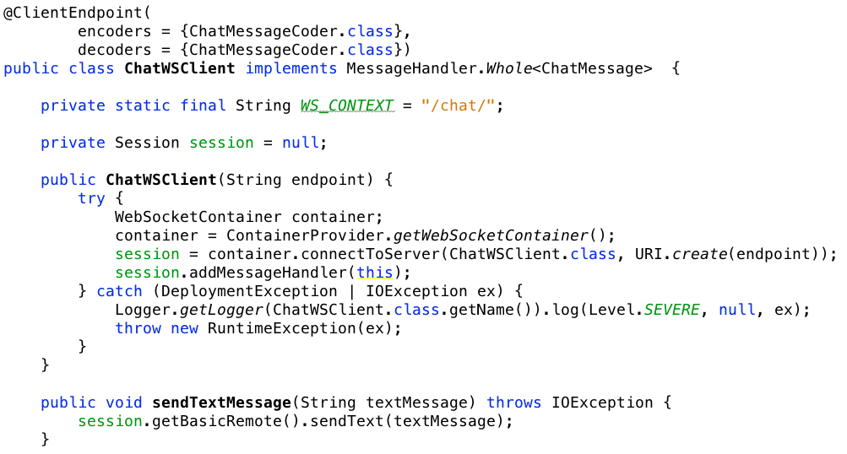
Java EE + Cloud
WebSockets Testing

Slide 80
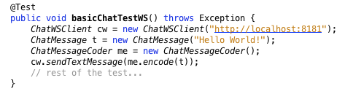
Java EE + Cloud
WebSockets Testing

Slide 81
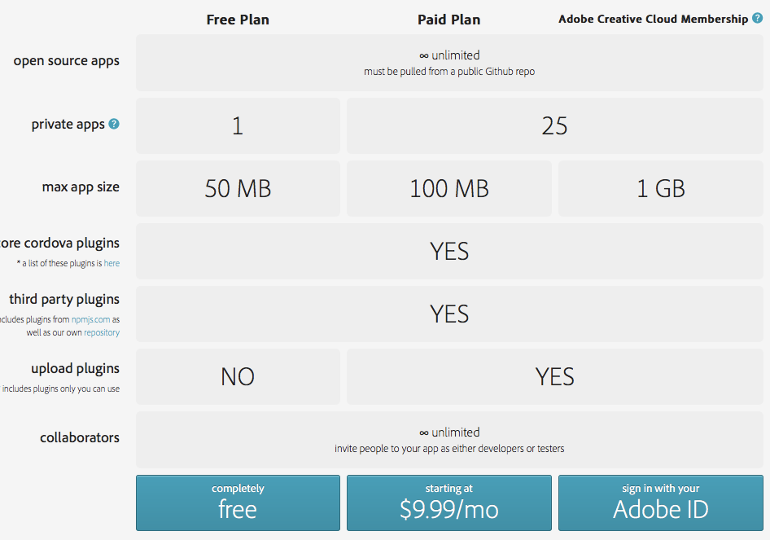
Cloud + Mobile
PhoneGap Cloud
https://build.phonegap.com/plans

Slide 82
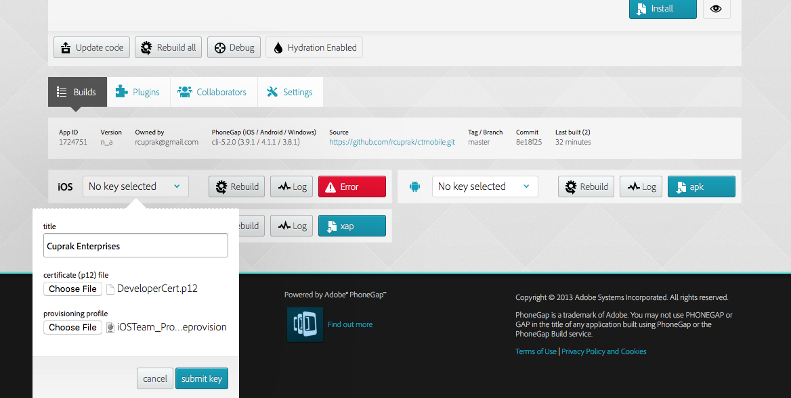
Cloud + Mobile
Mobile Development

Slide 83


Java EE + Cloud
Conclusion
Cloud tools + Java EE = Garage Startup!
Who wants to be the next billionaire?

Slide 84

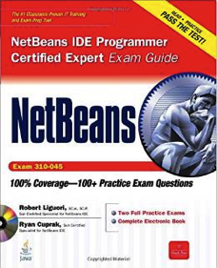
Q&A
Contact
Twitter: ctjava
Email: r5k@3ds.com
Blog: http://cuprak.info

