Slide 1


The JavaFX Accessibility API
Jonathan Giles
Principle Member of Technical Staff
Java Client Group
October, 2015
Copyright © 2015, Oracle and/or its affiliates. All rights reserved. |
Notes:
This is a Title Slide with Java FY15 Theme slide ideal for including the Java Theme with a brief title, subtitle and presenter information.
Do not customize this slide with your own picture.
To copy this branded background to another presentation on PC
Locate and open the presentation where you will be placing this artwork. Click New Slide from the Home tab's Slides group and select Reuse Slides.
Click Browse in the Reuse Slides panel and select Browse Files. Double-click the PowerPoint presentation that contains the background you wish to copy.
Check Keep Source Formatting and click the slide that contains the background you want.
Click the left-hand slide preview to which you wish to apply the new master layout.
Apply New Layout (Important): Right-click any selected slide, point to Layout, and click the slide containing the desired layout from the layout gallery.
Delete any unwanted slides or duplicates.
To copy this branded background to another presentation on Mac
Locate and open the presentation where you will be placing this artwork. Click New Slide from the Home tab's Slides group and select Insert Slides from Other Presentation…
Navigate to the PowerPoint presentation file that contains the background you wish to copy. Double-click or press Insert. This prompts the Slide Finder dialogue box.
Make sure Keep design of original slides is unchecked and click the slide(s) that contains the background you want. Hold Shift key to select multiple slides.
Click the left-hand slide preview to which you wish to apply the new master layout.
Apply New Layout (Important): Click Layout from the Home tab's Slides group, and click the slide containing the desired layout from the layout gallery.
Delete any unwanted slides or duplicates.

Slide 2
Notes:
This is a Safe Harbor Front slide, one of two Safe Harbor Statement slides included in this template.
One of the Safe Harbor slides must be used if your presentation covers material affected by Oracle’s Revenue Recognition Policy
To learn more about this policy, e-mail: Revrec-americasiebc_us@oracle.com
For internal communication, Safe Harbor Statements are not required. However, there is an applicable disclaimer (Exhibit E) that should be used, found in the Oracle Revenue Recognition Policy for Future Product Communications. Copy and paste this link into a web browser, to find out more information.
http://my.oracle.com/site/fin/gfo/GlobalProcesses/cnt452504.pdf
For all external communications such as press release, roadmaps, PowerPoint presentations, Safe Harbor Statements are required. You can refer to the link mentioned above to find out additional information/disclaimers required depending on your audience.

Slide 3
Program Agenda
1
Introduction / Overview
Fundamentals of Accessibility
Advanced Accessibility API
Making Your Code Accessible
Summary
2
3
4
5

Slide 4
What does it mean to be Accessible?
Accessibility is the degree to which a product, device, service, or environment is available to as many people as possible. Accessibility can be viewed as the "ability to access" and benefit from some system or entity. (*)
(*) http://en.wikipedia.org/wiki/Accessibility

Slide 5

Accessible Software
Accessible software aims to address :
  Visual Impairments (*)
  Auditory Impairments
  Motor/Mobility Issues
  Seizures
  Cognitive/Intellectual Impairments
Assistive technologies are often built into the operating system
  Screen readers (*), high contrast themes (*), zoom capability etc.

Slide 6

Screen Readers
Speak the contents of a control
Provide their own concept of focus and traversal
  Independent (but related to) normal focus and traversal
Interact with programs using platform specific keys
Examples:
  VoiceOver, from Apple, for the Mac
  Narrator, from Microsoft, for Windows
  JAWS, from Freedom Scientific, for Windows

Slide 7

Accessibility and JavaFX
Accessibility API came late to JavaFX
  Focus of the team was on implementing the controls
  There was a lot of engineering turn over on the team
  Prototypes were started but none were completed
Windows accessibility API was incomplete (until UIA)
  Non-native solutions such as IA2 available (augments MSAA API)
  Microsoft UIA only became available with Windows 7

Slide 8

Why is Accessibility hard to implement?
Requires a common portable JavaFX API
Must support many different kinds of controls
  Many different controls causes explosion of API and concepts
Lots of different platform specific native code
  Lack of documentation and native code examples
  Need to determine behavior by experimentation
Implementation cross cuts different layers in the JavaFX
  Implementers needs to be familiar with Glass, Controls, Skins …

Slide 9


Other Accessibility Implementations
AWT/Swing
  Relies on access bridge shared library and vendor support
  Incomplete, considered by some to be buggy
Eclipse SWT
  Uses native controls so gets native accessibility “for free”
  Uses IA2 on Windows (not supported by Microsoft)
  Some bugs and problems in the API and implementation

Slide 10

Design Goals for Java FX Accessibility
Provide a complete, minimal and unobtrusive API
  Support native behavior and platform specific mechanisms
  Use existing Java FX conventions and standards
  Ensure the implementation has a low overhead
Implement accessibility for all built-in FX controls
  Prove that the API is complete and full featured
Allow developers to make their own controls accessible

Slide 11
JavaFX Accessibility: A Lightweight Implementation
FX Nodes (API)
Accessible Objects
(no state, non-API)
Windows (UIA)
Stage
Role= Scene
Scene
1 to 1
Role=Parent
Group
Mac
(NSAccessible)
Role=Button
Button
Role=Text
Labeled Text

Slide 12

Accessibility Design Goals: Realised!
JavaFX scenegraph is used to contain accessibility info
  Avoid shadow hierarchies (decrease complexity, footprint)
Use FX properties, methods and subclassing
  Ensures that FX Accessibility is CSS and FXML friendly
Low overhead implementation
  Run code and create objects only when Screen Reader is active
  No Screen Reader == No Accessible Code Executed
  Screen Reader – No data duplication as accessibility data is represented by scenegraph

Slide 13
Fundamentals of Accessibility
The JavaFX Accessibility API

Slide 14

The Fundamental Accessibility API
A simple set of properties to solve the most common cases
Node#accessibleRoleProperty()
Node#accessibleRoleDescriptionProperty()
Node#accessibleTextProperty()
Node#accessibleHelpProperty()
Label#labelForProperty() (not a new property)

Slide 15
The Accessible Role Property
AccessibleRole is an enumeration property on Node
The Role tells the Screen Reader the “kind of control”
  Screen reader normally speaks the role (ie. says “Button”)
  A Node can have at most one accessible role
Some values the role might have:
  AccessibleRole.HYPERLINK (used by javafx.scene.control.Hyperlink)
  AccessibleRole.TABLE_VIEW (used by javafx.scene.control.TableView)
Notes:
It should say the role defines how the screen reader will interact with the node, it defines the Attributes and Actions the node should support.
No need to say it is property.

Slide 16
Setting the Role (Once, During Creation)
public Button(String text, Node graphic) {
super(text, graphic);
initialize();
}
private void initialize() {
getStyleClass().setAll(DEFAULT_STYLE_CLASS);
setAccessibleRole(AccessibleRole.BUTTON);
}

Slide 17
When should I set the role of a Node?
The role always set appropriately for built-in controls
The default role is AccessibleRole.NODE (or PARENT)
  Currently both of these roles are ignored by the screen reader (nothing spoken)
Set the role for Nodes that are not a Control
  Choose the closest matching role from the set of enums
  Very often AccessibleRole.BUTTON is a good choice
“But my control is not a button, it’s a bouncing ball!”
Notes:
Not sure I want to say Node and Parent are ignored, this is an implementation detail which we can change in the future…

Slide 18
The Accessible Role Description Property
Role Description is a string property on Node
The property value is always null for built-in Controls
  When null, the Screen Reader speaks native description
Together, role and role description allow customisation
  There are no user defined roles (AccessibleRole is an enum), but the role description allows the Screen Reader to say “Ball” instead of “Button”
“What about speaking the contents of my control?”
Notes:
Note, allowing in the screen reader to read the default role description minimizes the i18n work

Slide 19
The Accessible Text Property
Accessible Text is a Node Property, type is String (default is null)
Tells the Screen Reader how to speak the contents of a control
Always null by default for built-in Controls
  Controls speak the appropriate contents for the control
  A button will speak the button text and the role (ie. “OK”)
  A text field speaks the text contents or the grayed out prompt text
Notes:
Usually set for controls without text content, such as graphic-only buttons, image views, sliders, canvas.
Note that images and sliders, when possible, can be described by an Label (using Label#labelFor)

Slide 20
The Accessible Help Property
Accessible Help a Node property, type is String (default is null)
Used to provide a longer more detailed description of a control
  Always null by default for built-in controls
  When null, the tooltip text is provided to the Screen Reader
Extra help is provided when requested
  Makes sense to default to the same value as the tool tip
Notes:
No need to say it is property. Can this be made simpler ?

Slide 21
The “Label For” Property
“Label For” is a Label Property, type is Node (default is null)
The labelFor property was previously used for mnemonics only
Used to augment the description of TextFields and ComboBoxes
  Often used for text fields that appear in configuration dialogs
Used to provide description for other kinds of controls
  Most common controls are ImageView, Slider, ProgressIndicator

Slide 22
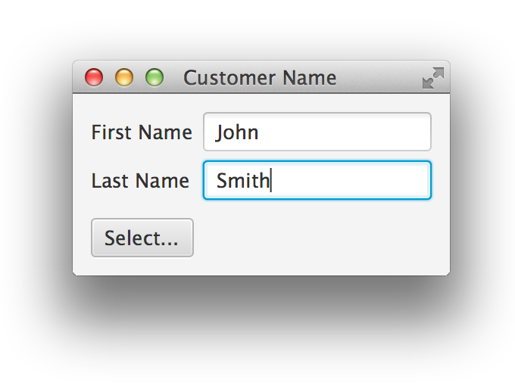
A Text Field that uses “Label For”
TextField field = new TextField("Smith");
Label label = new Label("Last Name");
label.setLabelFor(field);
When focused, the screen reader says:
“Last name, editable text, Smith”
Notes:
Obviously the order the content is read, along with any extra information, depends on the screen reader.

Slide 23
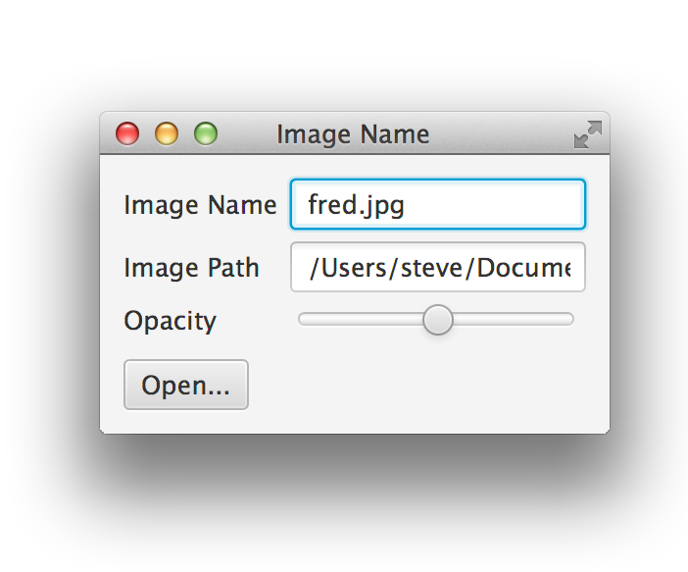
A Slider that uses “Label For”
Slider slider = new Slider(0, 100, 50);
Label label = new Label("Opacity");
label.setLabelFor(slider);
When focused, the screen reader says:
“Slider Opacity, 50%”

Slide 24
Advanced Accessibility API
The JavaFX Accessibility API

Slide 25

The Advanced Accessibility API
Supports direct interaction with the Screen Reader
  Return a value to the Screen Reader
  Perform an action on behalf of the Screen Reader
  Notify the Screen Reader that a value has changed
Exposes the “Accessibility running” state
  Determine whether accessibility is active

Slide 26
Accessible Methods: Called or Overridden
@override Object Node#queryAccessibleAttribute
(AccessibleAttribute, Object...)
@override void Node#executeAccessibleAction
(AccessibleAction, Object...)
void Node#notifyAccessibleAttributeChanged
(AccessibleAttribute)

Slide 27
Accessible Enums: Arguments to the Methods
AccessibleRole (already seen)
  BUTTON, CHECK_BOX, LIST_VIEW, ...
AccessibleAttribute
  PARENT, SELECTED, TEXT, ITEM_AT_INDEX, ...
AccessibleAction
  FIRE, EXPAND, COLLAPSE, SET_TEXT, ...
Notes:
Note that ITEM_AT_INDEX is a parametized attribute, SET_TEXT is a parametized action

Slide 28
Return a Value to the Screen Reader
The Screen Reader requests the current state of a control
  Different state is requested depending on the role of the control
Example:
  Return the number of rows in a list control
  Return the selected items in a list control
Some attributes the that might be queried:
  AccessibleAttribute.ROW_COUNT
  AccessibleAttribute.SELECTED_ITEMS

Slide 29
Overriding queryAccessibleAttribute()
@Override public Object queryAccessibleAttribute(
AccessibleAttribute attribute, Object... parameters) {
switch (attribute) {
case ROW_COUNT: return getRowCount();
default:
super.queryAccessibleAttribute(attribute, parameters);
}
}
IMPORTANT: Always call the super!

Slide 30
The Super: Node#queryAccessibleAttribute()
@Override public Object queryAccessibleAttribute(
AccessibleAttribute attribute, Object... p) {
switch (attribute) {
case ROLE: return getAccessibleRole();
case ROLE_DESCRIPTION: return getAccessibleRoleDescription();
case TEXT: return getAccessibleText();
case PARENT: return getParent();
case BOUNDS: return localToScreen(getBoundsInLocal());
case DISABLED: return isDisabled();
case FOCUSED: return isFocused();
default: return null;
}
}
}
Notes:
Also true for execute action, good stuff is inherit all thru the hiearchy

Slide 31
Perform an Action on behalf of the Screen Reader
The Screen Reader requests an action be performed
  Actions are platform specific request (might be voice activated)
Example:
  Activate a button or traverse a hyper link
  Expand a tree item or a title pane
Some actions that might be requested:
  AccessibleAction.FIRE
  AccessibleAction.EXPAND
Notes:
No need to say about the enum (it was said already), no need for the last example

Slide 32
Overriding executeAccessibleAction()
@Override public void executeAccessibleAction(
AccessibleAction action, Object... parameters) {
switch (action) {
case FIRE:
fire();
break;
default: super.executeAccessibleAction(action, parameters);
}
}
Notes:
Maybe added a action that shows parameterized action, such as SET_TEXT ?

Slide 33
Notify the Screen Reader an Attribute has Changed
The application changes the value of an attribute
  The screen reader must be informed (it cannot know)
Example:
  Focus moves to a ListView, but the focus node is an item in the list
  The user clicks on the (+) expansion indicator of a tree item
Some attributes that the program changes:
  AccessibleAttribute.FOCUS_NODE
  AccessibleAttribute.EXPANDED
  AccessibleAttribute.VALUE
Notes:
No need to say about the enum (it was said already), no need for the last example

Slide 34
Calling notifyAccessibleAttributeChanged()
public final DoubleProperty valueProperty() {
if (value == null) {
value = new SimpleDoubleProperty(this, "value", 0) {
@Override protected void invalidated() {
adjustValues();
notifyAccessibleAttributeChanged(AccessibleAttribute.VALUE);
}
};
}
return value;
}
Notes:
Change the value in Spinner control

Slide 35
Determine whether Accessibility is Active
Accessibility Active is a Platform property
  type is Boolean (default is false, true when Screen Reader active)
Used to implemented UI to better suit accessibility
Examples:
  Replace a chart or diagram with a table
  Set additional nodes to be focus traversable
Notes:
No need to say about the enum (it was said already), no need for the last example

Slide 36
Making a Circle Traversable
Circle circle;
...
circle.focusTraversableProperty().bind(
Platform.accessibilityActiveProperty());
...
Notes:
Maybe added a action that shows parameterized action, such as SET_TEXT ?

Slide 37
Making Your Code Accessible

Slide 38

A Quick Accessibility Check List
Use standard FX Controls as much as possible
  Standard controls are highly configurable with CSS
  Provide high contrast versions for custom CSS
Provide text equivalent for every non-text element
  Use accessibleText, helpText and/or tool tips
  Examples: Provide text for ImageView, an animation that shakes etc.
Use “label For” to connect text fields and combos to labels
Ensure that important nodes are traversable from the keyboard

Slide 39
A Complete Example: Bouncing Balls
A Ball is a Circle that draws a radial gradient
  By default, its role is NODE so nothing is spoken
  Need to tell the user that it is a ball and speak its state
  Balls can be selected in order to stop and start bouncing
Example Code
  apps/samples/Ensemble8/src/samples/java/ensemble/samples/graphics2d/bouncingballs/BouncingBallsApp.java
Notes:
There is no built-in AccessibleRole.BALL role
Use the AccessibleRole.BUTTON role (best match)
Use roleDescription and accessibleText to describe the BALL
Start and stop bouncing when the user selects the ball

Slide 40
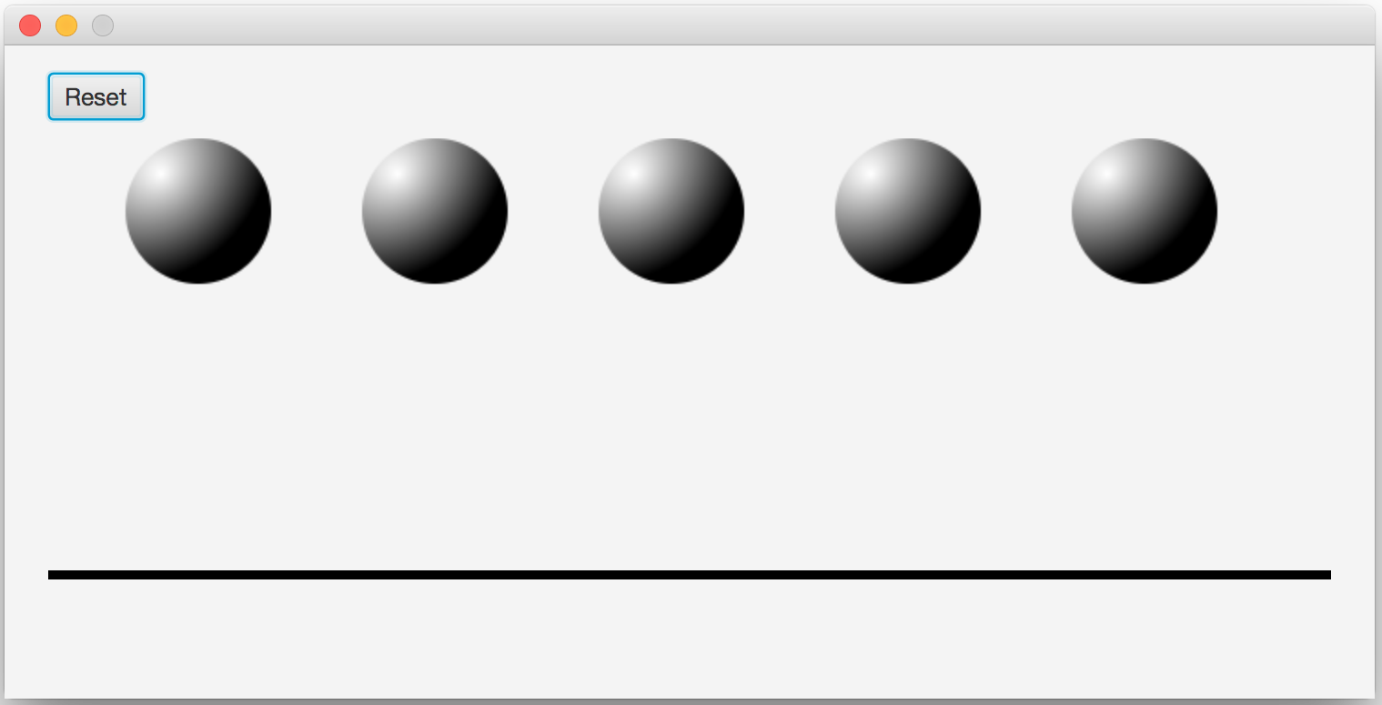
Bouncing Balls

Slide 41

Bouncing Balls: The Unmodified Code
Only the Reset button is read
Nothing else is reachable, all other nodes are ignored
Demo: Nothing works
Notes:
There is no built-in AccessibleRole.BALL role
Use the AccessibleRole.BUTTON role (best match)
Use roleDescription and accessibleText to describe the BALL
Start and stop bouncing when the user selects the ball

Slide 42
Using the Accessibility API Properties
…
ball.setAccessibleRole(AccessibleRole.BUTTON);
ball.setAccessibleRoleDescription("Bouncing Ball");
ball.setAccessibleText(text);
ball.setAccessibleHelp("This is bouncing ball, use the primary action to start animation");
…
Demo: The first cut at accessible bouncing balls
Notes:
Show Patch in Eclipse/Command Line

Slide 43
Bouncing Balls: The “Free Native Traversal”
The balls can be traversed using screen reader:
  OS X: Using Control + Option + Arrow
  Windows: Using Capslock + Arrow
The Screen Reader will read each ball correctly
  Ex. "First, Bouncing Ball”
Control+Option+Shift+N (OS X) or Capslock+F (Windows) reads the accessible help

Slide 44
Using Accessibility API to Enable FX Traversal
...
focusTraversableProperty().bind(
Platform.accessibilityActiveProperty());
...
Demo: Balls can be traversed using the tab key
Notes:
Show Patch in Eclipse/Command Line

Slide 45
Using the Accessibility API to Execute an Action
@Override public void executeAccessibleAction(
AccessibleAction action, Object... parameters) {
switch (action) {
case FIRE: toggleAnimation(); break;
default:
super.executeAccessibleAction(action, parameters);
}
}
Demo: Balls can be activated by Screen Reader
Notes:
Show Patch in Eclipse/Command Line

Slide 46

Bouncing Balls: The Final Code
All text content and functionality is available to the Screen Reader
Extra FX traversal is enabled only when Accessibility is active
Control+Option+Space (OS X) or Capslock+Space (Windows) is used to start the animation for a ball
Notes:
There is no built-in AccessibleRole.BALL role
Use the AccessibleRole.BUTTON role (best match)
Use roleDescription and accessibleText to describe the BALL
Start and stop bouncing when the user selects the ball

Slide 47
Summary

Slide 48
Which Accessibility API is Appropriate?
The fundamental API makes simple nodes accessible
  Choose a role, set the role description, set the text, etc.
The advanced API is used for custom controls
  Full featured: Used by FX to make built-in controls accessible

Slide 49
JavaFX Accessibility is Here
Supports native accessibility mechanisms
  No extra shared library or jar is required
Implements accessibility for all built-in controls
Provides a minimal but complete API
  Provides a simple API for the most common cases
  Provides an advanced API for custom controls

Slide 50

Thanks – Any Questions?

