Slide 1
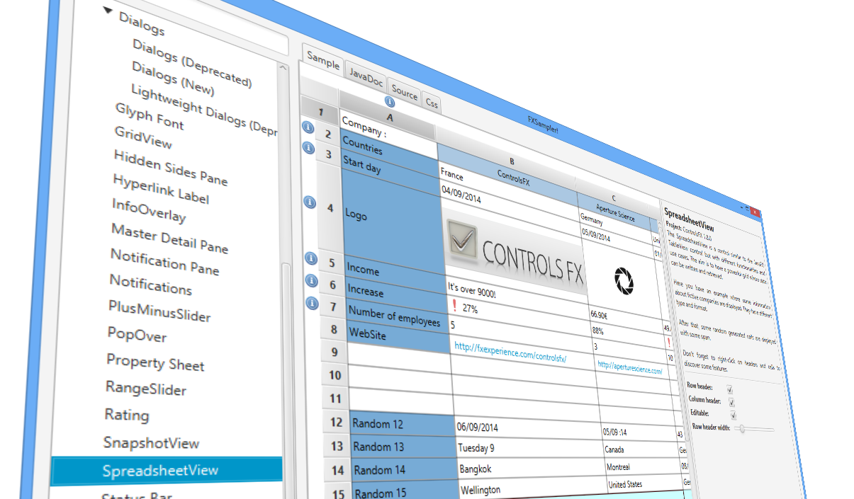
In control with ControlsFX
Eugene Ryzhikov Eugene.ryzhikov@gluonhq.com
@eryzhikov
Jonathan Giles
jonathan@jonathangiles.net
@JonathanGiles

Slide 2
Session overview
ControlsFX overview
Introduction to ControlsFX features
Demonstration
How to get involved
Future plans
Wrapping up / question time

Slide 3
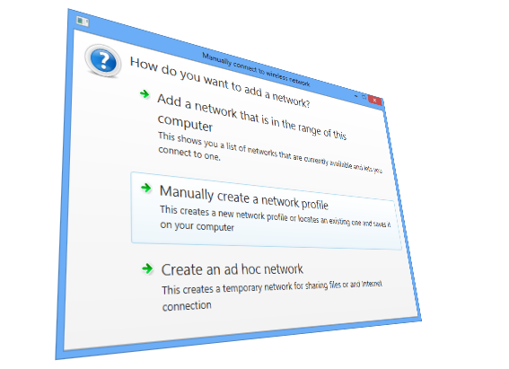
ControlsFX Overview

Slide 4
Answering your burning questions
How do
I get involved?
What is it?
ControlsFX
Who is
involved?
Can it
benefit me?
Why does
it exist?

Slide 5
What is ControlsFX?
Low bug count
JavaFX library
ControlsFX
Business
friendly licensing
(BSD)
Focus on
high quality API
Notes:
When we were kids, we were taught: ‘who, what, when, where, and why’.
Today we will answer the following:
Who is ControlsFX?
What is ControlsFX?
When is ControlsFX?
Where is ControlsFX?
Why is ControlsFX?

Slide 6
Who is ControlsFX?
Here today:
Eugene Ryzhikov Jonathan Giles

Slide 7
Who is ControlsFX?
Not here today:
Sven Reimers
John Malc
Stefan Saring
Henri Biestro
Ryan Jaeb
Werner Lehmann
Jean-François Henrard
Jens Deters
Badisi
Dirk Lemmermann
Tomas Mikula
Dennis Lee
Julien Coloos
Paul Jonas
Pascal Büttiker
Pedro Duque Vieira
Dennis Fischer
Alice Sotzek
Anirvan Sarkar
Adam Kosta
Gabriel Féron
Carolina Veiga
Artur Biesiadowski
Yair Oren
Davide Nabais
Tom Eugelink
Michał Skowroński
Uwe Sander
Laurent Gebus
Geoffrey Capper
Romain Moreau
Sriram Raghuraman
Mario Voigt
Ruben Paz
jonathan millman
Michael Berry
Chen Gaofeng
Γεράσιμος Μάκης Μαρόπουλος
Ladislav Török
Tiziano Lattisi
Victor Alfonso
Pineda Orozco
Daniel Rodrigues

Slide 8
Who is ControlsFX?
Not here today:
Christian Michelsen
Takayuki Shoji
Farzaneh Taleb
Steffen Rachner
Manel Sanchez i Ruiz
Samir Hadzic
John Zeringue
István Avramucz
Marek Budyn
George Keith Watson
Christoph Keimel
Łukasz Śliwiński
George Moralis
Yann D'Isanto
István Avramucz
James Denvir
Carlos Martins
Andreas Liebelt
André Lanouette
Ralf Schmitt
Thijs Walcarius
Roger Terrell
Thomas Nield
Jason Pollastrini
Bastien Aracil
Haval Ahmed
Jeff Plourde
Cole Markham
Nathaniel Sherry
Márcio Rodrigues
Robert Lichtenberger
Christoph Keimel
Sarah Skanes
Michael Ellis
Arthur McGibbon
Robert B. Colton
Farrokh Ghamsary
Harald Herres
Vitomir Spasojevic
John Brandon
Magliano Agarwal

Slide 9
Who is ControlsFX?
Not here today:
Christian Michelsen
Takayuki Shoji
Farzaneh Taleb
Steffen Rachner
Manel Sanchez i Ruiz
Samir Hadzic
John Zeringue
István Avramucz
Marek Budyn
George Keith Watson
Christoph Keimel
Łukasz Śliwiński
George Moralis
Yann D'Isanto
István Avramucz
James Denvir
Carlos Martins
Andreas Liebelt
André Lanouette
Ralf Schmitt
Thijs Walcarius
Roger Terrell
Thomas Nield
Jason Pollastrini
Bastien Aracil
Haval Ahmed
Jeff Plourde
Cole Markham
Nathaniel Sherry
Márcio Rodrigues
Robert Lichtenberger
Christoph Keimel
Sarah Skanes
Michael Ellis
Arthur McGibbon
Robert B. Colton
Farrokh Ghamsary
Harald Herres
Vitomir Spasojevic
John Brandon
Magliano Agarwal
All up, there are over 90 contributors to ControlsFX!

Slide 10
Who is ControlsFX?
More importantly, it can be you!
ControlsFX welcomes contributions
Bug fixes,
Translations,
New features,
New controls
We review all code that comes in, so you can learn a lot!
We are not a dumping ground for half-implemented ideas though!

Slide 11
What is ControlsFX? - Releases
Version | Release Date | Release Gap | Downloads
8.0.0 Developer Preview 1 | May 7, 2013 | - | 720
8.0.0 | June 3, 2013 | ~ One month | 627
8.0.1 | July 7, 2013 | ~ One month | 536
8.0.2 Developer Preview 1 | August 11, 2013 | ~ One month | 513
8.0.2 Developer Preview 2 | September 11, 2013 | ~ One month | 420
8.0.2 | October 11, 2013 | ~ One month | 881
8.0.3 | December 4, 2013 | ~ Two months | 614
8.0.4 | December 28, 2013 | ~ One month | 1382
8.0.5 | March 4, 2014 | ~ Two months | 3974
8.0.6 | May 29, 2014 | ~ Two months | 8324*
8.20.7 | September 30, 2014 | ~ Four months | 2129*
8.20.8 | October 19, 2014 | ~ One month | 16917*
8.20.9 / 8.40.9 | June 1, 2015 | ~ Eight months! | 1188* / 5319*
8.40.10 | October 26, 2015 | ~ Five months | -

Slide 12
What is ControlsFX? - Releases
Releases are generally slowing down
Why?
ControlsFX has filled in a lot of gaps in the JavaFX UI controls
A lot of the ‘interesting’ problems are solved
Focus is shifting more to quality, rather than new features
Pull requests and new features are still being accepted though!

Slide 13
Why does ControlsFX exist?
Official JavaFX UI controls are developed slowly and their APIs are fixed once released.
Jonathan should know – He the tech lead of JavaFX UI Controls at Oracle
ControlsFX exists to fill the gaps in JavaFX UI Controls:
API is much less rigid in ControlsFX
But: API quality is required to be exceptionally high to release
We follow the same API patterns as in JavaFX for consistency

Slide 14
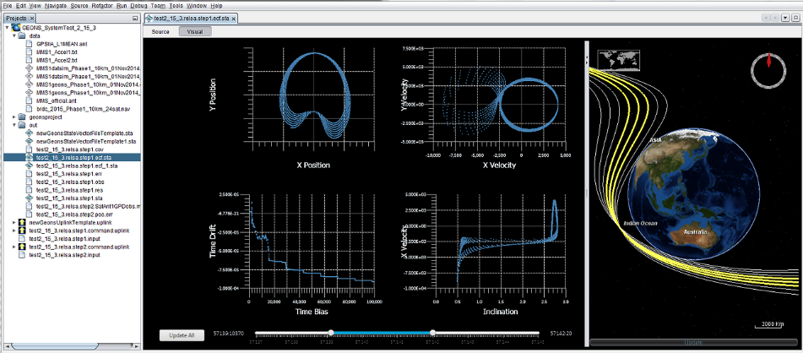
Who uses ControlsFX?
NASA Magnetospheric Multiscale
Mission Support Software
Mission info mms.gsfc.nava.gov
Developed at the Goddard Space Flight Center by ai-solutions, NASA partner
Sean Phillips, lead developer, and his team will be discussing and demonstrating some of the software developed for NASA at their sessions.

Slide 15
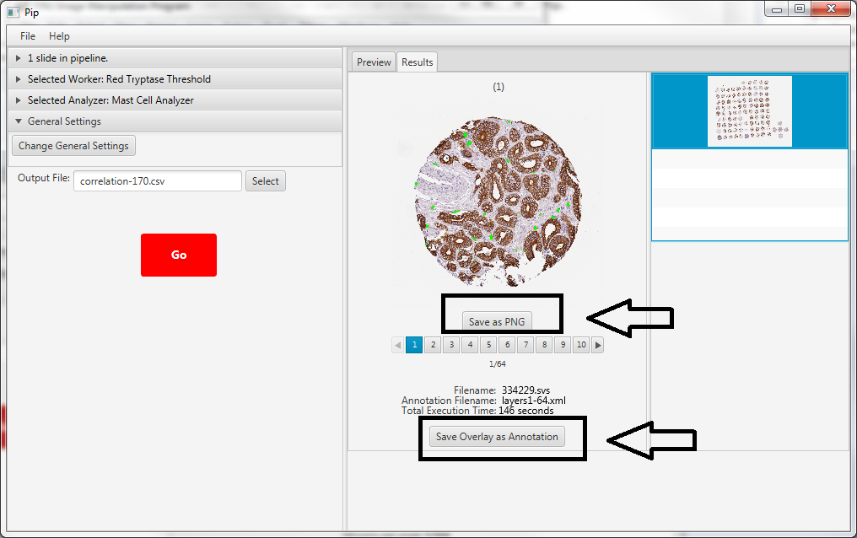
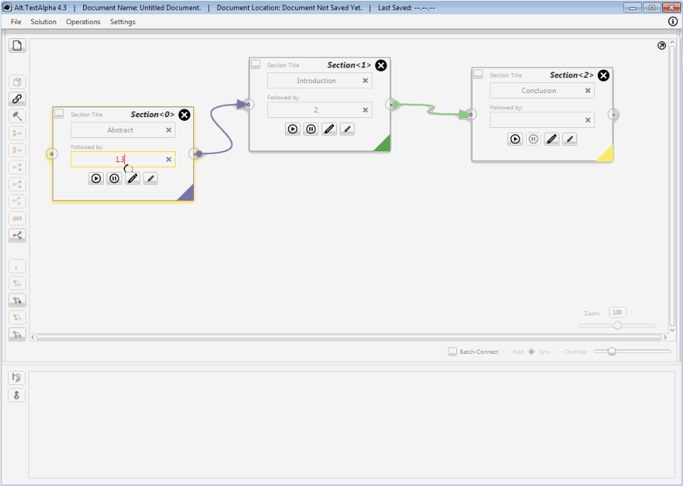
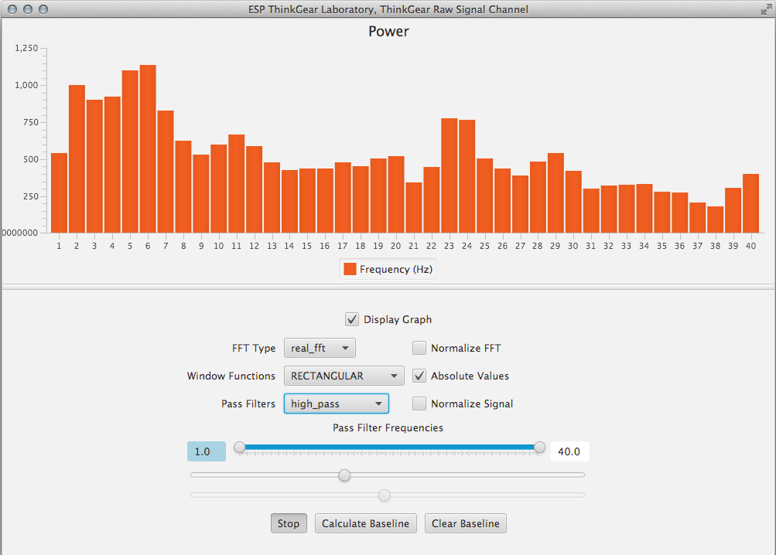
Who uses ControlsFX?
PIP – open source medical image analysis tool for for use with cancer research projects at the Department of Pathology and Laboratory Medicine of Johns Hopkins Hospital
Alt.Text – tool for exploring alternatives in text documents
ESPLab - JavaFX 8 GUI for ESP devices
We know there is a lot more …

Slide 16
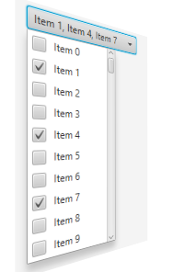
ControlsFX Features

Slide 17
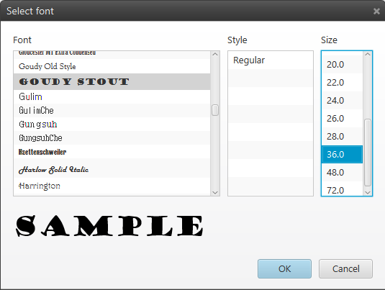
Dialog API The beginning
Featured since the first ControlsFX release
Enjoys wide popularity
Quickly became the de-facto Dialog API for JavaFX
Became a “victim of its own success”
Accepted and promoted to be a part of JavaFX, starting with JavaFX 8u40

Slide 18
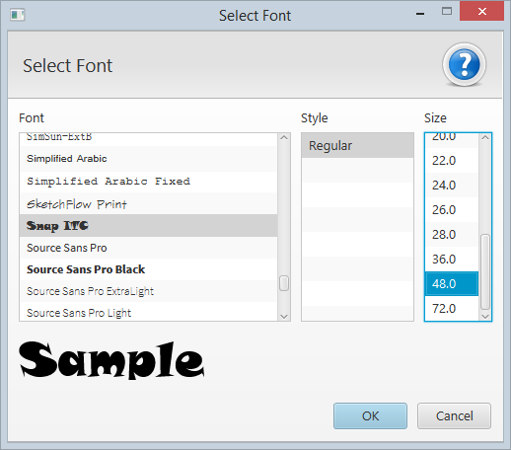
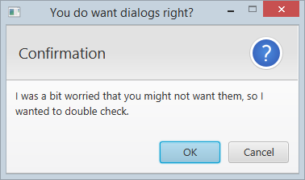
Dialog API Current status
Huge amount of API development in JavaFX 8u40.
Totally different API compared to ControlsFX (although implementation is the same).
What happened to the ‘original’ ControlsFX dialogs:
When our dialogs went into JavaFX, we deprecated our alternate API.
We have now removed the deprecated dialogs from ControlsFX
All dialogs that are now offered in JavaFX are not offered in ControlsFX
ControlsFX now uses the new, official API to provide dialogs not available in JavaFX itself.

Slide 19
Dialog API openjfx-dialogs
openjfx-dialogs is a fork of JavaFX 8u40 dialogs API
Works fine in 8u20
Fork is manually updated when necessary from openjfx
Available online under OpenJDK license (GPL + Classpath):
http://bitbucket.org/controlsfx/openjfx-dialogs

Slide 20
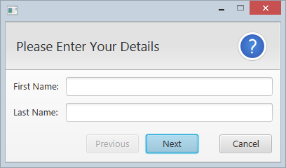
Wizard API
First iteration, based on dialogs
WizardPane based DialogPane
Wizard.Flow interface defines the logic of page traversal
Wizard.LinearFlow – simple linear flow
Custom flows can be easily defined
Wizard handles page history automatically

Slide 21
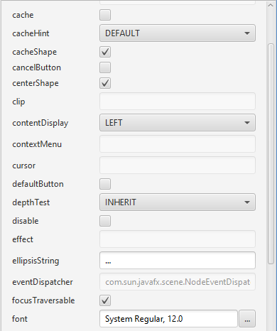
Property Sheet
Support for JavaBeans properties, as well as custom property models
Includes prebuilt editors as well as ability to register custom ones
Property grouping by name or category
Property filtering
Can also be used to implement simple forms.

Slide 22
Action API
JavaFX is missing an Action API, so we implemented it.
Action is an EventHandler<ActionEvent> implementing all common properties.
Can create UI controls such as buttons, menu items, etc from an Action
Can define an ‘action tree’ to effortlessly build ToolBar, MenuBar and ContextMenu
@ActionProxy annotation. Methods annotated with it become actions automatically

Slide 23
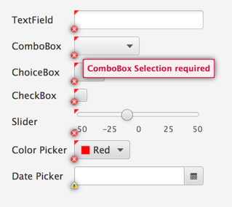
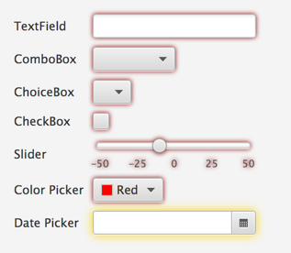
Decoration / Validation API
Can decorate nodes through CSS or graphic at predefined positions
Decoration is used as visual feedback mechanism for Validation API
Validation API is designed to be lightweight but flexible

Slide 24
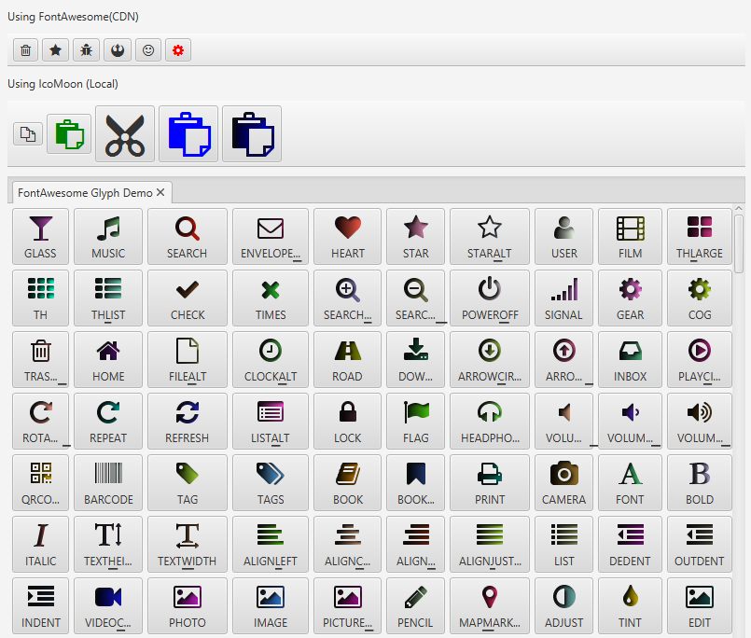
Glyph Font API
Inspired by Jens Deters’ excellent FontAwesomeFX library
Supports any icon fonts, such as FontAwesome, IcoMoon etc
Extended use of icon fonts in Action API: @ActionProxy(text=”Action Text”, image=”font>FontAwesome|STAR”)

Slide 25
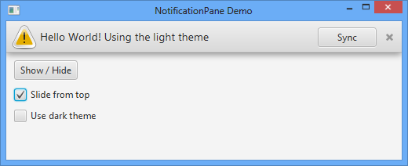
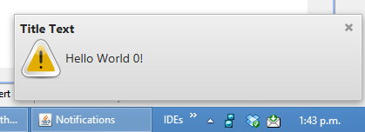
Notification API
NotificationPane: overlay pane, animates in and out, support for graphics, text, controls, has several visual styles
Notifications: Similar to NotificationPane but a separate window. Can appear in one of nine locations on the screen, support for stacking multiple notifications and showing complex screen graphs. Fades out after a set duration.

Slide 26
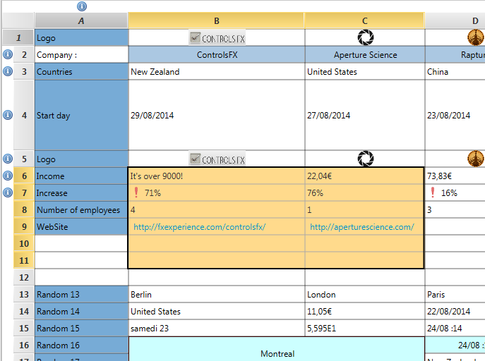
SpreadsheetView
TableView-like control that supports:
Cell spanning
Fixed rows and columns
Cell editing

Slide 27
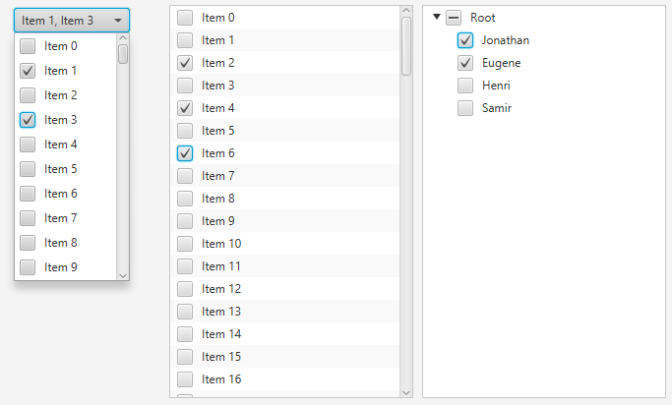
CheckComboBox CheckListView CheckTreeView
All three controls extend the standard JavaFX UI control
Adds support for a ‘check model’, to allow developers to easily
Check specific indices / items
Retrieve checked indices / items

Slide 28
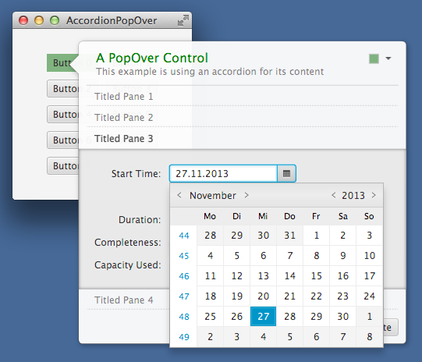
PopOver
Provides information in a visually pleasing way, without interfering with user’s workflow.

Slide 29
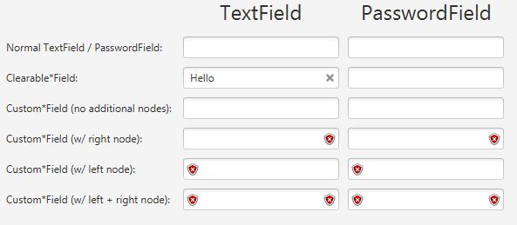
TextField API
Autocomplete TextField
Clearable Fields
Decorated Fields, where nodes can be placed within the text area.
Text does not go underneath the decoration!

Slide 30
Range Slider
Standard JavaFX slider but with two draggable thumbs, instead of one.
Thumbs represent low and high values.
User can drag range bar to concurrently adjust both values

Slide 31
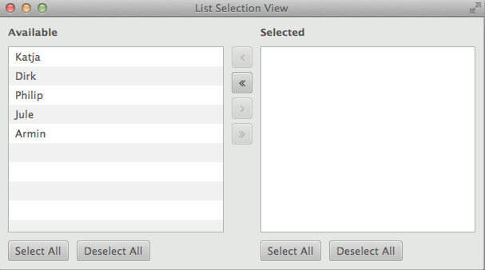
ListSelectionView
Allows for visual selection of multiple items using two lists
Selection is done by moving items from “available” to “selected” list
Each list can be decorated with a header and a footer node

Slide 32
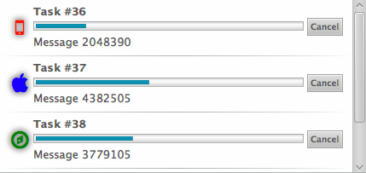
TaskProgressView
Allows for visualizing the progress of long running tasks, created via Task class
The view manages a list of tasks and displays each one with their name, progress, and update messages.
Optional graphic factory can be set for each task

Slide 33
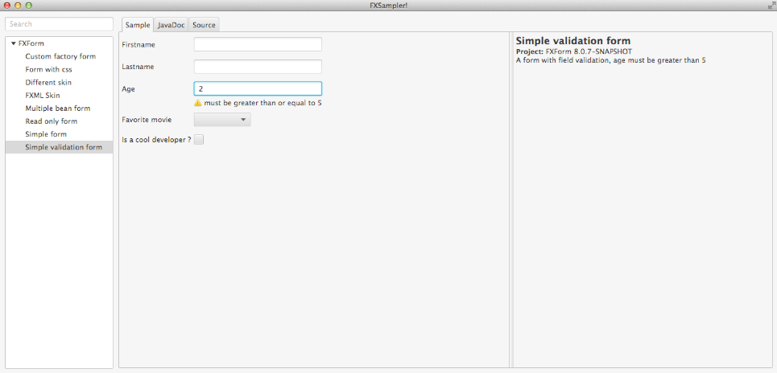
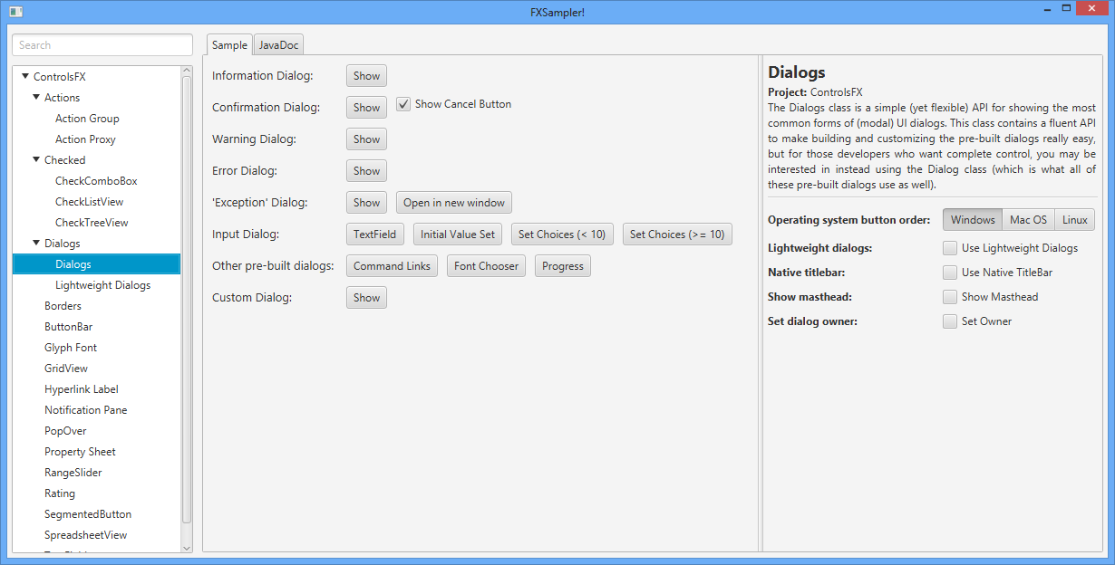
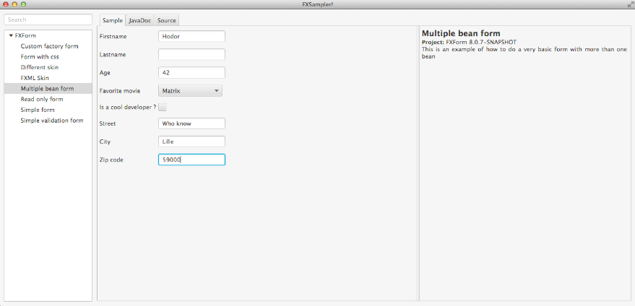
FX Sampler
To demonstrate ControlsFX, we built FX Sampler
Standalone application that detects samples at runtime
Can be used by anyone wanting to demonstrate their samples
E.g. JFXtras, FlexGanttFX, F(X)yz and FXForm2 use it

Slide 34
Even more controls
Border API: wraps nodes and panes with a border
BreadCrumbBar: Simple navigator for hierarchical page structures
GridView: fast, virtualized grid container. Great for showing images
HiddenSidesPane: Pane with possible hidden side panes
HyperlinkLabel: Label with clickable links
InfoOverlay: Designed to show text comment over a node
MasterDetailPane: Details pane can be made invisible on demand.
PlusMinusSlider: Allows continuous scrolling through large datasets
Rating: Shows star rating, including partial ratings
SegmentedButton: Visually groups toggle buttons together
SnapshotView: Draw a bounding box on screen graph and get selection
StatusBar: API for placing nodes in various places – commonly found on bottom of apps
ToggleSwitch: Simple on / off switch with JavaFX modena styling

Slide 35
Demonstration

Slide 36
Breaking News: ControlsFX 8.40.10 was just released….

Slide 37
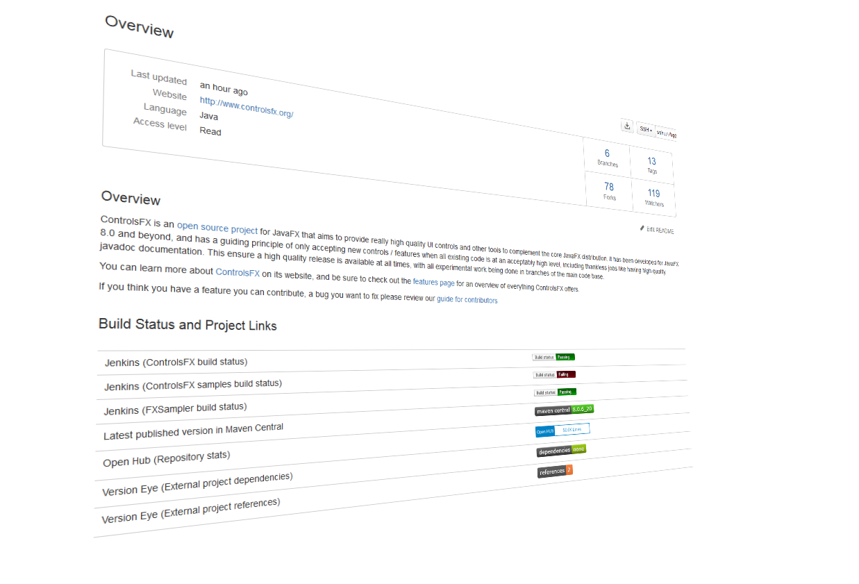
Getting Involved

Slide 38
Getting Started - In Six Simple Steps!
1
The following software is required:
Mercurial
Gradle
JDK 8u40
You’ll need a Bitbucket account
Accounts are free from http://bitbucket.org
2

Slide 39
Getting Started - In Six Simple Steps!
3
Fork the repo.
Go here to create your own fork
https://bitbucket.org/controlsfx/controlsfx/fork
Clone your fork:
hg clone https://<username>@bitbucket.org/<username>/<forkname>
e.g.
hg clone https://eryzhikov@bitbucket.org/eryzhikov/controlsfx
4

Slide 40
Getting Started - In Six Simple Steps!
5
Build your clone. From clone root directory, run:
gradle clean assemble
Run your clone:
gradle run
6

Slide 41
Where is ControlsFX?
ControlsFX.org

Slide 42
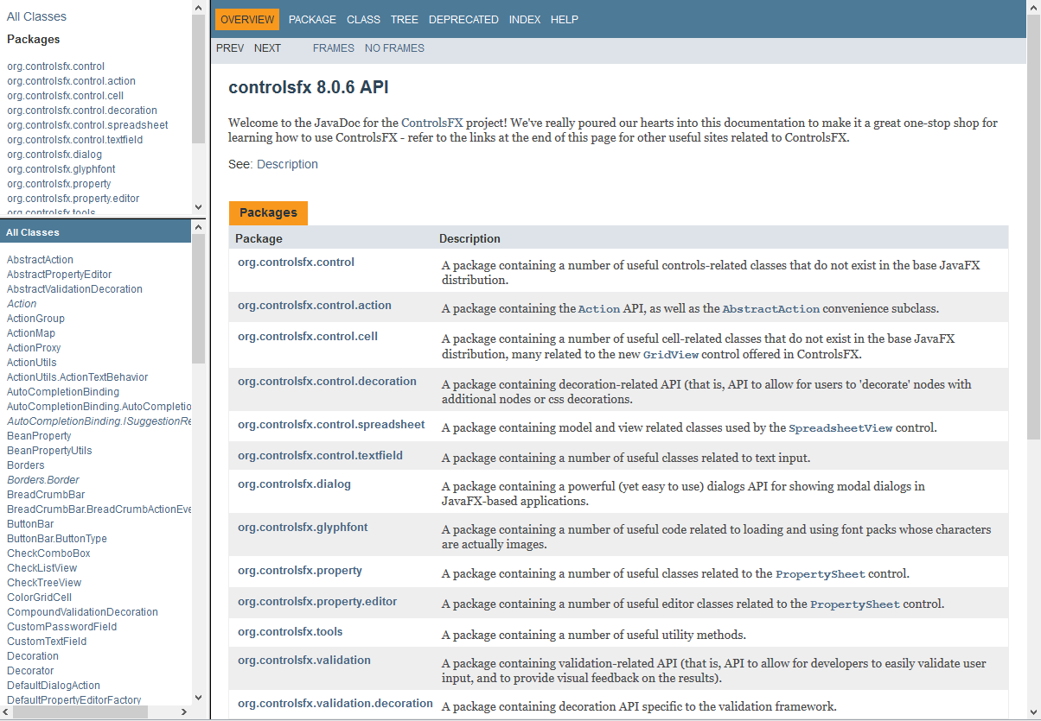
Where is ControlsFX?
docs.controlsfx.org

Slide 43
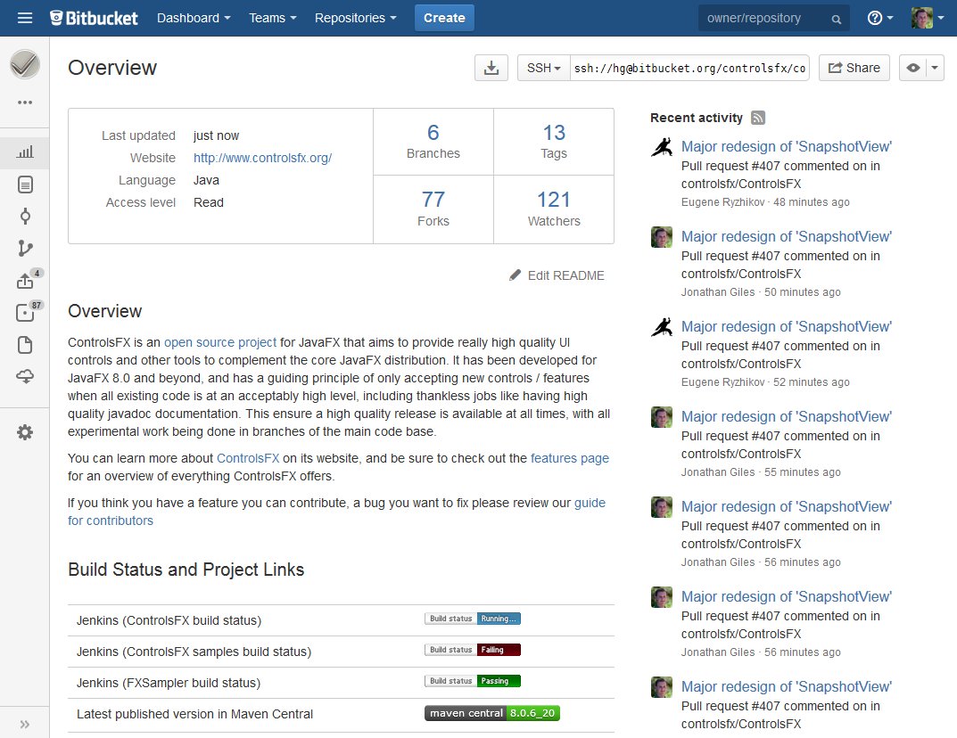
Where is ControlsFX?
code.controlsfx.org

Slide 44
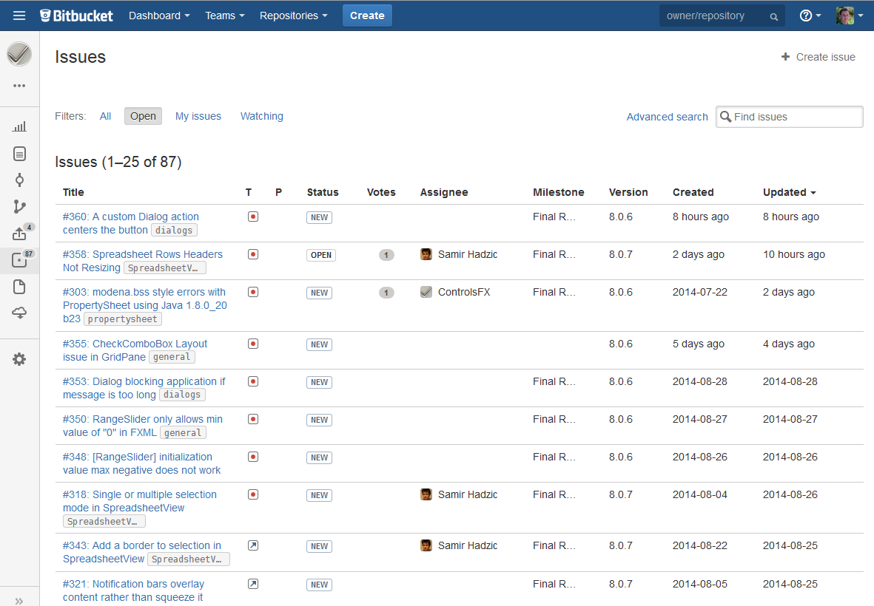
Where is ControlsFX?
issues.controlsfx.org

Slide 45
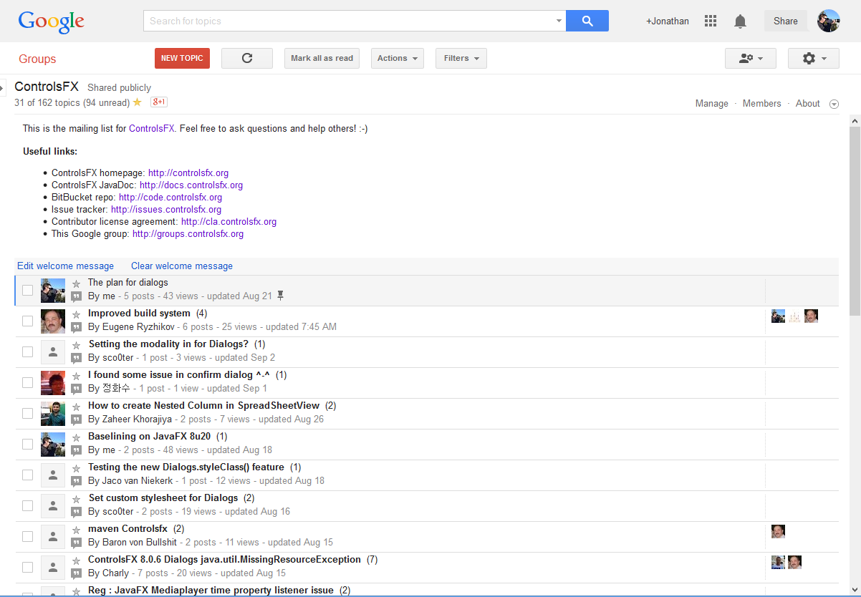
Where is ControlsFX?
Currently 284 members!
groups.controlsfx.org

Slide 46
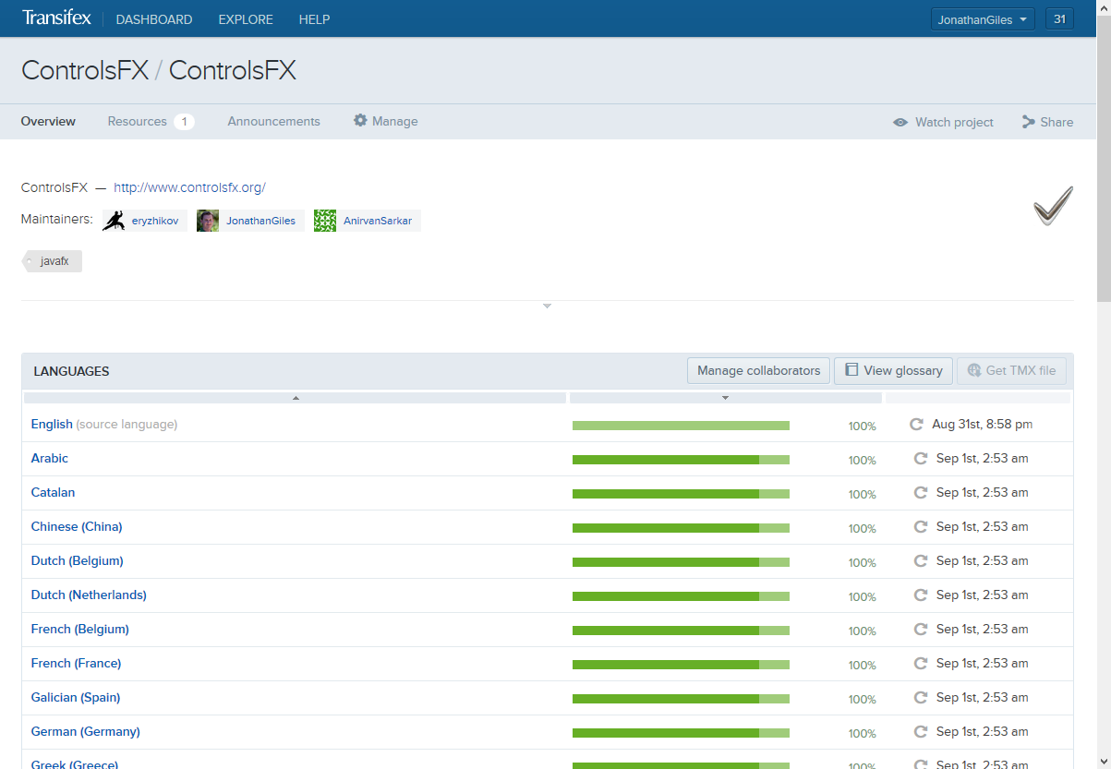
Where is ControlsFX?
Translated to 32 languages!
i18n.controlsfx.org

Slide 47
Where is ControlsFX? - at Maven Central
Stable builds are available in Maven Central at http://releases.controlsfx.org:
groupId : org.controlsfx
artifactId : controlsfx
Our CI server pushes latest snapshots every hour to http://snapshots.controlsfx.org

Slide 48
How To Contribute
ControlsFX is open source
ControlsFX has a CLA that needs signing (http://cla.controlsfx.org)
Everyone works in their own fork
All contributions are submitted as pull requests
Pull requests are reviewed and merged ASAP.

Slide 49
How To Contribute
Pull request stats:
Jonathan is naughty – he commits directly to the repo
Everyone else:
Over 550 pull requests have been merged
Around 50 have been declined
Another 11 or so are pending review

Slide 50
What Should You Contribute
Anything!
(although acceptance is not guaranteed)
If in doubt, post to controlsfx-dev and ask
Bug fixes, javadocs, samples are just about always welcome.
New features can be discussed on a per-feature basis
Our focus on quality means we don’t want to accept all features

Slide 51
Future Plans

Slide 52
Future Plans
We have a lot still to do! Ideas include:
Improve Scene Builder support
Accessibility support (using new a11y API in JavaFX 8u40)
Research / implement a GlassPane API
Rewrite decoration / validation API to use this
Reintroduce lightweight dialogs
TableView improvements
Improved search / filter tools
Docking framework

Slide 53
Wrapping Up

Slide 54
Conclusion
ControlsFX is a growing project
It depends on the community
Don’t be a passive user – get active and help grow the project!
Development is done in lieu of family time, and is unpaid
Expectations should be calibrated accordingly.
ControlsFX would gladly accept donations from generous benefactors
Show your appreciation by ranking this session highly!

Slide 55
Thanks for attending! Question Time!
http://www.controlsfx.org
http://code.controlsfx.org
http://groups.controlsfx.org

