Slide 1
Java One 2015 – Deep Dive Top Performance Mistakes
And other Tips & Tricks to make you a “Performance Expert”
More on http://blog.dynatrace.com
Andreas Grabner - @grabnerandi
Notes:
More detailed stories can also be found on our blog: http://blog.dynatrace.com
All examples have been found using Dynatrace Free Trial – http://bit.ly/dttrial

Slide 2
15 Years: That’s why I ended up talking about performance
Notes:
And that’s my professional background – and the reason why I think I have something to say about performance

Slide 3
Where do your
Stories come from?

Slide 4
#1: Real Life & Real User Stories

Slide 5
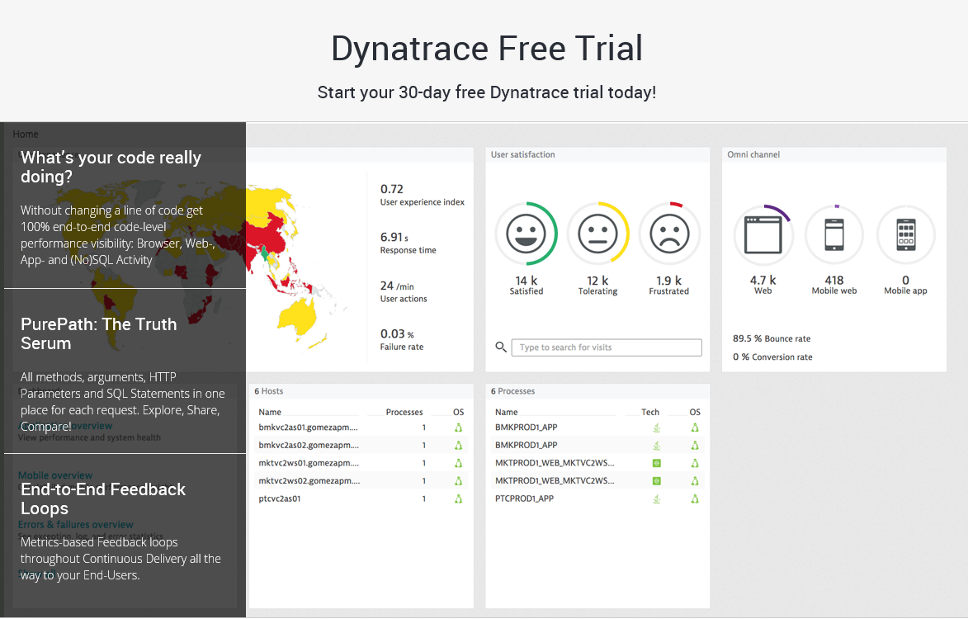
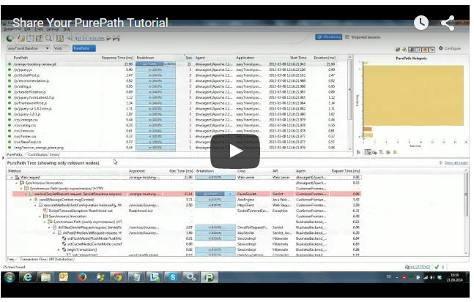
#2: http://bit.ly/sharepurepath

Slide 6
#3: http://bit.ly/onlineperfclinic

Slide 8
80%
20%
Notes:
Based on my experience
80% of the problems are only caused by 20% problem patterns. And focusing on 20% of potential problems that take away 80% of the pain is a very good starting point

Slide 9
Notes:
Most of the problems can easily be identified by just looking at the right metrics. Most performance problems can also be found by looking at metrics while your app is not even under load -> a simple click through / functional / unit or integration test will do

Slide 10
Frontend Performance
We are getting FATer!
Notes:
Lets start with the Frontend for all Web Developers

Slide 11
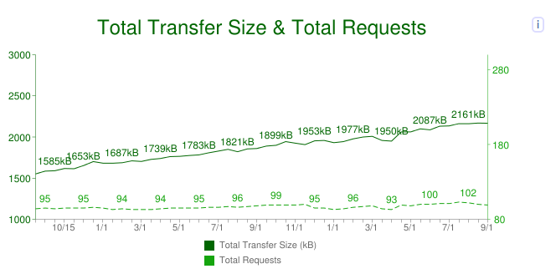
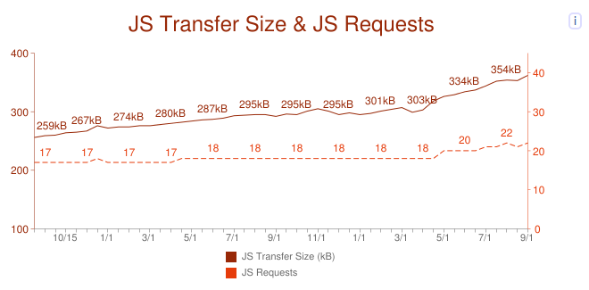
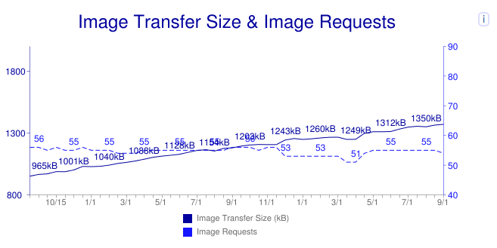
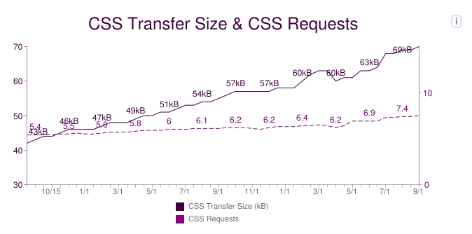
Notes:
http://httarchive.org – provides a good reference on how the top million websites in the world are constructed and whether they adhere to well known web performance best practices

Slide 12
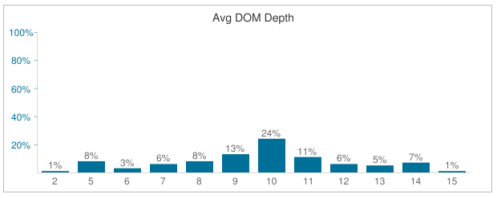
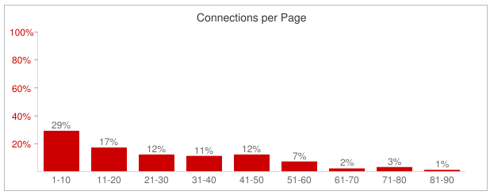
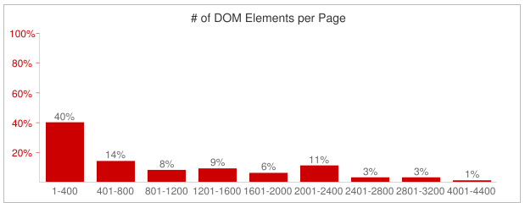
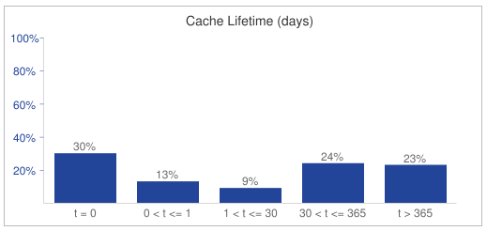
Notes:
Especially interesting some of the advanced metrics like DOM Depth, Connections per Page or # of DOM Elements

Slide 13
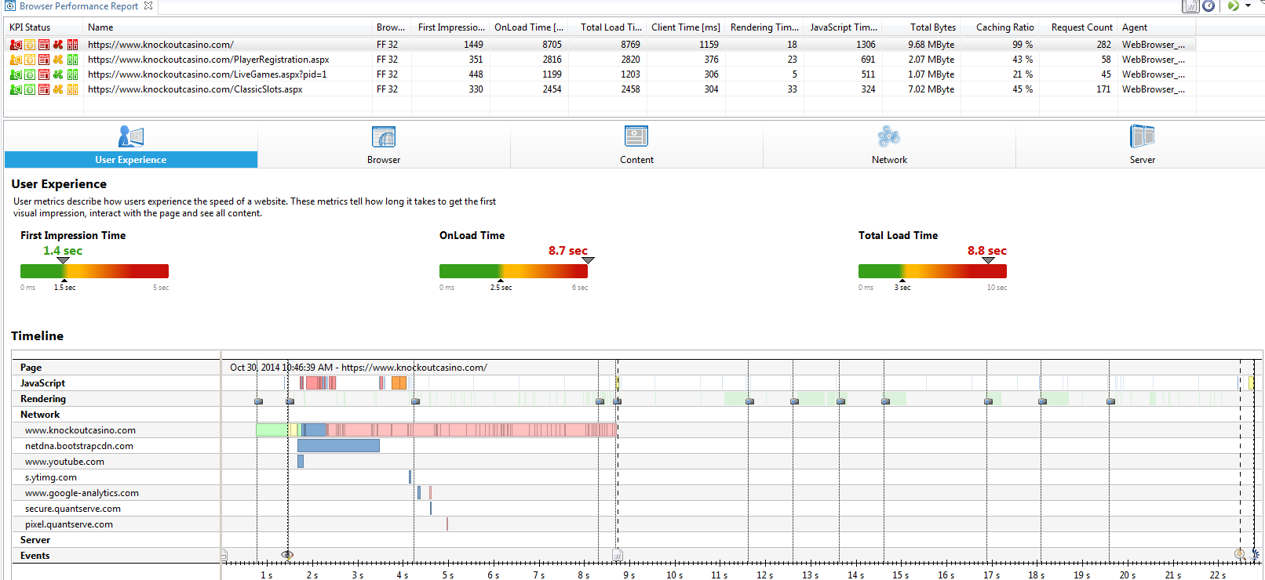
Example of a “Bad” Web Deployment
282! Objects on that page
9.68MB Page Size
8.8s Page Load Time
Most objects are images delivered from your main domain
Very long Connect time (1.8s) to your CDN
Notes:
Here is an example I recently worked on – an online casino that had a very bad deployment coming up. Two metrics from WPO (Web Performance Optimization) that should have been seen in dev & test before releasing this to prod

Slide 14
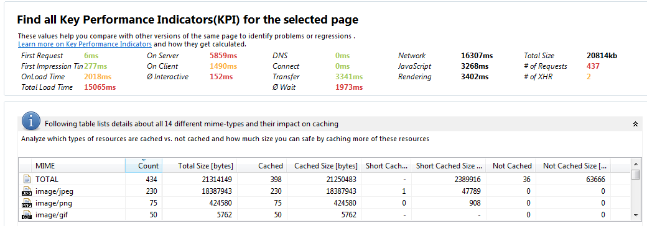
Mobile landing page of Super Bowl ad
Total size of ~ 20MB
434 Resources in total on that page:
230 JPEGs, 75 PNGs, 50 GIFs, …
Notes:
My all time favorite is the mobile landing page for a softdrink company during SuperBowl 2014 – 400+ individual images of selfie uploads aligned in a 20x20 grid. Pushed to my iPhone 4 in very high resolution causing 20MB data download and my phone to shrink each picture to be shown in a 20x20 grid on my small display

Slide 15
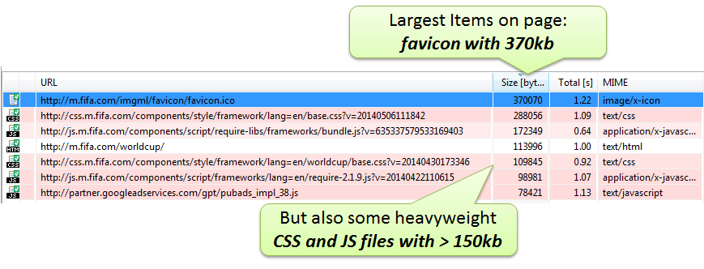
Fifa.com during Worldcup
Source: http://apmblog.compuware.com/2014/05/21/is-the-fifa-world-cup-website-ready-for-the-tournament/
Notes:
Another common problem are individual very large images – or in this case a very large favicon which should normally only be a couple of bytes

Slide 16
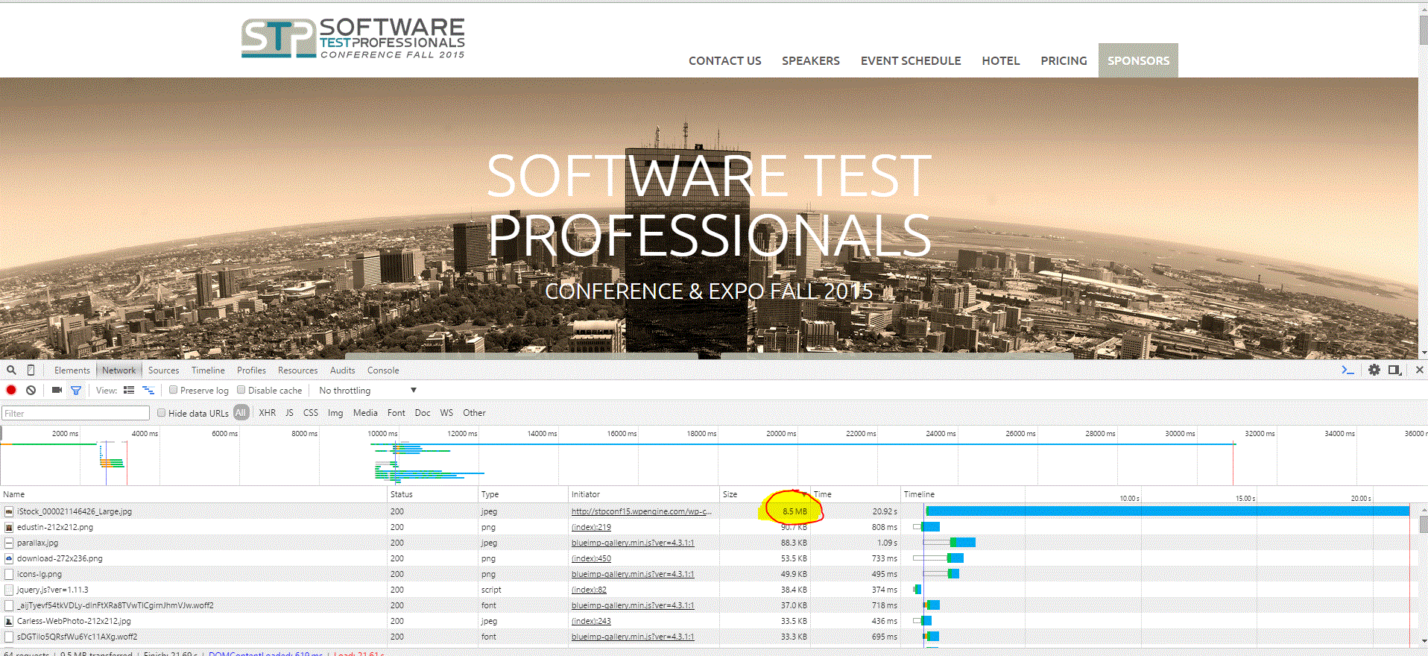
8MB of background image for STPCon (Word Press)
Notes:
Or people forgetting to shrink their high resolultion images before putting it on public websites

Slide 17
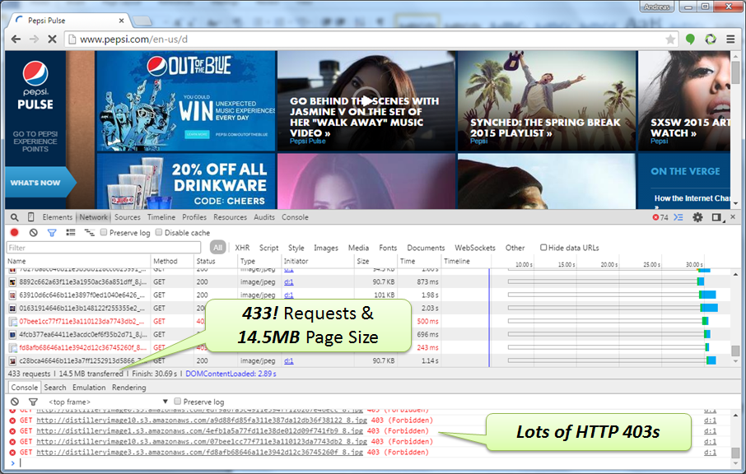
Make F12 or Browser Agent your friend!
Notes:
In case you didnt know – Hit F12 in your browser and you get all these metrics. Even better – you can automate that while running your browser driven tests

Slide 18
Compare yourself Online!

Slide 19
Key Metrics
# of Resources
Size of Resources
Total Size of Content

Slide 20
Tooling
Browser Built-In Developer Tools
Extensions such as YSlow, PageSpeed
Online Tools
WebPageTest
Google PageSpeed Insights
Dynatrace Performance Center
...
Automate!!

Slide 21
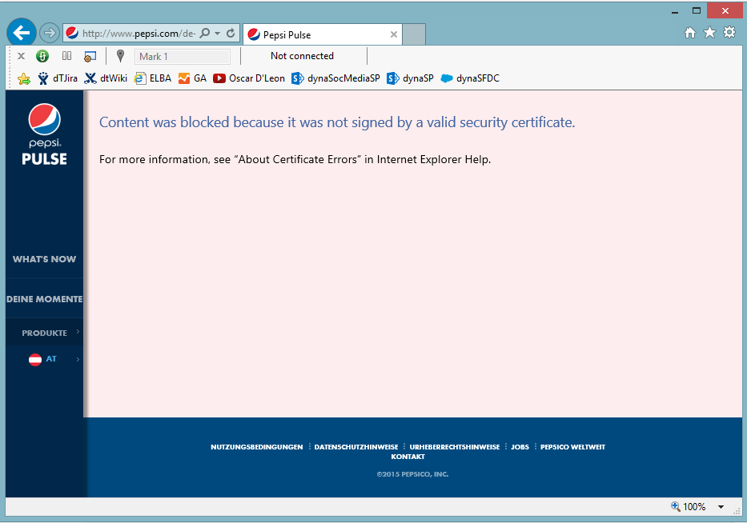
Frontend Availability
Back to Basics Please!
Notes:
Make sure deployments are done right – this is another example of pepsi having a certificate issue for some of their pages on the austrian website

Slide 22
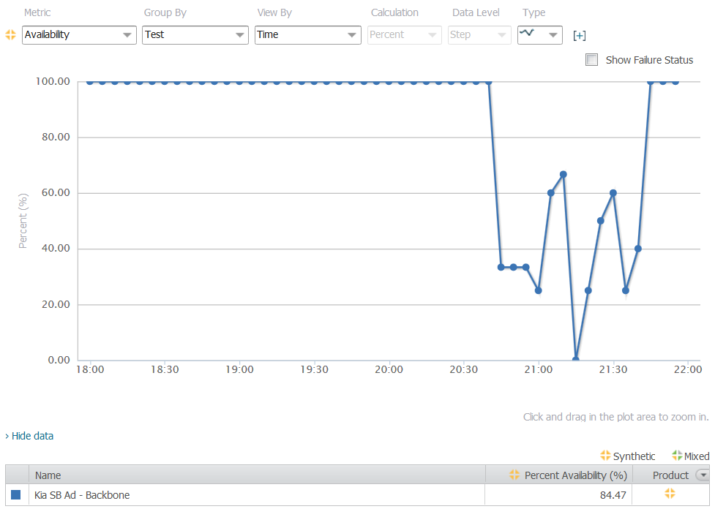
Notes:
What everybody should have at least as a minimum is availability monitoring -> lots of free or cheap offerings out there to do that!!

Slide 23
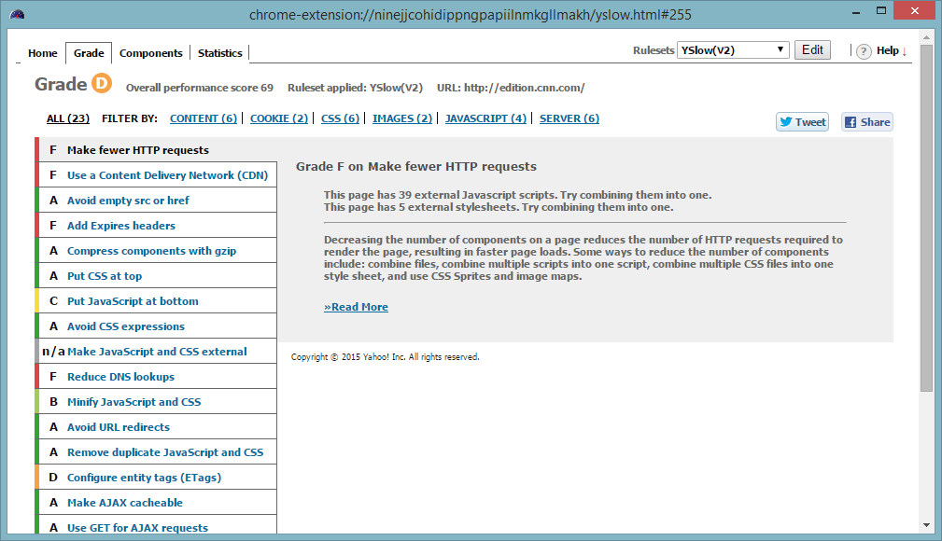
Notes:
Use tools like Yslow to do the basic deployment checks

Slide 24
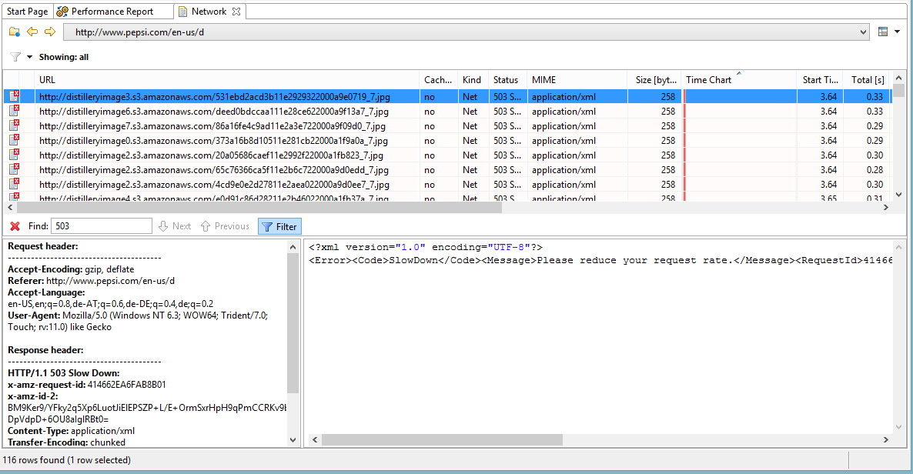
Notes:
You want to also avoid problems with your 3rd party or CDN providers – like in this case most images from Pepsi are not delivered by Amazons CDN

Slide 25
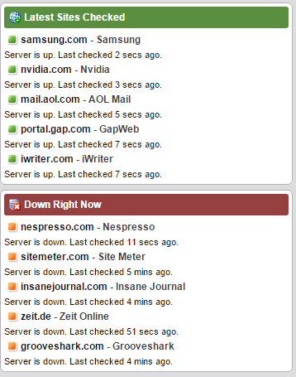
Online Services for you: Is it down right now?
Notes:
If you depend on 3rd parties it is worth checking out whether these 3rd parties are always available -> helps you make the right decision when choosing between different providers -> look at their track record

Slide 26
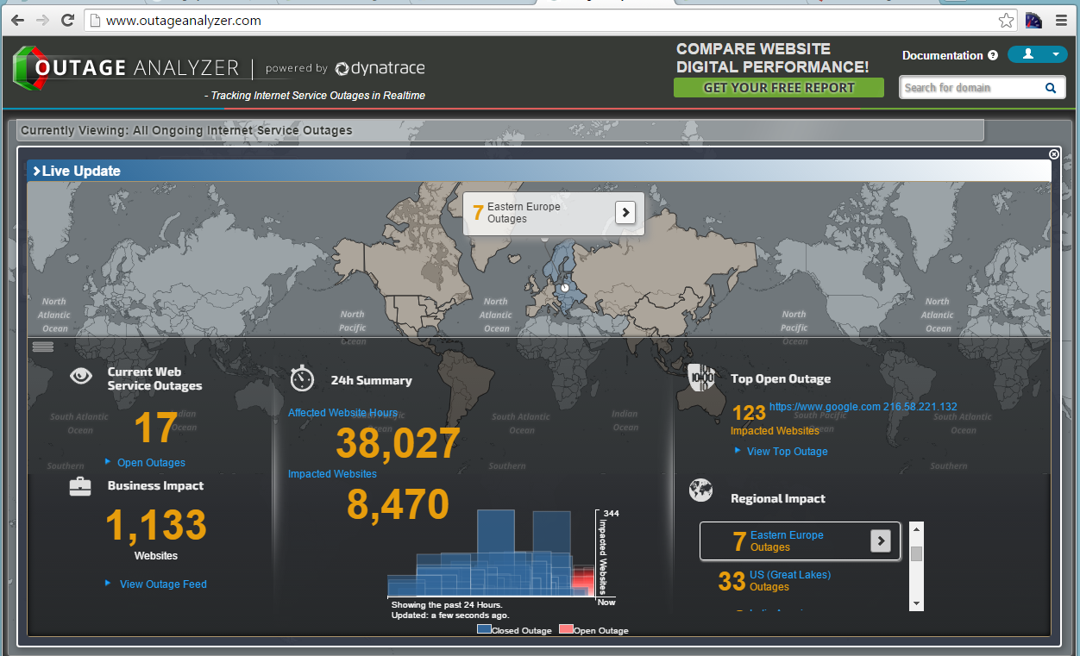
Online Services for you: Outage Analyzer
Notes:
Lots of online outage services available

Slide 27
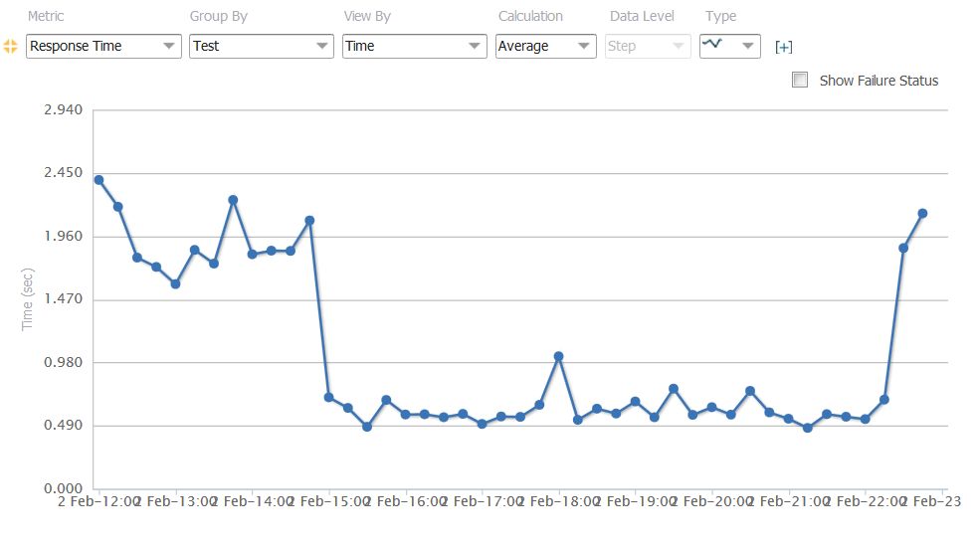
Tip for handling Spike Load: GO LEAN!!
Response time improved 4x
1h before
SuperBowl KickOff
1h after
Game ended
Notes:
If you have a peak period coming up – consider switching to an optimized landing page for that period – just as GoDaddy did during the SuperBowl.

Slide 28
Key Metrics
HTTP 3xx, 4xx, 5xx
# of Domains

Slide 29
Online Services
Dynatrace Synthetic
Ruxit Synthetic
NewRelic Synthetic
PingDom
...

Slide 30
Backend Performance
The Usual Suspects
Notes:
Now to the backend

Slide 31
Project: Online Room Reservation System
Symptoms
HTML takes between 60 and 120s to render
High GC Time
Developer Assumptions
Bad GC Tuning
Probably bad Database Performance as rendering was simple
Result: 2 Years of Finger pointing between Dev and DBA
Notes:
This story is from Joe – a DB guy from a very large telco arguing with his developers over performance problems of an online room reservation system which has evolved from a small project implemented by an intern to an application that is now used in their entire organization

Slide 32
Developers built own monitoring
void roomreservationReport(int officeId)
{
long startTime = System.currentTimeMillis();
Object data = loadDataForOffice(officeId);
long dataLoadTime = System.currentTimeMillis() - startTime;
generateReport(data, officeId);
}
Result:
Avg. Data Load Time: 45s!
DB Tool says:
Avg. SQL Query: <1ms!
Notes:
Devs buillt custom monitoring to proof their point! Contradicting what Joe‘s DB Tools had to say

Slide 33
#1: Loading too much data
24889! Calls to the Database API!
High CPU and High Memory Usage to keep all data in Memory
Notes:
Reading this Transaction Flow showed what the real problem was: Loading Too Much Data from the Database causing High Memory Usage and therefore high CPU to cleanup the garbage

Slide 34
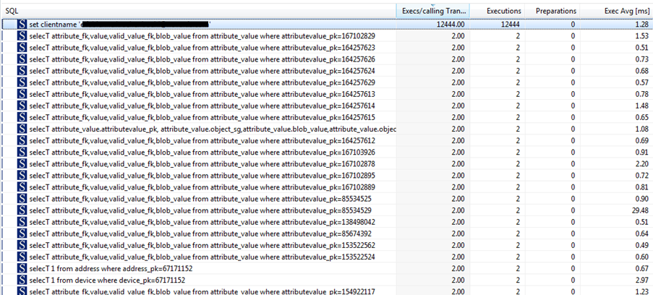
#2: On individual connections
12444! individual connections
Individual SQL really <1ms
Classical N+1 Query Problem
Notes:
Every SQL was executed on its on Connection

Slide 35
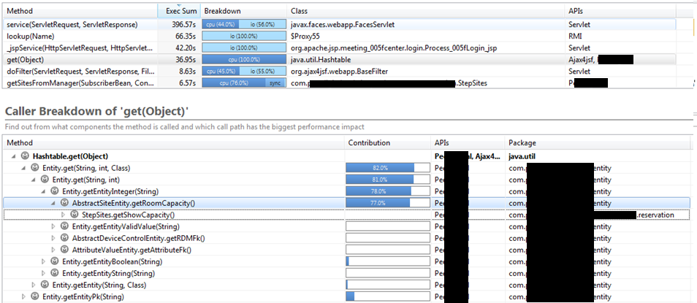
#3: Putting all data in temp Hashtable
Lots of time spent in Hashtable.get
Called from their Entity Objects
Notes:
The intern back then implemented its own OR Mapper by loading the full database content into a HashTable using individual queries

Slide 36
Lessons Learned – Don’t Assume …
… you know what code is doing you inherited!!
… you are not making mistakes like this ☺
Explore the Right Tools
Built-In Database Analysis Tools
“Logging” options of Frameworks such as Hibernate, …
JMX, Perf Counters, … of your Application Servers
Performance Tracing Tools: Dynatrace, Ruxit, NewRelic, AppDynamics, Your Profiler of Choice …

Slide 37
Key Metrics
# of SQL Calls
# of same SQL Execs (1+N)
# of Connections
Rows/Data Transferred

Slide 38
Backend Performance
Architectural Mistakes with „Migrating“ to (Micro)Services
Notes:
Everybody seems to migrate to MicroServices -> but be aware of the common mistakes

Slide 39
Architecture Violation: Direct access to DB instead from frontend logic
26.7s Execution Time
33! Calls to the same Web Service
171! SQL Queries through LINQ by this Web Service – request similar data for each call
Notes:
This is a monolithic app that was „migrated“ to microservices. The key use case is searching for sports clubs in a certain geographic area. A search that produces 33 search results used to take about 1s before „The Migration To MicroServices“. Now it takes 26.7s. AS you can see in the transaction flow there are many Issues: Architectural Violation, 1+N Query Problem but now between service calls as well as requesting too much static data redundantely from the database

Slide 40
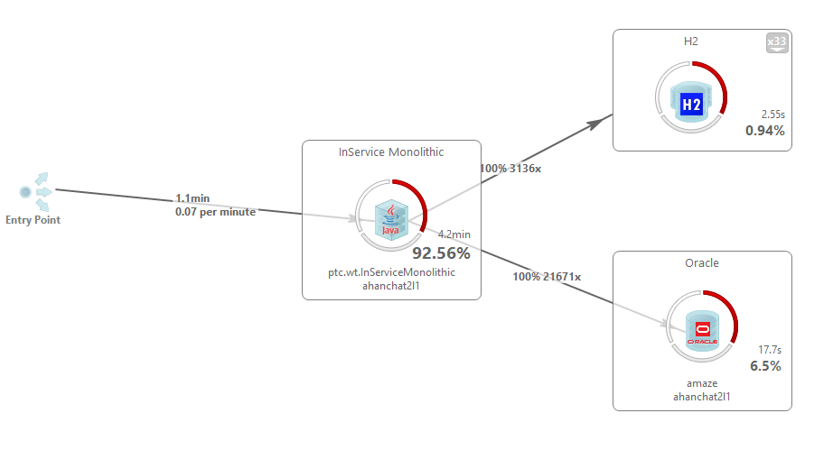
33! Different connections used
3136! Calls to H2 mostly executed on async background threads
DB Exceptions on both Databases
DB Exceptions on both Databases
40! internal Web Service Calls that do all these DB Updates
21671! Calls to Oracle
Notes:
Another example with an even more dramatic impact on the infrastructure

Slide 41
Key Metrics
# of Service Calls
Payload of Service Calls
# of Involved Threads
1+N Service Call Pattern!

Slide 42
Tooling
Dynatrace
Ruxit
NewRelic
AppDynamics
Any Profiler that can trace across tiers

Slide 43
Logging
WE CAN LOG THIS!!
Notes:
Thanks toi Splunk, Elastic Search and others we are able to analyze every log message we put out – but – does this really make sense?

Slide 44
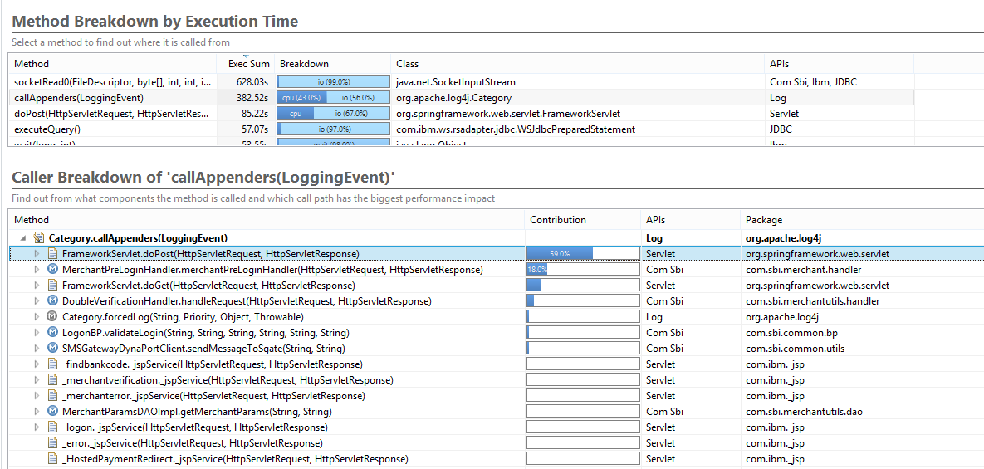
Log Hotspots in Frameworks!
callAppenders clear CPU and I/O Hotspot
Excessive logging through Spring Framework
Notes:
When logging becomes your performance issue -> misconfiguration of frameworks lead to CPU and I/O issues -> be aware of that!

Slide 45
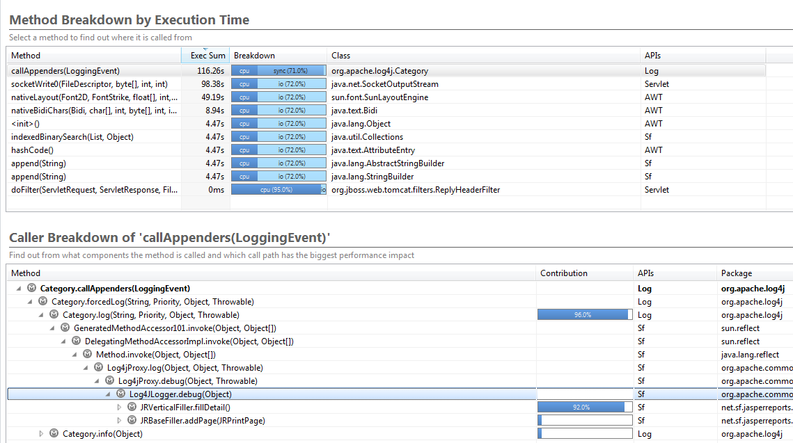
Debug Log and outdated log4j library
#1: Top Problem: log4j.callAppenders
-> 71% Sync Time
#3: Doing “DEBUG” log output: Is this necessary?
#2: Most of logging done from fillDetail method
Notes:
Wrong Log level and outdated log libraries can lead to serious performance impacts

Slide 46
Key Metrics
# of Log Entries
Size of Logs per Use Case

Slide 47
Response Time is not the only Performance Indicator
Look at Resources as well
Notes:
Now – response time should not be the only performance indicator

Slide 48
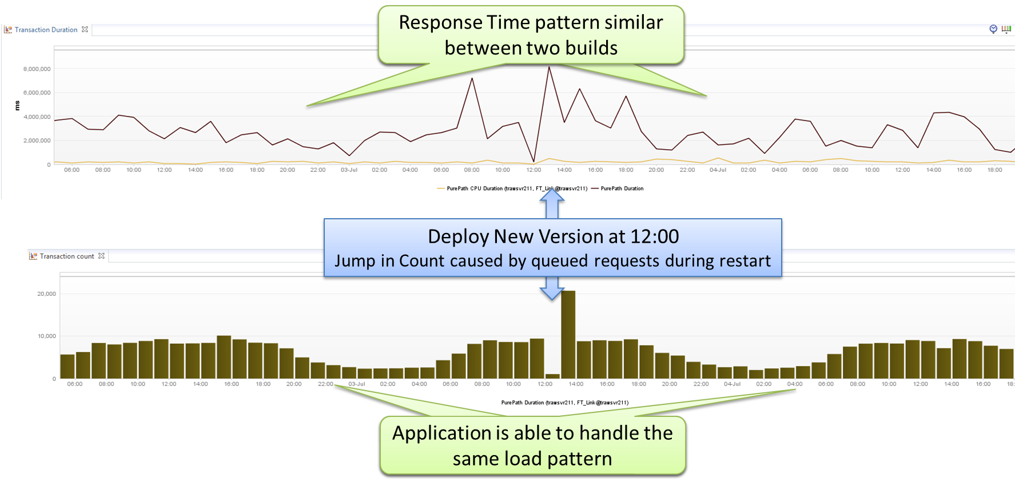
Is this a successful new Build?
Notes:
Is this a successful deployment? If you look at Response Time and Throughput it is!

Slide 49
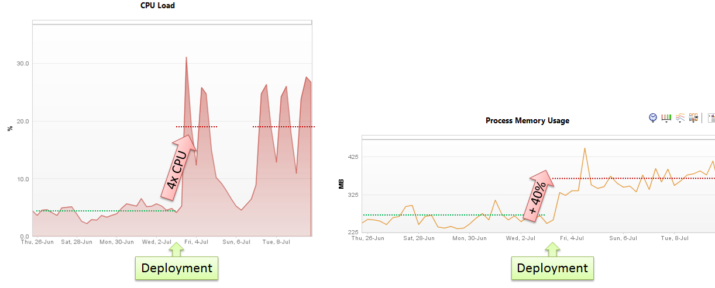
Look at Resource Usage: CPU, Memory, …
Notes:
But if CPU and Memory increases that dramatically it is NOT a good deployment -> this means a lot of extra costs!!

Slide 50
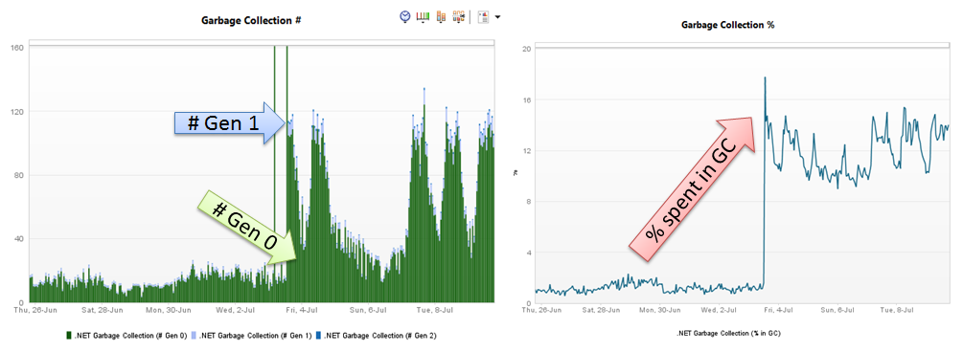
Memory? Look at Heap Generations
Notes:
Look at Heap Generations and Time spent in GC

Slide 51
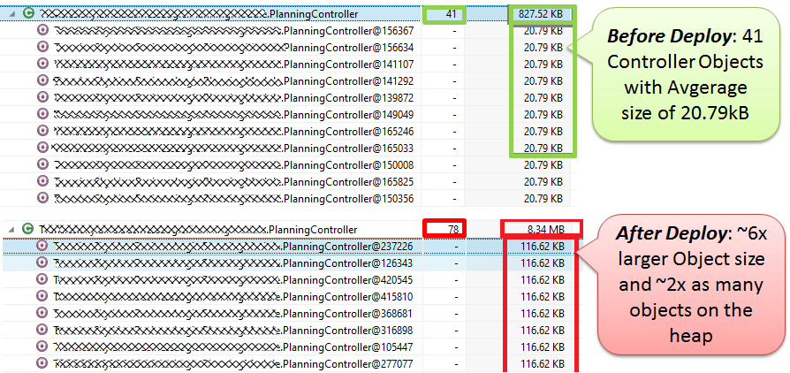
Root Cause: Dependency Injection
Notes:
In this case it was a configuration mistake in their Dependency Injection Configuration. Objects got bloated causing more objects and larger objects on the heap

Slide 52
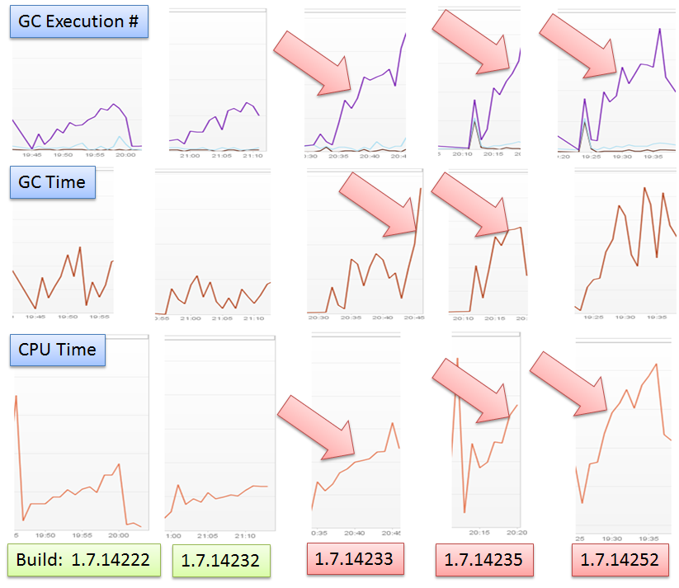
Prevent: Monitor Memory Metrics for every Build
Notes:
If you dont monitor memory for every build you may need to go back in time – rerun all your tests for every build – to figure out what the change in configuratoin caused this problem

Slide 53
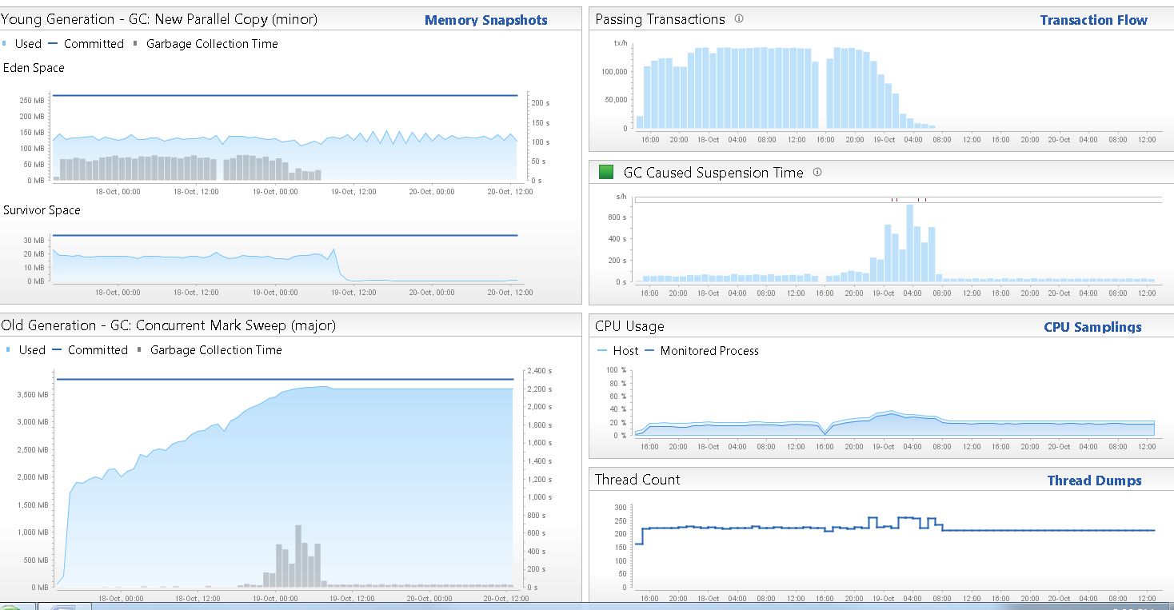
#1: Eden Space stays constant. Objects being propagated to Survivor Space
#5: Throughput of Application goes to 0 due to no memory available
#2: GC Activity in Young Generation ultimately moves objects into Old Generation
#4: Heavy GC kicks in when Old Generation is full!
#3: Growing “Old Gen” is a good indicator for a Mem Leak
Notes:
Another classical Memory Leak and how easy it is to observe it! – In this case it was a memory leak in Tibco‘s Messaging Platform

Slide 54
Key Metrics
# of Objects per Generation
# of GC Runs
Total Impact of GC

Slide 55
Tips & Tricks
And more Metrics of course ☺

Slide 56
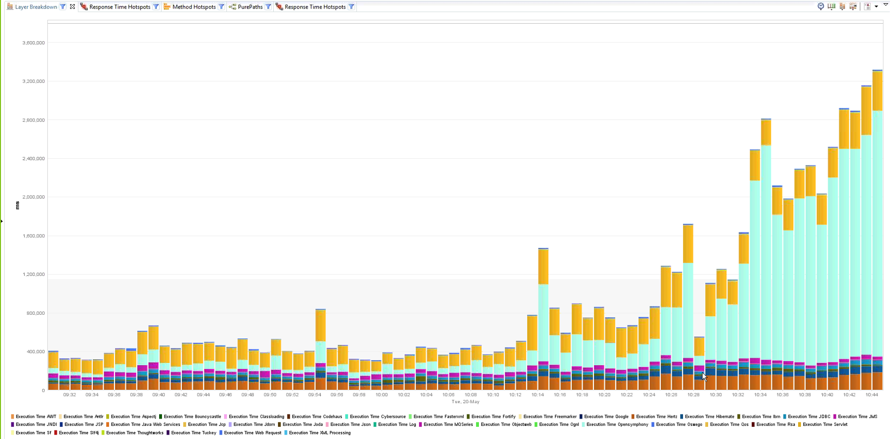
Tip: Layer Breakdown over Time
With increasing load: Which LAYER doesn’t SCALE?
Notes:
I love looking at Layers / APIs / Services -> if you have the chance to run a load test with slightly increasing load just monitor which of your APIs/Services/Methods behaviors „out of the norm“ -> thats your breaking point

Slide 57
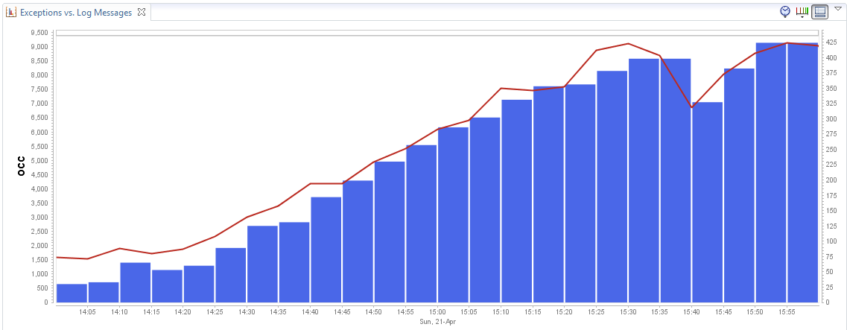
Tip: Exceptions and Log Messages
How are # of EXCEPTIONS evolving over time?
How many SEVERE LOG messages to we write in relation to Exceptions?
Notes:
I always look at Exceptions vs Log Messages. Especially with frameworks such as Hibernate/Spring you can end up with a lot of „internal exceptions“ that impact performance but there is no „visible“ entry in any log file. Thats why I chart them and assume they correlate. If not – you know that something is wrong

Slide 58
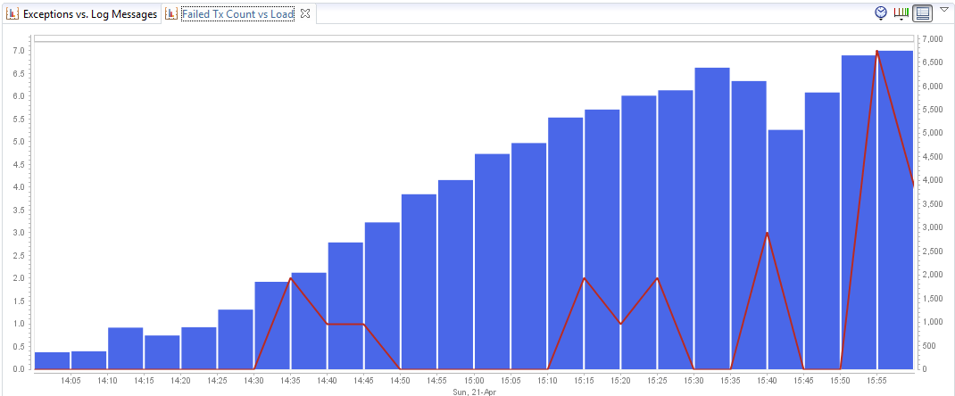
Tip: Failed Transactions
Are more TRANSACTIONS FAILING (HTTP 5xx, 4xx, …) under heavier load?
Notes:
Same is true for Failed Requests vs. Load -> at which point does your app break and return HTTP 4xx, 5xx?

Slide 59
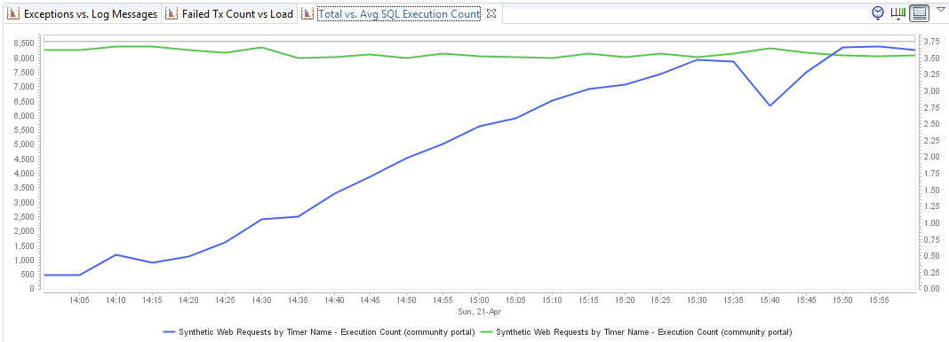
Tip: Database Activity
Do we see increased in AVG # of SQL Executions over Time?
Do TOTAL # of SQL Executions increase with load? Shouldn’t it flatten due to CACHES?
Notes:
Looking at Avg number of SQL Queries -> Do we have a data driven problem?
Looking at Total # of SQL -> should show a flatten curve as we assume we can cache some of the data

Slide 60
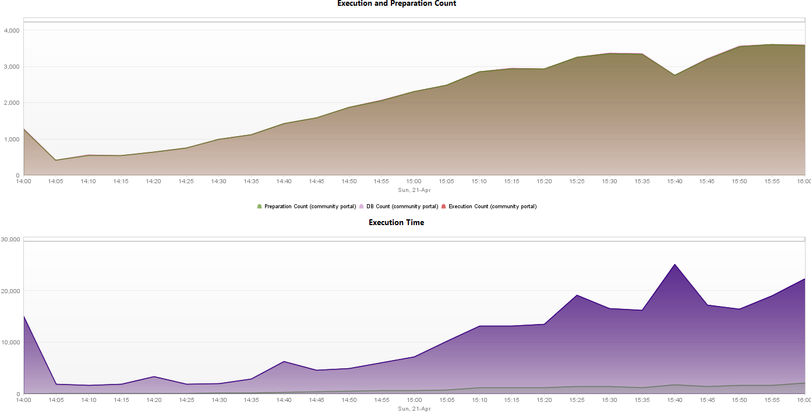
Tip: Database History Dashboard
How many SQL Statements are PREPARED?
What’s the overall Execution Time of different SQL Types (SELECT, INSERT, DELETE, …)
Notes:
Are we preparing SQLs – how many INSERTS, UPDATES, DELETES -> do we have certain periods during the day when heavy REPORTS or clean up jobs run?

Slide 61
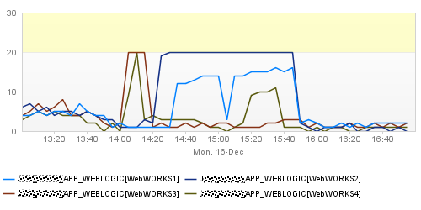
Tip: DB Connection Pool Utilization
Do we have enough DB CONNECTIONS per pool?
Notes:
Keep an eye on your pools. Not only Datbase but also Thread and network connectoin pools

Slide 62
For more Key Metrics
http://blog.dynatrace.com
http://blog.ruxit.com

Slide 63
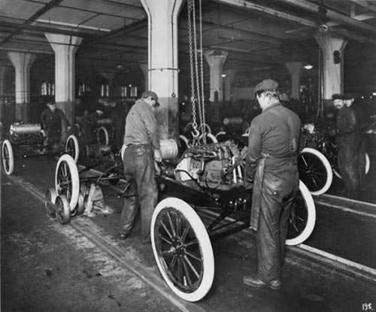
We want to get from here …

Slide 64
To here!

Slide 65
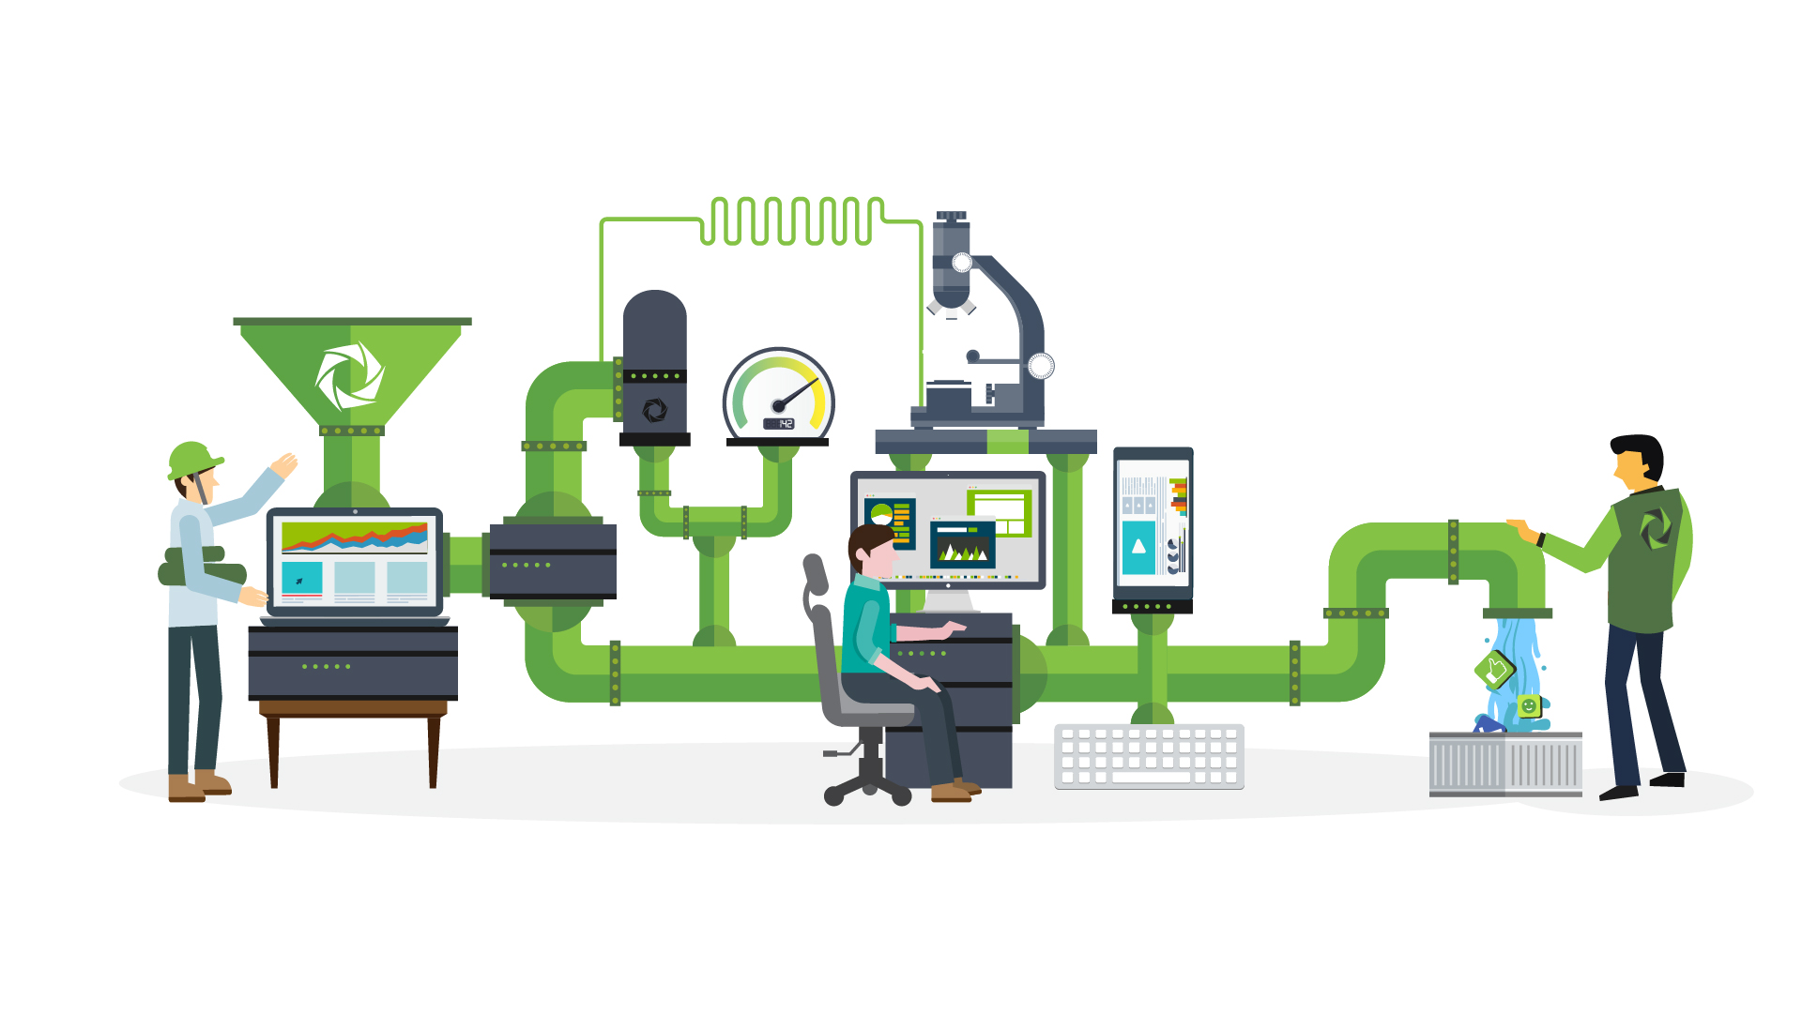
Use these application metrics as additional
Quality Gates
Notes:
If you are automating your build pipeline you shoudl also automate your performance checks – find all these problems I just told you about

Slide 66
Quality Metrics
in your CI
What you currently measure
# Test Failures
Overall Duration
What you should measure
Execution Time per test
# calls to API
# executed SQL statements
# Web Service Calls
# JMS Messages
# Objects Allocated
# Exceptions
# Log Messages
# HTTP 4xx/5xx
Request/Response Size
Page Load/Rendering Time
…

Slide 67
Connecting your Tests with Quality
Let’s look behind the scenes
Test Framework Results
Architectural Data
Build # | Test Case | Status
# SQL | # Excep | CPU
Build 17 | testPurchase | OK
 | testSearch | OK
12 | 0 | 120ms
3 | 1 | 68ms
Build 18 | testPurchase | FAILED
 | testSearch | OK
12 | 5 | 60ms
3 | 1 | 68ms
Build 19 | testPurchase | OK
 | testSearch | OK
75 | 0 | 230ms
3 | 1 | 68ms
Build 20 | testPurchase | OK
 | testSearch | OK
12 | 0 | 120ms
3 | 1 | 68ms
We identified a regresesion
Exceptions probably reason for failed tests
Problem fixed but now we have an architectural regression
Problem solved
Problem fixed but now we have an architectural regression
Now we have the functional and architectural confidence
Notes:
If you do this you can simply let tools such as Dynatrace, NewRelic, AppDynamics, ... Analyze the code execution of your unit, integration or API tests and find any architectural regressions introduced by a code change

Slide 68
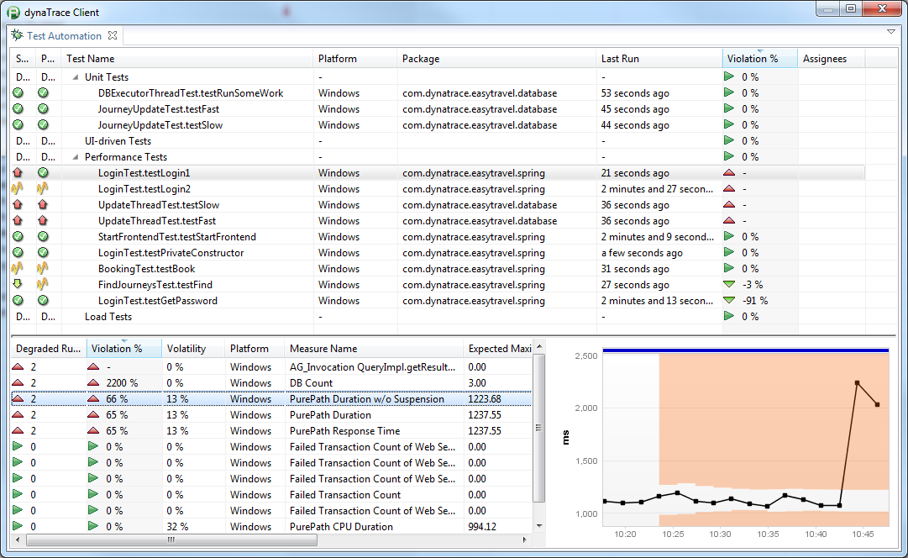
#1: Analyzing each Test
#3: Detecting Regression based on Measure
#2: Metrics for each Test
Notes:
This is how this can look like in a real life example. Analyzing Key Performance, Scalability and Architectural Metrics for every single test

Slide 69
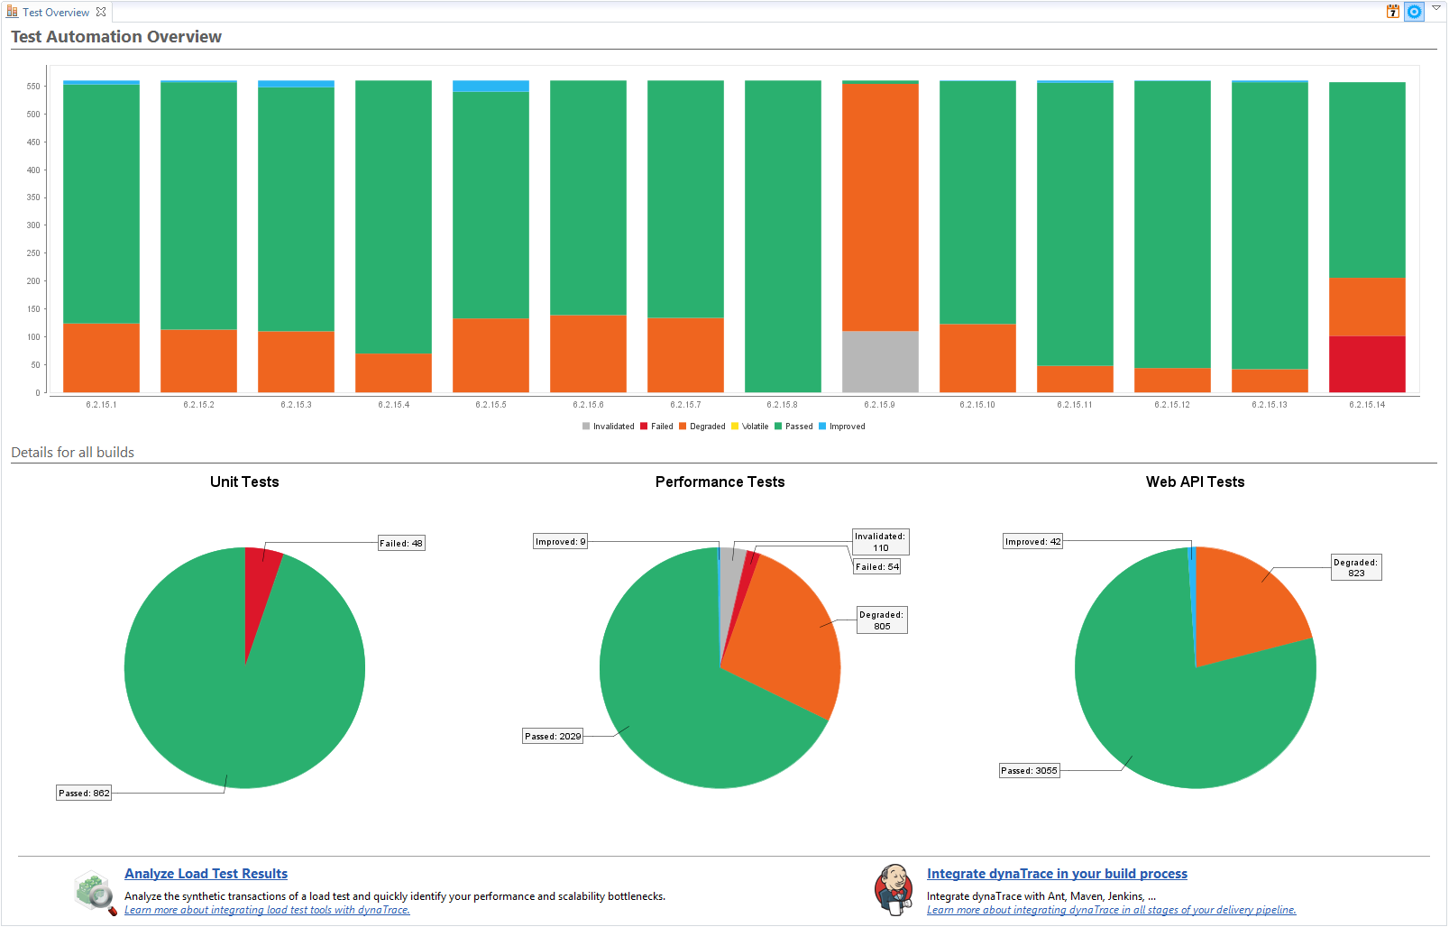
Quality-Metrics based Build Status
Notes:
Viewing data number of bad quality tests per build

Slide 70
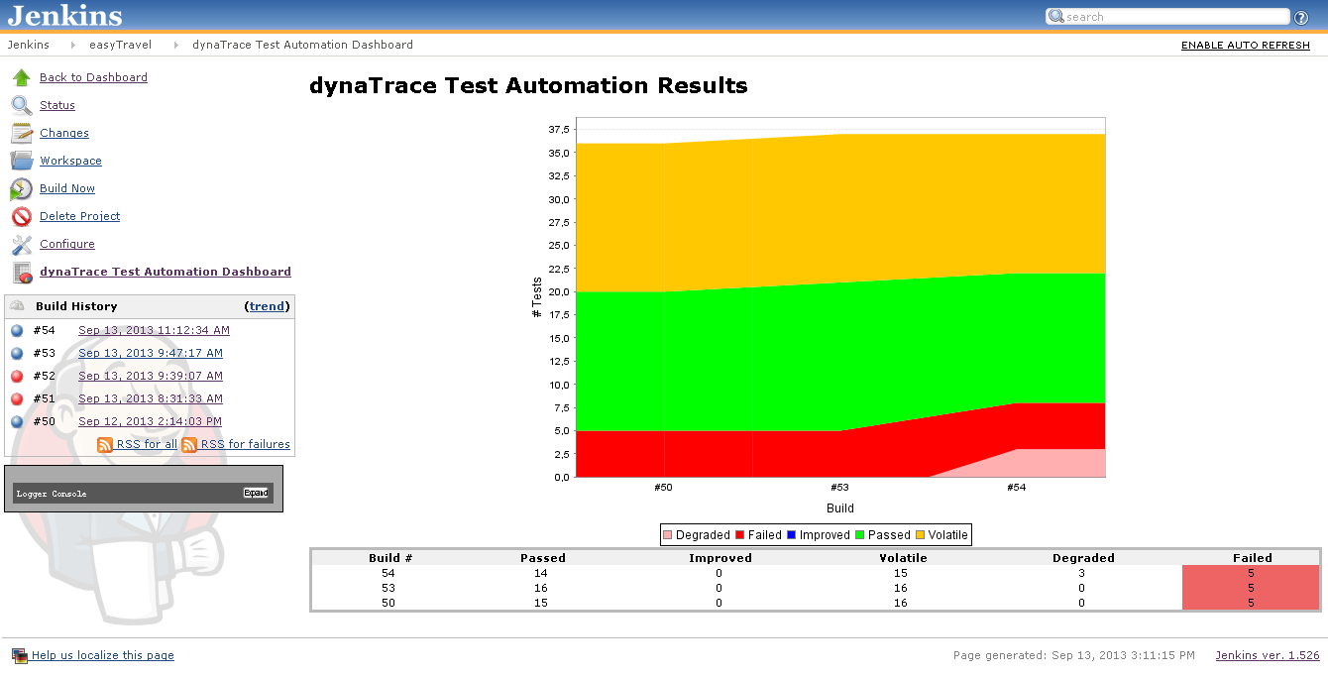
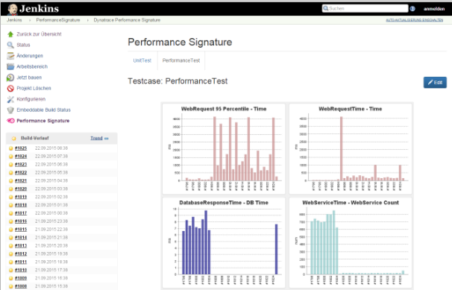
Pull data into Jenkins, Bamboo ...
Notes:
And of course – bring it into Jenkins

Slide 71
Making Quality a first-class citizen
„not cool enough“
„Too hard“
„we‘ll get round to this later“
Notes:
Help us make the world a better quality place so that you are not the one behind news like this ☺

Slide 72
Questions and/or Demo
Slides: slideshare.net/grabnerandi
Get Tools: bit.ly/dttrial
YouTube Tutorials: bit.ly/dttutorials
Contact Me: agrabner@dynatrace.com
Follow Me: @grabnerandi
Read More: blog.dynatrace.com

Slide 73
Andreas Grabner
Dynatrace Developer Advocate
@grabnerandi
http://blog.dynatrace.com

