Slide 1


CONNECTED CAR
CRUISING ON THE CLOUD

Slide 2
Phil Berman
Twitter: @pivotalphil
Website: http://pivotal.io
Michael Minella
Twitter: @michaelminella
Podcast: http://javaOffHeap.com
or @OffHeap
Website: http://spring.io
Scott Deeg
Website: http://pivotal.io

Slide 3


Slide 4

https://github.com/pivotal/IoT-ConnectedCar

Slide 5
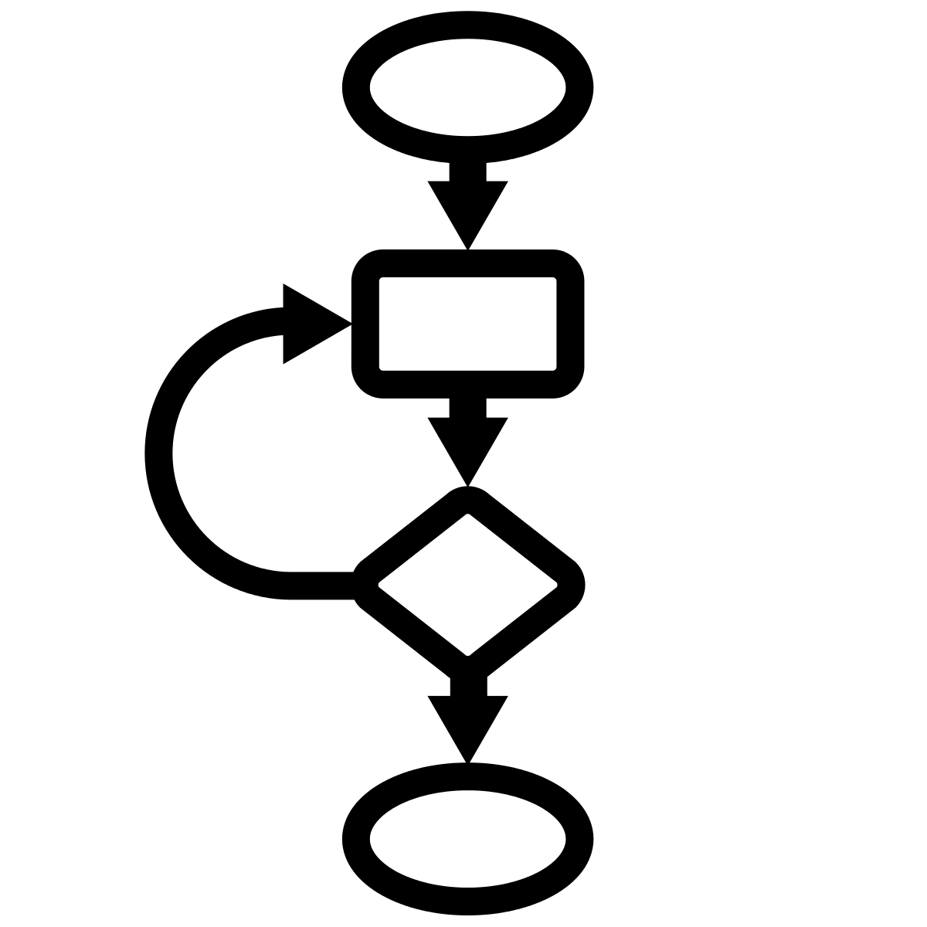


BACK TO THE
BEGINNING
Notes:
Where this talk came from

Slide 6

REALLY COOL IoT
PROJECT
Notes:
We had a really cool project that was the perfect example of IoT
Perfect example of Pivotal Vision
Ingestion of fast data
From a large number of clients
And provide real time analytics with a dashboard

Slide 7

COVERED BY AN
NDA
Notes:
Client was covered by an NDA so we can’t talk about them.

Slide 8

Notes:
We got thinking about what other use cases could we apply this same architecture.
Ingestion of fast data
From a large number of clients
And provide real time analytics with a dashboard

Slide 9
CONNECTED
CAR
Notes:
Everyone is familiar with a car

Slide 10

PREDICT THE
DESTINATION

Slide 11

PREDICT THE
RANGE

Slide 12









PIECES ARE THE
SAME
Notes:
The pieces of the architecture are the same as our NDA client.
Spring XD for ingestion
PHD/File based storage
Gemfire for “data cache”
HTML based dashboard

Slide 13

IoT IS ABOUT
OPERATIONAL EFFECIENCIES
Notes:
IoT is about operational efficiencies big and small
Nest on the consumer side
GE on the commercial side

Slide 14

GE Video?

Slide 15
1%
IS A
BIG DEAL
Notes:
In 2010 there were 1 billion cars worldwide
2 billion by 2035
2 billion cars = 120 million barrels of cude oil a day which =
$12 billion dollars a day in oil (Around the entire GDP of Albania)
51.6 million metric tons of CO2 per day
Removing 1% of that would be like Russia (the 4th heaviest polluter) not producing a single pound of carbon for a year
http://www.cbsnews.com/news/carbon-dioxide-emissions-rise-to-24-million-pounds-per-second/
Basic numbers for a “southwest like” situation:
314 Boeing 737’s in fleet
Each one has two CFM56 engines
Each engine requires to be pulled off for an overhaul about ever 15-20k flight hours (every 5-7 years).
Each overhaul costs around 1 million dollars including about 1,500 man hours of work.
Total number of overhauls needed per period (6 years) is 628
Reduce that by 1% means 6 million dollars savings per cyclke or about a million dollars a year.
Sources:
Southwest: http://swamedia.com/channels/Corporate-Fact-Sheet/pages/corporate-fact-sheet#fleet
Engine information: http://www.aircraft-commerce.com/sample_articles/sample_articles/maintenance_engineering_1_sample.pdf

Slide 16

WORLDWIDE
1 BILLION CARS
Notes:
In 2010 there were 1 billion cars worldwide
2 billion by 2035
2 billion cars = 120 million barrels of cude oil a day which =
$5.4 billion dollars a day in oil
51.6 million metric tons of CO2 per day
Removing 1% of that would be like Russia (the 4th heaviest polluter) not producing a single pound of carbon for a year
http://www.cbsnews.com/news/carbon-dioxide-emissions-rise-to-24-million-pounds-per-second/
Basic numbers for a “southwest like” situation:
314 Boeing 737’s in fleet
Each one has two CFM56 engines
Each engine requires to be pulled off for an overhaul about ever 15-20k flight hours (every 5-7 years).
Each overhaul costs around 1 million dollars including about 1,500 man hours of work.
Total number of overhauls needed per period (6 years) is 628
Reduce that by 1% means 6 million dollars savings per cyclke or about a million dollars a year.
Sources:
Southwest: http://swamedia.com/channels/Corporate-Fact-Sheet/pages/corporate-fact-sheet#fleet
Engine information: http://www.aircraft-commerce.com/sample_articles/sample_articles/maintenance_engineering_1_sample.pdf

Slide 17
2035
2 BILLION CARS
Notes:
In 2010 there were 1 billion cars worldwide
2 billion by 2035
Basic numbers for a “southwest like” situation:
314 Boeing 737’s in fleet
Each one has two CFM56 engines
Each engine requires to be pulled off for an overhaul about ever 15-20k flight hours (every 5-7 years).
Each overhaul costs around 1 million dollars including about 1,500 man hours of work.
Total number of overhauls needed per period (6 years) is 628
Reduce that by 1% means 6 million dollars savings per cyclke or about a million dollars a year.
Sources:
Southwest: http://swamedia.com/channels/Corporate-Fact-Sheet/pages/corporate-fact-sheet#fleet
Engine information: http://www.aircraft-commerce.com/sample_articles/sample_articles/maintenance_engineering_1_sample.pdf

Slide 18
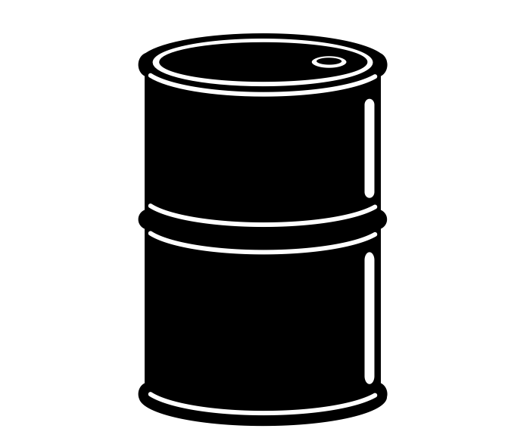
BARRELS PER DAY
120 MILLION
Notes:
2 billion cars = 120 million barrels of cude oil a day which =
$5.4 billion dollars a day in oil (just under $2 trillion…around the GDP of Mexico)
51.6 million metric tons of CO2 per day
Removing 1% of that would be like Russia (the 4th heaviest polluter) not producing a single pound of carbon for a year
http://www.cbsnews.com/news/carbon-dioxide-emissions-rise-to-24-million-pounds-per-second/
Basic numbers for a “southwest like” situation:
314 Boeing 737’s in fleet
Each one has two CFM56 engines
Each engine requires to be pulled off for an overhaul about ever 15-20k flight hours (every 5-7 years).
Each overhaul costs around 1 million dollars including about 1,500 man hours of work.
Total number of overhauls needed per period (6 years) is 628
Reduce that by 1% means 6 million dollars savings per cyclke or about a million dollars a year.
Sources:
Southwest: http://swamedia.com/channels/Corporate-Fact-Sheet/pages/corporate-fact-sheet#fleet
Engine information: http://www.aircraft-commerce.com/sample_articles/sample_articles/maintenance_engineering_1_sample.pdf

Slide 19
AS MUCH
CARBON AS
Notes:
In 2010 there were 1 billion cars worldwide
2 billion by 2035
2 billion cars = 120 million barrels of cude oil a day which =
$5.4 billion dollars a day in oil
51.6 million metric tons of CO2 per day
Removing 1% of that would be like Russia (the 4th heaviest polluter) not producing a single pound of carbon for a year
http://www.cbsnews.com/news/carbon-dioxide-emissions-rise-to-24-million-pounds-per-second/
Basic numbers for a “southwest like” situation:
314 Boeing 737’s in fleet
Each one has two CFM56 engines
Each engine requires to be pulled off for an overhaul about ever 15-20k flight hours (every 5-7 years).
Each overhaul costs around 1 million dollars including about 1,500 man hours of work.
Total number of overhauls needed per period (6 years) is 628
Reduce that by 1% means 6 million dollars savings per cyclke or about a million dollars a year.
Sources:
Southwest: http://swamedia.com/channels/Corporate-Fact-Sheet/pages/corporate-fact-sheet#fleet
Engine information: http://www.aircraft-commerce.com/sample_articles/sample_articles/maintenance_engineering_1_sample.pdf

Slide 20
CONNECTED
CAR

Slide 21





React
Applications
Edge
Ingest
Process
Analyze
Storage

Slide 22






React
Applications
Edge
Ingest
Process
Analyze
Storage

Slide 23

Notes:
It’s easier to understand the demo when we see it in action. Use VM or live demo to get demo starting here.

Slide 24

HOW DOES THIS
WORK?

Slide 25

START IN THE
CAR

Slide 26

ON BOARD DIAGNOSTICS
OBD II
Notes:
Available in every car sold in the US since 1996
Most other major auto markets have a version of OBD
Provides stats like
RPM
Speed
Mas Airflow Rate

Slide 27
01 0D
01 0D
18 DA F1 11 03 41 0D 30
>
Notes:
Mode 01
PID 0D = Speed
Yellow is the request
Blue is the full response
The orange is the echo of the request and the value in hex.
0x30 = 48 km/h = 30 mph

Slide 28

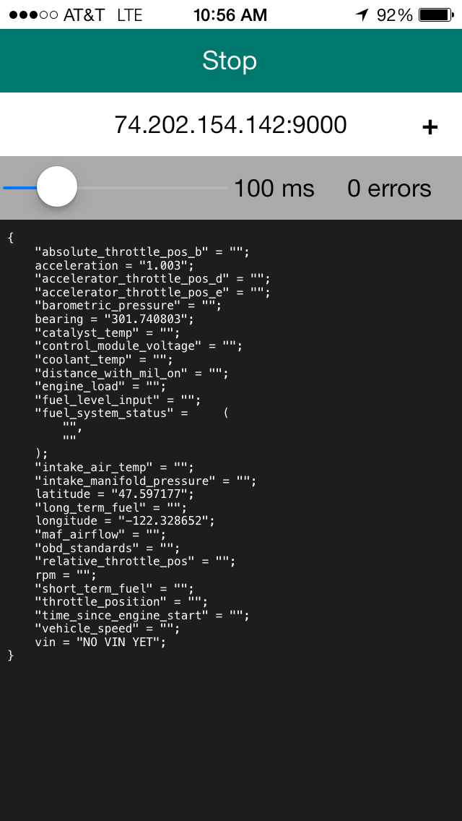
PHONE PROVIDES
CONNECTIVITY
127.0.0.1:9000
Notes:
Bluetooth to the dongle
Cellular to our server
Also enriches the data with GPS and acceleration

Slide 29
{
"vehicle_speed":103,
"obd_standards":2,
"intake_manifold_pressure":"",
"accelerator_throttle_pos_e":14,
"engine_load":89,
"maf_airflow":33,
"latitude":"32.897554",
"vin":"1HGCM82633A004352",
"bearing":"343.922580",
"catalyst_temp":779,
"relative_throttle_pos":12,
"fuel_level_input":89,
"fuel_system_status":[2,0],
"accelerator_throttle_pos_d":29,
"acceleration":"0.953",
"throttle_position":21,
"barometric_pressure":97,
"control_module_voltage":13,
"longitude":"-96.810236",
"distance_with_mil_on":0,
"coolant_temp":94,
"intake_air_temp":34,
"rpm":1593,
"short_term_fuel":-2,
"time_since_engine_start":4054,
"absolute_throttle_pos_b":38,
"long_term_fuel":3
}
Notes:
This is the Herbie JSON

Slide 30

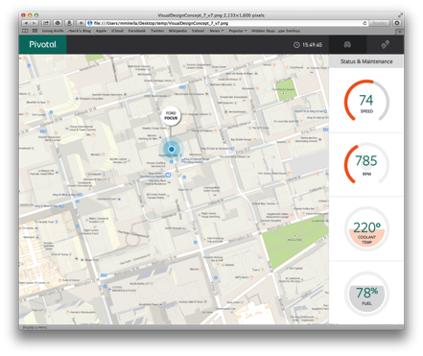


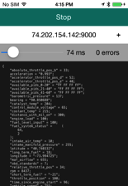
TCP SOCKET
OVER
BLUETOOTH
HTTP POST
OVER
CELLULAR

Slide 31

ON THE
SERVER

Slide 32


Slide 33

1
EASY

Slide 34
2
MATURE

Slide 35
3
NOT DEPENDENT

Slide 36

SPRING CLOUD
STREAM

Slide 37

Notes:
Introductions

Slide 38

EVOLUTION OF DATA
APPLICATIONS
Notes:
Integration/batch

Slide 39

MONOLITHS
Notes:
Tight coupling between data models and business logic
Operationally hard to deploy/troubleshoot/etc
Delayed time to market

Slide 40


EXISTING
INTEGRATION AND BATCH

Slide 41

DATA
MICROSERVICES

Slide 42

CLOUD
NATIVE

Slide 43

DEVELOPED AND TESTED
IN ISOLATION

Slide 44

APPLY MICROSERVICES
PATTERNS

Slide 45

OPERATIONALLY EASY TO
GOVERN

Slide 46
DATA INTEGRATION
AS A SERVICE

Slide 47

COMPOSTION OF
MICROSERVICES

Slide 48
<?xml version="1.0" encoding="UTF-8"?>
<beans xmlns="http://www.springframework.org/schema/beans"
xmlns:xsi="http://www.w3.org/2001/XMLSchema-instance"
xsi:schemaLocation="http://www.springframework.org/schema/batch http://www.springframework.org/schema/batch/spring-batch.xsd
http://www.springframework.org/schema/beans http://www.springframework.org/schema/beans/spring-beans.xsd">
<job id="ioSampleJob" xmlns="http://www.springframework.org/schema/batch">
<step id="step1">
<tasklet>
<chunk reader="itemReader" processor="itemProcessor" writer="itemWriter"
commit-interval="2" />
</tasklet>
</step>
</job>
<bean id="itemProcessor" class="org.springframework.batch.sample.domain.trade.internal.CustomerCreditIncreaseProcessor" />
</beans>
ZERO CODING

Slide 49

OPERATIONAL AND
ORCHESTRATION COVERAGE

Slide 50
Notes:
Introductions

Slide 51

WARS AND
APP SERVERS

Slide 52

DECOMPOSE INTO BOOT
MICROSERVICES

Slide 53

SPRING CLOUD
STREAMS

Slide 54
SPRING CLOUD
DATA FLOW

Slide 55
Bus
Source
Processor
Sink

Slide 56
Redis
http
transformer
type-transformer
hdfs
filter
python
gemfire

Slide 57

http
filter
transformer
python
hdfs
Hadoop
type-transformer
Gemfire
REST
Gemfire

Slide 58
http
filter
transformer
python
hdfs
Hadoop
type-transformer
Gemfire
REST
Gemfire

Slide 59
/**
* Performs the domain transformation into an acme motors specific domain model.
*
* @author gfoster
*
*/
public class AcmeMotorEnrichingTransformer implements Transformer{
@Bean
public Message<?> transform(final Message<?> message) {
final Object payload = message.getPayload();
Map<String, Object> = new HashMap<>();
try {
if (payload != null) {
map = mapper.readValue(payload.toString(), Map.class); }
map.put(“timestamp”, System.currentTimeMillis()); }
map.put(“guid”, UUID.randomUUID());
}
} catch (final Exception e) {

Slide 60

REALTIME DATA
SCIENCE

Slide 61
1
PREDICT
JOURNEY

Slide 62
2
PREDICT
RANGE
Notes:
Based on journey and driving behavior

Slide 63

HOW DOES IT
WORK?
Notes:
Based on journey and driving behavior

Slide 64
STORE SENSOR
DATA
Notes:
Based on journey and driving behavior

Slide 65
OFFLINE BATCH
TRAINING
Notes:
Based on journey and driving behavior

Slide 66

JOURNEY
CLUSTERS
Notes:
Based on journey and driving behavior

Slide 67
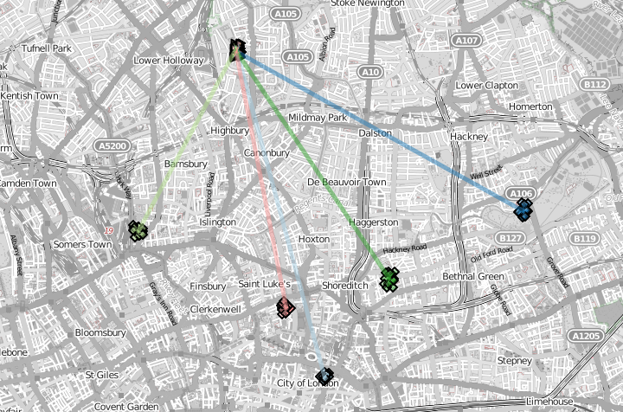
Notes:
Based on journey and driving behavior

Slide 68
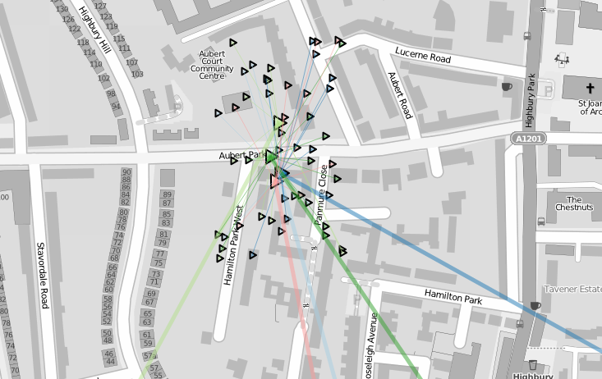
Notes:
Based on journey and driving behavior

Slide 69
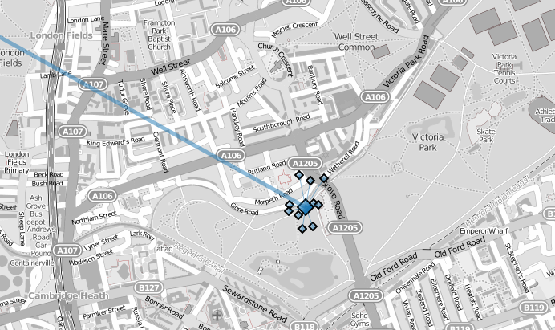
Notes:
Based on journey and driving behavior

Slide 70
INITIAL
PREDICTION
Notes:
Based on journey and driving behavior

Slide 71
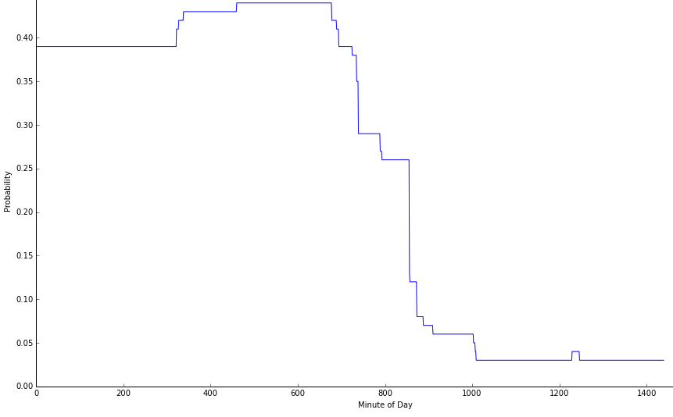
DRIVING
HOME TO WORK
Notes:
Based on journey and driving behavior

Slide 72
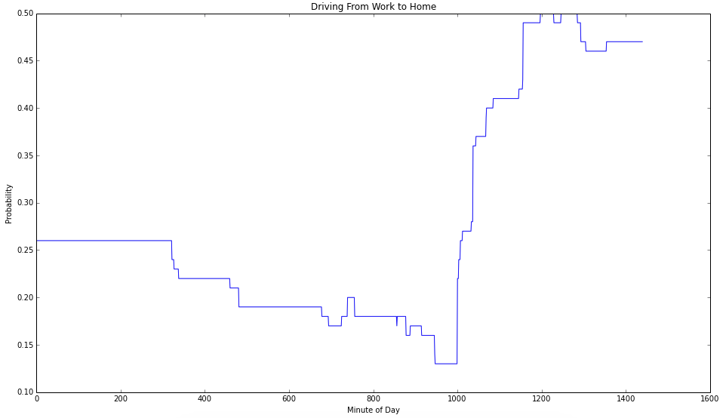
DRIVING
WORK TO HOME
Notes:
Based on journey and driving behavior

Slide 73

REALTIME
EVALUATION
Notes:
Based on journey and driving behavior

Slide 74
…
"Predictions": {
"ClusterPredictions": {
"0": {
"EndLocation": [
32.98525175453122,
-96.70940837440399
],
"MPG_Journey": 25.60900810315203,
"Probability": 0.63736
},
…
Notes:
This is the Herbie JSON

Slide 75
PERFORMANCE OF
CLASSIFICATION

Slide 76

RANGE
PREDICTION
Notes:
Based on journey and driving behavior

Slide 77
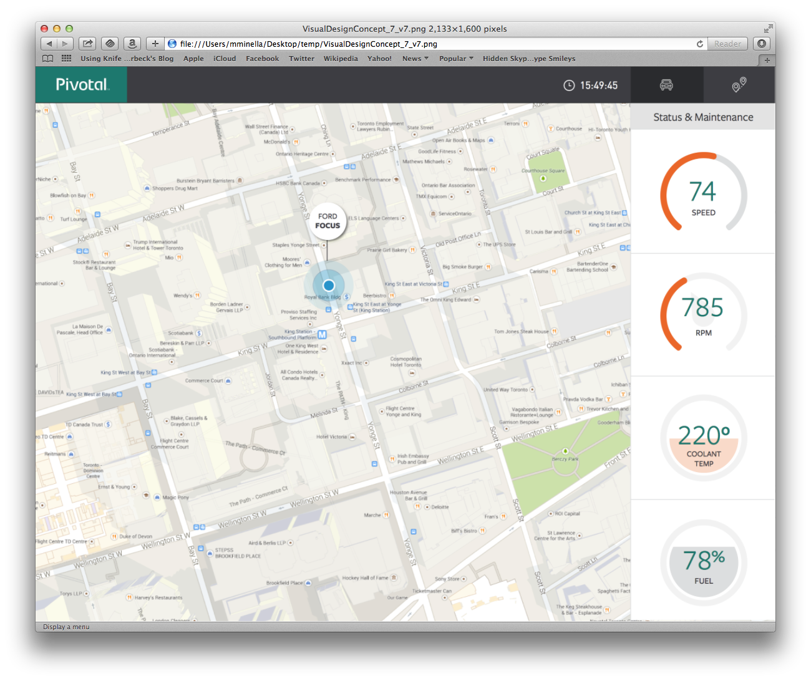
REALTIME
DASHBOARD

Slide 78
1
GEMFIRE

Slide 79
2
REST

Slide 80
3
YOEMAN

Slide 81
4
ANGULARJS

Slide 82

SOLUTION AT SCALE

Slide 83
100,000’s OF
CLIENTS
Notes:
300,000 clients (cars in our use case)?

Slide 84

MILLIONS OF
MESSAGES
Notes:
5 messages per second per client?

Slide 85

PER MINUTE OVER
100 GB
Notes:
5 messages per second per client?

Slide 86

IoT
ISSUES

Slide 87

COMPATIBILITY
Notes:
Lack of consumable APIs
OBD is a good example
Each car implements their own subset of the standard
Couldn’t get VINs off some cars
Other PIDs hit or miss
Each dongle exposes underlying standard differently

Slide 88

CONNECTIVITY
Notes:
Most “things” that want to be connected don’t have their own internet access so some other device (typically a phone) is required
Different dongles used different interfaces (bluetooth vs wifi) and not all worked with all phones

Slide 89
SECURITY

Slide 90

ADDITIONAL
USE CASES

Slide 91

QUALITY
FEEDBACK

Slide 92

FLEET
MANAGEMENT

Slide 93
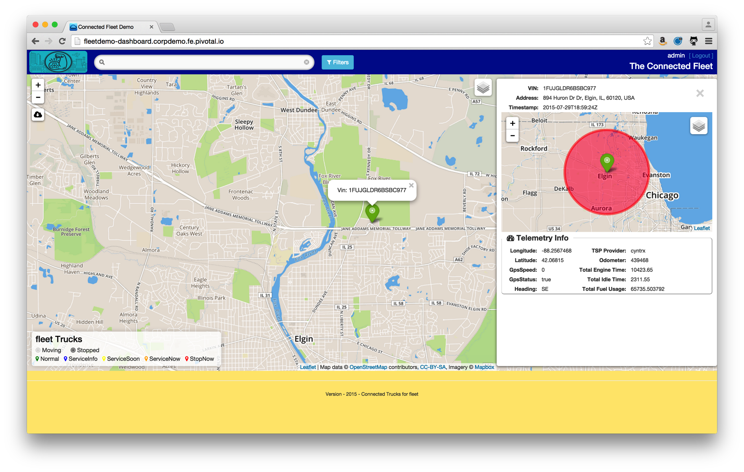

Gemfire
Spring XD
Greenplum
Data Warehouse
Data Science
Notes:
Transformer:
47 lines of java code
16 lines of XML
File system can be local, network, hdfs, etc.

Slide 94

ACCIDENT
ASSISTANCE

Slide 95

IoT PRESENTS UNIQUE
CHALLENGES

Slide 96

IF YOU CAN
BRIDGE THE GAPS
Notes:
5 messages per second per client?

Slide 97
SPRING CLOUD
MAKES THE REST EASY

Slide 98


Slide 99

Learn More. Stay Connected.
Pivotal: pivotal.io
Twitter: twitter.com/springcentral
YouTube: spring.io/video
LinkedIn: spring.io/linkedin
Google Plus: spring.io/gplus
Spring Framework
Project: spring.io/spring-framework
Github: github.com/spring-projects/spring-framework
Jira: jira.spring.io/browse/SPR
Spring Boot
Project: spring.io/spring-boot
Github: github.com/spring-projects/spring-boot
Spring XD
Project: spring.io/spring-xd
Github: github.com/spring-projects/spring-xd
Jira: jira.spring.io/browse/XD

Slide 100


























Connected Car by OliM
from The Noun Project
Scale by Edward Boatman
from The Noun Project
Question by Jessica Lock
from The Noun Project
Servers by Jaime Carrion
from The Noun Project
Running by Dillon Arloff
from The Noun Project
Puzzle by Matthew Hall
from The Noun Project
Sad by Austin Condiff
from The Noun Project
Happy by Austin Condiff
from The Noun Project
Nut by Naomi Atkinson
from The Noun Project
iPhone by Oleg Frolov
from The Noun Project
Plus by P.J. Onori
from The Noun Project
Erlenmeyer Flask by Emily van den Heever
from The Noun Project
Loop by useiconic.com
from The Noun Project
Square Peg Round Hole by Brady Clark
from The Noun Project
Arrows by Juan Pablo Bravo
from The Noun Project
Flow Chart by Michael Wohlwend
from The Noun Project
Network by Mister Pixel
from The Noun Project
Car Accident by Stephanie Wauters
from The Noun Project
Contract by Dimitry Baranovskiy
from The Noun Project
Thumbs Up by Alv Jørgen Bovolden
from The Noun Project
World by Janique Le Bail
from The Noun Project
Stopwatch by Scott Lewis
from The Noun Project
Puzzle by Eric M. Ellis
from The Noun Project
Thinking by Jens Tärning
from The Noun Project
Clock by Nick Green
from The Noun Project
Database by Anton Outkine
from The Noun Project
Refridgerator by Rohan Gupta
from The Noun Project
Car by Laura Beggs
from The Noun Project
Car Accident by Stephanie Wauters
from The Noun Project
Error by Dmitry Baranovskiy
from The Noun Project
Blueprint by Dimitry Sokolov
from The Noun Project
Hard Drive by Mike Wirth
from The Noun Project
Fuel by Yair Cohen
from The Noun Project

Slide 101

The
End

