Slide 1
Real-World Batch Processing with Java EE [CON3339]
Arshal Ameen (@AforArsh)
Hirofumi Iwasaki (@HirofumiIwasaki)
Financial Services Department, Rakuten, Inc.
Notes:
Hello. Let’s get started.
Let me share about the result of our financial systems using Java EE 6.

Slide 2
Agenda
What’s Batch ?
History of batch frameworks
Types of batch frameworks
Best practices
Conclusion
Demo
Notes:
Today’s agenda. Firstly, overview of our renewed systems.
Secondly, about the back-end systems using EJB.
The last is front-end systems using JSF.

Slide 3
“Batch”
Batch processing is the execution of a series of programs ("jobs") on a computer without manual intervention.
Jobs are set up so they can be run to completion without human interaction. All input parameters are predefined through scripts, command-line arguments, control files, or job control language. This is in contrast to "online" or interactive programs which prompt the user for such input. A program takes a set of data files as input, processes the data, and produces a set of output data files.
- From Wikipedia

Slide 4

Batch vs Real-time
Per sec, minutes, hours, days, weeks, months, etc.
Sometimes “job net” or “job stream” reconfiguration required
JBatch (JSR 352)
EJB
POJO
etc.
Long Running (minutes - hours)
Batch
Immediately
Short Running (nanosecond - second)
Fixed at deploy
JSF
EJB
etc.
Real-time

Slide 5
Batch vs Real-time Details
 | Trigger | UI support | Availability | Input data | Transaction time | Transaction cycle
Batch | Scheduler | Optional | Normal | Small - Large | Minutes, hours, days, weeks… | Bulk (chunk) operation
Real-time | On demand | Sometimes UI needed | High | Small | ns, ms, s | Per item

Slide 6
Batch app categories
File driven
Database driven
Message driven
Records or values are retrieved from files
Rows or values are retrieved from file
Messages are retrieved from a message queue
Combination

Slide 7
Batch procedure
Job A
Job B
Job C
Input A
Input B
Input C
Stream
Process A
Process B
Process C
Card
/Step
…
Output A
Output B
Output C
“Job Net” or “Job Stream”,
comes from JCL era. (JCL itself doesn’t provide it)

Slide 8
Agenda
What’s Batch ?
History of batch frameworks
Types of batch frameworks
Demo
Best practices
Conclusion
Notes:
Today’s agenda. Firstly, overview of our renewed systems.
Secondly, about the back-end systems using EJB.
The last is front-end systems using JSF.

Slide 9
Simple History of Batch Processing in Enterprise
1950
1960
1970
1980
1990
2000
2010
Mainframe COBOL
Java
J2EE
Java EE
C
FORTLAN
JCL
JSR 352
UNIX Sh
Bash
Hadoop
PL/I
CP/M Sub
MS-DOS Bat
Win NT Bat
Power Shell
BASIC
VB
C#

Slide 10
Agenda
What’s Batch ?
History of batch frameworks
Types of batch frameworks
Demo
Best practices
Conclusion
Notes:
Today’s agenda. Firstly, overview of our renewed systems.
Secondly, about the back-end systems using EJB.
The last is front-end systems using JSF.

Slide 11
Super Legacy Batch Script (1960’s – 1990’s)
COBOL
Call
JCL
//ZD2015BZ JOB (ZD201010),'ZD2015BZ',GROUP=PP1,
// CLASS=A,MSGCLASS=H,NOTIFY=ZD2015,MSGLEVEL=(1,1)
//********************************************************
//* Unloading data procedure
//********************************************************
//UNLDP EXEC PGM=UNLDP,TIME=20
//STEPLIB DD DSN=ZD.DBMST.LOAD,DISP=SHR
// DD DSN=ZB.PPDBL.LOAD,DISP=SHR
// DD DSN=ZA.COBMT.LOAD,DISP=SHR
//CPT871I1 DD DSN=P201.IN1,DISP=SHR
//CUU091O1 DD DSN=P201.ULO1,DISP=(,CATLG,DELETE),
// SPACE=(CYL,(010,10),RLSE),UNIT=SYSDA,
// DCB=(RECFM=FB,LRECL=016,BLKSIZE=1600)
//SYSOUT DD SYSOUT=*
Input
Proc
Output
JES

Slide 12
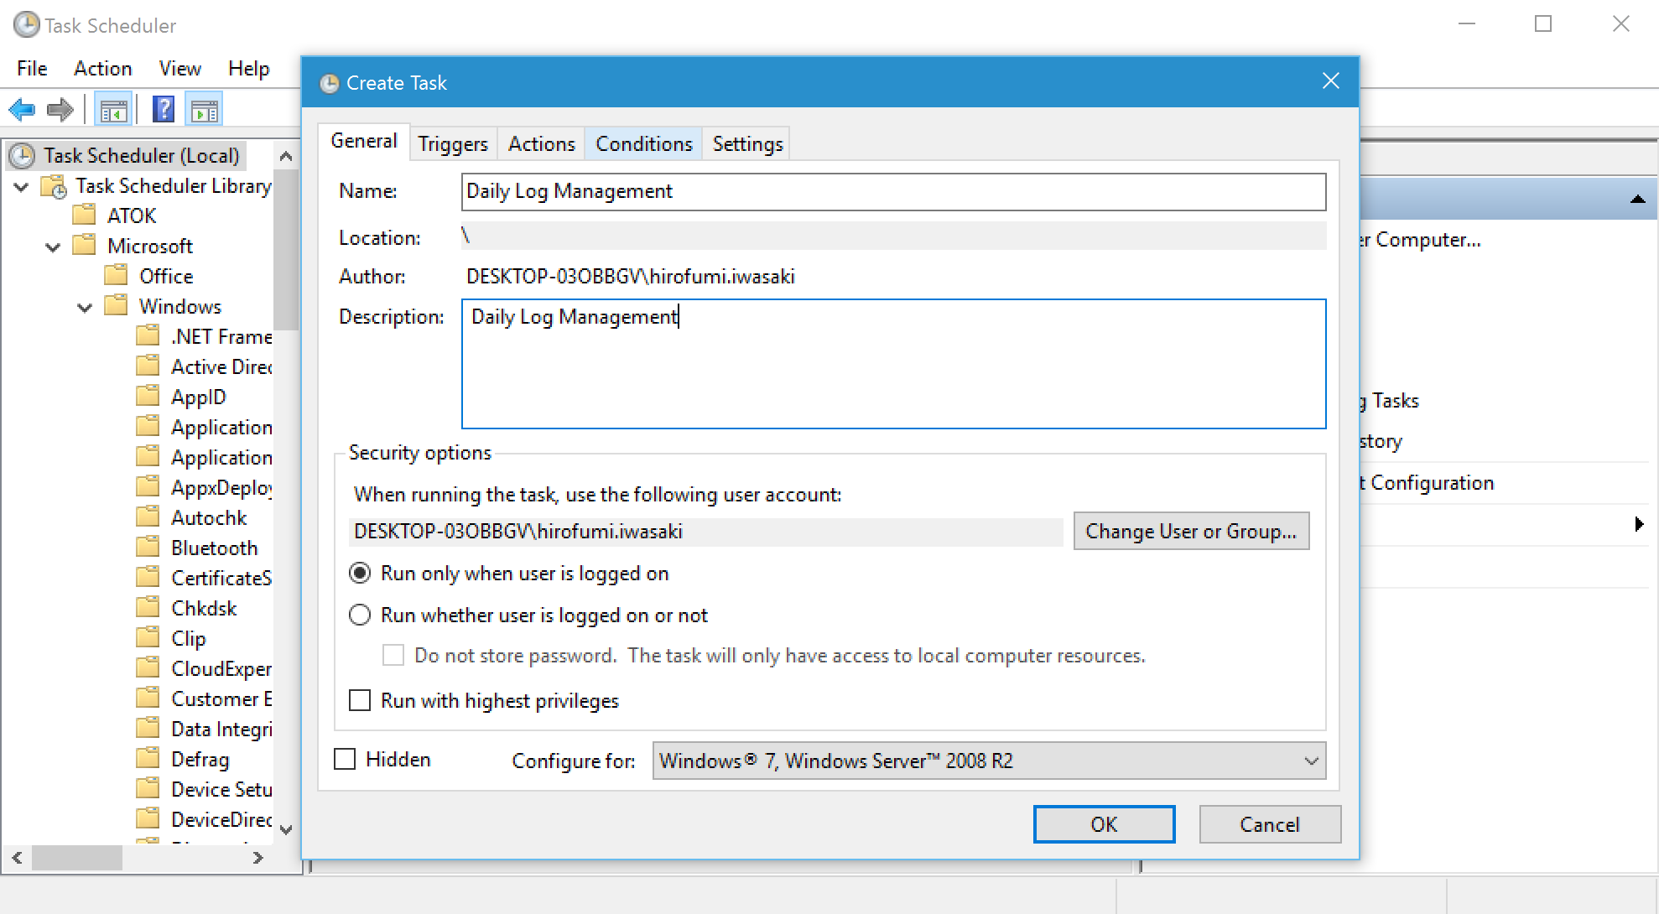
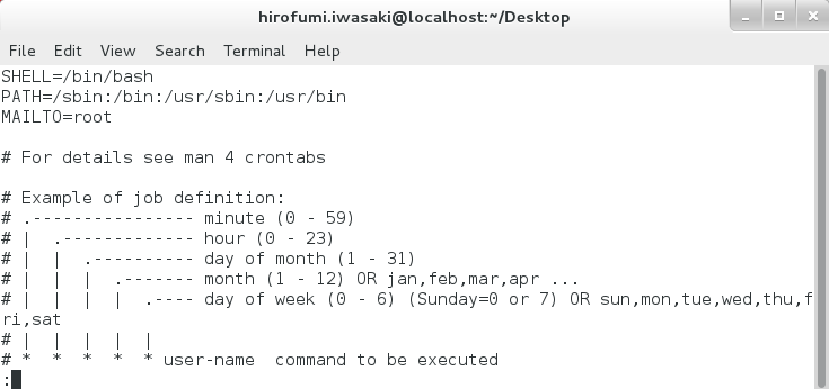
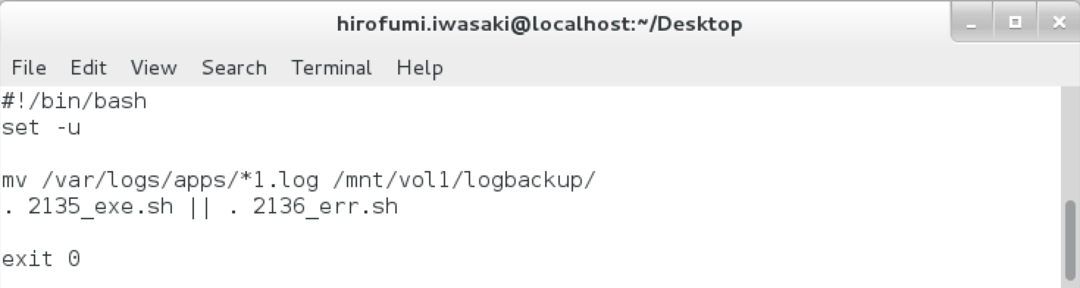
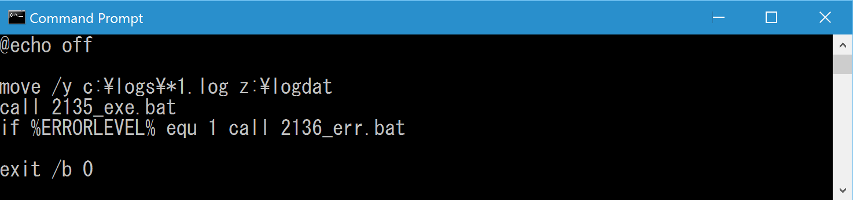
Legacy Batch Script (1980’s – 2000’s)
Linux Cron
Windows Task Scheduler
Call
Call
Bash Shell Script
command.com Bat File

Slide 13
Modern Batch Implementation
.NET Framework (ignore now)
or

Slide 14
Java Batch Design patterns
1. POJO
2. Custom Framework
3. EJB / CDI
4. EJB with embedded container
5. JSR-352

Slide 15
1. POJO Batch with PreparedStatement object
Create connection and SQL statements with placeholders.
Set auto-commit to false using setAutoCommit().
Create PrepareStatement object using either prepareStatement() methods.
Add as many as SQL statements you like into batch using addBatch() method on created statement object.
Execute SQL statements using executeBatch() method on created statement object with commit() in every chunk times for changes.

Slide 16
1. Batch with PreparedStatement object
Connection conn = DriverManager.getConnection(“jdbc:~~~~~~~”);
conn.setAutoCommit(false);
String query = "INSERT INTO User(id, first, last, age) " + "VALUES(?, ?, ?, ?)";
PreparedStatemen pstmt = conn.prepareStatement(query);
for(int i = 0; i < userList.size(); i++) {
User usr = userList.get(i);
pstmt.setInt(1, usr.getId());
pstmt.setString(2, usr.getFirst());
pstmt.setString(3, usr.getLast());
pstmt.setInt(4, usr.getAge());
pstmt.addBatch();
if(i % 20 == 0) {
stmt.executeBatch();
conn.commit();
}
}
conn.commit(); ....
Most effecient for batch SQL statements.
All manual operations.

Slide 17
1. Benefits of Prepared Statements
Parsing of SQL query
Compilation of SQL query
Planning & Optimization of data retrieval path
Execution
Create PreparedStatement
Execution
Prevents SQL Injection
Dynamic queries
Faster
Object oriented
FORWARD_ONLY result set
IN clause limitation

Slide 18
2. Custom framework via servlets
Pros
Customizability, full-control
Cons
Tied to container or framework
Sometimes poor transaction management
Poor job control and monitoring
No standard

Slide 19
3. Batch using EJB or CDI
Input
Job Scheduler
Use EJB Timer @Schedule to auto-trigger
Process
Database
Remote trigger
@Stateless / @Dependent EJB / CDI
@Stateless / @Dependent
EJB / CDI Batch
Other System
EJB @Remote or REST client
Remote Call
Java EE App Server
MQ
Output

Slide 20
3. Why EJB / CDI?
RMI-IIOP (EJB only) SOAP REST
Web Socket
EJB /CDI
(BEGIN)
EJB /CDI
Database
Client
(COMMIT)
1. Remote Invocation
2. Automatic Transaction Management
EJB only
Activate
Instance Pool
EJB
EJB only
Client
EJB
EJB
3. Instance Pooling for Faster Operation
4. Security Management

Slide 21
3. EJB / CDI Pros
Easiest to implement
Batch with PreparedStatement in EJB works well in JEE6 for database batch operations
Container managed transaction (CMT) or @Transactional on CDI: automatic transaction system.
EJB has integrated security management
EJB has instance pooling: faster business logic execution

Slide 22
3. EJB / CDI cons
EJB pools are not sized correctly for batch by default
Set hard limits for number of batches running at a time
CMT / CDI @Transactional is sometimes not efficient for bulk operations; need to combine custom scoping with “REUIRES_NEW” in transaction type.
EJB passivation; they go passive at wrong intervals (on stateful session bean)
JPA Entity Manager and Entities are not efficient for batch operation
Memory constraints on session beans: need to be tweaked for larger jobs
Abnormal end of batch might shutdown JVM
When terminated immediately, app server also gets killed.

Slide 23
4. Batch using EJB / CDI on Embedded container
Input
Process
Database
Job Scheduler
@Stateless / @Dependent
EJB / CDI Batch
Self boot
Other System
Remote trigger
Embedded EJB Container
MQ
Output

Slide 24
4. How ?
pom.xml (case of GlassFish)
<dependency>
<groupId>org.glassfish.main.extras</groupId>
<artifactId>glassfish-embedded-all</artifactId>
<version>4.1</version>
<scope>test</scope>
</dependency>
EJB / CDI
@Stateless / @Dependent @Transactional
public class SampleClass {
public String hello(String message) {
return "Hello " + message;
}
}

Slide 25
4. How (Part 2)
JUnit Test Case
public class SampleClassTest {
private static EJBContainer ejbContainer;
private static Context ctx;
@BeforeClass
public static void setUpClass() throws Exception {
ejbContainer = EJBContainer.createEJBContainer();
ctx = ejbContainer.getContext();
}
@AfterClass
public static void tearDownClass() throws Exception {
ejbContainer.close();
}
@Test
public void hello() throws NamingException {
SampleClass sample = (SampleClass)
ctx.lookup("java:global/classes/SampleClass");
assertNotNull(sample); assertNotNull(sample.hello("World”););
assertTrue(hello.endsWith(expected));
}
}

Slide 26
4. Should I use embedded container ?
Pros
Quick to start (~10s)
Efficient for batch implementations
Embedded container uses lesser disk space and main memory
Allows maximum reusability of enterprise components
Inbound RMI-IIOP calls are not supported (on EJB)
Message-Driven Bean (MDB) are not supported.
Cannot be clustered for high availability
Cons

Slide 27
5. JSR-352
Implement artifacts
Orchestrate execution
Execute
Notes:
Implement the artifacts
A JSL to orchastrate the executon of batch artifacts
A runtime executor for executon of artifacts ccording to orchstation

Slide 28
5. Programming model
Chunk and Batchlet models
Chunk: Reader Processor writer
Batchlets: DYOT step, Invoke and return code upon completion, stoppable
Contexts: For runtime info and interim data persistence
Callback hooks (listeners) for lifecycle events
Parallel processing on jobs and steps
Flow: one or more steps executed sequentially
Split: Collection of concurrently executed flows
Partitioning – each step runs on multiple instances with unique properties
Notes:
Chunk and batchlets provide model for implementing steps
Reader/writes in invoked until entire chink is processed, o/p is written atomically
Batchlets provides a roll your own step
Contexts provide job and step level info and provide interim persistence
Listeners provide callback hooks to respond to lifrcycle events on batch artifacts
Partitioning proveide a method to impose parellal processing n jobs and steps

Slide 29
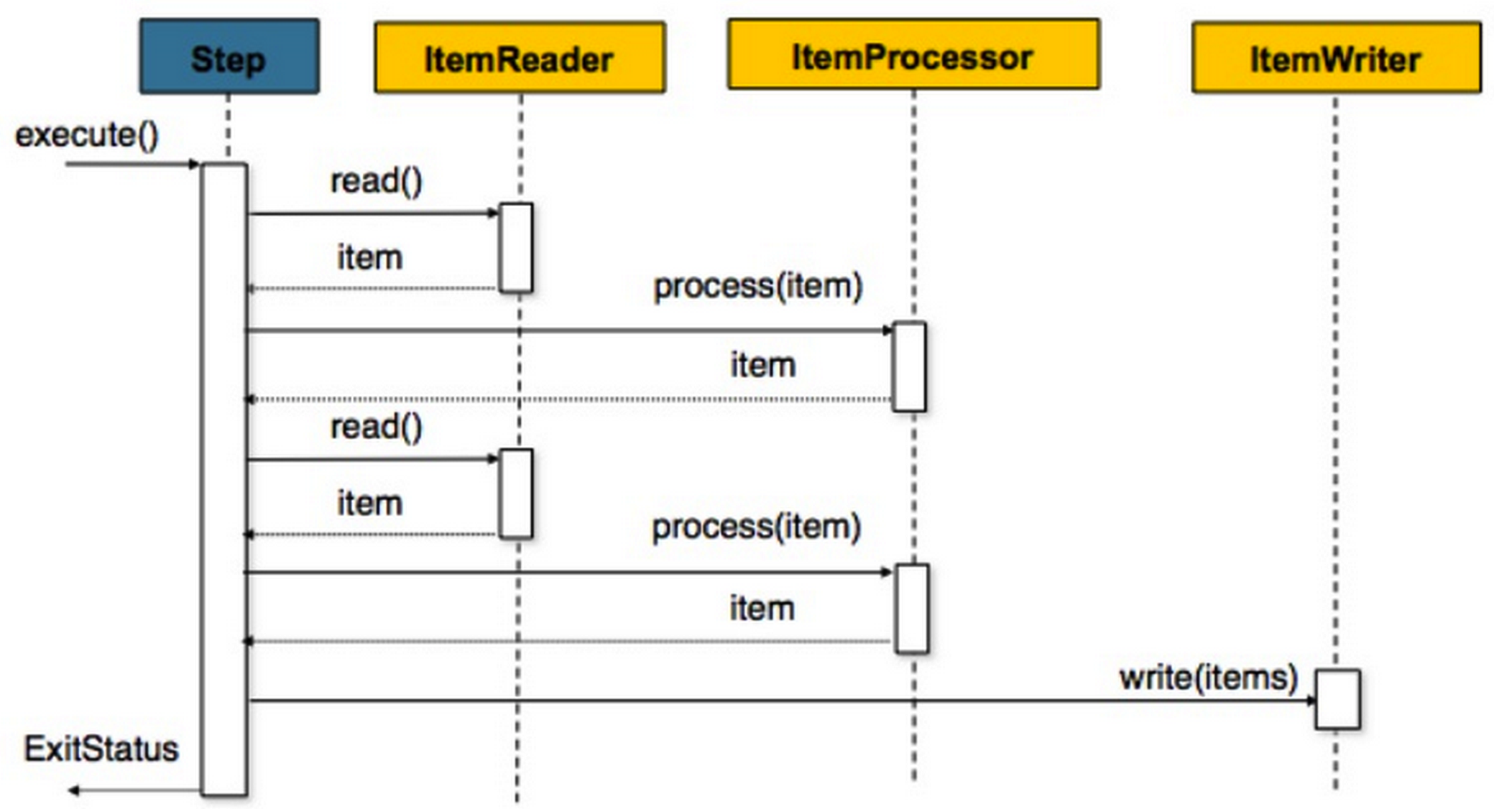
5. Batch Chunks

Slide 30
5. Programming model
Job operator: job management
Job repository
JobInstance - basically run()
JobExecution - attempt to run()
StepExecution - attempt to run() a step in a job
JobOperator jo = BatchRuntime.getJobOperator();
long jobId = jo.start(”sample”,new Properties());
Notes:
Operator manages a job; does start stop retry etc
Repository holds info of completed n executing jobs
Get an operator instance use it to start a job

Slide 31
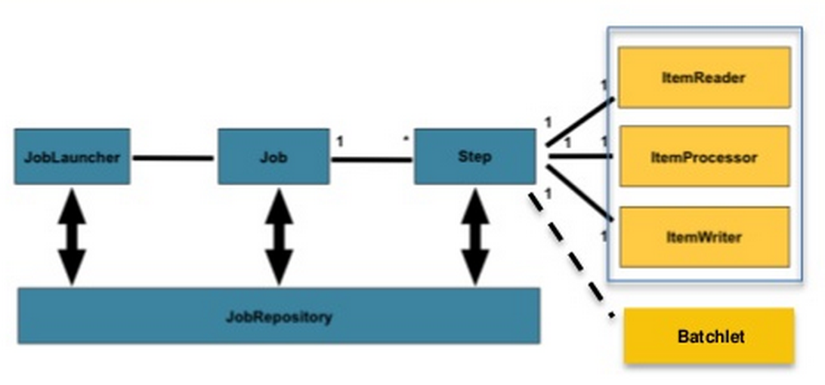
5. JSR-352
Chunk

Slide 32
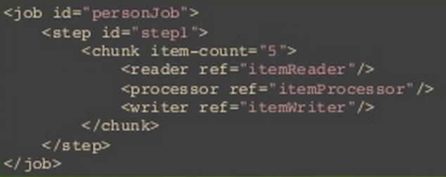
5. Programming model
JSL: XML based batch job
Notes:
Defines a step as collection of batch artifacts ie chunks and eachh chunk has reader, writer n processor

Slide 33
5. JCL & JSL
1970’s
2010’s
COBOL
JSR 352 Chunk or Batchlet
Call
Call
JCL
JSR 352 “JSL”
//ZD2015BZ JOB (ZD201010),'ZD2015BZ',GROUP=PP1,
// CLASS=A,MSGCLASS=H,NOTIFY=ZD2015,MSGLEVEL=(1,1)
//********************************************************
//* Unloading data procedure
//********************************************************
//UNLDP EXEC PGM=UNLDP,TIME=20
//STEPLIB DD DSN=ZD.DBMST.LOAD,DISP=SHR
// DD DSN=ZB.PPDBL.LOAD,DISP=SHR
// DD DSN=ZA.COBMT.LOAD,DISP=SHR
//CPT871I1 DD DSN=P201.IN1,DISP=SHR
//CUU091O1 DD DSN=P201.ULO1,DISP=(,CATLG,DELETE),
// SPACE=(CYL,(010,10),RLSE),UNIT=SYSDA,
// DCB=(RECFM=FB,LRECL=016,BLKSIZE=1600)
//SYSOUT DD SYSOUT=*
<?xml version="1.0" encoding="UTF-8"?>
<job id="my-chunk" xmlns="http://xmlns.jcp.org/xml/ns/javaee" version="1.0">
<properties>
<property name="inputFile" value="input.txt"/>
<property name="outputFile" value="output.txt"/>
</properties>
<step id="step1">
<chunk item-count="20">
<reader ref="myChunkReader"/>
<processor ref="myChunkProcessor"/>
<writer ref="myChunkWriter"/>
</chunk>
</step>
</job>
Input
Proc
Output
JES
Java EE App Server
Notes:
While jsl looks a bit similar to JCL
But in JCL we could define datatypes

Slide 34
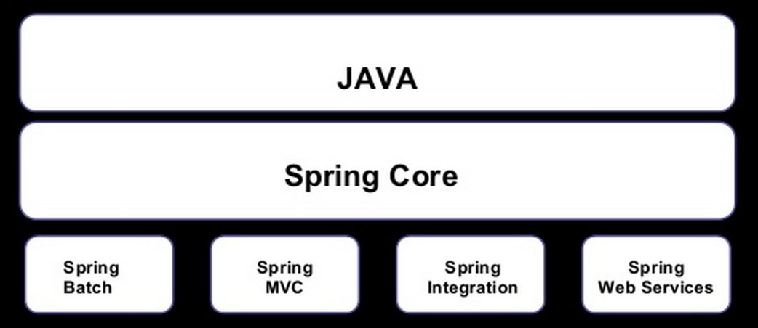
5. Spring 3.0 Batch (JSR-352)

Slide 35
5. Spring batch
API for building batch components integrated with Spring framework
Implementations for Readers and Writers
A SDL (JSL) for configuring batch components
Tasklets (Spring batchlet): collections of custom batch steps/tasks
Flexibility to define complex steps
Job repository implementation
Batch processes lifecycle management made a bit more easier

Slide 36
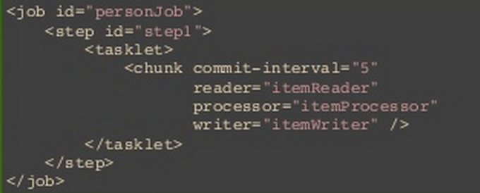
5. Main differences
 | Spring | JSR-352
DI | Bean definitions | Job definiton(optional)
Properties | Any type | String only

Slide 37
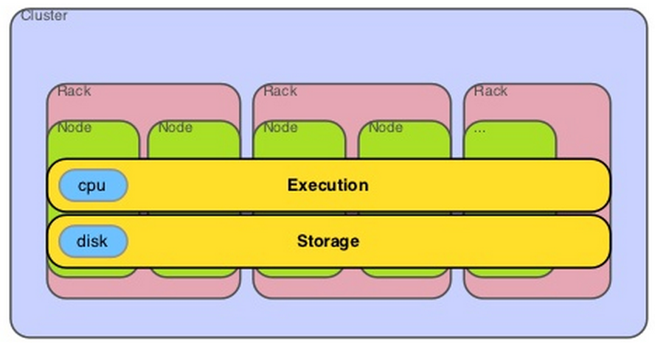
Appendix: Apache Hadoop
Apache Hadoop is a scalable storage and batch data processing system.
Map Reduce programming model
Hassle free parallel job processing
Reliable: All blocks are replicated 3 times
Databases: built in tools to dump or extract data
Fault tolerance through software, self-healing and auto-retry
Best for unstructured data (log files, media, documents, graphs)
Notes:
Hadoop is a massively scalable storage and batch data processing system.
Hadoop uses the MapReduce programming model for parallel processing
Map reduce – 5 files, find max n min number analogy
It provides an integrated storage and processing fabric that scales horizontally with
commodity hardware and provides fault tolerance through software
Rather than replace existing systems, Hadoop augments them by offloading the particularly difficult problem of simultaneously ingesting, processing and delivering/exporting large volumes of data so existing systems can focus on what they were designed to do: whether that be serve real time transactional data or provide interactive business intelligence
Takes care of sync, concurrency and fault tolerance automatically

Slide 38
Appendix: Hadoop’s not for
Not for small or real-time data; >1TB is min.
Procedure oriented: writing code is painful and error prone. YAGNI
Potential stability and security issues
Joins of multiple datasets are tricky and slow
Cluster management is hard
Still single master which requires care and may limit scaling
Does not allow for stateful multiple-step processing of records
Notes:
Batch Processing: Hadoop should be used when large dataset (>1TB) need to be analysedThere is a missing encryption methodology for storage and network levels.
As Java is used and without an expert this is prone for hacking
Procedural programming model requires (often repetitive) code for even the simplest operations (e.g., projection, filtering)

Slide 39
Agenda
What’s Batch ?
History of batch frameworks
Types of batch frameworks
Demo
Best practices
Conclusion
Notes:
Today’s agenda. Firstly, overview of our renewed systems.
Secondly, about the back-end systems using EJB.
The last is front-end systems using JSF.

Slide 40
Key points to consider
Business logic
Transaction management
Exception handling
File processing
Job control/monitor (retry/restart policies)
Memory consumed by job
Number of processes
Notes:
"eclipselink.jdbc.batch-writing.size"="1000” for prepared statements def is 100

Slide 41
Best practices
Always poll in batches
Processor: thread-safe, stateless
Throttling policy when using queues
Storing results
in memory is risky
Notes:
get only a batch of items, consume them, and then you can rerun the process until there is nothing left to process.
batch processor should be stateless
As long as the producing rate is finite you just to make sure you have the right number of consumers to balance out the producing rate
Choosing a persistence storage (MongoDb capped collection) is a better option. Or in memory dont forget to limit by an upper bound

Slide 42
Agenda
What’s Batch ?
History of batch frameworks
Types of batch frameworks
Demo
Best practices
Conclusion
Notes:
Today’s agenda. Firstly, overview of our renewed systems.
Secondly, about the back-end systems using EJB.
The last is front-end systems using JSF.

Slide 43
Agenda
What’s Batch ?
History of batch frameworks
Types of batch frameworks
Demo
Best practices
Conclusion
Notes:
Today’s agenda. Firstly, overview of our renewed systems.
Secondly, about the back-end systems using EJB.
The last is front-end systems using JSF.

Slide 44
Conclusion: Script vs Java
 | Shell Script Based (Bash, PowerShell, etc.) | Java Based (Java EE, POJO, etc.)
Pros | Super quick to write one Easy testing | Power of Java APIs or Java EE APIs Platform independent Accuracy of error handling Container transaction management (Java EE) Operational management (Java EE)
Cons | Lesser scope of implementation No transaction management Poor error handling Poor operation management | Sometimes takes more time to make Sometimes difficult to test

Slide 45
Conclusion
Java EE 6
Java EE 7
 | POJO | Custom Framework | EJB / CDI | EJB / CDI + Embedded Container | JSR 352
Pros | Quick to write Java easy testing | Depends on each product | Super power of Java EE Standardized | Super power of Java EE Standardized Easy testing Can stop forcefully | Super power of Java EE Standardized Easy testing Auto chunk, parallel operations
Cons | No standard no transaction management less operation management | No standard Depends on each product | Difficult to test Cannot stop forcefully No auto chunk or parallel operations | No auto chunk or parallel operations | New ! Cannot stop immediately in case of chunks

Slide 46
Questions ?
Contact
Arshal (@AforArsh) Hirofumi Iwasaki (@HirofumiIwasaki)

