Slide 1
Java EE 7 in the
Very Real World of
Higher Education
How shiny are the walls
of the ivory tower?

Slide 2
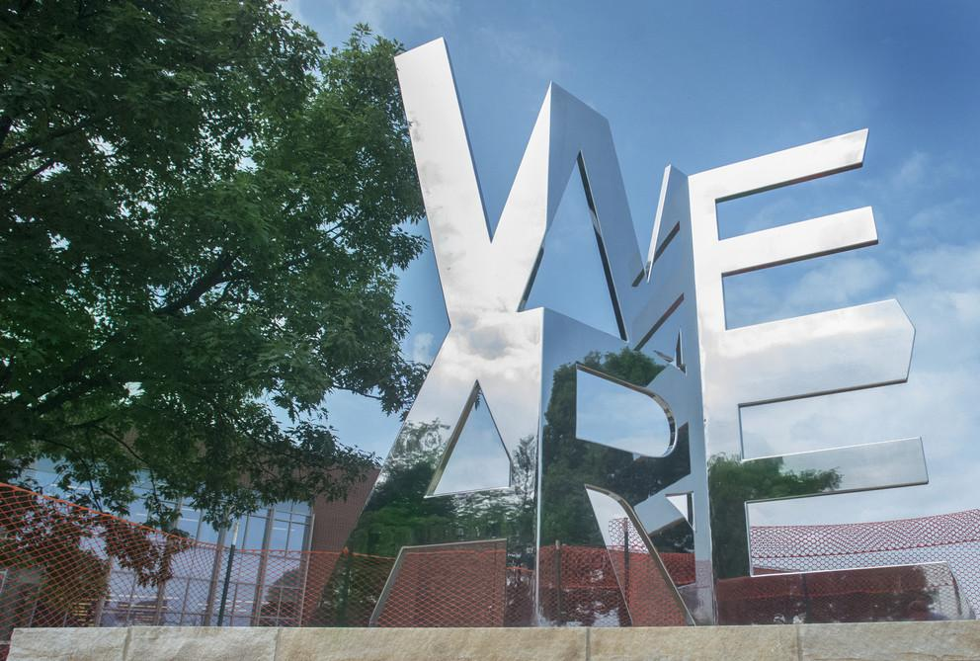
“WE ARE” - Software Engineering
Chris Harm
(Manager of Software Infrastructure)
Steve Moyer
(Enterprise Software Architect)
Shawn Smith
(Director of Software Engineering)

Slide 3
To understand what
we’re doing, it’s
probably important
to understand why

Slide 4
Me – Help me understand priorities, what needs to be rebuilt? My Boss – Everything.

Slide 5
Everything?

Slide 6
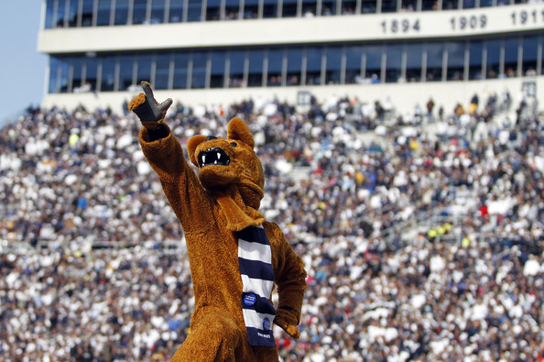
Scope
Students 96k
Employees 26k
Campuses 24
Locations > 100
Departments 100s
Titles¹ 1000s
1. (Job descriptions, positions, etc)

Slide 7
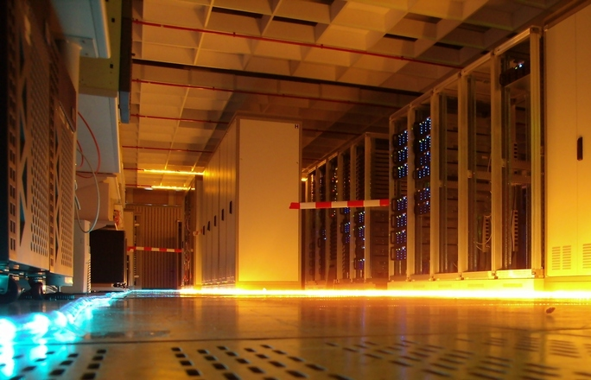
Mainframes & Cobol & Natural (oh my)

Slide 8
There was an effort that completed
as recently as 18 months ago
to “modernize” a large Cobol system
to the Natural programming language
on an IBM mainframe

Slide 9
We have lots of stuff like this...
#include <stdio.h> #include <stdlib.h> int main(void) { char *m,n; printf("%s%c%c\n", "Content-Type:text/html;charset=iso-8859-1",13,10); printf("<TITLE>Multiplication results</TITLE>\n"); printf("<H3>Multiplication results</H3>\n"); data = getenv("QUERY_STRING"); if(data == NULL) printf("<P>Error! Error in passing data from form to script."); else if(sscanf(data,"m=%ld&n=%ld",&m,&n)!=2) printf("<P>Error! Invalid data. Data must be numeric."); else printf("<P>The product of %ld and %ld is %ld.",m,n,m*n); return 0; }
use CGI qw(:standard); $data = param('sample') || '<i>(No input)</i>'; print <<END; Content-Type: text/html; charset=iso-8859-1 <!DOCTYPE HTML PUBLIC "-//W3C//DTD HTML 4.01//EN"> <title>Echoing user input</title> <h1>Echoing user input</h1> <p>You typed: $data</p> END

Slide 10
parseResponse: aResponseString
|aReturnList anXMLDocument aParamElmList aFault aFaultData aMemberElmList aData slist |
aReturnList := List new.
anXMLDocument := XML.XMLParser processDocumentString: aResponseString beforeScanDo: [:p | p validate: false].
aParamElmList := anXMLDocument root anyElementsNamed: 'param'.
aParamElmList isEmpty
ifTrue: [aFault := anXMLDocument root anyElementsNamed: 'fault'.
aFaultData := aFault at: 1.
aReturnList add: (PSU.PSUXML.XMLRPCType from: aFaultData)]
ifFalse: [aParamElmList := aParamElmList copyFrom: 1 to: aParamElmList size.
aMemberElmList := anXMLDocument root anyElementsNamed: 'member'.
aMemberElmList isEmpty
ifFalse: [aParamElmList := OrderedCollection new.
aMemberElmList do: [:mem | slist := mem anyElementsNamed: 'struct'.
slist isEmpty
ifTrue: [aParamElmList add: mem.].
].
aParamElmList
do: [:eachElem |
aData := eachElem elementNamed: 'value'.
aReturnList add: (PSU.PSUXML.XMLRPCType from: aData).
]
].
^aReturnList

Slide 13
But this is JavaOne,
where’s the Java?

Slide 14
The most modern Java
we found in 2011 was 1.4ish, and...

Slide 15
It wasn’t
what we
expected…
public class Structured {
public static void main(String [] args){
step1();
step2(); //etc….
}
private static void step1(){
System.out.println("Step 1");
}
private static void step2(){
System.out.println("Step 2");
}
}

Slide 16
Evolving a
stagnant legacy system
Java EE 7 in the Very Real World of Higher Education
(Welcome to the Summer Semester)

Slide 17
Friends of Penn State - Our first foray
The guest identity system at Penn State was having a problem. In February of each year, on a given date at a given time, roughly 2,000 kids would try to access their information to perform early registration.
Yup, just 2000 kids…
The system melted…
The investigation begins…

Slide 18
Friends of Penn State - The initial discovery
Client
Server
FPS
Server
DB2
Database
Kerberos
KDC
API Based on C CGI Technology

Slide 19
Friends of Penn State - We dig a little deeper
Client
Server
FPS
Server
DB2
Database
Kerberos
KDC
API Based on C CGI Technology
Unnecessary and inconsistent fields in request
Inconsistent XML formatting in responses

Slide 20
Friends of Penn State - And finally...
Client
Server
FPS
Server
DB2
Database
Kerberos
KDC
API Based on C CGI Technology
Unnecessary and inconsistent fields in request
Inconsistent XML formatting in responses
8-12 Database connections made per API call (~2000 students * 5 Api Calls * 10 connections = ~100,000 connections)

Slide 21
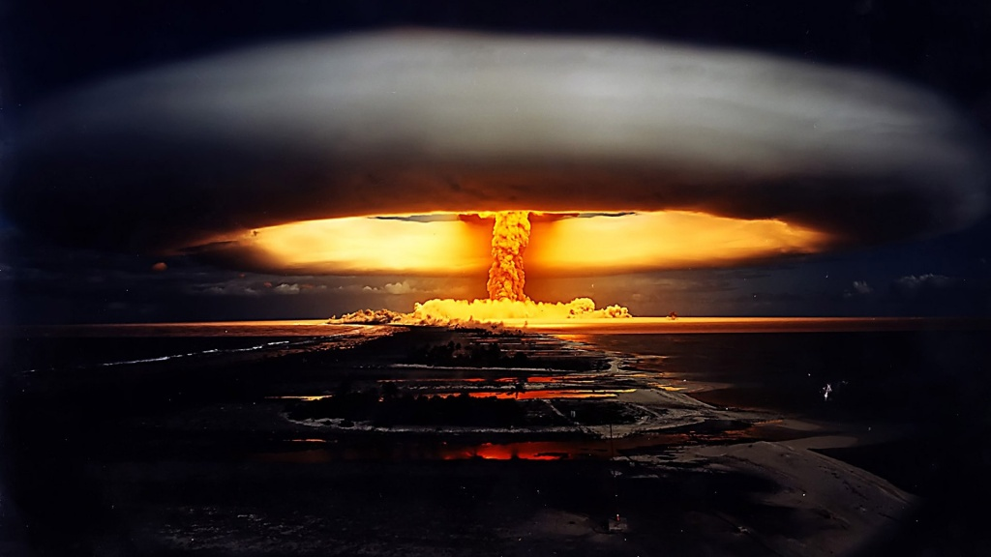
Java EE 7 in the Very Real World of Higher Education

Slide 22
Friends of Penn State:
The other shoe drops

Slide 23
We discovered that with about
25 lines of HTML
we could steal
every principal
in the system.
Notes:
Principal counts:
2.4M in 2012
2.8M today

Slide 24
Code redacted
to protect
the innocent
Code redacted
to protect
the innocent
<title>Steal Account</title> </head> <body> <h1>Change anyone's password</h1> <form name="change_password" method="POST" action="https://fps.psu.edu/api/change_passwd.cgi" target="_blank"> <input type="hidden" name="group_id" value="1" /> <input type="hidden" name="in_fields" value="userid,password,verify_password" /> <input type="hidden" name="min_flds" value="userid,password,verify_password" /> <table> <tr> <th>User id:</th> <td><input type="text" name="userid" value="" /></td> </tr> <tr> <th>New password:</th> <td><input type="text" name="password" value="" /></td>

Slide 25
Friends of Penn State - Enterprise Java to the rescue
Goals:
Fix the performance issues
Inject as much consistency as possible without requiring extensive rework by customers
CLOSE THE SECURITY HOLE!!

Slide 26
Quietly find the customers and coordinate the change

Slide 27
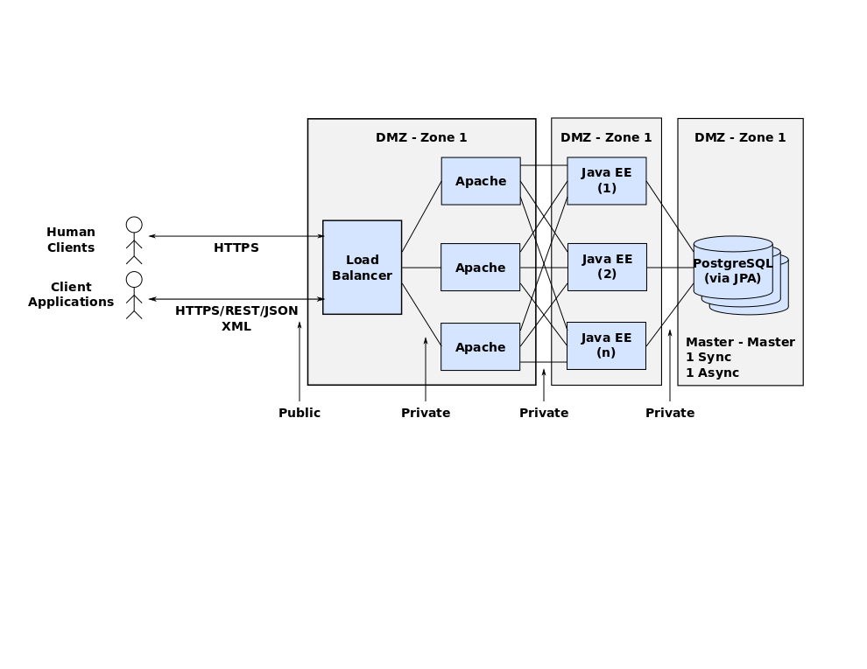
Recreate the architecture

Slide 28
Primary technologies used
Servlets
JAXB
EJB’s
JPA (round one)
JSF
JAX-RS (round two)

Slide 29
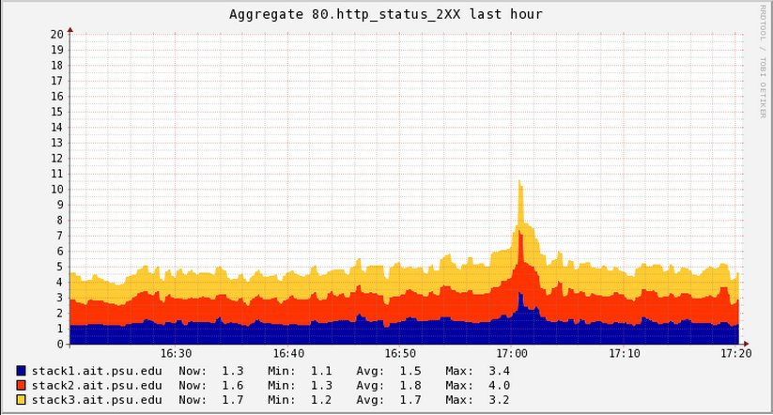
An anticlimactic result

Slide 30
Deprecating Heavily-Used Services
Java EE 7 in the Very Real World of Higher Education
You made it through Summer, welcome to Fall

Slide 31
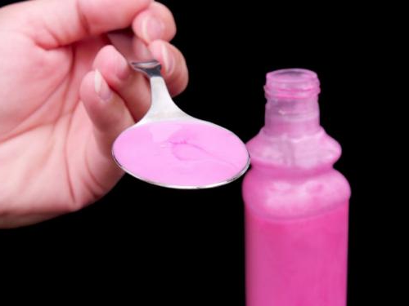
What’s a GI?
Not the Gastrointestinal Tract (Though it sometimes delivers the same result)
Approximately 780 core services
Provides fine-grained access control to mainframe
Hundreds of client applications
XML-RPC over HTTPS

Slide 32
What’s the problem?
No domain separation
Cobol/Natural/Smalltalk/Cuniform script on clay tablets
Mainframes (plural - yes we have more than one)
Poor XML-RPC implementation (HTTPS seems to work fine)
Software load-balancer crushed during critical busy periods
$$$ Licenses (and rent) to IBM/Software AG/Cincom
Notes:
Domain separation - One interface for:
Student Information System
HR/Payroll System
Accounting systems
Any miscellaneous function you could name
Plurality of languages and frameworks
One expert per system
Changes are risk-prone
Many (human) single points of failure (hope no one is hit by a bus)
XML-RPC
Not “object oriented”
List of strings (indexed by position - mostly to match the parameter passing in Natural)
Poor error reporting
“Parameter exceeds the maximum length” - without saying which parameter or what length (go read the Natural to find out)
Coupling (“It screams RPC. There is so much coupling on display that it should be given an X rating.” - Fielding)

Slide 33
Java EE 7 in the Very Real World of Higher Education

Slide 34
Us – Can we please fail in a different way this year
The Boss – Please dear God yes.

Slide 35
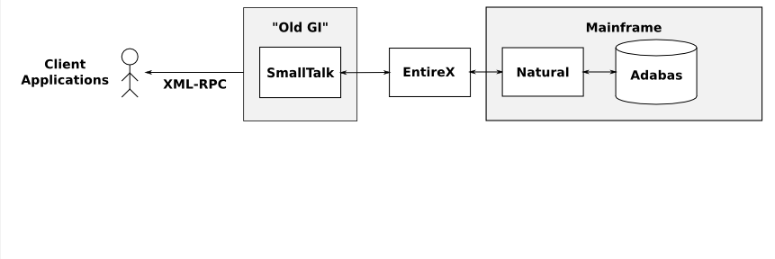
Legacy System

Slide 36
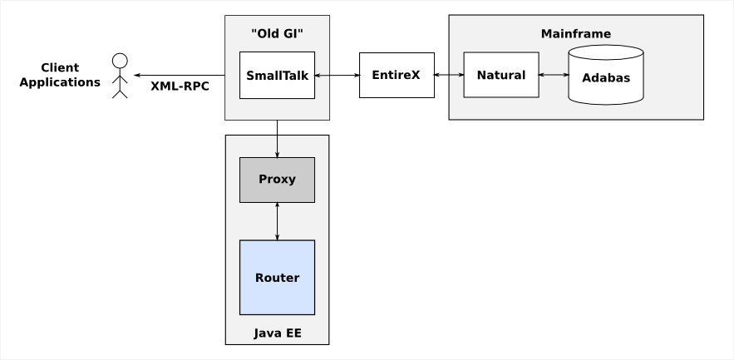
Java EE Service Proxy

Slide 37
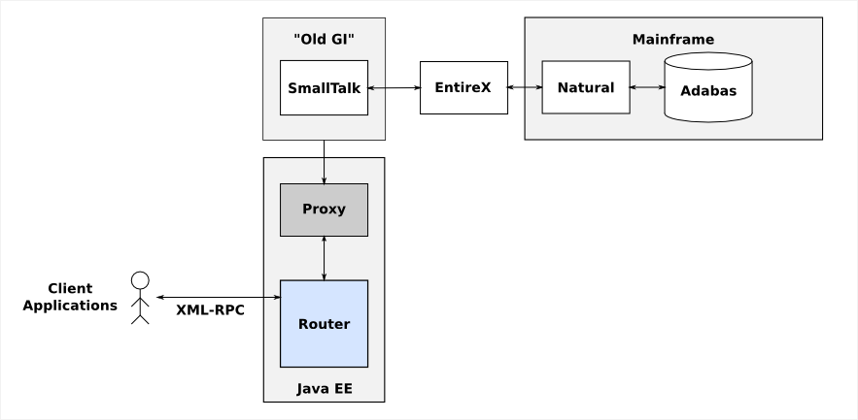
Move XML-RPC Clients

Slide 38
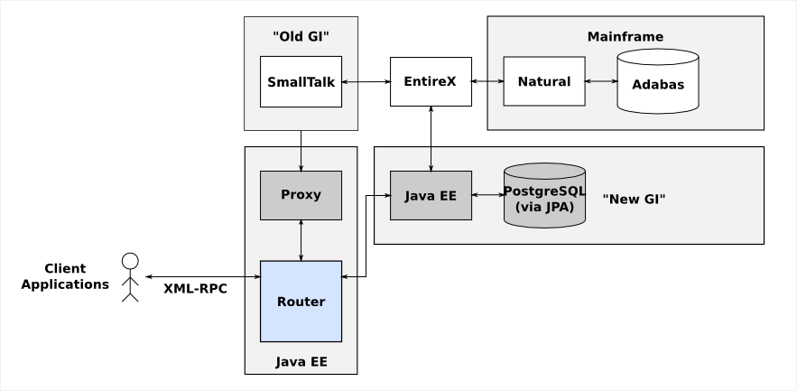
Replace GI Functionality

Slide 39
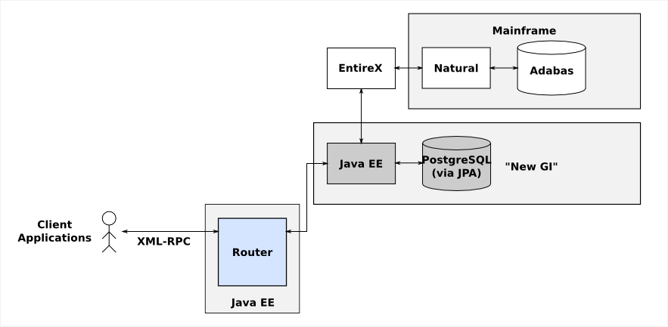
Eliminate Existing GI System

Slide 40
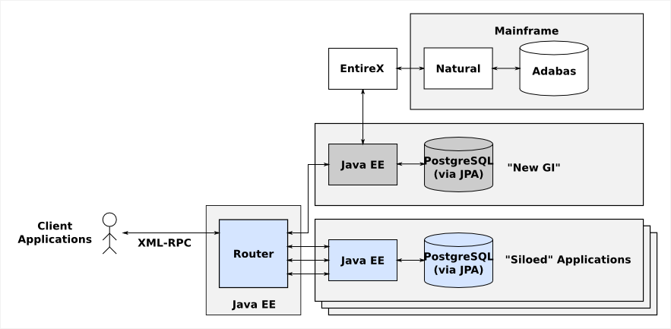
Replace Mainframe Applications
Notes:
PeopleSoft Student Solutions
Shoutout to Larry and his sales team
His keynote last year said they’d beat XXX
“PeopleCode is a javascript-like language that compiles to Cobol”
Had to buy a Cobol compiler (one step forward …)
WorkDay HR/Payroll
Hosted service
Data security
Network segmentation
PSU APIs used by 86 other applications
College Cost Estimator
Discrete application (an example of a small “silo”)
Micro-service because it’s a small problem domain

Slide 41
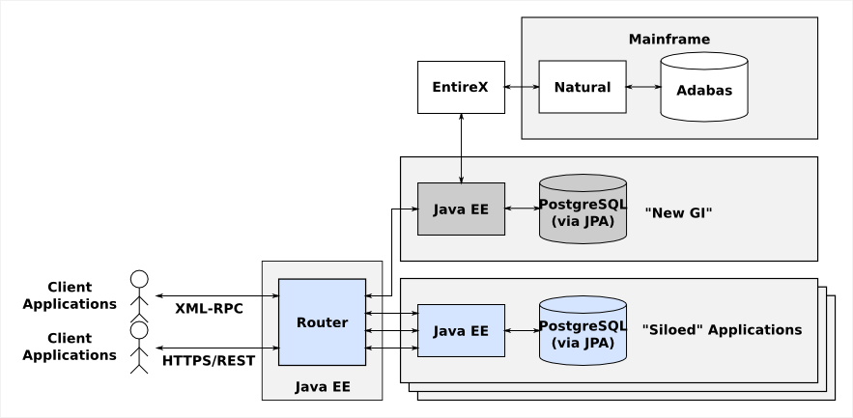
Add RESTful APIs

Slide 42
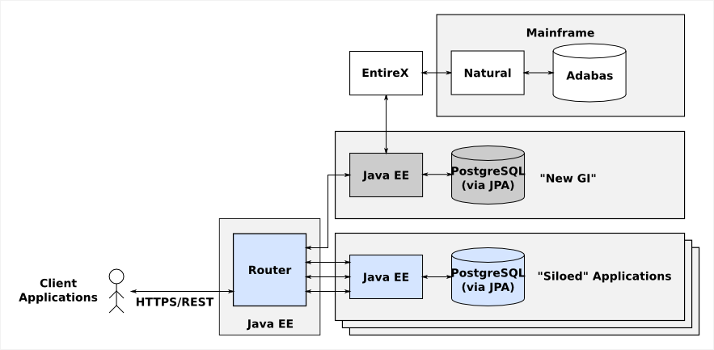
Eliminate XML-RPC Services

Slide 43
Eliminate the Mainframe
Notes:
At this point the “router” is actually just URL rewriting in Apache giving the appearance that there is only a single backing application at https://api.psu.edu

Slide 44
Java EE to the Rescue
JAXRS/JAXB
RESTful interfaces
XML-RPC implemented using JAXRS/JAXB (temporary!)
CDI
JPA
EJB
Security

Slide 45
Reinventing old technology
Java EE 7 in the Very Real World of Higher Education
(Or, please let JCL rest in peace)

Slide 46
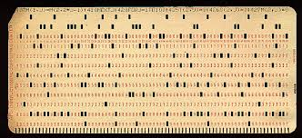
Mainframe Operations
Much of the work done at the University is still done using JCL and batch processing on IBM mainframe computers. Effectively, we’re still using virtual punch cards.
Yes, I said:
PUNCH
CARDS

Slide 47
A JEE solution to bridge a historical problem
Enterprise Java has the two key things needed to manage what the scheduler manages:
@Schedule annotation (and the underlying Timer)
Batch Processing Framework

Slide 48
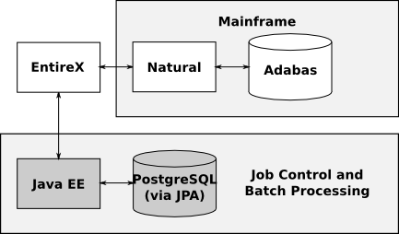
How to bridge the technologies
After a bit of research we discovered that there is an eclipse instance provided by Software AG that will generate IDL from natural code and generate Java stubs.

Slide 49
What is the future?
Java EE 7 in the Very Real World of Higher Education
What have we done?
Where are we going?

Slide 50
This is a story of hope and rebirth

Slide 51
Restructure Hiring Patterns
Really Important
Decision Maker
Decision
Relayer
Decision
Relayer
Downtrodden
Downtrodden
Downtrodden
Downtrodden

Slide 52
Restructure Hiring Patterns
Nerd
Nerd
Nerd
Nerd
Nerd
Nerd
Nerd

Slide 53
Restructure Hiring Patterns
Nerd
Nerd
Nerd
Nerd
Nerd
Nerd
Nerd

Slide 54
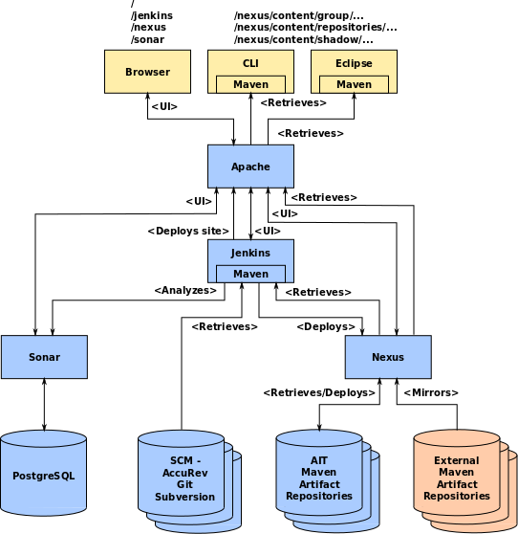
Embrace DevOps
Continuous Integration
Continuous deployment
Built in automated testing with auto fail
Rolling deployment
Ansible/Vagrant for replication of ops space
CFEngine for managing operational space

Slide 55
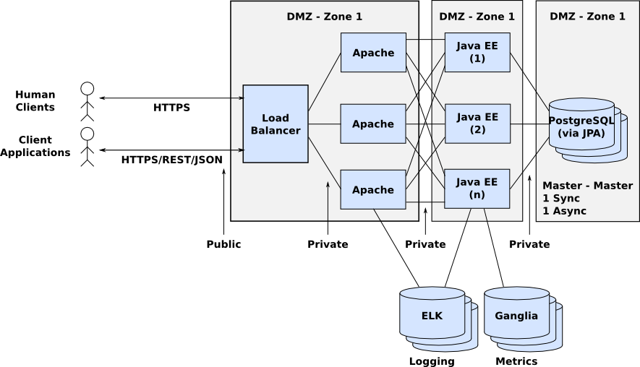
Establish a Reference Architecture
Notes:
80+ Applications supported by 30ish (?) developers

Slide 56
Keep up with changing technology
Embrace Technology Evolution
Contribute in the Open Source space to include Adopt a JSR, etc.
Penn State Internal Open Source (external where the lawyers allow)
The take away is:
We want to be a part of the engineering community that happens to work in higher ed, not a higher ed community that does some IT stuff.

Slide 57
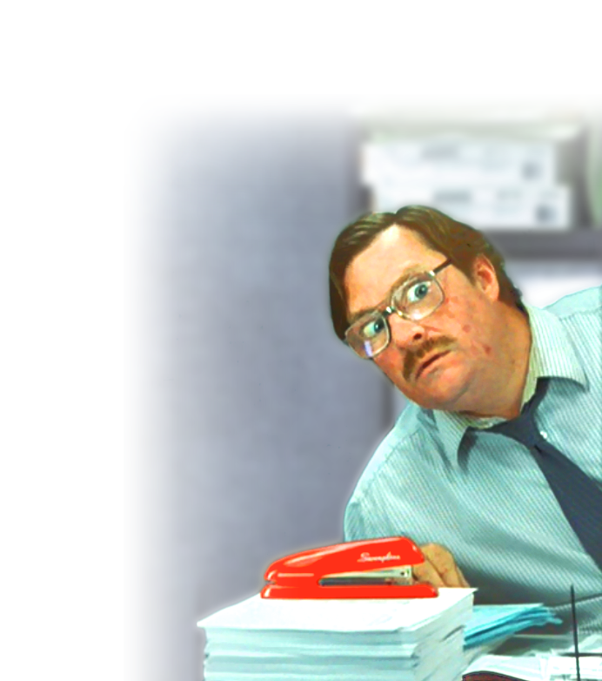
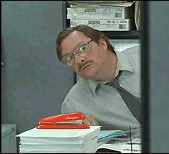
Encourage an Environment of Continual Learning
Penn State - CmpSc and IST (“WE ARE” a university)
MOOCS
Brown bag (lunch) interest groups
Happy Valley JUG

Slide 58
(Almost) The End

Slide 59
We’re Hiring!
Software Engineering - UI/UX https://psu.jobs/job/59211
System and Network Security Analyst https://psu.jobs/job/59541
Hardware Configuration Manager https://psu.jobs/job/59543
Software Configuration Manager https://psu.jobs/job/59542
Software Test Engineer https://psu.jobs/job/59670
Other jobs at Penn State https://psu.jobs/jobs

Slide 60
Questions?

