Slide 2
Gluon: JavaFX for the (Mobile) Enterprise
Johan Vos, Gluon
Eugene Ryzhikov, Gluon

Slide 3
About Gluon
Founded in early 2015.
One goal:
Help enterprises to create real cross-platform and cross-device Java client applications that:
Are visually stunning
Integrate with mobile device functionality
Support enterprise functionality / expectations
Integrate seemlessly with established backend and cloud systems

Slide 4
About Gluon
Our team has huge amounts of expertise in Java Client and Java Enterprise development.

Slide 5
About Gluon
Story so far:
Actively developing open source and commercial software since our founding.
Actively training and offering consultancy services to teams around the world.
Received significant funding from the Flemish Government.
This month we’ve delivered 1.0 releases of:
Gluon Charm
Gluon Cloud
Gluon Particle

Slide 6
About Gluon

Slide 7
Our Vision

Slide 8
Why JavaFX
JavaFX is an excellent UI toolkit for creating cross platform applications.
But it has a few gaps…
Support for mobile / embedded devices
Support for enterprise connectivity
Support for client frameworks
Support for professional UI controls and widgets.

Slide 9
Why JavaFX?
Java is the #1 language with a huge developer base.
JavaFX is part of Java SE 8, and is the standard for Java Client development.
JavaFX is a modern, hardware accelerated UI framework.
Implementations available on many different platforms.

Slide 10
Why Mobile?
The world is changing.
More business is conducted by mobile phones than ever before.
In general mobile app development is moving from web-based to native implementations.
With Gluon, JavaFX apps can easily be run on iOS, Android and embedded devices

Slide 11
What Gluon Offers

Slide 12
Gluon allows developers to
Create native apps for App Store/ Play Store
We maintain JavaFXPorts
Create amazing user interfaces for those apps
Scene Builder, Gluon Charm
Provide client apps with synchronization and persistence functionality, and to link them to back-end and cloud systems
Gluon Cloud + Gluon Charm
Use typical Java patterns (MVC, DI) for their app
Gluon Particle, Gluon Ignite
Make all of this easy
Jump-start your applications using IDE plugins

Slide 13
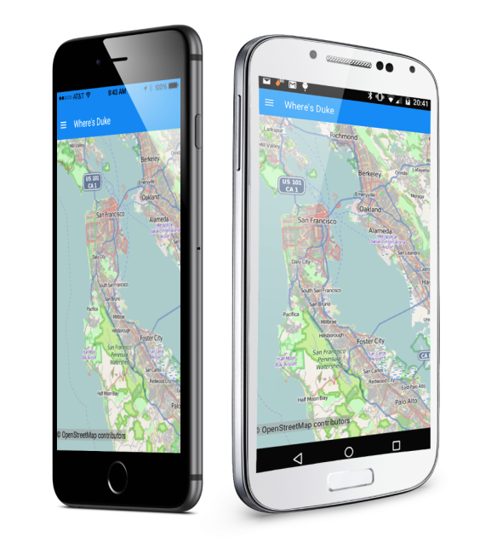
Summary
Gluon enables cross-device software.
Write in Java, run on desktop, iOS, Android, embedded.

Slide 14
Gluon IDE Plugins
Free plugins for all major IDEs
Jump-start new JavaFX application
Easily deploy and test your JavaFX applications on your mobile devices
Create IPA/APK that can be uploaded to the App Store and Play Store
Available for NetBeans, IntelliJ and Eclipse

Slide 15
Gluon Mobile & Embedded JavaFX SDK
Gluon maintains the JavaFXPorts repository (http://bitbucket.org/javafxports/8u-dev-rt)
JavaFXPorts repository is 99% synchronized with OpenJFX, patches flow both ways
JavaFXPorts contains fixes and enhancements for mobile/embedded

Slide 16
Gluon Scene Builder
Create FXML documents using a WYSIWYG editor
Based on the source code in OpenJFX, maintained, enhanced, and supported by Gluon

Slide 17
Gluon Charm
Client library for mobile, embedded, and even desktop applications.
Designed to work really well on mobile devices.
Split into three sub-components:
Connect
Glisten
Down

Slide 18
Gluon Charm: Connect
Introduces common API for web service connectivity.
Designed to integrate perfectly with Gluon Cloud.
Provides Observable / ObservableList implementations by adding remote capabilities

Slide 19
Gluon Charm: Glisten
Application framework for mobile development
Introduces common mobile UI metaphors into JavaFX
Most JavaFX UI controls restyled for mobile.
Custom UI controls where necessary
Based the Google ‘Material Design’ guidelines
Makes your applications shine!

Slide 20
Gluon Charm: Down
Provides device-agnostic API for accessing native hardware features
Storage
Camera
GPS
and more
Open source

Slide 21
Gluon Cloud
Gluon Cloud provides
Synchronization of data (automatic/manual) between all devices running your app
Remote persistence of your data
Integration of your data with back-end systems and cloud systems

Slide 22
Demo
+
+
+
Gluon Tasks

Slide 23
Gluon Particle
JavaFX Desktop application framework with
Minimal API
Convention over configuration
Runtime annotation scanning
Dependency Injection with support for JSR-330
Resource Injection
View/Form management
This is just the beginning! There is a lot in the works…

Slide 24
Gluon Ignite
Radically simplifies use of DI in JavaFX applications
Full support for JSR-330
Implementations for Guice, Dagger and Spring framework
Out-of-the-box injection, including FXML controllers

Slide 25
Demo
Gluon CodeVault
https://bitbucket.org/gluon-oss/samples

Slide 26
Looking Ahead

Slide 27
Looking Ahead
Gluon Cloud:
Continue to integrate with more cloud services
Gluon Charm:
Further UI polish / additional material design implementation
Additional hardware integration
Gluon Particle:
More APIs to improve ease of desktop client development

Slide 28
Summary
Gluon enables cross-device software.
Write in Java, run on desktop, iOS, Android, embedded.

Slide 29
Thanks For Attending
Any Questions?

