Slide 1
Robotics Programming with Java in MATLAB
[CON 3694]
JavaOne 2015
Florian Enner
florian@hebirobotics.com

Slide 2
Abstract
MATLAB, a powerful prototyping language, is widely used by scientists and engineers across a variety of disciplines. Although it is very powerful for working with offline data, MATLAB imposes significant limitations when it comes to doing real-time tasks. In the course of developing real-time-capable APIs for robotics R&D, this session’s speaker and his colleagues have learned many lessons and developed best practices they want to share with the community. The session, about designing Java APIs that can integrate seamlessly with MATLAB’s Java interface, covers a range of topics, including syntax mapping, data translation, runtime constraints, workflow mismatches, and key systemic concerns. You will see live coding and demonstrations on real robots.

Slide 3
About Me
Principal Systems/Software Engineer at Robotics Institute at Carnegie Mellon University
Co-Founder of HEBI Robotics

Slide 4
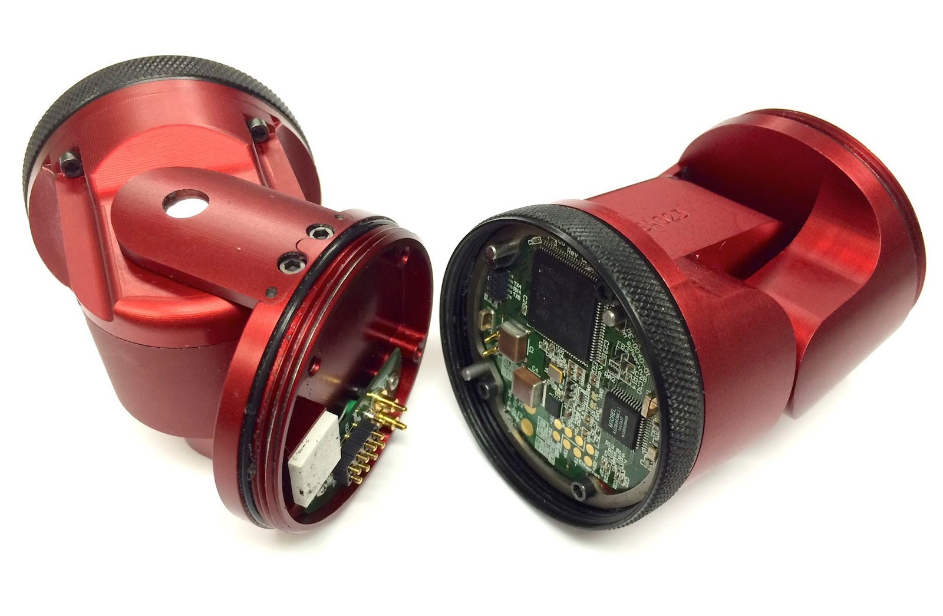
Modular Robots

Slide 5
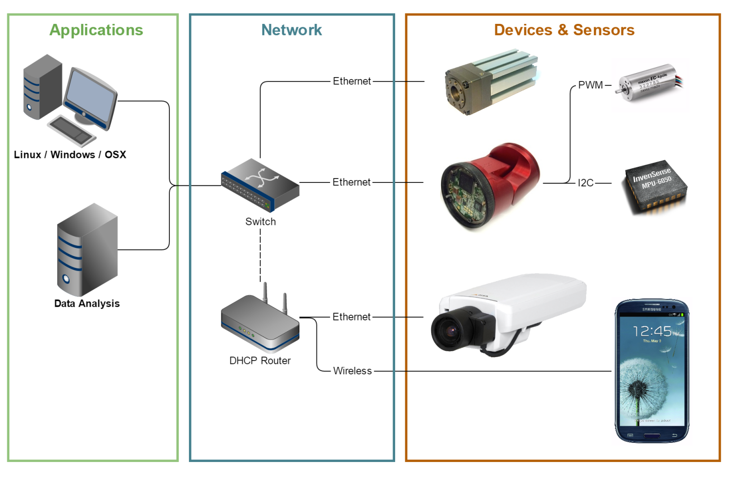
Internet of Things

Slide 6
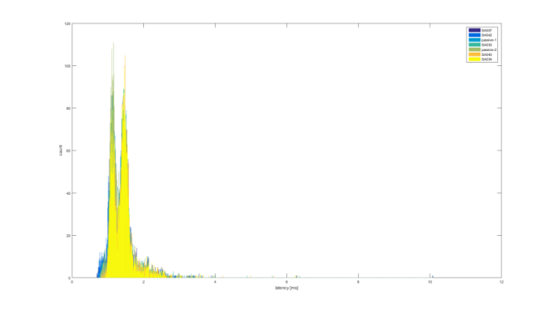
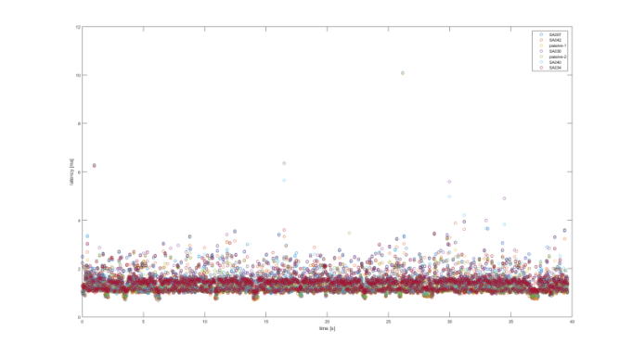
MATLAB
Excel for Engineering
TIOBE Top 20
Built-in visualization tools
Great for quick prototypes
Optimized for vectors / matrices
Interpreted Scripting Language
Dynamically typed
Single threaded
Call by value
1 Indexed

Slide 7
MATLAB Use Cases
Offline Analysis
Online Control
Minimum
Throughput > 10K msg/s
RTT 99.9% < 10 ms
RTT 100% < 80 ms
Goal
Throughput > 250K msg/s
RTT 99.99% < 5 ms
RTT 100% < 50 ms

Slide 8
MATLAB Use Cases
Offline Analysis
Online Control
Online Control (Java)
This Talk

Slide 9
Demo Time

Slide 10
MATLAB Basics

Slide 11
MATLAB Basics
Runtime
Integration
Types
Utilities
Problems

Slide 12
Bundled Runtime
>> version –java
>2007a = Java 6
>2013b = Java 7

Slide 13
JVM Flags
${startDir}/java.opts
${matlabroot}/bin/${arch}/java.opts

Slide 14
Change Runtime
export MATLAB_JAVA ${JAVA_HOME}
Oracle JDK 8
Azul Zing

Slide 15
Java Integration
% Write numbers 1-100 to text file
file = java.io.File('./dummy.txt');
writer = java.io.FileWriter(file);
for i=1:100
text = [num2str(i) ', '];
writer.write(text);
end
close(writer);

Slide 16
Java Integration
% Write numbers 1-100 to text file
file = java.io.File('./dummy.txt');
writer = java.io.FileWriter(file);
for i=1:100
text = [num2str(i) ', '];
writer.write(text);
end
close(writer);
autocompletes
better performance (~5x)

Slide 17
Custom Libraries
% Load custom library only once
if ~exist('us.hebi.sdk.matlab.HebiApi','class')
javaaddpath('hebi-sdk0.1-rev927.jar');
end
import us.hebi.sdk.matlab.*;

Slide 18
Types

Slide 19
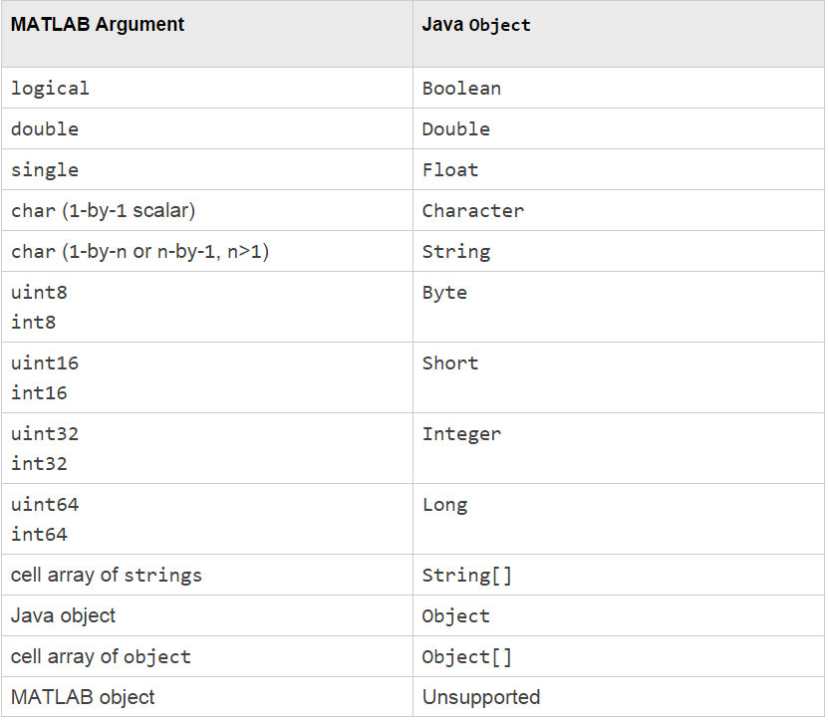
Primitive Types
Closest Java type
Null is []

Slide 20
Matrix and Vector Types
Convert to Java Arrays
Singleton dimensions get dropped
MATLAB | Java | MATLAB
[double 2x3] | new double[2][3] | [double 2x3]
[double 5x1] | new double[5] | [double 5x1]
[double 1x5] | new double[5] | [double 5x1]
 | new double[1][5] | [double 1x5]

Slide 21
MATLAB Object Types
Unsupported
No Objects
No Structs

Slide 22
Built-in Utilities
Common
methods()
methodsview()
fields()
Common Casts
struct()
double()
char()
Special functions
javaArray()
javaObject()
javaMethod()
Custom Java Casts
toString() changes display
toDouble() implements double()
toChar() implements char()

Slide 23
Broken Features

Slide 24
Nested Classes
obj = javaObject(‘namespace.Class$Nested');

Slide 25
Enums
value = javamethod('valueOf', ...
‘namespace$MyEnum', 'MY_VALUE');

Slide 26
Varargs
Object... == Object

Slide 27
API Design

Slide 28
API Design
Methods
Exchanging Data
Documentation
The Workspace
Advanced Topics
Pitfalls

Slide 29
Don’t Think Java

Slide 30
Avoid Loops
for i = 1:n
group.getModule(i).setPosition(position(i));
end

Slide 31
Avoid Constants
group.set(Command.POSITION, positions);

Slide 32
Avoid Builders
group = HebiApi.newGroup() ...
.addByName(‘Module1') ...
.addByName(‘Module2') ...
.addByName(‘Module3') ...
.addByName(‘Module4') ...
.build();

Slide 33
Think MATLAB

Slide 34
MATLAB
plot(x,y);
plot(x,y,'--rs');
plot(x,y,'--rs', ...
'LineWidth',2,...
'MarkerEdgeColor','k',...
'MarkerFaceColor','g',...
'MarkerSize',10)

Slide 35
Required Arguments
plot(x,y);
plot(x,y,'--rs');
plot(x,y,'--rs', ...
'LineWidth',2,...
'MarkerEdgeColor','k',...
'MarkerFaceColor','g',...
'MarkerSize',10)

Slide 36
Optional Arguments
plot(x,y);
plot(x,y,'--rs');
plot(x,y,'--rs', ...
'LineWidth',2,...
'MarkerEdgeColor','k',...
'MarkerFaceColor','g',...
'MarkerSize',10)

Slide 37
Key Value Pairs
plot(x,y);
plot(x,y,'--rs');
plot(x,y,'--rs', ...
'LineWidth',2,...
'MarkerEdgeColor','k',...
'MarkerFaceColor','g',...
'MarkerSize',10)

Slide 38
Replication Problems
Arbitrary Number of Arguments
Dynamic Types

Slide 39
Overload Methods
set(): void
set(Object): void
set(Object, Object): void
set(Object, Object, Object): void
set(Object, Object, Object, Object): void
set(Object, Object, Object, Object, Object): void

Slide 40
MATLAB Result
group.set(cmd);
group.set(cmd, 'led', [r g b]);
group.set(cmd, 'led', 'red');
group.set(cmd, 'led', 'g', 'gains', gains);

Slide 41
Exchanging Data

Slide 42
Primitive Types
Scalars
Vectors
Matrices
rgb = [1 0 0];
group.set('led', rgb);

Slide 43
Value Objects
Marshall as String or char[]
HebiApi.newGroupFromMacs('01:23:45:67:89:AB');
HebiApi.broadcastOn('10.10.10.255');

Slide 44
Tuples and Structs
Create Java Objects
public class CommandStruct { public double[][] position = null; public double[][] velocity = null; public double[][] torque = null; }

Slide 45
Tuples and Structs
Create Java Objects
cmd = CommandStruct();
cmd.position = vector;
vector = cmd.velocity;
group.set(cmd);
Call by reference !

Slide 46
Documentation

Slide 47
Documentation
Console Display
Help
Errors

Slide 48
Console Display
>> display(matlabStruct);
matlabStruct =
min: 0
max: Inf
shortField: [1 2 3 4 5]
longerField: [5x1 double]

Slide 49
Console Display
@Override public String toString() { string.clear(); string.appendField("position", position, "rad"); string.appendField("velocity", velocity, "rad/s"); string.appendField("torque", torque, "Nm"); return string.toString(); }

Slide 50
Help
>> help plot

Slide 51
Help
Display toString() of Help Object
>> help plot
>> HebiApi.help

Slide 52
Errors
Not Exceptional
>> plot('bad')
Error using plot
Invalid first data argument.
>> plot(1:5, 'bad')
Error using plot
Error in color/linetype argument.

Slide 53
Errors
>> socket = java.net.DatagramSocket(99999)
Java exception occurred:
java.lang.IllegalArgumentException: port out of range:99999
at java.net.InetSocketAddress.checkPort(Unknown Source)
at java.net.InetSocketAddress.<init>(Unknown Source)
at java.net.DatagramSocket.<init>(Unknown Source)
at java.net.DatagramSocket.<init>(Unknown Source)

Slide 54
Errors
public void set(Object one) { try { group.set(args.clear().addParam(one)); } catch (RuntimeException e) { throw Error.withoutStackTrace(e); } finally { args.clear(); } }

Slide 55
Errors
public void set(Object one) { try { group.set(args.clear().addParam(one)); } catch (RuntimeException e) { throw Error.withoutStackTrace(e); } finally { args.clear(); } }

Slide 56
The Workspace

Slide 57
Saving Workspace
Every object must implement Serializable!

Slide 58
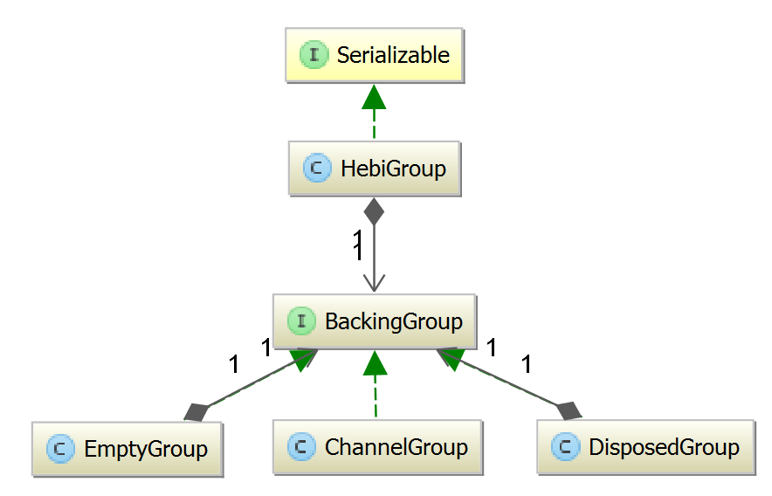
Object Lifecycle
Destruction
Re-execution
HebiApi.clearGroups();

Slide 59
Advanced Topics

Slide 60
Logging
File-Logging
In-Memory-Logging
Impedance Mismatch

Slide 61
Demo Time

Slide 62
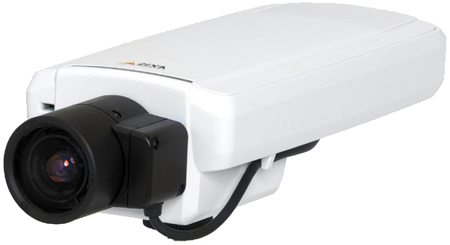
Big Data Types
Normal Conversion
Shared Memory
2-5 fps
byte[1280][720][3]
byte[3][720][1280]
1280 x 720

Slide 63
Demo Time

Slide 64
Background Tasks
Users expect single threaded behavior
Activities must stop on ctrl-c

Slide 65
Background Tasks
import com.mathworks.jmi.Matlab;
import com.mathworks.jmi.MatlabEvent;
import com.mathworks.jmi.MatlabListener;
Matlab.addListener(new MatlabListener() { public void matlabEvent(MatlabEvent event) { if(event.getEventType() == MatlabEvent.MATLAB_CTRLC){ // ... } } });

Slide 66
Pitfalls

Slide 67
Conflicting Dependencies
MATLAB has internal dependencies
Apache Commons *, Google *, …
Change Namespace
Maven Shade Plugin

Slide 68
Timeouts
No ctrl-c in Java code
Long methods look like system crash
Always add Timeouts !

Slide 69
Static Initialization
Exceptions in static initialization cause class to not be found
>> obj = us.hebi.sdk.matlab.BadClass()
Undefined variable "us" or class
"us.hebi.sdk.matlab.BadClass".

Slide 70
File Paths
Java Paths are
relative to working directory
absolute in startup directory
File workingDir = new File("."); File startDir = workingDir.getAbsoluteFile();

Slide 71
File Paths
import com.mathworks.jmi.MatlabPath;
File cwd = MatlabPath.getCurrentDirectory();

Slide 72
Recap

Slide 73
References
http://www.hebirobotics.com
https://hebirobotics.atlassian.net/wiki/display/documentation
https://www.youtube.com/channel/UCIOok6K_XlNoDPgCNPhDQnA
http://www.mathworks.com/help/matlab/using-java-libraries-in-matlab.html
http://www.azulsystems.com
http://www.undocumentedmatlab.com
http://stackoverflow.com/users/105904/andrew-janke
https://github.com/apjanke/matlab-bench

Slide 74
Questions?

