Slide 3
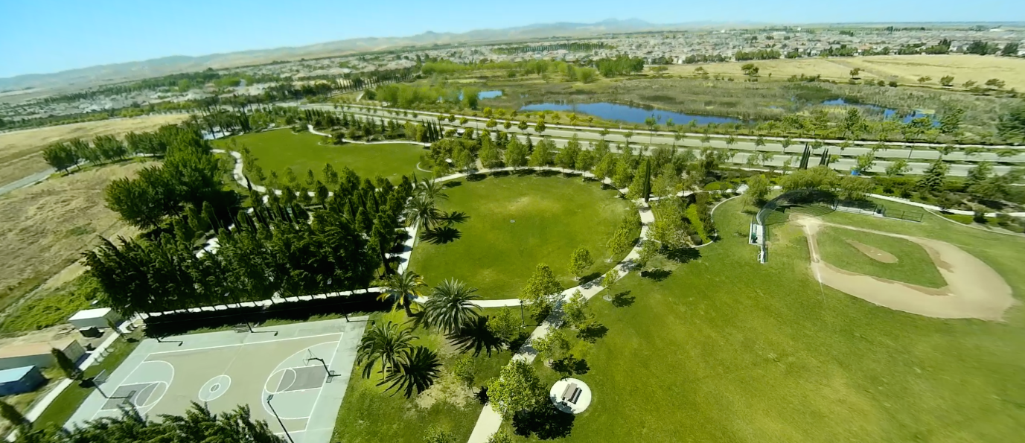
CON3743 Java and Security: Track Opening Presentation
Milton Smith
Sr. Principle Security Analyst, Oracle
Twitter: @spoofzu
Blog: securitycurmudgeon.com
Chris Wysopal
CTO, Vericode
Twitter: @weldpond
Web Site: veracode.com
October 2015

Slide 4
Who is Milton?
My background
Security leader working to secure Java in the clouds, former Java platform security leader, former Yahoo Paranoid

Slide 5
Program Agenda
1
Security in the World Today
Java Security Track
Welcome Chris Wysopal
2
3

Slide 6
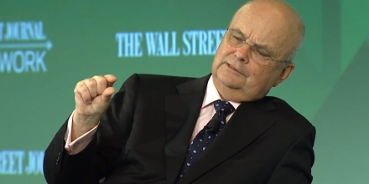
Security in the World Today
Context is important…

Slide 7
Security Cultural Milestones
Industry lessons learned…
Not all attacks financially motivated
Breach excuses no longer acceptable
Technology eclipsing ability to address social issues like security & privacy
Attacks embarrass executives, Sony
Top leadership (board/CEO) is responsible for security, Target
IoT, Drones, Blade Runner in 10 years

Slide 8
Security Cultural Milestones
Changing national security priority…
Size and scope of public security incidents will escalate
Significant future national changes in security are assured
But will future security changes be favorable to business and individuals when it’s over?

Slide 9
Potential Impact to Me?
Changing the way we work…
Government, taking security measures. Software supply chain security
Top leadership, security top board room discussion
Employee, impact how you develop, practices, and 3rd party software you use. Perhaps security include in performance evaluations
Developer, way you develop software may change

Slide 10
Security is Changing
Java and Security
Security & privacy are the most unrecognized social issues today
HEALTH/ CARE
HOMELESS
CIVIL RIGHTS

Slide 11
Java Security Track
Awareness, Education, Improvement

Slide 12
The Security Track
Some background
JavaOne 2015 is our 3rd year of the security track
Centrally organize security content vs. scattered across tracks
Defensive in nature, we teach: building, protecting, defending

Slide 13
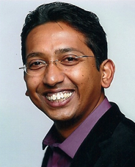
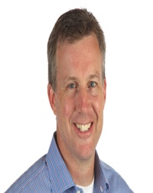
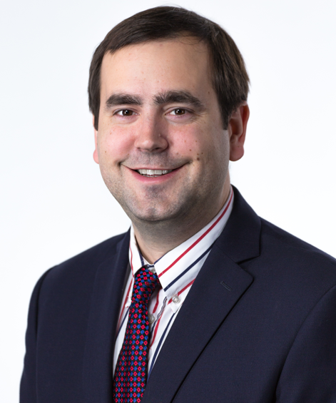
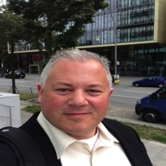
2015 Security Track Committee
Who are we?
Bala Sathiamurthy – Jive Software
Sean Mullan – Oracle
Jeff Williams – Contrast Security
Eric Costlow – Oracle
And me, Milton – Oracle

Slide 14
JDK 9 Security Features
http://openjdk.java.net/jeps/0
JEP 219: Datagram Transport Layer Security (DTLS)
JEP 229: Create PKCS12 Keystores by Default
JEP 232: Improve Secure Application Performance
JEP 244: TLS Application-Layer Protocol Negotiation Extension
JEP 246: Leverage CPU Instructions for GHASH and RSA
JEP 249: OCSP Stapling for TLS
JEP 273: DRBG-Based SecureRandom Implementations

Slide 15
To find out more about JDK Security …
Meet The Java Security Team [BOF2713]
Tuesday, Oct 27, 7:00 p.m. | Hilton—Plaza Room A
Safer and Faster: New JDK Security Features and Performance Improvements [CON6710]
Wednesday, Oct 28, 11:30 a.m. | Hilton—Continental Ballroom 5

Slide 16
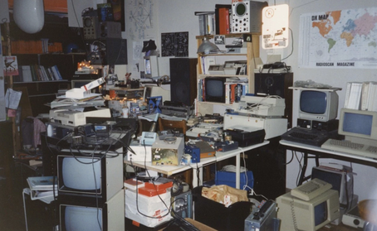
Welcome Chris Wysopal

Slide 17
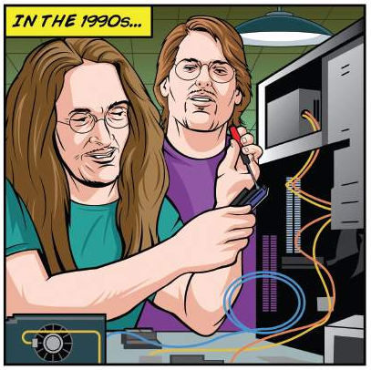
Chris Wysopal, CTO & Co-Founder
15+ years focused solely on application security
One of the original security researchers from mid 90’s. Was part of hacker think tank, The L0pht.
Founded Veracode to build automated application security testing
My son now keeps me busy installing Minecraft mods.
@weldpond

Slide 18
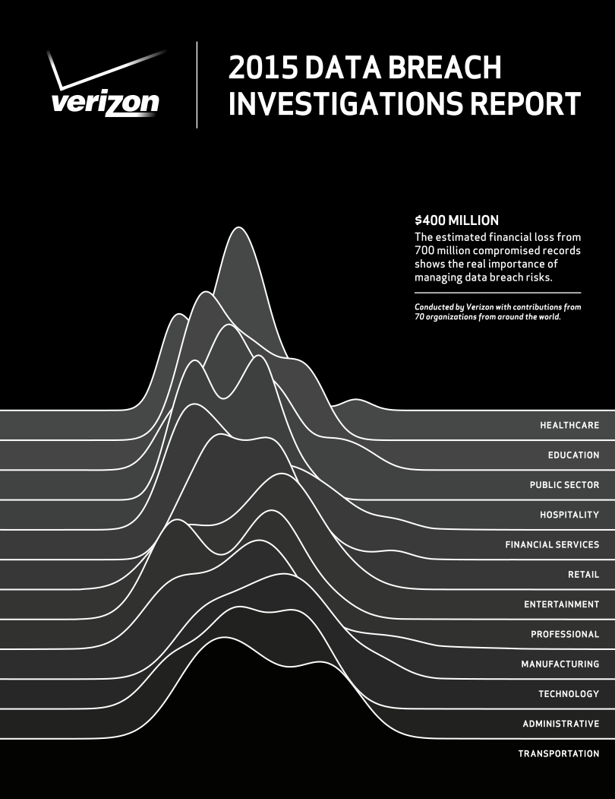
What is the SoSS report?
SoSS is the “BEFORE”
Breach Reports are the “AFTER”

Slide 19
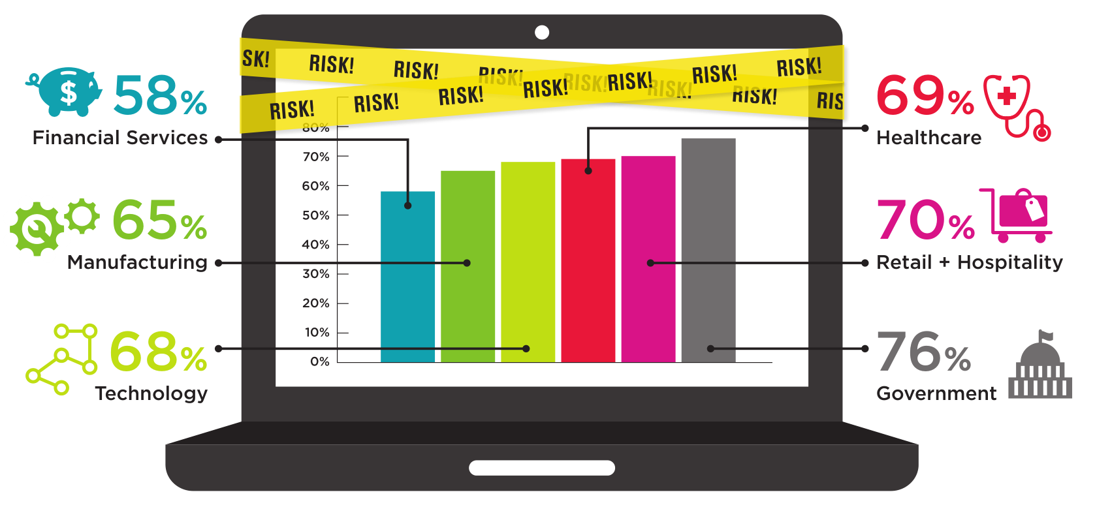
WHO DOES BEST AGAINST INDUSTRY STANDARDS?
What is the percentage of applications that fail an OWASP Top 10 policy upon initial submission?

Slide 20
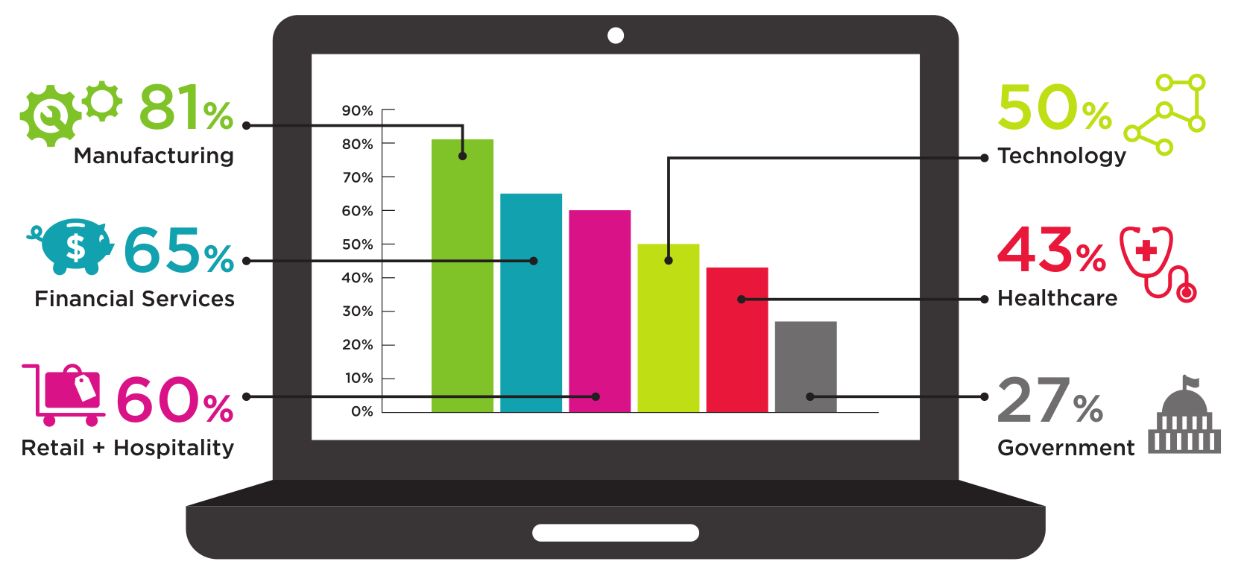
WHO FIXES THE MOST VULNERABILITIES?
What is the percentage of known vulnerabilities remediated by each industry vertical, in order to reduce application layer risk?

Slide 21
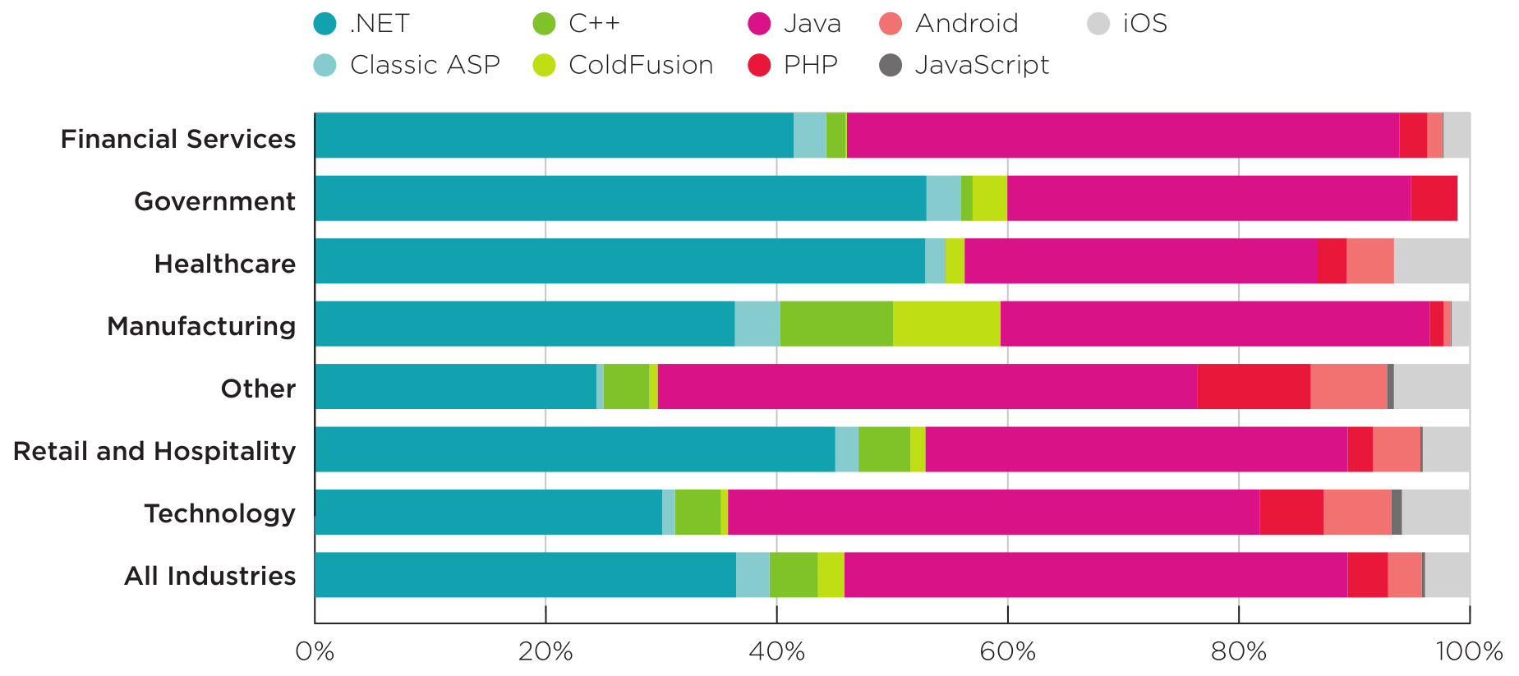
Programming languages used
#1
#7
#4
#2
#6
#5
#3

Slide 22
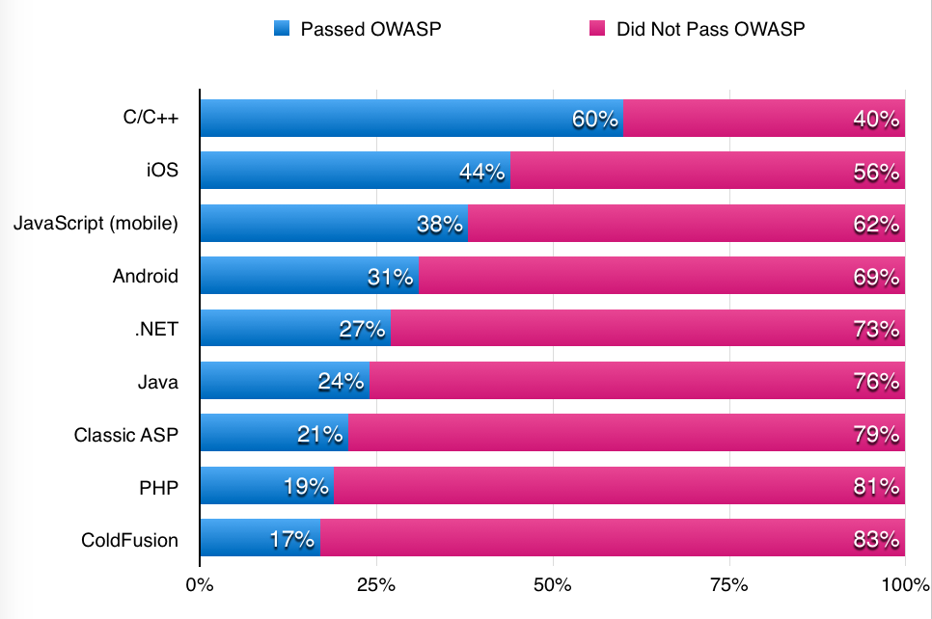
Policy compliance

Slide 23
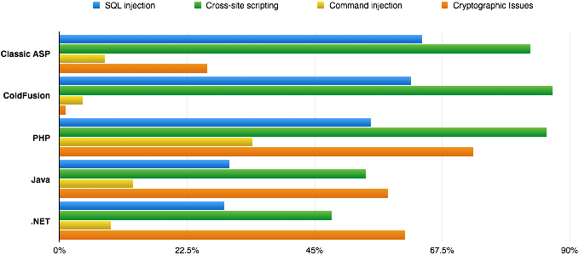
Web vulnerability prevalence by language

Slide 24
Breakdown of Cryptographic Flaws

Slide 25
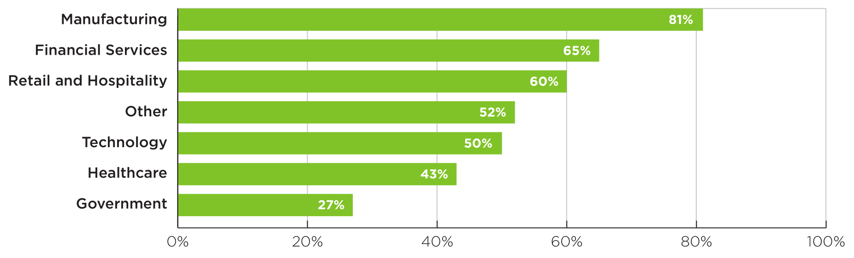
Flaw remediation rates
Wide spread in % of flaws found vs. fixed
May be due to external factors (industry regulations, competitive landscape) and/or security policies

Slide 26
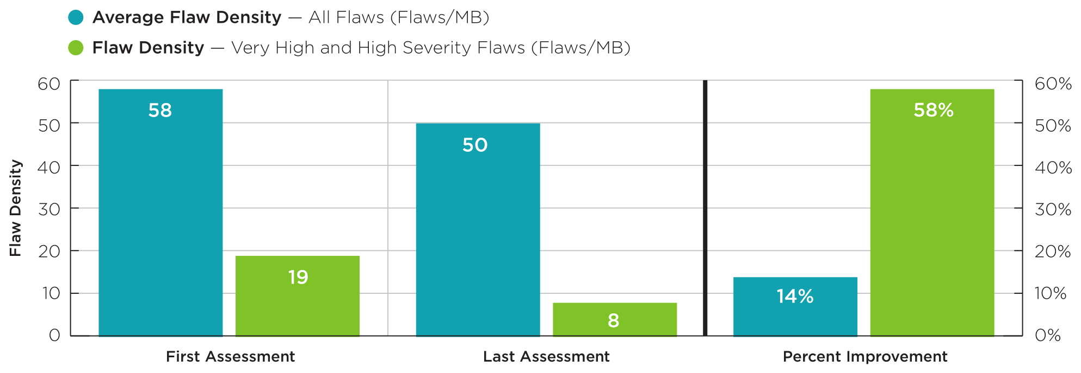
Remediation by flaw density
Small improvement in flaw density overall, greater improvement in very high and high severity flaws

Slide 27
Impact of remediation coaching
For applications that used a readout, the development team fixed more than 2.5x the average # of flaws per megabyte

Slide 28
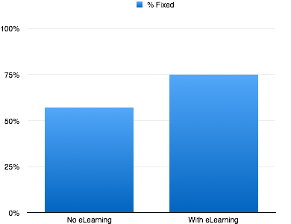
Fixing flaws - eLearning

Slide 29
Three characteristics of a successful application security program
Flickr: https://www.flickr.com/photos/james_michael_hill/1388906656 (CC BY-NC-ND 2.0)

Slide 30
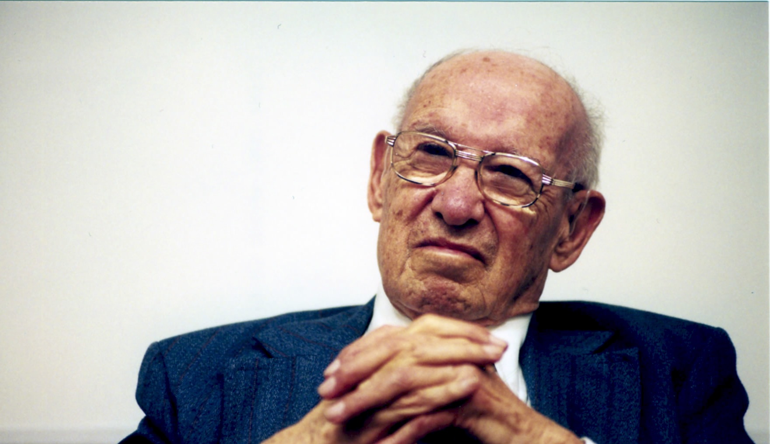
#1: Metrics driven
“What gets measured gets managed.”
—Peter Drucker

Slide 31
#2: Remediation focused
2.5x!
Flickr: https://www.flickr.com/photos/dlr_de/5476084104 (CC BY-NC-ND 2.0)

Slide 32
#3: Habit forming

Slide 33
Q&A
Chris Wysopal
cwysopal@veracode.com, @WeldPond

