Slide 1
AngularBeans
A modern real-time web framework
BESSEM HMIDI
2015

Slide 2
Agenda
About me.
The new web development challenges.
Java EE 7 /CDI
AnguarJS
Angular Beans.
Demo.
Q&A .
2015

Slide 3
About me
~ 9 years working with
Java/Java EE
R&D engineer @ ESPRIT
Freelancer Java/Java EE consultant.
Professional trainer
AngularBeans Framework Creator.

Slide 4
New web development challenges
Single page applications & Client Side MV*
The thin Server concept.
Real Time and fall-back.
Hybride Mobile app’s.
Loose coupling client/server development testability and productivity.

Slide 5
Classic approach
Client
Server
Initial Req
HTML Rendering
Page Reloading/forwarding
Rich clients :
req resource (via AJAX )
Upadates (prevent the reloading)
Backend Services
HTML Generation
Navigation rules
UI logic
MVC
Validations…
Sessions care
GET,POST…

Slide 6
SPA approach
Client
Server
Initial Req
HTML Rendering
Model’s updates
# routing
UI logic
Validation
Session data
(dom tree /HTML5 storages)
Single DOM tree
Thin Server
Backend
Scalability
Conserve a state
GET,POST…
Can contains session data
HTTP
Comet
JsonRPC
Wsocket
SockJS
STOMP
More stateless
More statefull

Slide 7
AngularJS
Designed for SPA app’s
MVC/MVVM/MV*
2 Ways DataBinding
Modules
Services (as services, factory, providers)
Blocs (run,config..)
Controllers
Directives
Events/watchers/filters
What about server side

Slide 8
RealTime and fall-Back
Polling
Long Polling
XHR Streaming
Server Sent Event’s
Web sockets
SockJS

Slide 9
JSON/JSON RPC
{
{
"is": ["compact", "readable"]
"web_service": "JS native object"
"enough" : "for majority of needs"
}
}
We want Objects !!

Slide 10
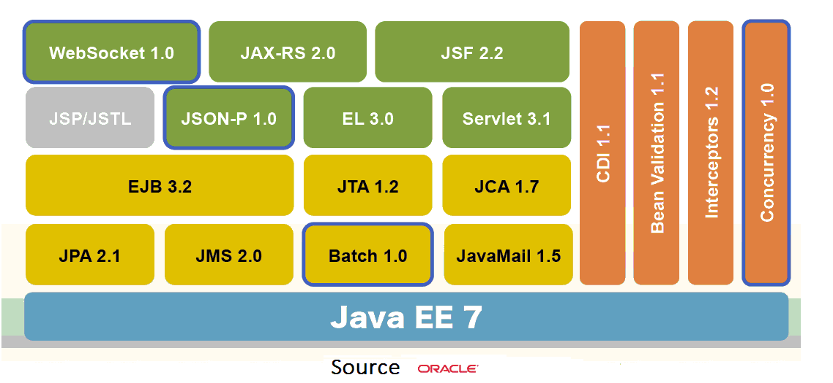
Java EE 7

Slide 11
Java EE 7/JSF
JSF use XHTML not pure HTML5:
Better than JSP (not compiled but evaluated at runtime).
But still XML instead of HTML.
HTML5 Templates? (Pass-through elem/attr)
Lifecycle: good as extensions points but:
Complexity for the developer.
UI interactions and navigations defined on the server side.
Not RealTime, not Event driven.
Still BAD !!

Slide 12
CDI
A reinvented component model for Java EE based on POJO’S.
Dependencies injection via Types /names /Qualifiers /Alternatives/Producers.
Context /custom lifecycle.
Powerful Event Mechanism
Highly customizable. (CDI extensions).
COOL !!

Slide 13
So what we need
An SPA aware Framework.
Using the power of CDI to easily integrate highly mature java EE enterprises services (or custom components, third party framework).
Manage half duplex and full duplex communications as they are options and not different tech’s. (same code, just configuration).
Abstract all the boilerplate client-server com’ code (RPC style).

Slide 14
AngularBeans

Slide 15
AngularBeans
If AngularJS is what should have been HTML, If CDI is what should have been JavaEE, AngularBeans is what should be JSF!
with AngularBeans Mustache is your EL, directives are you taglib’s.
No more XHTML ☺!!
No more JSP ☺!!

Slide 16
AngularBeans: principle
« Singleton »
NG ctrl
@AngularBean 1
NG Service 1
NG service
« Singleton »
NG Directive
NG Service 2
@AngularBean 2
Dependency injection
Dependency injection
@ Other CDI Bean

Slide 17
Features
RPC of CDI beans via: HTTP/ Websocket /fall back
Bi-directionnal-realtime-event mechanism
Publish-subscribe realtime message broadcasting.
Path & Action based file upload.
I18n Based on properties files-> JSON
Bean validation : source of truth.->HTML validation attrs.
Handle overloading +var-args?
Transparent binary content handling (cached or not).
Trigger client-side logging from the server.
Handle CORS requests.
ModelQuery (patchs)
COOL !!
COOL !!
CeOOL !!

Slide 18
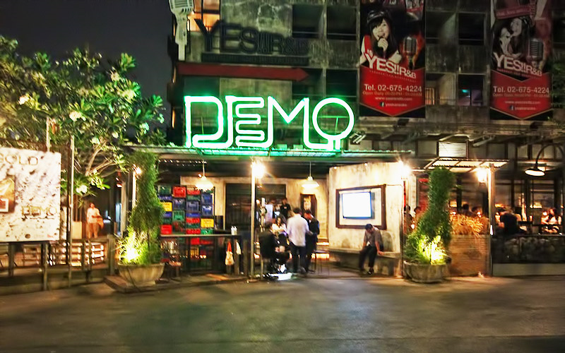
Let’s go to the demo
Demo Nightclub in Bangkok

Slide 19
https://github.com/bessemHmidi/javaOne2015
Is not production ready yet !!
Asynchronous support with EJB’s
Interaction with Event’s fired by EJB’s.
Interface based @’s
Tests…(Security? + Scaling?)
Multi modules? Lazy loading.
Multi AB EndPoints (* servers)?

Slide 20
The End
THANK YOU!
Q/A ?
2015
@BessemHmidi
Bessem Hmidi
Bessem.hmidi.perso@gmail.com

