Slide 1
Work With Hundreds of Hot Terabytes in JVMs
Peter Lawrey Higher Frequency Trading Ltd
Per Minborg Speedment, Inc.

Slide 2
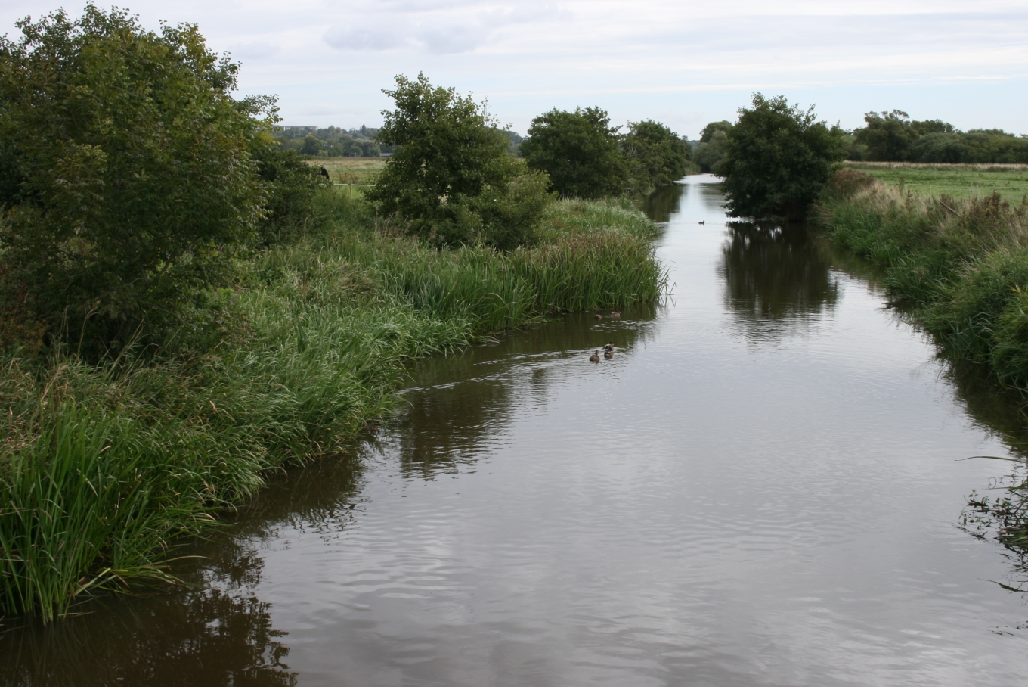
Do not Cross the Brook for Water
?
Why would you use a slow remote database
when you can have all your data available
directly in your JVM ready for concurrent
ultra-low-latency access

Slide 3
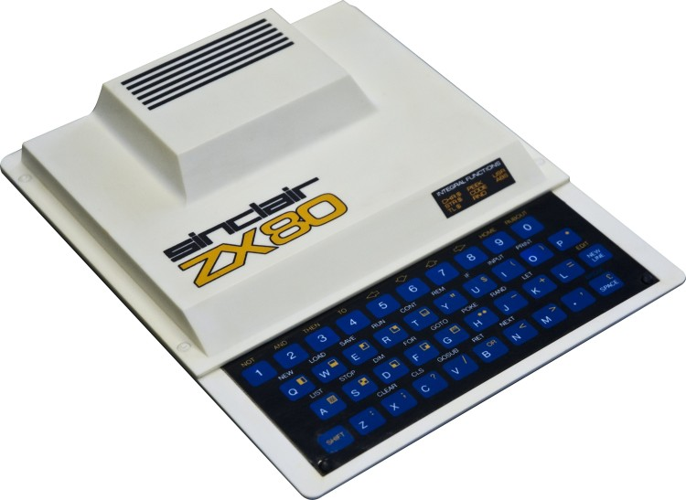
About Per
3

Slide 4
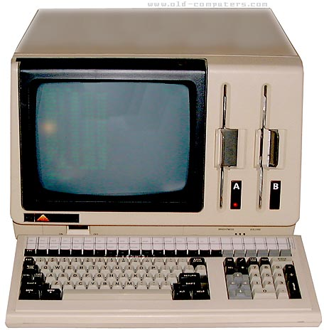
About Peter
About Peter

Slide 5
Real World Scenario
Application
Fraud Detection
In-JVM-Cache
Credit Card Company Web Shop Stock Trade Bank Back Testing
>10 TB
Source of Truth

Slide 6
Table of Content
Two Important Aspects of Big Data Latency
Cache synchronization strategies
How can you have JVMs that are in the TBs?
Speedment Reflector
Chronicle Map/Queue

Slide 7
Two Important Aspects of Big Data Latency
No matter how advanced database you may ever use, it is really the data locality that counts
Be aware of the big change in memory pricing

Slide 8
Compare latencies using the Speed of Light
During the time a database makes a 1 s query, how far will the light move?
Database query 1 s

Slide 9
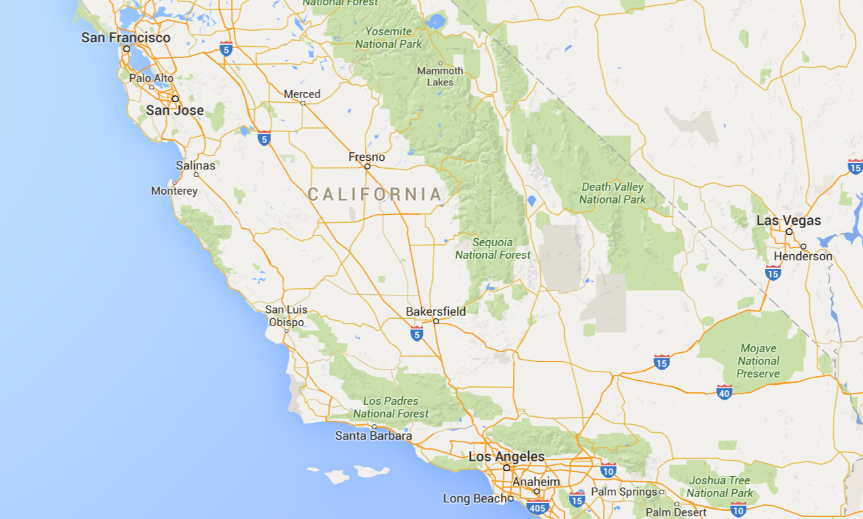
Compare latencies using the Speed of Light
SSD
Intra-data center TCP
Disk seek

Slide 10
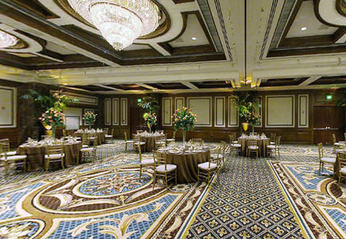
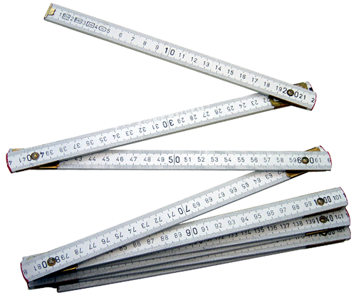
Compare latencies using the Speed of Light
Main Memory
CPU L2 cache
CPU L3 cache
CPU L1 cache

Slide 11
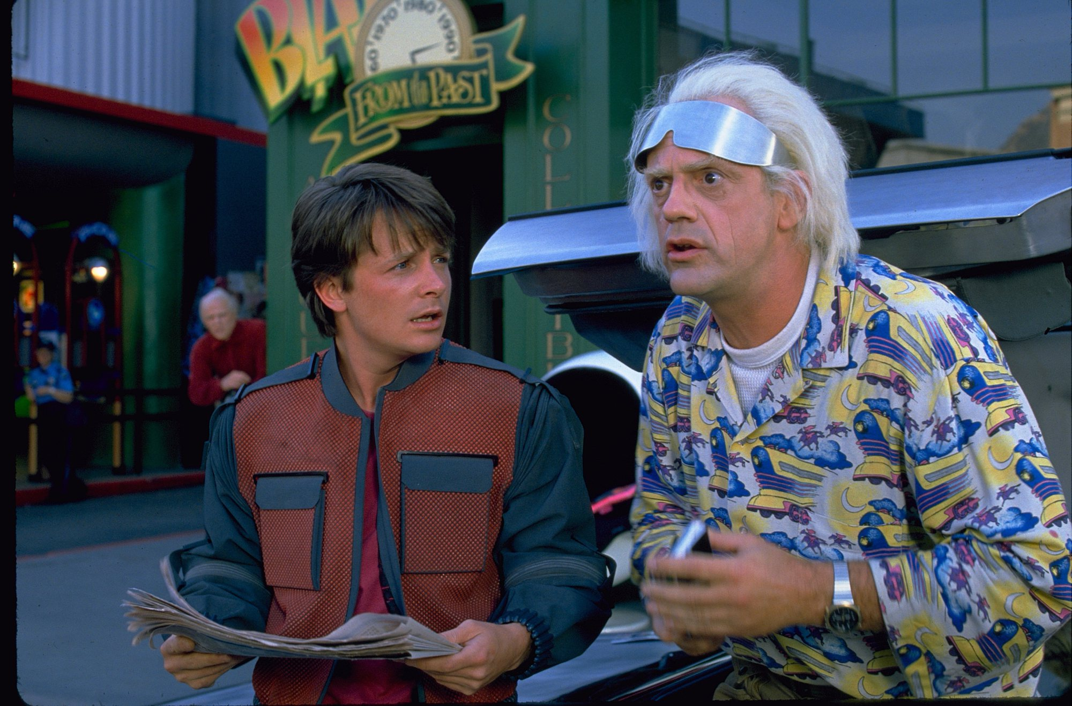
”Back to the Future”
How much does 1 GB cost?

Slide 12
Cost of 1 GB RAM - Back to The Future
$ 67,000,000,000
$ 720,000
$ 5
$ 0.04 (1 TB for $ 40)
Source: http://www.jcmit.com/memoryprice.htm

Slide 13
Conclusion
Keep your data close
RAM is close enough, cheap and getting even cheaper

Slide 14
Table of Content
Two Important Aspects of Big Data Latency
Cache synchronization strategies
How can you have JVMs that are in the TBs?
Speedment Reflector
Chronicle Map/Queue

Slide 15
Cache Synchronize Strategies
Common ways:
Dump and Load Caching
Dumps are reloaded periodically
All data elements are reloaded
Data remains unchanged between reloads
System restart is just a reload
Poll Caching
Data evicted, refreshed or marked as old
Evicted element are reloaded
Data changes all the time
System restart either warm-up the cache or use a cold cache

Slide 16
Cache Synchronize Strategies
Speedment and Chronicle way:
Reactive Persistent Caching
Changed data is captured in the Database
Changed data events are pushed into the cache
Events are grouped in transactions
Cache updates are persisted
Data changes all the time
System restart, replay the missed events

Slide 17
Comparison
 | Dump and Load Caching | Poll Caching | Reactive Persistance Caching
Max Data Age | Dump period | Eviction time | Replication Latency - ms
Lookup Performance | Consistently Instant | ~20% slow | Consistently Instant
Consistency | Eventually Consistent | Inconsistent - stale data | Eventually Consistent
Database Cache Update Load | Total Size | Depends on Eviction Time and Access Pattern | Rate of Change
Restart | Complete Reload | Eviction Time | Down time update rate -> 10% of down time
*

Slide 18
Comparison
 | Dump and Load Caching | Poll Caching | Reactive Persistance Caching
Max Data Age | Dump period | Eviction time | Replication Latency - ms
Lookup Performance | Consistently Instant | ~20% slow | Consistently Instant
Consistency | Eventually Consistent | Inconsistent - stale data | Eventually Consistent
Database Cache Update Load | Total Size | Depends on Eviction Time and Access Pattern | Rate of Change
Restart | Complete Reload | Eviction Time | Down time update rate -> 10% of down time
*

Slide 19
What you can do with TB
Spurious Correlations.
http://www.tylervigen.com/spurious-correlations

Slide 20
What you can do with TB

Slide 21
Table of Content
Two Important Aspects of Big Data Latency
Cache synchronization strategies
How can you have JVMs that are in the TBs?
Speedment Reflector
Chronicle Map/Queue

Slide 22
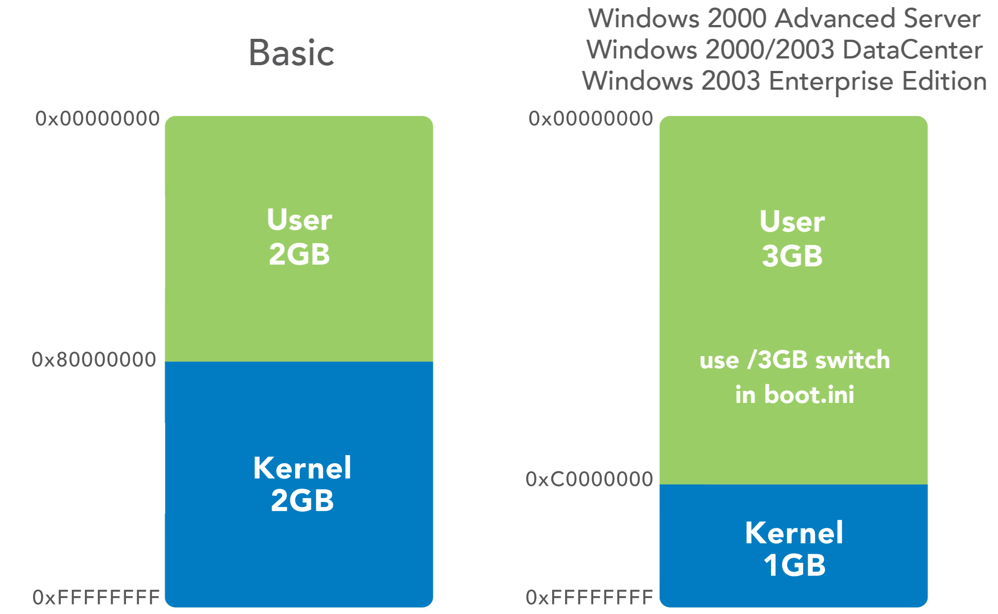
32 bit operating system (31-bit heap)

Slide 23
Compress Oops in Java 7 (35-bit)
Using the default of –XX:+UseCompressedOops
In a 64-bit JVM, it can use “compressed” memory references.
This allows the heap to be up to 32 GB without the overhead of 64-bit object references. The Oracle/OpenJDK JVM still uses 64-bit class references by default.
As all object must be 8-byte aligned, the lower 3 bits of the address are always 000 and don’t need to be stored. This allows the heap to reference 4 billion * 8-bytes or 32 GB.
Uses 32-bit references.

Slide 24
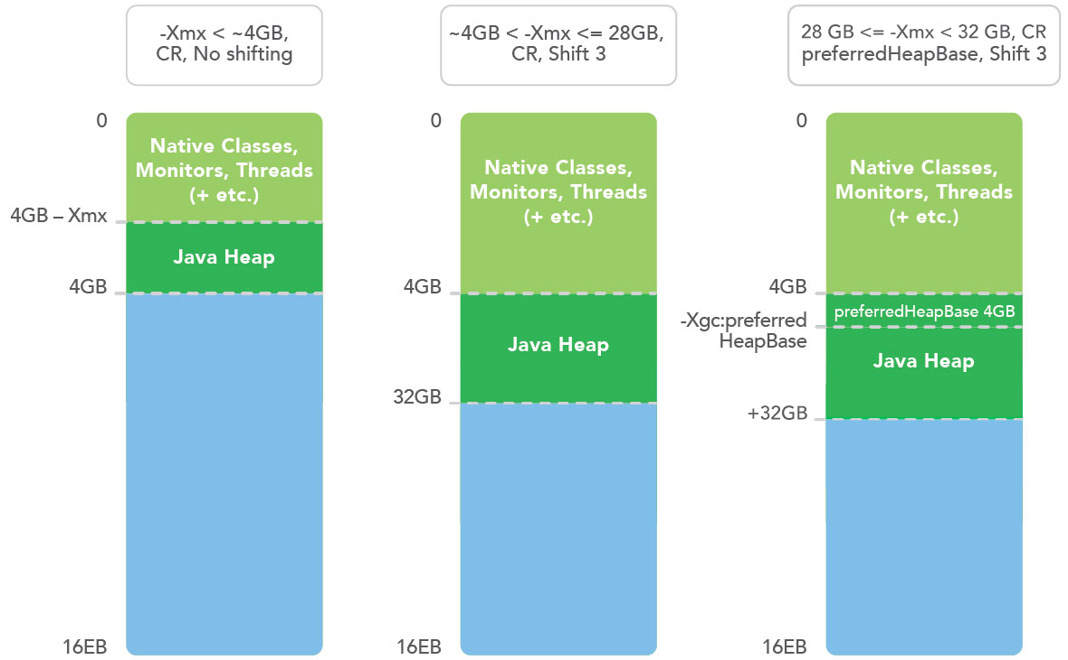
Compressed Oops with 8 byte alignment

Slide 25
Compress Oops in Java 8 (36 bits)
Using the default of –XX:+UseCompressedOops –XX:ObjectAlignmentInBytes=16
In a 64-bit JVM, it can use “compressed” memory references.
This allows the heap to be up to 64 GB without the overhead of 64-bit object references. The Oracle/OpenJDK JVM still uses 64-bit class references by default.
As all object must be 8 or 16-byte aligned, the lower 3 or 4 bits of the address are always zeros and don’t need to be stored. This allows the heap to reference 4 billion * 16-bytes or 64 GB.
Uses 32-bit references.

Slide 26
64-bit references in Java (100 GB?)
A small but significant overhead on main memory use.
Reduces the efficiency of CPU caches as less objects can fit in.
Can address up to the limit of the free memory. Limited to main memory.
GC pauses become a real concern and can take tens of second or many minutes.

Slide 27
NUMA Regions (~40 bits)
Large machine are limited in how large a single bank of memory can be. This varies based on the architecture.
Ivy and Sandy bridge Xeon processors are limited to addressing 40 bits of real memory.
In Haswell this has been lifted to 46-bits.
Each Socket has “local” access to a bank of memory, however to access other bank it may need to use a bus. This is much slower.
The GC of a JVM can perform very poorly if it doesn’t sit within one NUMA region. Ideally you want a JVM to use just one NUMA region.

Slide 28
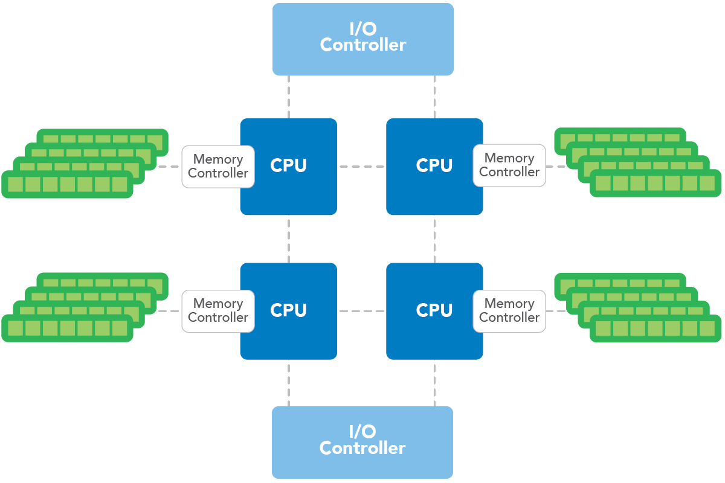
NUMA Regions (~40 bits)

Slide 29
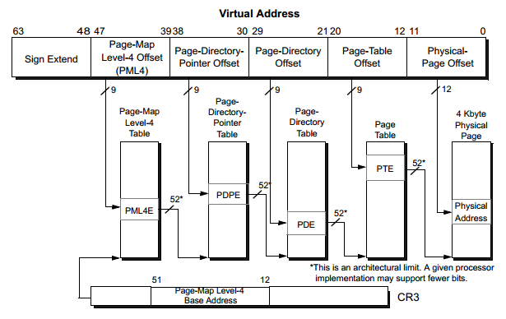
Virtual address space (48-bit)

Slide 30
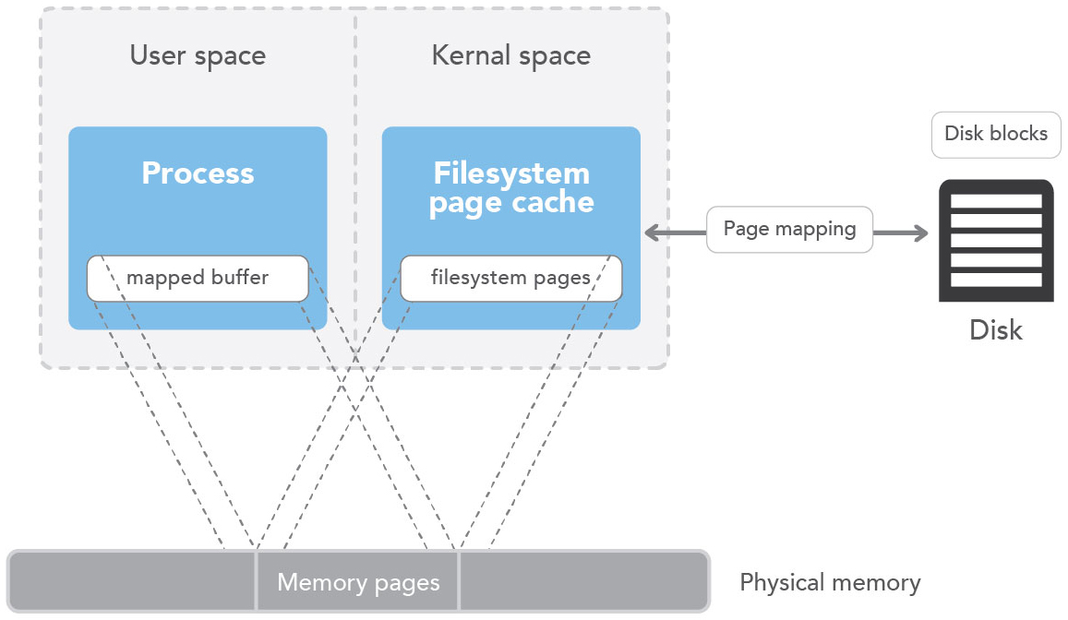
Virtual address space (48-bit)

Slide 31
Memory Mapped files (48+ bits)
Memory mappings are not limited to main memory size.
64-bit OS support 128 TiB to 256 TiB virtual memory at once.
For larger data sizes, memory mapping need to be managed and cached manually.
Can be shared between processes.
A library can hide the 48-bit limitation by caching memory mapping.

Slide 32
Peta Byte JVMs (50+ bits)
If you are receiving 1 GB/s down a 10 Gig-E line in two weeks you will have received over 1 PB.
Managing this much data in large servers is more complex than your standard JVM.
Replication is critical. Large complex systems, are more likely to fail and take longer to recover.
You can have systems which cannot be recovered in the normal way. i.e. Unless you recover faster than new data is added, you will never catch up.

Slide 33
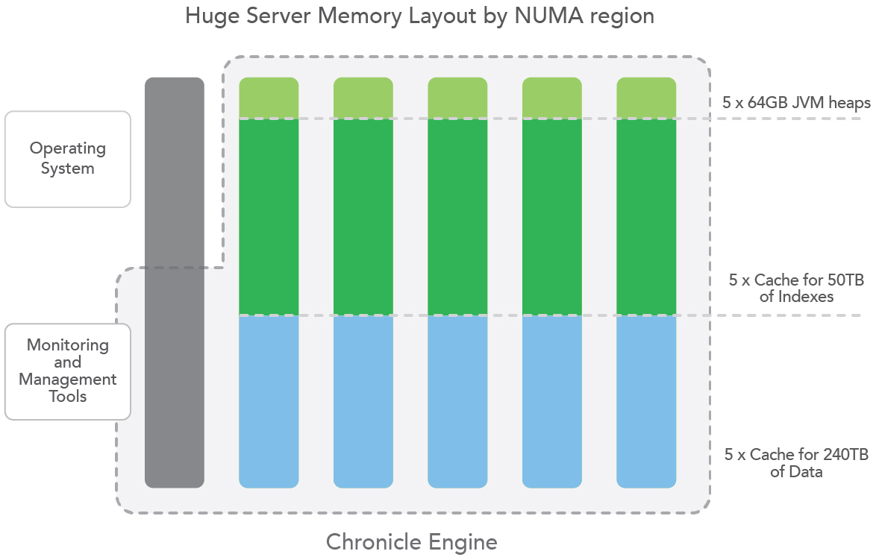
Peta Byte JVMs (50+ bits)

Slide 34
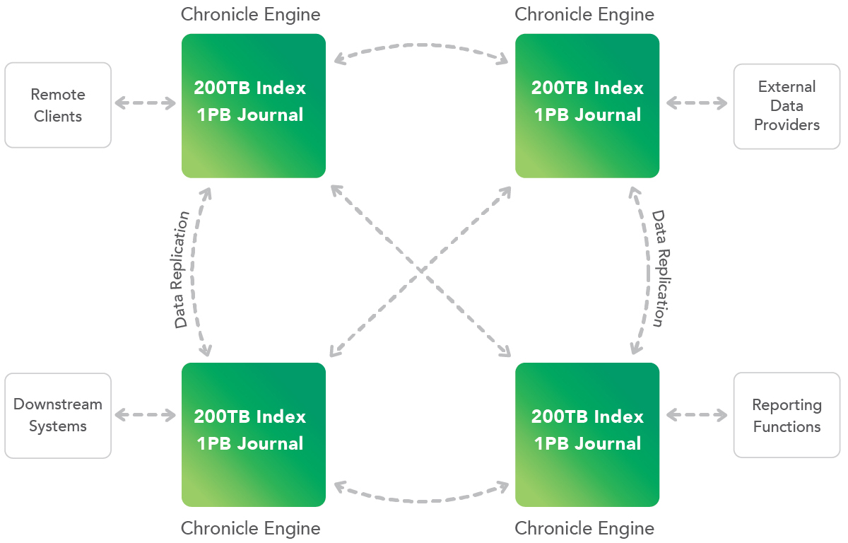
Peta Byte JVMs (50+ bits)

Slide 35
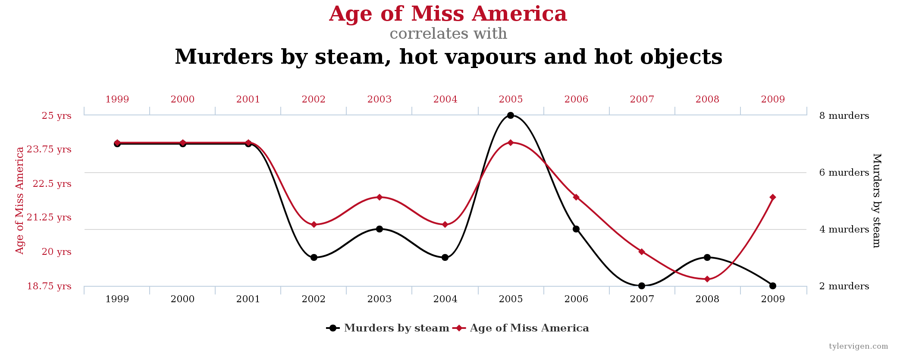
What you can do with TB

Slide 36
Table of Content
Two Important Aspects of Big Data Latency
Cache synchronization strategies
How can you have JVMs that are in the TBs?
Speedment Reflector
Chronicle Map/Queue

Slide 37
Real World Scenario
Application
Fraud Detection
In-JVM-Cache
Credit Card Company Web Shop Stock Trade Bank Back Testing
>10 TB
Source of Truth

Slide 38
What is Speedment?
Database Reflector
Code generation -> Automatic domain model extraction from databases
In-JVM-memory technology
Pluggable storage engines (ConcurrentHashMap, OffHeapConcurrentHashMap, Chronicle-Map, Hazelcast, etc.)
Transaction-aware

Slide 39
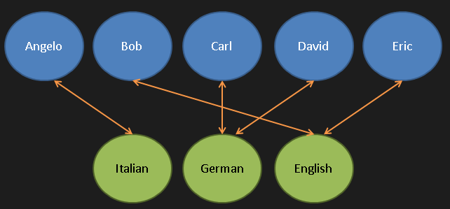
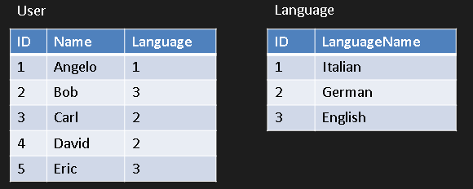
Database Reflector
Detects changes in a database
Buffers the changes
Can replay the changes later on
Will preserve order
Will preserve transactions
Will see data as it was persisted
Detects changes from any source
JVM
Graph View
CQRS
In-JVM-Memory

Slide 40
Scale Out With Chronicle
INSERT
UPDATE
DELETE
Database

Slide 41
Workflow

Slide 42
Super Easy Integration
@Override
public void add(User user) {
chronicleMap.put(user.getId(), user);
}

Slide 43
Speedment – OSS and Enterprise

Slide 44
What you can do with TB

Slide 45
Table of Content
Two Important Aspects of Big Data Latency
Cache synchronization strategies
How can you have JVMs that are in the TBs?
Speedment Reflector
Chronicle Map/Queue

Slide 46
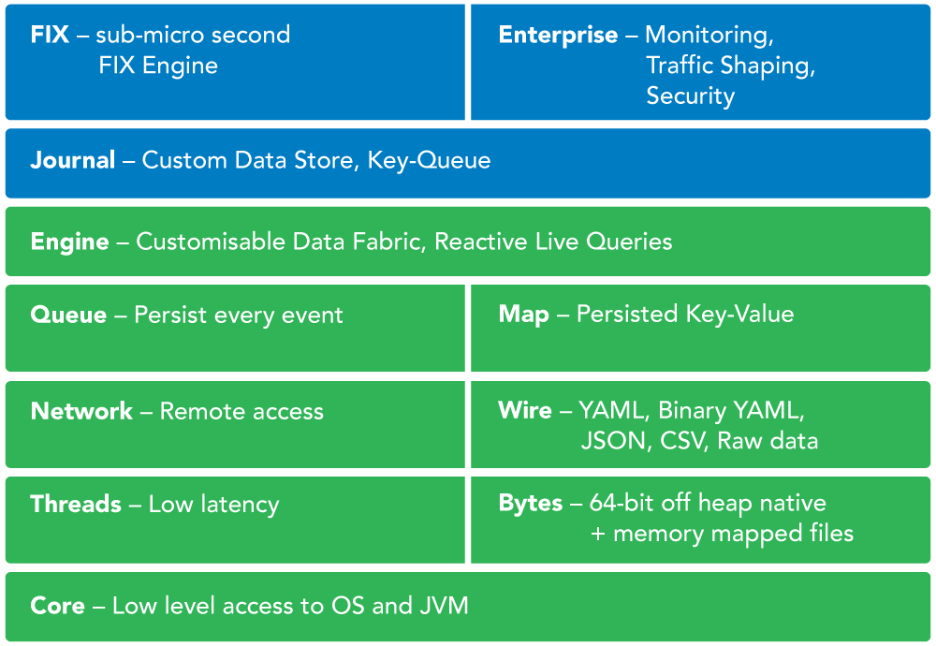
What is Chronicle?

Slide 47
Thank you!
sales@chronicle.software
@ChronicleUG http://chronicle.software
sales@speedment.com
@Speedment www.speedment.com www.speedment.org
Meet us at Oracle Open World together with Sencha:
Mobile Showcase, Moscone South, Booth 2207

