Slide 1
NASA Space Mission Support Fueled by the Java Ecosystem
Sean M Phillips
a.i. solutions, Inc.
CON4635 - JavaOne 2015

Slide 2
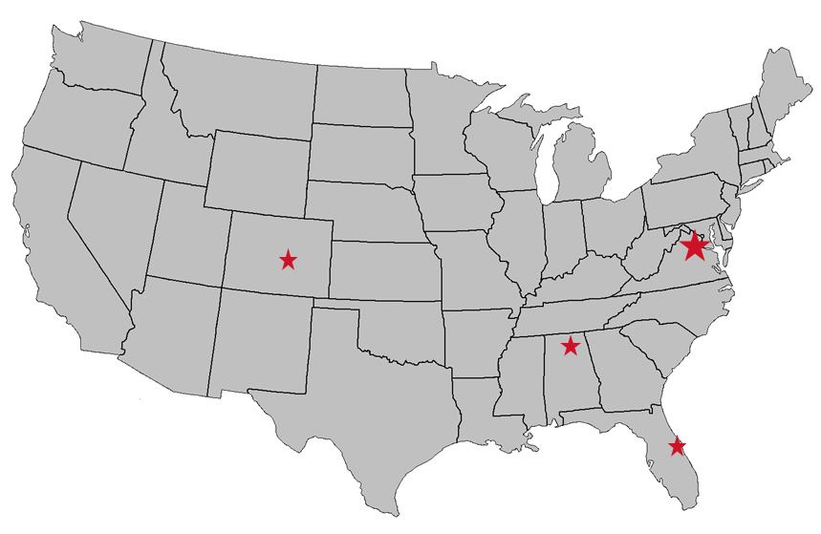
a.i. solutions Company Profile
Company Overview:
Founded in 1996
400+ Employees
Mature Small Business
Core Capabilities:
Flight Dynamics & Satellite Systems Engineering
Launch Vehicle & Missile Systems Engineering
Ground System Application Development
Information Assurance & Cybersecurity
COTS Products: FreeFlyer® Flight Dynamics Software
Customer Site
Lompoc, CA
Headquarters
Lanham, MD
Regional Office
Colorado Springs, CO
Customer Site Albuquerque, NM
Regional Office
Huntsville, AL
Regional Office
Cape Canaveral, FL
Regional Office
Houston, TX
Certifications & Awards
ISO 9001:2008 / AS9100 Certified
CMMI-Dev ML3
2010 NASA Small Business Prime Contractor of the Year

Slide 3
Discussion of Technologies
Deep Space Climate Observatory
NetBeans Platform, MATLAB and STK
Magnetospheric MultiScale
NetBeans Platform, JavaFX, MATLAB, FreeFlyer and WorldWind
James Webb Space Telescope
NetBeans Platform, JavaFX, FreeFlyer and WorldWind
Contact Analysis Visualization Demo
Deep Space Trajectory Explorer
JavaFX, Java Astrodynamics Toolkit and Apache Commons Math
Asteroid Trajectory Visualization Demo
Lunar Lagrange Point Halo family analysis Demo
Deep Space planetary-moon ballistic science orbit Demo

Slide 4
Deep Space Climate Observatory - DSCOVR
Real-time solar wind data
Earth-Sun Lagrange point 1
Postponed in 2001
In storage for 10 years
Mission reactivated in late 2013
Launched in early 2015 via SpaceX Falcon 9
Arrived in science orbit June 2015.
Three years of estimated effort compressed into one

Slide 5
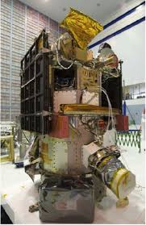
Tools Developed as NetBeans Platform Plugins
Ephemeris generation
Ingests legacy state vector file (c. 1976)
Supports various output formats
Orbit product generation
Collates ground station contact times
Visual of proximity to Sun and Moon
Maneuver planning
Incorporate maneuvers into ephemerides
Comparisons of burn to no-burn cases

Slide 6
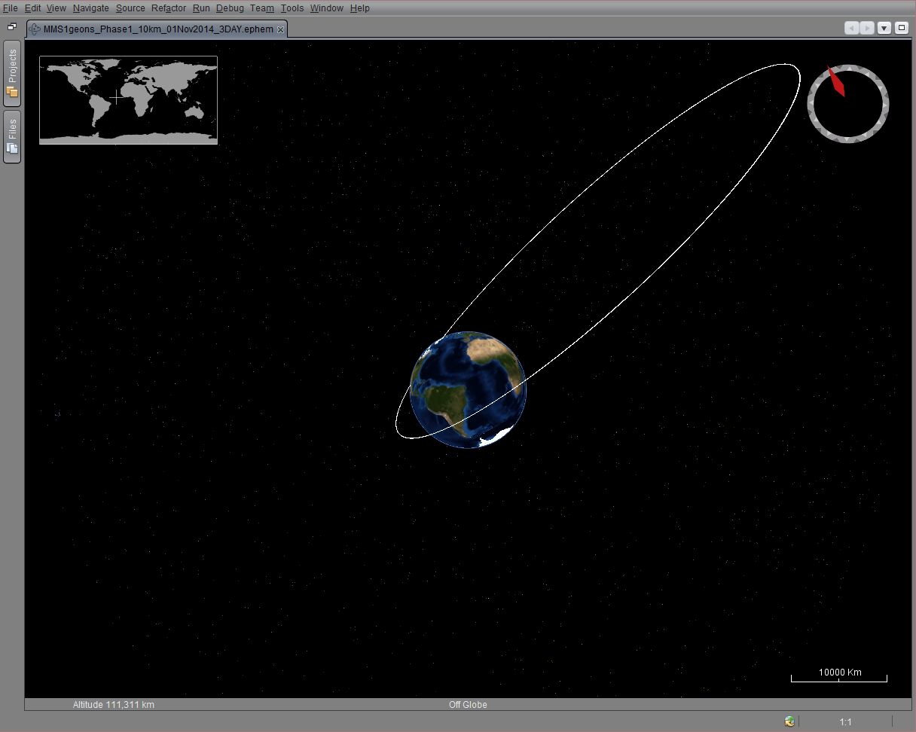
Magnetospheric MultiScale - MMS
Collects data on the Reconnection effect of the Magnetosphere, solar energy acceleration and “Space Weather”
High Earth “Molniya” Orbit
Four Spinning Spacecraft
Maneuver Planning maintains 3D Tetrahedron
Formation Self-Navigates during Science phase (GEONS)
Launched March 2015
Arrived in science orbit June 2015
Achieved Primary 3D Tetrahedral Science Formation September 2015

Slide 7
MMS Mission Complexity: Tetrahedron Formation
Daily Collision Avoidance, Telemetry QA and Navigation
Simultaneously for four spacecraft flying in a tetrahedron formation

Slide 8
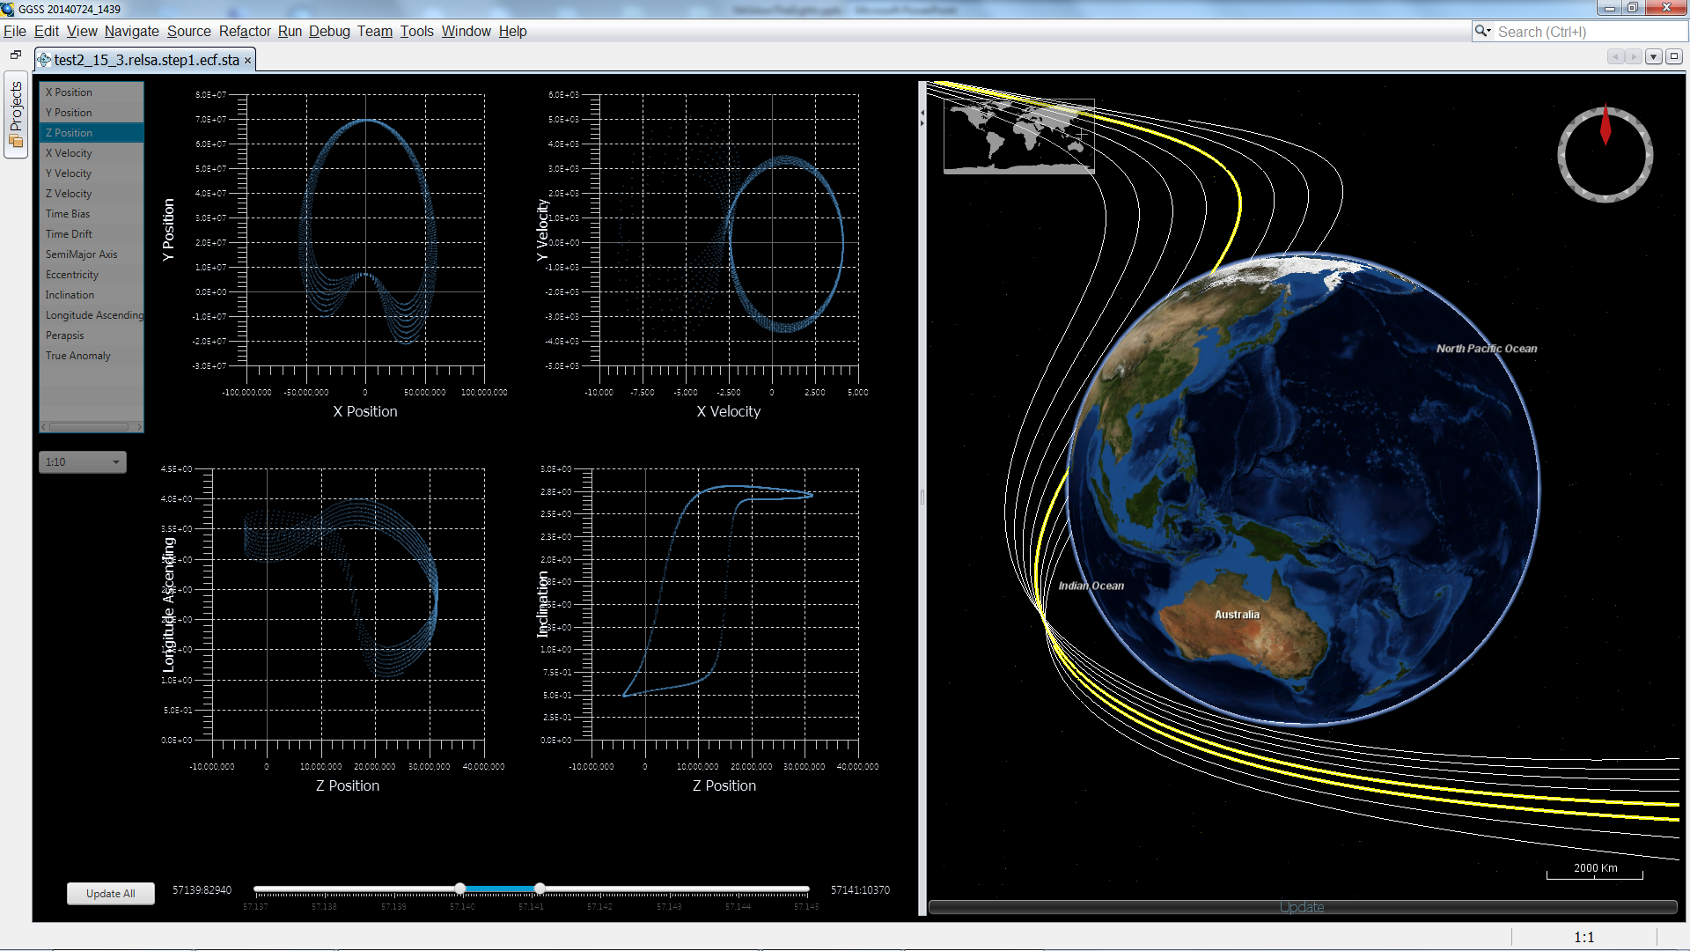
Integrated Drag and Drop Data Analysis
JavaFX provides easy drag and drop, charting, animation and concurrency.
NetBeans Platform binds visuals and file products via Lookup, Project, and Wizard APIs

Slide 9
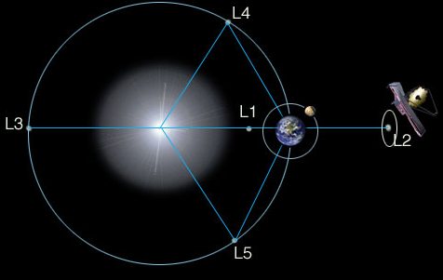
James Webb Space Telescope - JWST
Space Observatory telescope spacecraft which will succeed Hubble and Spitzer.
Earth-Sun Lagrange 2 point
Station Keeping,Orbit Determination and Attitude must maintain Halo orbit so that sun shield protects spacecraft.
Must maintain mirror and science instruments at ultra low temp (-220 c)
Scheduled Launch is Oct 2018
Ariane 5 launch system
Launch Window Analysis in process

Slide 10
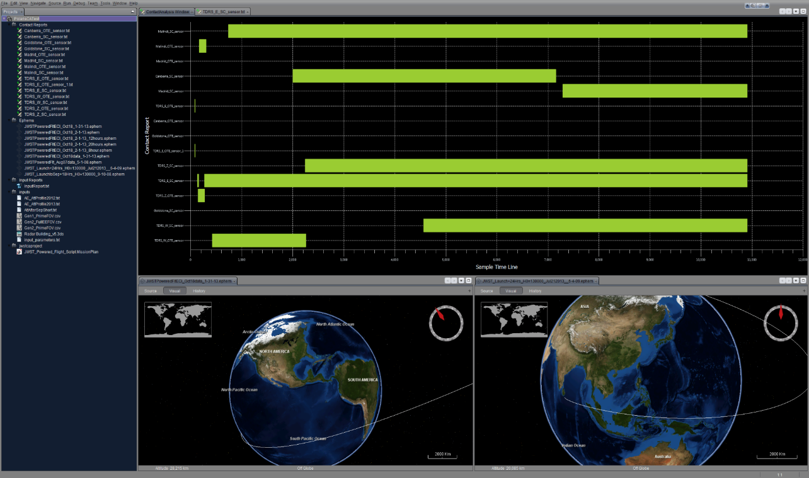
JWST: Simulation Integration and Visualization
Automates spacecraft radio contact simulation
Captures contact reports for dozens of ground and space assets
Correlates over 100K contact data points into interactive timelines.
Technologies Used:
JavaFX
WorldWind
NetBeans Platform
NetBeans Platform minimizes effort for integrating simulation processes
Combining JavaFX controls with Java 8 parallel streams reduces render times

Slide 11
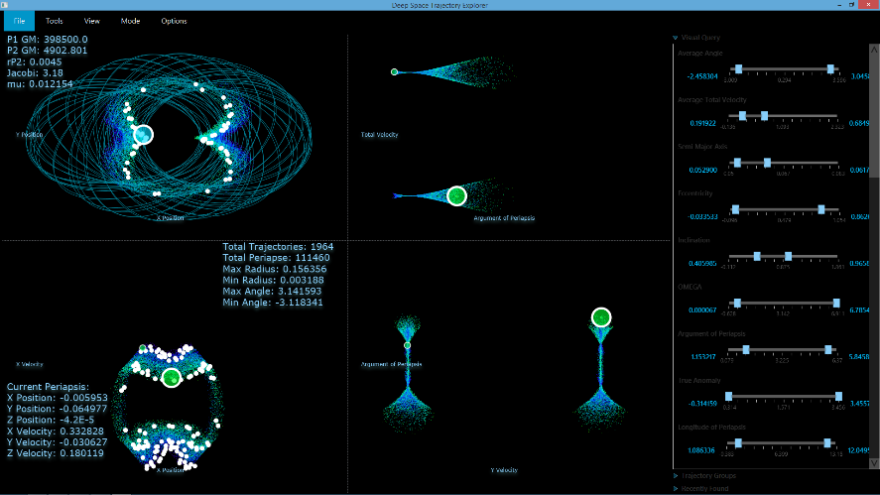
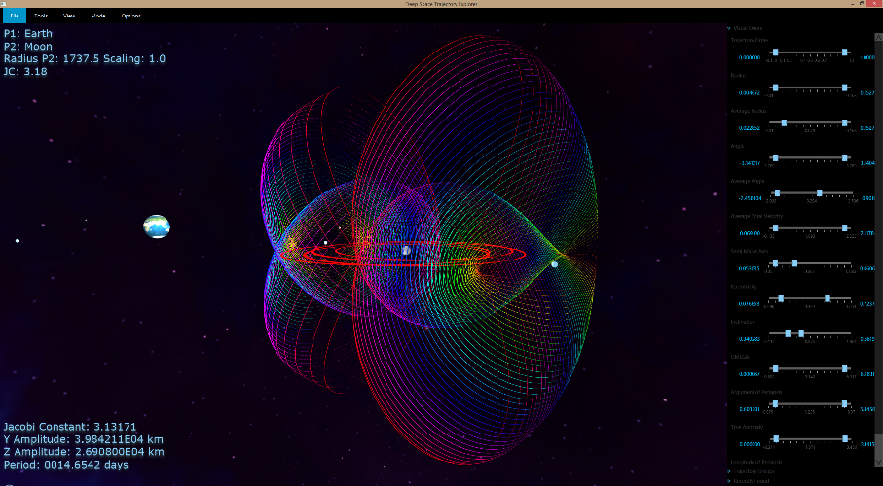
Deep Space Trajectory Explorer (DSTE)
Thousands of potential trajectories exist at any given position and energy
Data spaces to represent scenarios start in the 100Ks and go up
Interactive 2D and 3D data selection and constraint tools
Automatic trajectory generation, grouping and visualization
Ballistic Primary centered CR3BP
Planetary-Moon Halo Families
Asteroid Centered Ballistic
JavaFX 8 is the key enabling framework
High speed Canvas plots for visually interactive interface
Parallel Streams enable background search and filtering of data responsive in million point scenarios
Integrated Pure JavaFX 3D Trajectory Renderings

Slide 12
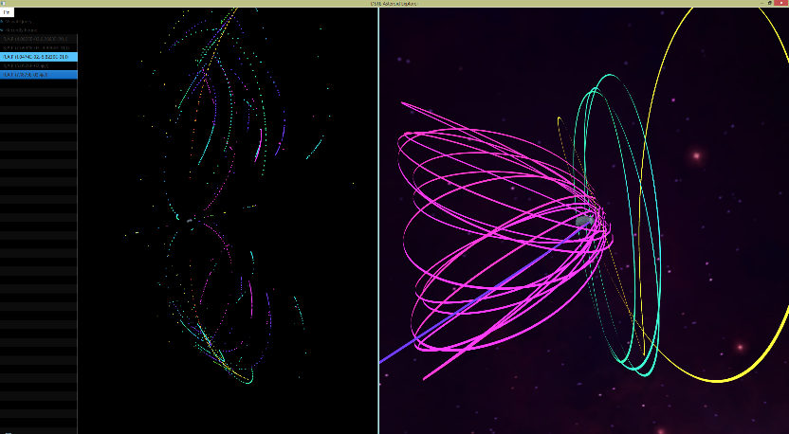
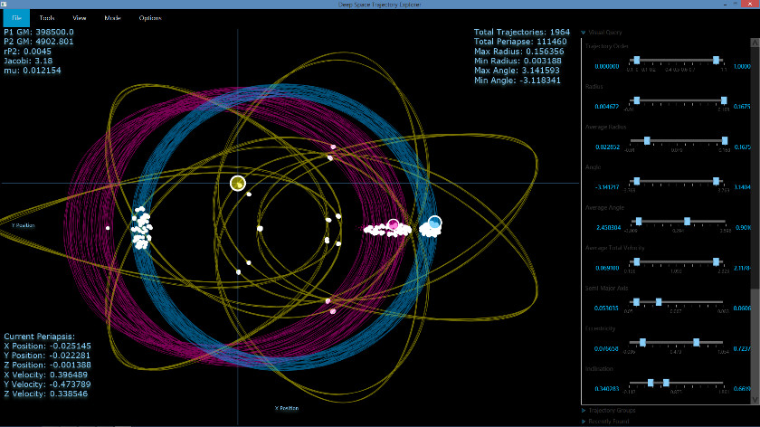
DSTE Mission Support Use Cases
Asteroid Redirect Mission trajectories (JSC)
Deep Space Planetary-Moon Ballistic Science Endgame Orbits (JPL)
Cassini (Titan, Enceladus, Dione etc)
Clipper (Europa)
Ballistic Transfer Design Space Analysis
Earth-Moon Lagrange Point Human Habitat trajectory design (GSFC/JSC)

Slide 13
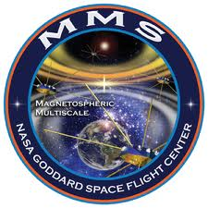
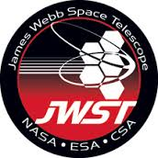
Some Interesting Space Links
a.i. solutions
http://www.ai-solutions.com/
Goddard Space Flight Center
http://www.nasa.gov/centers/goddard/
MMS Mission Site
http://mms.gsfc.nasa.gov/
JWST Mission Site
http://www.jwst.nasa.gov/
DSCOVR
http://www.osd.noaa.gov/DSCOVR/dscovr.html

