Slide 1

Scala in the Wild
Tomer Gabel, JavaOne 2015

Slide 2

Agenda
Scala in a nutshell
Bootstrapping
Practical Considerations
Ecosystem
Call to action

Slide 3

Who is this guy?
Me
System architect at Wix
Scala user since 2011
User group leader:
Underscore (Scala)
Java.IL (Java/JVM)
Organizer of Scalapeño

Slide 4


Who is this guy?
Me
Wix
System architect at Wix
Scala user since 2011
User group leader:
Underscore (Scala)
Java.IL (Java/JVM)
Organizer of Scalapeño
>70M sites
Scala shop since 2012
The usual suspects:
Microservices
Continuous delivery
Legacy Java codebase

Slide 5

Scala in a nutshell

Slide 6

Recap
You’ve heard it all before!
Statically-typed
Targets the JVM
… and JavaScript, and Android
Hybrid object-oriented/functional
Ponies, unicorns, yada yada yada

Slide 7
Executive Summary
A better Java
Less boilerplate
Less baggage
Less old and boring
New toys to play with
⇒ Happier developers

Slide 8
Executive Summary
A better Java
Gateway drug to Haskell
Less boilerplate
Less baggage
Less old and boring
New toys to play with
⇒ Happier developers
Can be functional
... if you want it to
Better abstractions

Slide 9
Executive Summary
A better Java
Gateway drug to Haskell
Less boilerplate
Less baggage
Less old and boring
Can be functional
... if you want it to
Better abstractions
New toys to play with
⇒ Happier developers

Slide 10
The Fineprint
Warts
Compilation times
Imperfect IDEs
Documentation
Debugging*
Semi-known quantity
Still pretty new
Few best practices
No style guide
New ⇒ prone to abuse

Slide 11

Bootstrapping

Slide 12
Gimme Three Steps
1. Stick with what you know
IntelliJ IDEA
NetBeans
Eclipse
gradle
maven
ant

Slide 13
Gimme Three Steps
2. Grow a hybrid codebase
Mix Scala/Java freely!
Same codebase
Same libraries
A single runtime dependency!
Guava/Guice
Spring
Hibernate

Slide 14

Gimme Three Steps
3. Keep it simple
You don’t have to go all in
In fact, you probably shouldn’t:
Language mastery takes time
Paradigm shifts take time
Start slowly and learn as you go

Slide 15

Migration Strategies

Slide 16

1. Greenfield project
Applicable for:
New projects
Self-contained
Experimental/non-critical
Assume 3-4 weeks’ overhead
Notes:
Image source: https://www.flickr.com/photos/sarairachel/7876010420 (CC)

Slide 17
2. Gateway drug
Scala rocks your tests!
Expressive syntax
DSL support
Excellent libraries
Trivial integration
Ant/Maven/Gradle…
Non-production code!
class StackTest extends Specification {
"Seq.head" should {
"throw an exception if empty" in {
Seq.empty[Any].head should
throwA[NoSuchElementException]
}
"return the first element" in {
Seq(1, 2, 3).head shouldEqual 1
}
}
}

Slide 18
3. The layered approach
Executable Container
Crawler framework
Twitter
TripAdvisor
Web framework
Dashboard
Backoffice
OpenTable
Deployment
Frameworks
Components

Slide 19
4. The silo approach
Executable Container
Crawler framework
Twitter
TripAdvisor
Web framework
Dashboard
Backoffice
OpenTable
Deployment
Frameworks
Components

Slide 20

Learning

Slide 21

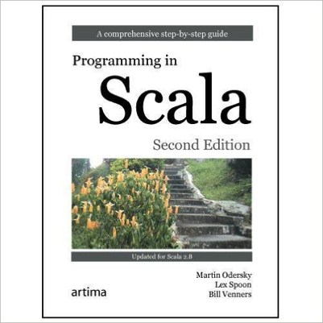
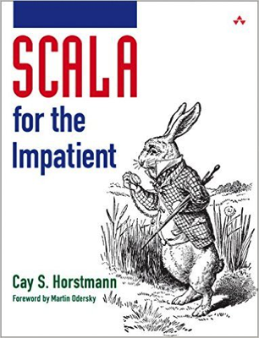
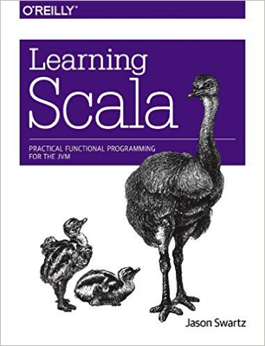
Books

Slide 22








Online Resources
Online training
The usual suspects
… and more

Slide 23

Practical Considerations

Slide 24
On Build Times
Initial Build
Compiling Scala is slow…
Incremental compilation helps. A lot
Refactoring

Slide 25


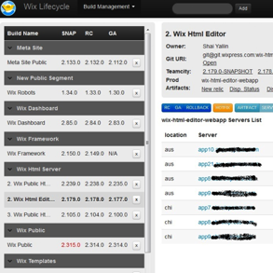
On Build Times
Development
Use IDEA
… or Eclipse
CI
Using Maven? Add Zinc
… or use Sbt
Release
Clean builds
Skip Zinc

Slide 26

Embrace Immutability
Scala makes it easy:
“val” keyword
Collections
Case classes
Do I need to reiterate why?
Easier to reason about!
Notes:
Image source: https://www.flickr.com/photos/60848944@N00/3537064556

Slide 27


Functional Madness
Scala supports functional programming
That doesn’t mean you do…
Recursion is hard
Category theory is hard
Being side-effect free is hard
Stick to what you know… for now.

Slide 28

Collective Abuse
Scala has a massive collection library
Loads of built-ins too
Case classes
Functions and partials
Tuples, tuples, tuples
Fairly easy to abuse
Notes:
Image source: http://onlinesalesstepbystep.com/wp-content/uploads/2014/08/Toppling-books.jpg

Slide 29
Collective Abuse
Anti-pattern: Too many inline steps
val actors: List[(Int, String, Double)] = // ...
def bestActor(query: String) =
actors.filter(_._2 contains query)
.sortBy(-_._3)
.map(_._1)
.headOption
What does this even do?!
How does data flow here?

Slide 30
Collective Abuse
Anti-pattern: Too many inline steps
val actors: List[(Int, String, Double)] = // ...
def bestActor(query: String) = {
val matching = actors.filter(_._2 contains query)
val bestByScore = matching.sortBy(-_._3).headOption
bestByScore.map(_._1)
}
Name intermediate steps!

Slide 31
Collective Abuse
Anti-pattern: Tuple overload
val actors: List[(Int, String, Double)] = // ...
def bestActor(query: String) =
actors.filter(_._2 contains query)
.sortBy(-_._3)
.map(_._1)
.headOption
What’s with all these underscores?

Slide 32
Collective Abuse
Anti-pattern: Tuple overload
case class Actor(id: Int, name: String, score: Double)
def bestActor(query: String, actors: List[Actor]) =
actors.filter(_.name contains query)
.sortBy(-_.score)
.map(_.id)
.headOption
Scala classes are cheap. Use them.

Slide 33
Symbolic Operators
Just because you can…
… doesn’t mean you should
What does that even mean?
s(7) <*> (s(8) <*> (s(9) ∘ add3))

Slide 34
Use the Force
scala.Option
scala.concurrent.Future
Pattern Matching

Slide 35
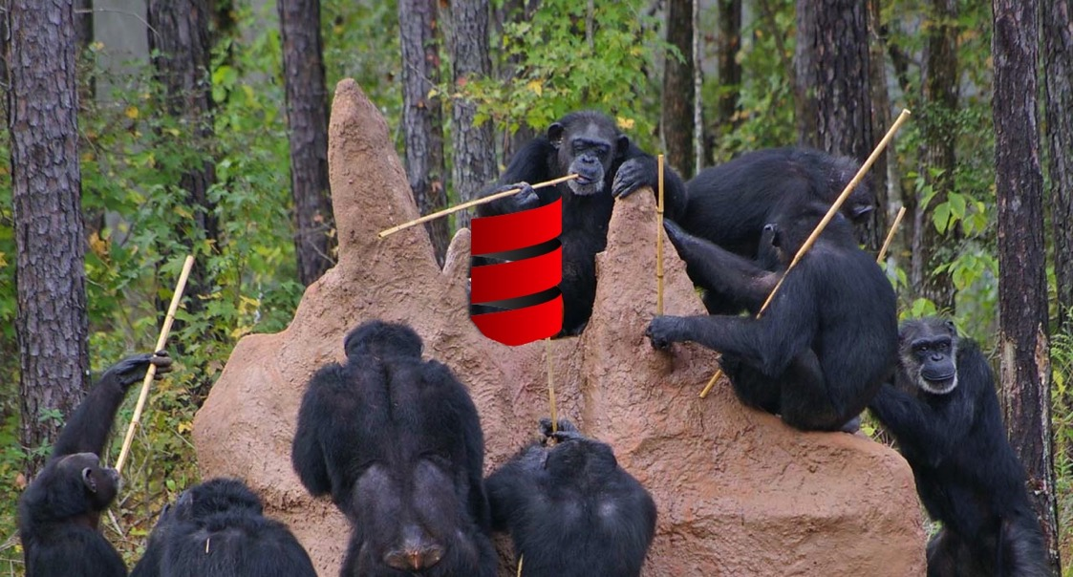
Ecosystem

Slide 36
Let’s Get Busy
The Scala ecosystem is huge
It subsumes Java’s
Also features unique offerings
Let’s discuss a few…

Slide 37



Testing

Slide 38



Web Servers

Slide 39



Microservices

Slide 40
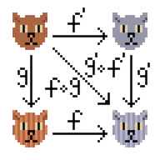
Cautionary Tale
Beware scalaz and cats
Both are amazing
Both do a lot
But they’re quite advanced
… and poorly documented
Remember: YAGNI

Slide 41

A Word on Akka
Akka is fantastic
High performance
Full-featured
Great libraries (akka-http)
But: is the actor model for you?
Remember: YAGNI

Slide 42

Call to Action
Last but not least…

Slide 43
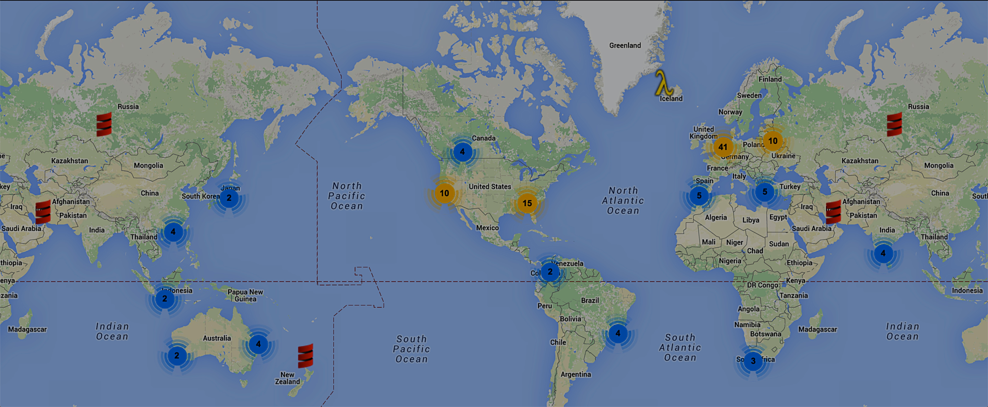
Participate!
>120 User Groups worldwide! http://scala.space

Slide 44
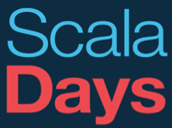







Participate!

Slide 45


We’re done here!
tomer@tomergabel.com @tomerg
http://il.linkedin.com/in/tomergabel
Time to push the green button :-)

