Slide 1
CON5364 Security on Java-based IoT Gateways
Luca Dazi Marco Carrer

Slide 2
Disclaimer
This presentation has been prepared by Eurotech S.p.A. (or “Eurotech”) and has to be read in conjunction with its oral presentation.
The information contained in this presentation does nor purport to be comprehensive. Neither Eurotech nor any of its officers, employees, advisers or agents accepts any responsibility for/or makes any representation or warranty, express or implied, as to the truth, fullness, accuracy or completeness of the information in this presentation (or whether any information has been omitted from the presentation) or any other information relating to Eurotech, its subsidiaries or associated companies, whether written, oral or in a visual or electric form, transmitted or made available.
This document is confidential and is being provided to you solely for your information and may not be reproduced, further distributed to any other person or published, in whole or in part, for any purpose.
The distribution of this document in other jurisdictions may be restricted by law, and persons into whose possession this document comes should inform themselves about, and observe, any such restrictions.
This document is directed only at relevant persons. Other persons should not act or rely on this document or any of its contents.
No reliance may be placed for any purposes whatsoever on the information contained in this document or any other material discussed during this presentation, or on its completeness, accuracy or fairness.
The information in this document and any other material discussed at this presentation is subject to verification, completion and change.
The information and opinions contained in this document are provided as at the date of the presentation and are subject to change without notice.
Some of the information is still in draft form and will only be finalized.
By attending the presentation you agree to be bound by the foregoing terms.
Trademarks or Registered Trademarks are the property of their respective owners.

Slide 3
Agenda
Threats on the Gateway side of an IoT system
Security Blueprints
Eclipse Kura and its Security Model
Advanced Security in Eurotech Software Framework
Security in Device Management
Q&A

Slide 4
IoT Security
Attackers / Hackers Targets
Quality, Performance, Availability, Reputation
Service interruption & malfunction
Manipulation of equipment, actuators
Damage to image and financial results
Know-How, Intellectual Property
Data
Code
Process information
Resources
Systems / distributed systems
Bandwidth
Attackers / Hackers Profiles:
Hackers (white hat)
Cracker (black hat, criminal)
Script Kiddies
Competitors
Criminal Organizations
Governments
Harm,
Steal,
Play

Slide 5
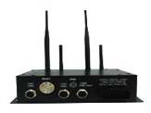
Reference IoT Architecture
All levels:
Authentication / root of trust
Integrity / hardening of solution
Efficiency (unattended, distributed)
Best practice processes
Application
Layer
Communication
Infrastructure
API´s
Communication channels / sessions
Application
Infrastructure
M2M
Integration
Platform
M2M/IoT Integration Platform
Deployment options / infrastructure
SW architecture and elements
Communication
Infrastructure
Security End-to-End
Communication channels / sessions
SSL/TLS
Pairing
Infrastructure security aspects
- SIM card management
MQTT
Client
Field Infrastructure
Multi-Service Gateway
Hardware
SW architecture and elements
Device HW
Field technology, protocols, communication

Slide 6
IoT Gateways
Duties
Hardware and Field Abstraction
Sensor Connectivity
I/O Access
Manage Network and Connectivity
Wireless Modems, Firewall, Wi-Fi Hotspot, VPN
Online / Offline mode
Manage Applications
Remote Start/Stop, Install/Uninstall of applications
Remote Configuration Management and Snapshots
Manage IoT Connectivity
MQTT / CoAP Connections
Data Buffering and Retries
Provisioning, Credentials and Certificates

Slide 7
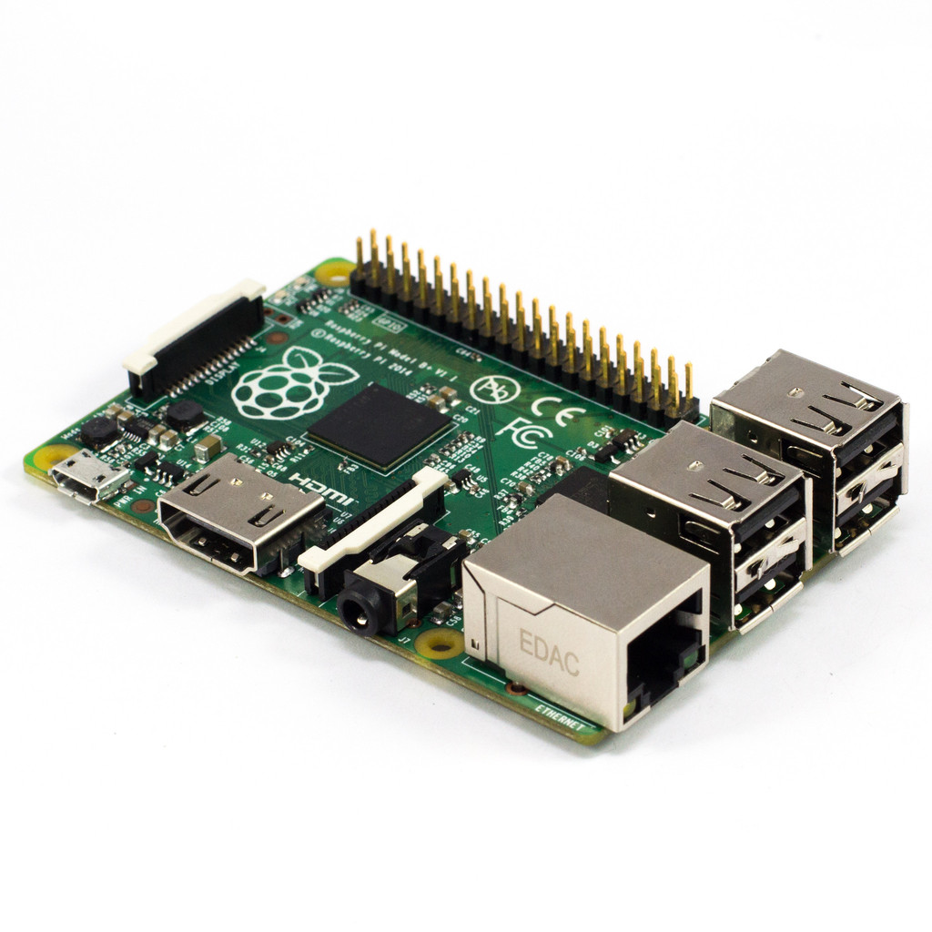
Security Threats for IoT Gateways
Software Tampering
Phisical Tampering
Man in the Middle
Device Tampering

Slide 8
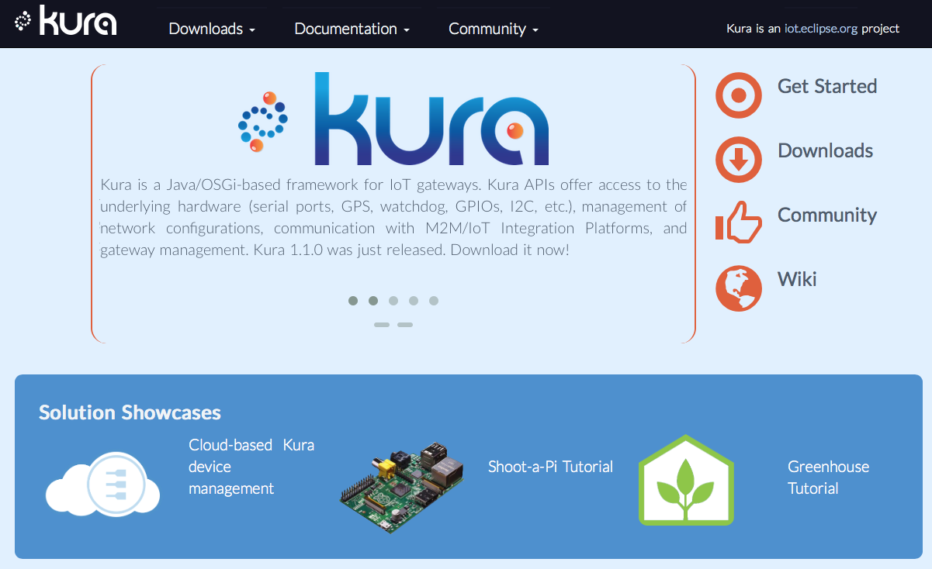
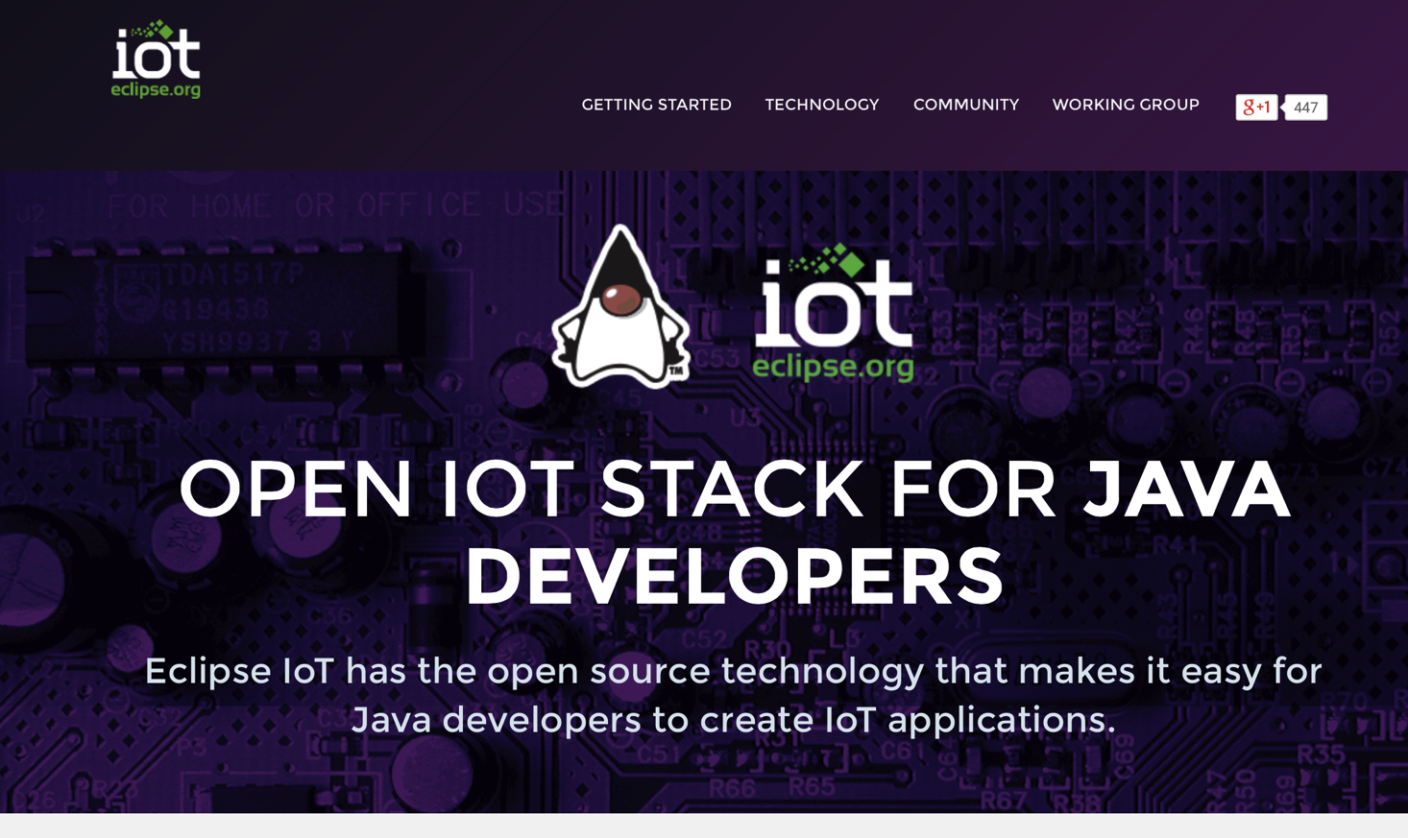
Eclipse Kura
Open Java Framework for IoT Gateways
www.eclipse.org/kura/
iot.eclipse.org/java/

Slide 9
Eclipse Kura
Applications
Remote Access
Your Application
Your Application
Connectivity and Delivery
Field Protocols
Cloud Services
Data Services
MQTT Paho
ModBUS
Updates
Management
Network Configuration
Remote Management
Network Configuration
Administration GUI
CAN bus
Cellular, Wi-Fi, Ethernet
Firewall, Port Forwarding
Network Monitors
Configuration
Management
Basic Gateway Services
DB Service
Device Profile
Custom Protocols
Clock Service
Watchdog
Security
Security Manager
Certificate Manager
SSL Manager
Provisioning
Device Abstraction
javax.comm / RS-485
javax.usb + udev
GPS Position
GPIO / SPI / PWM / I2C jdk.dio
javax.smartcardio
Java USB HID APIs
javax.bluetooth / BLE
OSGi Application Container (Eclipse Equinox, Concierge)
OpenJDK 7, Oracle Java SE 7 Embedded
Notes:
What we used in the Eclipse IoT demo.

Slide 10
Information Security
Information is always available to authorized people when required
Information is protected from accidental or malicious tampering
Availability
Integrity
INFORMATION
Confidentiality
Information and hardware resources access is limited to authorized people

Slide 11
Eclipse Kura Security Model
Offers APIs to manage security policies and start script consistency
Certificate Service API
APIs used to retrieve, store and verify certificates for SSL, Device Management, Bundle Signing
Security
Service API
Crypto
Service API
SSL Manager API
APIs used to manage the SSL certificates, trust stores, private and public keys
APIs used to encrypt and decript secrets, and to retrieve the System Master Password
Notes:
What we used in the Eclipse IoT demo.

Slide 12
Everyware Software Framework (ESF)
A Short History
0.7.0
2.0.9
on
ESF has Kura at its Core.
on
ESF-only components:
Commercial Support
Advanced Security
Remote Access via VPN
Diagnostics
Field Protocols
Bundles for specific vertical applications
1.1.0
Java/OSGi
Linux OS
on
3.0.0
on
1.1.1
Java/OSGi
Linux OS
on
Versions kept aligned

Slide 13
ESF Advanced Security
Applications
Java/OSGi Security
Signed Bundles
Integrity
Authenticity
Security Manager
Environment Integrity
Runtime Access Policies
Allowed Jar / Bundle Signatures
Allowed Services Invocations
Encrypted Configuration Storage
Device Unique Master Password
Certificate Manager
Remote Certificate Management
Management Platform Signature Validation
Integrity
Authenticity
SSL Manager
SSL Socket Factory Configuration
SSL Hostname Validation
SSL Mutual Authentication
Eclipse Kura
ESF Bundles
ESF Security
ESF SSL Manager
ESF Certificate Manager
ESF Security Manager
OSGi
Java SE Embedded
JKS ESF
JKS SSL
Encrypted Configuration Snapshots

Slide 14
ESF Security Features
Advanced Crypto Service – Startup
Advanced Crypto Service Implementation
Startup
Retrieve Master Password
Check Environment Consistency
Start Crypto Service
Decrypt Configuration
Advanced Crypto Service is responsible for checking framework security policies, storing secrets, retrieving them and managing encrypting and decrypting of passwords and keystores.

Slide 15
ESF Security Features
Security Service
Security Service Implementation
Crypto Service
Open Custom Policies File
Check Policies Consistency
Apply the Policies
Check Start Script Consistency
Security Service is responsible for checking the framework policies and applying them. Standard OSGi and Java policies are evaluated. The service also checks for start script tampering.

Slide 16
ESF Security Features
Advanced Crypto Service – Bundles and Services
Advanced Crypto Service Implementation
Certificate Service
Bundle Signatures
OSGi Services Permissions
Import/Export Permissions
File access Permissions
Advanced Crypto Service is also responsible for checking signatures of all the OSGi Bundles, for assuring Service availability and giving access to files and packages only to authorized Bundles.
Ready

Slide 17
ESF Security Features
SSL Manager Service
SSL Manager Service Implementation
Connect
Crypto Service
Retrieves SSL Trust Certificate
Builds SSL Socket Factory
Install new Trust Certificate
Install new Private Key for Mutual Auth.
Web UI
DM
SSL Manager Service is responsible of building SSL Socket Factories and storing/retrieving of SSL Trust Certificates. Standard Eurotech Trust Certificate is pre-installed in the devices.
Ready

Slide 18
ESF Remote Management
Overview
Secure Management the M2M/IoT Gateway Middleware
Provisioning
Bundle Updates
Service Configuration
Remote Executions
Batch Updates
Based on OSGi; transparent to the developer
Management of the Device
Full Remote Access
Monitor and Diagnostics
Firmware Updates
One Protocol for Telemetry and Device Management
Single protocol
Single security
Simplified deployment
Simplified management
MQTT
Protocol
Notes:
Device Firmware/Software Updates
Did the device get the update? When? Was it valid & installed?
Configuration Updates
Same Questions…
Remote Resource Control/Interaction
Device management/Backend business logic needs to start/stop/interact with a device side service
Control of actuators
Dynamic status requests
Remote Command execution
Remote Service Control/Interaction
Other considerations
Extensibility, mutitenancy, client addressing, multiple applications, resource management…

Slide 19
ESF Remote Management
Certificate Manager Service
Crypto Service
Provisioning
Certificate Manager Service Implementation
Stores Device Management Certificate
DM Message Received
Verifies DM Message signature
Get SSL Certificate
Connect
Certificate Manager Service is used to get the certificates for SSL communication and to verify the signature of Device Management messages coming from the Cloud

Slide 20
ESF Remote Management
Secure and Signed Communication
Signed MQTT
Message
Guarantees
Integrity
Authenticity
Non-repudiation of origin
Certificate Management
Dedicated administrative web panel
Standard X509 certificate format
Certificate chain support
Certificate validations and export functionalities
Trusted message server signed digest over MQTT
EDC jobs to provision, update and revoke certificates
Signed Digest
MQTT Message Payload
Everyware Cloud (Remote Server)
ESF Security
PKI - Certificate Management
ESF Security Bundles
EDC Public Certificate
EC Public Certificate
EC Private Key

Slide 21
Everyware Cloud
Device Provisioning
Administrator
Application Integration
IoT Analytics Integration
3
Device Management
1
Device Connectivity
Big Data Management
Administration
2
on
Complex Event Processing
Platform & Security Management
4
Gateway
Administrator creates a Provision Request
Device connects to the provision account and sends a provisioning message
Platform checks for a valid provision request for the device
Platform executes provision job sending the device:
Platform certificate for secure communication
New device configuration
The device applies new configuration and connects under target account

Slide 22
DNSSec
Device Provisioning
Provision request
Everyware Cloud
DNSSEC Server
New entry request
Common Name
Common Name
Certificate and Private Key creation
Certificate
Certificate
Store Certificate and Common Name

Slide 23
DNSSec
Device Authentication
Connection Req.
Everyware Cloud
DNSSEC Server
Common Name
Certificate
SSL Authentication
SSL Authentication

Slide 24
Summary
Device has a validated identity
IoT platform has a validated identity
Mutual authentication for communication
Signed messages over an encrypted channel
Secure execution environment (devices & IoT platform)
Secure software management / distribution
State-of-the art network & system security (firewall, hardening)
Secrets stored in encrypted files
Custom Security Policies for Bundles, Services, Packages, Files

