Slide 1


WebRTC With Java
Binod PG, Architect, Oracle
Amitha Pulijala, Oracle Product Management
Communications Business Unit
October 27, 2015
Copyright © 2015, Oracle and/or its affiliates. All rights reserved. |

Slide 3
Program Agenda
1
WebRTC Introduction
WebRTC Architecture Components
Java in WebRTC Eco-System
Common Development/Architecture Issues
Demo
2
3
4
5

Slide 4







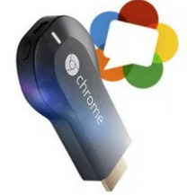
Real Time Communications Meets The WEB
A state-of-the-art audio/video/data communication stack in your WEB*client
Communications at web speed
Billions of end-points
Allows communications to be integrated into the “web” experience
Voice
Browsers
Video
Data
Mobile
Machine to Machine/Embedded
*WEB here is referred in a broader sense than just browsers
Notes:
Icon made by Freepik from www.flaticon.com

Slide 5








Communications as a feature
Screen Share
Context Awareness
Personalized Service
Connected Interactions
Rewarding Relationship
Chat
Document
Share
Audio/Video Call
Audio
Video
Data
Connecting Customer’s journey through your application with Communications

Slide 6
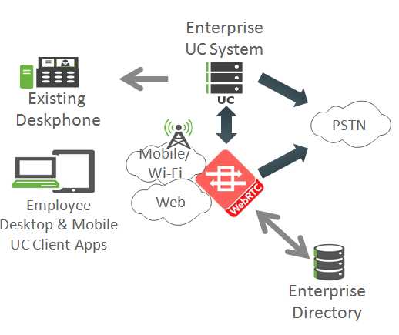
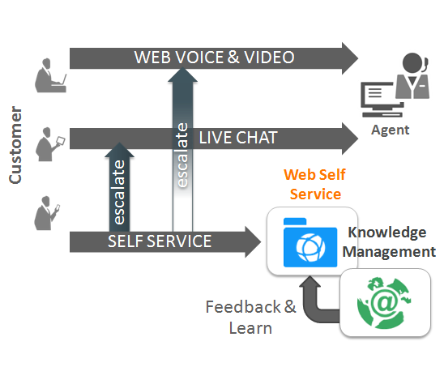
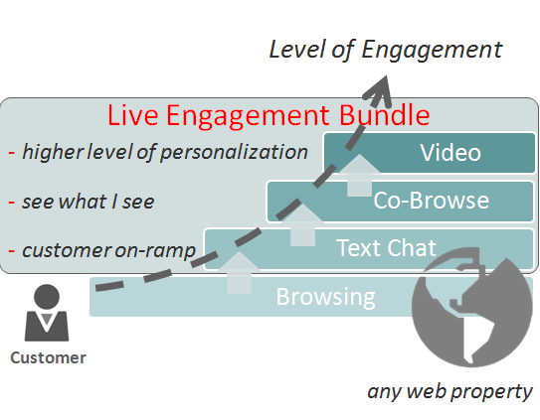
WebRTC Enabling Enterprises to Create Value for Customers
Web Customer Service
Advanced Customer Experience
Unified Communications
Offer faster web-based service tools where most interactions with a business begin, on the Web
Offer a ‘Mayday Bundle’ for advanced live engagement, but make it available for any website across any devices
Provide BYOD mobile UC clients to employees as an extension of existing desk phone experience for mobility & remote worker

Slide 7
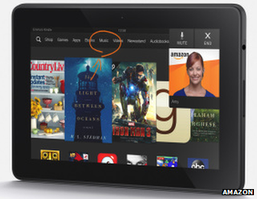



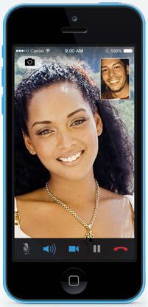
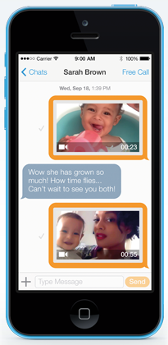

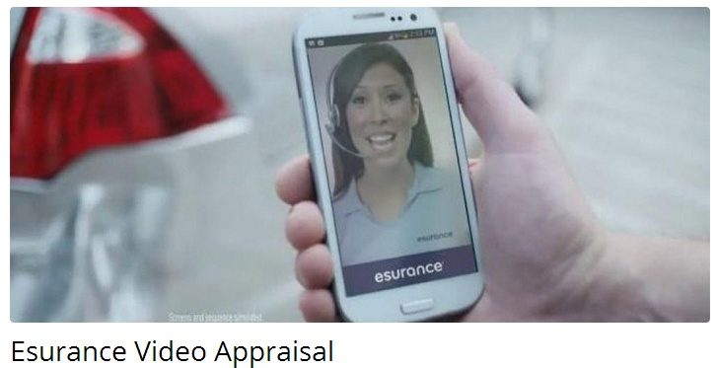
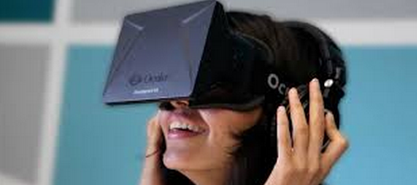
WebRTC Services
Video Calling
Video Messaging

Slide 8

What Does WebRTC Really Provide?
WebRTC 1.0
WebRTC.org
Lowers Technology Barriers
Lowers Technology
Barriers
WebRTC 1.0
WebRTC.org
IETF + W3C
Standards Specifications
Software Stack
NAT Traversal
Secure Media
Data Transport
Free, Open Source
Media APIs & SDK
Media Codecs
No Plug-ins

Slide 9
Agenda
1
WebRTC Introduction
WebRTC Architecture Components
Java in WebRTC Eco-System
Common Development/Architecture Issues
Demo
2
3
4
5

Slide 10


WebRTC Simple View
Signaling
Signaling
Media (SRTP)
App
App

Slide 11







WebRTC Server-Side Considerations
Identity
Media
Mixing
Push Notifications
Signaling
Media
Transcoding
Reliability
Reliability
WebRTC
PSTN
/SIP Trunk
STUN
NAT Traversal
Interworking
Notification
GW
TURN
Signaling and Media GW
Notes:
Icon made by Freepik from www.flaticon.com

Slide 12



WebRTC “Real-World” Architecture
WebRTC Session Controller
Signaling Engine
APNS, GCM
Identity Server
Web Server
REST
Notification Server
SIP
Signaling Normalization
JSON/ WebSocket
PSTN Gateway
REST/ JSR 309
JSON/ WebSocket
App
Media Engine
Media Normalization
RTP
SRTP
Browser
Transcoding
MCU/SFU
SRTP
STUN/TURN
RTP
Notes:
Icon made by Freepik from www.flaticon.com

Slide 13










WSC Client-Side Considerations
HW
Platforms
Browser Compatibility
Browser
Mobile
IE /Safari
HW
acceleration
Codec
Support
Quality
WebRTC
Audio
Fall back
JS SDK
Frameworks
SDK
UX/CX
Device
Handoffs
Native SDK
“Look & Feel”
Notes:
Icon made by Freepik from www.flaticon.com

Slide 14




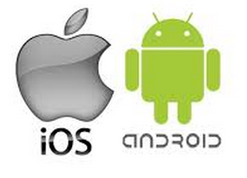

WebRTC Client Side SDK
Broader client side reach – Native, Browsers, versions, hardware architectures
Non-WebRTC Browser support
Consistent feature evolution across native and browser SDKs
Application specific signaling extensions and optimizations
SDK
32
SDK
64
Oracle WebRTC SDK: http://www.oracle.com/technetwork/developer-tools/webrtc/overview/index.html
Notes:
Icon made by Freepik from www.flaticon.com

Slide 15
Program Agenda
1
WebRTC Introduction
WebRTC Architecture Components
Java in WebRTC Eco-System
Common Development/Architecture Issues
Demo
2
3
4
5

Slide 16

Typical Web Application
JSF JSP JAX-RS
WebSocket MVC
HTTP Traffic
Java EE Server handles HTTP Requests.

Slide 17
WebRTC is a W3C JavaScript API in the Browser
JavaScript API
Protocols
Acquire Audio and Video
Communicate Audio and Video Streams
Communicate Arbitrary Data (Text, File

Slide 18
RTCMediaStream
RTCPeerConnection
Represents stream of audio or video
Stream from camera or microphone
Navigator.getUserMedia
Fundamental block of WebRTC API
Represents Communication with a Peer
Codec, Security, Bandwidth etc etc.
HTML App
SDP
PeerConnection
RTCPeerConnection
Browser

Slide 19
WebRTC API is in browser
How to get two PeerConnections to communicate?

Slide 20
Add WebRTC to your Java EE Web Application
JSF JSP JAX-RS
WebSocket MVC
WebRTC
Signaling
WebRTC
Signaling
HTTP Traffic
HTTP Traffic
Media (SRTP)

Slide 21
JSEP (JavaScript Session Establisment Protocol
JSF JSP JAX-RS
WebSocket MVC
WebRTC
Signaling
WebRTC
Signaling
HTML App
HTML App
SDP
SDP
PeerConnection
PeerConnection
RTCPeerConnection
Media (SRTP)
RTCPeerConnection
Browser
Browser

Slide 22


WebRTC Signaling Choices
JAX-RS + SSE
Standard Paradigm
Wait for incoming (eg: disconnect) messages
How about incoming calls?
Java API for WebSocket (JSR 356)
Bi directional
Suits communication signaling
Signaling
Signaling
Media (SRTP)

Slide 23


WebRTC in Web Application (Add a WebSocket Endpoint)
javax.websocket.server.ServerEndpoint
onOpen()
onOpen()
onMessage(offer)
Session.getBasicRemote().sendText(offer)
Session.getBasicRemote().sendText(answer)
onMessage(answer)
<Candidate Exchange>
<Candidate Exchange>
Media (SRTP)

Slide 24

Extend Communication To Legacy Phone Networks
SIP Servlet 2.0 API (JSR 359)
Integrates with Java EE 7
Allows you to connect with traditional SIP networks
Also supports SIP over WebSockets
voice

Slide 25
WebRTC to SIP with SIP Servlets
ServerEndpoint + SipServlet
onOpen()
onMessage(offer)
SIP INVITE (offer)
Session.getBasicRemote().sendText(answer)
SIP/183 (answer)
<Candidate Exchange>
SIP/INFO/OK (candidate)
Session.getBasicRemote().sendText()
SIP/200 ()
Media (SRTP)

Slide 26
How about Conferencing?
Media Mixer / SFU
Media Server Control API
Server Side Java API (JSR 309)
Abstract Interaction with Media Server
Dialogic, Radisys
Connect your ServerEndpoint with a Media Server
voice, Video
Voice, Video
Voice, Video

Slide 27
Media Server Control with WebRTC
WebRTC
Signaling
WebRTC
Signaling
WebSocket App
(ServerEndPoint)
WebRTC
Signaling
JSR 309
PeerConnection
MediaGroup
(Record, Play, DTMF)
MediaMixer
NetworkConnection
Media Server

Slide 28

How about a MicroService for WebRTC?
Java EE
Server
WebRTC
Server
Jax-RS/RxJava
WebRTC
Signaling
WebRTC
Signaling
Http Traffic
Http Traffic
Media (SRTP)

Slide 29

WebRTC in Android
WebRTC Java Binding
RTCPeerConnectionFactory
https://chromium.googlesource.com/external/webrtc/
Google’s open source project
Matches with W3C JavaScript API

Slide 30

WebRTC in Android - Architecture
Android App
WebRTC Java Binding (webrtc.org)
Java WebSocket Client
(eg: Tyrus)
WebRTC Stack (webrtc.org)
Android Platform

Slide 31
Initiate a WebRTC call in Android
PeerConnectionFactory pcf = …;
PeerConnection pc = pcf.createPeerConnection(iceSrvrs, constraints, obsrvr);
pc.addStream(localStream); //add the stream from local camera/mic
pc.createOffer(this, offerConstraints);
public void onCreateSuccess(final SessionDescription offer) {
sendMessage(offer) ; // send on signaling channel
}

Slide 32
Java WebRTC SDKs for Android
Android App
WebRTC Java SDK (eg: WSC)
WebRTC Java Binding (webrtc.org)
Java WebSocket Client
(eg: Tyrus)
WebRTC Stack (webrtc.org)
Android Platform
Similar stack exists for IOS as well

Slide 33
Program Agenda
1
WebRTC Introduction
WebRTC Architecture Components
Java in WebRTC Eco-System
Common Development/Architecture Issues
Demo
2
3
4
5

Slide 34
Security, Authentication and Authorization
Java EE
Security
WSS
(Signaling +
Identity
Assertion)
WSS
(Signaling +
Identity
Assertion)
Identity
Provder
Verify Assertion
Get Assertion
Media (DTLS/SRTP)
Alice
Bob

Slide 35
Peer Authentication
Alice calls Bob
Alice’s browser fetches assertion from IDP (JAX-RS)
Alice’s browser app sends the assertion to Bob (Java WebSocket)
Bob’s browser verifies the assertion (JAX-RS)
Bob’s browser displays authorization
Bob accepts the call

Slide 36


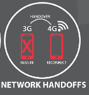
Session Connectivity and Reliability
Customers expect a seamless experience across
Web-style Browser reloads
Web-style “Back Button” navigation
Native app crashes
IP network connectivity changes (WiFi <-> 4G)
Device Handoffs
Server-side failures
This can be solved using the concept of Session Rehydration
Ability to keep the session alive when connectivity is interrupted and recreate it as soon as the connectivity is re-established

Slide 37
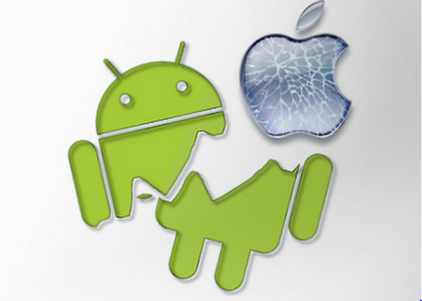
Session Rehydration
In the event that the local app state is reinitialized, either due to a user reload of the page, or a decision within the app to reload itself it is possible to keep an existing session alive, via a process called "rehydration“
Inspired by the approach described in IETF rtcweb-jsep-03 draft
Upon reconnect, resurrect the session (voice, video, Data Channel)
Client Information (sessionId etc) is stored in LocalStorage
Completely reliable signaling protocol
WebSocket connection is kept for a short time and the message resynchronization happens when clients is reconnected
Restart ICE procedures, send new SDP

Slide 38


The World is a Chatty Place!
Customers expect to stay “engaged” when they wander away from the app without draining device resources – battery power
This can be solved by:
Optimizing the WebSocket connections with Push Notifications
Hibernation of the session during periods of inactivity
Session rehydration upon wake up/ call resume
Mobile Push Notification Gateway
Manages connectivity to APNS, GCM; registers and activates multiple apps
Supports templates
Delivers push notifications to iOS and Android
Chrome Push Notifications – Service Worker, W3C API
On desktop and mobile browsers
WebRTC server uses JAX-RS to send messages to notification server

Slide 39
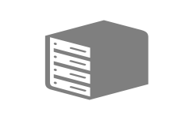

Is network that simple? No!
WebRTC
Signaling
WebRTC
Signaling
TURN Server
Media (SRTP)
Media (SRTP)
NAT
NAT
STUN
STUN

Slide 40

WebRTC with Java
SIP
Network
SIP Servlet 2.0
JAX-RS
Notification Server
Java Media Server Control API
Java API for WebSocket
Java API for WebSocket
Identity
Provider
Servlet, JSF, JAX-RS, MVC
Servlet, JSF, JAX-RS, MVC
Conference
Server
JAX-RS
JAX-RS
Android
Java Binding

Slide 41
Additional Developer Resources
Oracle WebRTC Developer Page : http://www.oracle.com/technetwork/developer-tools/webrtc/overview/index.html
Oracle WebRTC Session Controller: http://www.oracle.com/us/products/applications/communications/web-rtc-session-controller/overview/index.html
Oracle WebRTC Documentation: http://docs.oracle.com/en/industries/communications/webrtc-session-controller/index.html
Sandbox (partner maintained): http://tadhack.optaresolutions.com/

Slide 42
Demo
Notes:
This slide can also be used as a Q and A slide

Slide 43
Session Surveys
Help us help you!!
Oracle would like to invite you to take a moment to give us your session feedback. Your feedback will help us to improve your conference.
Please be sure to add your feedback for your attended sessions by using the Mobile Survey or in Schedule Builder.

