Slide 1
Smart Open Spaces Powered by Java ME, Java SE and Single Board Computers
Jorge Hidalgo & Julio Palma
JavaOne Conference – CON6489 – October 2015
Notes:
Hello,
Wellcome everybody to our conference sesión six thousand four hundred eighty nine, Smart Open Spaces.

Slide 2
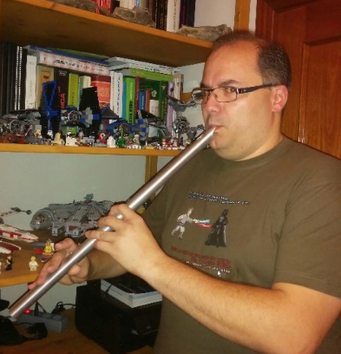
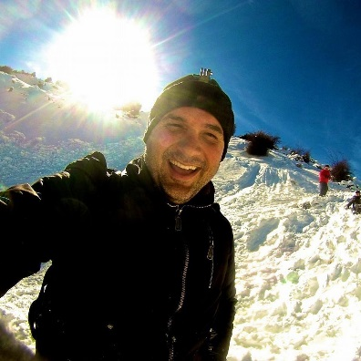
Presenter Introductions
Jorge Hidalgo @_deors http://deors.wordpress.com
Senior Technology Architect – Accenture Delivery Center in Spain
Capability Lead – Custom Distributed & Architecture domain
Father of two kids, husband, whistle player, video gamer, sci-fi junkie, Raspberry Pi fan, gadgets maniac... My other car is a Millenium Falcon.
Julio Palma @restalion
Technology Architect – Accenture Delivery Center in Spain
Team Lead – Custom Distributed & Architecture domain
Mountain biker, SW & LOTR fan, gamer, Nyarlathotep enemy, father of two kids who show me something new every day, husband. In my spare time I work at Accenture.
Notes:
My name is Julio Palma, I’m Technology Architect from Accenture based in Málaga, in Spain.

Slide 3
Objectives for the Session
Describe Open Spaces and common use cases
Introduce the proposed Architecture
Highlights of how the solution works
Examples
Live Demo

Slide 4
What are Open Spaces and common use cases

Slide 5

Smart Open Spaces
Notes:
To help us to visualize this problem I need help from a friend of mine.
Let me introduce you Mark. He's very excited in his new role as an open space manager.

Slide 6


Smart Open Spaces
Notes:
As an Open Space Manager he needs to manage spaces with a little number of customers …

Slide 7
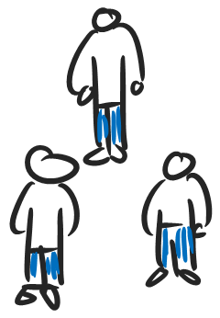
Smart Open Spaces
Notes:
... and others with a huge amount of them.

Slide 8

Smart Open Spaces
Notes:
Customers can be indoors ...

Slide 9
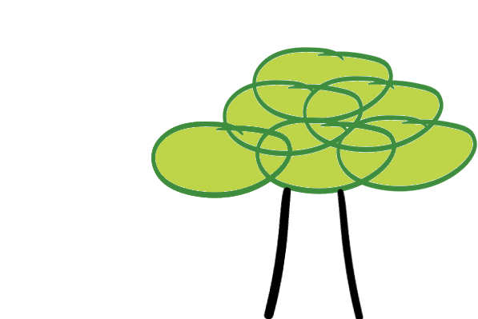
Smart Open Spaces
Notes:
... or outdoors

Slide 10

Smart Open Spaces
Department stores, smaller stores, hypermarkets
Notes:
He is not restricted to one specific industry, he can manage
Department stores, smaller stores, hypermarkets

Slide 11
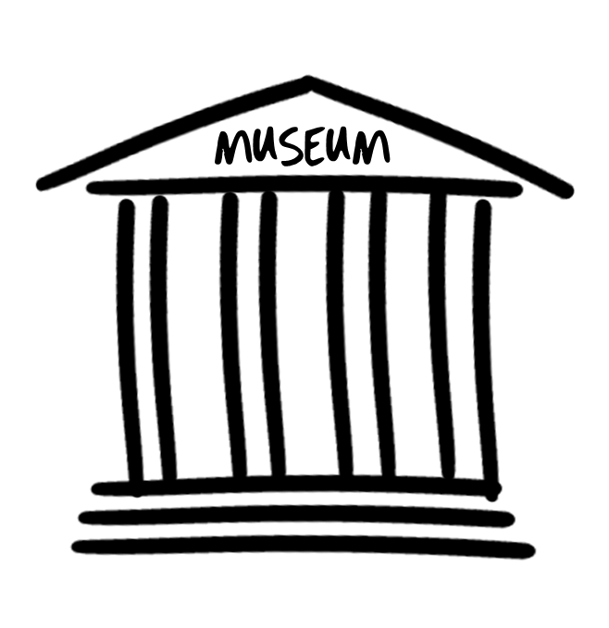
Smart Open Spaces
Museums, airports, train/bus stations
Department stores, smaller stores, hypermarkets
Notes:
Museums, airports, train/bus stations

Slide 12
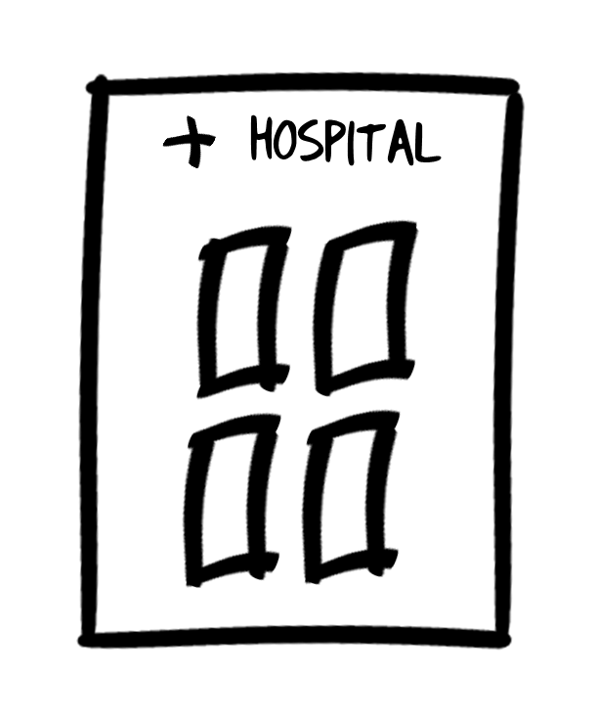
Smart Open Spaces
Museums, airports, train/bus stations
Department stores, smaller stores, hypermarkets
Hospitals
Notes:
City downtowns, hospitals

Slide 13
Smart Open Spaces
Museums, airports, train/bus stations
Department stores, smaller stores, hypermarkets
Hospitals
Manufacturing plants, oil rigs
Notes:
Manufacturing plants, oil rigs

Slide 14
Smart Open Spaces
Museums, airports, train/bus stations
Department stores, smaller stores, hypermarkets
Hospitals
Manufacturing plants, oil rigs
Offices
Notes:
and, of course, offices

Slide 15
Smart Open Spaces
Museums, airports, train/bus stations
Department stores, smaller stores, hypermarkets
Hospitals
City Downtowns
Manufacturing plants, oil rigs
Offices
Notes:
and, of course, offices

Slide 16
Smart Open Spaces
Any kind of volume open to people activity
Indoors/Outdoors
Not restricted to one specific industry
Department stores, smaller stores, hypermarkets
Museums, airports, train/bus stations
City downtowns, hospitals
Manufacturing plants, oil rigs
Offices

Slide 17
Smart Open Spaces
I wish I could know what is exactly happening, real-time and historic info
Notes:
Mark wants to implement a “Smart” aproach to his new role.
We can imagine a scenario where our common friend is facing a simple (aparentely) problem. How can he make this space Smart?

Slide 18
Smart Open Spaces
Smart in this context mean
Presence Zones platform to enable intelligent decision making
Real-time decisions
Strategy decisions
Notes:
One of the first things we can imagine is to create some “Presence Zones” within we are going to monitor people activity.

Slide 19



Smart Open Spaces
Smart in this context mean
Track people activity through the radio signals of their personal devices
Smartphones
Wearables
Laptops
Tablets
Notes:
In order to be as unintrusive as possible we use signals of their personal devices: Smart phones, weareables, laptops, tablets…

Slide 20



Smart Open Spaces
Smart in this context mean
Track people activity through the radio signals of their personal devices
Smartphones
Wearables
Laptops
Tablets
Notes:
When customers are into the “presence zones” this information is captured and retrieved in different times

Slide 21


Smart Open Spaces
Smart in this context mean
Track people activity through the radio signals of their personal devices
Smartphones
Wearables
Laptops
Tablets
Notes:
, we are taking “shots” of where each device is at this exact moment in time.

Slide 22


Smart Open Spaces
Smart in this context mean
Track people activity through the radio signals of their personal devices
Smartphones
Wearables
Laptops
Tablets
Notes:
In order to have a look that let us know, let us… understand, how customers are ‘moving’ into our “Open Space”

Slide 23
Smart Open Spaces
Now we can use collected information in real time:
Where are the customers located at this exact moment in time?
Which places are capturing the customer attention?
Notes:
We can use collected information in multiple ways:
We can use it in “real time” trying to answer questions:
Where are the customers located at this exact moment in time? Or …
Which places are capturing the customer attention? Which places has a high density of customer.

Slide 24
Smart Open Spaces
Now we can use collected information in real time:
Where are the customers located at this exact moment in time?
Which places are capturing the customer attention?
Or analyse aggregated data for insights on people habits
Which are the paths that customers follow more frequently inside the store?
A sale on selected items started yesterday at noon How was the activity in the surrounding area compared to normal days?
What is the activity pattern along the day in the electronics department? That information would be helpful to plan working shifts better
Notes:
We also can use this information to analyse aggregated data, in this case we use this tool as a way to understand customer habits: which path customers follow inside the store, where they spent more time (special offers?, at electronic or music department?), which places in the store, hospital, airport… are capturing people’s attention.
All this information helps us to plan, for example, working shifts of attendants or space distribution, better.

Slide 25
Smart Open Spaces
Smart in this context mean
Presence Zones platform to enable intelligent decision making
Track people activity through the radio signals of their personal devices
Smartphones
Wearables: Smart watches, Sport bands
Laptops, Tablets
Use that information in real time
Analyse aggregated data for insights on people habits

Slide 26
Smart Open Spaces
Use case: Smart Store
Where are the customers located at this exact moment in time?
Which places are capturing the customer attention?
Which are the paths that customers follow more frequently inside the store?
A sale on selected items started yesterday at noon How was the activity in the surrounding area compared to normal days?
What is the activity pattern along the day in the electronics department? That information would be helpful to plan working shifts better

Slide 27
Proposed Architecture

Slide 28
Smart Open Spaces
Why develop a new solution for Presence Zones?
“Vendor X already has a product named Y that does exactly this.”
Our approach was born with one main objective
TCO should be as low as possible
To enable that objective
Leverage open standards, minimise cost of software licenses
Leverage low-cost, easy to obtain devices
Simple & lightweight, but easy to scale
Notes:
Why do we develop a new solution for presence zones? We know that there is previous products that does exactly what we wont. This aproach has one main objective: TCO should be as low as possible.
- we’re going to use open standards, minimise the cost of software licenses.
we’re basing the solution on low-cost devices, and we want to use easy to obtain devices
We want a simple and lightweight solution, and of course, easy to scale.
-

Slide 29
Architectural Approach
Java and Python as programming languages/runtimes
Device sniffing through Java ME 8 midlet or Python script (for devices that cannot run ME... yet)
Data collector through Java SE 8 server
Bluetooth LE
More precise than WiFi
Not as frequently used compared with WiFi, but usage is growing fast thanks to wearables
Single Board Computers
Raspberry Pi A+, B+, 2 B
Beaglebone Black
Arduino
Notes:
For the technology selection we indentify Python and Java as the programming languages and runtimes that we wanted to use for the platform.
Basically we’ll have a device sniffing tool that uses a Java ME midlet or Python script to sniff all the devices arround the area (know about their ssignal strength, mac adress,…), sending all this information to a data collector.
The data collector, also can run on a python script or a Java SE server application, we are going to integrate all the different sniffers, and all this collected information in just one collector platform.
To listen to he devices we’re using Bluetooth Low Energy technology because is more precise than WiFi, is nor as frequently use as WiFi but its usage is growing fast, mostly thanks to wearables.
All this software runs on single board computers such as Raspberry Pi, Beaglebone or Arduino. In our life demo we’re going to use Rapberry Pi

Slide 30
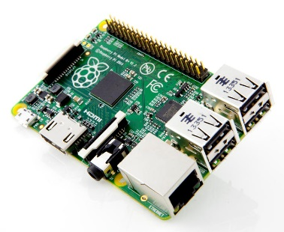

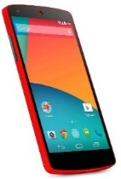

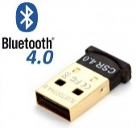

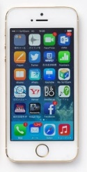
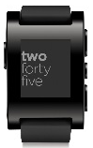


Architectural Approach
❶
❶ Sniff devices on spot
❷ Send data to collector
❸ Correlate and store
❹ Generate reports (daily, on demand, real-time)
❷
❸
❹

Slide 31
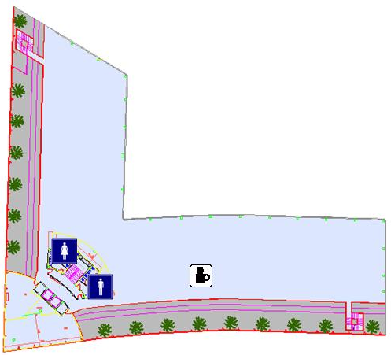



Architectural Approach
Device ❶ (Nexus 5) detected by RPis ① & ②
Device ❷ (Pebble) detected by RPi ②
Device ❸ (iPhone 6) detected by RPi ④
Four packets sent to collector
Matched by MAC address and timeframe
Only three events are generated
①
❶
②
❷
③
④
❸

Slide 32
Architectural Approach
Device ❶ (Nexus 5) detected by RPis ① & ②
After some time, detected only by RPi ②
After some time, detected only by RPi ③
Events are timestamped
Easy to obtain time series for a given device
①
❶
②
③
④

Slide 33
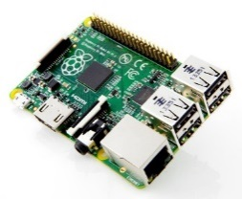
Architectural Approach – Scaling Out
Intranet Domain
Internet Domain
Edge
Devices
Sockets
Historic Info
Sockets
MQTT
Real-Time Info
Data Collector
Data Centre /
Cloud
Sockets
Analytics

Slide 34

Architectural Approach – Scaling Out

Slide 35
Architectural Approach – Scaling Out
acme/activity/americas/#
acme/activity/europe/uk/london
acme/activity/europe/uk/edinburgh/electronics
acme/activity/+/+/+/electronics
acme/activity/#

Slide 36
Examples and Demo

Slide 37
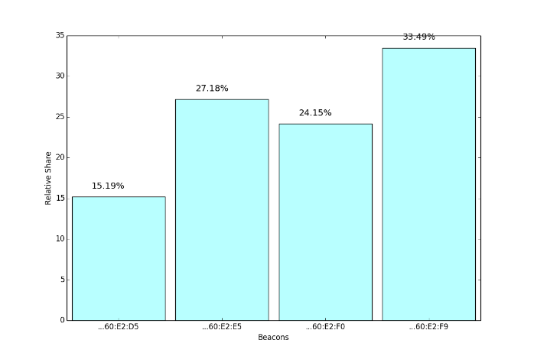
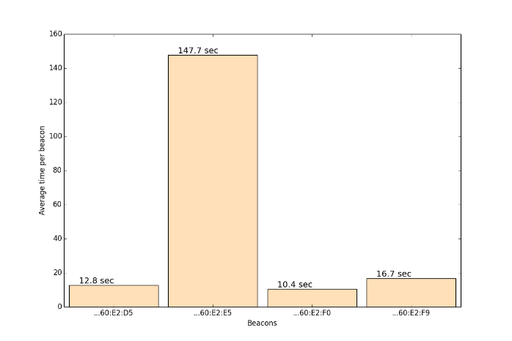
Examples and Demo – Reports
Distribution of time at beacon per device
Average time per beacon

Slide 38
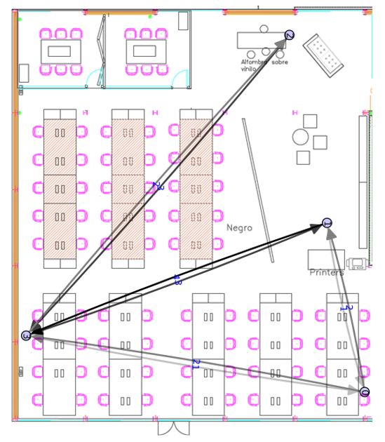
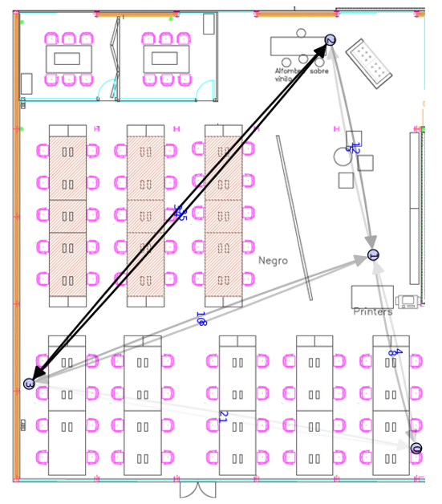
Examples and Demo – Reports
Frequent Paths

Slide 39
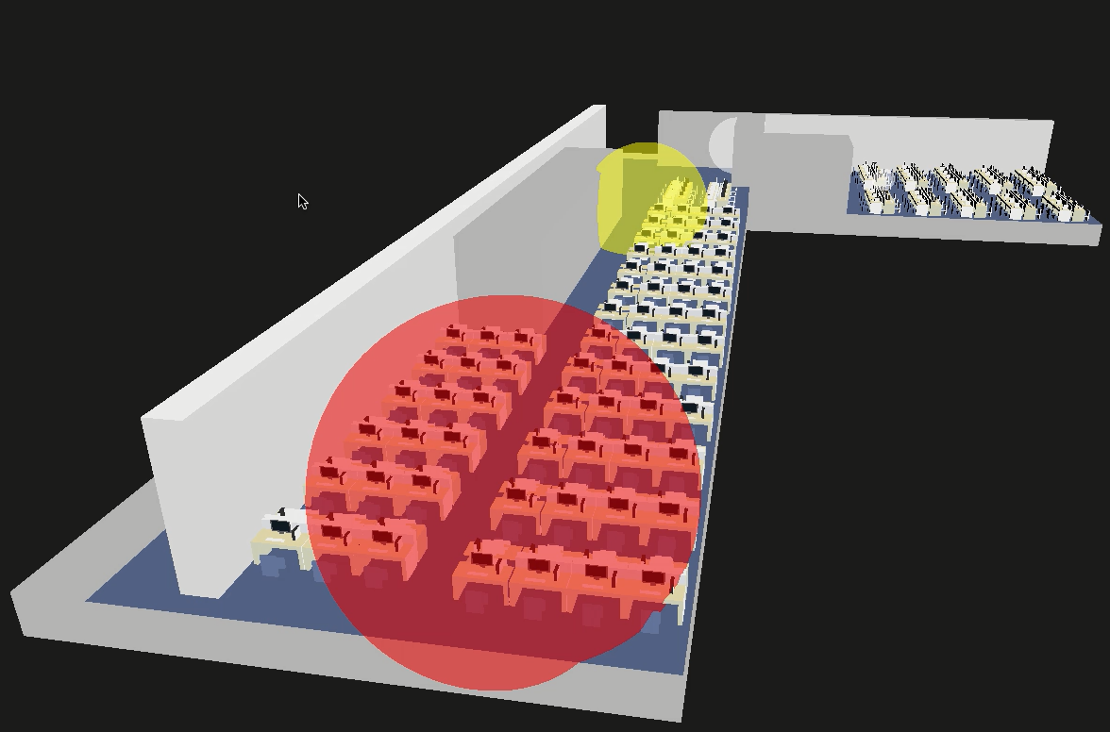
Examples and Demo – 3D Real-Time

Slide 40
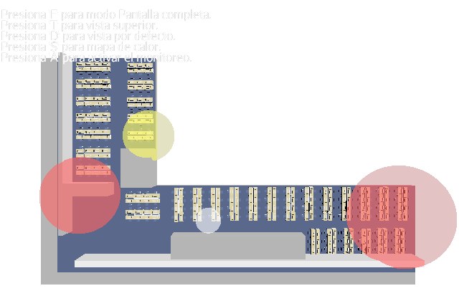
Examples and Demo – Hot Zones

Slide 41
Summary

Slide 42
Conclusion – Lessons Learned
Raspberry Pis are cheap but powerful enough to take multiple roles simultaneously:
Bluetooth device detection
Collector device correlating data and producing reports
When multiple languages can do the job, leverage the skills of your team
More complex platforms like OEP are very useful... ...but can be overkill – mind the KISS principle
Open standards facilitate integration and addition of new features in the future

Slide 43
If you want to get in touch
Public Accenture Portal Sub-site for Application Services for Java:
https://www.accenture.com/us-en/service-enterprise-systems-java.aspx
Follow (and interact with) us on Twitter:
https://twitter.com/AccentureTech
https://twitter.com/_deors
https://twitter.com/restalion

