Slide 2
JavaFX on Mobile and Embedded: Status and Future Plans
Johan Vos, Gluon

Slide 3
Java Client Applications
Write JavaFX Applications
One API for many platforms (desktop, mobile, embedded)
Part of JDK 8
The standard for creating Java client applications
Use your favorite IDE
(show a picture of a happy developer writing code)
Result: Java bytecode
Distribute and deploy them
(show a picture of a confused developer with lots of devices)

Slide 4
Deploy Java Client Applications
For every device type (desktop/laptop/iOS/Android/embedded), we need:
Java Runtime (Oracle, IBM, RoboVM, Dalvik/ART)
JavaFX Runtime (OpenJFX, JavaFXPorts) containing Java code and native code
Optional: Packaging tools

Slide 5
On the desktop
Java SE 8u60 contains everything you need:
Java Runtime
JavaFX implementation (win/mac/linux)
Javapackager
All supported by Oracle

Slide 6
On Embedded and Mobile
Java 8u60 SDK for ARM contains
A Java Runtime
No JavaFX runtime
Android has no JavaFX Runtime
iOS has no Java Runtime and no JavaFX Runtime

Slide 7
OpenJFX
All Oracle source code for JavaFX is in an open-source project: OpenJFX
OpenJFX also contains native code for embedded and mobile devices
Oracle releases binaries of the JavaFX code for desktop as part of the Oracle Java SE 8 releases
Gluon releases binaries of the JavaFX code for mobile and embedded

Slide 8
JavaFXPorts
OpenJFX is a project in OpenJDK
Release schedule aligned with JDK releases
JavaFXPorts is a (manually) synchronized clone of OpenJFX, containing specific changes and bugfixes for mobile and embedded.
Patches flow both ways
JavaFXPorts source is the basis for the Gluon Mobile and Embedded JavaFX SDKs
http://bitbucket.org/javafxports/8u-dev-rt

Slide 9
OpenJFX - JavaFXPorts
OpenJFX
Oracle JavaFX SDK
JavaFXPorts
Gluon JavaFX Mobile/Embedded SDK

Slide 10
Gluon
Provides products and services allowing companies to create high-quality Java Client Applications for enterprise goals
Enhances JavaFX with UI support and Cloud support
Heavily invested in open source
JavaFXPorts
Scene Builder
Gluon Charm Down
Gluon Ignite

Slide 11
Remember earlier slide:
For every device type (desktop/laptop/iOS/Android/embedded), we need:
Java Runtime (Oracle, IBM, RoboVM, Dalvik/ART)
JavaFX Runtime (OpenJFX, JavaFXPorts) containing Java code and native code
Optional: Packaging tools

Slide 12
Java Runtime on mobile
On Android:
Dalvik/ART, Java 7 based VM
On iOS:
RoboVM AOT compiler, compiling Java bytecode to a native iOS application (including native code)

Slide 13
Packaging tools
On desktop: Java is installed
But it needs to be updated
Many consumers worry
Use Javapackager to bundle your application with the Java Runtime for every platform (win/mac/linux)
On embedded: install Oracle Java SE 8u60 and Gluon JavaFX Embedded SDK, and run your application
On mobile: you have to use the AppStore and PlayStore

Slide 14
App Store and Play Store
You can’t upload a JAR to the stores
App Store requires an IPA
Play Store requires an APK
Many complex steps between your Java Application and a self-contained Application (IPA/APK)
Gluon has tools for this!
Gradle plugin
IDE tools

Slide 15
Jfxmobile gradle plugin
Use this plugin in your code and it will add tasks to create IPA and APK
Under the hood, it downloads Gluon Mobile SDKs, RoboVM AOT and it leverages the Android SDK
Convention over configuration

Slide 16
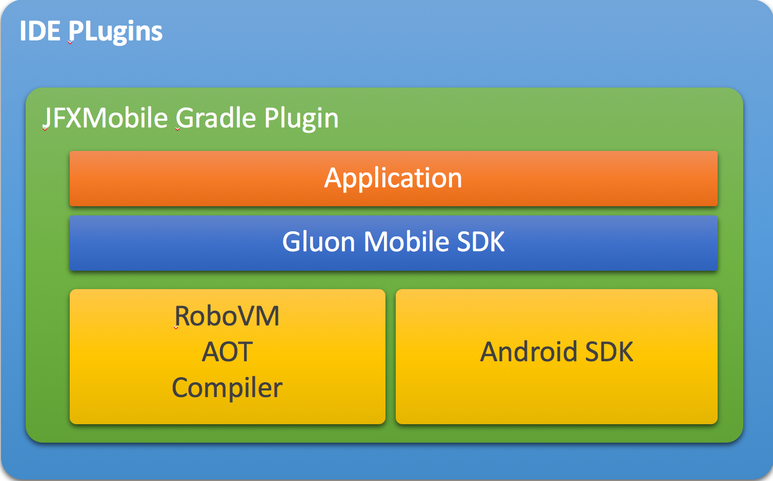
IDE plugins
Gluon IDE plugins make the functionality of the Gradle plugin available in specific IDE’s.
NetBeans
IntelliJ
Eclipse
Under the hood, the IDE plugins leverage the JFXmobile Gradle plugin

Slide 17
Demo
Notes:
Remember last year’s demo? It took lots of command-line operations to have Hello World running
NetBeans, Gluon plugin, HelloJavaFX
NetBeans, Gluon plugin, HelloGlisten

Slide 18
Half-way summary
You can write JavaFX Applications in your favorite IDE and test/run them on desktop/laptop
You use plugins in your favorite IDE to test your application on mobile, and to create self-contained applications that can be uploaded to the App Store and the Play Store

Slide 19
Mobile is cool!
Apart from the standard functionality offered by the JavaFX API’s, mobile applications can contain mobile-specific functionality
Often, functionality is available on iOS and on Android, but with a different API

Slide 20
Charm-Down
Charm is Gluon’s client library
Charm-Down is an Open Source component, abstracting access to platform-specific functionality
Platform p = PlatformFactory.getPlatform()
AndroidPlatform, IOSPlatform, DesktopPlatform
Platform contains services
Platform.getPositionService()
Platform.getCacheManager()

Slide 21
Native functionality
Before we standardize functionality in Charm-Down, we make sure the API is relevant on Android and iOS

Slide 22
Android Activity integration
Your JavaFX Application can call other Android Activities and process the results!
Demo: barcode reader/camera/filechooser

Slide 23
Android Wearable
Demo: notifications on an Android Watch

Slide 24
Participate!
JavaFXPorts is an open-source repository, accepting contributions from the community.
All contributions (Gluon and third party) are done in http://bitbucket.org/javafxports/8u-dev-rt and developers can build releases whenever they want

Slide 25
Get support
Gluon JavaFX Mobile and Embedded SDKs are released every 6 months.
Gluon Open Source customers get access to daily/monthly releases
JavaFXPorts issues: consider Gluon support

Slide 26
Conclusion
Make it possible to run JavaFX applications on mobile/embedded
Make it easy to deploy JavaFX applications
Leverage mobile-specific functionality in a cross-platform way
Allow for an eco-system with additional products, tools and services

Slide 27
Bonus
Biggest drawback is Java 7
No support for Java 8 APIs such as streams
What about JavaFX 9?
What about modularization?
Open JDK mobile port

Slide 28
Upcoming Sessions

Slide 29
Upcoming Sessions
Two important sessions right after this one!
Gluon: JavaFX for the (Mobile) Enterprise
Johan Vos, Eugene Ryzhikov
Hilton—Golden Gate 6/7/8
One Codebase to Rule Them All: Going Mobile with 2048FX
José Pereda, Jens Deters
Hilton—Golden Gate 2/3

Slide 30
Thanks For Attending
Any Questions?

