Slide 1
Moving From JFreeChart To JavaFX Charts with JavaFX Chart Extensions
JavaOne 2015 Session:
Moving Enterprise Data From JFreeChart To JavaFX Charts
Bruce Schubert, Independent Software Architect and Developer
Emxsys - Emergency Management Expert Systems (emxsys.com)
Projects: https://bitbucket.org/emxsys
Notes:
Name
Open source software developer.
My company, Emxsys, make tools for firefighters to help predict the behavior of wildfires
All my open source projects are hosted on Bitbucket - Emxsys

Slide 2
Enterprise Data Shared by the users of an organization; often plotted or graphed with JFreeChart
JFreeChart
JavaFX Charts
De facto standard, rich, mature library
Free, open source; pay for the Developer Guide
Forum support by author
Comprehensive collection of chart types
Swing-based
Cool, new, native
JavaFX-based
Missing many key features that are found in JFreeChart
Notes:
JFreeChart is a great tool for charting complex data
Plethora of chart types
David Gilbert, the author, has provided a comprehensive treatment for data presenation
JavaFX is Cool!
Perhaps the siren song of JavaFX has lured you into a “port”
Sirens were mythical creatures—mermaids—that lured sailors to their deaths with their beauty.
Whatever the reason, I’m here to share my experience porting a complex chart to JavaFX

Slide 3
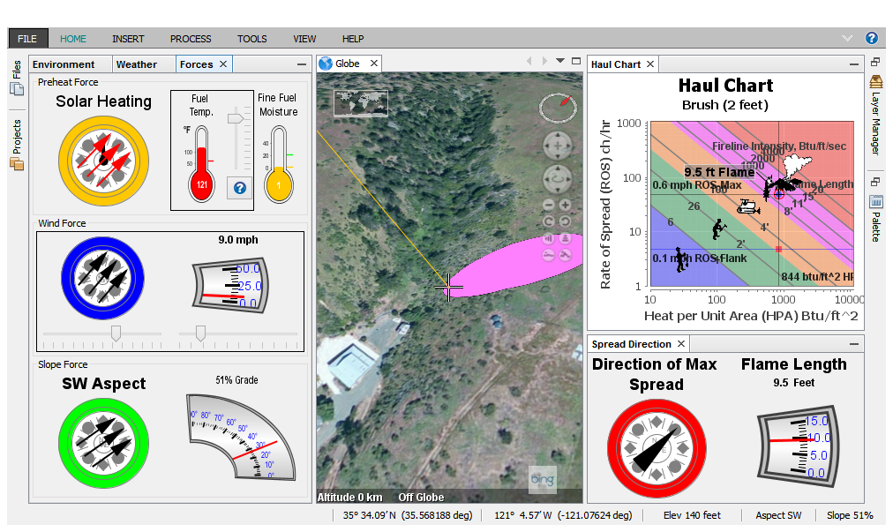
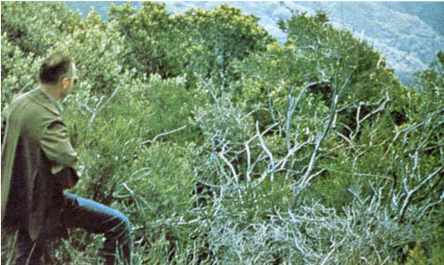
Case Study: WildfireFX Application Port the Wildfire Management Tool (WMT) to JavaFX
https://bitbucket.org/emxsys/wildfire-management-tool
https://bitbucket.org/emxsys/wildfirefx
Notes:
I want to share my experience porting the WMT to JavaFX
WMT is a modular NetBeans Platform application
It computes the potential fire behavior of wildland fires from fuel models, terrain, and environmental data
Data is presented in dials and charts for easy consumption by firefighters (not scientists!)
My goal is to create a lightweight JavaFX application with a fire behavior simulation (a particle system) -- WildfireFX
WildfireFX is a NetBeans, Maven-based project

Slide 4
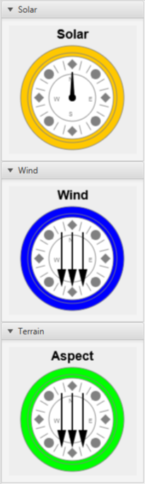
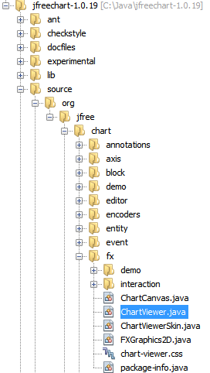
Objective: Use JFree’s ChartViewer for Unique Chart Types ChartViewer included in the JFreeChart source distribution
// Example: FXMLController snippet
import org.jfree.chart.fx.ChartViewer;
public class FXMLController
implements Initializable {
@FXML
private AnchorPane pane;
// A JFreeChart!
private final SolarChart chart
= new SolarChart("Solar");
@Override
public void initialize(URL location,
ResourceBundle resources) {
pane.getChildren().add(
new ChartViewer(chart));
}
}
Notes:
My first objective is to use the Jfree ChartViewer for unique JFreeChart types, e.g.:
Compass Plots
Dial Plots
Warning! The ChartViewer class is not included in the jfreechart-1.0.19.jar file!
Thus it is not included in a maven dependency.
You must add the source to your project.
Example: Here’s typical FXMLController code snippet adding a ChartViewer Control (Node) to an AnchorPane

Slide 5
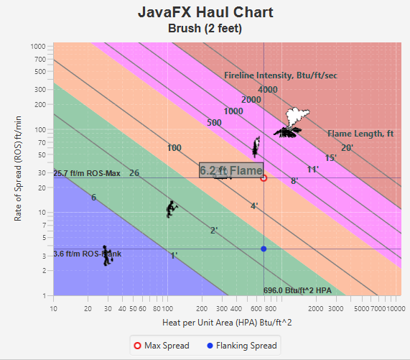
Objective: Port the “Haul Chart” to JavaFX Logarithmic scatter chart depicting wildland fire behavior
Logarithmic Axis
Major Gridlines
Subtitles
Value Markers
Annotations
Text
Lines
Polygons
Images
Notes:
WMT has a “Haul Chart” used to display fire behavior data.
Y-Axis: ROS, X-Axis: Heat Output
Intersection: Flame Length and Fireline intensity
As flame lengths increase from lower right:
Haul men, haul equipment, haul retardant, haul everyone to safety
My 2nd Objective in WildfireFX is to port the Haul Chart to JavaFX.
Seems simple enough: it’s XY Scatter Chart - JavaFX has one of those…
REVIEW SLIDE BULLETS
Discovery:
None of the listed features were supported by the ScatterChart!
So I implemented them!

Slide 6
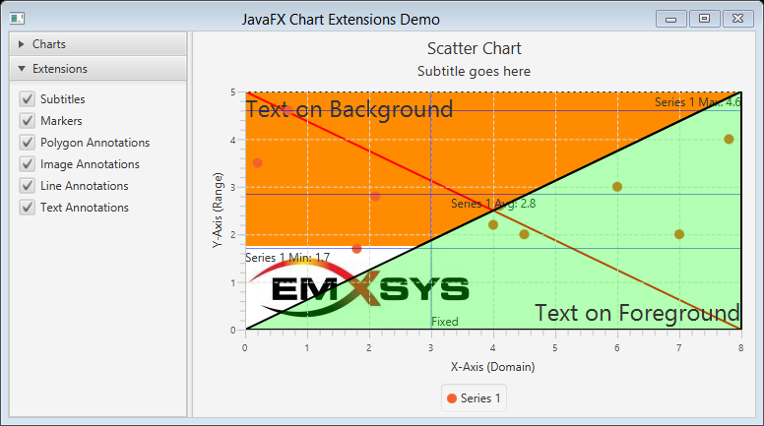
JavaFX Chart Extensions Library (Free!) Easier porting of JFreeChart charts to JavaFX Charts
https://bitbucket.org/emxsys/javafx-chart-extensions
Notes:
I created the Chart Extensions library
to make porting of JFreeChart charts to JavaFX Charts easier.
It adds subset of common JFreeChart functionality to JavaFX Charts
It uses concepts and syntax similar (not identical) to JFreeChart
The Bitbucket project Includes:
Source
JavaDoc and Wiki
Demo application
Issue tracker
And this PowerPoint!

Slide 7
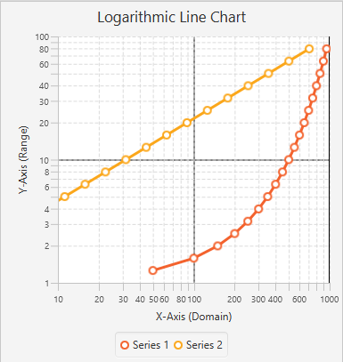
LogarithmicAxis Creates a Logarithmic XYChart
LogarithmicAxis
Pass to XYChart axis arguments
MajorLogGridlines
Add to XYChart subclass
Call layoutGridlines()
CSS:
chart-major-vertical-grid-lines
chart-major-horizontal-grid-lines
final double MIN_X = 10d;
final double MAX_X = 1000d;
final double MIN_Y = 1d;
final double MAX_Y = 100d;
LogarithmicAxis xAxis = new LogarithmicAxis("Domain", MIN_X, MAX_X);
LogarithmicAxis yAxis = new LogarithmicAxis("Range", MIN_Y, MAX_Y);
LineChart chart = new LineChart(xAxis, yAxis, dataset);
Notes:
To create a logarithmic chart, simply create a logarithmic axis object and add it to an XYChart.
To show major gridlines, you must subclass an XYChart and add a MajorLogGridlines object.
You override the Chart’s layoutChildren() and call layoutGridlines()
REVIEW SNIPPET

Slide 8
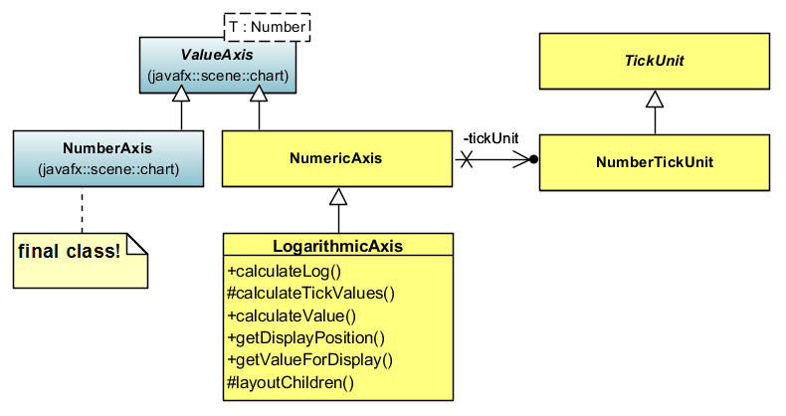
LogarithmicAxis Implementation
Notes:
Here’s a class diagram depicting LogarithmicAxis implementation.
Note the JavaFX NumberAxis class is final…
I had to duplicate it as NumericAccess to implement

Slide 9
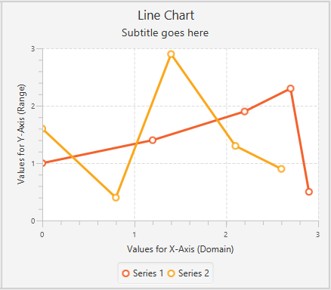
Subtitle Extension Adds subtitle text to a chart
Subtitle
Add to Chart subclass
Call layoutSubtitle()
setSubtitle(“…”)
CSS Style:
chart-subtitle
// Chart subclass snippet
private Subtitle subtitle;
public void setSubtitle(String text) {
this.subtitle.setSubtitle(text);
this.requestLayout();
}
Notes:
To add subtitles you must subclass a Chart and add a Subtitle object.
You must override the Chart’s layoutChildren() and call layoutSubtitles()

Slide 10
Subtitle Implementation subtitleLabel is added to chart.getChildren() collection
getChildren() returns {titleLabel,chartContent,legend}
subtitleLabel added to children after titleLabel
layoutSubtitle() modifies chartContent’s size
FYI: getChartChildren() returns chartContent
chartContent
titleLabel
subtitleLabel
yAxis
plotArea
plotBackground
xAxis
legend

Slide 11
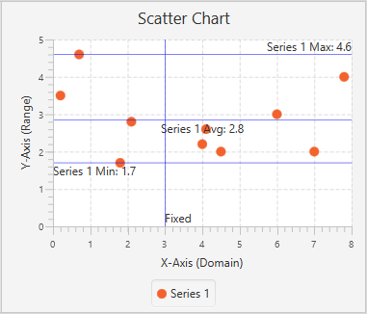
XYMarker Extension ValueMarkers highlight values with a line and label
XYMarkers
Add to XYChart subclass
Call layoutMarkers()
ValueMarker
Pos controls label layout
addDomainMarker()
addRangeMarker()
CSS Style:
chart-marker-line
chart-maker-label
// XYChart subclass snippet
private XYMarkers markers;
public void addMinMaxMarkers(double maxX, double maxY) {
markers.addDomainMarker(new ValueMarker(
maxX, String.format("Max: %1$.1f", maxX), Pos.BOTTOM_RIGHT));
markers.addRangeMarker(new ValueMarker(
maxY, String.format("Max: %1$.1f"", maxY), Pos.TOP_LEFT));
}
Notes:
To add value markers, you must subclass an XYChart and add a XYMarkers object
You must override layoutPlotChildren() and call layoutMarkers()
ValueMarkers are added to the X and Y axes with addDomainMarker() and addRangeMarker()
Label placement controlled by Pos enum

Slide 12
XMarkers Implementation Label placement controlled by Pos enum
Horizontal (range) marker labels
Anchored to left/right of graph
Placed above or below line
Vertical (domain) marker labels
Anchored to top/bottom of graph
Placed left or right of line
Tip: Create listeners on label’s width and height properties to trigger text layout
Label width and height are initially zero!
TOP_LEFT
TOP_RIGHT
TOP_LEFT
TOP_RIGHT
BOTTOM_LEFT
BOTTOM_RIGHT
BOTTOM_LEFT
BOTTOM_RIGHT
Notes:
Pos enum passed to addRangeMarker() and addDomainMarker() controls placement

Slide 13
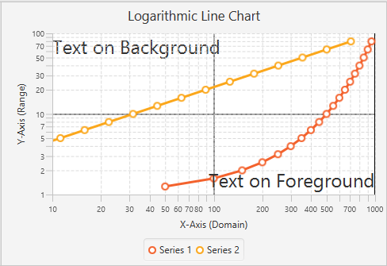
XYTextAnnotation Draws a label on an XYChart
XYAnnotations
Add to XYChart subclass
Call layoutAnnotations()
XYTextAnnotation(…)
Layer controls foreground/background
Pos controls label layout
add(XYTextAnnotation)
CSS: chart-text-annotation
// XYChart subclass snippet...
private XYAnnotations annotations;
public void addTextAnnotation(double x, double y, String text) {
annotations.add(new XYTextAnnotation(
text, x, y, Pos.TOP_LEFT), Layer.FOREGROUND);
}
Notes:
To add annotations you must subclass an XYChart and add a XYAnnotations object
You must override layoutPlotChildren () and call layoutAnnotations()
All XY annotations are added with a call to add()
Pos enum controls label placement relative to X,Y
Layer enum controls foreground/background
REVIEW EXAMPLE SNIPPET

Slide 14
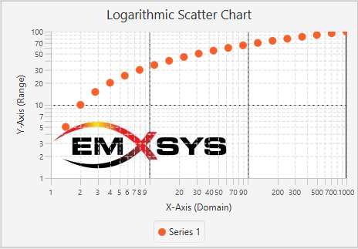
XYImageAnnotation Draws an image on an XYChart
XYAnnotations
Add to XYChart subclass
Call layoutAnnotations()
XYImageAnnotation(…)
Layer controls foreground/background
Pos controls image placement
add(XYImageAnnotation)
// XYChart subclass snippet...
private XYAnnotations annotations;
public void addImageAnnotation(double x, double y, String path) {
Image image = new Image(getClass().getResourceAsStream(path));
annotations.add(new XYImageAnnotation(
image, x, y, Pos.CENTER), Layer.FOREGROUND);
}
Notes:
To add annotations you must subclass an XYChart and add a XYAnnotations object
You must override layoutPlotChildren () and call layoutAnnotations()
All XY annotations are added with a call to add()
Pos enum controls image placement relative to X,Y
Layer enum controls foreground/background
REVIEW EXAMPLE SNIPPET

Slide 15
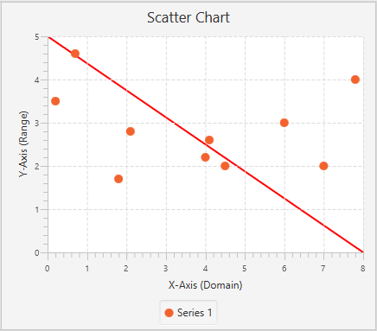
XYLineAnnotation Draws a line on an XYChart
XYAnnotations
Add to XYChart subclass
Call layoutAnnotations()
XYLineAnnotation(…)
Layer foreground/background
Optional width and color
add(XYLineAnnotation)
CSS: chart-line-annotation
// XYChart subclass snippet...
private XYAnnotations annotations;
public void addLineAnnotation(double x, double y, double x2, double y2) {
annotations.add(new XYLineAnnotation(
x1, y1, x2, y2, 2.0, Color.RED), Layer.FOREGROUND);
}
Notes:
To add annotations you must subclass an XYChart and add a XYAnnotations object
You must override layoutPlotChildren () and call layoutAnnotations()
All XY annotations are added with a call to add()
Layer enum controls foreground/background
REVIEW EXAMPLE SNIPPET

Slide 16
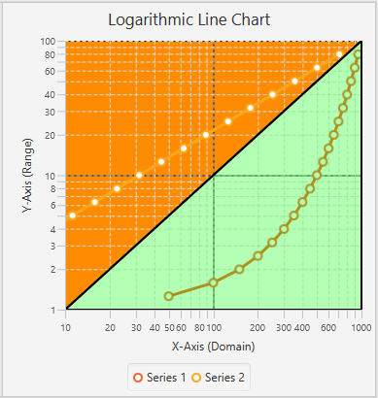
XYPolygonAnnotation Draws a polygon on an XYChart
XYAnnotations
Add to XYChart subclass
Call layoutAnnotations()
XYPolygonAnnotation(…)
Layer foreground/background
Optional line width and fill colors
add(XYPolygonAnnotation)
CSS: chart-polygon-annotation
// XYChart subclass snippet...
private XYAnnotations annotations;
public void addPolygonAnnotation(double[] xyPoints) {
annotations.add(new XYPolygonAnnotation(
xyPoints, 2.0, Color.BLACK, Color.DARKORANGE), Layer.BACKGROUND);
}
Notes:
To add annotations you must subclass an XYChart and add a XYAnnotations object
You must override layoutPlotChildren () and call layoutAnnotations()
All XY annotations are added with a call to add()
Layer enum controls foreground/background
REVIEW EXAMPLE SNIPPET

Slide 17
XYAnnotations Implementation chart.getPlotChildren() returns plotArea
Annotation layers are Group objects added to plotArea children
Foreground: last entry in plot area
Background: first entry in plot area
plotArea
foreground
plotContent
zero lines, gridlines, row fills
zero lines, gridlines, row fills
zero lines, gridlines, row fills
zero lines, gridlines, row fills
background

Slide 18
In Closing
JavaFX Chart Extensions project:
https://bitbucket.org/emxsys/javafx-chart-extensions
WildfireFX project:
https://bitbucket.org/emxsys/wildfirefx
Wildfire Management Tool project:
https://bitbucket.org/emxsys/wildfire-management-tool
Twitter: @Emxsys
Email: bruce@emxsys.com

