Slide 1
JSCANNER
An Open-Source Java Malware Defense Tool
By: Desmond Jackson

Slide 2
Overview
Java
Security issues
Bytecode
Virus Scanners
Methods of scanning
Trouble detecting malicious Java programs
Malicious Java Programs
JStrokeClient
JStrokeServer
JManager
JWorm
JScanner
Functionality
Screenshots
Algorithm
VirusTotal
57 commercial antivirus products
JScanner vs. VirusTotal Comparison
Scan Results
Conclusion
Advantages
Disadvantages
Bibliography & References
Questions?

Slide 3
Over 3 Billion Devices Run Java
It is a programming language designed to create programs that could be ran on any operating system.
Was the cause of 91% of all cyber attacks in 2013. (exploit percentage dropped 34% in 2014)
Virus Scanners have great difficulty detecting malicious Java programs.
A method has to be developed in order to detect malicious Java programs.

Slide 4
Research
Java Bytecode
Instruction Set of the Java Virtual Machine (JVM)
Tells the JVM how to execute a Java program (i.e. applets, classes, and jars)
Methods of Virus Scanning
Signature Scan identifies a virus by static string sequence of bytes (i.e. code patterns)
Behavioral Scan identifies a virus by abnormal code actions (i.e. making attempts to reformat the hard drive, modify system files)
Generic Scan identifies a virus by appearance (i.e. file hashes, file size, file name, file location)

Slide 5
Hypothesis
Java Bytecode analysis could be used to help identify malicious Java programs.
A Java program crafted to understand threatening Java Bytecode instructions could be used to detect malicious Java programs.
Because the user will have to specify the threatening Java Bytecode instructions, detection success rate is dependent upon the user’s input.

Slide 6
Materials
Laptop or Computer
Eclipse Luna
Java Runtime Environment and Java Development Kit
ObjectWeb ASM API
Jsoup API
Apache Commons IO API
PircBot API
JNativeHook API
Java Virtual Machine Specification
VirusTotal

Slide 7
Experimentation, Part I.
Understood that although many Java programs could be written differently to accomplish a common goal, their bytecode instructions would not be identical. Similarities between the bytecode instructions of the Java programs would have to be identified.
Created, tested, and analyzed the bytecode instructions of 4 malicious Open-Source Java programs: JStrokeClient, JStrokeServer, JManager, and JWorm.
The bytecode instructions of each individual malicious Java program contained method invocations that matched the functionality of the program.

Slide 8
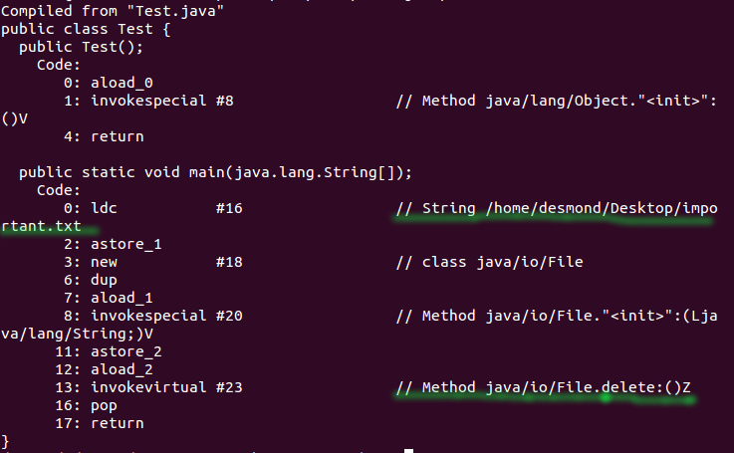
Analyzing Bytecode Instructions

Slide 9
JStrokeClient
An Open-Source Java Keylogger Client
Gets the hostname of the user’s computer
Records the keys typed by the user
Sends the hostname to a JStrokeServer
Sends the recorded keys to a JStrokeServer

Slide 10
JStrokeServer
An Open-Source Java Keylogger Server
Receives the hostname from a JStrokeClient
Creates a text file with the hostname received
Receives the recorded keys from a JStrokeClient
Stores the recorded keys into the created text file

Slide 11
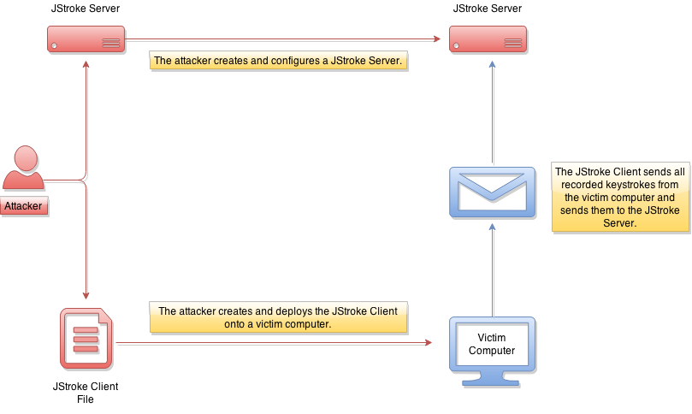
JStroke Visual

Slide 12
JManager
An Open-Source Java Remote Administration Tool
Connects to an Internet Relay Chat (IRC or chatroom)
Receives and executes chat messages as commands
Commands
Delete - Deletes a specified file
Download - Downloads a file from the internet
HomeDirectory - Gets the home directory of the user’s computer
List - Lists files in a specified directory
OSName - Gets the Operating System name
Ping - Replies with the word “pong”
Quit - Exits the IRC
Run - Runs a command on the native command line interface

Slide 13
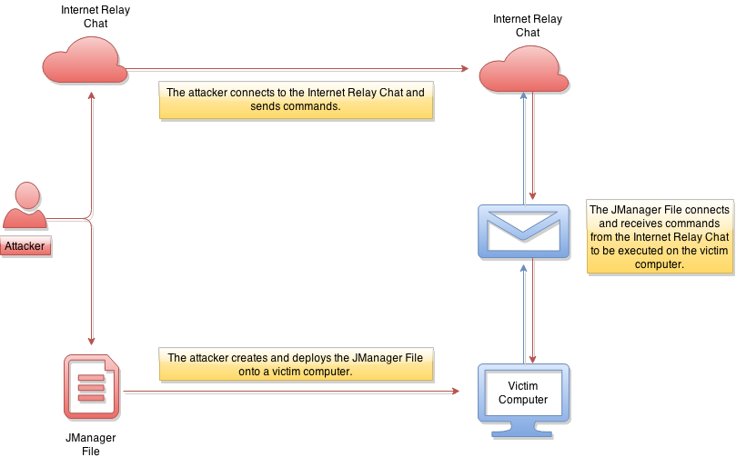
JManager Visual

Slide 14
JWorm
An Open-Source Java Worm
Replicates by infecting executable Jar files that are not already infected with JWorm.
Once Jar files are infected, if executed, they will continue JWorm’s replication function.

Slide 15
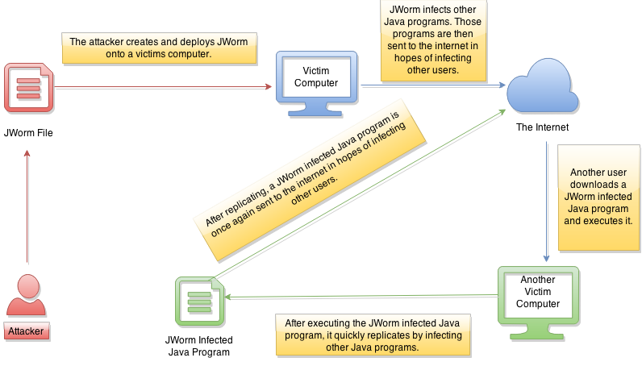
JWorm Visual

Slide 16
Experimentation, Part II.
Developed JScanner to scan Java programs for bytecode instructions that users define as malicious. Features include:
Easy-To-Use graphical user interface
Ability to scan Java Applets, Jar files, and Class files
Ability to create and select threatening bytecode instructions for scanning
Ability to hook method calls of a Java program using JScanner to observe interactions with external entities (i.e. files, servers)
Scanned the malicious Java programs with JScanner and the 57 commercial antivirus products of VirusTotal. The results were recorded.

Slide 17
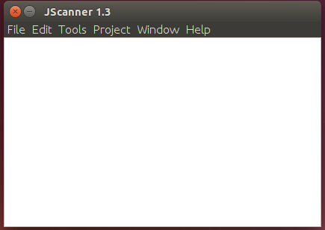
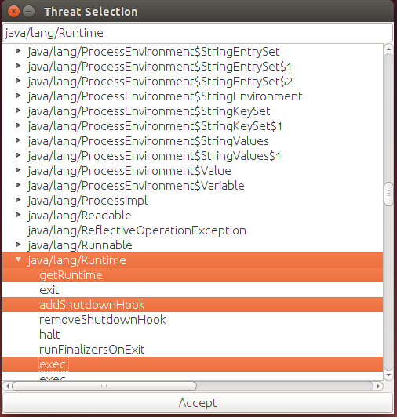
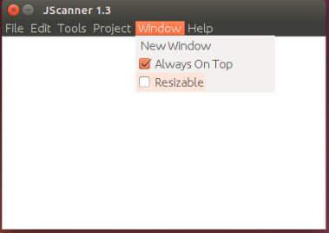
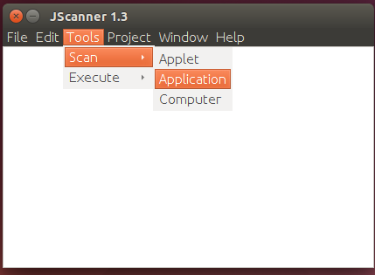
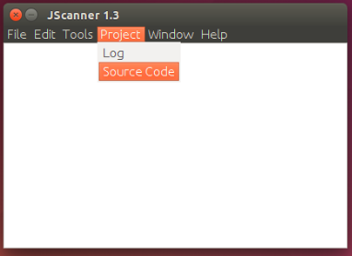
JScanner Screenshots

Slide 18
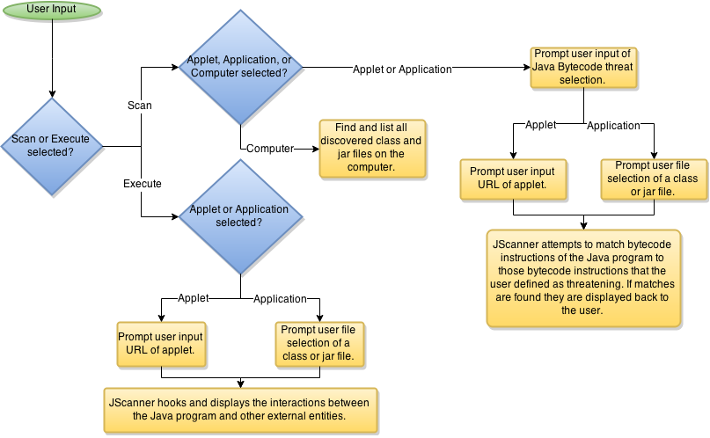
JScanner Algorithm

Slide 19
VirusTotal
A subsidiary of Google that analyzes files and URLs for viruses, worms, trojans, and other kinds of malicious content. Uses the following to perform scans and return results:
57 commercial antivirus products
61 website/domain scanning engines and datasets
15 file characterization tools and datasets

Slide 20
Results
JScanner detected 100% of the malicious Java programs when bytecode instructions whose method invocations would perform the following actions:
Interacting with files
Executing Java code from external sources
Connecting to servers
Reading/Writing data from different sources
Running commands on the command line interface
The 57 commercial antivirus products of VirusTotal detected 0% of the malicious Java programs.

Slide 21
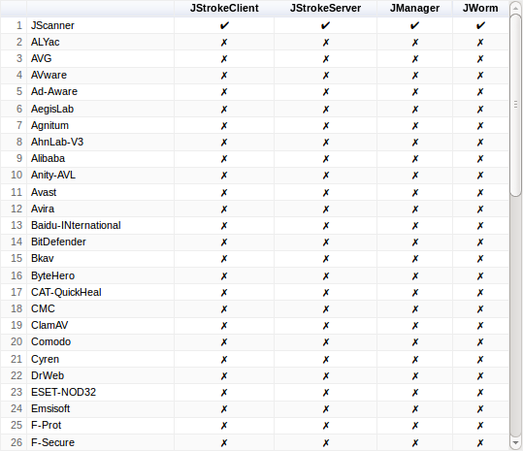
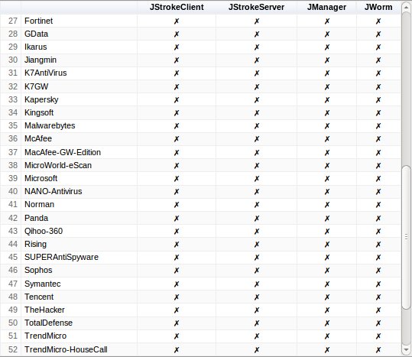
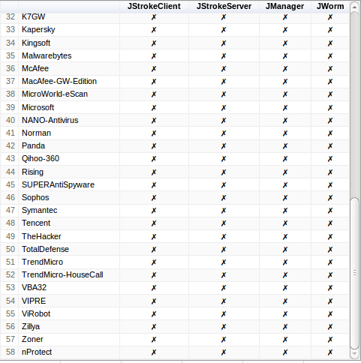
JScanner vs. VirusTotal

Slide 22
Conclusion
JScanner is very efficient at detecting malicious Java programs.
Java Bytecode analysis can be used to identify malicious Java programs.
If implemented, it could protect the vulnerable 3 billion devices that run Java, from attack.

Slide 23
Bibliography & References, I.
"Apache Commons - Apache Commons." Apache Commons. The Apache Software Foundation <http://commons.apache.org/>.
"Build Software Better, Together." Github INC <http://www.github.com/>.
"Cisco 2014 ASR." Cisco 2014 Annual Security Report Cisco Systems. <http://www.cisco.com/web/offer/gist_ty2_asset/Cisco_2014_ASR.pdf>.
"Cisco 2015 ASR." Cisco 2015 Annual Security Report Cisco Systems. <http://www.cisco.com/web/offer/gist_ty2_asset/Cisco_2015_ASR.pdf>.
"Java Shrinker and Obfuscator." Jshrink. Eastridge Technology <http://www.e-t.com/jshrink.html>.
"Java Update Is Not Enough." Tech2 <http://tech.firstpost.com/news-analysis/us-homeland-security-says-oracles-java-update-is-not-enough-212595.html>.
"Java Virtual Machine." Project Gutenberg Self-Publishing Press <http://self.gutenberg.org/articles/java_virtual_machine>.
"Learn about Java Technology." Java. Oracle <http://www.java.com/en/about/>.
"Penetration Testing Software." Metasploit. Rapid7. <http://www.metasploit.com>.
"Software Protection Algorithms." Sandmark. University of Arizona <http://sandmark.cs.arizona.edu/>.
"The Growth of Cybersecurity Jobs." Growth of Cybersecurity Jobs. Burning Glass Technologies <http://www.burning-glass.com/research/cybersecurity/>.
"The Ultimate Security Vulnerability Datasource." CVE Security Vulnerability Database. MITRE Corporation <http://cvedetails.com/>.
"Unlimited Web Hosting." Website Hosting Services, VPS Hosting & Dedicated Servers. HostGator Web Hosting <http://www.hostgator.com/>.
Barker, Alex. "Kwhat/jnativehook." Github <https://github.com/kwhat/jnativehook/releases>.
Bodnar, Jan. "ZetCode." , Tutorials for Programmers. Jan Bodnar <http://zetcode.com/>.
Bruneton, Eric, Pierre Cregut, Rémi Forax, Eugene Kuleshov, and Andrei Loskutov. "ASM." ASM. OW2 Consortium <http://asm.ow2.org/>.
Drozdek, Adam. "E-Study Guide for Data Structures and Algorithms in Java, Textbook by Adam Drozdek." Google Books. Just The Facts 101 <https://books.google.com/books?id=OZfKAQAAQBAJ>.
Ducklin, Paul. "Twitter Hacked, at Least 250,000 Users Affected." Naked Security. <http://nakedsecurity.sophos.com/2013/02/02/twitter-hacked-at-least-250000-users-affected-what-you-can-do-to-protect-yourself/>.
Duke, Meg. "New Java Virus a Threat to Computer Security." The Western Front <http://www.westernfrontonline.net/news/article_1c783606-6a2c-11e2-8d66-001a4bcf6878.html>.
Eastaugh, Matthew. "Microprocessor Tutorial." <http://www.eastaughs.fsnet.co.uk/cpu/execution-instructions.htm>
Eclipse. The Eclipse Foundation <http://www.eclipse.org>.
Fazard. How Symantec Antivirus System Detects Viruses. Symantec <http://www.symantec.com/connect/articles/how-symantec-antivirus-system-detects-viruses>.
Hall, Mark. "Asteroids Applet." Asteroids Applet. <http://www.brainjar.com/java/games/asteroids/>.
Hedley, Jonathan. "Jsoup: Java HTML Parser." Jsoup Java HTML Parser, with Best of DOM, CSS, and Jquery. Jonathan Hedley <http://jsoup.org/>.
Hess, Ken. "Three Billion Devices Run Java. Yeah, but Do They like It? | ZDNet." ZDNet <http://www.zdnet.com/article/three-billion-devices-run-java-yeah-but-do-they-like-it/>.
JManager Source: http://www.github.com/DMoneigh/JManager
JManager Scan Results: https://www.virustotal.com/en/file/58202ce3d5179f0a67e14f904075595ab1e945073fad5d3b4ea3ff2b5189f82c/analysis/1429321521/
JScanner Source: http://www.github.com/DMoneigh/JScanner
JStrokeClient Source: http://www.github.com/DMoneigh/JStrokeClient
JStrokeClient Scan Results: https://www.virustotal.com/en/file/fa7e080fe8bdfb9580ba94457a99fc725679b1dfd42acec9b0ade0ef07a48576/analysis/1428538328/
JStrokeServer Source: http://www.github.com/DMoneigh/JStrokeServer
JStrokeServer Scan Results: https://www.virustotal.com/en/file/9ea237d49eb0d93a605e83c941b88ea275828103764b3c0e35a02ab851c23949/analysis/1428538399/
JWorm Source: http://www.github.com/DMoneigh/JWorm
JWorm Scan Results: https://www.virustotal.com/en/file/e884cfd63a57b7e412ddb0ac521d25d9768cea967238670c74ccc21eb7676e5b/analysis/1429321631/

Slide 24
Bibliography & References, II.
Jason D. O'Grady, "Apple, Facebook Employees Hacked." ZDNet. <http://www.zdnet.com/apple-facebook-employees-hacked-via-website-malware-java-vulnerability-7000011601/>.
Kerner, Sean M. "Java Primary Cause of 91 Percent of Attacks: Cisco." Java Primary Cause of 91 Percent of Attacks: Cisco. EWeek <http://www.eweek.com/security/java-primary-cause-of-91-percent-of-attacks-cisco.html>.
Korolov, Maria. “Java Is the Biggest Vulnerability for US computers.” CSO Online <http://www.csoonline.com/article/2875535/application-security/java-is-the-biggest-vulnerability-for-us-computers.html>.
Kuenning, Geoff. "How Does a Computer Virus Scan Work?" Scientific American Global. Scientific American <http://www.scientificamerican.com/article/how-does-a-computer-virus/>.
Lafortune, Eric. "ProGuard." <http://proguard.sourceforge.net/>.
Lindholm, Tim, Frank Yellin, Gilad Bracha, and Alex Buckley. "The Java® Virtual Machine Specification." The Java® Virtual Machine Specification. Oracle America Inc. <http://docs.oracle.com/javase/specs/jvms/se8/html/>.
MediaFire. <http://mediafire.com/>.
Mishra, Umakant. Methods of Virus Detection And Their Limitations, Free Journal. <http://freejournal.heliohost.org/freejournal/public/feb2007/Methods%20of%20virus%20scanning%20and%20their%20limitations.pdf>.
Mutton, Paul. "PircBot Java IRC Bot." PircBot. Paul Mutton <http://www.jibble.org/pircbot.php>.
Perlroth, Nicole. "Department of Homeland Security: Disable Java 'Unless It Is Absolutely Necessary'" Bits <http://bits.blogs.nytimes.com/2013/01/14/department-of-homeland-security-disable-java-unless-it-is-absolutely-necessary/?_r=0>.
Rose, Margaret. "What Is Bytecode?" WhatIs.com. Tech Target <http://whatis.techtarget.com/definition/bytecode>.
Schlumberger, Johannes, Christopher Kruegel, and Giovanni Vigna. "Jarhead." University of California <http://wwwcip.cs.fau.de/~spjsschl/jarhead.pdf>.
Venners, Bill. "How the Java Virtual Machine Handles Method Invocation and Return." Java World <http://www.javaworld.com/article/2076949/learn-java/how-the-java-virtual-machine-handles-method-invocation-and-return.html?page=2>.
Vimeo, Your Videos Belong Here. <http://vimeo.com/>.
VirusTotal - Free Online Virus, Malware and URL Scanner. Google <https://www.virustotal.com/>.
Wagenseil, Paul. "Microsoft's Macs Hacked in Java Attack." Yahoo! News. <http://news.yahoo.com/microsofts-macs-hacked-java-attack-045502922.html>.
YouTube. <http://www.youtube.com/>.

Slide 25
Questions?

