Slide 1
What’s in an Object?
Java Garbage Collection for the Polyglot
Charlie Gracie, Garbage Collection Architect
Charlie_Gracie@ca.ibm.com
@crgracie
28 October 2015

Slide 2
Who am I?
I have been working on the IBM J9 Virtual Machine since 2004 and I am currently the Garbage Collection Architect. J9 is IBM's independent implementation of the JVM.
I have worked on almost all aspects of the J9 JVM including garbage collection, core interpreter, RAS and L3 service.
My main focus areas have been improving garbage collection scalability and de-coupling JVM components from the JVM
Notes:
A little bit of background on me….

Slide 3
Important disclaimers
THE INFORMATION CONTAINED IN THIS PRESENTATION IS PROVIDED FOR INFORMATIONAL PURPOSES ONLY.
WHILST EFFORTS WERE MADE TO VERIFY THE COMPLETENESS AND ACCURACY OF THE INFORMATION CONTAINED IN THIS PRESENTATION, IT IS PROVIDED “AS IS”, WITHOUT WARRANTY OF ANY KIND, EXPRESS OR IMPLIED.
ALL PERFORMANCE DATA INCLUDED IN THIS PRESENTATION HAVE BEEN GATHERED IN A CONTROLLED ENVIRONMENT. YOUR OWN TEST RESULTS MAY VARY BASED ON HARDWARE, SOFTWARE OR INFRASTRUCTURE DIFFERENCES.
ALL DATA INCLUDED IN THIS PRESENTATION ARE MEANT TO BE USED ONLY AS A GUIDE.
IN ADDITION, THE INFORMATION CONTAINED IN THIS PRESENTATION IS BASED ON IBM’S CURRENT PRODUCT PLANS AND STRATEGY, WHICH ARE SUBJECT TO CHANGE BY IBM, WITHOUT NOTICE.
IBM AND ITS AFFILIATED COMPANIES SHALL NOT BE RESPONSIBLE FOR ANY DAMAGES ARISING OUT OF THE USE OF, OR OTHERWISE RELATED TO, THIS PRESENTATION OR ANY OTHER DOCUMENTATION.
NOTHING CONTAINED IN THIS PRESENTATION IS INTENDED TO, OR SHALL HAVE THE EFFECT OF:
CREATING ANY WARRANT OR REPRESENTATION FROM IBM, ITS AFFILIATED COMPANIES OR ITS OR THEIR SUPPLIERS AND/OR LICENSORS
Notes:
We start with our safe harbor slide that tells us basically, don’t trust anything I have to say.
Don’t worry, by the end of the conference, I’m sure we’ll be sick of these slides.

Slide 4
Resurgence of polyglot
Notes:
We are here at JavaOne because we all know and love Java.
Java is a stable, performant and scalable runtime.
It has decades of development into JIT, GC and other technologies
Over the last few years a lot of new languages are gaining traction.
With more and more applications moving to the cloud we see more developers requiring skills in more than one language
How many people work Ruby??? Python??? JavaScript???? As well as java

Slide 5
Resurgence of polyglot

Slide 6
Resurgence of polyglot

Slide 7
Resurgence of polyglot

Slide 8
Resurgence of polyglot

Slide 9
Resurgence of polyglot
Notes:
These languages all have their strengths and weaknesses
More than just learning the language developers need to know how to run, tune, profiling and debug all of these languages.
How do you configure options? How do you set the maximum size of the heap? Is there even a maximum size
IDE, profilers, monitoring agents?
"Groovy-logo" by Zorak1103 - Own work. Licensed under CC BY-SA 3.0 via Commons - https://commons.wikimedia.org/wiki/File:Groovy-logo.svg#/media/File:Groovy-logo.svg

Slide 10
No shared technology between runtimes
Effort in one runtime has no leverage in other runtimes
…looking very costly to support many language runtimes
Notes:
If one language is updated to take advantage of a feature like transitional memory it does not help any of the other runtimes.
Another example would be platform support. Not all of these runtimes support and are optimized for platforms like arm or PPC.
Add support for method profiling and a tool to display it. Each language would do this themselves.

Slide 11
Languages on the JVM
Leverage the investment in JVM by running on the JVM
Cross platform support
High performance runtime
Production quality
Tooling / monitoring support
Interoperability with Java
Notes:
One solution would be to move all of these languages to run on the JVM
You get free platform support everywhere java is supported
With great JIT and GC technology
Production quality. There are thousands of applications running on java every day, many of which are running critical infrastructure

Slide 12
Languages on the JVM
Works great for new languages like Scala and Groovy
Many existing languages have a vibrant non-JVM based community
JVM implementation forks language and runtime communities
Bridging the divide would mean migrating an entire community
Not all languages map nicely to Java semantics
We decided to experiment with a different approach that would allow new and existing language communities to leverage JVM capabilities
Notes:
Scala and groovy were implemented on the JVM and work well with in the JVM consrtaints

Slide 13
IBM to open-source runtime technology!
IBM is going to open source runtime technology
Announced by Mark Stoodley at JVMLS 2015
See the complete talk here.

Slide 14
Our vision
Open community of contribution based around a toolkit of components that can be used to build VMs for any language
Efficient place for individuals, communities, and companies to safely collaborate on core VM infrastructure
Enable everyone to focus more energy on innovation, not on building more wheels
More robust core technology
Fix bugs once
Tested in many different scenarios
Collection of best practices and shared learning
Lower entry barrier for new languages and VM ideas
Test ideas faster and more reliably

Slide 15
Unlock the VM from the JVM
Refactor J9 components to create a language-agnostic toolkit designed for integration into language runtimes (including J9 JVM)
Memory allocator, thread library, platform port library, event hook framework, VM and application level trace engine, garbage collector, JIT compiler
Not a research project: out JDK product development team aggressively refactoring our VM, GC, and JIT technology
Shipped IBM JDK8 from snapshot of refactored code base
JDK9 development ongoing as we continue to experiment

Slide 16
Transplant J9 Java capabilities to other runtimes
Common utilities
Thread library
Core
runtime infrastructure
Tool Agents
Port Library
VM Structures
Trace
GC
…
JIT
Notes:
The light blue components make up the core infrastructure that is required by the other feature components
The core infrastructure can be consumed on its own to provide a portability layer
Port library provides a platform agnostic API to get access to features like native memory allocation, file, io, etc
The feature components have no required dependencies on other feature components
You could just add the GC to your runtime or just add the JIT to another runtime
Components may have optional features you can use. GC component has features like mark/sweep, compaction, generational copying, concurrent marking, etc.

Slide 17
Integrate the toolkit
./configure the toolkit
Select components and features
Copy generic language glue folder into the language
Provide implementation for the required language glue APIs
Call toolkit APIs from runtime
Initialization, object allocation, file io, etc.
Compile and link the toolkit using makefiles provided
Notes:
Sounds easy right?
What is the language glue?

Slide 18
Language glue
Components are language agnostic
Some operations still require language knowledge
Language glue is a set of API that answer questions about the language
Different components require different glue

Slide 19
What is in an object?
Notes:
This is the title of my talk.

Slide 20
What is in an object?
I do not know

Slide 21
What is in an object?
I do not know
Languages define the shape of objects
Notes:
The GC allocates memory for the language and the language fills in the data

Slide 22
Language agnostic garbage collection
Secret….
Notes:
What is the secret to decoupling our garbage collection technology from the JVM?

Slide 23
Language agnostic garbage collection
Secret…. a lot of garbage collection operations use an opaque type
Perform math on the actual pointer not the contents
mark map, card table, etc.
Store a reference to the object
work stack, remembered set, etc.
Notes:
None of these operations actually need to know the contents of the object

Slide 24
Language agnostic garbage collection
What does the garbage collector need from the language?
object size
object shape / layout
Getting this information needs to be fast!!!
iterating an objects references is on the hot path
Notes:
With this little bit of data the GC can actually perform all of its required operations on objects

Slide 25
Language agnostic garbage collection
Decoupled the garbage collector from J9 JVM
Using an opaque object type wherever possible
Defining glue API to answer language questions
Performance critical API implemented in hpp to ensure inlining
Investigating templates to improve iterating an objects references

Slide 26
Garbage collection features
Allocator, work stack, parallel operation intrinsics, etc.
Mark / sweep global collector
Compactor
Concurrent global collector
Generational copying collector
Compressed references
Notes:
By default when you enable to GC component you get 1 and 2. As you enable the other features it will require more language glue
Also the language will have to obey components contracts by calling required APIs
An example of such a contract would be having an object write barrier so that the GC can track object references for genernational and concurrent collectors

Slide 27
Garbage collection features
Pre/post calls for each garbage collection operation
Allows the language to do any specific work it requires
By default these calls do nothing
Example
When object marking is complete (all live objects found) Java needs to handle finalizable objects

Slide 28
Integrate the garbage collector
Make this as easy as possible
Only require glue for enabled features
Compile time flags control which features are enabled
Required glue API contain #error messages
Missing implementations cause compile failures and not runtime failures
Provide detailed documentation and examples for glue
Notes:
All of the code for a feature is control via a compile time flag for that feature.

Slide 29
Integrate the garbage collector
1 day
By default object allocation and single threaded mark / sweep is enabled
ONLY 3 glue APIs to implement
3 days
Enable parallelism and compaction
5 days
Enable concurrent marking
7 days
Enable generational collection
9 days
Enable compressed references on 64 bit platforms
NOTE sample schedule for adding support
Notes:
3 API. Object size, scan object and mark roots
Language must implement object write barriers. Need the ability to track writes to objects
Generational collector requires per object flags. The language object will need to be instrumented to include space for these flags
Compaction and generational could only be supported if your language permits objects to move
Compressed references could only be supported if your language controls fetching a field from an object via APIs and not directly in any c-extension. Effectively requires an object read barrier

Slide 30
Testing the garbage collector
Simple C application to test garbage collector functionality
Just need to provide the appropriate glue
Created a test framework to build object graphs
Easy to write repeatable test cases
Test performance of algorithm changes
No need to bring up the entire runtime to unit test the GC
Can force operations to happen in a particular order
Very difficult to force operations when testing the whole system (a test written in the language)

Slide 31
CSOM example
C implementation of Simple Object Machine (SOM)
SOM is a minimal Smalltalk used for teaching and research on VMs
“Clarity of implementation over absolute performance”
http://som-st.github.io/
https://github.com/SOM-st/CSOM
Notes:
I would like to show you an example of integrating our portability layer and GC into CSOM
CSOM is the c implementation of SOM
SOM is minimal Smalltalk used for teaching
Clarity of implementation over absolute performance

Slide 32
VM startup and shutdown
void Universe_initialize(int argc, const char** argv) {
Initialize_VM(&VM, &VMThread, …);
//complete the normal startup
…
Interpreter_start();
}
File: CSOM/src/vm/universe.c
Notes:
Part of the core architecture was generic VM structures required by the feature components. That would be the VM and VMThread paramters. The Initialize_VM function creates and initializes all of the components configured to be used.

Slide 33
VM startup and shutdown
void Universe_destruct(void) {
// complete normal CSOM destruction
…
Shutdown_VM(VM, VMThread);
}
File: CSOM/src/vm/universe.c
Notes:
Part of the core architecture was generic VM structures required by the feature components. That would be the VM and VMThread paramters. The Initialize_VM function creates and initializes all of the components configured to be used.

Slide 34
GC allocation
void* gc_allocate (size_t size) {
if ((gc_get_free_heap_size() <= BUFFERSIZE_FOR_UNINTERRUPTABLE)
&& (uninterruptable_counter <= 0)) {
gc_collect();
}
return GC_Allocate(VMThread, size, 0);
}
File: CSOM/src/memory/gc.c
Notes:
CSOM relies on no GCs not interrupting certain operations. So if the free memory drops below the threshold and you are not in an uninterruptable state it forces a global collection.

Slide 35
GC collection
void gc_collect() {
// delete CSOM collect code and call collection API
GC_GlobalCollect(FORCED_GLOBAL);
}
File: CSOM/src/memory/gc.c
Notes:
Delete all of the collection code and directly call global collection API

Slide 36
Implement required glue
/**
* How big is this object
*/
uintptr_t getSizeInBytesWithHeader(objectptr_t objectPtr) {
// return object_size from som object
return ((pOOObject)objectPtr)->object_size;
}
File: CSOM/glue/ObjectModel.hpp
Notes:
Normally this would use an implementation of the ObjectSlotIterator which is part of the glue but to keep this simple I left it out

Slide 37
Implement required glue
/**
* Find all reference slots in objectPtr and call
* MM_MarkingScheme::markObject() on them
*/
void markingScheme_scanObject(objectptr_t objectPtr) {
// call actual CSOM function for marking on objects references
SEND((pVMObject)objectPtr, mark_references);
}
File: CSOM/glue/CollectorLanguageInterface.cpp
Notes:
Normally this would use an implementation of the ObjectSlotIterator which is part of the glue but to keep this simple I left it out

Slide 38
Implement required glue
extern “C” {
/**
* Provide implementation for function required by mark_references function
* in src/memory/gc.c
*/
void gc_mark_object(void *object) {
// use tls to get the current environment pointer since mark object does not pass it
MM_EnvironmentBase *env = getCurrentEnvironment();
MM_MarkingScheme *markingScheme = getMarkingScheme();
if (markingScheme->isHeapObject((objectptr_t)object)) {
markingScheme->markObject(env, (objectptr_t)object);
}
}
}
File: CSOM/glue/CollectorLanguageInterface.cpp
Notes:
CSOM provided this function which would mark the object as live and then call mark_references on itself.
Instead we just mark the object and let GC work stack handle processing marked objects
markObject will set a bit in the mark map for this object if it was not already marked and push it on the work stack to be processed.

Slide 39
Implement required glue
/**
* This function is called by all worker threads. Be sure to
* use the synchronization APIs
*/
void markingScheme_scanRoots(MM_EnvironmentBase *env) {
// handle all roots with just one thread
if (env->_currentTask->synchronizeGCThreadsAndReleaseSingleThread(env, UNIQUE_ID)) {
// call actual CSOM function for marking roots
gc_mark_reachable_objects(); //<-- this function was not changes at all
env->_currentTask->releaseSyncrhonizedGCThreads(env);
}
}
File: CSOM/glue/CollectorLanguageInterface.cpp

Slide 40
CSOM results
With this small changeset you get
Object allocation
Parallel mark / sweep collector
verbose:gc output which can be consumed by GCMV
Passes all CSOM tests and benchmarks
Full benchmark suite is about 20% faster
Notes:
I have the complete changesets from this example which will be available on my GITHUB account once the toolkit has been open sourced.
I will also be including the changes for adding compaction support and removing the requirement to not GC during object initialization

Slide 41
CSOM verbose:gc output
<cycle-start id="2" type="global" contextid="0" timestamp="2015-10-27T17:21:58.105" intervalms="5066.731" />
<gc-start id="3" type="global" contextid="2" timestamp="2015-10-27T17:21:58.105">
<mem-info id="4" free="596848" total="4194304" percent="14">
<mem type="tenure" free="596848" total="4194304" percent="14" />
</mem-info>
</gc-start>
<allocation-stats totalBytes="3596216" >
<allocated-bytes non-tlh="720016" tlh="2876200" />
</allocation-stats>
<gc-op id="5" type="mark" timems="4.881" contextid="2" timestamp="2015-10-27T17:21:58.110">
<trace-info objectcount="8914" scancount="7208" scanbytes="288320" />
</gc-op>
<gc-op id="8" type="sweep" timems="0.688" contextid="2" timestamp="2015-10-27T17:21:58.111" />
<gc-end id="9" type="global" contextid="2" durationms="5.89" usertimems="7.99" systemtimems="1.99" timestamp="2015-10-27T17:21:58.112“ activeThreads="2">
<mem-info id="10" free="2508160" total="4194304" percent="59">
<mem type="tenure" free="2508160" total="4194304" percent="59" micro-fragmented="297048" macro-fragmented="723458" />
</mem-info>
</gc-end>
<cycle-end id="11" type="global" contextid="2" timestamp="2015-10-27T17:21:58.111" />
Sample Data
Notes:
This was free. There were no changes for this.

Slide 42
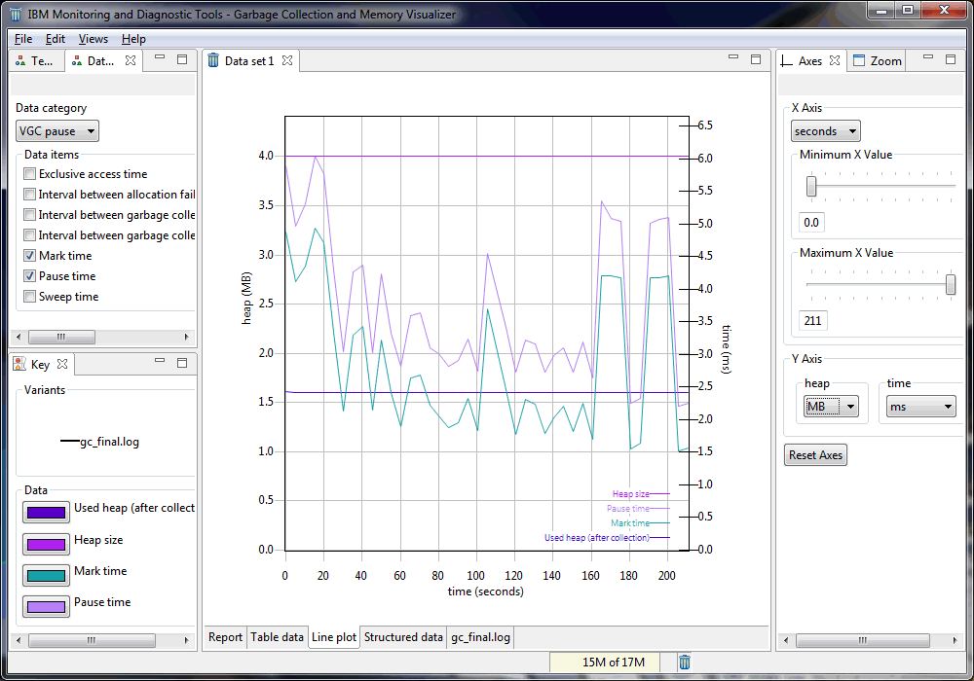
CSOM verbose:gc in GCMV
Notes:
This was free. There were no changes to the tool for this

Slide 43
Proof points
Integrated the toolkit into MRI and CPython
JIT support
Scalable garbage collection
Monitoring tools
Our emphasis has been on compatibility
Consistent behaviour for compiled code vs interpreted code
No restrictions on native code used by extension modules
All tests that ship with both languages continue to pass
We can run Rails

Slide 44
JIT integration
Ruby MRI and CPython do not have JIT compilers
Both environments are challenging for JIT compilers
Highly dynamic
Unmanaged direct use of internal data structures by extensions
Design choices in the runtimes themselves (e.g., setjmp/longjmp)
Our effort to date has particular emphases
Compile native instructions for methods and blocksConsistent behavior for compiled code vs. interpreted code
No restrictions on native code used by extension modules
No benchmark tuning or specials
Compatibility story: We can run Rails!
Performance story: 1.2x + on many Bench9k kernels on 3 architectures without tuning
Notes:
Neither language had JIT support before

Slide 45
Scalable garbage collection
Integrated GC into CPython and MRI
Type accurate, but used conservatively so extensions work as-is
CPython investigating reference count improvements and/or removal
MRI can move off-heap native memory into manageable heap
Provides performance improvement by moving data closer to objects
Perform mark and sweep operations in parallel
Verbose:gc and GCMV support out of the box
Notes:
Neither had parallel GC before

Slide 46
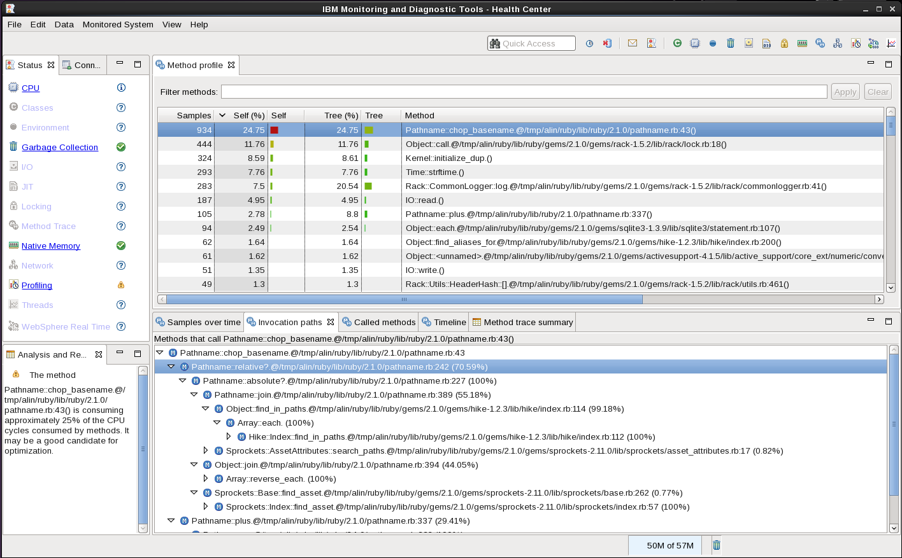
MRI method profiling via Health Center

Slide 47
We are keen to hear your feedback
Early results are very promising
Next steps
Open source components and features that are ready
Balance refactoring work against improving proof points
Engaging with communities and partners
Open request for feedback or interest to get involved!
Charlie Gracie Mark Stoodley John Duimovich
O/S GC Architect O/S Project Lead CTO, IBM Runtimes
charlie_gracie@ca.ibm.com mstoodle@ca.ibm.com john_duimovich@ca.ibm.com

Slide 48
More information
Daryl Maier - Wednesday, Oct 28, 1:00 p.m. | Hilton—Golden Gate 6/7/8
Beyond the coffee cup: Leveraging Java Runtime Technologies for Polyglot [CON7547]
Follow us on twitter
Charlie Gracie - @crgracie
Daryl Maier - @0xdaryl
Mark Stoodley - @mstoodle
Notes:
Neither had parallel GC before

Slide 49
Questions??
Any questions or comments?
Notes:
Neither had parallel GC before

Slide 50
Legal Notice
IBM and the IBM logo are trademarks or registered trademarks of IBM Corporation, in the United States, other countries or both.
Java and all Java-based marks, among others, are trademarks or registered trademarks of Oracle in the United States, other countries or both.
Other company, product and service names may be trademarks or service marks of others.
THE INFORMATION DISCUSSED IN THIS PRESENTATION IS PROVIDED FOR INFORMATIONAL PURPOSES ONLY. WHILE EFFORTS WERE MADE TO VERIFY THE COMPLETENESS AND ACCURACY OF THE INFORMATION, IT IS PROVIDED "AS IS" WITHOUT WARRANTY OF ANY KIND, EXPRESS OR IMPLIED, AND IBM SHALL NOT BE RESPONSIBLE FOR ANY DAMAGES ARISING OUT OF THE USE OF, OR OTHERWISE RELATED TO, SUCH INFORMATION. ANY INFORMATION CONCERNING IBM'S PRODUCT PLANS OR STRATEGY IS SUBJECT TO CHANGE BY IBM WITHOUT NOTICE.

