Slide 1
Empowering the NetBeans IDE with New Java Hints
HOL 2846
Martin Balin
Sr. Development Manager
Oracle
OOW/JavaOne Oct 27th, 2015

Slide 2
HOL staff
Karol Harezlak
Oracle, Principal Member of Technical Staff
David R. Heffelfinger
NetBeans DreamTeam
Martin Klähn
NetBeans DreamTeam

Slide 3
Content
Introduction
NetBeans APIs
Javac and NetBeans
Javac APIs in NetBeans
Code Transformation in NetBeans
Hints APIs
Lab - Java Antipaterns
4 hints to be developed

Slide 4
NetBeans APIs
More than 1530 classes with APIs
http://bits.netbeans.org/8.0/javadoc/
Platform extensions and development
Languages support
Editing
Javac integration

Slide 5
Javac integration
Javac:
has a well designed Java source code model including ASTs
is widely used and well tested
and its model are enhanced for all language changes immediately
NetBeans bundles and uses javac as Java source modeling library

Slide 6
NetBeans javac - nbjavac
Slight enhancements to javac needed to improve its capabilities when used from IDE
Error recovery (better AST for erroneous source code and attributing all AST nodes, incl. invalid source code)
Support for canceling
Parsing AST from source for Elements loaded from .class files
Stable anonymous innerclass numbering
Trees.getElement enhanced to work on all AST nodes
nb-javac

Slide 7
Code transformation options in NetBeans
Possibilities to manipulate Java code in NetBeans
Custom use of javac & java.source API
Plugin into Java Hints (imperative, error rules, pattern based) - available in editor and Inspect & Transform
Upgrade rules

Slide 8
Javac API
Trees API (com.sun.source.tree)
Elements API (javax.lang.model.element)
Interfaces used to model elements of the Java programming language. Includes classes, interfaces, methods, constructors, and fields not constructs like for-loop
TypeMirror API (javax.lang.model.type)
Interfaces to model Java programming language types
Utilities (Trees, Elements, Types)

Slide 9
java.source API
Integrates single threaded javac into the IDE
Defines a threading & memory model for javac operations
Synchronous Tasks invoked by user code
scheduled tasks automatically invoked by event eg. source modification
Parsing result passed to the tasks (CompilationInfo, CompilationController, WorkingCopy)
Tree node factory (TreeMaker)
Source file index (ClassIndex)
Utilities (TreeUtilities, ElementUtilities, TypeUtilities, GeneratorUtilities)

Slide 10
Upgrade Rules
Both Hint & Fix described by pattern
Suitable for deprecation replacement
Example:
"Use FileObject.toURI":
$f.getURL().toURI() :: $f instanceof org.openide.filesystems.FileObject
=> $f.toURI();;

Slide 11
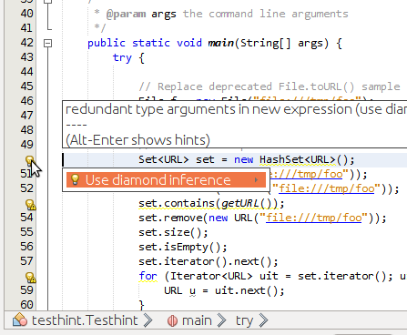
Java Hints
SPI to check for and replace problematic parts of code
Possible to perform even refactorings
Main APIs:
org.netbeans.spi.editor.hints
org.netbeans.spi.java.hints

Slide 12
Java Hints development
Part of NetBeans module project
Java Hints template is the simplest way to start
NetBeans hint is registered to IDE through
Generated-layer.xml file
More at https://platform.netbeans.org/tutorials/nbm-java-hint.html

Slide 13
Java Hints most used classes
HintContext
Access to CompilationInfo
Access to matched AST (TreePath)
Access to variables ASTs ($<name> - match exactly one occurrence)
Access to multiple variables ASTs ($<name>$ - match 0 to N occurrences)
TransformationContext
Used to rewrite code when hint provides also fix
Passed in JavaFix.performRewrite method
Provides access to CompilationInfo and TreePath as well

Slide 14
Prepare the environment
VM setup, code cloning,…

Slide 15
Prepare the environment
Start HOL2846 VM on your desktop
Run “refresh.bat” on Windows VM desktop
Start NetBeans – you will see HintsHOL2015 project open
Select File | Open Project … navigate to “C:\Users\Lab\demos”
Open projects HintsHOLWorking and TestHints
HintsHOLWorking - empty project where we will work
TestHints - project with simple java file to test hints being developed
HintsHOL2015 - contains all hints prepared and we will use it for reference and Copy&Paste code

Slide 16
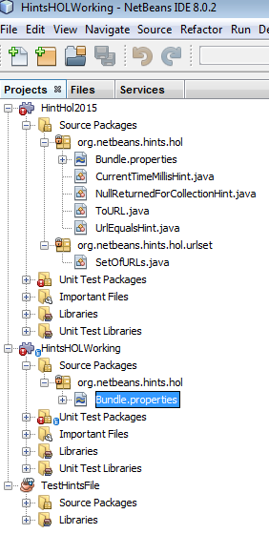
Environment ready for Lab
Your NetBeans should look like this after preparation is done
Red error badges are due to missing reference to Junit which we don’t need during our Lab.

Slide 17
Java Anti-patterns Hints - Lab
4 samples

Slide 18
Java Anti-patterns Hints - Lab
Replace System.currentTimeMillis() with nanoTime()
Fix deprecated File.toURL() call using URI
Replace URL.equals() with URI.equals(URI)
Replace 'return null' by an empty array or an empty parameterized type
Convert Set<URL> to Set<URI> - Hint of refactoring scale

Slide 19
Lab 1 - Replace System.currentTimeMillis() by nanoTime()
currentTimeMillis() expresses current time milliseconds since midnight, January 1, 1970 UTC. Can be changed in the middle of operation by polling a value from the NTP server – then time difference by 2 subsequent calls can be even negative
nanoTime – returns nanoseconds. Needs to be divided by 1mio to get ms.
For reference see CurrentTimeMillisHint from HintsHOL2015 project

Slide 20
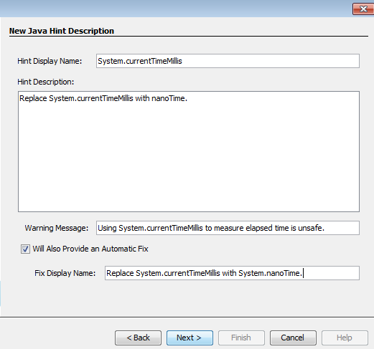
Lab1/Step 1 - Replace System.currentTimeMillis()
Create a new Java Hint
Select project HintsHOLWorking
Press Ctrl+N and select Java Hint for New File type, press Next

Slide 21
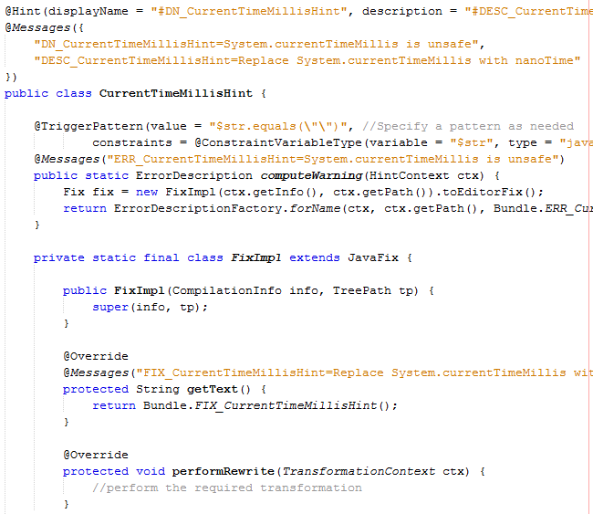
Lab1/Step 2 - Replace System.currentTimeMillis()
Enter class name: CurrentTimeMillisHint to last step of wizard.
Press Finish
You should see something like this

Slide 22
Lab1/Step 3 - Replace System.currentTimeMillis()
Modify TriggerPattern
@TriggerPattern(value = "$1.currentTimeMillis",
constraints = @ConstraintVariableType
(variable = "$1", type = "System"))
Leave computeWarning() method untouched
Build the project and run current Hint in debugger press Ctrl+F5
In debugged NetBeans open project TestHintsFile and its only file Testhint.java.
You should see hints warning is displayed for System.currentTimeMillis() call

Slide 23
Lab1/Step 4 - Replace System.currentTimeMillis()
Implement JavaFix inside performRewrite():
final TreeMaker maker = ctx.getWorkingCopy().getTreeMaker();
final TreePath tp = ctx.getPath().getParentPath();
if (tp.getLeaf().getKind() != Tree.Kind.METHOD_INVOCATION){
return;
}
final MethodInvocationTree mit = (MethodInvocationTree) tp.getLeaf();
final MemberSelectTree selector = (MemberSelectTree)mit.getMethodSelect();
final ExpressionTree expr = selector.getExpression();

Slide 24
Lab1/Step 5 - Replace System.currentTimeMillis()
final MethodInvocationTree ns = maker.MethodInvocation(Collections.<ExpressionTree>emptyList(),
maker.MemberSelect(expr, "nanoTime"), Collections.<ExpressionTree>emptyList());
// conversion from nanosec to milisec – optional
final ExpressionTree ms = maker.Binary(Tree.Kind.DIVIDE, ns, maker.Literal(1000000));
ctx.getWorkingCopy().rewrite(tp.getLeaf(), ms);
Add all missing imports
Save and Compile the project

Slide 25
Lab1/Step 6 - Replace System.currentTimeMillis()
Debug current file to see if Hint works.

Slide 26
Lab 2 - Fix deprecated File.toURL() by File.toURI().toURL()
Why is this anti-pattern?
Deprecated API

Slide 27
Lab 2/Step 1 - Fix deprecated File.toURL()
Create a new Java Hint
Select project HintsHOLWorking
Press Ctrl+N and select Java Hint for New File type, press Next
Fill all fields, e.g.
Hint Display Name: “Deprecated File.toURL() call”
Click Next, enter Class name: “ToURL”
Finish
New Java Hint named ToURL is created

Slide 28
Lab 2/Step 2 - Fix deprecated File.toURL()
Write down TriggerPattern
@TriggerPattern(
value = "$file.toURL()",
constraints = {
@ConstraintVariableType(variable = "$file", type ="java.io.File")
})
Save, Compile and Debug to check in Testhints.java file.

Slide 29
Lab 2/Step 3 - Fix deprecated File.toURL()
Leave computeWarning() untouched
Write the code into performRewrite() method:
final WorkingCopy tx = ctx.getWorkingCopy();
final TreeMaker maker = tx.getTreeMaker();
final TreePath match = ctx.getPath();
final MethodInvocationTree callTree = (MethodInvocationTree) match.getLeaf();
final Tree methodSelectTree = callTree.getMethodSelect();
CharSequence toURL;
ExpressionTree target;
This code finds variable and method call

Slide 30
Lab 2/Step 4 - Fix deprecated File.toURL()
Finding current variable identifier and method:
if (methodSelectTree.getKind() == Tree.Kind.MEMBER_SELECT) {
final MemberSelectTree selectTree = (MemberSelectTree) methodSelectTree;
toURL = selectTree.getIdentifier();
target = selectTree.getExpression();
} else {
toURL = ((IdentifierTree) methodSelectTree).getName();
target = null;
}

Slide 31
Lab 2/Step 5- Fix deprecated File.toURL()
Replacing deprecated call:
final MethodInvocationTree updatedCallTree = maker.MethodInvocation(
Collections.<ExpressionTree>emptyList(),
maker.MemberSelect(
maker.MethodInvocation(Collections.<ExpressionTree>emptyList(),
target != null ?
maker.MemberSelect(target, "toURI") : //NOI18N
maker.Identifier("toURI"), //NOI18N
Collections.<ExpressionTree>emptyList()),toURL),
Collections.<ExpressionTree>emptyList());
tx.rewrite(callTree, updatedCallTree);

Slide 32
Lab 2/Step 6 - Fix deprecated File.toURL()
Add all imports
Save file
Compile it
Run in debugger

Slide 33
Lab 3 - Replace URL.equals() with URI.equals(URI)
JavaOne 2007: “the URL object's equals() method is, in effect, broken. In this case, two URL objects are equal if they resolve to the same IP address and port, not just if they have equal strings. However, Bloch and Pugh point out an even more severe Achilles' Heel: the equality behavior differs depending on if you're connected to the network, where virtual addresses can resolve to the same host, or if you're not on the net, where the resolve is a blocking operation. Don't use URL; use URI instead. URI makes no attempt to compare addresses or ports. In addition, don't use URL as a Set element or a Map key.”
http://docs.oracle.com/javase/8/docs/api/java/net/URL.html#equals-java.lang.Object-
http://docs.oracle.com/javase/8/docs/api/java/net/URI.html#equals-java.lang.Object-

Slide 34
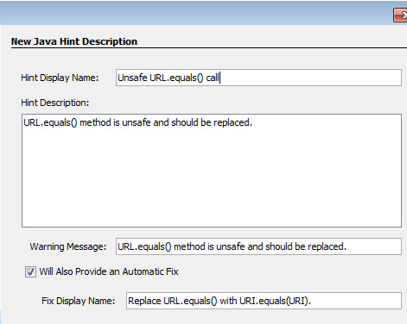
Lab 3/Step 1 - Replace URL.equals() with URI.equals(URI)
Create a new Java Hint in HintsHOLWorking project
In the next step name the class UrlEqualsHint
Finish the wizard
Ignore or delete created unit test.

Slide 35
Lab 3/Step 2 - Replace URL.equals() with URI.equals(URI)
Create TriggerPattern
@TriggerPattern(value = "$url1.equals($url2)",
constraints = {
@ConstraintVariableType(variable = "$url1", type = "java.net.URL"),
@ConstraintVariableType(variable = "$url2", type = "java.net.URL")
}
)
Keep computeWarning() as it was generated

Slide 36
Lab 3/Step 3 - Replace URL.equals() with URI.equals(URI)
Modify performRewrite() method:
final TreeMaker maker = ctx.getWorkingCopy().getTreeMaker();
final Tree t = ctx.getPath().getLeaf();
if (t.getKind() != Tree.Kind.METHOD_INVOCATION)
return;
final MethodInvocationTree mit = (MethodInvocationTree) t;
final ExpressionTree param = mit.getArguments().get(0);
final MemberSelectTree selector = (MemberSelectTree)mit.getMethodSelect();
final ExpressionTree expr = selector.getExpression();
Here we’ve found tree elements to be modified.

Slide 37
Lab 3/Step 4 - Replace URL.equals() with URI.equals(URI)
Complete rewrite with replacing variable and arguments with new ones:
final MethodInvocationTree exprToUri = maker.MethodInvocation( Collections.<ExpressionTree>emptyList(), maker.MemberSelect(expr, "toURI"), Collections.<ExpressionTree>emptyList());
final MethodInvocationTree paramToUri = maker.MethodInvocation( Collections.<ExpressionTree>emptyList(), maker.MemberSelect(param, "toURI"), Collections.<ExpressionTree>emptyList());
// expr.toURI().equals(param.toURI()) is created
final Tree nue = maker.MethodInvocation( Collections.<ExpressionTree>emptyList(), maker.MemberSelect(exprToUri, "equals"), Collections.singletonList(paramToUri));
ctx.getWorkingCopy().rewrite(t, nue);

Slide 38
Lab 3/Step 5 - Replace URL.equals() with URI.equals(URI)
Add all imports
Save file
Compile it
Run in debugger

Slide 39
Lab 4 - Replace 'return null' by an empty array or an empty parameterized type
Eliminate the risk of NullPointerException
Client code does not have to check for null return value
Code becomes shorter, more readable and easier to maintain

Slide 40
Lab 4/Step 1 - Replace 'return null' by an empty array …
Create a new Java Hint in HintsHOLWorking project.
Name the class NullReturnedForCollectionHint

Slide 41
Lab 4/Step 2 - Replace 'return null' by an empty array …
Write down TriggerPattern
@TriggerPattern(value = "return null")
Very simple, but needs to be accompanied by checking method return type in computeWarning() and performRewrite()
We will implement 2 helper methods to check the return type
1st one getReturnType checks for return type – needs to be
array or
special valid type – parameterized type with special handling in Collections class, e.g. Collections.emptySet() method or similar one
https://docs.oracle.com/javase/8/docs/api/java/util/Collections.html

Slide 42
Lab 4/Step 3 - Replace 'return null' by an empty array …
Coding helper methods, see the HintsHOL2015/NullReturnedForCollectionHint
public static Pair<Tree,TypeMirror> getReturnType(CompilationInfo cI, TreePath entry)
public static boolean isValidType(CompilationInfo cI, TypeMirror type)
Add check for return type into computeWarning()
if (null == getReturnType(ctx.getInfo(), ctx.getPath()))
return null;
Fix fix = new FixImpl(ctx.getInfo(), ctx.getPath()).toEditorFix();
Add imports, save, compile and run in debugger to see it works

Slide 43
Lab 4/Step 4 - Replace 'return null' by an empty array …
Performing Rewrite inside performRewrite()
See code in HintsHOL2015/NullReturnedForCollectionHint
Special treatment of Parameterized types – to return exact empty type using Collections.emptyXYZ() method
Or return e.g. new HashMap<>() for non-abstract types
Or create empty arrays for return statement: return new long[0][0];

Slide 44
Lab 4/Step 5 - Replace 'return null' by an empty array …
Compile and run in debugger
Test it on a set of getXYZ methods at the bottom of Testhints.java file

Slide 45
Lab 5 - Convert Set<URL> to Set<URI> - Refactoring scale
Hint which performs complete refactoring of code when replacing Set<URL> with URI
Needs to check all declarations
Uses class Finder extends TreePathScanner<Collection<? extends TreePath>, Void>
Very complex hint
Recommended to study and as a good start if you want to code complex NetBeans JavaHint
See HintsHol2015/org.netbeans.hints.hol.urlset/SetOfURLs

Slide 46
Samples
Samples can be found at
http://hg.netbeans.org/demos/
$ Hg pull http://hg.netbeans.org/demos/

Slide 48
Thank you

