Slide 1
Deploying Elastic Java EE Microservices in the Cloud with Docker
Steve Millidge : Founder Payara

Slide 2
What are we Trying to Do!

Slide 3
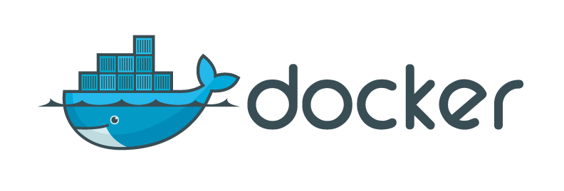
2 Hours: Microservice -> Cloud

Slide 4
More Information and Code
REST Payara JCache Example Code
https://github.com/payara/Payara-Examples/tree/master/rest-examples/rest-jcache
Docker File Example
https://github.com/smillidge/JavaOne-Docker-Example
Payara Micro Docker Image (Just Add WAR)
https://hub.docker.com/r/payaradocker/j1-payara-micro/
Payara GitHub Project
https://github.com/payara/Payara
Payara Web Site
http://www.payara.fish

Slide 6
What is a Microservice?
In computing, microservices is a software architecture style in which complex applications are composed of small, independent processes communicating with each other using language-agnostic APIs.
Wikipedia

Slide 7
What is a Microservice?
The term "Microservice Architecture" has sprung up over the last few years to describe a particular way of designing software applications as suites of independently deployable services. While there is no precise definition of this architectural style, there are certain common characteristics around organization around business capability, automated deployment, intelligence in the endpoints, and decentralized control of languages and data.
Martin Fowler

Slide 8
Why Java EE and not ######?
Java EE is incredibly lightweight
Rapid to develop
Majority of alternative Java frameworks based on Java EE
Concentrate on building business functionality
Produces small skinny wars
Versioned runtime – aids operations

Slide 9
Let’s Build a Micro-service!
JAX-RS – JSON-Cache
Use JCache apis
Key – Value Store
PUT puts JSON to a Key
GET gets JSON from a Key

Slide 10
Coding Interlude

Slide 11
JCache
Standard Java API for Caching
JSR107
API and CDI binding
Supported by Many Cache Providers
Built in to Payara
Uses Hazelcast
Hazelcast JCache can be added to other JavaEE runtimes

Slide 12
JCache CDI
@CacheResult
Caches the result of a method call
@CachePut
Cache a specific method parameter
@CacheRemove
Removes a cache entry based on parameters
@CacheRemoveAll
Removes all entries in the cache

Slide 13
Coding Interlude

Slide 14
Skinny WAR
JAX-RS – 5Kb in Size
No messing with Maven
Tooling is great
Only contains what you Need!
No need to assemble a Runtime
Use a well known Versioned Runtime
Aids Operations
You don’t have to test it

Slide 15
What is Payara Micro
Small Footprint Based from GlassFish Runtime (60Mb)
Used GlassFish’s Java EE Web Profile Support
Embeds JCache Support
Auto clusters using Hazelcast
Fully Embeddable API – (Fat Jar anybody)
Designed for microservices (Easily deployable)
Designed for Cloud (Elastic)
java –jar payara-micro.jar –deploy test.war

Slide 16
Demonstration Interlude

Slide 17
What is Docker?
Docker containers wrap up a piece of software in a complete filesystem that contains everything it needs to run: code, runtime, system tools, system libraries – anything you can install on a server. This guarantees that it will always run the same, regardless of the environment it is running in.
Docker Website

Slide 18
Docker Layers
WAR
Java
Operating System
Payara Micro
Described by Dockerfile

Slide 19
Essentially What Does this Mean
Unit Test
Package WAR
Create Docker Image
Test Image
Deploy Image to Production
Push to Repository
Pull from Repository
Standardised OS Image runs on
many environments
Aids Continuous Delivery Pipeline

Slide 20
Coding Interlude

Slide 21
What we’ve just done!
Create Docker Image
Test Image
Deploy Image to Production
Push to Repository
Pull from Repository

Slide 22
What is Elastic Beanstalk
With Elastic Beanstalk, you can quickly deploy and manage applications in the AWS cloud without worrying about the infrastructure that runs those applications. AWS Elastic Beanstalk reduces management complexity without restricting choice or control. You simply upload your application, and Elastic Beanstalk automatically handles the details of capacity provisioning, load balancing, scaling, and application health monitoring.
Amazon

Slide 23
Simple Elastic Beanstalk Architecture
Internet
Monitors Health
Auto-spins up containers
Elastic Load Balancer
Docker Container
Docker Container
Docker Container
Docker Container

Slide 24
Coding Interlude

Slide 25
What we’ve just done!
Create Docker Image
Test Image
Deploy Image to Production
Push to Repository
Pull from Repository

Slide 26
Summary
Create Skinny WAR
Use Micro Java EE runtime
Package in Docker
Run in Production

Slide 27
More Information and Code
Docker File Example
https://github.com/smillidge/JavaOne-Docker-Example
REST Payara JCache Example Code
https://github.com/payara/Payara-Examples/tree/master/rest-examples/rest-jcache
Payara Micro Docker Image (Just Add WAR)
https://hub.docker.com/r/payaradocker/j1-payara-micro/
Payara GitHub Project
https://github.com/payara/Payara
Payara Web Site
http://www.payara.fish

Slide 28
Questions

