Slide 1
NetBeans & HTML5
Ryan Cuprak

Slide 2
NetBeans & HTML5
Notes:
One of the things that many Java developers and also JavaScript don’t realize is that in NetBeans we have one of the best HTML5/JavaScript IDEs.
Note, I said IDE as opposed to editor. NetBeans is much more than just an editor – as you’ll see it provides all of the features that you would expect in an integrated development environment. You get debugging, integration with a build system etc.
NetBeans has been adding support for HTML5 over the last several years – each set of features incrementally improving the IDE.
As I learned last night, Oracle is making heavy investments in NetBeans to support their work on JavaScript frameworks.

Slide 3
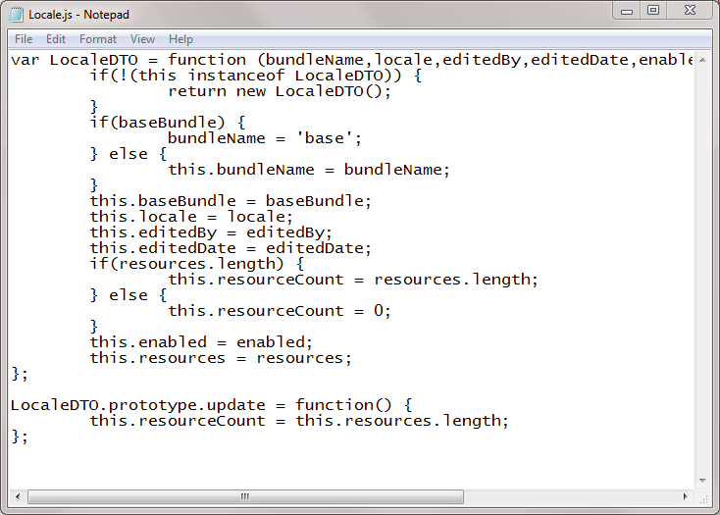
NetBeans & HTML5
HTML5 Editors
NetBeans 8+ (free!)
WebStorm ($99)
VisualStudio 2015 ($500)
Eclipse (with JSDT)
Komodo ($99/295)
Sublime Text ($70)
Notepad/vim/emacs
Notes:
Now, NetBeans is just one of a number of HTML5 IDEs out there.
The three best IDEs are probably NetBeans, WebStorm and VisualStudio.
One thing to realize is the scope of NetBeans support – ranges from Node.js to your standard browser web development to mobile frameworks such as Cordova.

Slide 4
NetBeans & HTML5
NetBeans HTML5 Support
Fully integrated - no need for additional plugins!
Code completion
Syntax highlighting
Debugging
Flexible project structure
HTML5 native
Build systems: Grunt and Gulp
Unit testing: Karma, Jasmine, etc.
CSS: CSS3, SASS, LESS
Browser integration
NetBeans does not force you into its idea of an HTML5 project.
Notes:
In terms of functionality – NetBeans has
No need to install plugins

Slide 5
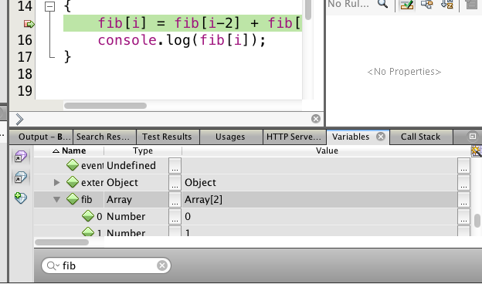
NetBeans & HTML5
Debugging
Breakpoints on DOM, line, event, and XMLHttpRequests.
Callstack, variables, watches
Notes:
Integrated debugger – while it isn’t a replacement for the debugger in Chrome, it is an easy way to start debugging. NetBeans is my first line of defense.

Slide 6
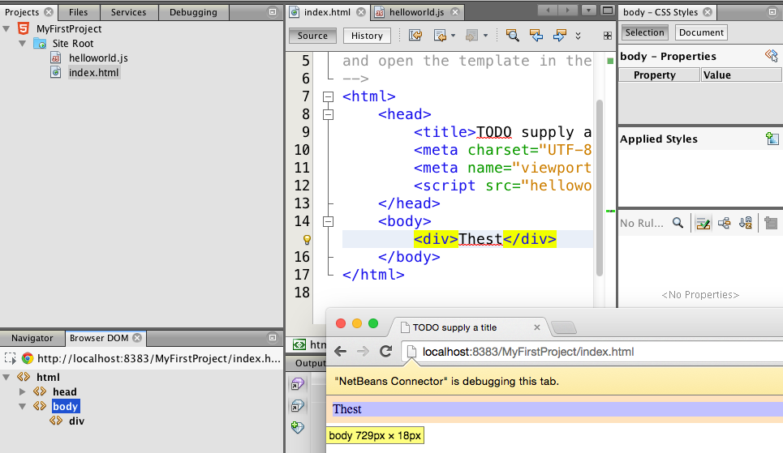
NetBeans & HTML5
Browser Integration
DOM Browser selects elements in Chrome and displays CSS information.
Changes in source files are reflected instantly in Chrome.

Slide 7
NetBeans & HTML5
End-to-End
Mobile (Cordova)
Browser
Node.js

Slide 8
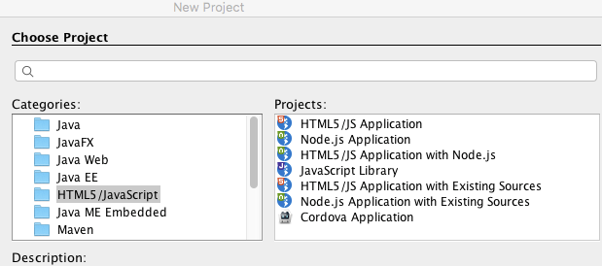
NetBeans & HTML5
Easy to start!

Slide 9
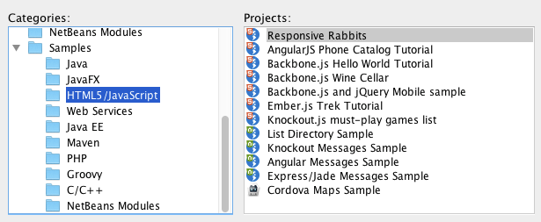
NetBeans & HTML5
Example Projects

Slide 10
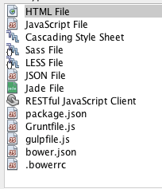
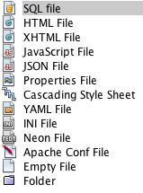
NetBeans & HTML5
HTML5 File Templates/Editors
HTML5
Unit Testing
Other

Slide 11
NetBeans & HTML5
Demo

