Slide 1
The Health of Networks
JavaOne 2015
by Csaba Toth

Slide 2
About me
Csaba Toth
csaba.toth.us@gmail.com
Twitter: @tocsa2
LinkedIn: http://www.linkedin.com/in/csabatothdev
Polyglot full-stack developer (C++, Java, C#, Python)
Co-founder of Nashville JUG
Founder of Central California JUG
Living in Fresno

Slide 3
Agenda
Summary of my two JUGs I’m affiliated with
Three pillars of tech meetups
Lessons learned
Take aways
Scope: both JUGs are in the US

Slide 4
Three pillars
1. Quality content
2. Venue
3. Food (+ swags)
(+ Shared leadership)
The key is always: the member should get satisfactory experience for his time and effort!

Slide 5
Java User Groups
Nashville Java User Group, co-founded in 2010
Central California Java User Group, founded in 2014

Slide 6
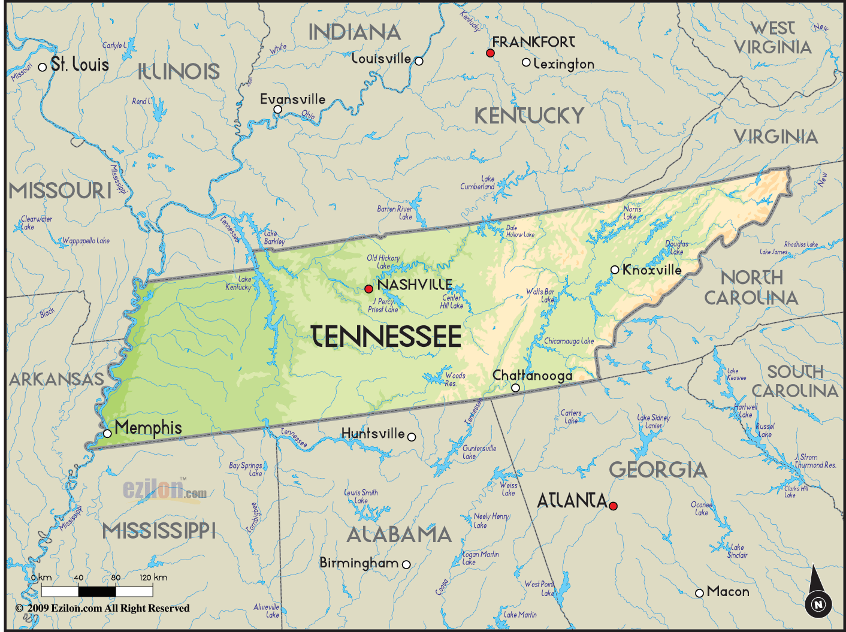
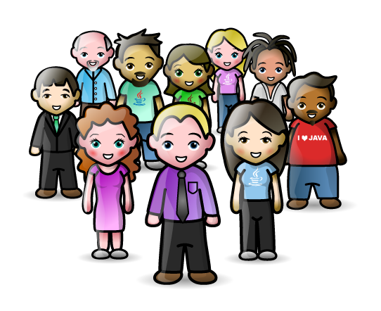
Nashville
Notes:
Central location in Tennessee
Booming tech industry
Google Fibre is being introduced right now
There is blossoming tech meetup scene (.NET, Linux UG, Functional Programming, PHP, ...)
Awesome low-cost 2-3 day conferences nearby
Needed a Java User Group too!

Slide 7
Nashville JUG
There was a functioning JUG in Nashville before 2006 but it got dissolved
Maybe the JUG was dependent on the leader?
Maybe there were content issues?
Many things depend on the companies around
Takeaway: it matters how many/how big companies are Java shops
Takeaway: dissolved JUG is good and bad news

Slide 8
Nashville JUG
Takeaway 2 - by Dr JUG:
A JUG can dissolve if it mainly depends on a sole person and that person steps down
In 2010 I met with Greg Turnquist (from SpringSource – now VMWare) at DevLink conference in Nashville, where I initiated a Java talk in the open spaces section
We decided to found NJUG

Slide 9
Nashville JUG – Beginning
First 3 meetings were at Vanderbilt University
Greg presented
We initiated a site on Posterous to cover multiple social media channels
I tried to distribute flyers and at least motivate Java developers at Vanderbilt
The attendance was very low
Takeaway1: it may take a long tiem to boot up Takeaway2: members may not only come from where you think / focus

Slide 10
Nashville JUG – Early Days
Kerry Wilson joined the leadership board
He helped to move the meetings to VACO
a local recruiter, hosts other user groups too
Food/pizza + drinks (including beer) provided
Good internet access and projector, screen
Much better parking compared to Vanderbilt
He also spread the word
Takeaway1: good venue is important
Takeaway2: helpers come along

Slide 11
Nashville JUG – Growing
Attendance slowly started to rise.
When Oracle visited us to give an insight about the upcoming Java 7 our attendance was still not too high
Chris Mihalcik joined the board and he advised to put our main site to Meetup
The subscription costs money
Takeaway1: Meetup - looking back it worth it

Slide 12
Nashville JUG – Growing
Our attendance ramped up above 20
Jeremy Ary and Josh Murphy joined the board
Jeremy designed T-shirts and logo
Helped with other errands
We got to know great presenters and developers like David Escandell and Jim Siegienski, who also help in the leadership board
Takeaway: worth looking for and involving excellent local presenters

Slide 13
Nashville JUG – Raffles
Raffles
We got 5 text books from O’Reilly and also from Oracle, we raffle one per meeting
E-book vouchers from O’Reilly
We got a lot of Java 7 T-shirts
Food is important!
Takeaway: Oracle’s JUG program can help a lot

Slide 14
Nashville JUG – Presenters
Early presenters:
Greg Turnquist: different topics about testing, Spring introduction, Security, Spring Roo
Zach McCormick presented 3 times on Android
Eliah Minor on bad JavaScript habits for Java programmers
Oracle
Takeaway: it’s beneficial to invite inter-meetup presenters, co-operate, plug-in to the local meetup scene

Slide 15
Nashville JUG – Budget
Absolutely no budget, we don’t deal with money Some user group goes to non-profit
Chapter 3, 5, 7 ???
There are some opportunities to get help, in the $100-$150 range, they’ll do all work
Can be inevitable if you organize a conference
VACO and some sponsors are willing to chip in if we’ll organize a conference

Slide 16
Nashville JUG – Now
More than 600 members* on Meetup
30+ attendees per meeting
There seems to be enough people in the leadership board and enough momentum that it won’t dissolve (I moved away and Greg is not always there)

Slide 17
Nashville JUG
Joined the JCP - Easy to do

Slide 18
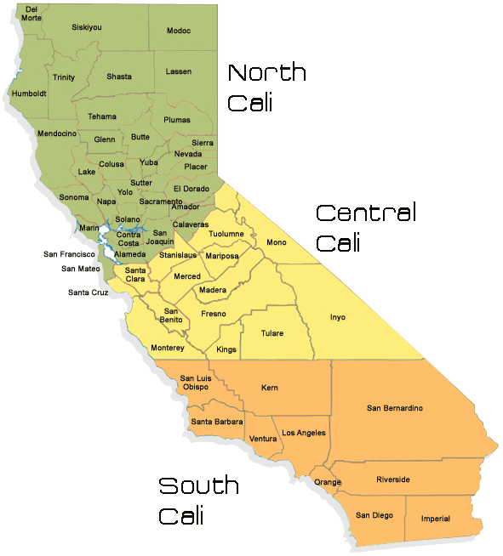
Central California JUG

Slide 19
Central California
Agriculture
But there’s a blossoming meetup scene, much smaller though than Nashville
Needs a JUG!

Slide 20
Central California JUG
Founded in 2014 summer
I provided a presentation in the beginning
PlayN framework
Java 2014 recap
…
Venue and food is taken care of Bitwise Industries (local tech incubator hub) - THANKS!
Many members and first timers are beginners
There are a few advanced developers

Slide 21
Central California JUG
80+ members on meetup
But low attendance
Started to watch vJUG recordings and add annotations
Takeaway: people expect live content. Although James Gosling is better speaker, they want local presenter. They also think they gonna watch the YouTube recording…

Slide 22
Central California JUG
Plans:
Will provide local content on beginner topics
May try to attract kids with Minecraft modding
Some conversation about book reading
Co-operating with other meetups
Involve more people in the leadership

Slide 23
Thanks for listening
Questions?
Csaba Toth
http://www.linkedin.com/in/csabatothdev

Slide 24
The Health of Networks
JavaOne 2015
by DrJUG

Slide 25
About me
Daniel deOliveira (DrJUG)
daniel@drjug.inf.br
Twitter / Facebook / Skype: danieldfjug
Site: http://www.dfjug.org/drjug
DFJUG JUG Leader
Founding Java Champion
Researcher University of Kent
Living in Canterbury (UK)

Slide 26
Agenda
User Groups Structure
People not technology
JUGs Life & Death
JUGS are Teaching/Learning Machines
Social Responsibility of JUGs
User Groups Demography (video)
There's a world surrounding your JUG

Slide 27
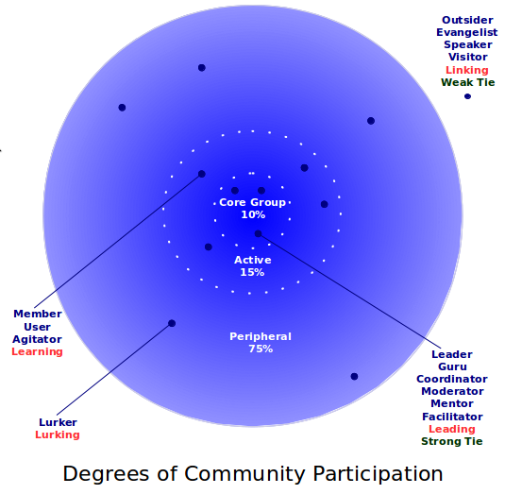
User Groups Structure

Slide 28
Social Responsibility of JUGs
THE JAVA COMMUNITY CARES!
JUG Sardegna (Italy) with Jug4Avis
DFJUG (Brazil) with JEDI, GreenFootBR, Rybená
BeJUG, BruJUG and WaJUG (Belgium) for Devoxx4Kids.

Slide 29
Thanks for listening
Questions?
DrJUG
http://www.dfjug.org/drjug

