Slide 1
GlassFish Performance Tuning: Tips from the Field
Steve Millidge : Founder Payara

Slide 2
First Day at Work

Slide 3
It’s All Gone to *#*@!

Slide 5
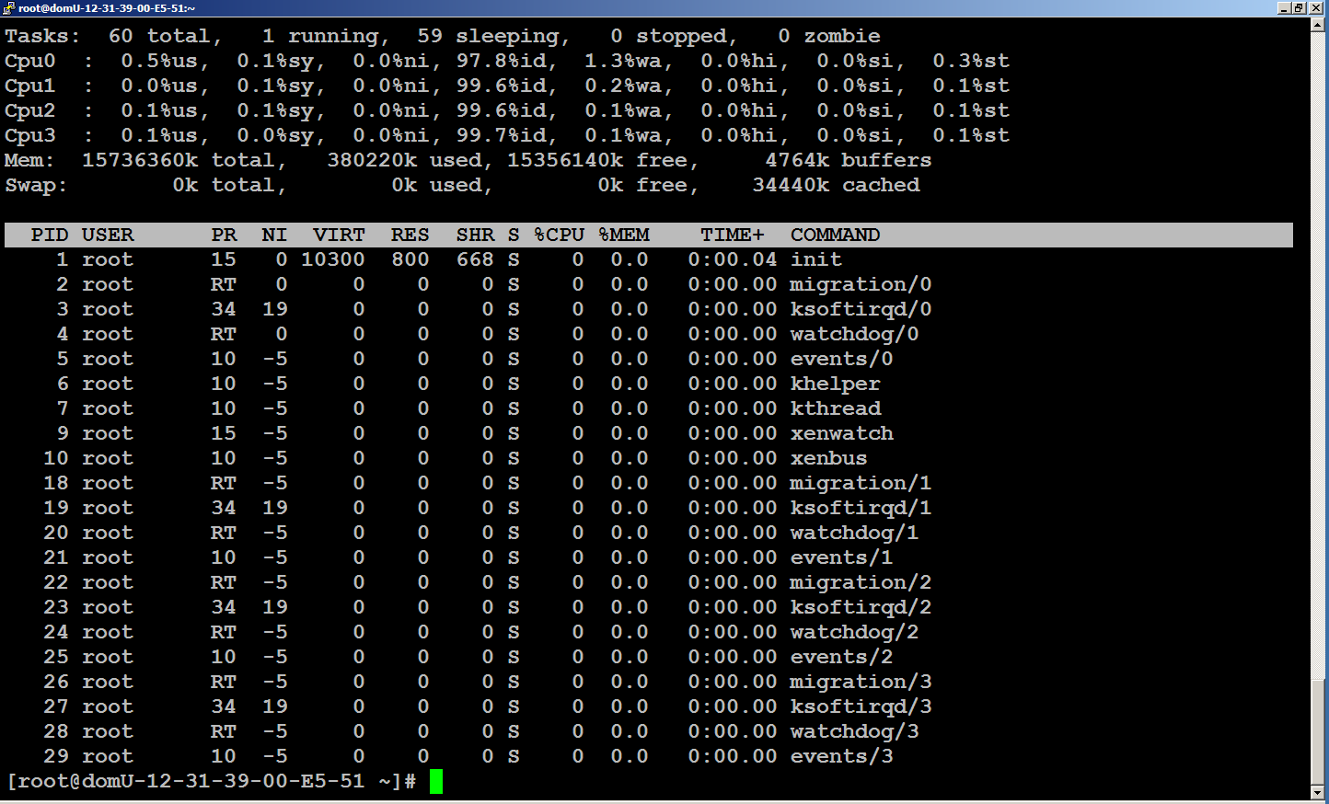

Slide 6
asadmin discovery commands
version
What version are we running
list-domains
Discover what domains exist and are running
list-servers and list-clusters
what exists in the domain
list-modules
What is running in the domain
list-applications
Lists all the applications deployed
list-commands
Lists all knows asadmin commands

Slide 7
What are we looking for?
Notes:
We need to know if this is going to happen again
We need to know why this happened this time
How do we do this?

Slide 8
Barriers to Performance
Raw Algorithmic Performance
Resource Limitations
Not enough cpu, disk, memory
Resource Contention
Locks
IO Latency
Network, Disk
Notes:
Algorithmic Performance can be helped with profilers etc. in my experience a very rare performance issue in a production system
Resource Limitations require tuning and ability to scale yourself out of the problem (See scalability)
If you can’t scale you will hit a wall
Resource contention requires careful tuning as you can’t scale your way out of this problem you must architect and design your system to

Slide 9
Tuning Process
Measure
Analyse
Hypothesis
Change
Test

Slide 10
Analyse
Analyse data to correlate issues
Use tools during the performance issue
Use historical data for trends
Look for evidence of Barriers

Slide 11
Hypothesis
Use EVIDENCE from tools
Create a causal hypothesis
Determine fix that will mitigate

Slide 12
Change
Change ONE thing
Configuration Changes
Try these first
Many Many things in App Servers to change
Code Changes
Only optimise when you have evidence
Document all Changes

Slide 13
Test
Create reproducible test case
(If Possible)
Test Before and After
Gather Evidence of effect of Change

Slide 14
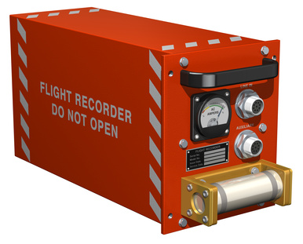
How do we Measure GlassFish?
Notes:
We need to know if this is going to happen again
We need to know why this happened this time
How do we do this?

Slide 15
Standard JVM Tools
JPS – Discover running Java process
Jstack – View Stack Trace
Jstat – view Garbage collection and other statistics
JVisual VM
Mission Control

Slide 16
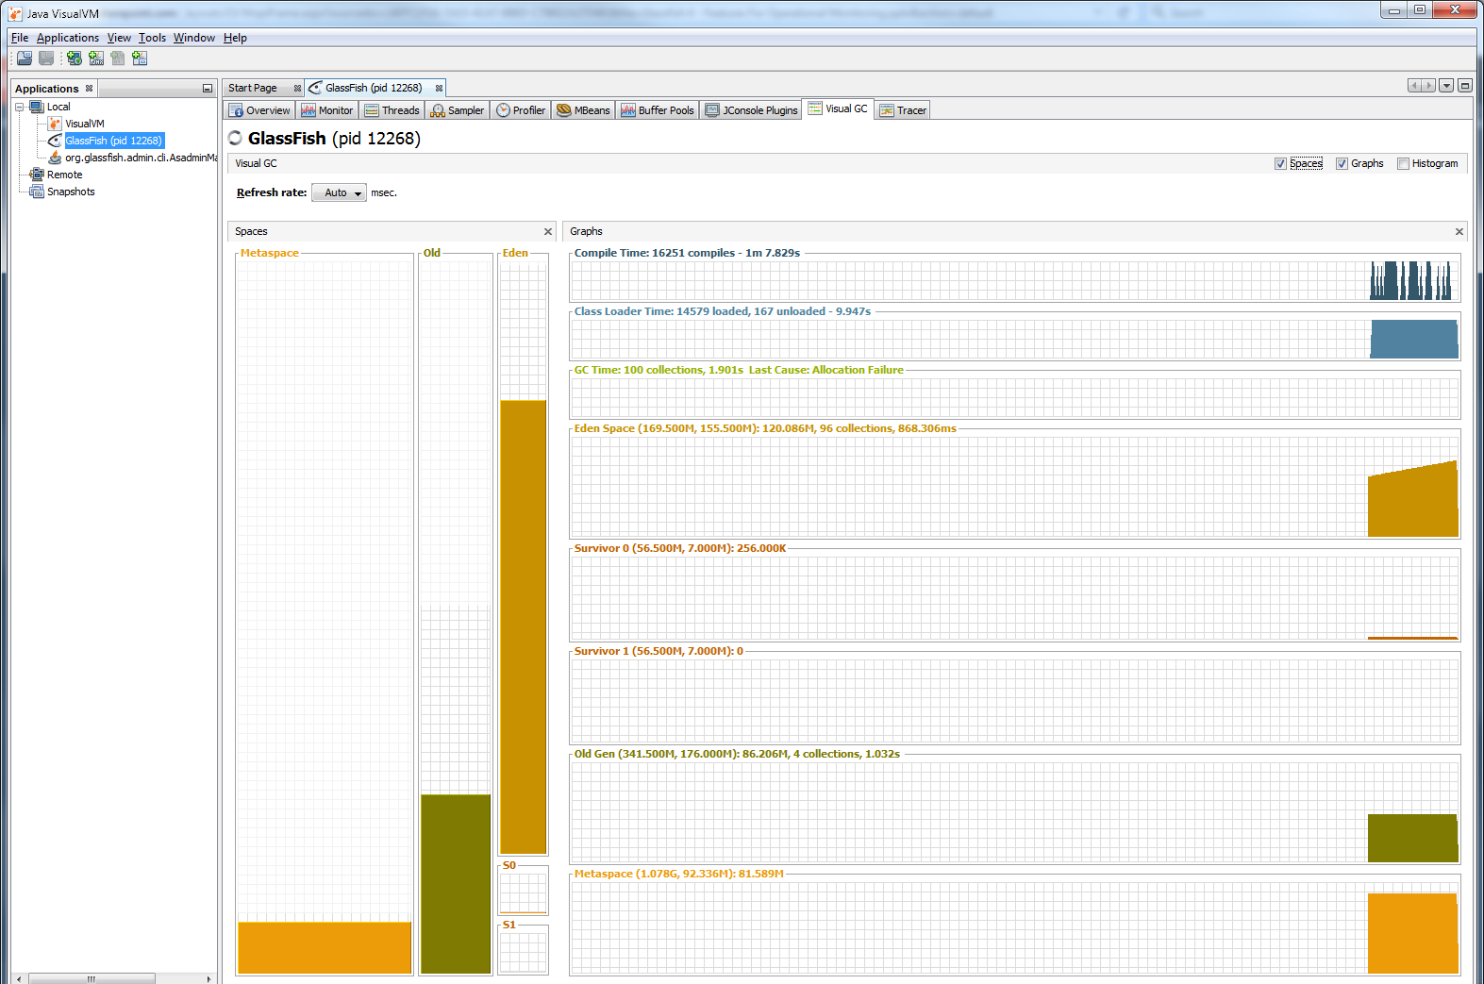
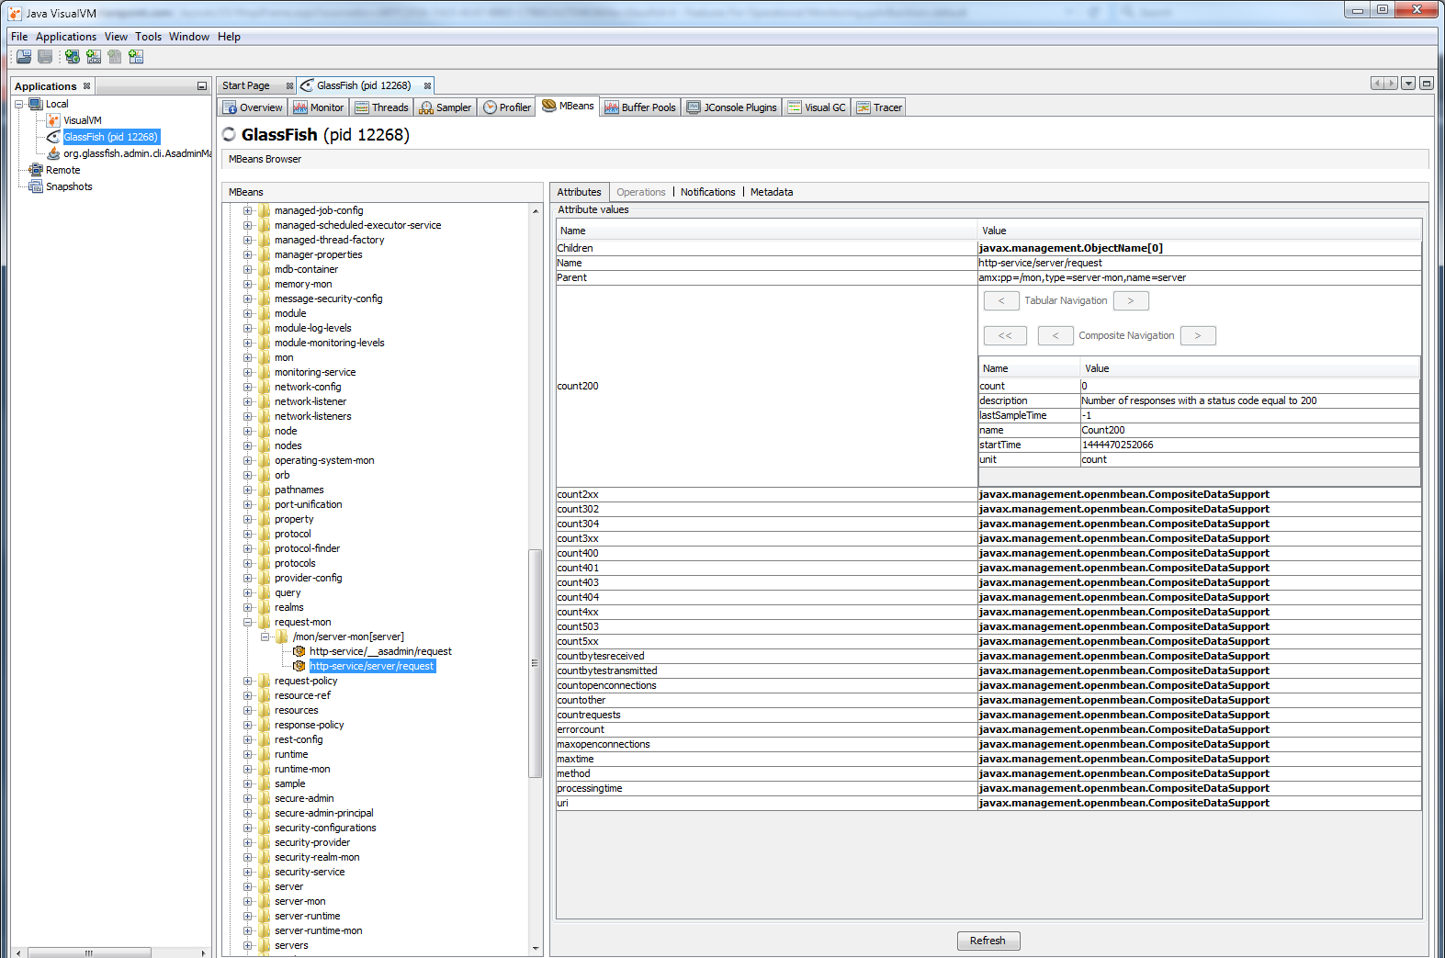
Monitoring in JVisualVM
Install all the available Plugins

Slide 17
Monitoring
Check Monitoring
get server.monitoring-service.module-monitoring-levels.*
Switch Monitoring On
set server.monitoring-service.module-monitoring-levels.jvm=HIGH
Monitor
Monitor –type jvm

Slide 18
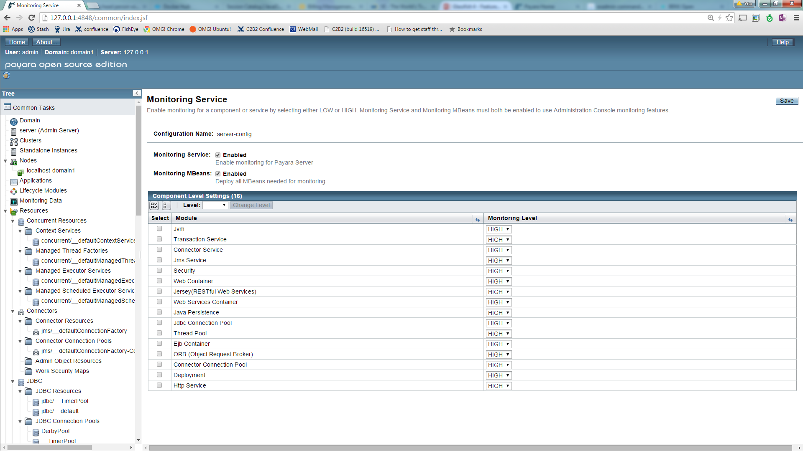
Enable Monitoring

Slide 19
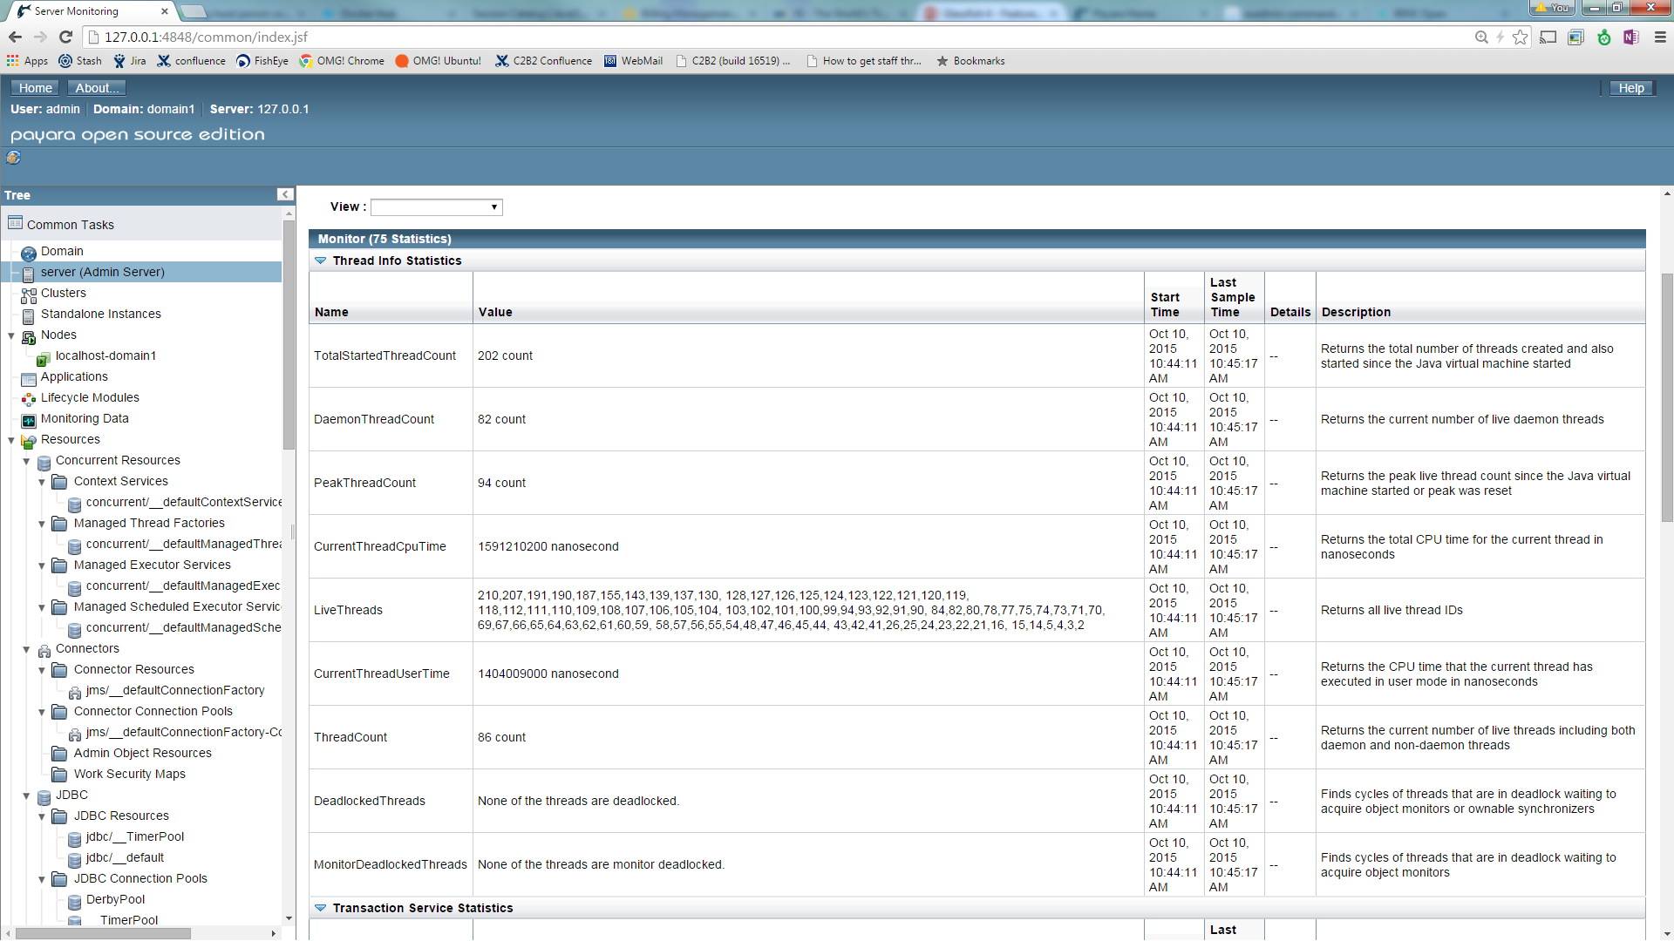
Monitoring Data

Slide 20
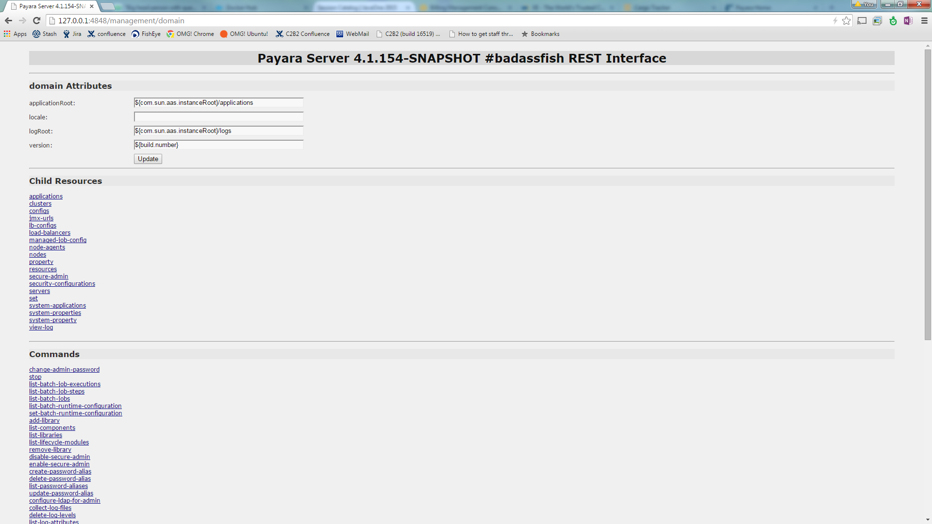
REST Interface
You can CURL commands if desperate!!!!!

Slide 21
What to Change

Slide 22
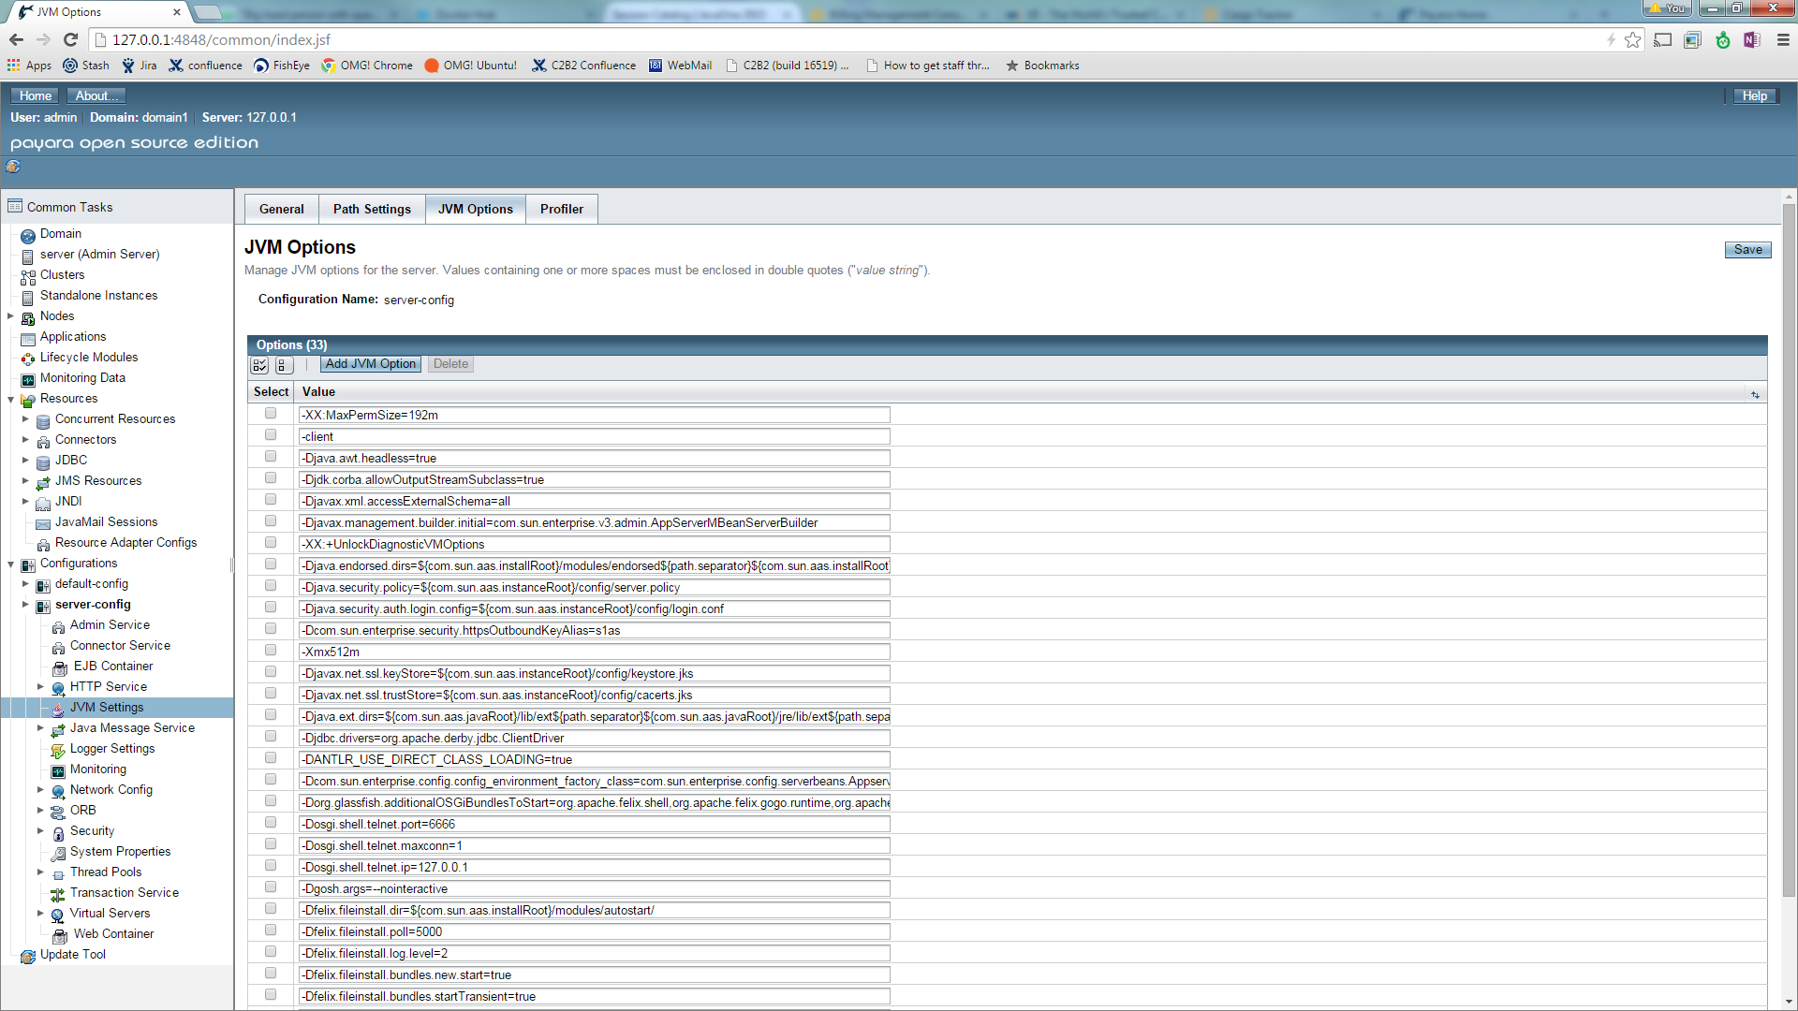
Setting JVM Parameters

Slide 23
JVM Tuning options
-server : Out of the box GlassFish uses –client for the DAS
Set Max/Min Heap Sizes to be similar
-Xmx2048m –Xms2048m
On JDK 7?
Set Perm Gem Max and Min to be similar
-XX:PermSize=256m –XX:MaxPermSize=256m
On Large Heaps
Use G1GC
Log Garbage Collection
-verbose:gc
-Xloggc:/path_to_log/gc.log
-XX:+PrintGCDetails
-XX:+PrintGCDateStamps
Heap Dump on Error
-XX:+HeapDumpOnOutOfMemoryError
-XX:HeapDumpPath=/opt/dumps/gf.hprof

Slide 24
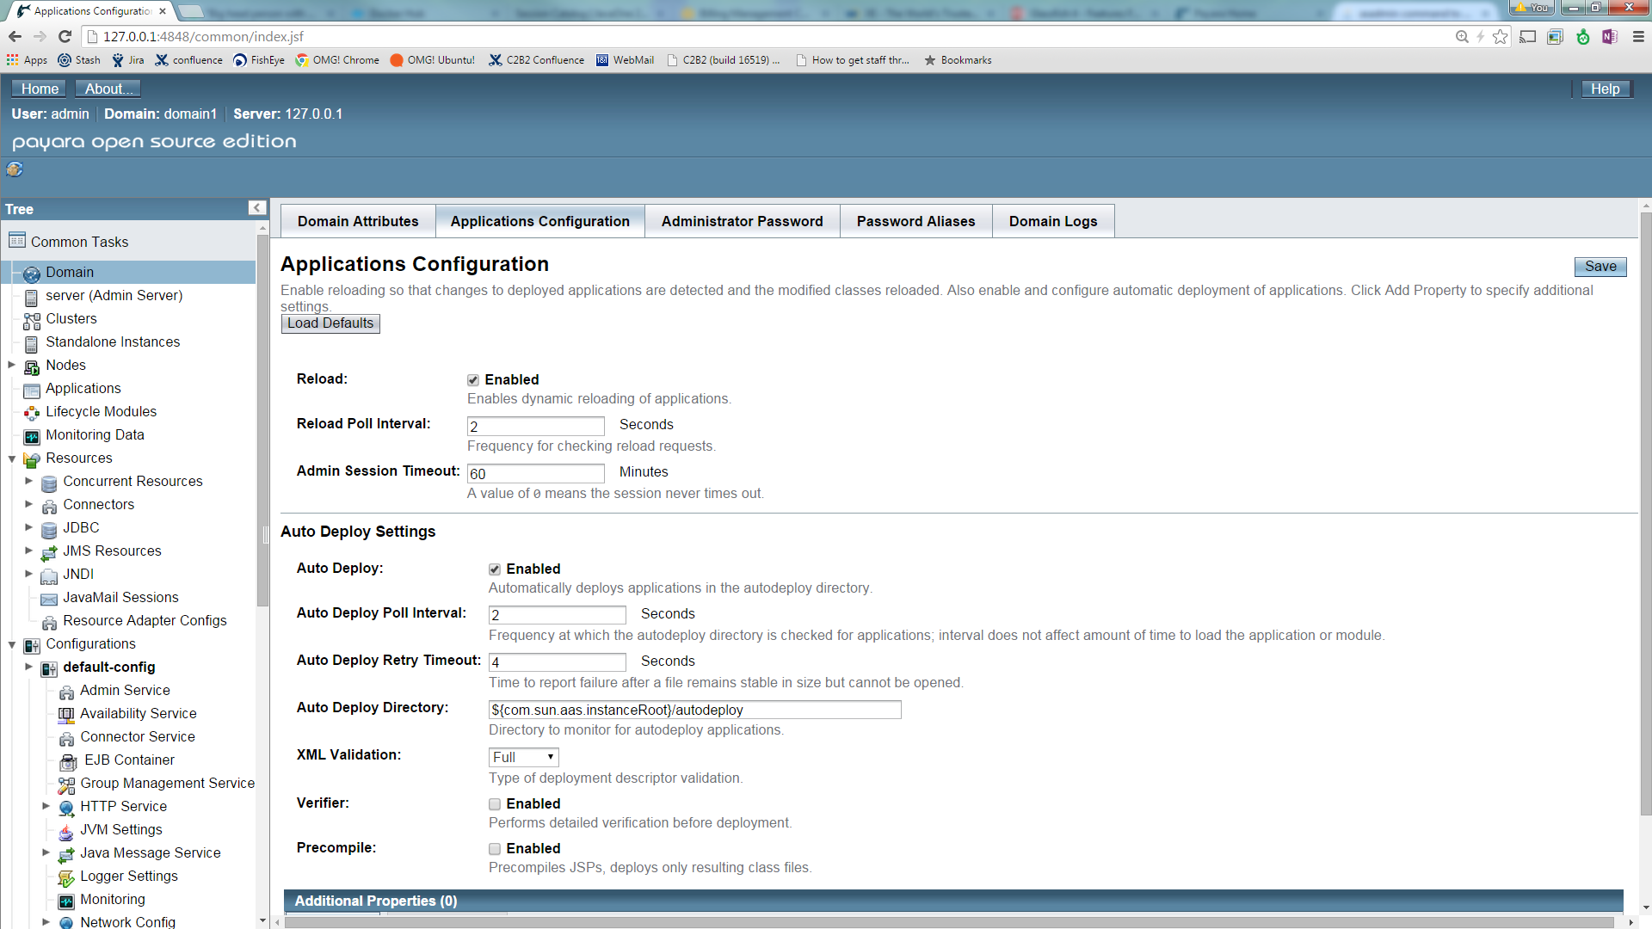
GlassFish Settings
Turn off Auto-deploy and dynamic application reloading in production

Slide 25
Modify default-web.xml
${domain-home}/config/default-web.xml
Turn off Development
Set genStrAsCharArray to true

Slide 26
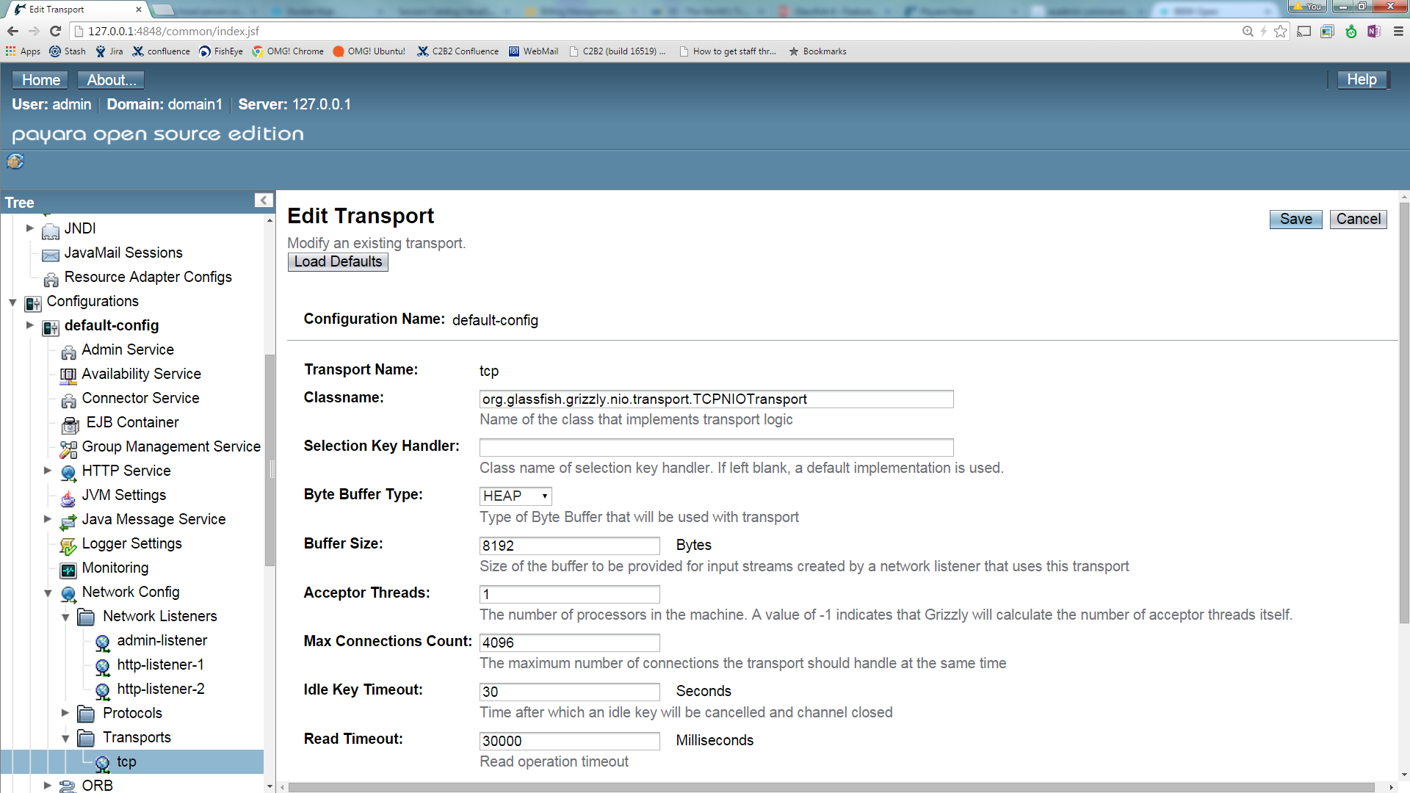
Low Level Grizzly Tuning

Slide 27
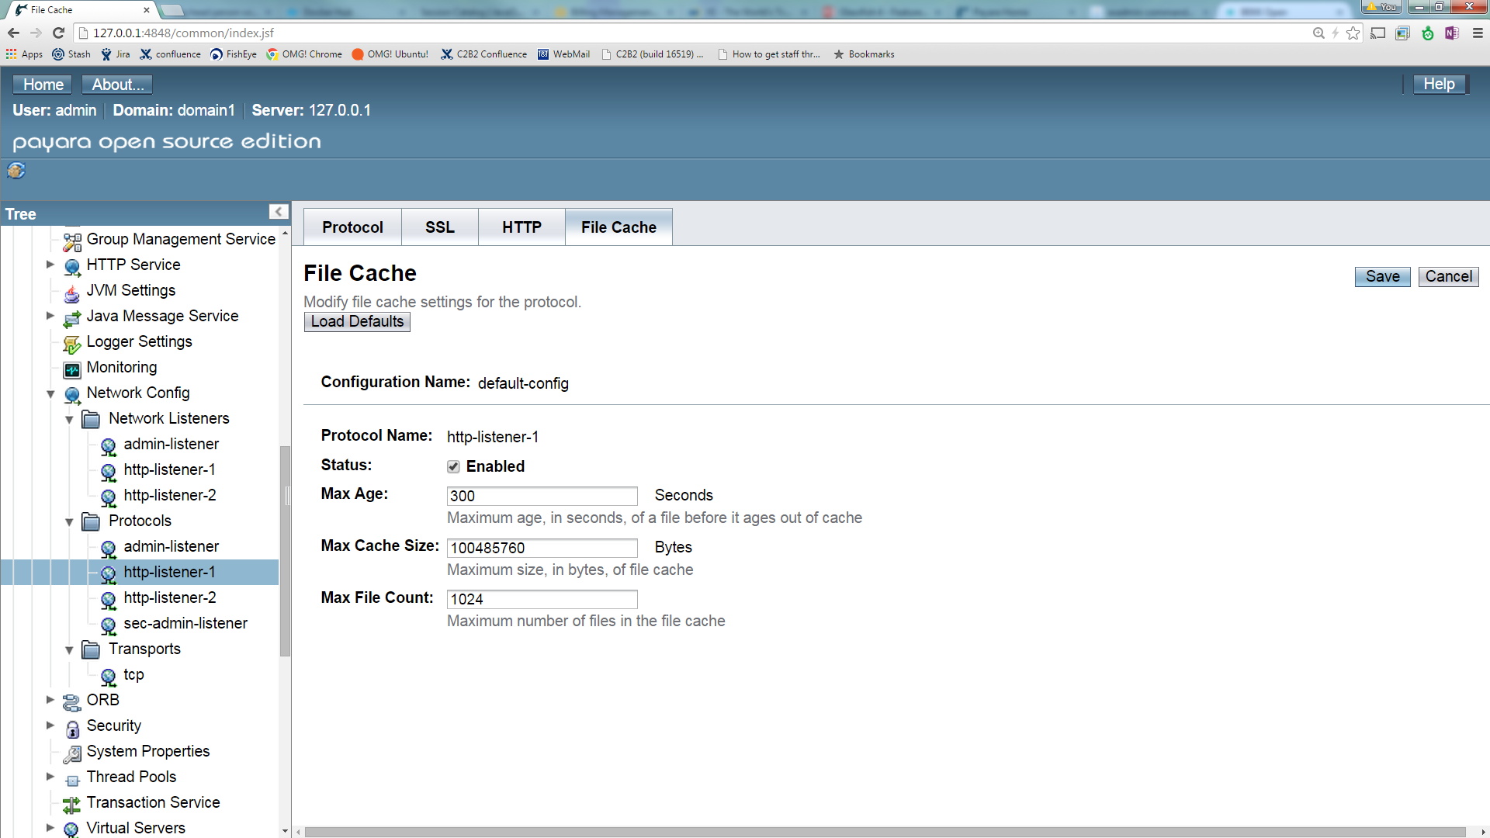
HTTP Tuning

Slide 28
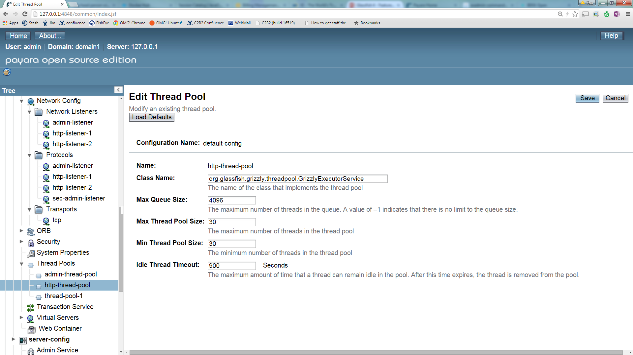
HTTP Thread Pool
Can be set similar to HTTP workers
For example Apache Workers if proxied

Slide 29
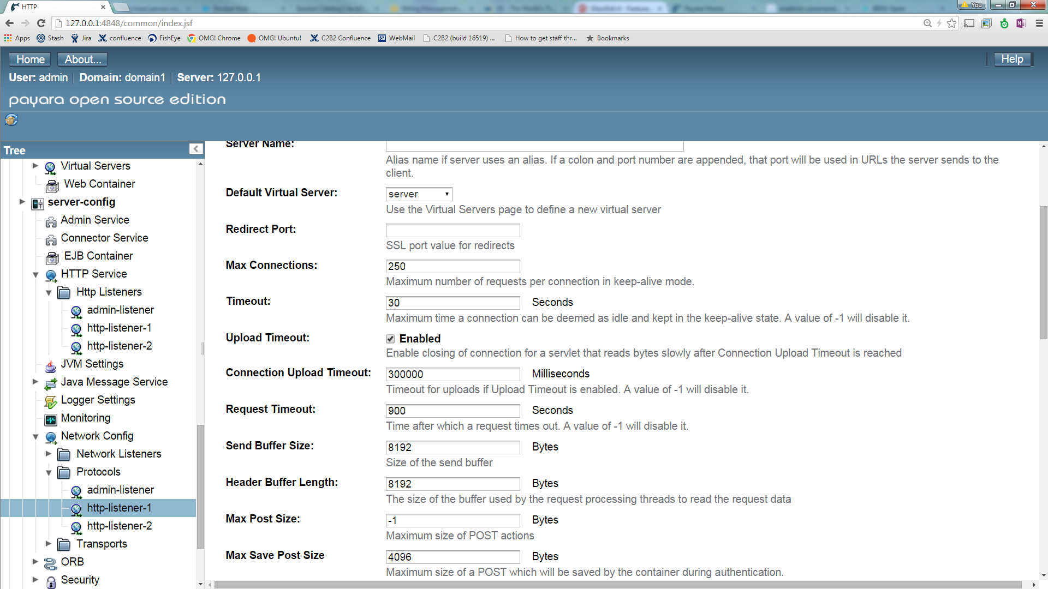
Tune HTTP Keep Alive
Tune Keep Alive
Protect from Malicious Attacks

Slide 30
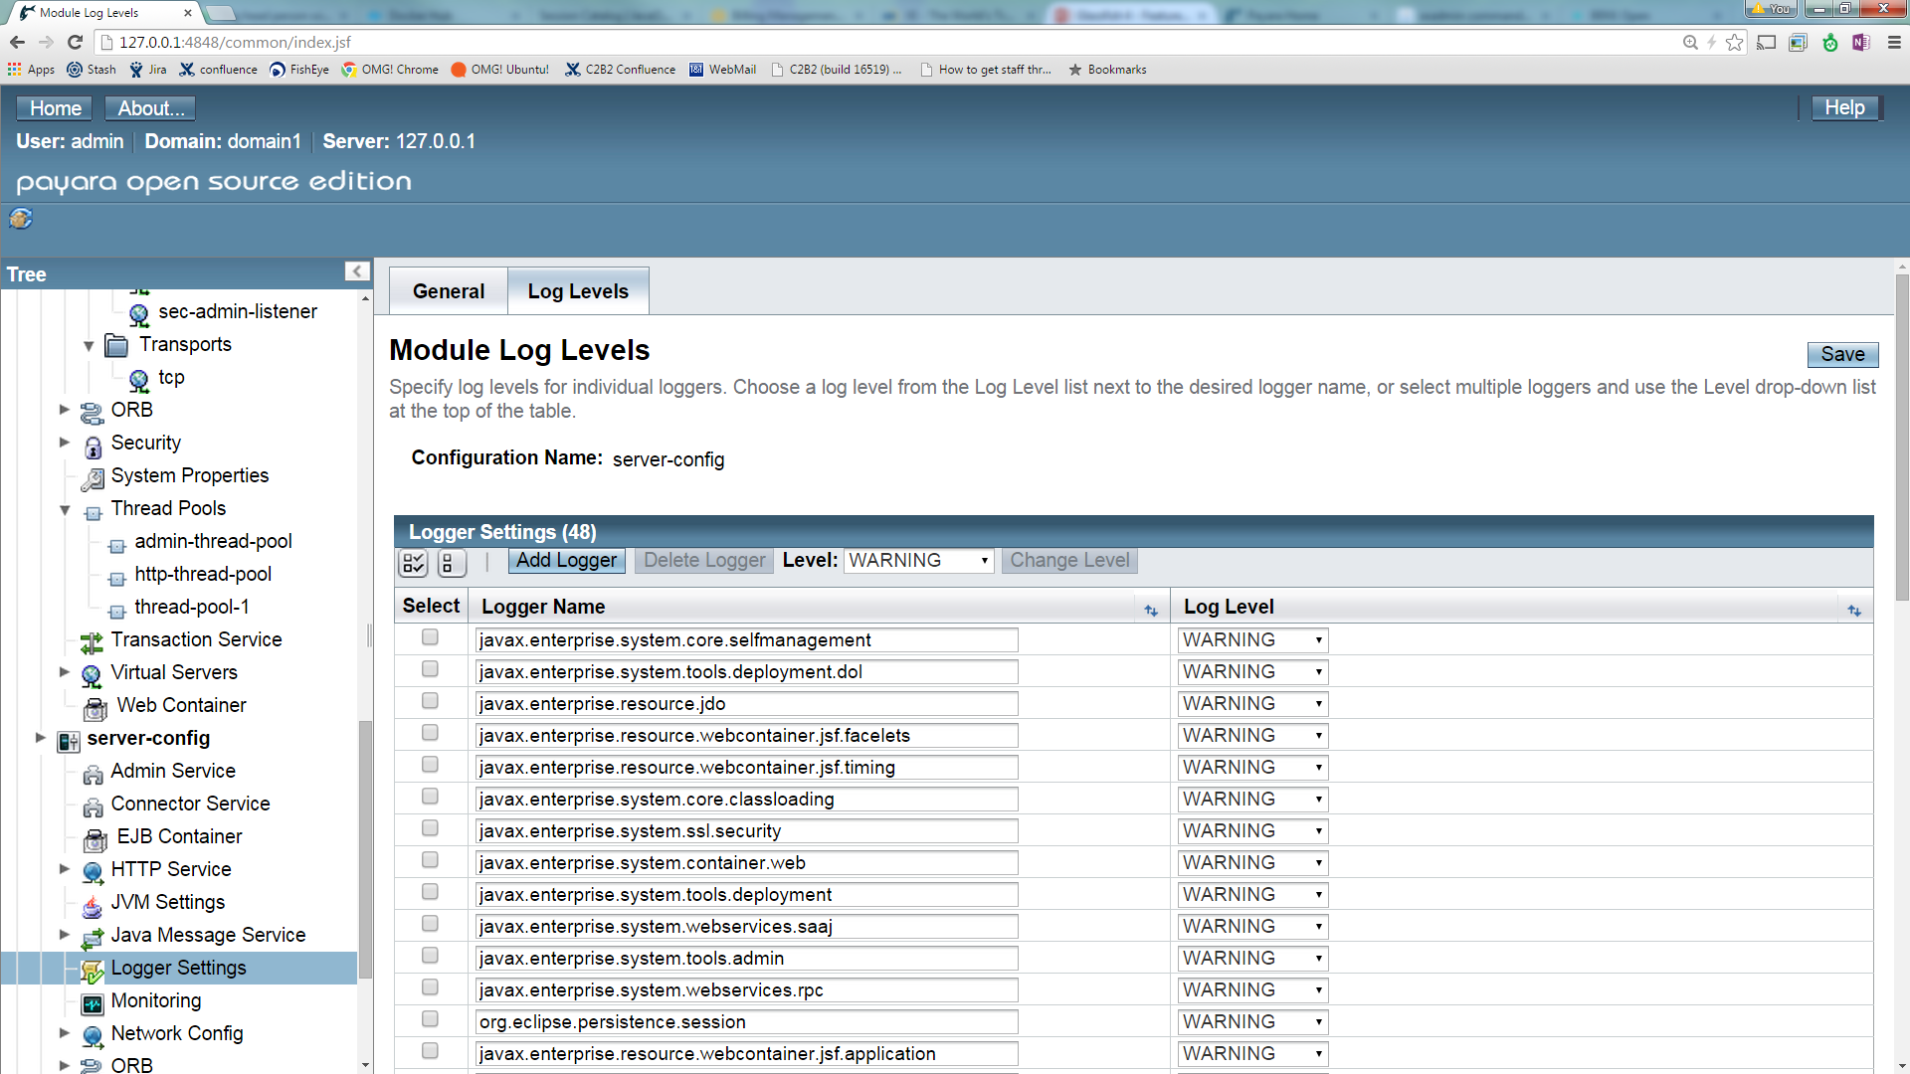
Reduce Logging

Slide 31
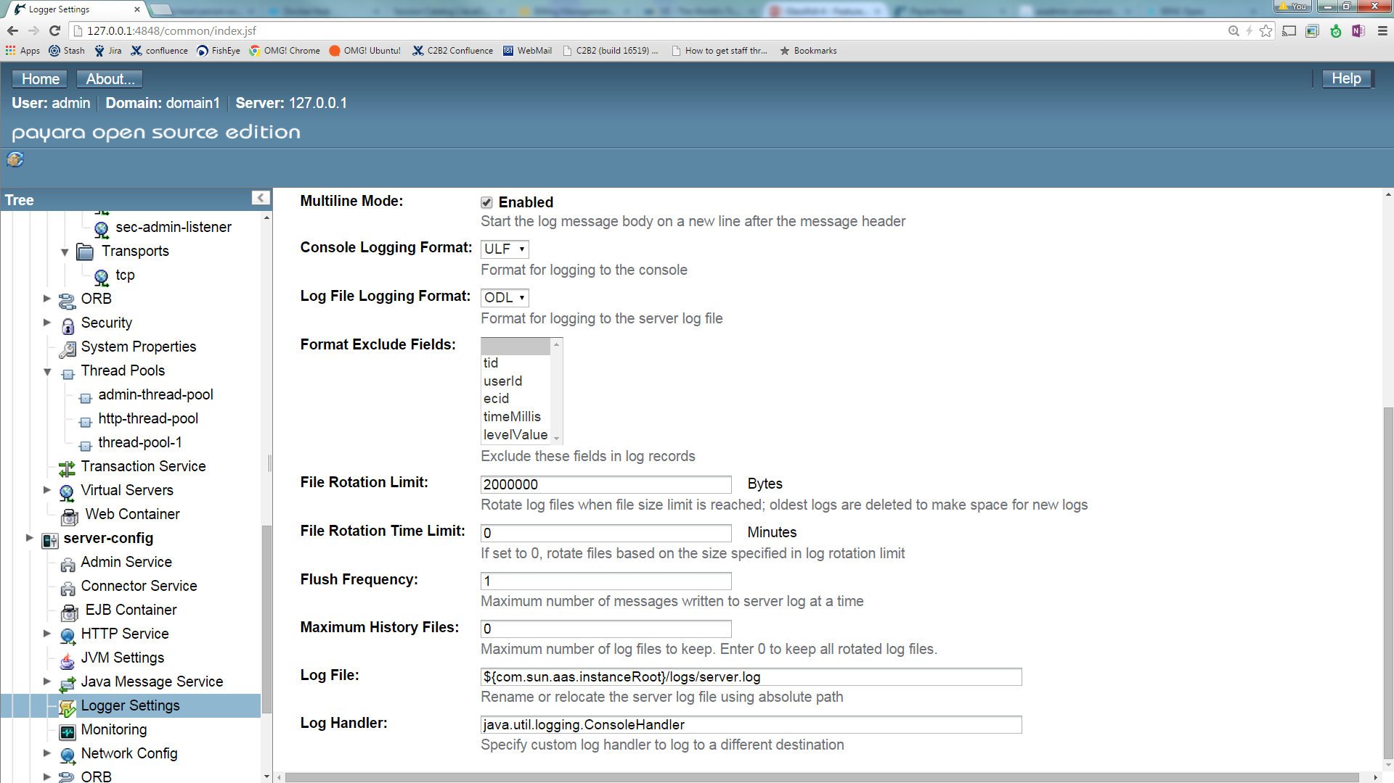
Change Log Flush Frequency

Slide 32
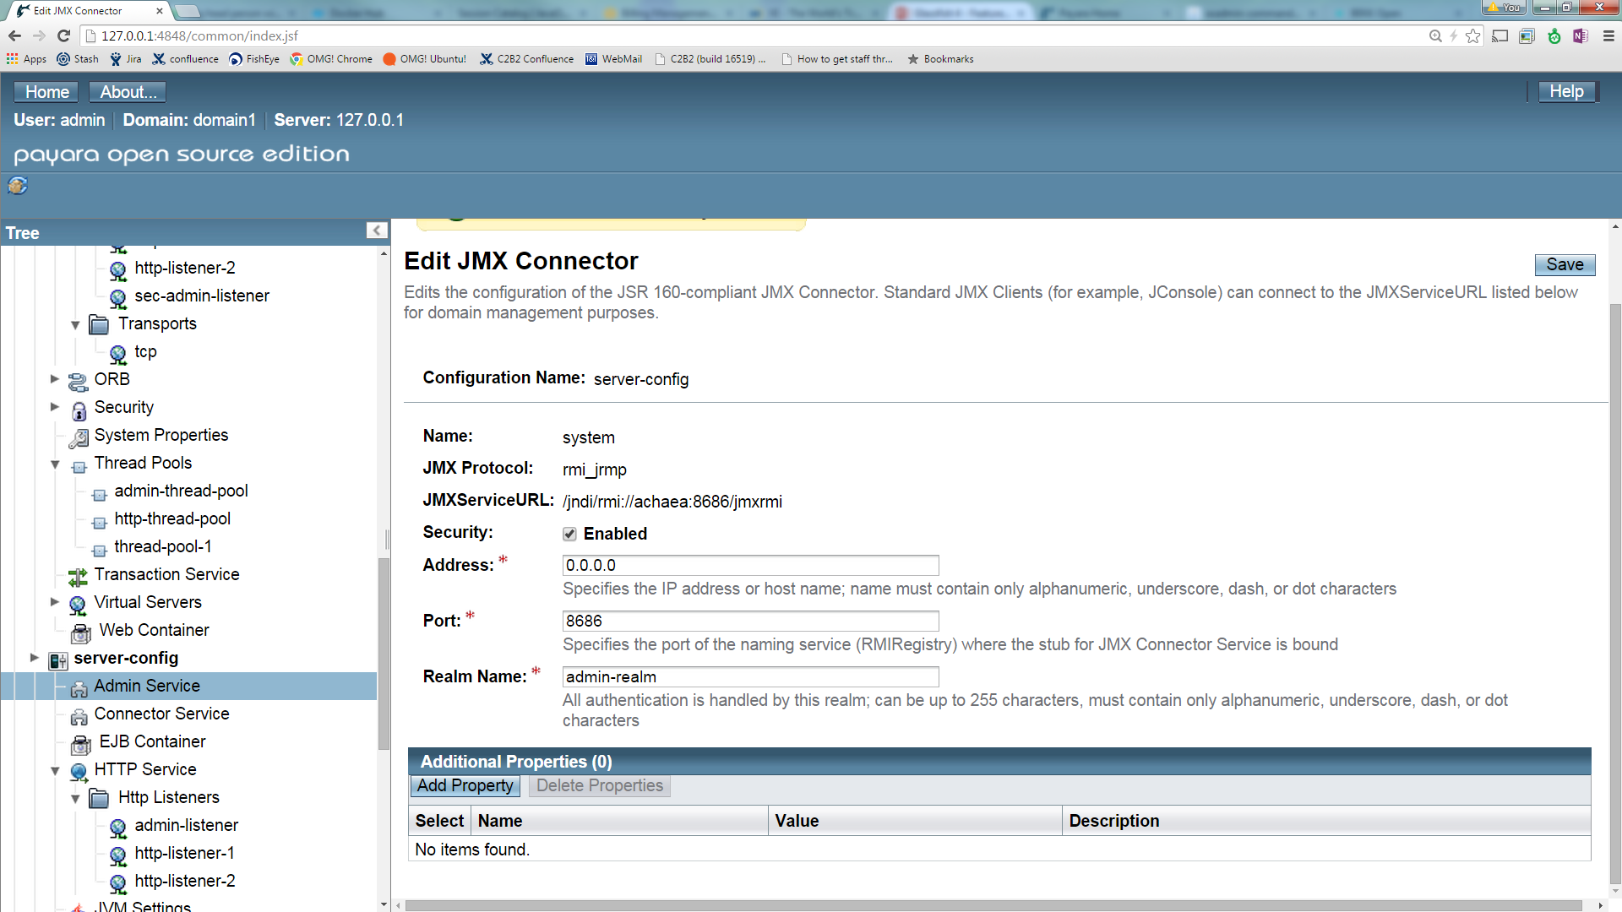
Ensure Security on JMX Connector

Slide 33
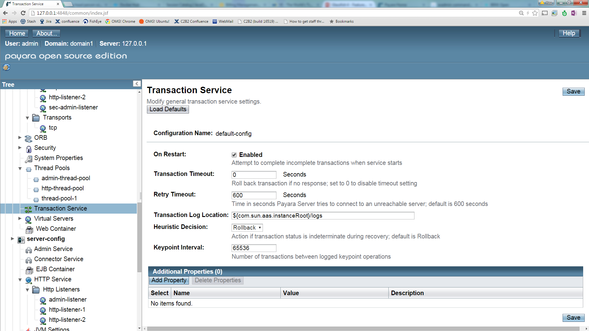
Consider Setting a Transaction Timeout

Slide 34
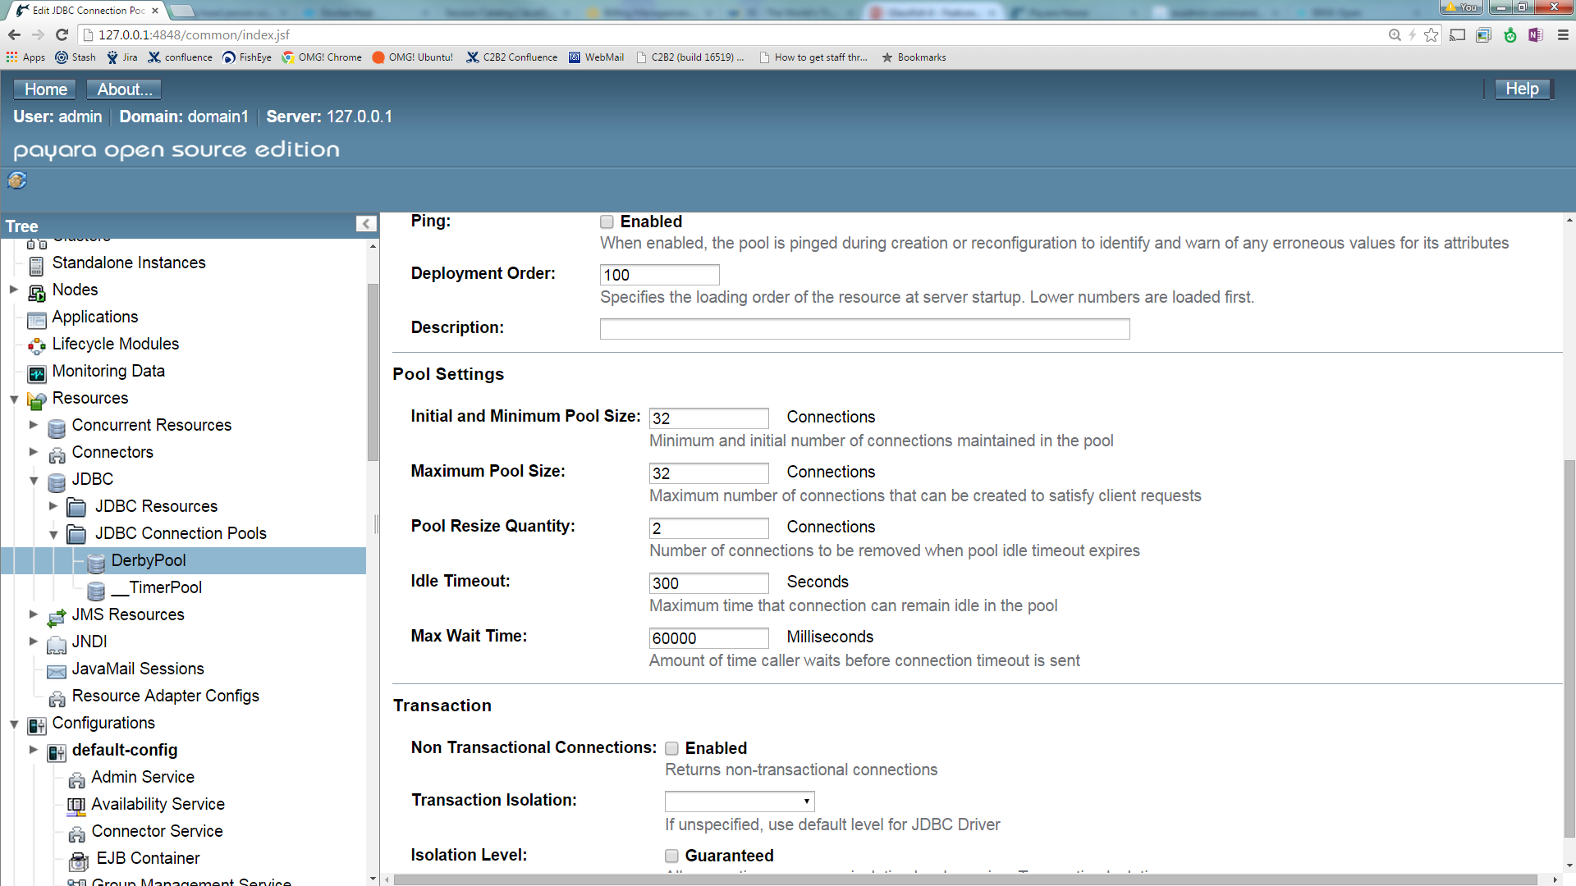
Datasource Connections
Max and Min the Same
Consider HTTP Thread pool setting

Slide 35
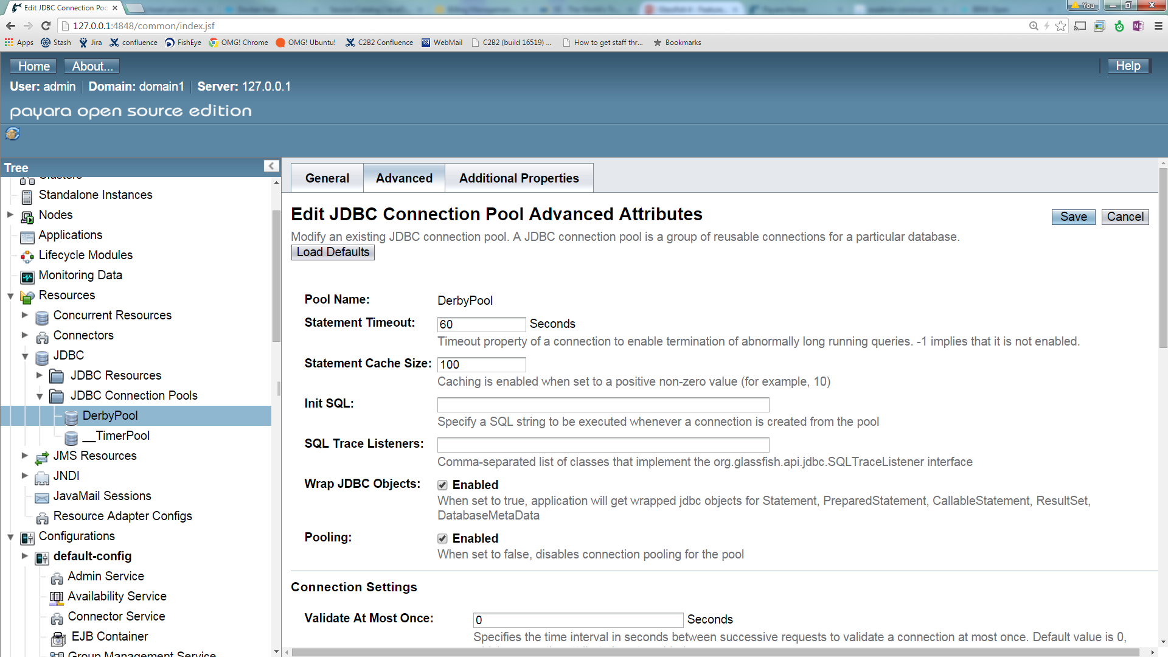
Datasources
Consider Timeouts and Statement Caching

Slide 36
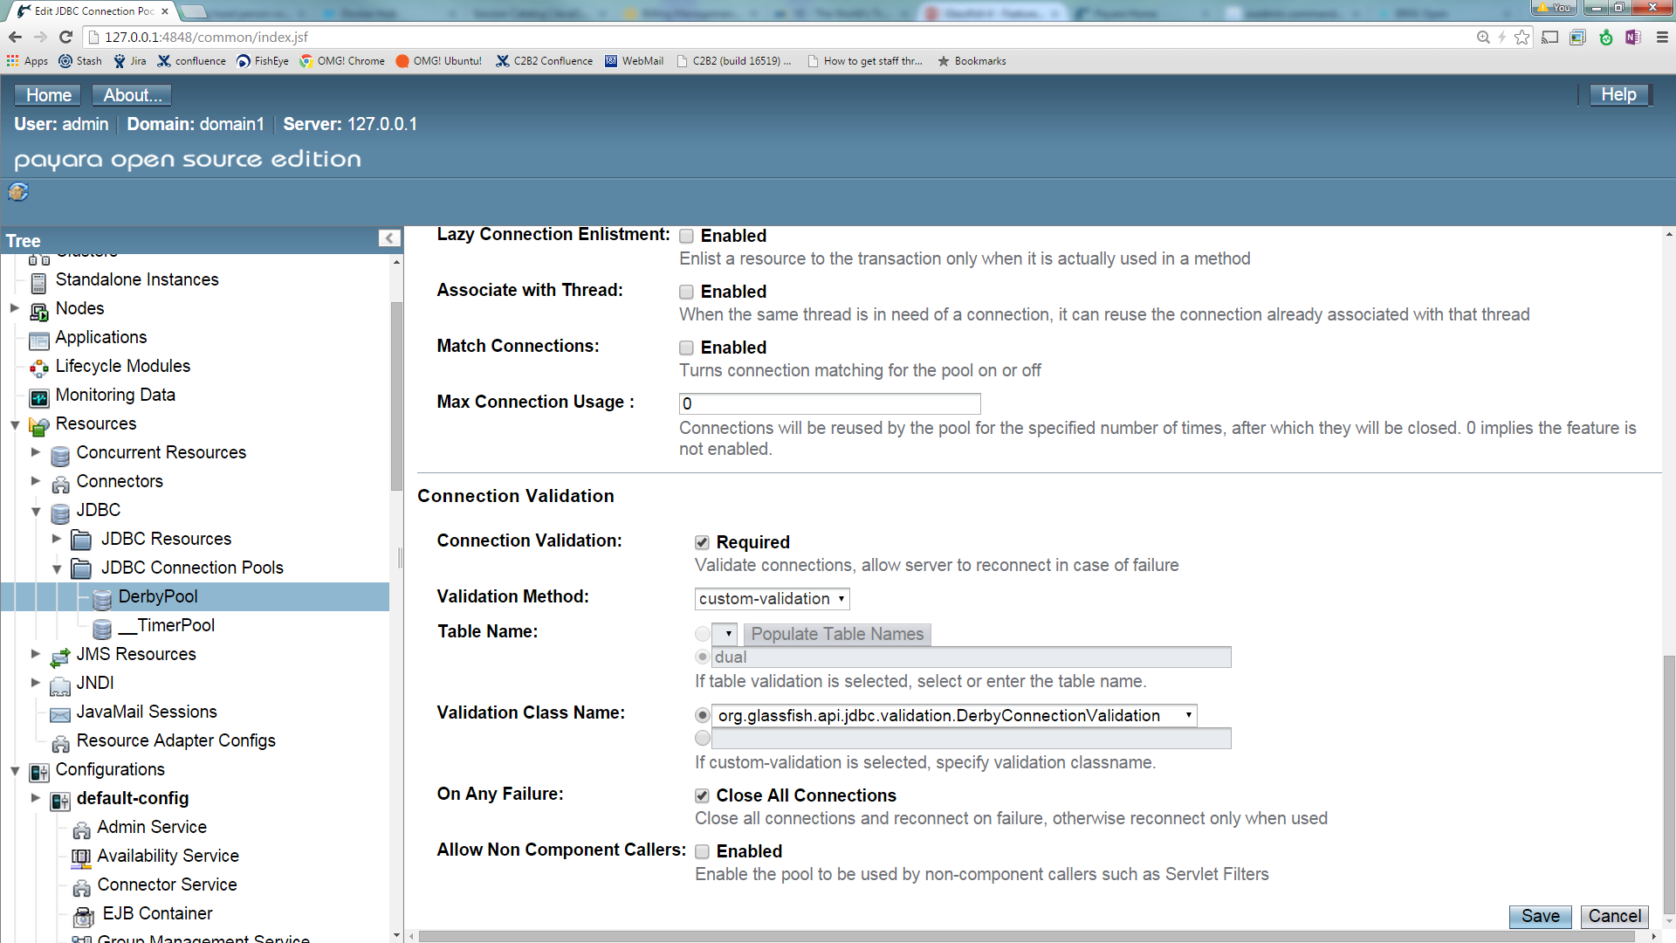
Datasources - Validation

Slide 37
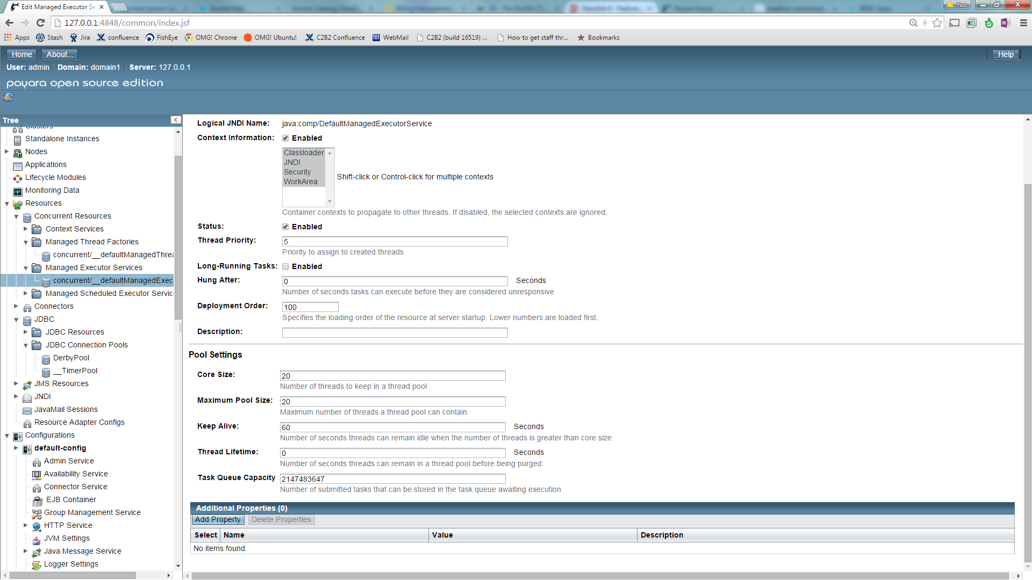
Tune Executor Service

Slide 38
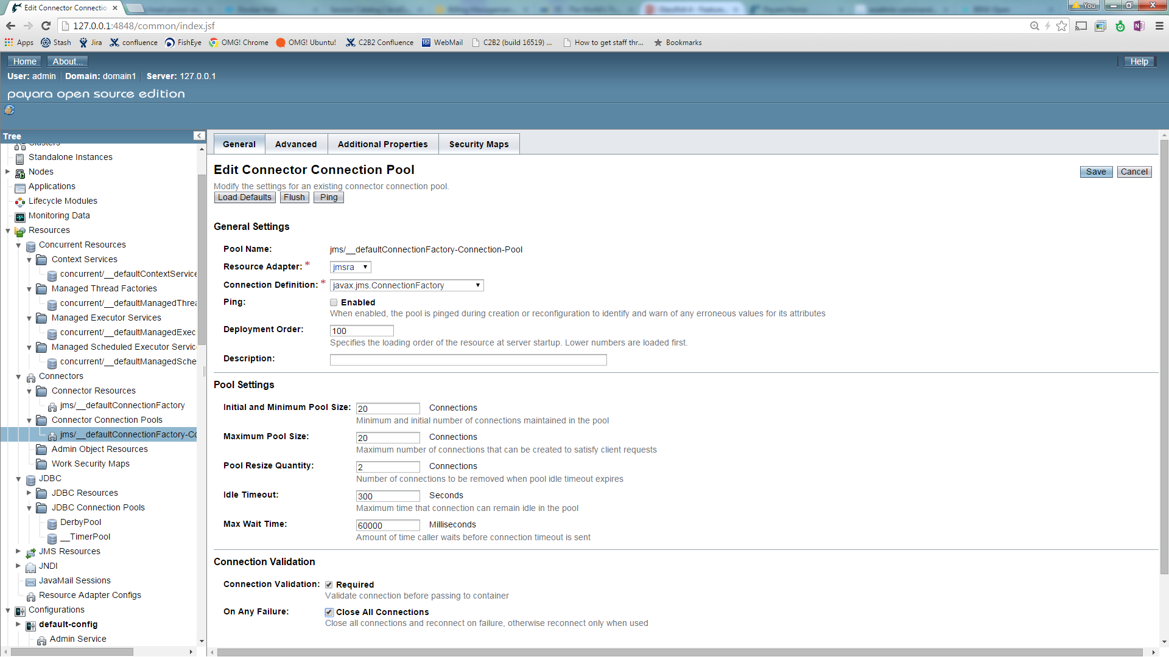
JCA Connector Settings (JMS)

Slide 39
Questions

