Slide 1
Continuous Integration at Yahoo!
Dean Yu
Yahoo!, Inc.
http://www.yahoo.com
© 2011 Yahoo!, Inc. All rights reserved.

Slide 2
About Software Development @ Yahoo!
Multiple language standards:
PHP for web page serving
C/C++/Java for business logic
Perl for lots of other stuff
RHEL/FreeBSD
Lots of in-house tech
We’ve been around for a while
Corporate SSO for all web apps
ssh for host to host connections

Slide 3
About Yahoo! & Jenkins
Yahoo! chooses Hudson as its standard CI server in Q2 2008 (Hudson 1.252)
Maintain a private fork
Integration with internal systems/processes
Disable features that are security concerns
Most modifications & plugins are contributed back to the project
CSRF protection
Test result parser API
Configurable Update Center
Subversion exclusion regions
Labeled Test Result Groups plugin
Collapsible Console Sections plugin
Next Build Number plugin

Slide 4
About Jenkins @ Yahoo!
Central team responsible for
Maintaining internal fork
Interacting with Jenkins community
Project teams responsible for
Maintaining individual Jenkins instances
Standard configuration
Apache + Tomcat
Java 6
Slaves via ssh

Slide 5
The Big Kahuna
Master
Multiple CPU cores/64-bit JVM/filer-based storage for JENKINS_HOME
Cold standby for fail-over
10 Slaves
8 executors per slave/64-bit JVM/local storage
3500 jobs
2500+ builds per day
950+ users

Slide 6
Problem: Dashboard Scalability
“All” view with small icons equivalent to 62 printed pages
102 view tabs require really wide screens to see

Slide 7
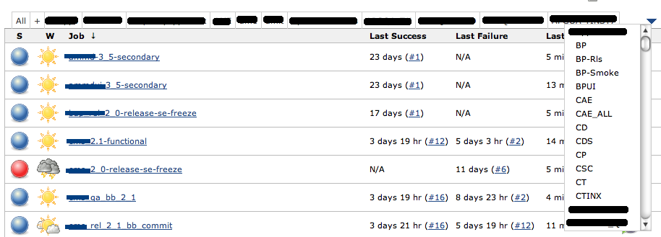
Solution: Dropdown Tab Views
Status: Work in progress (anyone want to help?)

Slide 8
Problem: SCMChangeLog Memory Consumption
SCM change logs are strongly referenced objects
With near-constant builds, memory usage can increase 10x over a few hours

Slide 9
Solution: Patch the core
--- hudson/trunk/core/src/main/java/hudson/model/AbstractBuild.java 2011/07/14 20:31:08 3699
+++ hudson/trunk/core/src/main/java/hudson/model/AbstractBuild.java 2011/08/12 02:42:30 3822
@@ -66,6 +66,7 @@
import java.io.File;
import java.io.IOException;
import java.io.StringWriter;
+import java.lang.ref.WeakReference;
import java.text.MessageFormat;
import java.util.AbstractSet;
import java.util.ArrayList;
@@ -81,6 +82,7 @@
import java.util.logging.Level;
import java.util.logging.Logger;
+
/**
* Base implementation of {@link Run}s that build software.
*
@@ -122,7 +124,7 @@
/**
* Changes in this build.
*/
- private volatile transient ChangeLogSet<? extends Entry> changeSet;
+ private volatile transient WeakReference<ChangeLogSet<? extends Entry>> changeSet;
/**
* Cumulative list of people who contributed to the build problem.
@@ -526,10 +528,10 @@
SCM scm = project.getScm();
AbstractBuild.this.scm = scm.createChangeLogParser();
- AbstractBuild.this.changeSet = AbstractBuild.this.calcChangeSet();
+ AbstractBuild.this.changeSet = new WeakReference<ChangeLogSet<? extends Entry>>(AbstractBuild.this.calcChangeSet());
for (SCMListener l : Hudson.getInstance().getSCMListeners())
- l.onChangeLogParsed(AbstractBuild.this,listener,changeSet);
+ l.onChangeLogParsed(AbstractBuild.this,listener,getChangeSet());
return;
}
} catch (AbortException e) {
@@ -712,17 +714,17 @@
}
}
- if (changeSet==null) // cached value
+ if (changeSet == null || changeSet.get() == null) // cached value
try {
- changeSet = calcChangeSet();
+ changeSet = new WeakReference<ChangeLogSet<? extends Entry>>(calcChangeSet());
} finally {
// defensive check. if the calculation fails (such as through an exception),
// set a dummy value so that it'll work the next time. the exception will
// be still reported, giving the plugin developer an opportunity to fix it.
if (changeSet==null)
- changeSet=ChangeLogSet.createEmpty(this);
+ changeSet=new WeakReference<ChangeLogSet<? extends Entry>>(ChangeLogSet.createEmpty(this));
}
- return changeSet;
+ return changeSet.get();
}
/**
@@ -1158,3 +1160,4 @@
private static final Logger LOGGER = Logger.getLogger(AbstractBuild.class.getName());
}
+

Slide 10
Problem: Managing Job Relationships
3 types of build artifacts
Packages | Images | Release Definitions
jenkins-core-1.409.2 | jenkins-master | yhudson-2.10
remoting-1.409.2 | jenkins-slave-bsd
subversion-plugin-1.25 | jenkins-slave-linux
gmake-plugin-1.3
cppunit-parser-plugin-1.0.1

Slide 11
Problem: Managing Job Relationships
Multiple pipeline paths
package commit
package release
image assembly
release definition assembly
deploy
test
package commit
package release
image assembly
package commit
package release
image assembly
release definition assembly
deploy
test

Slide 12
Solution: Implied Dependencies
New versions of artifacts in repositories trigger downstream builds
Job relationships established with fingerprints
Jenkins-1.429:
-Dhudson.tasks.Fingerprinter.enableFingerprintsInDependencyGraph=true
package release
image assembly
release definition assembly
deploy
test
package release
image assembly
package
repository
image
repository
release definition
repository

Slide 13
Problem: Long Console Logs
Build logs run to hundreds of printed pages
Needles in haystacks

Slide 14
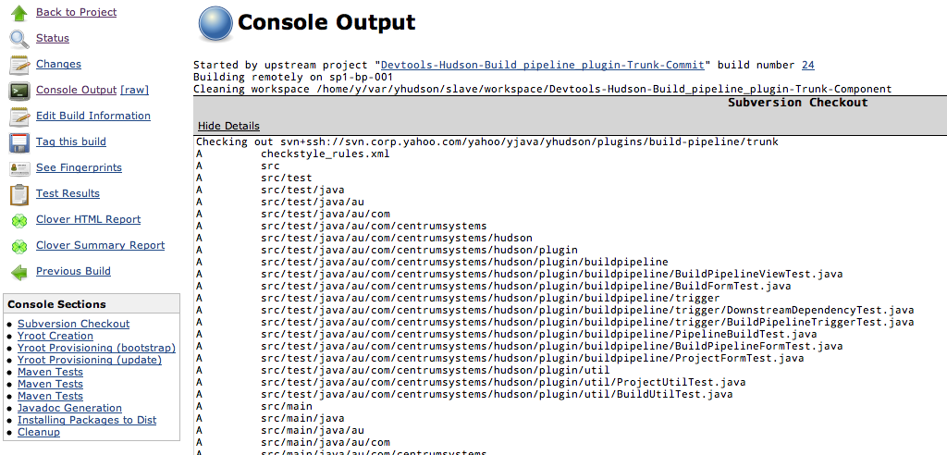
Solution: Collapsible Console Sections
Section visibility toggle
Jump to log sections

Slide 15
Solution: Collapsible Console Sections
Configurable section definitions
Open sourced
https://wiki.jenkins-ci.org/display/JENKINS/Collapsing+Console+Sections+Plugin

Slide 16
Problem: Reproducible Build Environments
Build environments are images
Dedicating slaves per build environment not cost effective

Slide 17
Solution: Jobs run in chroots
slave 1
project A chroot
slave
filesystem
project B chroot
project C chroot
project D chroot
slave 2
project B chroot
slave
filesystem
project D chroot
project E chroot
project F chroot

Slide 18
Donate to Jenkins!
https://wiki.jenkins-ci.org/display/JENKINS/Donation

Slide 19
Thank You To Our Sponsors
Platinum Sponsor
Gold Sponsor
Silver Sponsor
Bronze Sponsors
Coming Soon: The CloudBees Newsletter for Jenkins
Please complete the Jenkins survey to help us better serve the community
(bonus: a chance to win an Apple TV!)

Slide 20
Questions

