Slide 1
Business Process Model & Notation (BPMN) Workflows in Jenkins
Max Spring
Cisco
https://wiki.jenkins-ci.org/display/ JENKINS/Jenkow+Plugin

Slide 2
Goals
Attract users
Get feedback
Gain contributors

Slide 3
Agenda
What is BPMN & Activiti?
How to setup & use Jenkow plugin
For Jenkins admins
Plugin internals
For Plugin developers
Future Features

Slide 4
Problem: Job Orchestration
Putting jobs into relation
Defining logic for execution of multiple jobs
Existing orchestration mechanisms
Built-in Upstream / Downstream
Join Plugin
Locks and Latches Plugin
Drools Plugin (deprecated)
Build Flow Plugin
...
Notes:
Join Plugin: provides concurrency join operation (last release v1.15 3-May-2012)
Locks and Latches: another plugin to control parallel execution (last release v0.6 16-Apr-2010)
Drools: similar to Jenkow in using graphical editor in Eclipse
Build Flow: define workflow in DSL (last release v0.5 3-Sep-2012)
https://wiki.jenkins-ci.org/display/JENKINS/Join+Plugin
https://wiki.jenkins-ci.org/display/JENKINS/Locks+and+Latches+plugin
https://wiki.jenkins-ci.org/display/JENKINS/Drools+Plugin
https://wiki.jenkins-ci.org/display/JENKINS/Build+Flow+Plugin

Slide 5
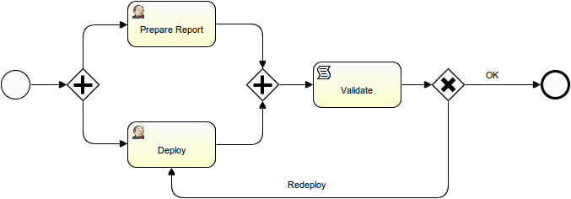
BPMN
Business Process Model & Notation
Similarity with UML activity diagrams
BPMN < 2.0
Just modeling standard
BPMN 2.0
Introduced in 2011
Added well-defined execution semantics

Slide 6
BPMN Concepts
Process: workflow definition
Process instance: “running” workflow
Task: workflow step
Notes:
Task in BPMN: similar to task in Rally, resolved by a human actor/

Slide 7
Basic BPMN Constructs
Start / End Events
Script Task
Groovy
Javascript
No concurrency!
User Task
Executed by real person
Jenkins Task
Invoke Jenkins job

Slide 8
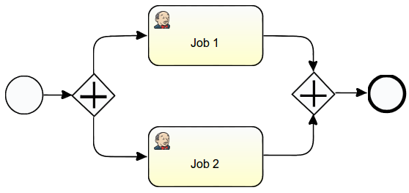
Basic BPMN Constructs
Parallel Gateway

Slide 9
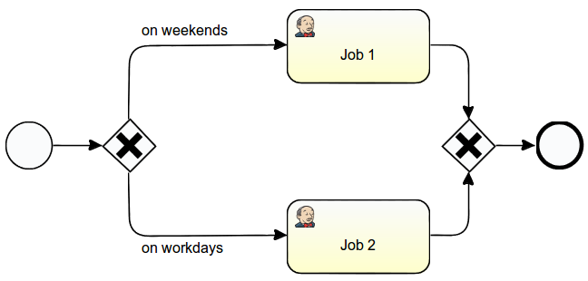
Basic BPMN Constructs
Exclusive Gateway

Slide 10
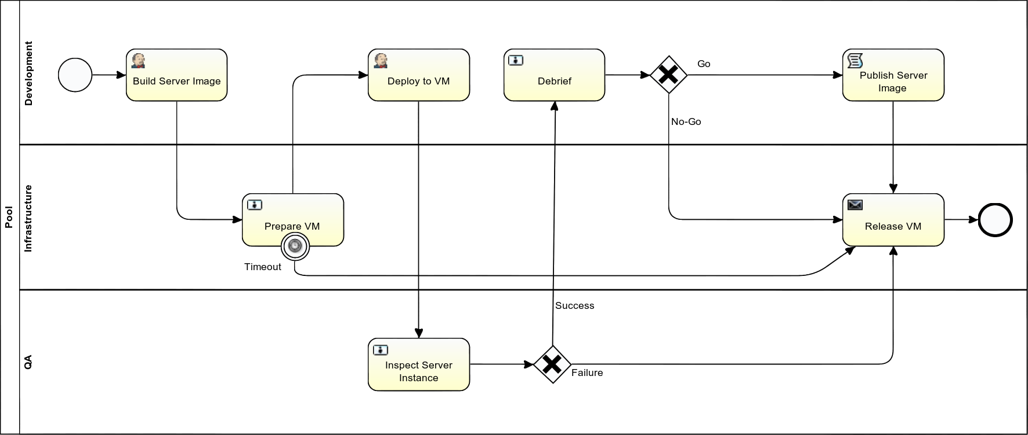
More complex workflow

Slide 11
BPMN Benefits
It’s a standard
Geared towards non-software developers
Constructs for interactions with other actors (persons and systems)
Powerful graphical notation
Existing tooling
Well-documented XML

Slide 12
http://activiti.org
Open Source (Apache License)
BPMN 2.0 workflow engine
Implemented in Java
Web-based Workflow Management
Workflow Editor
Activiti Designer (Eclipse Plugin)
Extensible
Web-based Activiti Modeler not under active development
Notes:
Post subject: Re: Activiti Modeler by Signavio
Posted: Tue Mar 27, 2012 11:30 am
Sure, the Activiti Designer is supported in the Activiti project.
The Activiti modeler codebase isn't part of the Activiti codebase, that's the reason it isn't supported.
Best regards,
Tijs Rademakers

Slide 13
Earlier Activiti / Jenkins Integration
Part of a larger commit automation effort
Jenkins as Execution Engine
Activiti Workflow Engine in Apache ServiceMix Container (OSGi)
Using Jenkins’ Channel (ssh) mechanism

Slide 14
Jenkow Overview
Jenkins plugin ("Jenkins On Workflow")
Early release (v0.2.4)
Emphasis on workflow editor
Activiti Engine in Jenkins
Activiti Designer in Eclipse
Bundled with Jenkow
Served by Jenkins Update Site plugin
Git repository in Jenkins to store workflows
Using Git Server plugin (thanks Kohsuke)
Version-controlled workflows

Slide 15
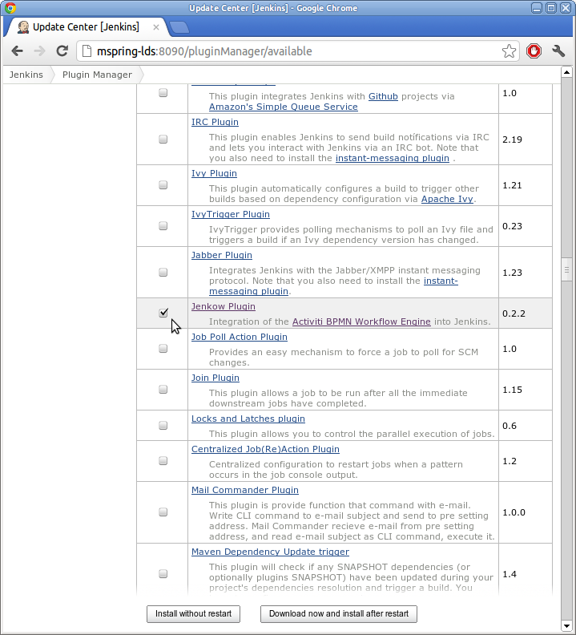
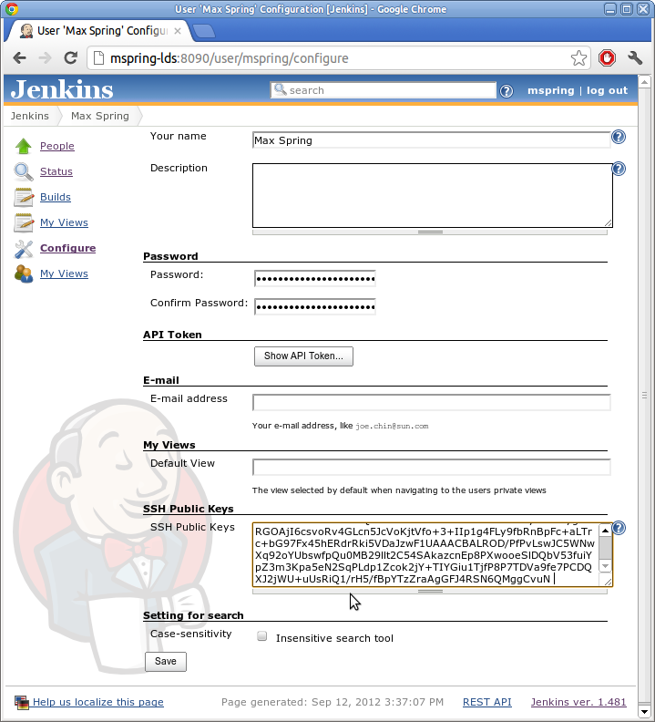
Jenkow Setup (one time)
Install plugin from “Available” catalog
If authorization is on, configure SSH public key
To allow push into workflow Git repository
People⇨userid⇨Configure⇨SSH Public Keys

Slide 16
<demo>

Slide 17
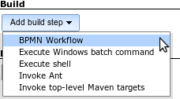
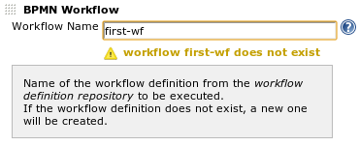
Jenkow Setup
Create first job with workflow step
Job Configure⇨Build⇨Add build step ⇨BPMN Workflow Workflow Name: first-workflow
If workflow doesn’t exist, a simple “hello world” workflow gets created

Slide 18
Jenkow Setup
Build first job

Slide 19
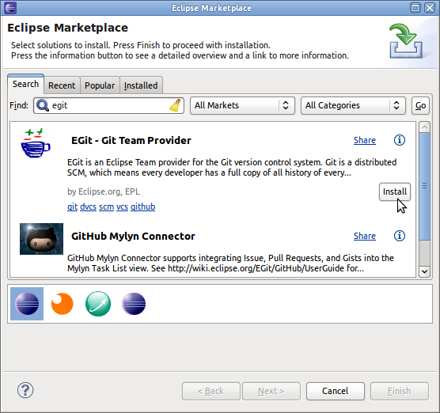
Workflow Editor Setup (one time)
Get Eclipse (3.7 Indigo)
http://www.eclipse.org/downloads/ (Eclipse IDE for Java Developer)
Or install EGit
Help ⇨Eclipse Marketplace… ⇨Find:egit⇨Install

Slide 20
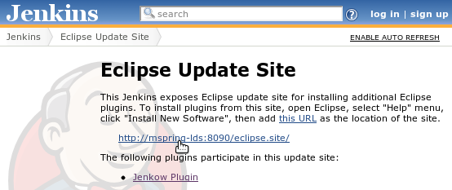
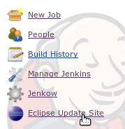
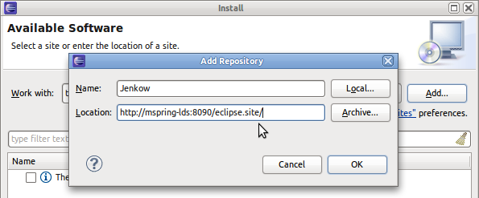
Workflow Editor Setup (one time)
Install Jenkow Activiti Designer
Jenkins: Eclipse Update Site ⇨ copy URL
Eclipse: Help⇨Install new Software…⇨Add… ⇨Name:Jenkow, Location: paste URL ⇨OK

Slide 21
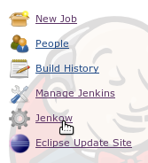
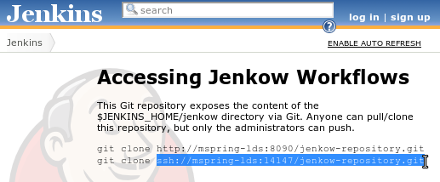
Import Workflow Project (one time)
Git repository in Jenkins
Jenkow: copy Git ssh URI

Slide 22
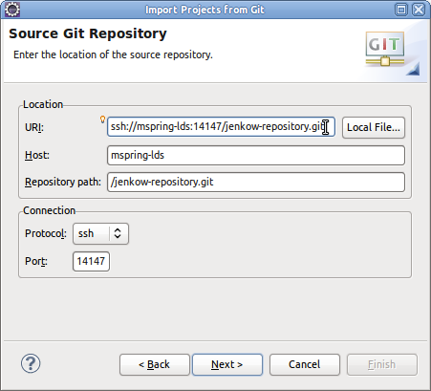
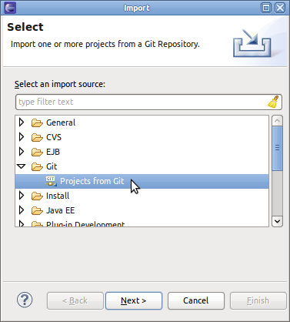
Import Workflow Project (one time)
Import in Eclipse (1/2)
File⇨Import…⇨Git⇨Projects from Git⇨Next URI⇨Next ⇨ URI: paste Git URI⇨Next

Slide 23
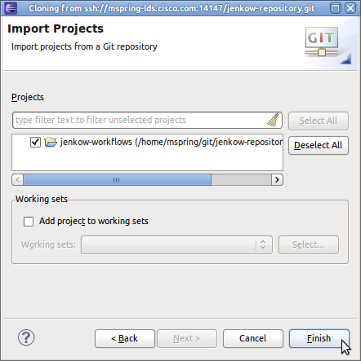
Import Workflow Project (one time)
Import in Eclipse (2/2)
… Branch selection: select master⇨Next Local Destination … ⇨Next …Import existing project…⇨Next Import Projects: select jenkow-workflows ⇨Finish

Slide 24
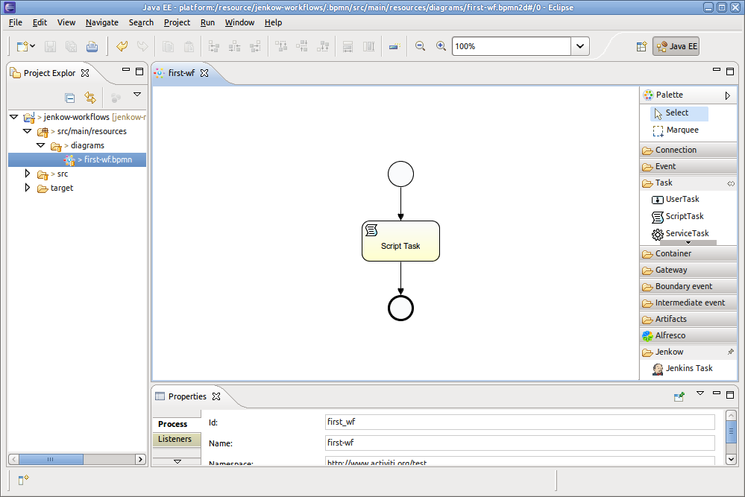
Import Workflow Project (one time)
Open Workflow Project
Project Explorer: jenkow-worfklows ⇨src/main/resources⇨diagrams⇨first-wf.bpmn

Slide 25
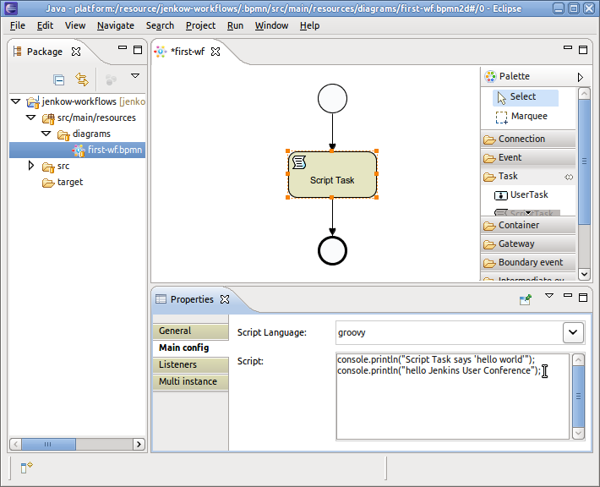
Edit Workflow
Script Task

Slide 26
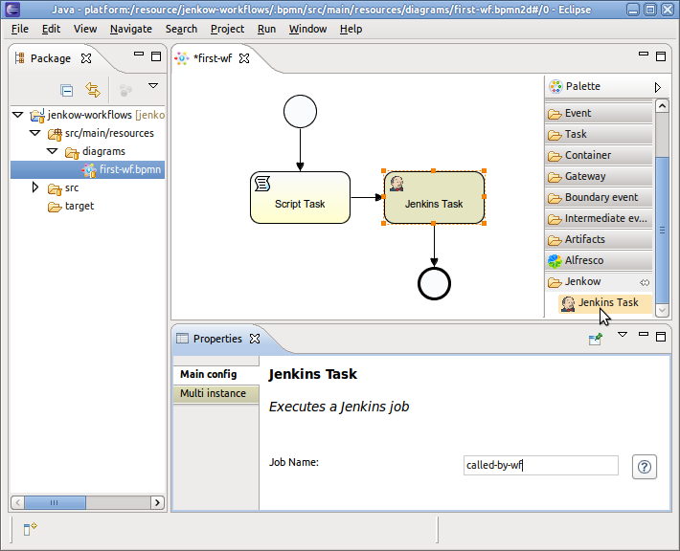
Edit Workflow
Jenkins Task

Slide 27
Push changed Workflow
Save workflow
Commit
Project Explorer: right-click jenkow-workflows ⇨Team⇨Commit… ⇨Commit message⇨Commit
Push
Project Explorer: right-click jenkow-workflows ⇨Team⇨Push to Upstream⇨OK

Slide 28
Run changed Workflow
Create “called-by-wf” job
Kick “first-job”

Slide 29
</demo>

Slide 30
Example Launch Sequence

Slide 31
Implementation Details

Slide 32
Execution Modes
“Script Mode”
Build step
Occupies executor
No persistency
Short running
“Workflow Mode” (not yet implemented)
Workflow Job Type
No executor wasted
Workflow state persisted in DB
Long “running” (days, weeks, …)
Interact with other systems / actors

Slide 33
Plugin Elements
Jenkow Plugin
Jenkow Update Site
Jenkow IDE Config
Jenkow Designer Extension
Eclipse
Activiti Workflow Engine
Activiti Designer + Patch: Palette Extension Provider (Eclipse Extension Point)
❶
❷
EGit
Eclipse Graphiti
~/.jenkow/lib/

Slide 34
Run Time
CI Server
Admin Workstation
Jenkins
Eclipse
Jenkow Plugin
Jenkow IDE Config
Activiti Workflow Engine
Activiti Designer
DB
EGit
Git Server Plugin (JGit)
Eclipse Update Site Plugin
~/.jenkow/lib/ jenkow-designer-extension.jar
$JENKINS_HOME/ jenkow-repository/
.git/ jenkow-workflows/
git reset --hard

Slide 35
Run Time & External DB
CI Server
Admin Workstation
Jenkins
Eclipse
Jenkow Plugin
Jenkow IDE Config
Activiti Workflow Engine
Activiti Designer
EGit
Git Server Plugin (JGit)
Eclipse Update Site Plugin
~/.jenkow/lib/ jenkow-designer-extension.jar
$JENKINS_HOME/ jenkow-repository/
.git/ jenkow-workflows/
Database
Activiti Explorer

Slide 36
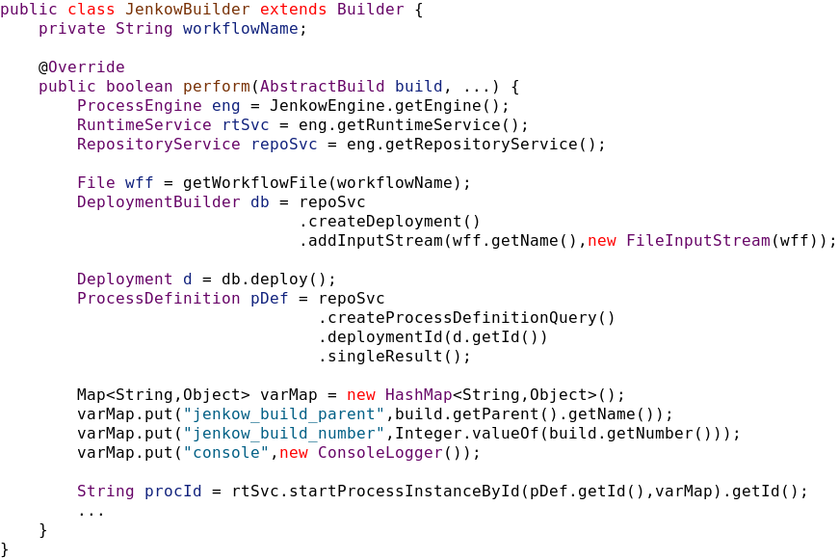
JenkowBuilder (start workflow)

Slide 37
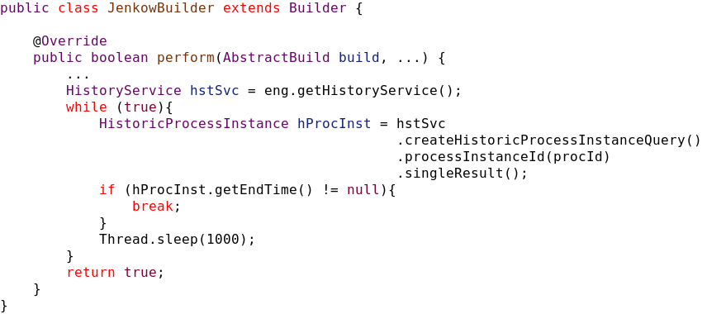
JenkowBuilder (end workflow)

Slide 38
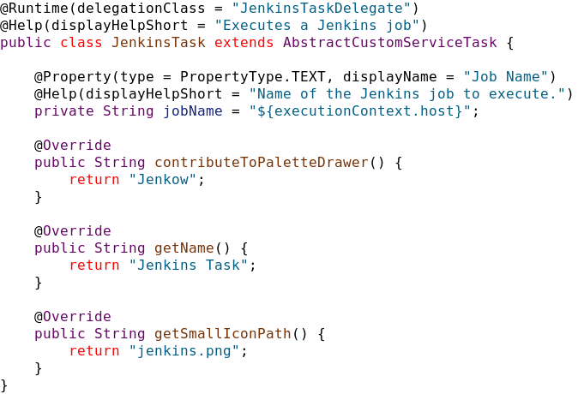
JenkinsTask

Slide 39
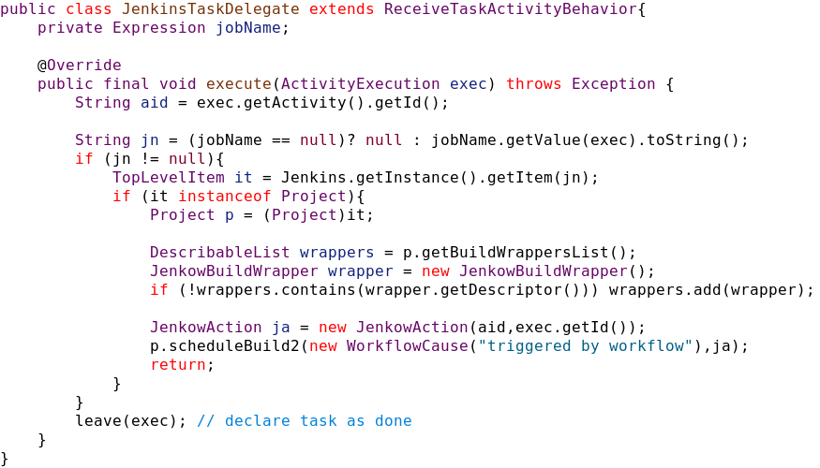
JenkinsTaskDelegate

Slide 40
Future Features
Workflow Job Type (workflow mode)
How to manage active workflows?
Workflow diagrams in Jenkins
Showing execution state
Integrate Activiti Web UIs?
Activiti Modeler

Slide 41
Future Features
Job parameter support
More task types for other Jenkins functions
Slave node management
Build promotion
…
Multi-instance task support

Slide 42
Future Features
Find alternative to bundling Eclipse update site with Jenkow plugin
Other mechanisms to expose workflow repository
Eclipse EFS over SSH

Slide 43
Jenkow Take Away
Use for complex job orchestration
Git Server Plugin usage example
Eclipse Update Site usage example
Maven / Tycho integration
Resources
https://wiki.jenkins-ci.org/display/JENKINS/Jenkow+Plugin
http://www.activiti.org/

Slide 44
Thank You To Our Sponsors

