Slide 1
Pre-Tested Commits with Jenkins and Reviewboard
Yardena Meymann
VMware
http://www.vmware.com/
@jenkinsconf

Slide 2
About our team
Developing a new product for IT financial management
≈30 engineers, Israel and Bangalore
Infrastructure: Virtual Appliance, Linux, Java, Spring, tcServer, vPostgres, ExtJS
Development: Git, Maven, IntelliJ, Bugzilla, Reviewboard, Jenkins (compilation, static analysis, tests, code coverage)

Slide 3
Typical developer workflow

Slide 4
But what if things go wrong?
Build failure

Slide 5
Solution: pre-tested commits

Slide 6
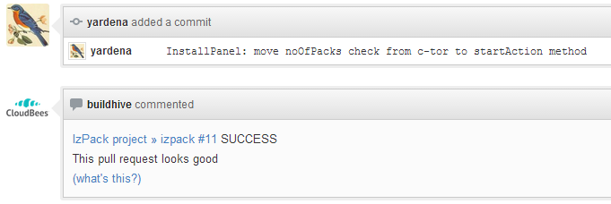
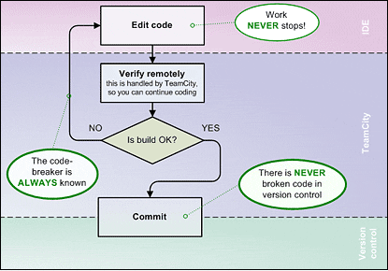
Inspiration
GitHub - CloudBees
JetBrains
TeamCity
Gerrit

Slide 7
Reviewboard
http://www.reviewboard.org/
Open source code review tool developed at VMware
Can be used from command line or via web
Written in Python, cross-platform client
Integration with SVN, Git and (of course) Perforce
Can send e-mails for reviews and comments

Slide 8
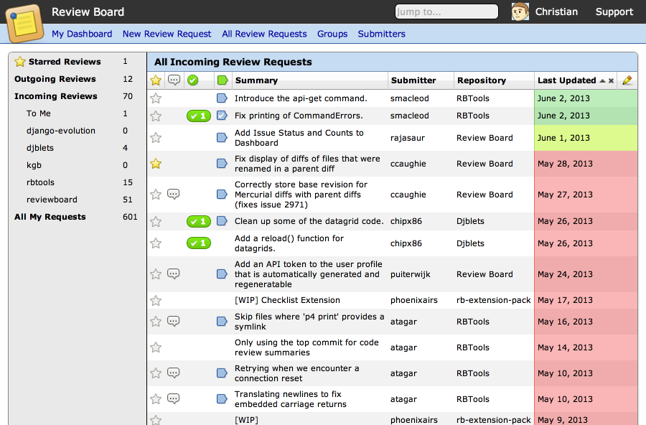
Reviewboard

Slide 9
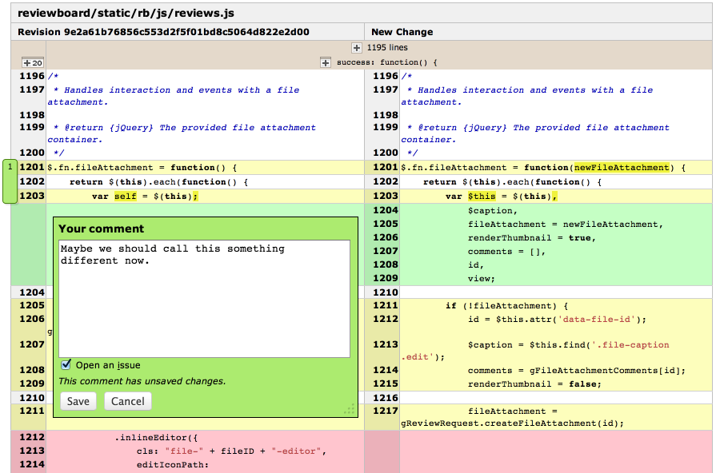
Reviewboard

Slide 10
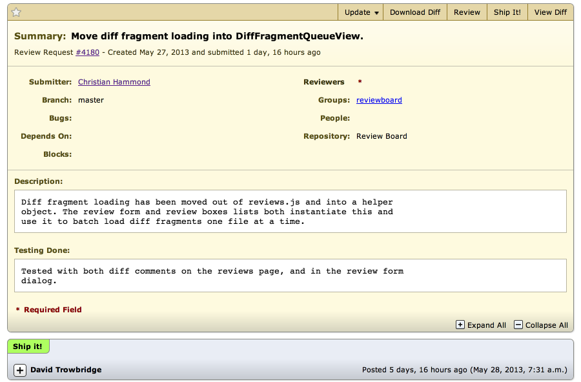
Reviewboard

Slide 11
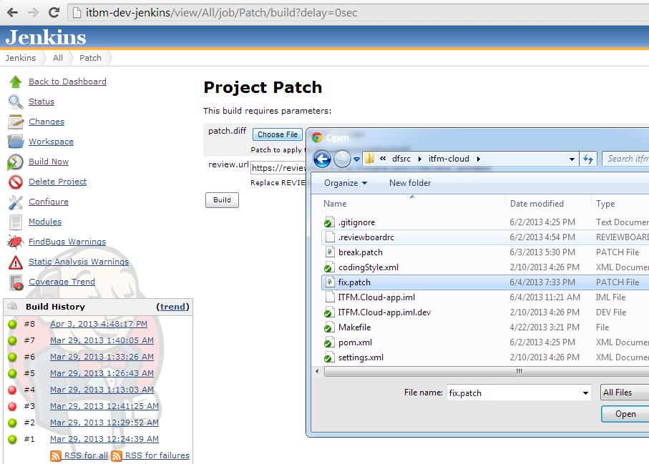
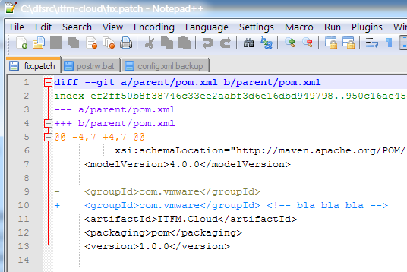
Jenkins Patch Parameter plugin
Create a job which is a copy of the “regular” main line build, but with a patch parameter

Slide 12
Integrating Reviewboard and Jenkins
Developer posts review
Patch job is triggered via Jenkins API
Instead of patch file, we pass review URL
Jenkins downloads the diff using Reviewboard API, applies it and builds the project
Jenkins reports the build result by sending a comment to Reviewboard (via API)

Slide 13
Demo
And now…

Slide 14
Jenkins Reviewbot architecture
1. trigger
0. submit diff
for review
2. retrieve the diff
5. Jenkins
approval
@
3. apply patch and build
3+. peer
approval
Reviewboard
server
Jenkins
server
@
4. post build result
6.push
request
comments
@
2+. provide comments
git

Slide 15
Gory details
Developed a “Reviewbot” plugin – extension of the Patch Parameter plugin
A wrapper script to postreview – plan to replace it with a trigger based on mail
Currently in process of approving the release to open-source

Slide 16
Thank You To Our Sponsors

