Slide 1
From Oracle to Hadoop: Unlocking Hadoop for Your RDBMS with Apache Sqoop and Other Tools
Guy Harrison, David Robson, Kate Ting
{guy.harrison, david.robson}@software.dell.com, kate@cloudera.com
October 16, 2014

Slide 2
About Guy, David, & Kate
Guy Harrison @guyharrison
- Executive Director of R&D @ Dell
- Author of Oracle Performance Survival Guide & MySQL Stored Procedure Programming
David Robson @DavidR021
- Principal Technologist @ Dell
- Sqoop Committer, Lead on Toad for Hadoop & OraOop
Kate Ting @kate_ting
- Technical Account Mgr @ Cloudera
- Sqoop Committer/PMC, Co-author of Apache Sqoop Cookbook

Slide 3
Notes:
When you think about Dell you probably think about laptops

Slide 4
Notes:
Or servers that might run databases or a Hadoop cluster, but you probably don't think of Dell as having expertise in either Oracle or Hadoop

Slide 5
Notes:
But actually Dell now has a billion-dollar software arm which includes the world's number one independent database tool – toad – used by millions of users and supporting almost every data platform

Slide 6
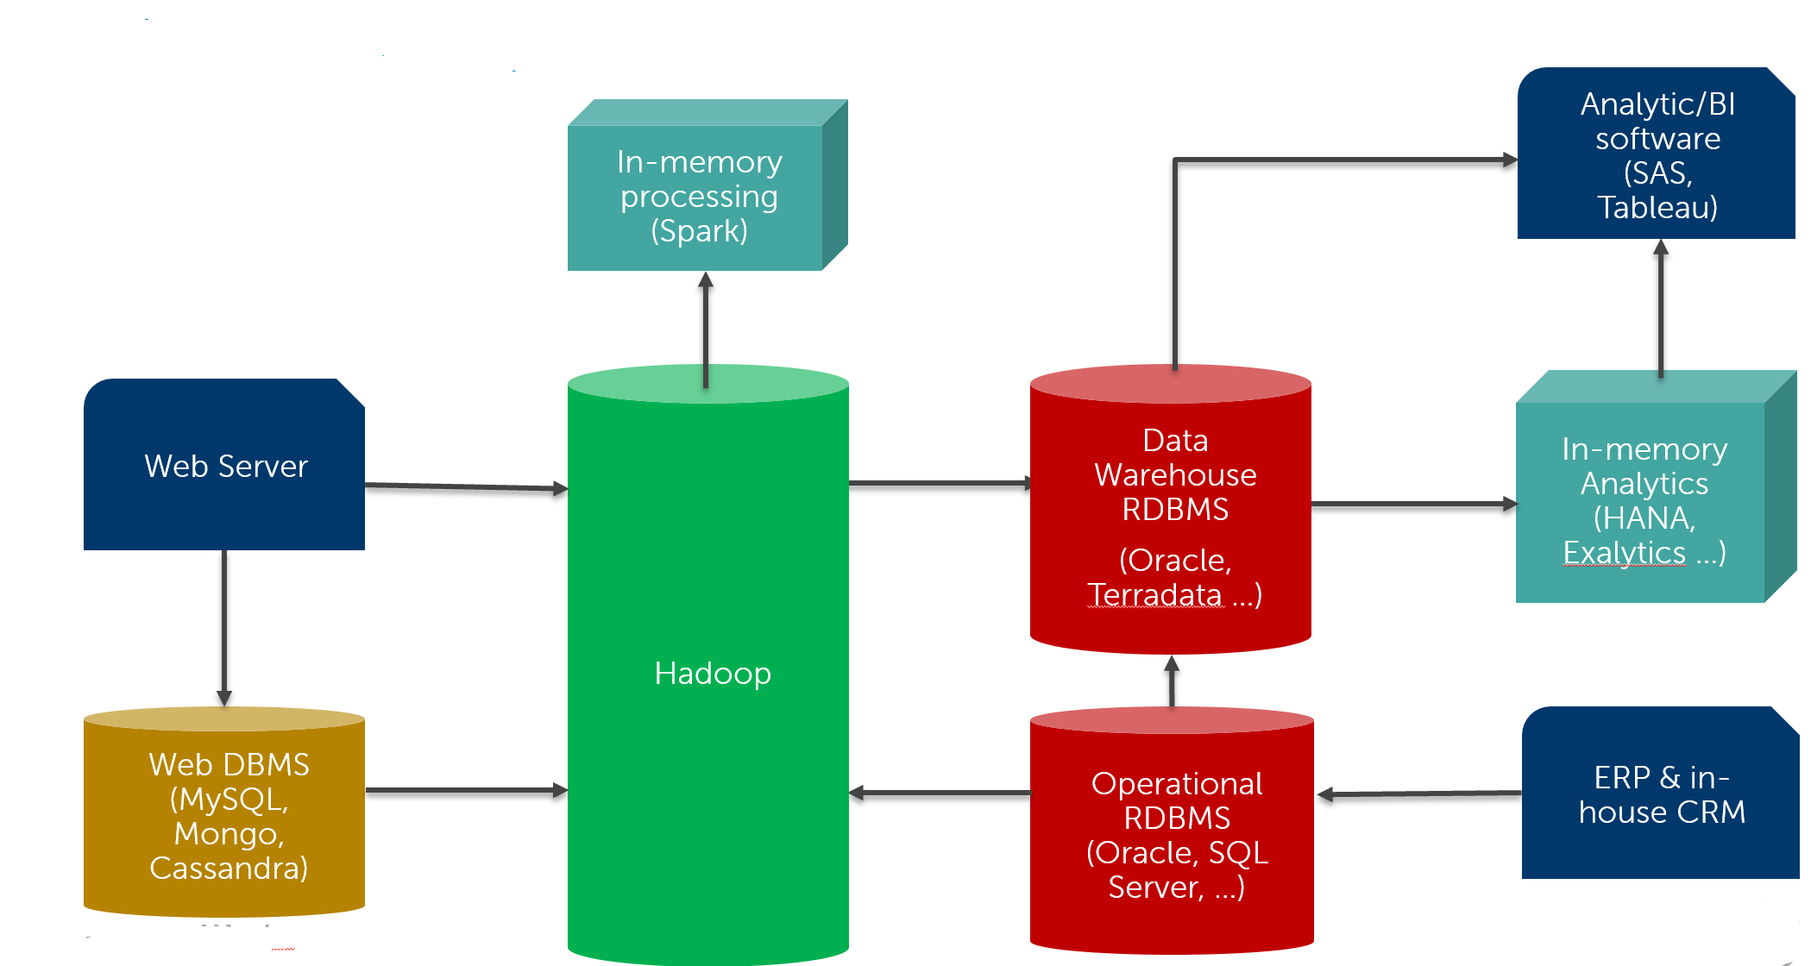
RDBMS and Hadoop
The relational database reigned supreme for more than two decades
Hadoop and other non-relational tools have overthrown that hegemony
We are unlikely to return to a “one size fits all” model based on Hadoop
Though some will try ☺
For the foreseeable future, enterprise information architectures will include relational and non-relational stores
Notes:
Guy to improve diagram

Slide 7
Scenarios
We need to access RDBMS to make sense of Hadoop data
Analytic output
YARN/MR1
HDFS
RDBMS
Weblogs
Flume
SQOOP
Products

Slide 8
Scenarios
Reference data is in the RDBMS
We want to run analysis outside of the RDBMS
Analytic output
YARN/MR1
HDFS
RDBMS
SQOOP
Products
SQOOP
Sales

Slide 9
Scenarios
Reference data is in the RDBMS
We want to run analysis outside of the RDBMS
Feeding YARN/MR output into RDBMS
Analytic output
YARN/MR1
HDFS
RDBMS
Weblogs
Flume
Weblog
Summary
SQOOP

Slide 10
Scenarios
We need to access RDBMS to make sense of Hadoop data
We want to use Hadoop to analyse RDBMS data
Hadoop output belongs in RDBMS Data warehouse
We archive old RDBMS data to Hadoop
BI platform
HQL
SQL
HDFS
RDBMS
Old Sales
SQOOP
Sales

Slide 11
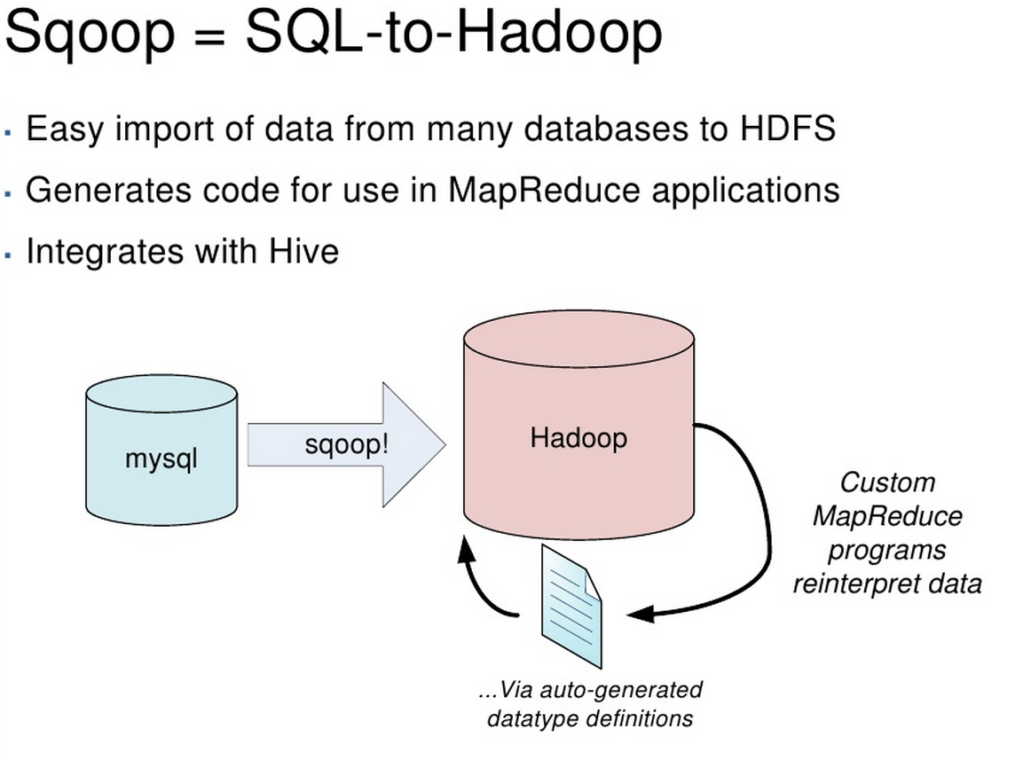
SQOOP
SQOOP was created in 2009 by Aaron Kimball as a means of moving data between SQL databases and Hadoop
It provided a generic implementation for moving data
It also provided a framework for implementing database specific optimized connectors

Slide 12
How SQOOP works (import)
Hive DDL
HDFS
RDBMS
Hive Table
Table.java
SQOOP
Table
Metadata
HDFS files
Map Task
Table
Data
DataDrivenDBInputFormat
FileOutputFormat
Map Task
DataDrivenDBInputFormat
FileOutputFormat

Slide 13
SQOOP & Oracle

Slide 14
SQOOP issues with Oracle
SQOOP uses primary key ranges to divide up data between mappers
However, the deletes hit older key values harder, making key ranges unbalanced.
Data is almost never arranged on disk in key order so index scans collide on disk
Load is unbalanced, and IO block requests >> blocks in the table.
ID > 0 and ID < MAX/2
ID > MAX/2
MAPPER
MAPPER
ORACLE SESSION
ORACLE SESSION
RANGE SCAN
RANGE SCAN
Index block
Index block
Index block
Index block
Index block
Index block
ORACLE TABLE on DISK

Slide 15
Other problems
Oracle might run each mapper using a full scan – clobbering the database
Oracle might run each mapper in parallel – clobbering the database
Sqoop may clobber the database cache

Slide 16
High speed connector design
Partition data based on physical storage
By-pass Oracle buffering
By-pass Oracle parallelism
Do not require or use indexes
Never read the same data block more than once
Support Oracle datatypes
HDFS
ORACLE
TABLE
Hadoop
Mapper
ORACLE
SESSION
Hadoop
Mapper
ORACLE
SESSION
Hadoop
Mapper
ORACLE
SESSION

Slide 17
Imports (Oracle->Hadoop)
Uses Oracle block/extent map to equally divide IO
Uses Oracle direct path (non-buffered) IO for all reads
Round-robin, sequential or random allocation
All mappers get an equal number of blocks & no block is read twice
If table is partitioned, each mapper can work on a separate partition – results in partitioned output
HDFS
ORACLE
TABLE
Hadoop
Mapper
ORACLE
SESSION
Hadoop
Mapper
ORACLE
SESSION
Hadoop
Mapper
ORACLE
SESSION

Slide 18
Exports (Hadoop-> Oracle)
Optionally leverages Oracle partitions and temporary tables for parallel writes
Performs MERGE into Oracle table (Updates existing rows, inserts new rows)
Optionally use oracle NOLOGGING (faster but unrecoverable)
HDFS
ORACLE
TABLE
Hadoop
Mapper
ORACLE
SESSION
Hadoop
Mapper
ORACLE
SESSION
Hadoop
Mapper
ORACLE
SESSION

Slide 19
Import – Oracle to Hadoop
When data is unclustered (randomly distributed by PK), old SQOOP scales poorly
Clustered data shows better scalability but is still much slower than the direct approach.
New SQOOP outperforms 5-20 times typically
We’ve seen limiting factor as:
Data IO bandwidth, or
Network out of DB, or
Hadoop CPU

Slide 20
Import - Database overhead
As you increase mappers in old sqoop, database load increases rapidly
(sometimes non-linear)
In new Sqoop, queuing occurs only after IO bandwidth is exceeded

Slide 21
Export – Oracle to Hadoop
On Export, old SQOOP would hit database writer bottleneck early on and fail to parallelize.
New SQOOP uses partitioning and direct path inserts.
Typically bottlenecks on write IO on Oracle side

Slide 22
Reduction in database load
45% reduction in DB CPU
83% reduction in elapsed time
90% reduction in total database time
99.9% reduction in database IO

Slide 23
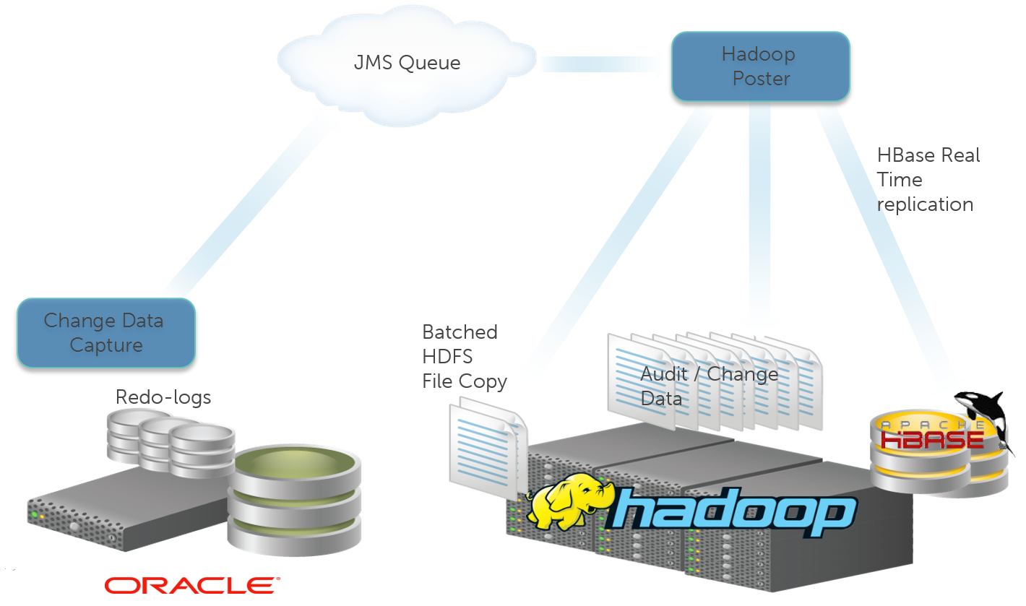
Replication
No matter how fast we make SQOOP, it’s a drag to have to run a SQOOP job before every Hadoop job.
Replicating data into Hadoop cuts down on SQOOP overhead on both sides and avoids stale data.
Shareplex® for Oracle and Hadoop

Slide 24
Sqoop 1.4.5 Summary
Sqoop 1.4.5 without –direct | Sqoop 1.4.5 with --direct
Minimal privileges required | Access to DBA views required
Works on most object types: e.g. IOT | 5x-20x faster performance on tables
Favors Sqoop terminology | Favors Oracle terminology
Database load increases non-linearly | Up to 99% reduction in database IO

Slide 25
Future of SQOOP

Slide 26
Sqoop 1 Import Architecture
sqoop import \
--connect jdbc:mysql://mysql.example.com/sqoop \
--username sqoop --password sqoop \
--table cities

Slide 27
Sqoop 1 Export Architecture
sqoop export \
--connect jdbc:mysql://mysql.example.com/sqoop \
--username sqoop --password sqoop \
--table cities \
--export-dir /temp/cities

Slide 28
Sqoop 1 Challenges
Concerns with usability
Cryptic, contextual command line arguments
Concerns with security
Client access to Hadoop bin/config, DB
Concerns with extensibility
Connectors tightly coupled with data format

Slide 29
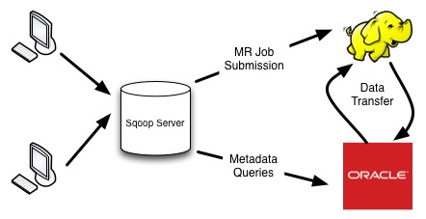
Sqoop 2 Design Goals
Ease of use
REST API and Java API
Ease of security
Separation of responsibilities
Ease of extensibility
Connector SDK, focus on pluggability

Slide 30
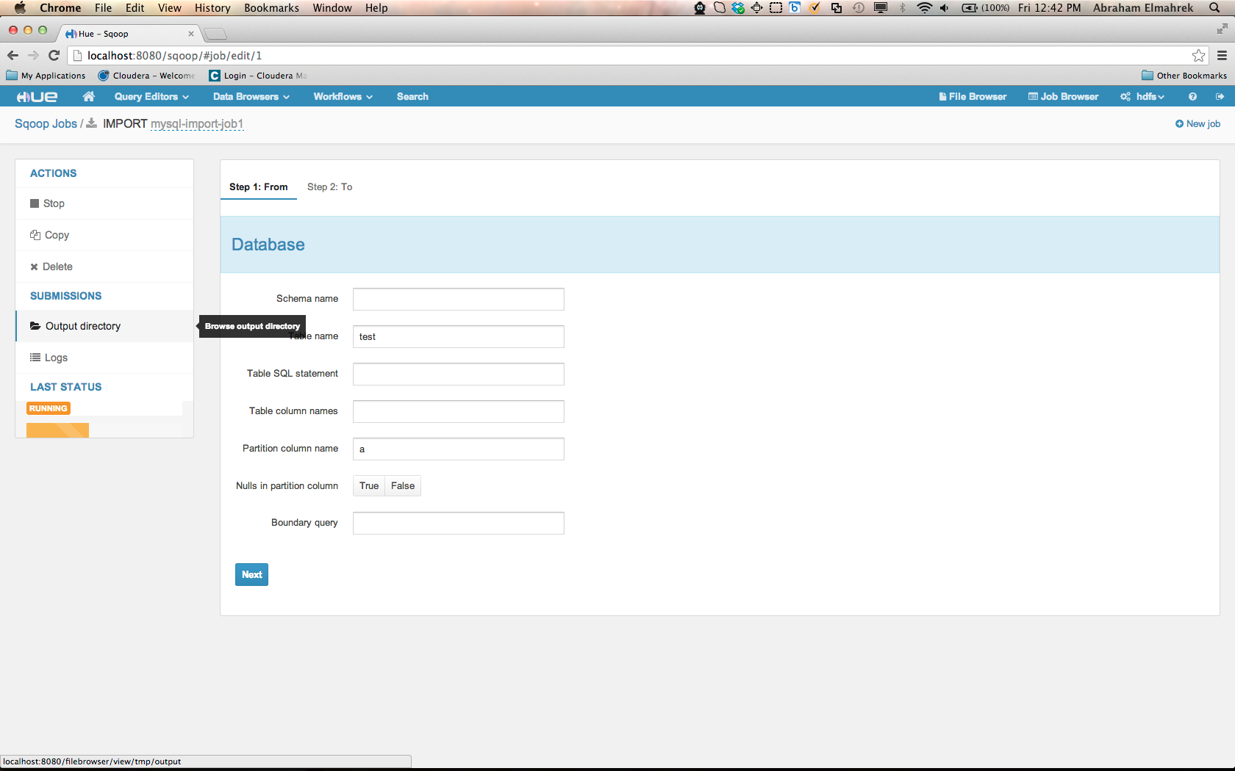
Ease of Use
Sqoop 1
Sqoop 2
sqoop import \
-Dmapred.child.java.opts="Djava.security.egd=file:///dev/urandom“\
-Ddfs.replication=1 \
-Dmapred.map.tasks.speculative.execution=false \
--num-mappers 4 \
--hive-import --hive-table CUSTOMERS --create-hive-table \
--connect jdbc:oracle:thin:@//localhost:1521/g12c \
--username OPSG --password opsg --table OPSG.CUSTOMERS \
--target-dir CUSTOMERS.CUSTOMERS

Slide 31
Ease of Security
Sqoop 1
Sqoop 2
sqoop import \
-Dmapred.child.java.opts="Djava.security.egd=file:///dev/urandom“\
-Ddfs.replication=1 \
-Dmapred.map.tasks.speculative.execution=false \
--num-mappers 4 \
--hive-import --hive-table CUSTOMERS --create-hive-table \
--connect jdbc:oracle:thin:@//localhost:1521/g12c \
--username OPSG --password opsg --table OPSG.CUSTOMERS \
--target-dir CUSTOMERS.CUSTOMERS
Role-based access to connection objects
Prevents misuse and abuse
Administrators create, edit, delete
Operators use

Slide 32
Ease of Extensibility
Sqoop 1
Sqoop 2
Connectors fetch and store data from db
Framework handles serialization, format conversion, integration
Tight Coupling

Slide 33
Takeaway
Apache Sqoop
Bulk data transfer tool between external structured datastores and Hadoop
Sqoop 1.4.5 now with a --direct parameter option for Oracle
5x-20x performance improvement on Oracle table imports
Sqoop 2
Ease of use, security, extensibility

Slide 34
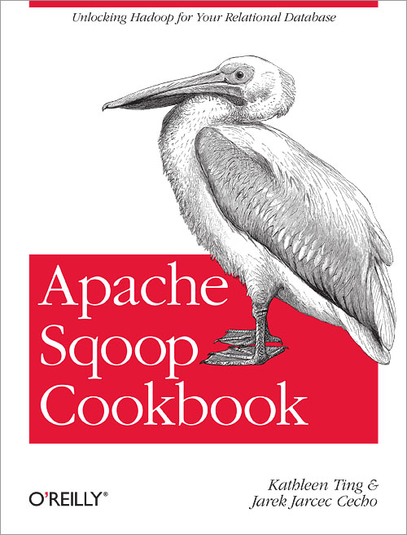
Questions?
Guy Harrison @guyharrison
David Robson @DavidR021
Kate Ting @kate_ting
Visit Dell at Booth #102
Visit Cloudera at Booth #305
Book Signing: Today @ 3:15pm
Office Hours: Tomorrow @ 11am

