Slide 1
How We Built Our Community
Uri Cohen
Head of Product @ GigaSpaces
@uri1803
#oscon 2013

Slide 2
How We Built Are Still Building Our Community
Uri Cohen
Head of Product @ GigaSpaces
@uri1803
#oscon 2013

Slide 3
What This Talk Won’t Cover

Slide 4
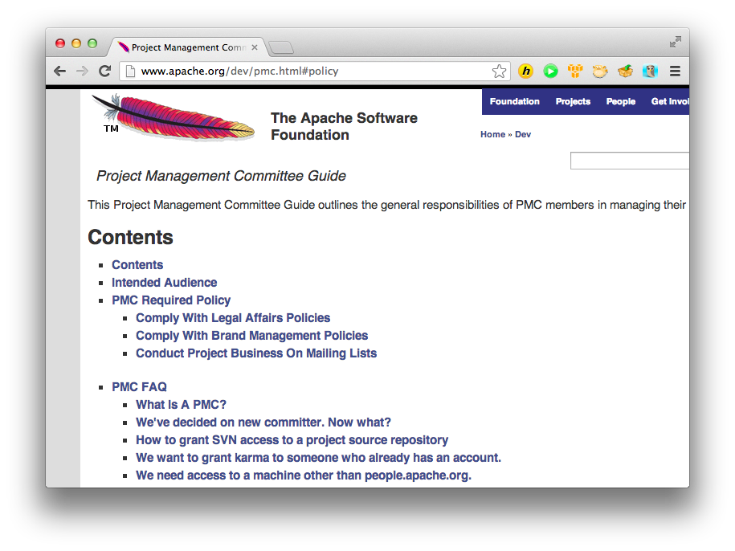
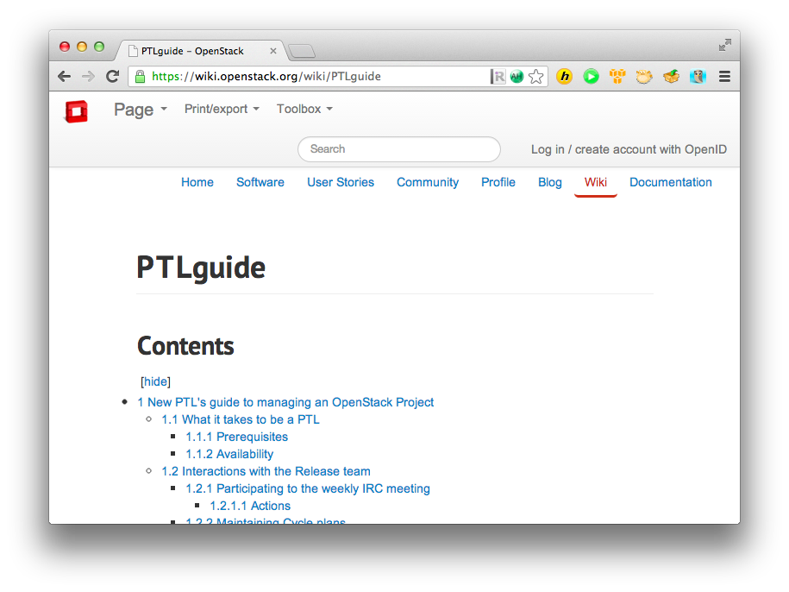
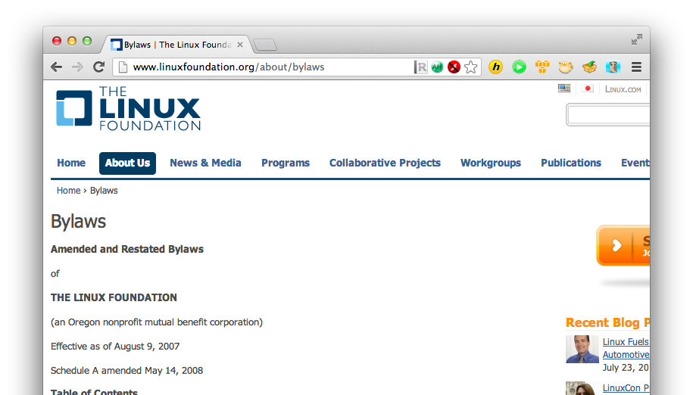
How to Manage an Open Source Project

Slide 5
When / What to Open Source
https://www.madison.k12.wi.us/files/Calendar_0.jpg

Slide 6
Which License to Choose

Slide 7
And I won’t say “Software is eating the world”
Really, I Promise…

Slide 8
What I Will Talk about
Our Journey as a company, moving from closed to open source
Do’s and Dont’s
The toolkit we used

Slide 9
Some Background

Slide 10
Why Open Source?
Aside from the obvious reasons, it’s become a precondition

Slide 11
So Here’s What You Shouldn’t Do

Slide 12
This
Developers, Developers, Developers, Developers, Developers, Developers

Slide 13
Put It on Github and Think You’re Done
http://octodex.github.com/hipster-partycat/
Notes:
It’s not just about the code, it’s about the way you run things
4 million projects on github, no one will know you’re there.

Slide 14
Have a “Community Guy” that Handles All This OSS Stuff…

Slide 15
Check the Mailing Lists Once a Week
http://www.cetofnc.com/images/2009/angry_user.jpg

Slide 16
What Worked for Us

Slide 17
Get Everyone Involved
It’s not a developer thing, it’s a company mindset
Notes:
Support, devs, marketing, management
Daily standups include community status
Weekly meetings with marketing,
events,
blogs,
discussions all the way up to CEO about goals, hurdles etc.

Slide 18
Build Your Eco-System

Slide 19
Make It Easy to Consume
Notes:
Use github,
Readme,
build,
dependencies,
changelog,
State maturity,
supported envs,
license,
docs,
tags,
announce,
milestones…

Slide 20
Cut the Bureaucracy, Make It Easy for People to Contribute
Notes:
Contributor agreement
Pull request
License

Slide 21
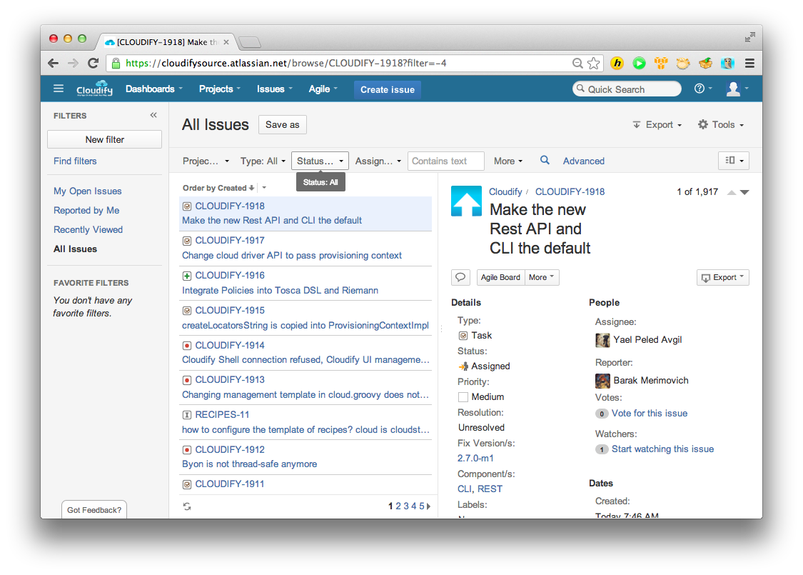
Be Transparent
Notes:
Share Your Roadmap
Share Your Darkest Secrets

Slide 22
Measure, Measure & Measure Some More
Notes:
Measure everything you can – website, mailing lists, downloads, usage (downloads CDN, version checks)
Always opt in, don’t be intrusive to the user

Slide 23
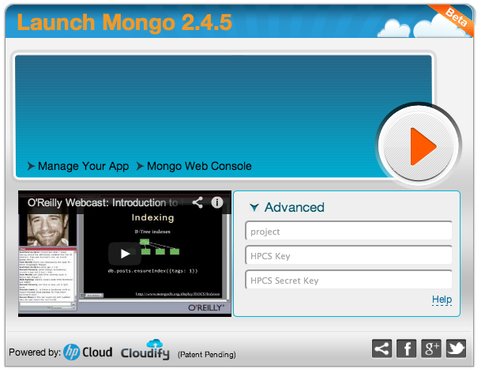
Incentivize Users

Slide 24
Our Toolkit

Slide 25
Requirements…
Code
Docs
Issues
Forums
Videos
Blogs
Social
Analytics
SEO
Search
Comments
IRC

Slide 26
No Servers

Slide 27
For the Most Part, This Is What We Know

Slide 28
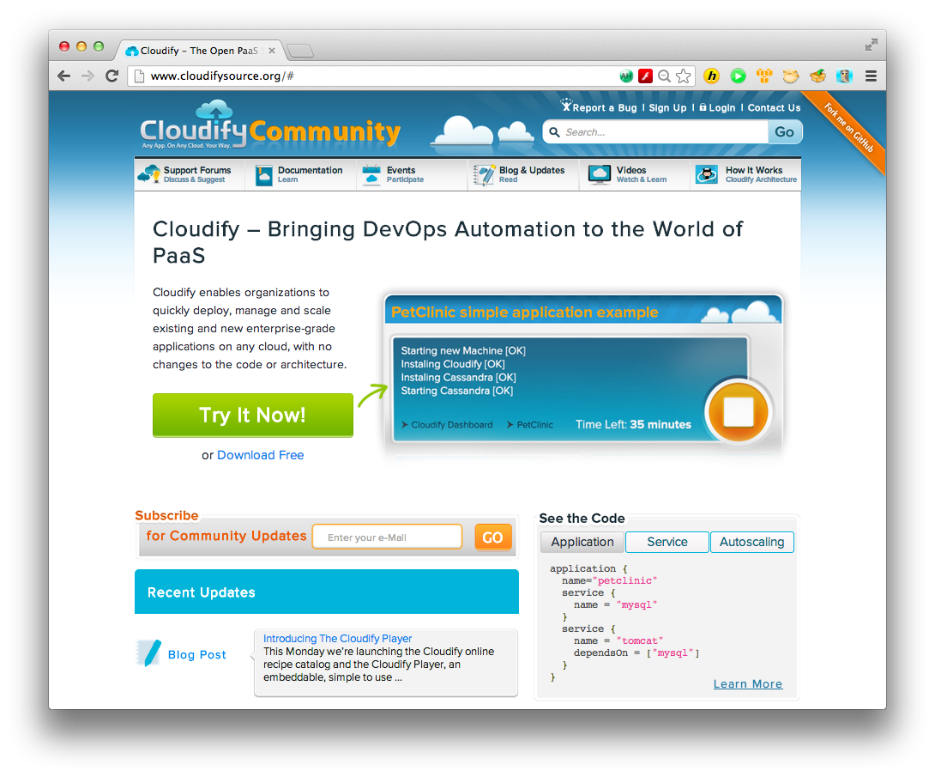
We Wanted Our Own L&F

Slide 29
Github to the Rescue
Notes:
Github pages, github for code

Slide 30
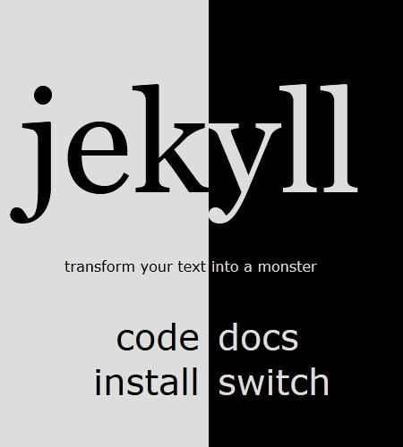
Jekyll
Notes:
What Jekyll does
Who uses it
Geared for Blog Sites
Paging
Categories
Tags
Pluggable
Supports several markups

Slide 31
Tracking

Slide 32
Search

Slide 33
User Forums & Feedback

Slide 34
Issue Tracking

Slide 35
Key Takeways
Building a community is HARD
It’s an iterative process
Have realistic expectations

Slide 36
Resources
Community site www.cloudifysource.org
OSS project repo: github.com/CloudifySource/cloudify
Community web site repo: github.com/CloudifySource/cloudifysource.github.com
Jira: https://cloudifysource.atlassian.net/

Slide 37
Thank You!

